Slide 1
Chapter 12:
Physical Architecture Layer Design

Slide 2
Objectives
Understand the different physical architecture components.
Understand server-based, client-based, and client–server physical architectures.
Be familiar with distributed objects computing.
Be able to create a network model using a deployment diagram.
Understand how operational, performance, security, cultural, and political requirements affect the design of the physical architecture layer.
Be familiar with how to create a hardware and software specification.

Slide 3
Introduction
Most modern systems span two or more networked computers
The physical architecture layer design specifies
  How the system will be distributed across the computers
  What hardware and software will be used
Most systems’ design is constrained by existing systems and networks

Slide 4
ELEMENTS OF THE PHYSICAL ARCHITECTURE LAYER

Slide 5
Architectural Components
Software components
  Data storage
  Data access logic
  Application logic
  Presentation logic
Hardware components
  Computers (clients, servers)
  Networks

Slide 6
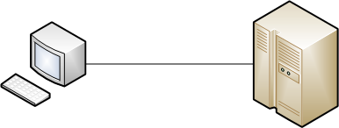
Server-Based Architectures
The server performs all four application functions
The client only needed a monitor, a keyboard, and a communications device (e.g. modem)
Data Storage
Data Access Logic
Application Logic
Presentation Logic

Slide 7

Client-Based Architectures
All logic resides on the client computer
A separate computer may hold the data
Simple to develop, but difficult to maintain
Data Access Logic
Application Logic
Presentation Logic
Data Storage

Slide 8

Client-Server Architectures
Balance processing between client and server
Predominant architecture in modern systems
Amount of client processing varies
  Thin clients do only presentation logic
  Thick clients do presentation and application
Application Logic
Presentation Logic
Data Storage
Data Access Logic

Slide 9
Client-Server Tiers
Client server architectures can have two or more tiers depending on application logic partitioning
  2-tier: all application and data logic on one server
  3-tier: application logic on one server, data logic on another
  4-tier: application logic split among two servers, data logic on another
Sometimes called an n-tier architecture

Slide 10
Distributed Objects Computing
Next generation of client-server computing
The client need not know which server to call
Middleware intercepts the client request and sends it to the appropriate server
Three competing approaches
  CORBA
  Enterprise Java Beans
  .NET

Slide 11
Selecting a Physical Architecture
Cost of infrastructure
Cost of development
Ease of development
Interface capabilities
Control and security
Scalability

Slide 12
Architecture Characteristics
 | Server-Based | Client-Based | Client-Server
Cost of infrastructure | Very high | Medium | Low
Cost of development | Medium | Low | High
Ease of development | Low | High | Low-Medium
Interface capabilities | Low | High | High
Control and Security | High | Low | Medium
Scalability | Low | Medium | High

Slide 13
INFRASTRUCTURE DESIGN

Slide 14
Deployment Diagram
Represent relationships between hardware components of an information system
Elements of a deployment diagram
  Nodes: a computational resource
  Artifacts: a piece of the information system which will be installed on a node
  Communication paths: a communication link such as a network connection or a USB cable

Slide 15
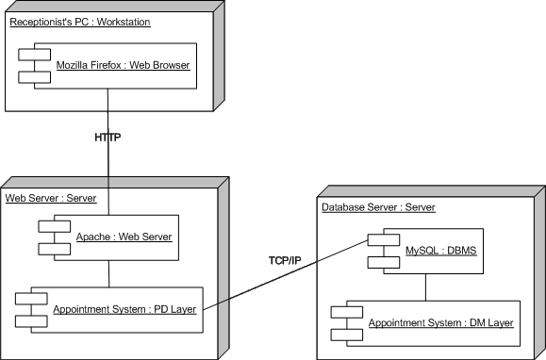
Sample Deployment Diagram

Slide 16
Network Model
Shows the major components of the information system and their geographic locations throughout the organization
Purposes of the network model:
  To convey the complexity of the system
  To show how the system’s software components will fit together

Slide 17
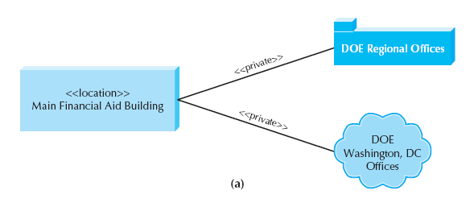
Sample Network Model

Slide 18
NONFUNCTIONAL REQUIREMENTS

Slide 19
Nonfunctional Requirement Types
Operational
Performance
Security
Cultural and Political

Slide 20
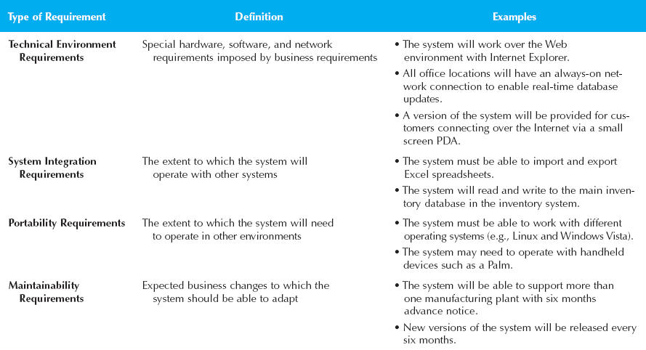
Operational Requirements

Slide 21
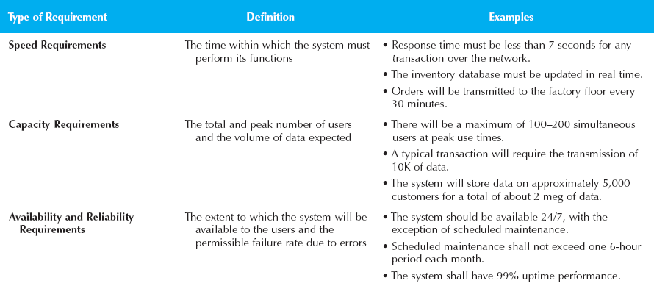
Performance Requirements

Slide 22
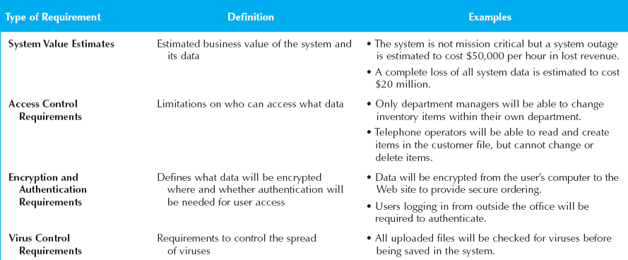
Security Requirements

Slide 23
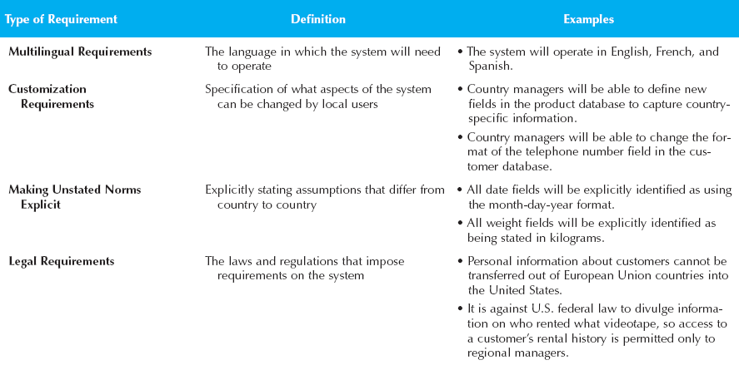
Cultural & Political Requirements

Slide 24
Summary
Elements of the Physical Architecture Layer
Infrastructure Design
Nonfunctional Requirements

