Slide 1
Factor Analyst
Team 05
Th.S Huynh Nam

Slide 2
Members::
ĐẶNG THỊ NHƯ QUỲNH | 21091761
NGUYỄN THANH THÙY TRANG | 21084151
TRẦN THU HUYỀN | 21106211
ĐỖ NGUYỄN QUỲNH HƯƠNG | 21101831

Slide 3
Table of contents
01
02
03
04
05
06
Aventureworks2022 database description
Introduce the assigned topic
Design data usage
Solution design and measurements
Dashboard design
Install dashboard using power BI

Slide 4
01
Aventureworks2022 database description

Slide 5

Overview:
AdventureWorks2022 is a sample database developed by Microsoft to help users become familiar with and practice working with the SQL Server database management system.
The AdventureWorks2022 database comprises a range of tables and relationships between them to represent information about customers, orders, products, employees, and various aspects of the business.

Slide 6
Data Structure:
Production
Sales
HumanResources
Contains information about products, product lists, and product details
Includes data about orders, order details, and customer lists.
Contains information about employees, departments, and job roles.
Person
Purchasing
Contains information about customers and contacts.
Pertains to procurement and company purchase orders.

Slide 7
Introduce the assigned topic
02

Slide 8
Introduce the assigned topic
Topic: Analysis of Factors Influencing the Sales Volume of Bike Product Group.
Research Objective: To identify and analyze the factors that impact the sales volume of the Bike product group. This objective aims to gain a better understanding of the significant factors and discover strategies for optimizing sales volume in this domain.

Slide 9

Design data usage
03

Slide 10
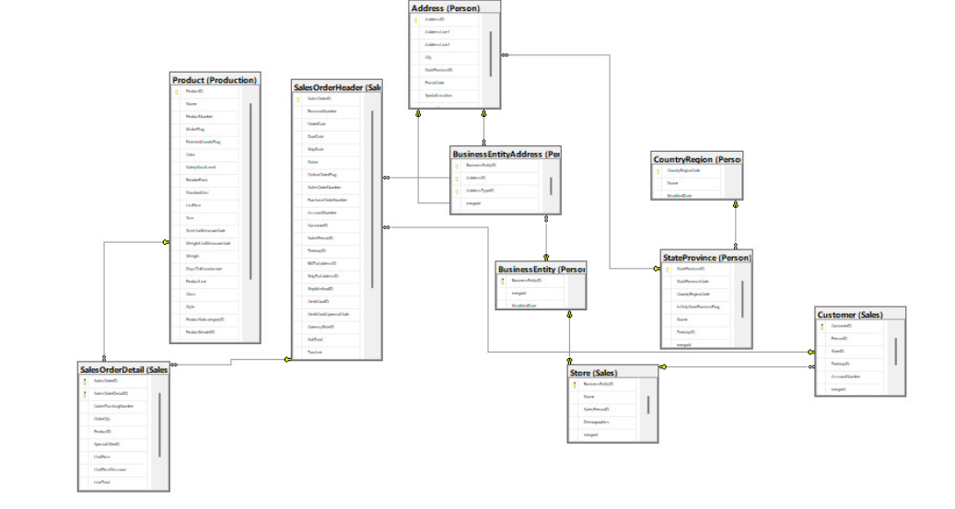
3. Design data usage

Slide 11
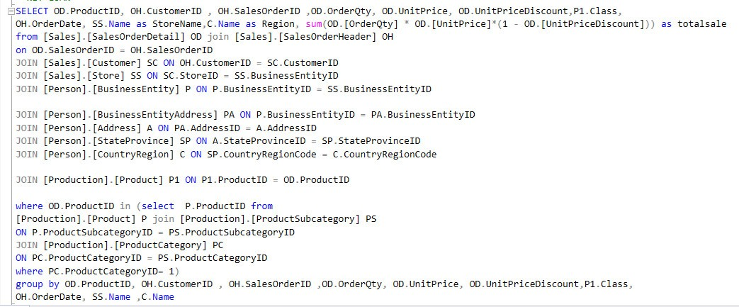
3. Design data usage

Slide 12
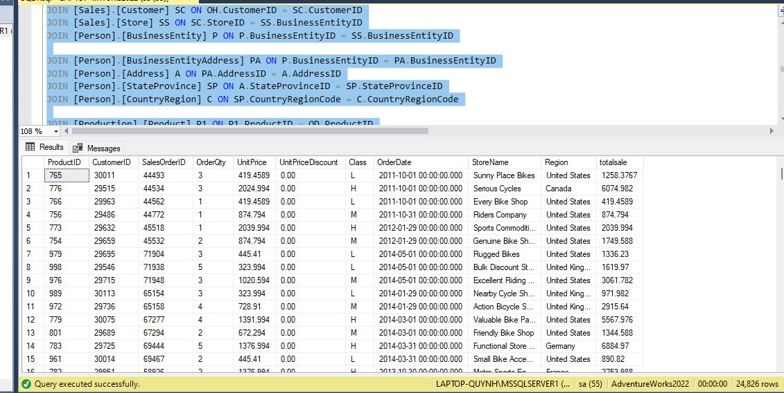
3. Design data usage

Slide 13
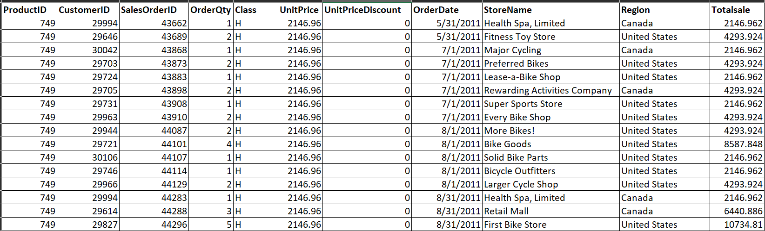
3. Design data usage

Slide 14
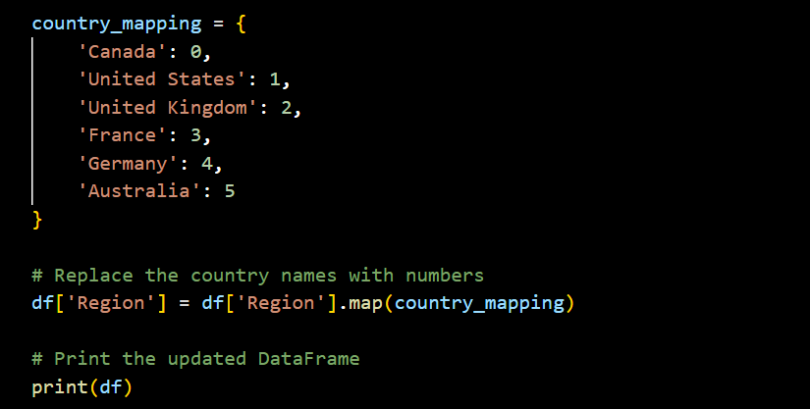
3. Design data usage

Slide 15
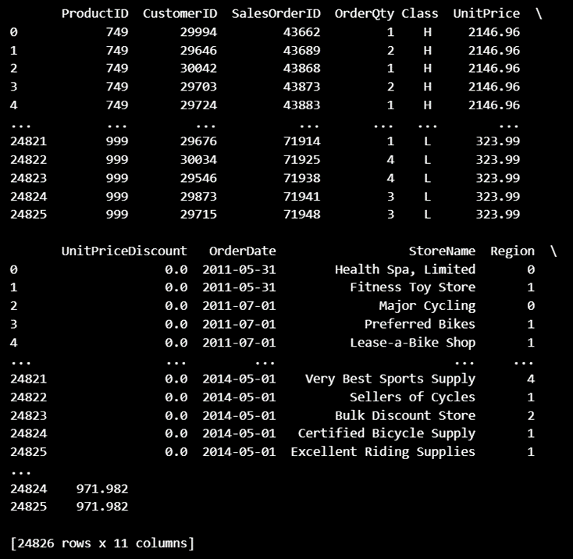
3. Design data usage

Slide 16
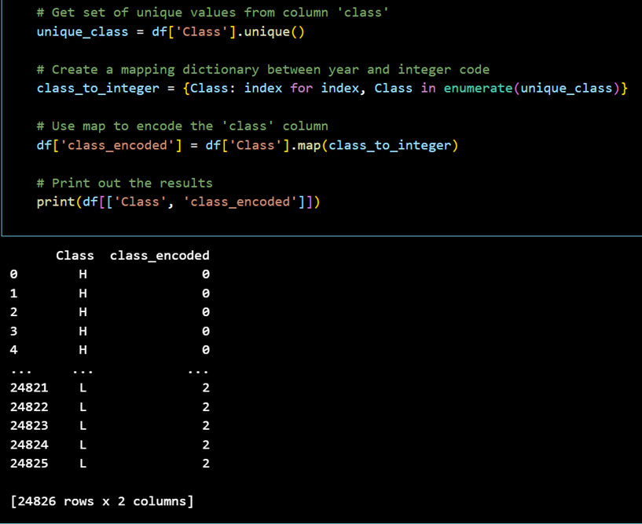
3. Design data usage

Slide 17
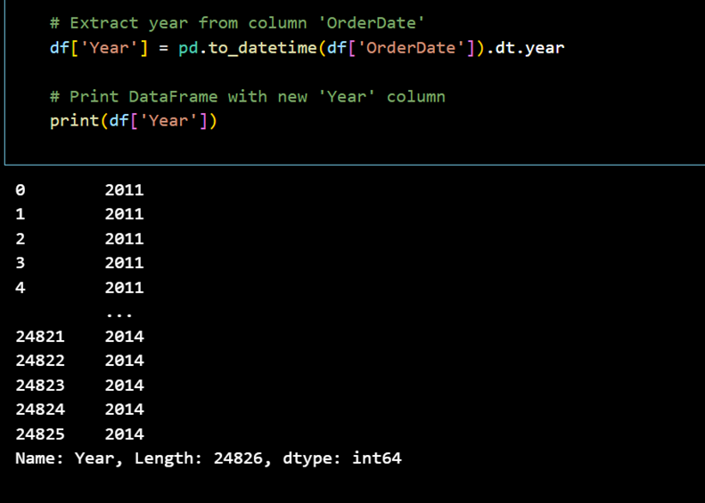
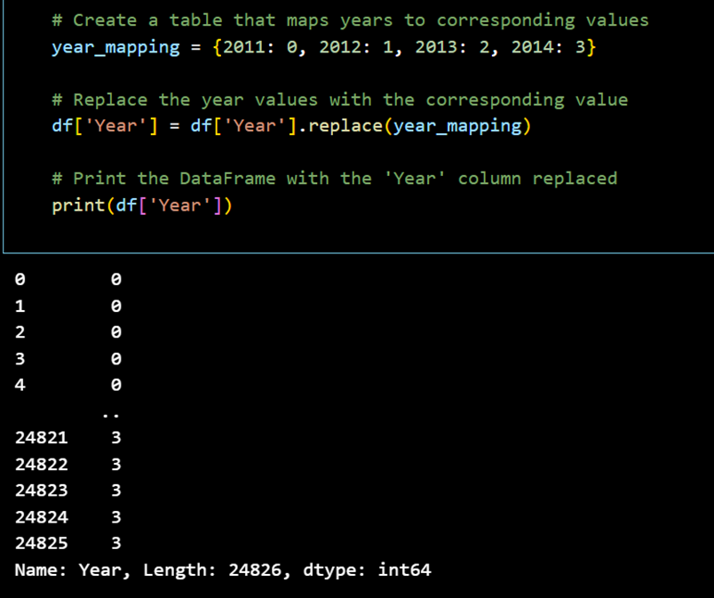
3. Design data usage

Slide 18
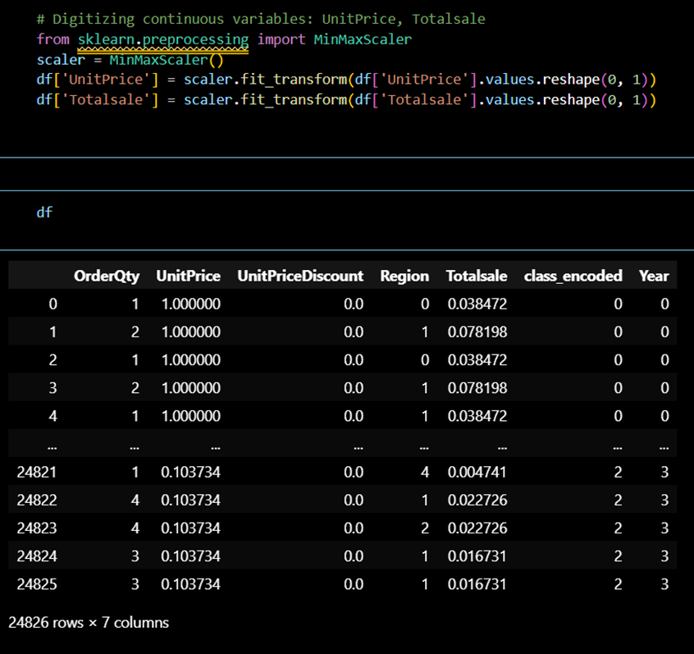
3. Design data usage

Slide 19
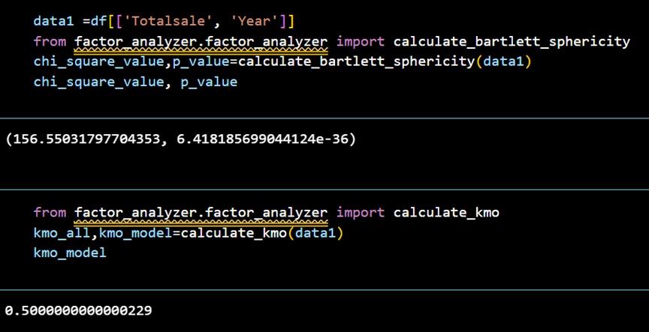
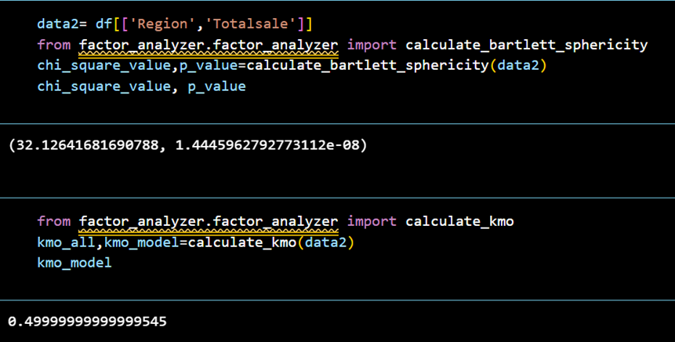
3. Design data usage

Slide 20
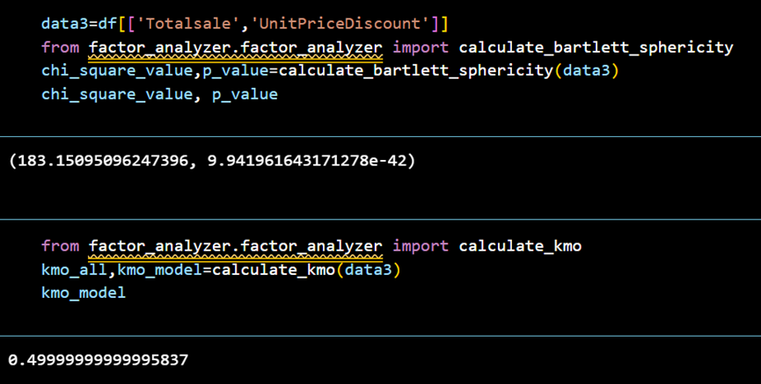
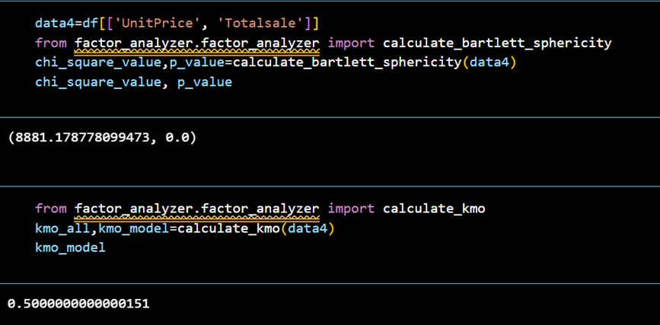
3. Design data usage

Slide 21
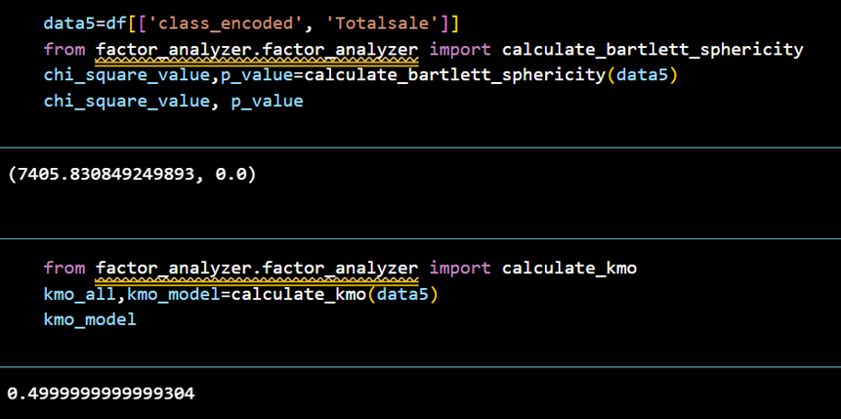
3. Design data usage

Slide 22
Solution design and measurements
04

Slide 23

1. Determine Measurements
Total sales by year.
Total number of orders by year.
Average unit price by year.
Sales percentage by region.
Total sales by quality.

Slide 24

2. Solution design
- What kind of quality bicycles are most interested in by customers?
- Does dealing with the number of stores affect sales revenue?
- Does price affect a customer's decision to buy a bicycle?

Slide 25
Dashboard design
05

Slide 26
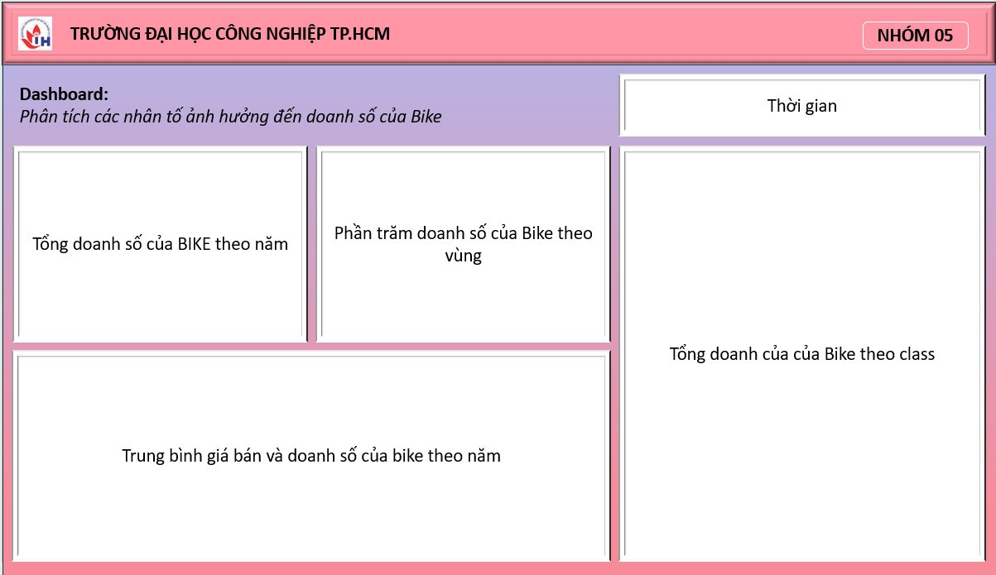
Dashboard design

Slide 27
Install dashboard using power BI
06

Slide 28
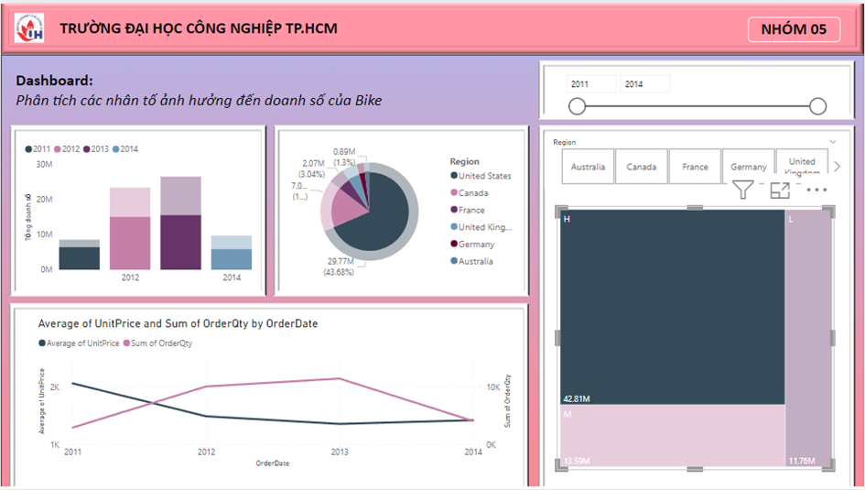
Install dashboard using power BI

Slide 29
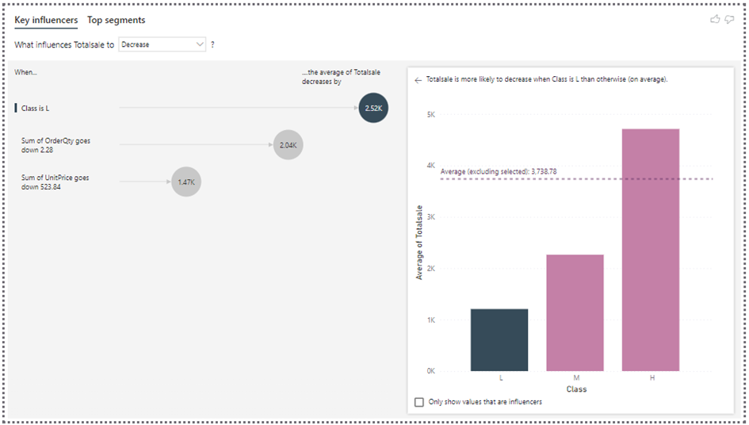
Install dashboard using power BI

Slide 30
Thanks for your listening!

