Slide 1
Classification

Slide 2
Classification
01
02
03
05
06
04
Trainning the Binary Classifier
Performance Measure
Multicalss Classification
Error Analysis
Multilabel Classification
Multioutput Classification

Slide 3
01
Training the Binary Classifier

Slide 4

Training the binary calssifier
In machine learning, binary classification is a supervised learning algorithm that categorizes new observations into one of two classes.
Ex:
- We identify one digit, the number 5. Then, we build “5 detector” will be capable of distinguishing between just two classes, 5 and not-5

Slide 5
02
Performance Measure
There are many ways to measure the model’s performance.

Slide 6
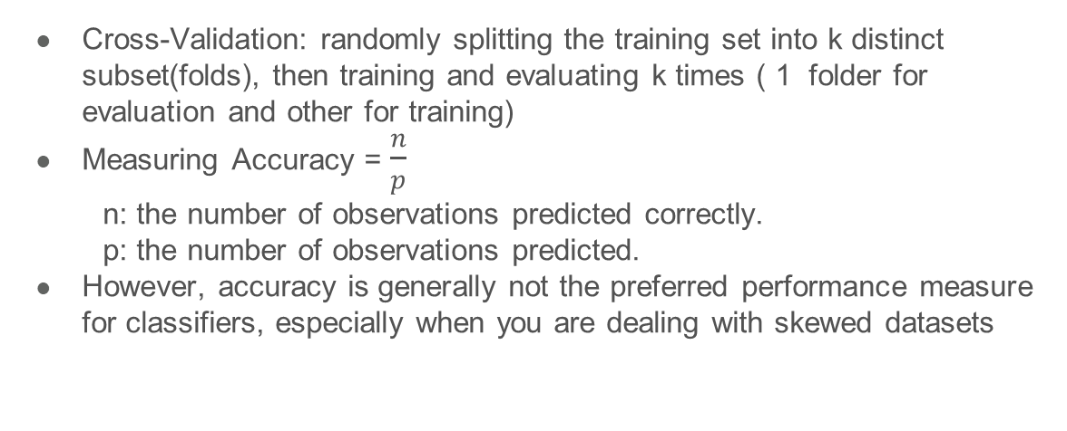
Measuring Accuracy Using Cross-Validation
Cross-Validation: randomly splitting the training set into k distinct subset(folds), then training and evaluating k times ( 1 folder for evaluation and other for training)
Measuring Accuracy = $\frac{n}{p}$
n: the number of observations predicted correctly.
p: the number of observations predicted.
However, accuracy is generally not the preferred performance measure for classifiers, especially when you are dealing with skewed datasets

Slide 7
Confusing Matrix
A much better way to evaluate the performance of a classifier is to look at the confusion matrix.
The general idea: counting the number of times instances of class A are classified as class B
Each row in a confusion matrix represents an actual class, while each column represents a predicted class.
For example:
53892: correctly calssified as non-5s (True Negative – TN)
687: wrongly classified as 5s (False Positive - FP)
1891: wrongly classified as non-5s (False Negative - FN)
3530: correctly classified as 5s (True Positive - TP)
 | non-5s | 5s
non-5s | 53892 | 687
5s | 1891 | 3530

Slide 8
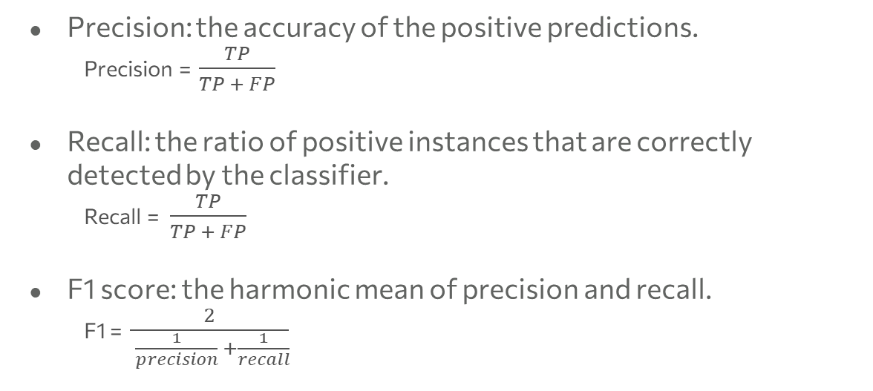
Precision and Recall
Precision: the accuracy of the positive predictions.
Precision = $\frac{TP}{TP + FP}$
Recall: the ratio of positive instances that are correctly detected by the classifier.
Recall = $\frac{TP}{TP + FP}$
F1 score: the harmonic mean of precision and recall.
F1 = $\frac{2}{ \frac{1}{precision} +\frac{1}{recall}}$

Slide 9
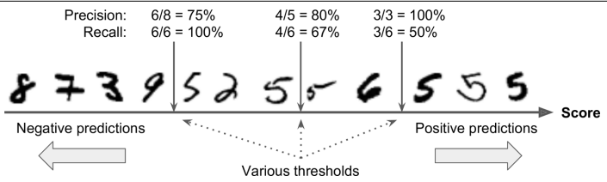
Precision/Recall Trade-of
Unfortunately, you can’t have it both ways: increasing precision reduces recall, and vice versa. This is called the precision/recall trade-of
For example:
we will use Stochastic Gradient Descent to train model. Then we find how Stochastic Gradient Descent make it classification:
For each instance, it computes a score based on a decision function:
Score > threshold => positive class
Score > threshold => positive class

Slide 10
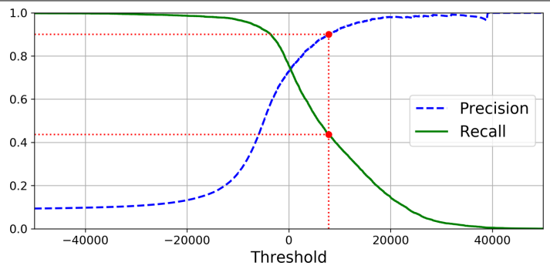
Precision/Recall Trade-of
For example (continue):
How to choose threshold:
- Get 1 decision score
- Compute precision and recall
- Plot precision and recall to make decision

Slide 11
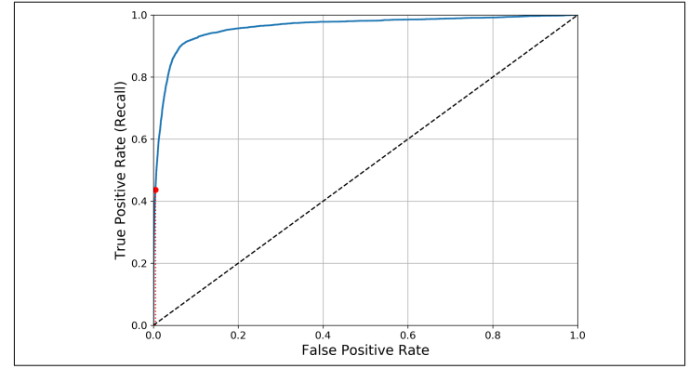

The ROC Curve
The ROC (Receiver Operating Characteristic) Curve is another common tool used with binary classifiers.
It plots the true positive rate (Recall ) against the false positive rate (FPR)
FPR = 1 - $\frac{TN}{TN + FP}$

Slide 12
03
Multiclass Classification

Slide 13
Multiclass Classification
What is Multiclass Classification ?
One-versus-the-rest (OvR)
Distinguish between more than two classes
Strategies that we can use to perform multiclass classification with multiple binary classifiers If we have N classes:
Training N binary classifiers, one for each class. Then when you want to classify a observation, you get the decision score from each classifier for that observation and you select the class whose classifier outputs the highest score.
One-versus-one (OvO)
Training a binary classifier to every pair of class
(need N * (N-1) / 2 classifier)

Slide 14
04
Multilabel Classification

Slide 15

Multilabel Classification
In some cases, we may want your classifier to output multiple classes for each instance
For example: We classify image as 5 and odd number

Slide 16
05
Multioutput Classification

Slide 17

Multioutput Classification
It is simply a generalization of multilabel classification where each label can be multiclass

Slide 18
Thanks for Watching

