Slide 1
Topic:Website to buy and guide to take care of bonsai
My members: KHÚC THỪA HUY – 20SE6
PHẠM VĂN HUY – 20SE6
LƯƠNG VĂN DUY – 20SE4

Slide 2
Thank you
We would like to express our sincere thanks to Mr. Nguyen Khanh Ty – The our teacher of “Technology and web programming” at Vietnam - Korea University of Information and Communication Technology to equip us with the knowledge and skills necessary to complete this subject.

Slide 3
CONTENT
CONTENT
1. Introduct
2. Technology analysis and selection
4 Interface
3. Database
5. Conclude

Slide 4

1 Introduce
The need to buy ornamental plants for decoration or gifting is no longer strange to society, but it is still difficult for customers to directly choose to buy or directly exchange with each other. they can hardly compare the quality of plants with many different stores, moreover, bonsai buyers may have to pay a higher price for the tree they buy than the market value of bonsai because they have Very useful information as well as the price of the tree they buy in the market. For those who care for trees, they need the most concise information channel for tree care tips instead of having to look up a large amount of information on network. Because of those difficulties, the website for selling and caring for bonsai was born to overcome those difficulties.

Slide 5
2. Technology analysis and selection
Php
Mysql
Jquery
Javascript
Html
Css
Bootstrap

Slide 6
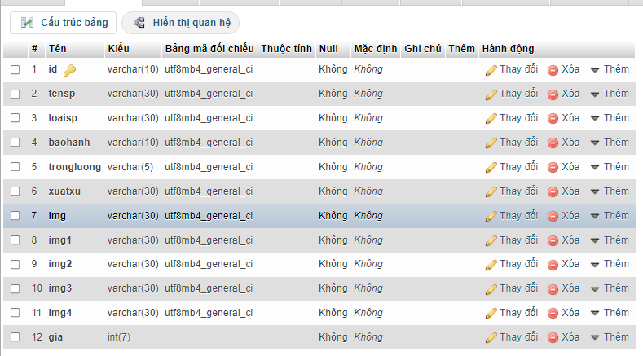
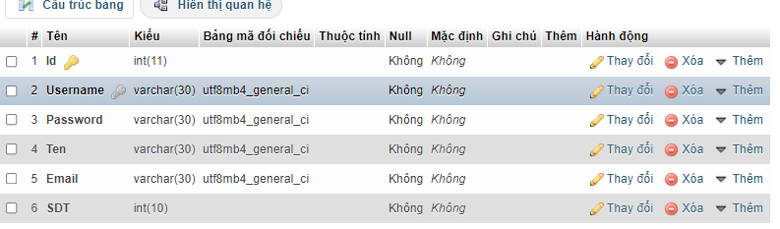
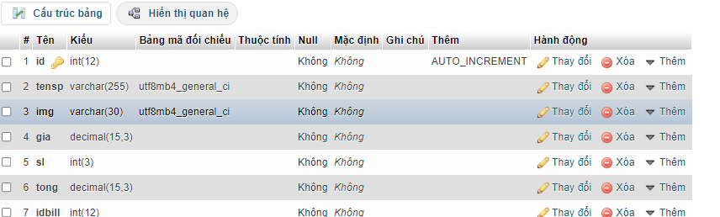
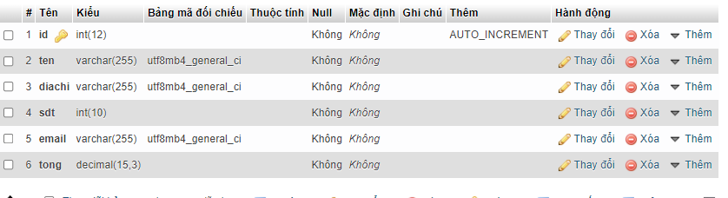
3.Database

Slide 7
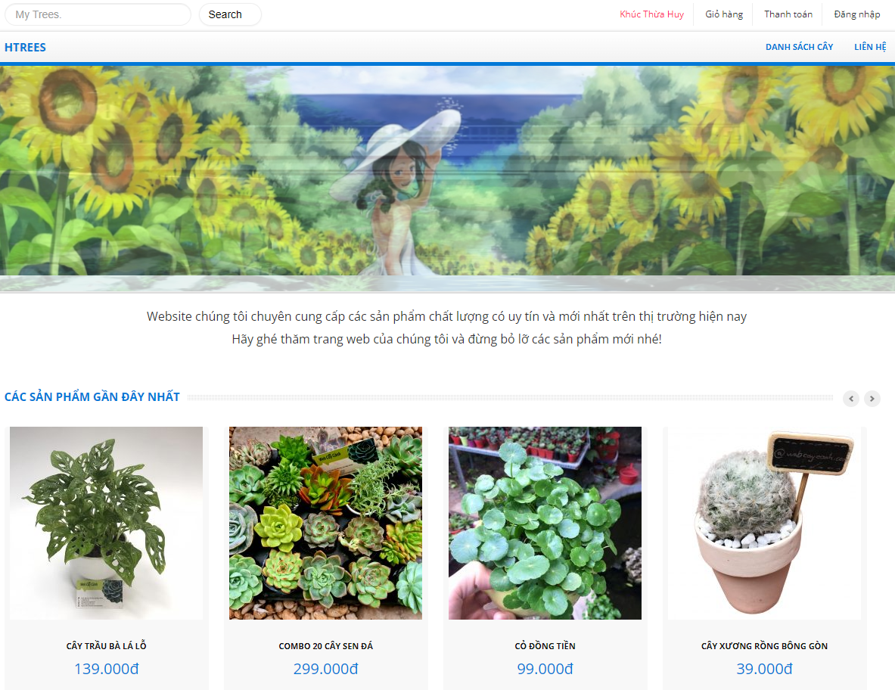
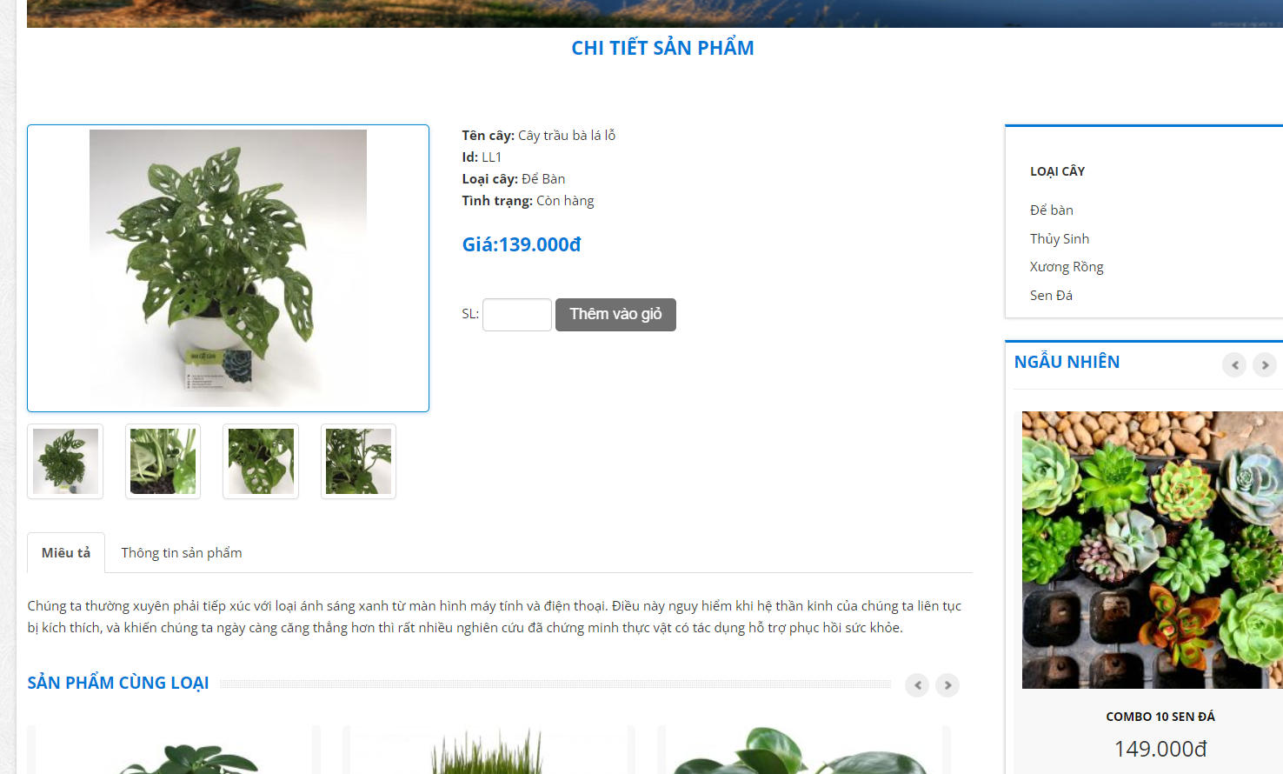
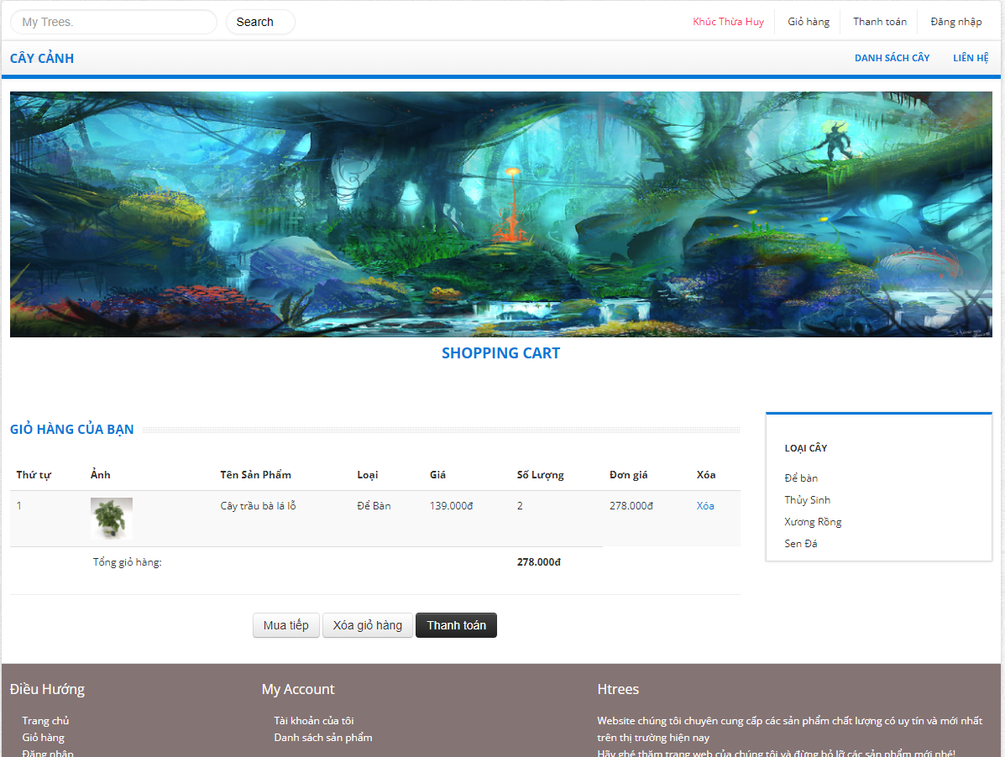
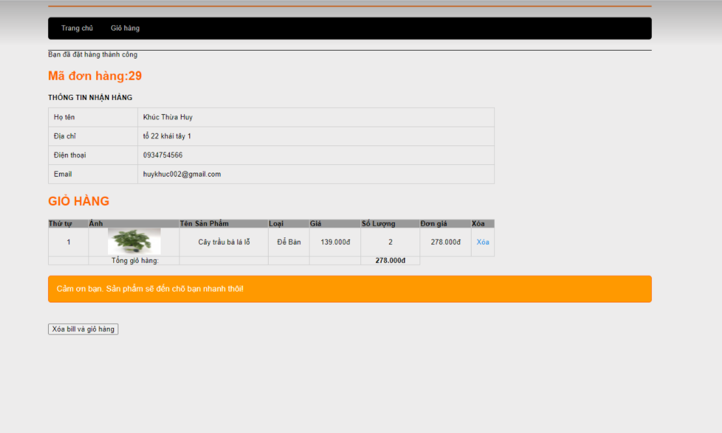
4.Interface

Slide 8
5. Conclude
Result achieved
- The website can be deployed in bonsai shops.
- The website has an easy-to-see, user-friendly interface.
- After researching, the team has built a website for managing bonsai sales, replacing manual management, which takes a lot of time and effort of the manager.

Slide 9


