Slide 1
Nodejs
Express Framework
Notes:
Run on startup package (forever).

Slide 2
Objectives
Setting up
What is REST architecture?
Creating a first application
Routing
Using body-parser module
Serving static files
Uploading file

Slide 3
1. Setting up
Open command prompt (cmd)
Create a project folder
mkdir <project_name>
Move to project folder
cd <project_name>
Initialize project
npm init
Fill project info.

Slide 4
Install express framework
npm install express --save
npm install body-parser –save
npm install multer –save
Notes:
body-parser − This is a node.js middleware for handling JSON, Raw, Text and URL encoded form data.
express-session − Manage session for middleware.
multer − This is a node.js middleware for handling multipart/form-data.

Slide 5
2. What is REST architecture?
REST stands for REpresentational State Transfer.
REST is web standards based architecture and uses HTTP Protocol.
REST was first introduced by Roy Fielding in 2000.
HTTP methods
GET - This is used to provide a read only access to a resource.
POST - This is used to create a new resource or update a existing resource.
PUT - This is used to update a existing resource or create a new resource.
DELETE - This is used to remove a resource.

Slide 6
3. Creating a first application
3.1. Creating a simple api
3.2. Enabling CORS

Slide 7
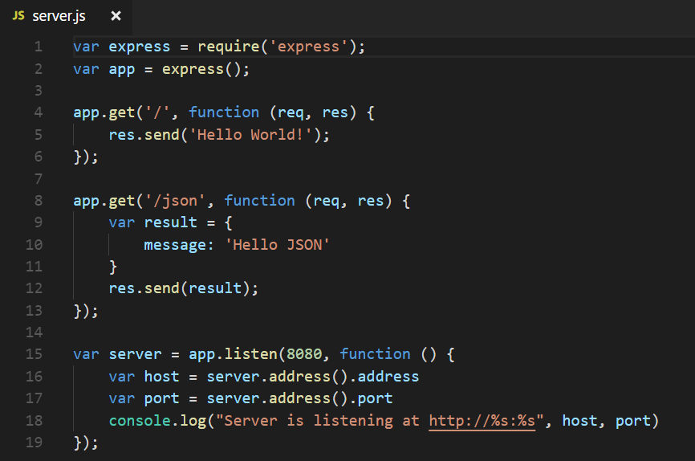
3.1. Creating a simple api

Slide 8
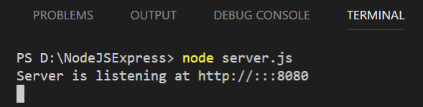
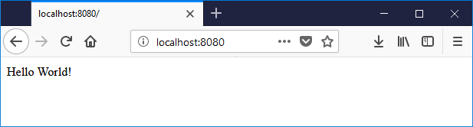
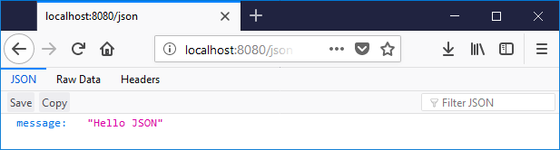

Slide 9
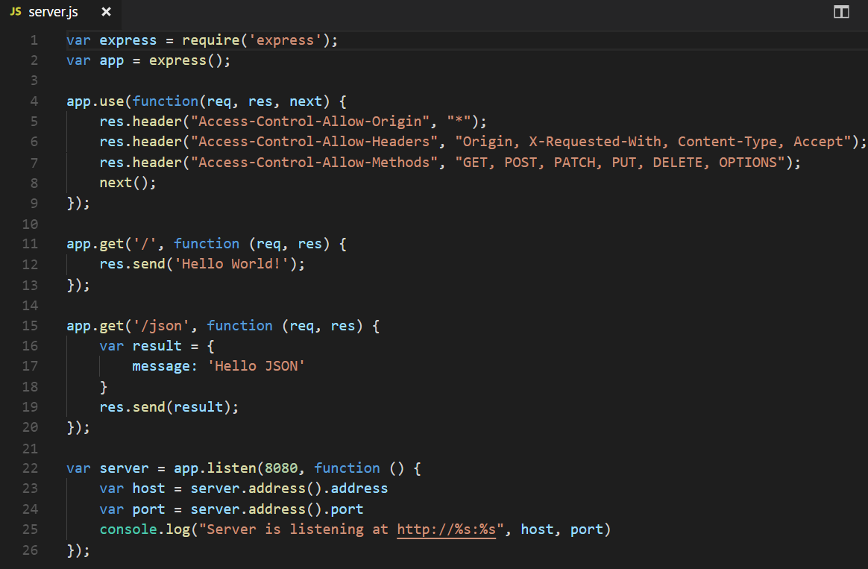
3.2. Enabling CORS
Notes:
Cors (Cross-origin resource sharing) − The mechanism that allows restricted resources (e.g. fonts) on a web page to be requested from another domain outside the domain from which the first resource was served.

Slide 10
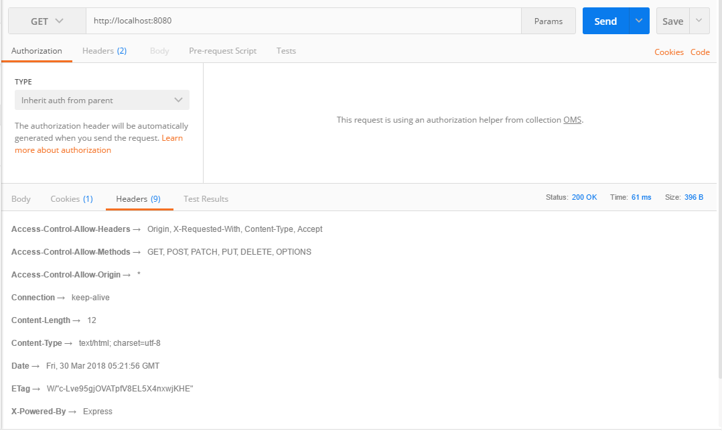

Slide 11
4. Routing
4.1. Route methods
4.2. Route paths
4.3. Route parameters
4.4. Response methods
4.5. app.route() method
4.6. express.Router class

Slide 12
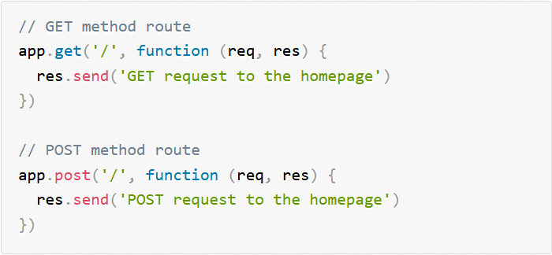
4.1. Route methods

Slide 13
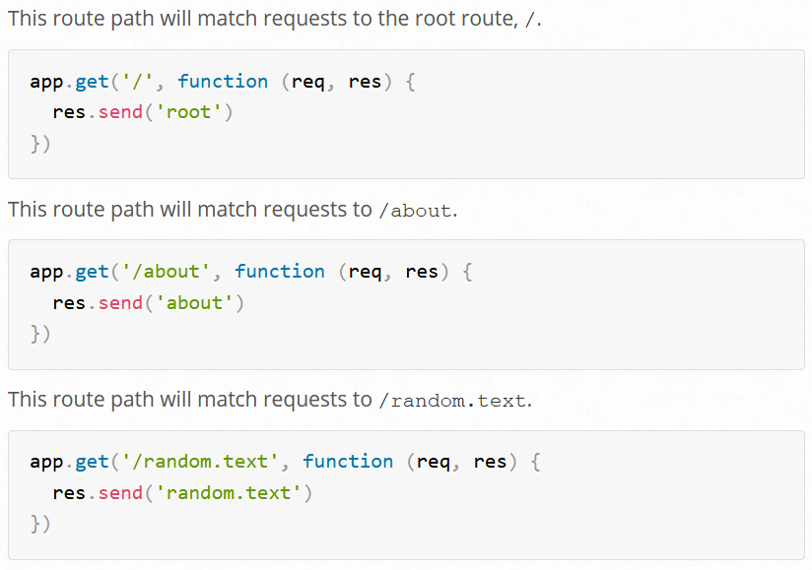
4.2. Route paths

Slide 14
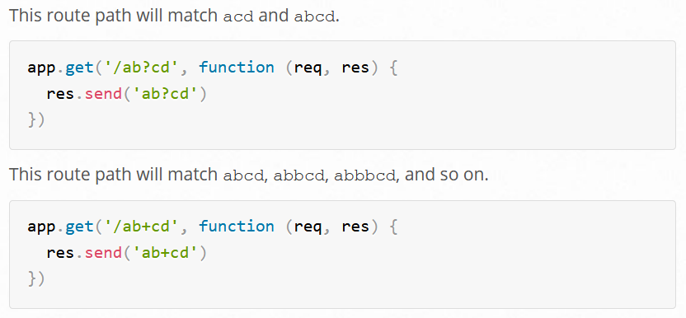
Notes:
(1) B? : B is optional
(2) B+: can duplicate B
(3) [BC]: can C or B
(4) [BC]+: can duplicate B or C or both. ex: B, C, BC, BBC, BCC, BBCC, …
(5) *: any characters or nothing
(6) (CD)?: CD is optional

Slide 15
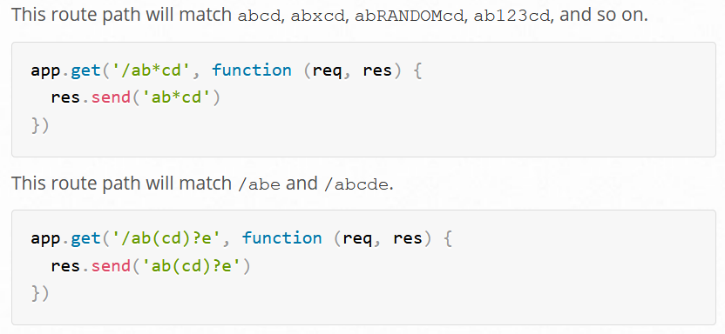

Slide 16
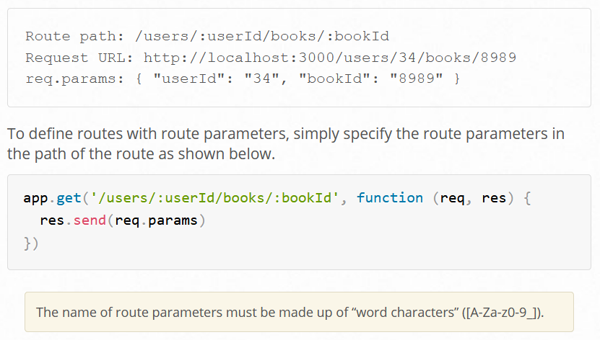
4.3. Route parameters

Slide 17
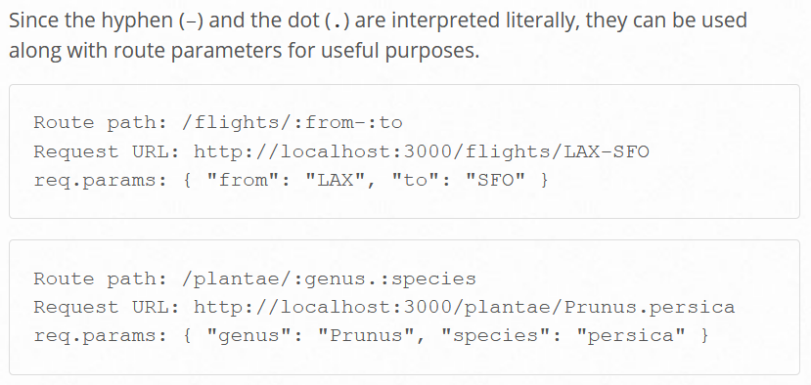

Slide 18
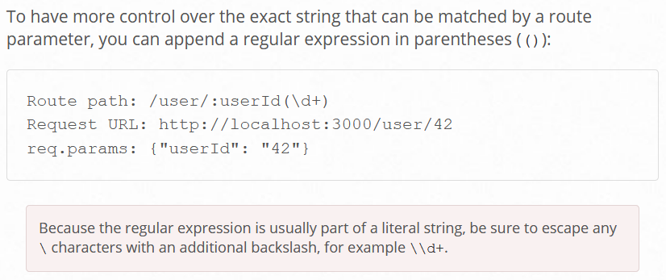

Slide 19
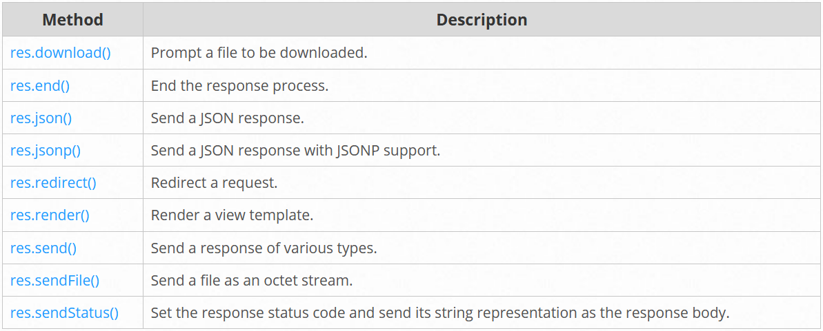
4.4. Response methods

Slide 20
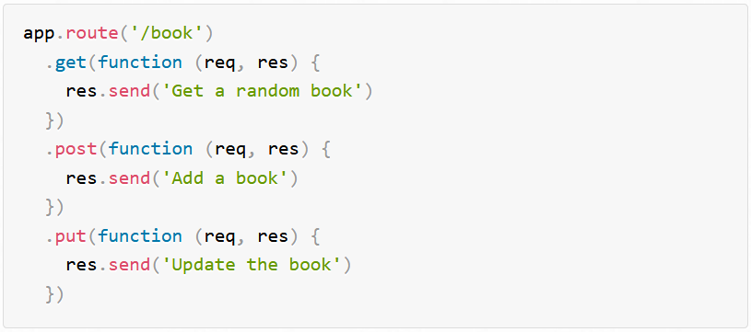
4.5. app.route() method
You can create chainable route handlers for a route path by using app.route(). Because the path is specified at a single location, creating modular routes is helpful, as is reducing redundancy and typos.

Slide 21
4.6. express.Router class
Use the express.Router class to create modular, mountable route handlers. A Router instance is a complete middleware and routing system
For this reason, it is often referred to as a “mini-app”

Slide 22
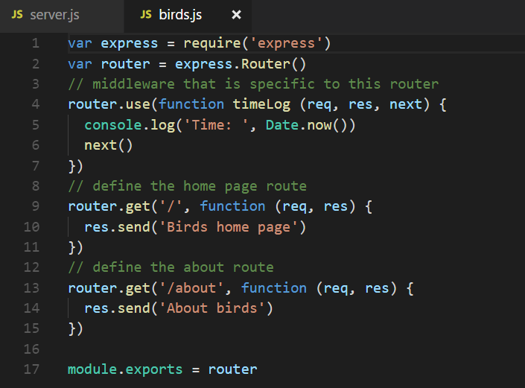

Slide 23
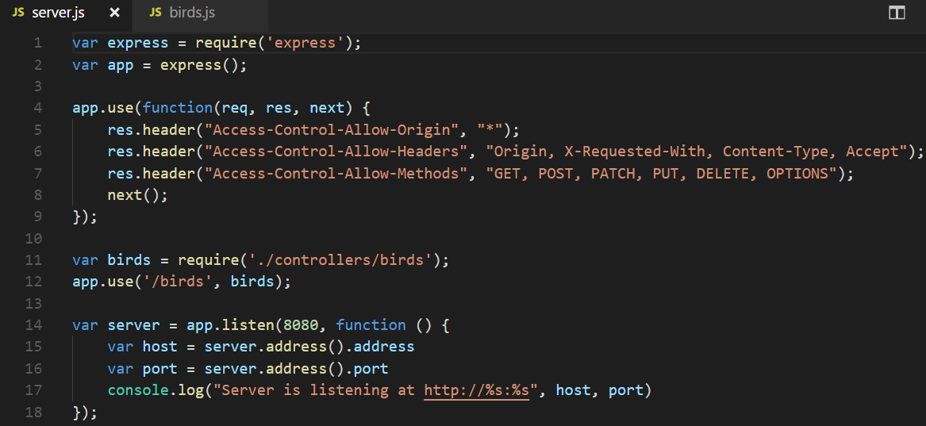

Slide 24
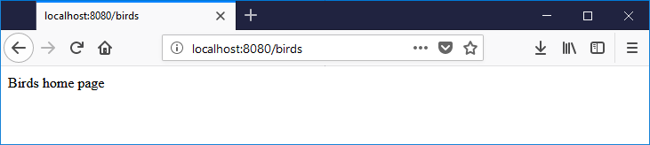
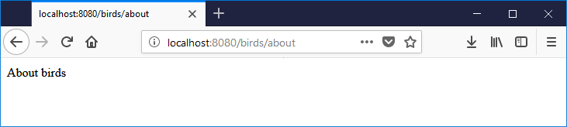

Slide 25
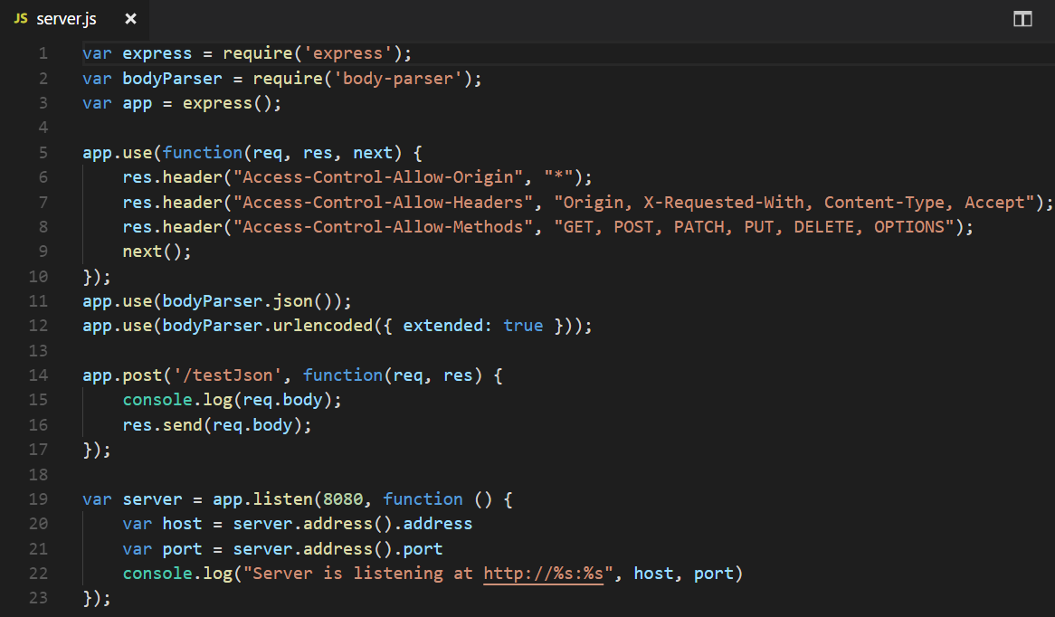
5. Using body-parser module

Slide 26
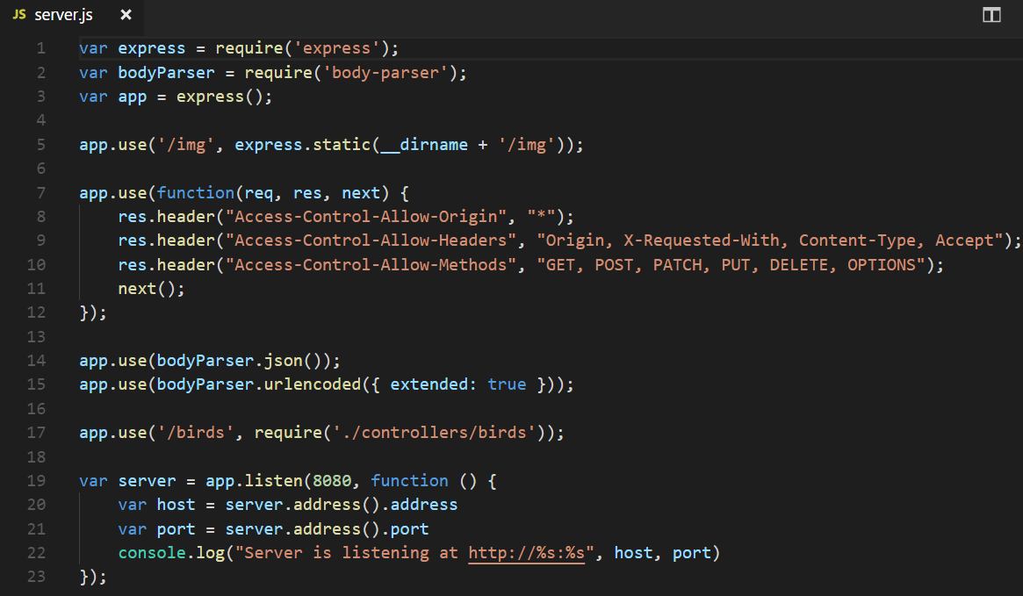
6. Serving static files

Slide 27
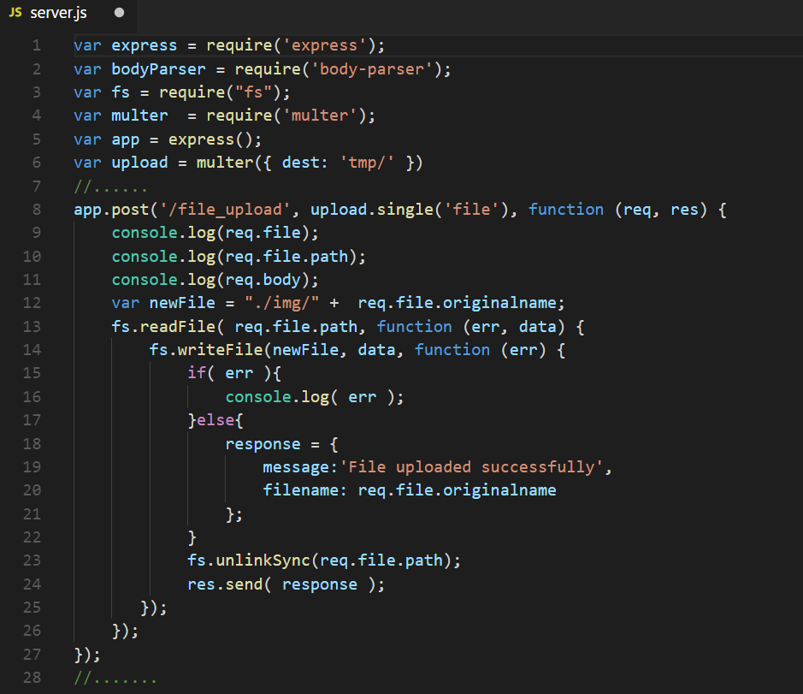
7. Uploading file

