Slide 1
Requirements Verification and Validation
SEG3101 (Fall 2010)
Based on Powerpoint slides by Gregor v. Bochmann, Gunter Mussbacher
with material from:
G. Kotonya and I. Sommerville, M. Jackson, P. Heymans,
S. Somé 2008, and D. Amyot 2008

Slide 2
Table of Contents
Introduction to Requirements Verification and Validation
Requirements Verification and Validation Techniques
  Simple checks
  Prototyping
  Functional test design
  User manual development
  Reviews and inspections
  Model-based (formal) Verification and Validation
The software is done. We are just trying to get it to work…¹
[1] Anonymous

Slide 3
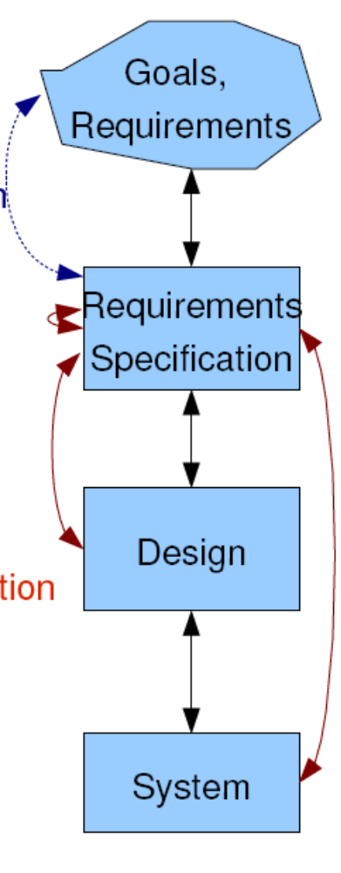


Requirements Verification and Validation
Requirements Validation
  Check that the right product is being built
  Ensures that the software being
  developed (or changed) will satisfy its
  stakeholders
  Checks the software requirements specification
  against stakeholders goals and requirements
Requirements Verification
  Check that product is being built right
  Ensures that each step followed in the process of
  building the software yields the right products
  Checks consistency of the software requirements
  specification artefacts and other software
  development products (design, implementation, ...)
  against the specification

Slide 4
Requirements Verification and Validation (2)
Help ensure delivery of what the client wants
Need to be performed at every stage during the (requirements) process
  Elicitation
    Checking back with the elicitation sources
    “So, are you saying that . . . . . ?”
  Analysis
    Checking that the domain description and requirements are correct
  Specification
    Checking that the defined system requirement will meet the user requirements under the assumptions of the domain/environment
    Checking conformity to well-formedness rules, standards…

Slide 5
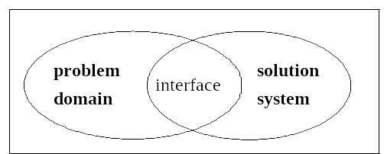
The World and the Machine¹
(or the problem domain and the system) These 6 slides are taken from Introduction to Analysis
Specification (S)
Domain
properties (D)
these are assumptions about the environment of the system-to-be
Requirements (R)
Hardware (C)
Software (P)
Validation question (do we build the right system?) : if the domain-to-be (excluding the system-to-be) has the properties D, and the system-to-be has the properties S, then the requirements R will be satisfied.
D and S ⇒ R
Verification question (do we build the system right?) : if the hardware has the properties H, and the software has the properties P, then the system requirements S will be satisfied.
C and P ⇒ S
Conclusion:
D and C and P ⇒ R
[1] M. Jackson, 1995

Slide 6
Example
Requirement
  (R) Reverse thrust shall only be enabled
  when the aircraft is moving on runway.
Domain Properties
  (D1) Deploying reverse thrust in mid-flight
  has catastrophic effects.
  (D2) Wheel pulses are on if and only if wheels are turning.
  (D3) Wheels are turning if and only if the plane is moving on the runway.
System specification
  (S) The system shall allow reverse thrust to be enabled if and only if wheel pulses are on.
Does D1 and D2 and D3 and S ⇒ R?
  Are the domain assumptions (D) right? Are the requirement (R) or specification (S) what is really needed?
The assumption D3 is false
because the plane may
hydroplane on wet runway.
based on P. Heymans, 2005

Slide 7
Requirement specifications including assumptions
Often the requirements for a system-to-be include assumptions about the environment of the system.
The system specification S, then, has the form:
  S = A ⇒ G
  where A are the assumptions about the environment and G are the guarantees that the system will provide as long as A hold.
If these assumptions (A) are implied by the known properties of the domain (D), that is D ⇒ A, and we can check that the domain properties (D) and the system guarantees (G) imply the requirements (R), that is D and G ⇒ R, then the “validation condition” D and S ⇒ R is satisfied.

Slide 8
Specification with assumptions and guarantees (example)
Example: A power utility provides electricity to a client. The problem is that the monthly invoice is not related to the electricity consumption, because there is no information about this consumption.
Idea of a solution: introduce an electricity counter.
Specification of the electricity counter
  Inputs and outputs
    input power from utility (voltage, current) – voltage supplied by utility
    output power to client (voltage, current) – current used by client
    Reset button (input)
    consumption (output - watt-hours of electricity consumption)

Slide 9
Example (suite)
  Assumptions
    Input voltage < 500 Volts (determined by utility)
    Output current < 20 Amps (determined by client)
  Guarantees
    Output voltage = input voltage
    Input current = output current
    Consumption output shall indicate the consumption since the last reset operation, that is, the integral of (output voltage x output current) over the time period from the occurrence of the last reset operation to the current time instant.
Software example
Specification of a method providing the interface “List search(Criteria c. Assumption: c is a data structure satisfying the Criteria class properties. Guarantee: the returned result is a list satisfying the List class properties and includes all items from the database that satisfy c.

Slide 10
Formal Verification and Validation
Evaluating the satisfaction of “D and S ⇒ R” is difficult with natural language
  Descriptions are verbose, informal, ambiguous, incomplete...
  This represents a risk for the development and organization
Verification of this “validation question” is more effective with formal methods (see below)
  Based on mathematically formal syntax and semantics
  Proving can be tool-supported
Depending on the modeling formalism used, different verification methods and tools may be applied. We call this “Model-Based V&V”
  In the case of the aircraft example above, we used Logic to write down statements about the model. This is a particular case of modeling formalism.

Slide 11
V&V vs. Analysis
Both have several activities in common
  Reading requirements, problem analysis, meetings and discussions...
Analysis works with raw, incomplete requirements as elicited from the system stakeholders
  Develop a software requirements specification document
  Emphasis on "we have the right requirements"
Requirements V&V works with a software requirements specification and with negotiated and agreed (and presumably complete) domain requirements
  Check that this these specifications are accurate
  Emphasis on "we have the right requirements well done"

Slide 12
Requirements V&V Techniques

Slide 13
Various Requirements V&V Techniques
Simple checks
  Traceability, well-written requirements
Prototyping
Functional test design
User manual development
Reviews and inspections
  Walkthroughs
  Formal inspections
  Checklists
Model-Based V&V
  First-order logic
  Behavioral models

Slide 14
Simple Checks
Various checks can be done using traceability techniques
  Given the requirements document, verify that all elicitation notes are covered
  Tracing between different levels of requirements
    Checking goals against tasks, features, requirements…
Involves developing a traceability matrix
  Ensures that requirements have been taken into consideration (if not there should be a reason)
  Ensures that everything in the specification is justified
Verify that the requirements are well written (according to the criteria already discussed)

Slide 15
Prototyping (1)
Excellent for validation by users and customers
  More accessible than specification
  Demonstrate the requirements and help stakeholders discover problems
Come in all different shapes and sizes
  From paper prototype of a computerized system to formal executable models/specifications
  Horizontal, vertical
  Evolutive, throwaway

Slide 16
Prototyping (2)
Important to choose scenarios or use cases for elicitation session
Prototyping-based validation steps
  Choose prototype testers
  Develop test scenarios
    Careful planning is required to draw up a set of test scenarios which provide broad coverage of the requirements
    Users should not just play around with the system as this may never exercise critical system features
  Execute test scenarios
  Document problems using a problem reporting tool

Slide 17
Comment on next two techniques
The two V&V techniques, namely Functional Test Design and User Manual Development, are not really V&V techniques.
They are activities that must be performed anyway, and they are based on the specification document.
  Through these activities, as for any other activities based on the specification document, errors and other problems with this document may be detected.

Slide 18
Functional Test Design
Functional tests at the system level must be developed sooner or later...
  Can (and should) be derived from the requirements specification
  Each (functional) requirement should have an associated test
  Non-functional (e.g., reliability) or exclusive (e.g., define what should not happen) requirements are harder to validate with testing
  Each requirements test case must be traced to its requirements
  Inventing requirements tests is an effective validation technique
Designing these tests may reveal errors in the specification (even before designing and building the system)!
  Missing or ambiguous information in the requirements description may make it difficult to formulate tests
Some software development processes (e.g., agile methods) begin with tests before programming ➔ Test-Driven Development (TDD)

Slide 19
User Manual Development
Same reasoning as for functional test design
  Has to be done at some point
  Reveals problems earlier
Forces a detailed look at requirements
Particularly useful if the application is rich in user interfaces / for usability requirements
Typical information in a user manual
  Description of the functionality
  How to get out of trouble
  How to install and get started with the system

Slide 20
Reviews and Inspections (1)
A group of people read and analyze requirements, look for potential problems, meet to discuss the problems, and agree on a list of action items needed to address these problems
A widely used requirements validation technique
  Lots of evidence of effectiveness of the technique
Can be expensive
  Careful planning and preparation
  Pre-review checking
  Need appropriate checklists (must be developed if necessary and maintained)

Slide 21
Reviews and Inspections (2)
Different types of reviews with varying degrees of formality exist (similar to JAD vs. brainstorming sessions)
  Reading the document
    A person other than the author of the document
  Reading and approval (sign-off)
    Encourages the reader to be more careful (and responsible)
  Walkthroughs
    Informal, often high-level overview
    Can be led by author/expert to educate others on his/her work
  Formal inspections
    Very structured and detailed review, defined roles for participants, preparation is needed, exit conditions are defined
    E.g., Fagan Inspection

Slide 22
Reviews and Inspections (3)
Different types of reviews (cont’d)
  Focused inspections
    Reviewers have roles, each reviewer looks only for specific types of errors
  Active reviews
    Author asks reviewer questions which can only be answered with the help of the document to be reviewed

Slide 23
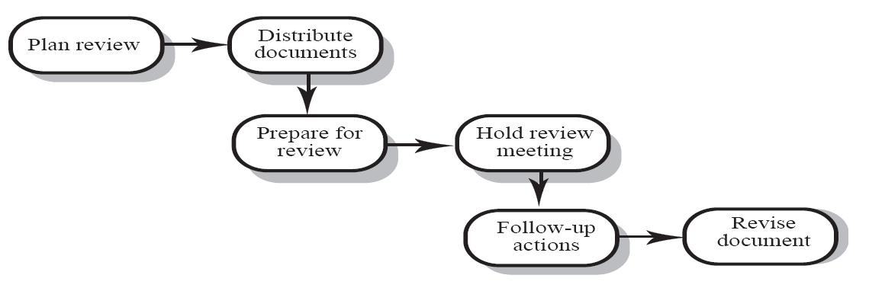
Typical Review / Inspection Steps (1)
Plan review
  The review team is selected and a time and place for the review meeting is chosen
Distribute documents
  The requirements document is distributed to the review team members

Slide 24
Typical Review / Inspection Steps (2)
Prepare for review
  Individual reviewers read the requirements to find conflicts, omissions, inconsistencies, deviations from standards, and other problems
Hold review meeting
  Individual comments and problems are discussed and a set of action items to address the problems is established

Slide 25
Typical Review / Inspection Steps (3)
Follow-up actions
  The chair of the review checks that the agreed action items have been carried out
Revise document
  Requirements document is revised to reflect the agreed action items
  At this stage, it may be accepted or it may be re-reviewed

Slide 26
Review Team
Reviews should involve a number of stakeholders drawn from different backgrounds
  People from different backgrounds bring different skills and knowledge to the review
  Stakeholders feel involved in the RE process and develop an understanding of the needs of other stakeholders
  Review team should always involve at least a domain expert and a user

Slide 27
Review – Problem Categorization
Requirements clarification
  The requirement may be badly expressed or may have accidentally omitted information which has been collected during requirements elicitation
Missing information
  Some information is missing from the requirements document
Requirements conflict
  There is a significant conflict between requirements
  The stakeholders involved must negotiate to resolve the conflict
Unrealistic requirement
  The requirement does not appear to be implementable with the technology available or given other constraints on the system
  Stakeholders must be consulted to decide how to make the requirement more realistic

Slide 28
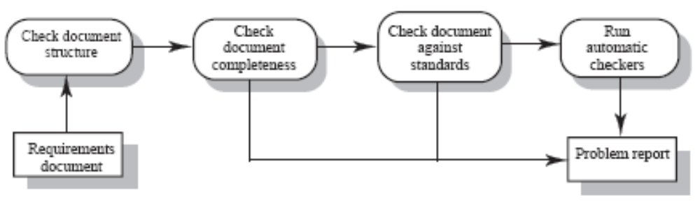
Pre-Review Checking
Reviews can be expensive because they involve many people over several hours reading and checking the requirements document
We can reduce this cost by asking someone to make a first pass called the pre-review
  Check the document and look for straightforward problems such as missing requirements (sections), lack of conformance to standards, typographical errors, etc.

Slide 29
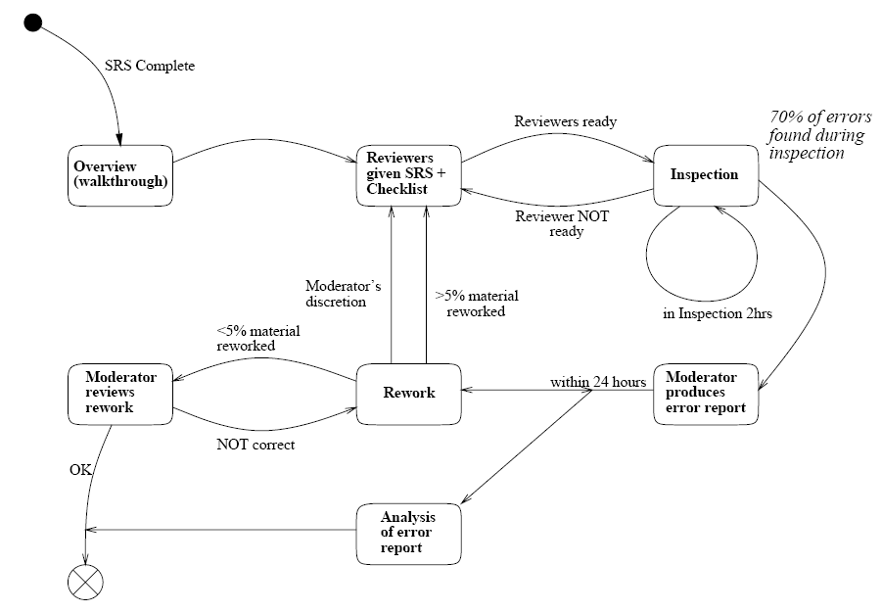
Fagan Inspection (1)
Formal and structured inspection process
Note: the boss is not involved in the process!

Slide 30
Fagan Inspection (2)
Characterized by rules on who should participate, how many reviewers should participate, and what roles they should play
  Not more than 2 hours at a time, to keep participants focused
  3 to 5 reviewers
  Author serves as the presenter of the document
  Metrics are collected
    Important: the author’s supervisor does not participate in the inspection and does not have access to data
    This is not an employee evaluation
  Moderator is responsible for initiating the inspection, leading the meeting, and ensuring issues found are fixed
  All reviewers need to prepare themselves using checklists
  Issues are recorded in special forms

Slide 31
Fagan Inspection (3)
The inspection meeting is like a brainstorming session to identify (potential) problems
Re-inspection if > 5% of the document change
  Some variants are less tolerant... too easy to introduce new errors when correcting the previous ones!

Slide 32
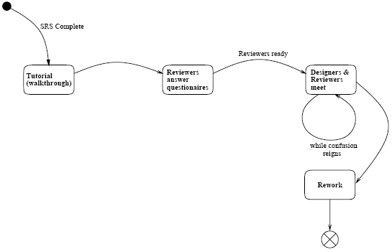
Active Review
Reviewer is asked to use the specification
Author poses questions for the reviewer to answer that can be answered only by reading the document
Author may also ask reviewer to simulate a set of scenarios

Slide 33
Requirements Review Checklists (1)
Essential tool for an effective review process
  List common problem areas and guide reviewers
  May include questions an several quality aspects of the document: comprehensibility, redundancy, completeness, ambiguity, consistency, organization, standards compliance, traceability ...
There are general checklists and checklists for particular modeling and specification languages
Checklists are supposed to be developed and maintained
See example on course website

Slide 34
Requirements Review Checklists (2)
Sample of elements in a requirements review checklist
  Comprehensibility – can readers of the document understand what the requirements mean?
  Redundancy – is information unnecessarily repeated in the requirements document?
  Completeness – does the checker know of any missing requirements or is there any information missing from individual requirement descriptions?
  Ambiguity – are the requirements expressed using terms which are clearly defined? Could readers from different backgrounds make different interpretations of the requirements?
  Consistency – do the descriptions of different requirements include contradictions? Are there contradictions between individual requirements and overall system requirements?

Slide 35
Requirements Review Checklists (3)
Sample of elements (cont’d)
  Organisation – is the document structured in a sensible way? Are the descriptions of requirements organised so that related requirements are grouped?
  Conformance to standards – does the requirements document and individual requirements conform to defined standards? Are departures from the standards justified?
  Traceability – are requirements unambiguously identified? Do they include links to related requirements and to the reasons why these requirements have been included?

Slide 36
Comments on Reviews and Inspections
Advantages
  Effective (even after considering cost)
  Allow finding sources of errors (not only symptoms)
  Requirements authors are more attentive when they know their work will be closely reviewed
    Encourage them to conform to standards
  Familiarize large groups with the requirements (buy-in)
  Diffusion of knowledge
Risks
  Reviews can be dull and draining (need to be limited in time)
  Time consuming and expensive (but usually cheaper than the alternative)
  Personality problems
  Office politics…

Slide 37
Model-based (formal)
Verification and Validation

Slide 38
The problem domain and the system – copied from Introduction to Analysis and Specification
Specification (S)
Domain
properties (D)
these are assumptions about the environment of the system-to-be
Requirements (R)
Hardware (C)
Software (P)
Validation question (do we build the right system?) : if the domain-to-be (excluding the system-to-be) has the properties D, and the system-to-be has the properties S, then the requirements R will be satisfied.
D and S ⇒ R
Verification question (do we build the system right?) : if the hardware has the properties H, and the software has the properties P, then the system requirements S will be satisfied.
C and P ⇒ S
Conclusion:
D and C and P ⇒ R
[1] M. Jackson, 1995

Slide 39
Modeling paradigms
Modeling paradigms
  Entity-Relationship modeling – e.g. UML Class diagrams
  Workflow modeling notations – there are many different “dialects”, such as UML Activity diagrams, UCM, BPML, Petri nets (a very simple formal model), Colored Petri nets
  State machines – e.g. Finite State Machines (FSM – a very simple formal model), extended FSMs, such as UML State diagrams
  First-order logic – notations such as Z, VDM, UML-OCL, etc.
    Can be used as an add-on with the other paradigms above, by providing information about data objects and relationships (possibly in the form of “assertions” or “invariants” that hold at certain points during the dynamic execution of the model)
    Can be used alone, expressing structural models and behavioral models (there are many examples of using Z for such purpose)

Slide 40
Formal V&V techniques and tools (i)
Available V&V techniques will vary from one modeling paradigms to another and will also depend on the available tools (that usually only apply to a particular “dialect” of the modeling paradigm)
The following functions may be provided through tools
  Completeness checking – only according to certain syntax rules, templates
  Consistency checking : given model M, show that M does not imply a contradiction and does not have any other undesirable general property (e.g. deadlock possibility)
  Refinement checking : given two models M and M’, show that the properties of M imply the properties of M’. This can be used for the validation of the system specification S, that is, showing that D and S ⇒ R where D are the domain properties and R are the domain requirements (M = D and S; M’ = R)
  Model checking : given a model M and some properties P, show that any system implementation satisfying M will have the properties P
  Generation of system designs or prototype implementations (from workflow or state machine models)
  Generation of test cases
  Performance evaluation

Slide 41
Formal V&V techniques and tools (ii)
Consistency and Refinement checking
  Logic models
    Theorem proving
  Workflow and State machine models
    Simulated execution (prototype implementations)
    Reachability analysis (determining all reachable states of a system consisting of a composition of several state machines, or of a workflow model). In contrast, simulated execution will only perform partial analysis – namely a certain number of test cases (note: one may consider a very large number of such cases, possibly randomly generated).

Slide 42
Consistency checking for state machines
  Different types of refinements
    Refinement (also called Conformance) between two machines (for example, one abstract and the other one more concrete)
    Reduction of non-determinism
    Reduction of optional behavior (compliant, but some behaviors are not supported)
    Extension (conformance, but some new events are treated and lead to new behaviors)
  Equivalence checking
    Between two machines (for example, one abstract and the other one more concrete)
    Several types of equivalence: trace equivalence (same traces of events can be observed), refusal equivalence (same blocking behavior), observational equivalence (equivalent states in both machines), etc.

Slide 43
Formal V&V techniques and tools (iii)
Model checking: Is normally used for behavioral workflow and state machine models (however, the Alloy tool can also be used for checking structural Class diagram models).
  Uses the approach of reachability analysis
  The typical properties to be verified for a given model could be the following (note: can also be checked by simulated execution):
    General properties (to be satisfied by most systems):
      Absence of deadlocks in a system with concurrency
      No non-specified messages, that is, for all events that may occur their handling is defined
      All states can be reached and all transitions can be traversed
    Specific properties (depending on this particular system): Such specific properties must be specified in some suitable notation, such as
      Logic assertions or invariants
      Temporal logic (extension of predicate calculus with two operators: always and eventually (corresponding to Maintain/Avoid goals and Achieve goals, respectively)

Slide 44
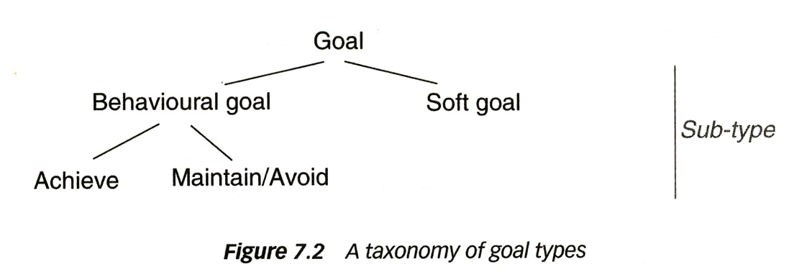
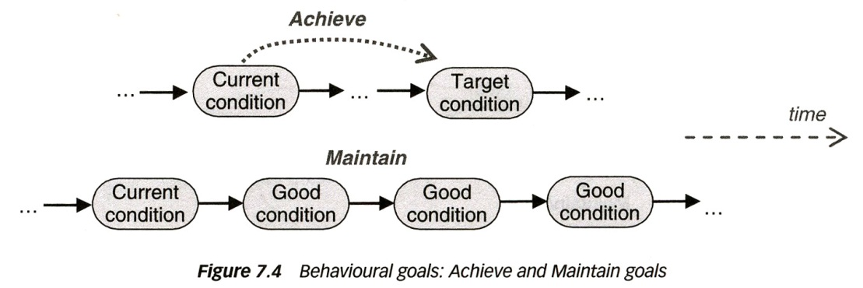
Different types of goals – copied from Goal-oriented modeling
Behavioral goal: establishment of goal can be checked
  Describes intended behavior declaratively
  Implicitly defines a maximal set of admissible behaviors
    Achieve: points to future (like “eventually” operator in Temporal Logic)
    Maintain/Avoid: states property that always holds (like “always” operator)
Soft-Goal: are more or less fulfilled by different alternatives of (external) design – often difficult to quantify – one says, some alternative may “satisfice” the goal

Slide 45
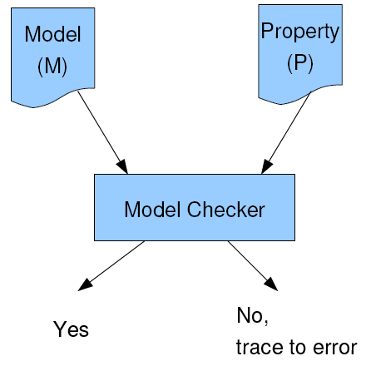
Model checking
  Verifies that the model satisfies temporal logic
  properties, for example:
    If A occurs, B will occur in the future (eventually)
    If C occurs, D will be true always in the future
  Traverse systematically all possible behaviors
  (execution paths) of the machine (reachability analysis)
    Verification of properties done after reachability analysis or on the fly
  Model checker verifies M ⇒ P (if no trace of states and transitions leading to the violation of P is found) – otherwise a counter example trace is provided
  Major obstacle is state space explosion
  Example tools:
  SPIN (see http://spinroot.com/spin/whatispin.html ) - for distributed systems with message passing
  Alloy (see http://alloy.mit.edu/community/ ) – for OO Class diagrams with assertions

Slide 46
Performance modeling and evaluation

Slide 47
Performance Analysis
Different approaches to performance analysis
  Informal: Qualitative analysis with GRL strategies
  Counting the number of messages involved: e.g. transformations of workflow scenarios into sequence diagrams
  Model-based performance evaluation
    Queuing models : consider resources, service times and request queuing
    Markov models : consider transition probabilities of state machine models

Slide 48
Performance modeling : Markov models
Markov models
State machine model where each transition has a given rate of occurrence; this leads to an exponential distribution of the sejourn time in a given state.
This modeling paradigm is often used for modeling reliability, availability etc.
Example: Machine may be operational or failed. In the operational state, the rate of the failing transition is 0.001 per hour, in the failed state, the rate of the repaired transition (back to the operational state) is 1.0 per hour (the machine remains in the failed state a duration that has an exponential distribution with average 1 hour).

Slide 49
Performance modeling : Queuing models
Queuing models
  One considers: user requests, resources (servers), service times (for processing requests by resources) and request queuing
  One talks about queueing networks – a kind of workflow model involving several resources providing various services and requests that flow between resources (closed system: users are also modeled as resources – open system: users are outside the “system”)
  The performance of workflow models (UML Activity diagrams or UCMs) can be naturally modeled by queueing networks.
    The jUCMNav provides for the automatic transformation into such a model using an intermediate representation called Core Senario Model (CSM)
  The functional workflow model must be complemented with performance parameters in order to provide the necessary input data for performance modeling. This includes:
    Performance data on resources: e.g. service times, queuing disciplines, etc.
    Performance data on work load: e.g. number of requests per unit time, etc.

Slide 50
Performance evaluation tools
For both, Markov and Queuing models, there are two basic approaches to performance evaluation:
  Analytical formulas
  Simulation studies
Special versions of modeling paradigms
  Layered Queuing Networks (LQN - using several layers of abstraction, like layered operating system functions) – developed by Dr. Woodside at Carleton University
  Stochastic Petri nets (Markov’s rate-based transitions applied to Petri nets)

Slide 51
Typical Performance Results from Queuing models
General statistics
  Elapsed time, system time…
Measured quantities
  Service demands, number of blocking and non-blocking calls, call delays, synchronization delays
Service times
  For every entry and activity, with confidence intervals and variances (where relevant)
Throughputs and utilizations for every entry and activity, with confidence intervals
Utilizations and waiting times for devices (by entry)

Slide 52
e.g. Performance Annotations for UCMs (Use Case Maps)
Resource Characteristics
Passive/active, external operations
Disks, processors, …
Operation time
Multiplicity
Automated translation to Core Scenario Model (CSM) for analytical evaluations and simulations
Workload
Characteristics
Poisson, periodic…
Population size
Open/closed
TaxPayer
Security
E_Accountant
CheckBio
Continue
Access
Ready
Rejected
Components
Allocated responsibilities
Resource assignment
Responsibilities
Host demand
External op. demands
Multiplicity
OR Forks and
Dynamic Stubs
Probability

Slide 53
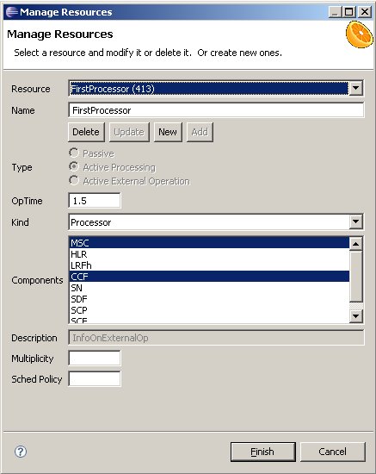
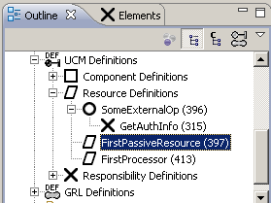
Resource Management

Slide 54
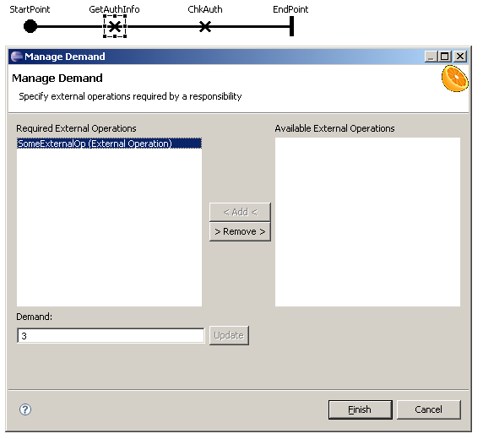

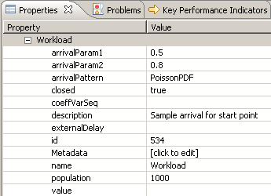
Demand and Workload Management

Slide 55
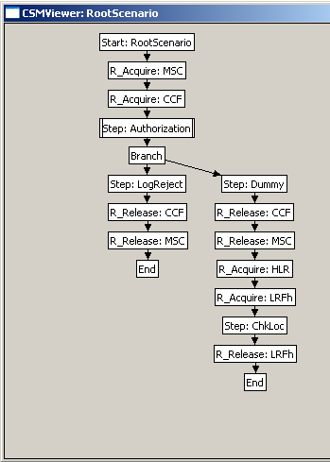
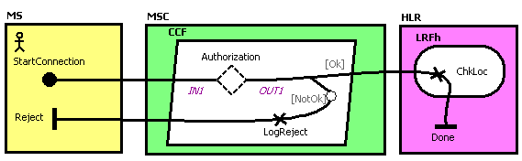
From UCM to Core Scenario Model (CSM)
Export CSM (XML) from URN model
Translation of CSM file to LQN, QN, stochastic Petri Nets…

Slide 56
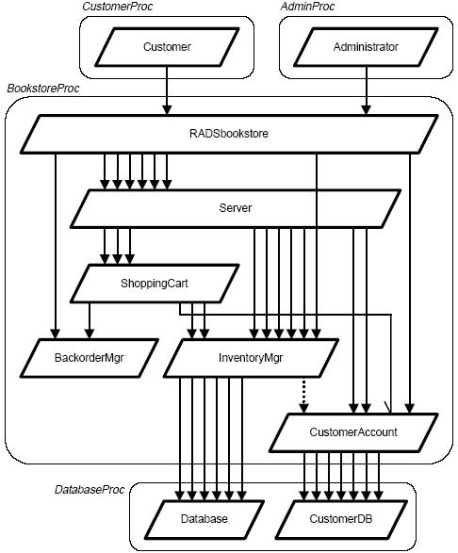
LQN (Layered Queuing Network) Generation from UCMs (2)
Useful for various types of analyses
  Sensitivity (importance or impact
  of parameters)
  Scalability (what if there are
  more users/requests?)
  Concurrency (what if there are
  more/fewer threads?)
  Deployment and configuration
  (different hardware allocation)
Quantitative evaluation of
architecture!
Source: D.B. Petriu et al., 2003

Slide 57
Model transformations:
Test case derivation

Slide 58
Model-based testing
Behavioral models can be used for
  Deriving test cases
  Providing an oracle that predicts the correct output expected for given inputs. (However: if the behavioral model is non-deterministic – for a given input there may be different outputs – then this is quite difficult)
This is black-box testing – the system implementation under test is observed only at its external interfaces – no internal view
Test cases – two complementary coverage issues
  Covering different control flows through the behavior
  Covering different data parameter values
  Question of executability of given control flow path with given data parameters

Slide 59
Coverage issues for black-box testing
Issues of control flow coverage
  All branches of the behavioral model will be exercised at least once
    E.g. so-called transition tour for FSM model
  All paths … (leads normally to too many test cases)
  Covering all faults – one needs a fault model
    Fault model for FSMs:
      Output faults (wrong output produced): will be detected by transition tour
      Transfer faults (wrong next state): difficult to detect - either introduce state visibiility, or use so-called state identification test sequences

Slide 60
Automating test development from models ?
FSM models:
  There has been much work on deriving test suites (sets of test cases) from FSM models (for different coverage criteria)
UCM models:
  Deriving sequence diagram (test case – without data) for each scenario that can be realized from the given UCM
  Automatic generation of scenarios and corresponding test cases (see next page)

Slide 61
Model transformations:
Deriving distributed system designs

Slide 62
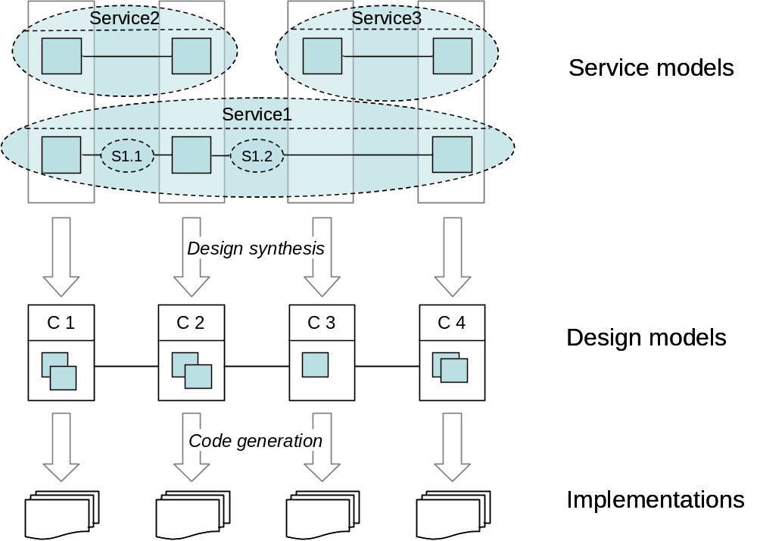
The problem

Slide 63
Type of applications
Communication services
  telephony features (e.g. call waiting)
  teleconference involving many parties
  Social networking
Workflows
  Intra-organization, e.g. banking application, manufacturing
  inter-organisations, e.g. supply-chain management
  Different underlying technologies:
    Web Services
    GRID computing
    Cloud computing
  Dynamic partner selection: negotiation of QoS – possibly involving several exchanges

Slide 64
The problem
(early phase of the software development process)
Define
  Global functional requirements
  Non-functional requirements
Make high-level architectural choices
  Identify system components
  Define underlying communication service
Define behavior of system components:
  Locally performed functions
  Communication protocol
    Required messages to be exchanged and order of exchanges
    Coding of message types and parameters

Slide 65
Issues
Define
  Global functional requirements
  Non-functional requirements
Make high-level architectural choices
  Identify system components
  Define underlying communication service
Define behavior of system components
  Local functions
  Protocol:
    Required messages to be exchanged and order of exchanges
    Coding of message types and parameters
What language / notation to use for defining global requirements (dynamic behavior)
Architectural choices have strong impact on performance
Automatic derivation of component behaviors ? e.g. [Bochmann 2007]
Performance prediction – based on component behavior
    Response time, Throughput, Reliability
Choice of middleware platform for inter-process communication
  E.g. Java RMI, Web Services, etc.

Slide 66
Example: Taxi system (an activity diagram - each activity is a collaboration between several roles: client, taxi, manager)
M : taxi manager
taxi leaves
new client C
new taxi T
Request
C
Free
T
Off-duty
M
M
C
T
Withdraw
Free
M
M
M
T
initiating role
Assign
Pick-up
T
C
C
M
client leaves
terminating
roles
T
T
Drive
Meet
T
T
C
Pay
T
client leaves

Slide 67
Taxi System
Detailed definitions of collaborations
C
M
C
M
T
C
T
C
T
meet
drive
req
assign
assign
OK
OK
Request
Assign
Meet
Drive
C
M
T
free
req
Example scenario
(sequence diagram)
pay
drive
assign
assign
meet
OK
OK
off-duty

Slide 68
Taxi System : Problematic scenarios
C
M
T
C
M
T
C2
C1
M
T
req
free
free
req
free
req
pick-up
assign
assign
assign
assign
assign
meet
with-
draw
assign
non-local
choice
[Gouda 84] suggests: define different priorities
for different roles
race
condition
non-local
Choice
(conflict over taxi)
“implied scenario”:
[Alur 2000] component behaviors
that realize the normal scenario
will also give rise to implied scenarios

Slide 69
Model transformations:
Deriving prototype implementations

Slide 70
Code generation from behavioral models
This has been explored in research projects since the 1980s for extended FSM languages and commercial tools have been around since the 1990s, in particular for SDL, Statecharts and other notations – now also for UML State machines.

