Slide 1
CHAPTER 10
Warehousing Management
Copyright © 2015 Pearson Education, Inc.

Slide 2
Learning Objectives
To discuss the role of warehousing in a logistics system
To learn about public, private, contract and multiclient warehousing
Copyright © 2015 Pearson Education, Inc.
10-<number>

Slide 3
Learning Objectives
To analyze select considerations when designing warehousing facilities
To examine some prominent operational issues in warehousing
Copyright © 2015 Pearson Education, Inc.
10-<number>

Slide 4
Warehousing Management Key Terms
Accumulating (bulk making)
Allocating (bulk breaking)
Assorting
Contract (third-party) warehousing
Cross-docking
Distribution center
Dunnage
Fixed slot location
Hazardous materials
Multiclient warehousing
Copyright © 2015 Pearson Education, Inc.
10-<number>

Slide 5
Warehousing Management Key Terms
Occupational Safety and Health Administration (OSHA)
Private warehousing
Public warehousing
Regrouping function
Sorting out
Throughput
Variable slot location
Warehouse
Warehouse automation
Warehousing
Copyright © 2015 Pearson Education, Inc.
10-<number>

Slide 6
The Role of Warehousing in a Logistics System
Warehousing
  refers to “that part of the firm’s logistics system that stores products (raw materials, part, good-in-process, finished goods) at an between points of origin and point of consumption.”
Source: Douglas M. Lambert, James R. Stock, and Lisa M. Ellram, Fundamentals of Logistics Management (New York: Irwin McGraw-Hill, 1998), Chapter 8.
Copyright © 2015 Pearson Education, Inc.
10-<number>

Slide 7
Warehousing Management
Warehousing and transportation are substitutes for each other, with warehousing having been referred to as “transportation at zero miles per hour.”
Copyright © 2015 Pearson Education, Inc.
10-<number>

Slide 8
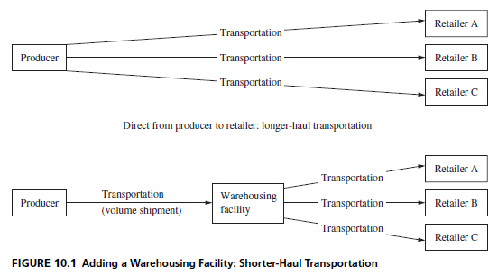
The Role of Warehousing in a Logistics System
Copyright © 2015 Pearson Education, Inc.
10-<number>

Slide 9
The Role of Warehousing in a Logistics System
Key reason for warehousing
  because patterns of production and consumption do not coincide
Warehousing
  serves to match different rates or volumes of flow when patterns of production and consumption do not coincide
Copyright © 2015 Pearson Education, Inc.
10-<number>

Slide 10
The Role of Warehousing in a Logistics System
Warehousing facilitates the regrouping function in a supply chain
  Involves rearranging the quantities and assortment of products as they move through the supply chain
Copyright © 2015 Pearson Education, Inc.
10-<number>

Slide 11
The Role of Warehousing in a Logistics System
Warehousing facilitates the regrouping function in a supply chain – can take place in four forms
  Accumulating (bulk making)
    involves bringing together similar stocks from different sources
  Allocating (bulk breaking)
    involves breaking larger quantities into smaller quantities
  Assorting
    refers to building up a variety of different products for resale to particular customers
  Sorting out
    “separating products into grades and qualities desired by different target markets”¹
¹William D. Perreault, Jr., Joseph P. Cannon, and E. Jerome McCarthy, Basic Marketing, 16th ed. (New York: McGraw-Hill Irwin, 2008), Chapter 11.
Copyright © 2015 Pearson Education, Inc.
10-<number>

Slide 12
The Role of Warehousing in a Logistics System
Warehousing can be provided by
  Warehouses
    Emphasize the storage of products
    Primary purpose is to maximize the usage of available storage space
  Distribution centers
    Emphasize rapid movement of products through the facility
    Attempt to maximize throughput
      Throughput is defined as the amount of product entering and leaving a facility in a given time period
Copyright © 2015 Pearson Education, Inc.
10-<number>

Slide 13
The Role of Warehousing in a Logistics System
Warehousing can be provided by
  Cross-docking facilities
    Has grown due to the increased emphasis on time reduction in supply chains
    Defined as “the process of receiving product and shipping it out the same day or overnight without putting it into storage”¹
    Key benefits include improved service by allowing products to reach their destinations more quickly as well as reduced inventory carrying costs from less stock because of faster product delivery²
¹No author, “2008 Cross-Docking Trends Report,” Saddle Creek Corporation, 2008.
²Mike DelBoro, “Cross-Docking Rediscovered,” Material Handling & Logistics, May 2011, 34–37.
Copyright © 2015 Pearson Education, Inc.
10-<number>

Slide 14
The Role of Warehousing in a Logistics System
Warehousing can be provided by
  Cross-docking facilities
    Is differentiated from distribution centers by the length of time a product is in a facility (24 hours or less for cross-docking facility)
    Design of the facility is an important consideration to facilitate quick movement of product
      Should be designed with a minimal amount of storage space and truck doors on two or more sides¹
      Some designs include “H”, “I”, “T”, “U” and “E” configurations
¹DelBoro, “Cross-Docking Rediscovered.”
Copyright © 2015 Pearson Education, Inc.
10-<number>

Slide 15
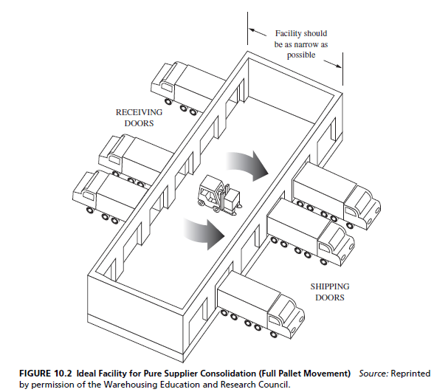
The Role of Warehousing in a Logistics System
Copyright © 2015 Pearson Education, Inc.
10-<number>

Slide 16
Public, Private, Contract, and Multiclient Warehousing
Organizations must also decide the proper mix in terms of warehouse ownership
  Owning
    Private warehousing
  Renting
    Public warehousing
    Contract warehousing
    Multiclient warehousing
Copyright © 2015 Pearson Education, Inc.
10-<number>

Slide 17
Public, Private, Contract, and Multiclient Warehousing
Public warehouses
  Serve all legitimate users
  Require no capital investment on the user’s part
  Allows users to rent space as needed
  Can be rented on a month-to-month basis
  Warehousing companies have responsibility for personnel decisions and regulatory issues
  Offers more locational flexibility
  May provide specialized services
Copyright © 2015 Pearson Education, Inc.
10-<number>

Slide 18
Public, Private, Contract, and Multiclient Warehousing
Potential drawback of public warehouses
  Lack of control by the user
Warehousing labor safety practices monitored by Occupational Safety and Health Administration (OSHA)
Copyright © 2015 Pearson Education, Inc.
10-<number>

Slide 19
Public, Private, Contract, and Multiclient Warehousing
Private warehousing
  Owned by the firm storing goods in the facility
  Generates high fixed costs
  Should only be considered by companies dealing with large volumes of inventory
  Largest uses of private warehousing are retail chain stores
  Offers control to owner
  Assumes both sufficient demand volume and stability so that warehouse remains full
Copyright © 2015 Pearson Education, Inc.
10-<number>

Slide 20
Public, Private, Contract, and Multiclient Warehousing
Private warehousing potential drawbacks
  High fixed cost of private storage
  Necessity of having high and steady demand volumes
  Less attractive when interest rates are high
  May reduce an organization’s flexibility
    Internally
    Externally
Copyright © 2015 Pearson Education, Inc.
10-<number>

Slide 21
Public, Private, Contract, and Multiclient Warehousing
Contract warehousing
  Also referred to as third-party (3PL) warehousing or dedicated warehousing
  “a long term, mutually beneficial arrangement which provides unique and specially tailored warehousing and logistics services exclusively to one client, where the vendor and client share the risks associated with the operation.”¹
¹Warehousing Education and Research Council, Contract Warehousing: How It Works and How to Make It Work Effectively (Oak Brook, IL: Author, 1993).
Copyright © 2015 Pearson Education, Inc.
10-<number>

Slide 22
Public, Private, Contract, and Multiclient Warehousing
Contract warehousing
  Both vendor and client share the risks associated with the warehousing
  Less costly than private warehousing and more costly than public warehousing
Copyright © 2015 Pearson Education, Inc.
10-<number>

Slide 23
Public, Private, Contract, and Multiclient Warehousing
Contract warehousing has evolved to include value-adding services to a greater degree than public warehousing¹
  Customization
  Reverse logistics
  Repair and refurbishment
¹William Hoffman, “Contract Warehousing Evolves,” Traffic World, January 31, 2005, 16.
Copyright © 2015 Pearson Education, Inc.
10-<number>

Slide 24
Public, Private, Contract, and Multiclient Warehousing
Multiclient warehousing
  Mixes attributes of contract and public warehouses
  Services are more differentiated than those in a public facility
  Services are less customized than those in a contract facility
  Services are purchased through minimum 1 year contracts
  Are attractive to smaller organizations
Copyright © 2015 Pearson Education, Inc.
10-<number>

Slide 25
Public, Private, Contract, and Multiclient Warehousing
Multiclient warehousing
  Are attractive to smaller organizations that don’t have sufficient volumes to:
    Build their own storage facilities
    Use traditional one client contract warehousing services¹
¹William Hoffman, “Dividing the Box,” Journal of Commerce, February 25, 2008, 23.
Copyright © 2015 Pearson Education, Inc.
10-<number>

Slide 26
Design Considerations in Warehousing
General considerations
  Quantity and character of goods to be handled must be known—product profiling
  Know the purpose to be served
      Facility with low rates of product turnover should be laid out in a manner that maximizes utilization of the cubic capacity of the storage facility
      Facility that emphasizes rapid product movement with limited time in storage should be configured to facilitate the flow of product into and out of it
Copyright © 2015 Pearson Education, Inc.
10-<number>

Slide 27
Design Considerations in Warehousing
Trade-offs
  Must be made among space, labor, and mechanization with respect to warehouse design
  Fixed versus variable slot locations for merchandise
    In fixed slot locations each SKU has one or more permanent slots assigned to it
    Variable slot location involves empty storage slots being assigned to incoming products based on space availability
Copyright © 2015 Pearson Education, Inc.
10-<number>

Slide 28
Design Considerations in Warehousing
Trade-offs
  Build out (horizontal) versus build up (vertical)
    General rule of thumb is that it is cheaper to build up than build out
    Illustrates the importance of understanding interfunctional trade-offs when thinking about warehousing design
Copyright © 2015 Pearson Education, Inc.
10-<number>

Slide 29
Design Considerations in Warehousing
Trade-offs
  Order-picking versus stock-replenishing functions
    Organizations must decide whether workers who pick outgoing orders and those who are restocking storage facilities should work at the same time or in the same area
  Two-dock versus single-dock layout
    generally has receiving docks on one side of a facility and shipping docks on the other side, with goods moving between them
    In single-dock system, each and every dock can be used for both shipping and receiving
Copyright © 2015 Pearson Education, Inc.
10-<number>

Slide 30
Design Considerations in Warehousing
Trade-offs
  Conventional, narrow, or very narrow aisles
    As aisle space increases, storage space decreases
    Easier to operate mechanical equipment in wider aisles
    Reduce the chances of accidents and product damage with wider aisles
    Narrower aisles require specialized storage and handling equipment (more expensive)
Copyright © 2015 Pearson Education, Inc.
10-<number>

Slide 31
Design Considerations in Warehousing
Trade-offs
  Degree of warehouse automation
    Refers to utilizing mechanical or electronic devices to substitute for human labor
    Examples include narrow aisle forklifts, automated guided vehicles, automated storage and retrieval systems, and radio frequency identification, and others
    Offers the potential to reduce labor costs and to improve warehouse productivity
    Managers must ensure that automation results in noticeable improvement in warehousing effectiveness and efficiency
Copyright © 2015 Pearson Education, Inc.
10-<number>

Slide 32
Design Considerations in Warehousing
Trade-offs
  Other space needs
    Only approximately 10 percent of a facility’s cubic capacity is actually occupied by product¹
    Warehousing facilities set aside space for nonstorage activities such as employee washrooms, lunchrooms, office space, specialized storage for hazardous items, warehousing supplies, and many more
Copyright © 2015 Pearson Education, Inc.
10-<number>

Slide 33
Warehousing Operations
Efficient and effective warehousing management can be an exacting task
Workforce motivation can be difficult because the work can be:
  Repetitive in nature
  Strenuous and physically demanding
  On occasion dangerous
Copyright © 2015 Pearson Education, Inc.
10-<number>

Slide 34
Warehousing Operations
Some prominent operational issues include:
  Warehousing productivity analysis
  Safety considerations
  Hazardous materials
  Warehousing security
  Cleanliness and sanitation issues
Copyright © 2015 Pearson Education, Inc.
10-<number>

Slide 35
Warehousing Operations
Warehousing productivity analysis
  Productivity is a measure of output/input
  Numerous productivity metrics can be used to assess warehouse productivity, but not all are relevant to all facilities
  Examples of representative measures include:
    Cases shipped per person
    Product lines shipped per person
    Pallets shipped per person
    Average warehouse capacity used
    Forklift capacity used
Copyright © 2015 Pearson Education, Inc.
10-<number>

Slide 36
Warehousing Operations
Safety considerations
  Warehouses, distribution centers, and cross-docking facilities can be dangerous workplaces
    Fatality rate in warehousing is higher than the average rate for all industries¹
  Warehouse safety can by influenced by governmental regulations
    In the U.S. safety standards have been set for warehousing equipment and operations and are enforced by OSHA
¹Tommie Jones, “Warehousing & Storage Safety: Establishing a Comprehensive Safety Approach,” Professional Safety, June 2010, 34–36.
Copyright © 2015 Pearson Education, Inc.
10-<number>

Slide 37
Warehousing Operations
Safety considerations
  Warehouse safety categories include:
    Employee
    Property
    Motor vehicles
Copyright © 2015 Pearson Education, Inc.
10-<number>

Slide 38
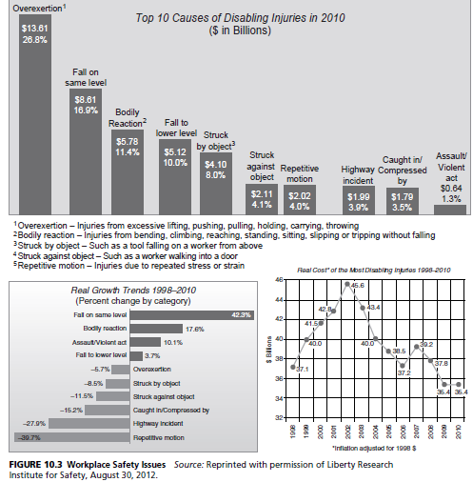
Warehousing Operations
Copyright © 2015 Pearson Education, Inc.
10-<number>

Slide 39
Warehousing Operations
Hazardous materials “hazmat”
  Examples include:
    Explosives
    Flammable liquids
    Flammable solids
  Government regulations often require shipping documents indicating the hazardous materials
  Government regulations require the use of safety data sheets (SDS)
Copyright © 2015 Pearson Education, Inc.
10-<number>

Slide 40
Warehousing Operations
Warehousing security
  Example potential threats include:
    Theft
    Pilferage
    Heat and humidity
    Vandalism
    Fire
    Loss of electricity
  Focuses on protecting products and preventing their theft
Copyright © 2015 Pearson Education, Inc.
10-<number>

Slide 41
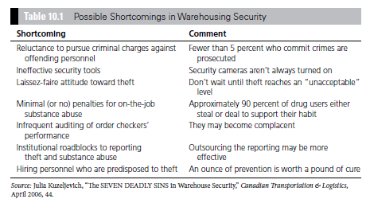
Warehousing Operations
Copyright © 2015 Pearson Education, Inc.
10-<number>

Slide 42
Warehousing Operations
Cleanliness and sanitation issues
  Particularly important in many industries, such the foodservice industry
  Can have a positive impact on employee safety, morale, and productivity while also reducing employee turnover¹
  Requires common sense and due diligence
¹Ned Bauhof, “Keeping It Clean,” Beverage World, July 2007, 77.
Copyright © 2015 Pearson Education, Inc.
10-<number>

Slide 43

Copyright Notice
All rights reserved. No part of this publication may be reproduced, stored in a retrieval system, or transmitted, in any form or by any means, electronic, mechanical, photocopying, recording, or otherwise, without the prior written permission of the publisher. Printed in the United States of America.
Copyright © 2015 Pearson Education, Inc.
10-<number>

