Slide 1

Ecommerce Sales Analysis

Slide 2
Requirement
This is the dataset of a brand A selling infant formula for children aged 1-2 years old, showing order details for the year 2023. Please check sheet "Raw Data“
These are the questions for you: 1. Clean & transform data (20%) 2. Analyze the sales performance of brand A (30%) 3. Analyze customer behavior of brand A (30%) 4. Creative insights or key initiatives for brand development (20%)

Slide 3
Agenda Slide
Analysis Approach/Framework
Sales Performance Analysis
Customer Behavior Analysis
Trend Analysis
Key Recommendations Slide
Q&A

Slide 4

Analysis Approach/Framework
GMV = Total value of orders
NMV = GMV - Canceled orders - Shop discount - Shopee discount
Objective: Increase total sales revenue and reduce cancellation rate
Sales
Revenue ($)
=
# of Orders
x
AOV
As menu prices for the year have already been set, we can’t increase the selling price
Business Opportunities
1. Increase customers (acquire new customers + retain existing customers)
2. Increase order frequency (more orders per person)
3. Decrease cancellation rate

Slide 5
1. Sales Performance Analysis

Slide 6
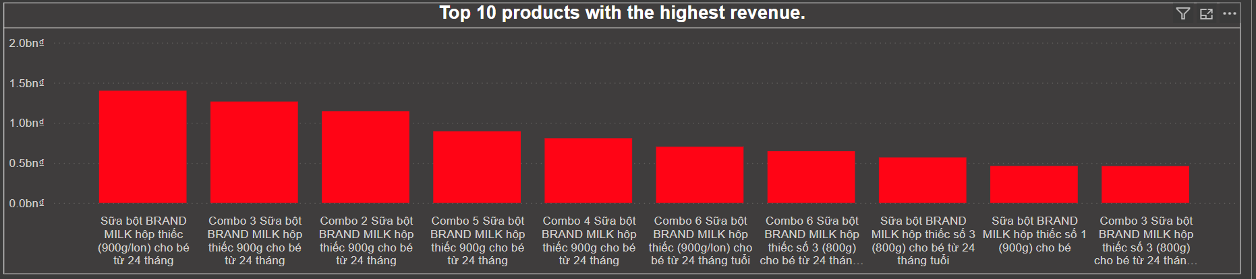
Enhanced Marketing Strategies for Top-Selling Products
The products listed are primarily different combos and sizes of BRAND MILK formula, suitable for children aged 24 months and older. The highest revenue comes from the single pack of BRAND MILK (900g), followed by various combo packs which bundle multiple units of the product.

Slide 7
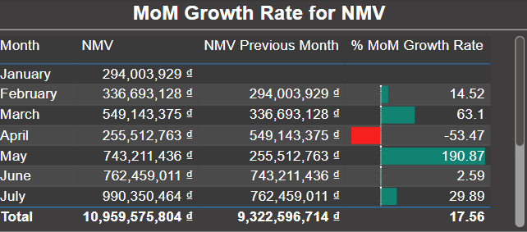
Increase Average Order Value (AOV) and Boost Customer Acquisition to achieve consistent growth
The chart showcases the fluctuations in NMV growth rate. While there are significant increases in some months (March, May), there are also substantial dips (April). This indicates a need for strategies to achieve more consistent growth in NMV.

Slide 8
2. Customer Behavior Analysis

Slide 9
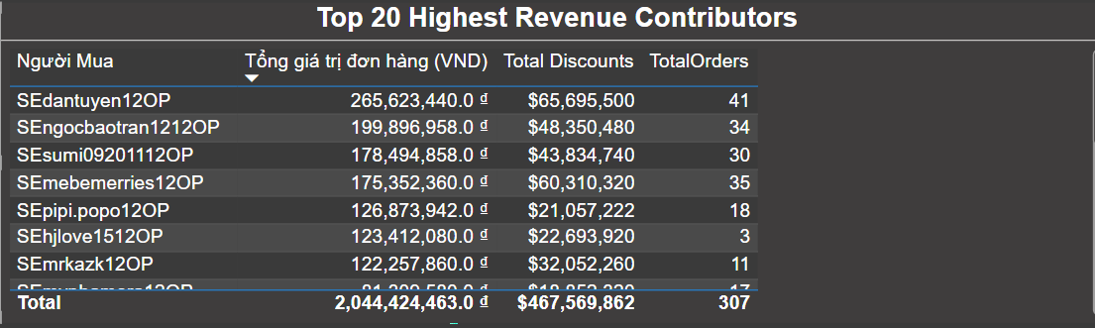
Send emails or push notifications about discounts to increase order frequency.
The data shows significant contributions from these customers, with 'SEdantuyen12OP' leading the list. The total for all top 20 contributors reaches over 2 billion VND, with significant discount amounts, highlighting the importance of these customers to the business's revenue.

Slide 10
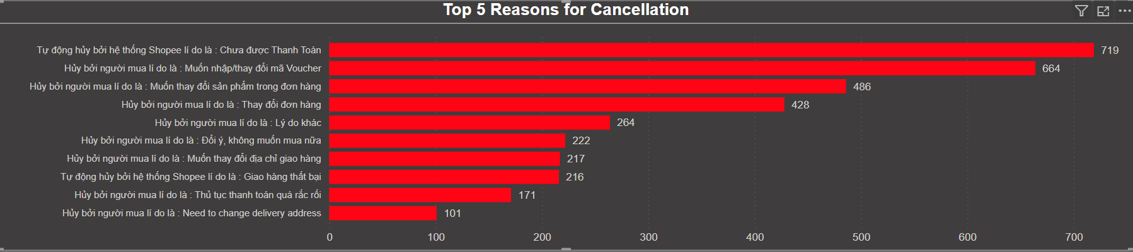
Enhance Payment System Reliability and Extend Payment Deadlines to Increase Payment Completion Rates
Automatic cancellation by the system due to unpaid orders: This is the most common reason, showing a significant number of cancellations occur because payments were not received by the deadline.
Cancellation by buyers wanting to enter/change a voucher code: This reason suggests that buyers frequently cancel orders to apply or modify discount codes.
➔ Implement Payment Reminders + timely reminders to prompt customers to complete payments

Slide 11
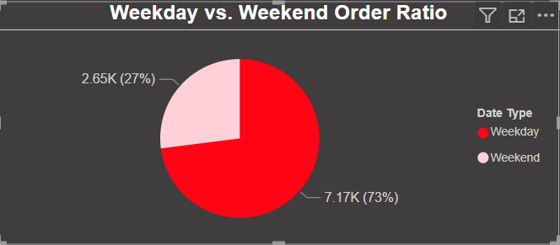
Run targeted marketing campaigns focusing on weekend to increase orders
The majority of orders (73%) are placed on weekdays.
A significantly smaller portion (26.25%) of orders are placed on weekends.

Slide 12
3. Trend Analysis

Slide 13
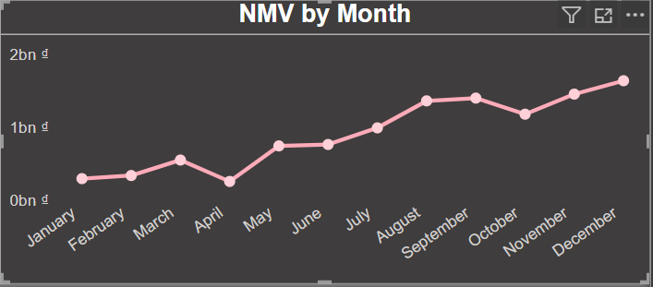
Promotional activities based on anticipated seasonal demands.
It shows a steady increase in NMV, starting from below 1 billion VND in January and rising to nearly 2 billion VND by December. The line graph illustrates a consistent upward trend with a noticeable rise beginning in July, suggesting a strong second half of the year.

Slide 14
Key Recommendations
Sales Performance Analysis
Optimize High-Performing Product Promotion: Increase marketing efforts and allocate more resources to the top 10 high-revenue products, as seen in the dashboard. These are proven market winners and could benefit from enhanced visibility and targeted promotions to maximize sales.
Customer Behavior Analysis
Develop Incentives for High-Value Customers: Given the data showing significant contributions from the top 20 highest revenue contributors, develop exclusive incentives for these customers to enhance loyalty and encourage more frequent purchases. This could involve customized discounts, special loyalty rewards, or personalized shopping experiences.
Enhance the reliability and user-friendliness of the payment system. Implement multiple secure and easy payment options and provide clear instructions for successful transactions. Consider introducing payment reminders and extending the payment deadline to accommodate delays.
Develop a more flexible voucher system that allows customers to apply or modify voucher codes without canceling their orders. This could include features that let users add or change vouchers directly from their shopping cart or through customer service before finalizing the purchase.

Slide 15
Key Recommendations
Weekend Promotions:
Implement special discounts or offers specifically for weekends to attract more customers.
Run targeted marketing campaigns focusing on weekend shoppers through social media, email newsletters, and advertisements.
Enhanced Weekend Services: Improve services available during weekends, such as extended customer support hours or faster delivery options.
Trend Analysis
Capitalize on End-Year Sales Surge: The GMV trend from the dashboard indicates a substantial increase in sales towards the end of the year. Implement strategic marketing campaigns starting in early Q4 to capitalize on this trend, focusing on holiday sales and end-of-year promotions to maximize revenue during this peak period.

Slide 16
Thank You!

