Slide 1
CS4622 - Machine Learning
DengAI: Predicting Disease Spread
CS 4622 - Machine Learning
140285M P.T. Kannangara
140499X M.D.S.K. Ranasinghe
140577K P. Seneviratne
140616G D.D.N.A. Tharindu

Slide 2
Overview
Project Description
Methodology
Results & Analysis
Conclusion

Slide 3
Project Description
A competition hosted by drivendata.org for accurate dengue predictions
Main objective is to predict number of dengue cases for two cities San Juan, Puerto Rico and Iquitos, Peru
Data set consists of 1456 data samples and 20 features including weather details and vegetation indexes

Slide 4
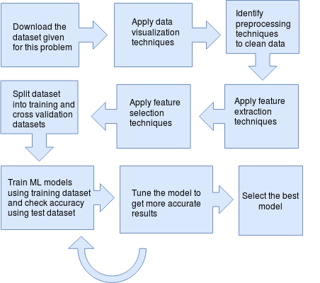
Methodology
Data Preprocessing
Feature Engineering
Feature Extraction
Selection of ML Models
Parameter Optimization / Tuning
Evaluation of Selected ML Models

Slide 5
Data Preprocessing
Fill missing values
Forward Fill
Bin Average
Normalize data
Z-Score
Transforming temperature units into Celsius scale

Slide 6
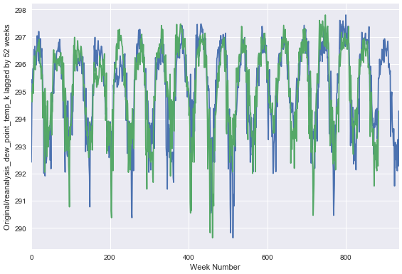
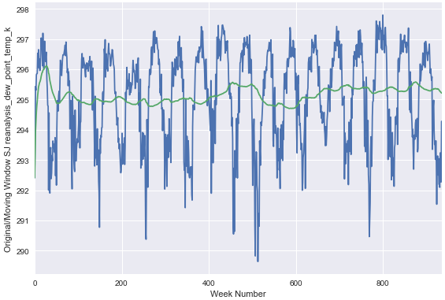
Feature Engineering
Feature Lag
The cumulative effect of prior weeks might impact the number of dengue fever cases in subsequent weeks.
Moving Window Average

Slide 7
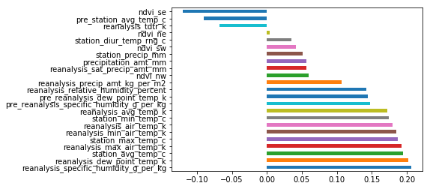
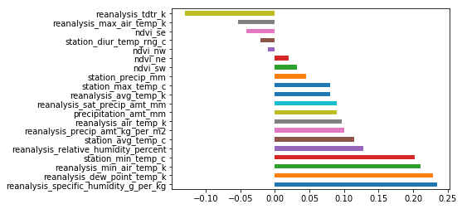
Feature Selection
Feature Selection
Correlation Analysis
Correlation of features in San Juan
Correlation of features in Iquitos

Slide 8
Splitting Dataset
2-Fold Cross-validation was used as a preventative mechanism against overfitting.
Initial dataset was splitted into two parts, 90% as training dataset and rest 10% as test dataset.

Slide 9
Model Selection
Support Vector Regression
One of the simple but powerful supervised learning model.
Experimented the model by changing following parameters,
Kernel - [ ​ ‘linear’, ‘poly’, ‘rbf’, ‘sigmoid’, ‘precomputed’ or a callable​ ]
C - ​ Penalty parameter C of the error term.
Gamma - ​ Kernel coefficient
Epsilon - ​ Epsilon in the epsilon-SVR model

Slide 10
Model Selection(cont.)
2. Random Forest Regression
Used grid search to determine optimal values for following hyper-parameters,
Number of trees
Maximum depth
Used mainly due RF’s tolerance to noisy data
Feature selection using information gain

Slide 11
Model Selection(cont.)
3. Gradient Boosting Regression
Produces a prediction model in the form of an ensemble of weak prediction models, typically decision trees.
Used grid search to determine optimal values for following hyper-parameters,
Learning rate
Number of trees
Maximum depth

Slide 12

Model Evaluation
Using Mean Absolute Error (MAE)

Slide 13
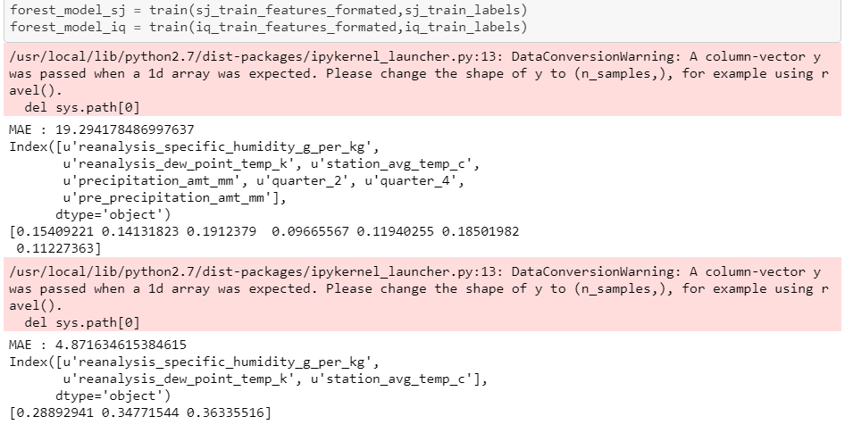
Model Evaluation(cont.)
Using Mean Absolute Error (MAE)
Example MAE values for Random Forest Regressor Model

Slide 14
Results & Analysis
ML Model | Hyper Parameters | Best Score (MAE)
 |  | San Juan | Iquitos
Gradient Boosting Regressor | Learning rate - 0.1 No of trees (n_estimators) - 490 max_depth - 5 random_state - 67 Min_samples_leaf - 1 | 16.5139 | 5.8687
Random Forest Regressor | No of trees (n_estimators) - 300 max_depth - 5 random_state - 67 Min_samples_leaf - 1 | 17.4818 | 6.1338
Support Vector Regression | C - 1e3 Gamma - 0.1 Epsilon - 0.9 | 18.3936 | 3.8461

Slide 15
Conclusion
Data preprocessing has a huge impact on results of machine learning algorithms
Although there are huge number of attributes, only few of them will be useful for predicting the results
Data conversion and normalization is required for more accurate predictions
Some models of machine learning suits for set of problem types, selecting the best model for the job is the challenge

