Slide 1

Netflix Stock price analysis
Thulasi Gabbita
Campus ID: NU01134
DATA606
Instructor: Dr Chaojie Wang

Slide 2
Research Questions
What insights can we gain from exploratory data analysis of stock price data
Common data quality issues
Which machine learning models are most suitable
Scope for ethical considerations
Challenges associated in a real time

Slide 3
Data Overview
Netflix stock price data from 05th Feb 2018 to 05th Feb 2022
Data sources: https://www.kaggle.com/datasets/jainilcoder/netflix-stock-price-prediction
Data Size – 74kb
Shape – 1009 rows and 7 columns
Columns
Date
Open
High
Low
Close (Target Variable)
Adj Close
Volume

Slide 4
EDA
Data Cleaning and Sanitary checks:
Checking for missing values
Statistical summary observation
Formatting for correct data type of columns
Data Analysis:
Distribution of each type of price
Calculating Daily returns
Cumulative returns
Finding Moving average and comparing with Close price

Slide 5
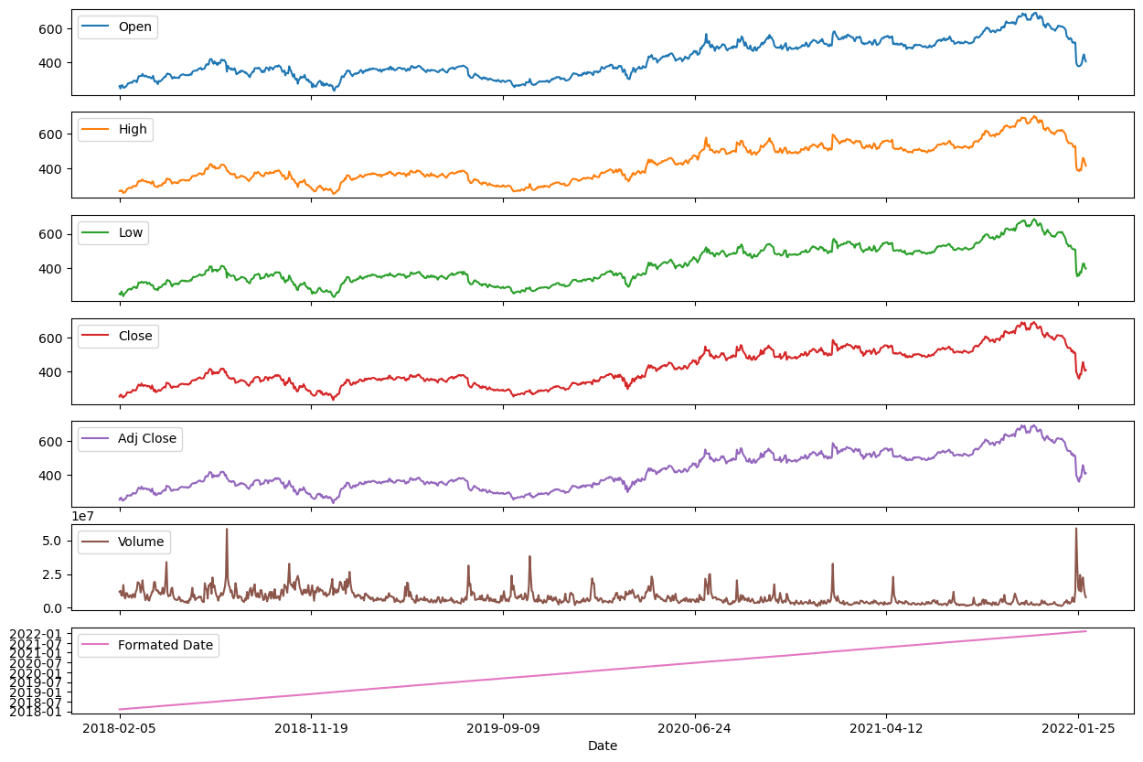
EDA (Continued)
Visualization of all Price values

Slide 6
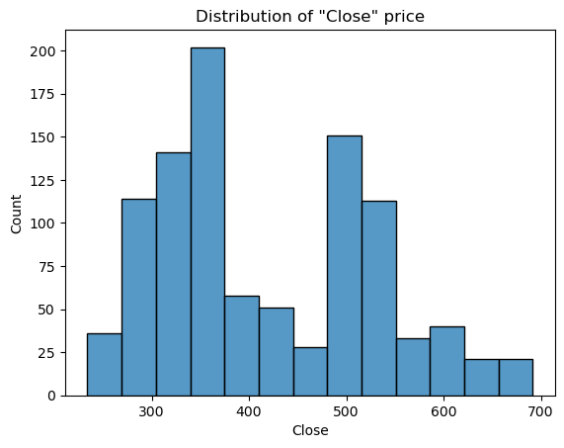
EDA (Continued)
Distribution of Close price

Slide 7
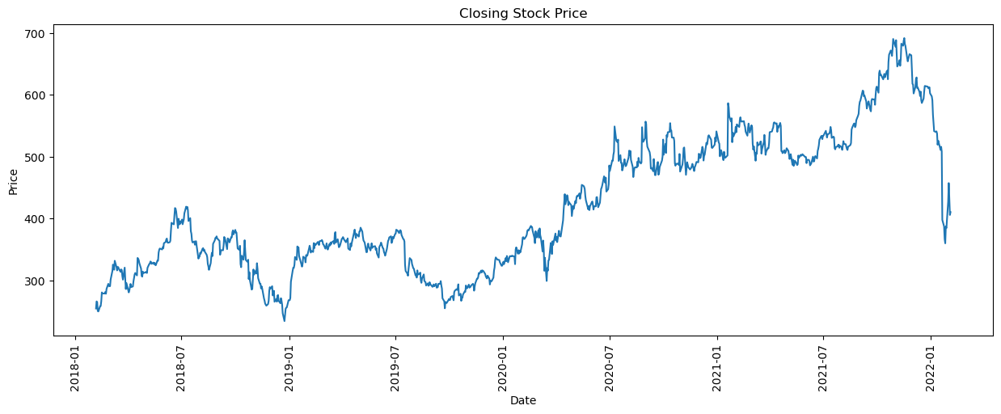
EDA (Continued)
Variation of Close price over 5 years

Slide 8
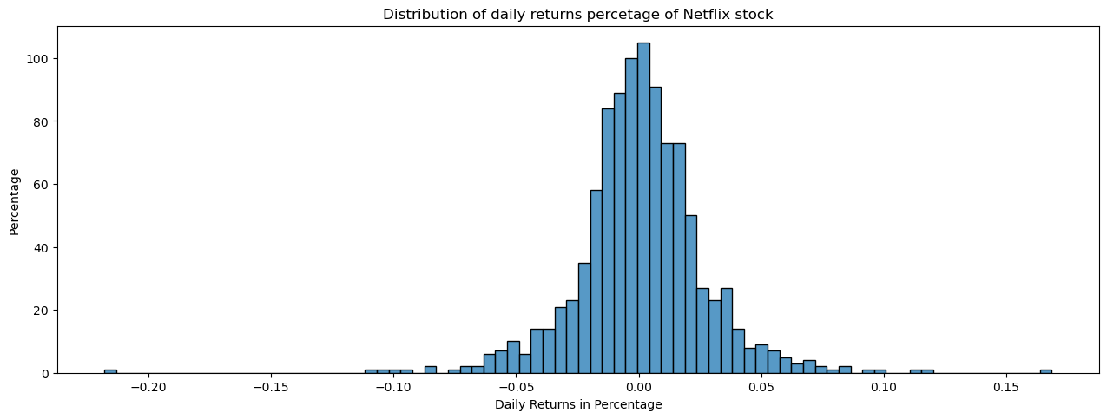
EDA (Continued)
Distribution of Daily returns

Slide 9
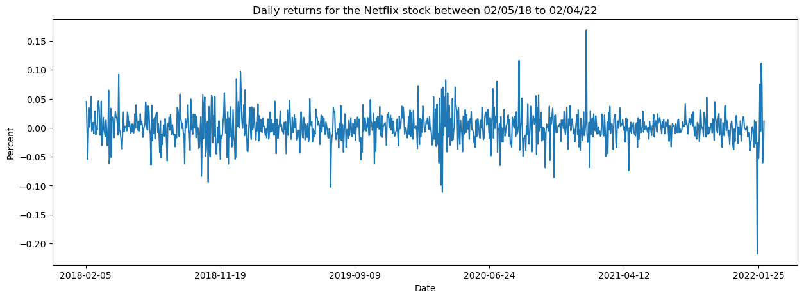
EDA (Continued)
Visualizing Daily returns over 5 years

Slide 10
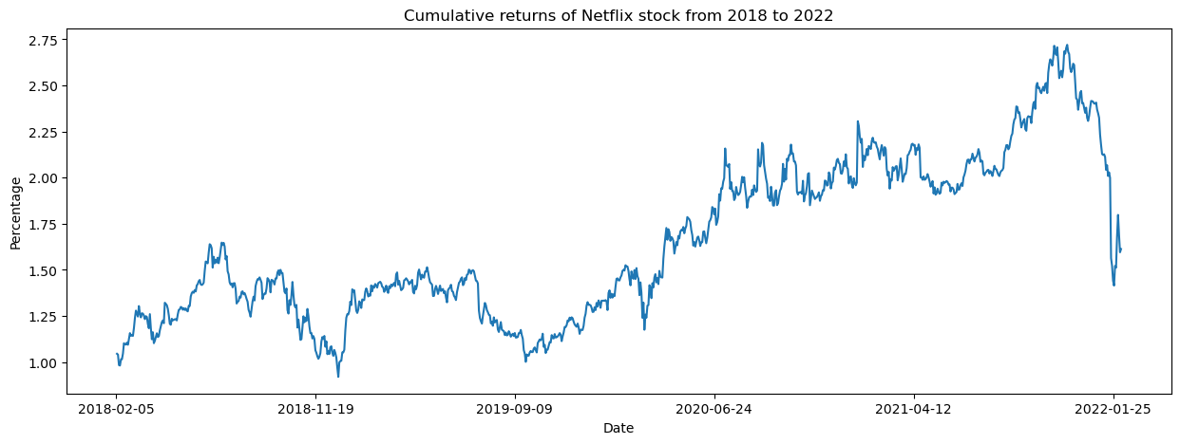
EDA (Continued)
Cumulative returns of Netflix share

Slide 11
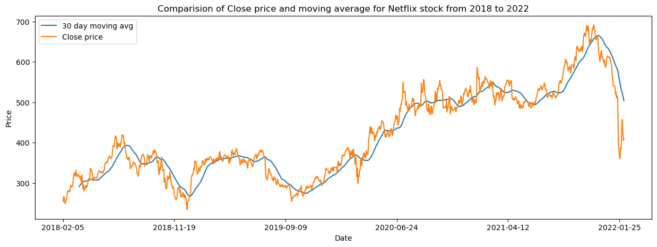
EDA (Continued)
Comparison of Close price and 30 day moving averages of Netflix

Slide 12
ML models
Linear regression
Random Forest
ARIMA

Slide 13
ARIMA model
Testing for data stationarity using ADFuller test
Differencing and performing ADFuller test again to make the data stationary
Fit data using ARIMA model and predict test values

Slide 14
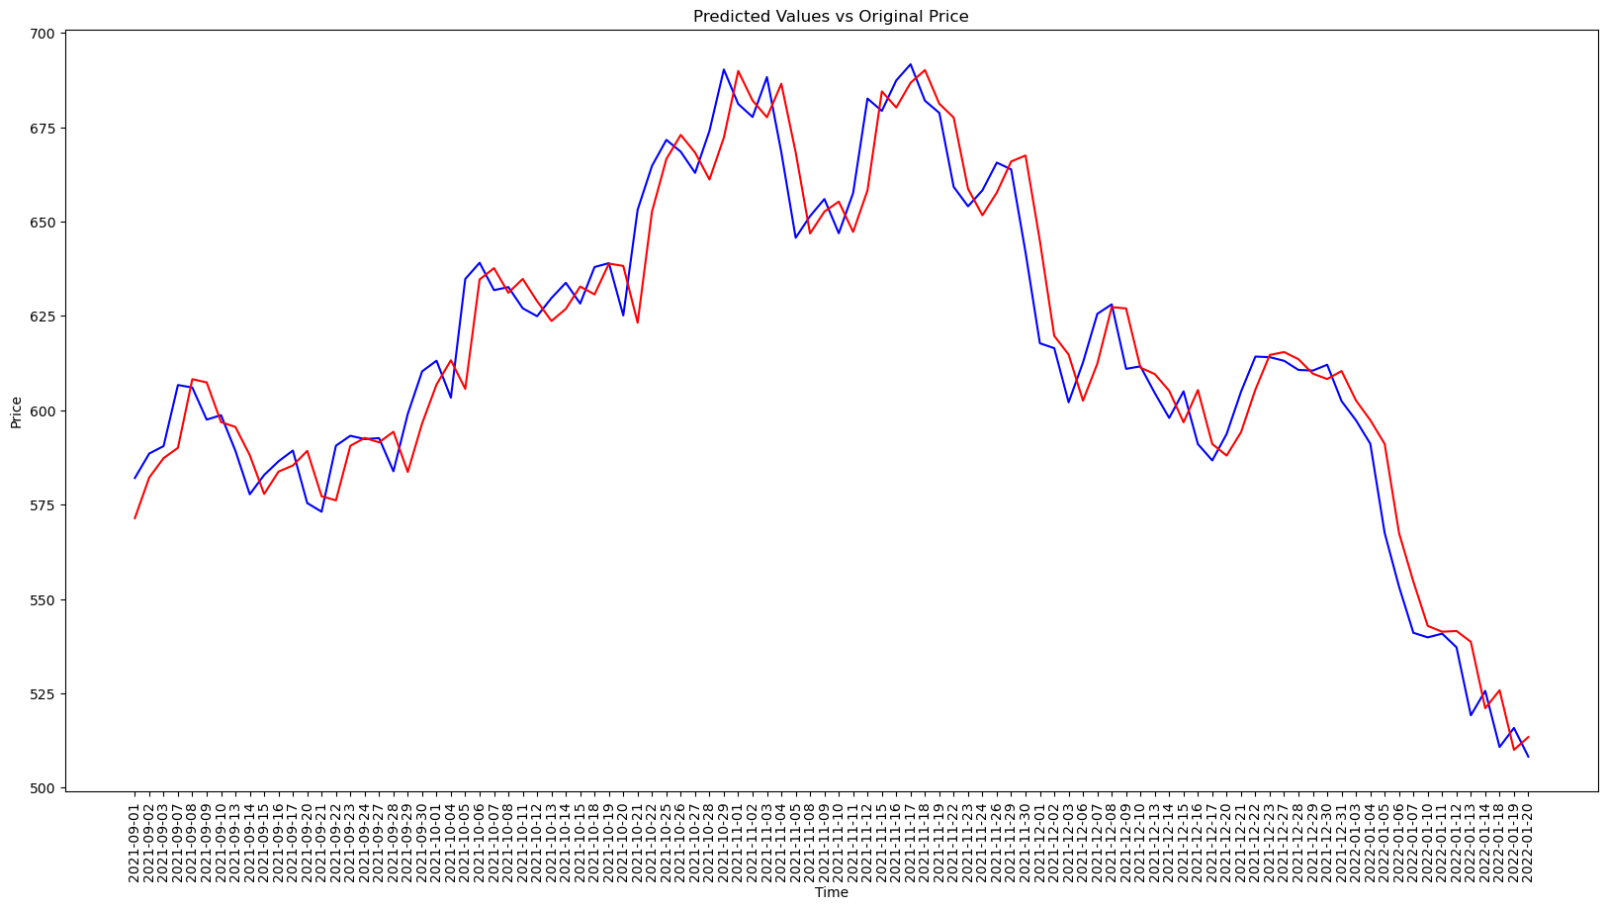
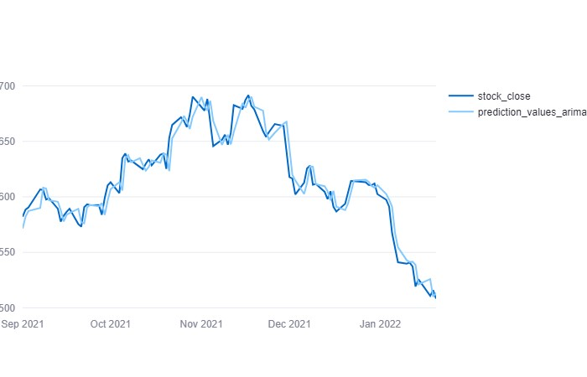
ARIMA model
Original price values vs Predicted price values from ARIMA

Slide 15
Challenges and Lessons Learned
Challenges:
Performing EDA with an unconventional approach of using statistical data like cumulative returns, moving average
Training and prediction of time series data using ARIMA model
Lessons Learned:
Analysis of time series data
Finding different parameters and their scope in analyzing stock price data
Time series forecast using ARIMA

Slide 16


