Slide 1



CSA0811 – Python Programming – Slot D
File Explorer
Guided By,
T. Vincent Gnanaraj (Course Faculty) Python Programming SSE, SIMATS
Project by,
C Thulasi Ram
(191711057)
Computer Science & Engineering SSE, SIMATS

Slide 2
Abstract
A file explorer, also commonly known as a file manager, is a software application that facilitates the organization and manipulation of files and folders on a computer's storage system. Its primary function is to provide users with a graphical interface to navigate through the file hierarchy, manage files, and perform various operations such as copying, moving, deleting, and renaming.It play a crucial role in facilitating file management tasks, streamlining workflows, and providing users with a convenient way to interact with the digital content stored on their devices. They are an integral part of modern operating systems, contributing to a user-friendly computing experience.
Keywords : Python,Navigation,Search,Sort,File Operations.

Slide 3
Introduction
A file explorer, sometimes referred to as a file manager, is a fundamental software tool designed to simplify the organization and manipulation of digital files and folders within a computer's storage system.
A file explorer offers a range of functionalities aimed at enhancing user control over their digital content
Key aspects of a file explorer include its ability to display the file hierarchy, allowing users to visualize the relationships between different folders and files.
With the prevalence of digital content and the increasing complexity of file systems, file explorers have become integral components of operating systems across various platforms

Slide 4
Hardware and Software Requirements
Software requirements
Pycharm
VS code
Sdk : 3.11.6
Pygame library
Hardware Requirements
Processor : 11th Gen Intel(R) Core(TM) i5- 1135G7 @ 2.4GHz
Installed RAM : 8.0 GB
System type : 64-bit operating system
GPU : Intel® Iris® Xe Graphics

Slide 5
Existing System
The file explorer systems in popular operating systems such as Windows, macOS, and Linux have undergone various updates and improvements. Keep in mind that the information provided here might not reflect the most recent developments after that date.
Interface Updates: Windows File Explorer has undergone several interface updates, with efforts to make it more user-friendly and visually appealing. The introduction of the Fluent Design System in Windows 10 brought a cleaner and more modern look.
Quick Access: Windows 10 introduced the Quick Access feature, allowing users to quickly navigate to frequently used folders and recently accessed files.
OneDrive Integration: Enhanced integration with Microsoft's cloud storage service, OneDrive, allows for seamless file access and synchronization across devices.

Slide 6
Proposed System
Enhanced Search and Filtering:
Implement advanced search capabilities, including natural language processing for more intuitive searches.
Introduce customizable filters to refine search results based on file attributes, tags, and metadata.
Integration with AI and Machine Learning:
Utilize AI algorithms to provide intelligent file categorization and organization suggestions.
Implement machine learning algorithms for predictive features, such as suggesting folders for file storage based on usage patterns.

Slide 7
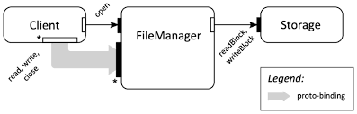
Architecture

Slide 8
Design
Designing a file explorer involves considering both the user interface (UI) and user experience (UX) aspects to ensure an intuitive and efficient tool for managing files. Below is a high-level design outline with key elements to consider.
1. Navigation Panel
Favorites/Quick Access: Provide a section for users to pin their frequently accessed folders or directories for quick navigation.
2. File and Folder Display
Grid and List Views: Allow users to toggle between grid and list views for file and folder display.
Thumbnail Previews: Include thumbnail previews for image and document files to aid visual identification.

Slide 9
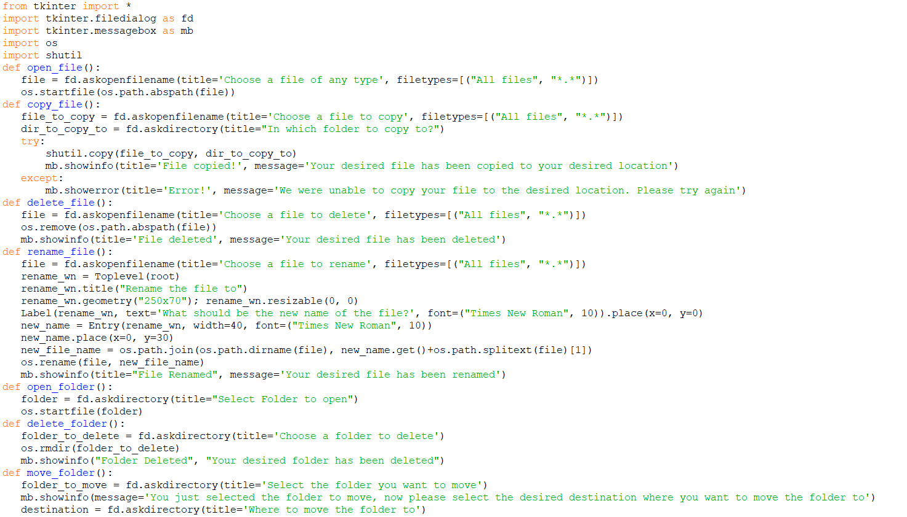
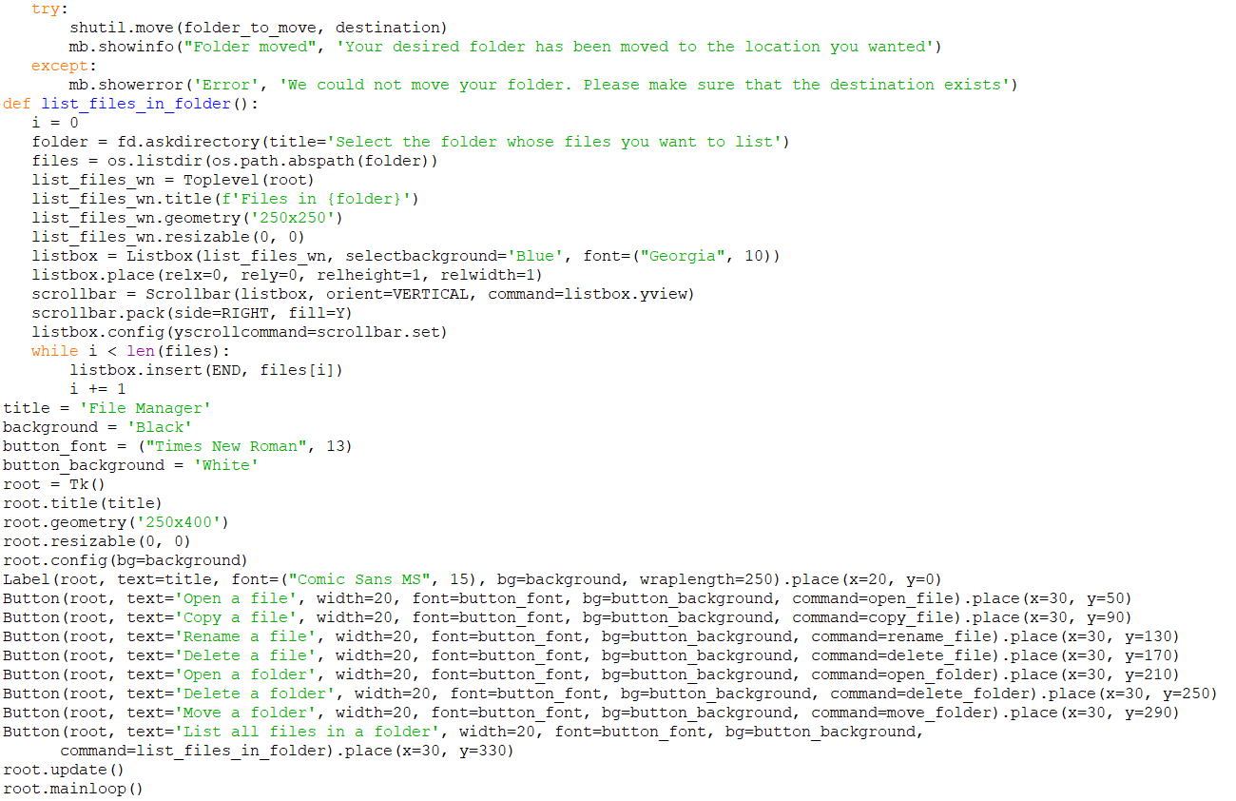
Coding

Slide 10
Testing
1. Functional Testing:
File Operations:
Verify that the text editor can create new files, open existing files, and save changes correctly.
Test the "Save As" functionality with various file types.
2. Usability Testing:
Accessibility:
Verify that the text editor is accessible to users with disabilities.
Test with screen readers and ensure keyboard navigation is effective

Slide 11
Implementation
Implementing a file explorer involves creating a software application that can navigate, manage, and interact with files and directories on a computer's storage system. Below is a simplified outline of steps for implementing a basic file explorer using a hypothetical programming language.
Note that the actual implementation details may vary based on the chosen programming language, platform, and specific requirements.
Read the file system to populate the navigation panel with drive and directory information.
Implement functions to handle directory navigation events, allowing users to click on folders to view their contents.

Slide 12
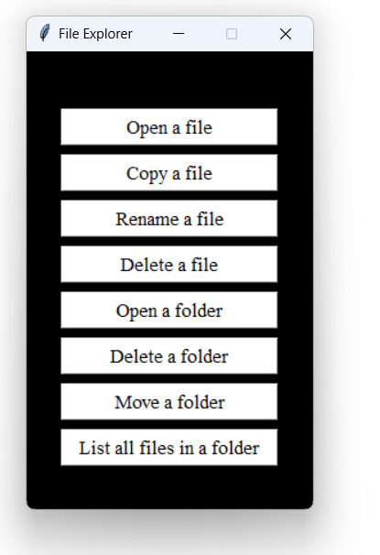
Final Output

Slide 13
Conclusion
In conclusion, a file explorer is a crucial component of modern computing systems, providing users with a graphical interface to navigate, manage, and interact with their digital files and folders
Key components and features that can enhance a text editor include:
User Interface (UI) and Experience (UX): A well-designed UI with an intuitive and user-friendly experience is essential for a file explorer. Visual clarity, ease of navigation, and thoughtful placement of features contribute to a positive user experience.
Functionality and Features: File explorers should offer a range of features to cater to diverse user needs. This includes basic file operations (copy, paste, delete), search capabilities, preview options, and integration with external services like cloud storage.

Slide 14
Future Scope
The future scope of file explorers involves continuous evolution to meet the changing needs of users and adapt to advancements in technology. Several trends and potential developments can shape the future of file explorers:
Enhanced integration with cloud services to facilitate seamless file storage, synchronization, and collaboration across multiple devices.
Real-time collaboration features within the file explorer, allowing multiple users to edit and work on documents simultaneously.

Slide 15
References
"November 14, 2023—KB5032190 (OS Builds 22621.2715 and 22631.2715)". Microsoft Support. Microsoft.
^ "Releasing Windows 11 Builds 22621.2787 and 22631.2787 to the Release Preview Channel". Windows Insider Blog. November 16, 2023.
^ "November 14, 2023—KB5032190 (OS Builds 22621.2715 and 22631.2715)". Microsoft Support. Microsoft.
^ "Announcing Windows 11 Insider Preview Build 22635.2776 (Beta Channel)". Windows Insider Blog. November 28, 2023.
^ "Announcing Windows 11 Insider Preview Build 23595 (Dev Channel)". Windows Insider Blog. November 29, 2023.

Slide 16


