Slide 1
Employee Data Analysis using Excel
STUDENT NAME : THULASI.S
REGISTER NO : 312204639,3BF361D079E0CD9B83C4EAFED7939CFA
DEPARTMENT : COMMERCE
COLLEGE : K.C.S.KASI NADAR COLLEGE OF ARTS AND SCIENCE

Slide 2
PROJECT TITLE
Employee Rating Card Analysis

Slide 3

AGENDA
Problem Statement
Project Overview
End Users
4.Our Solution and Proposition
5.Data Description
6.Modelling Approach
7.Result and Discussion
8.Conclusion
3/21/2024 Annual Review

Slide 4

PROBLEM STATEMENT
To identify the employee rating with employee database.

Slide 5

PROJECT OVERVIEW
Table
Slicers
Pivot chart(Line chart and Pie chart)
Pivot formula

Slide 6

END USERS
Civil engineering
Computer engineering
Electronical engineering
Electronics engineering

Slide 7

OUR SOLUTION AND PROPOSITION
VISUAL REPRESENTATION:
Chart and graphics
USER-FRIENDLY INTERFACES:
Accessibility
Ease of use
SCENARIO ANALYSIS:
Used to analyze different situation
COMPREHENSIVE DATA MANAGEMENT:
Data organization
Data integration
ADVANCED ANALYTICAL TOOLS:
Formula and function
Pivot table
7

Slide 8
DATASET DESCRIPTION
Data description for Excel refers to the process of documenting and summarizing the key characteristics of a dataset, including:
1. Data Source: Origin of the data (e.g., database, file, survey)
2. Data Type: Classification of data (e.g., numerical, text, date)
3. Data Format: Organization and structure of the data (e.g., tables, columns, rows)
Data Range: Scope of the data (e.g., date range, geographical area)
DATA FIELDS:
1.Problem solving
2.Punctuality
3.Communication
4.Technical knowledge
5.Teamwork
6.Meeting deadline

Slide 9
MODELLING APPROACH
Data cleaning.
Creating table.
Creating pivot chart.
Creating dash board.
Inserting pivot chart in dash board.
Inserting formula in dash board to make interaction.
Creating interactive dash board by putting all together elements.

Slide 10
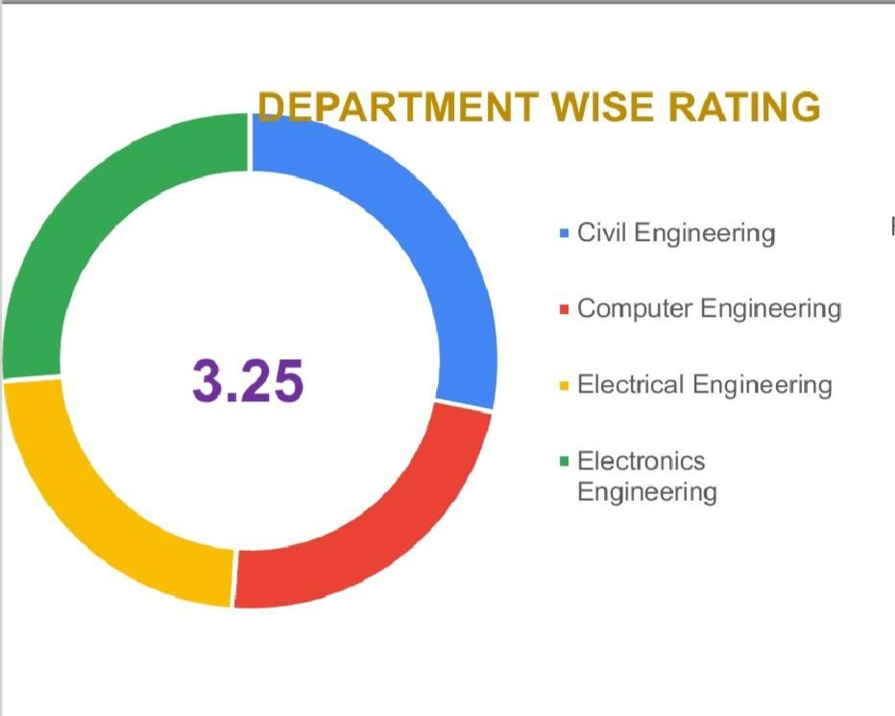
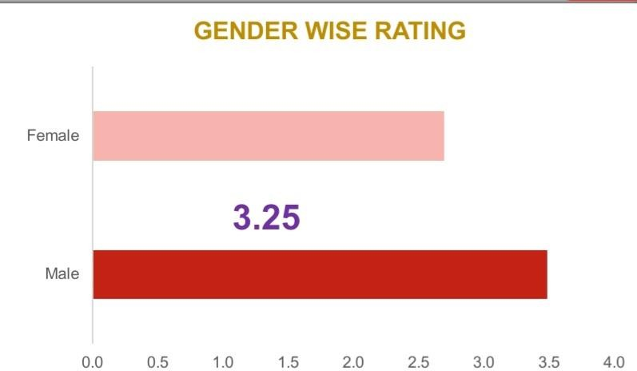
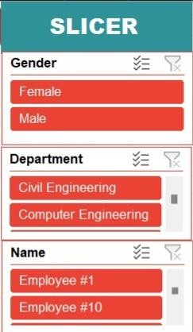
RESULTS
(click to open file)

Slide 11
CONCLUSION
The employee rating card analysis using Excel provides a clear and objective framework for evaluating performance, identifying top performers, areas for improvement, and performance gaps. This data-driven approach enables fair and informed decision-making, and is easy to update and maintain. Key benefits include:
- Enhanced performance management
Improved decision-making
Increased transparency and fairness
Identification and development of top talent
This analysis is a valuable tool for driving business success by optimizing employee performance.

