Slide 1

MY PCTO EXPERIENCE
Menerva is the company where I carried out my PCTO experience and where I learned the first things about working.

Slide 2
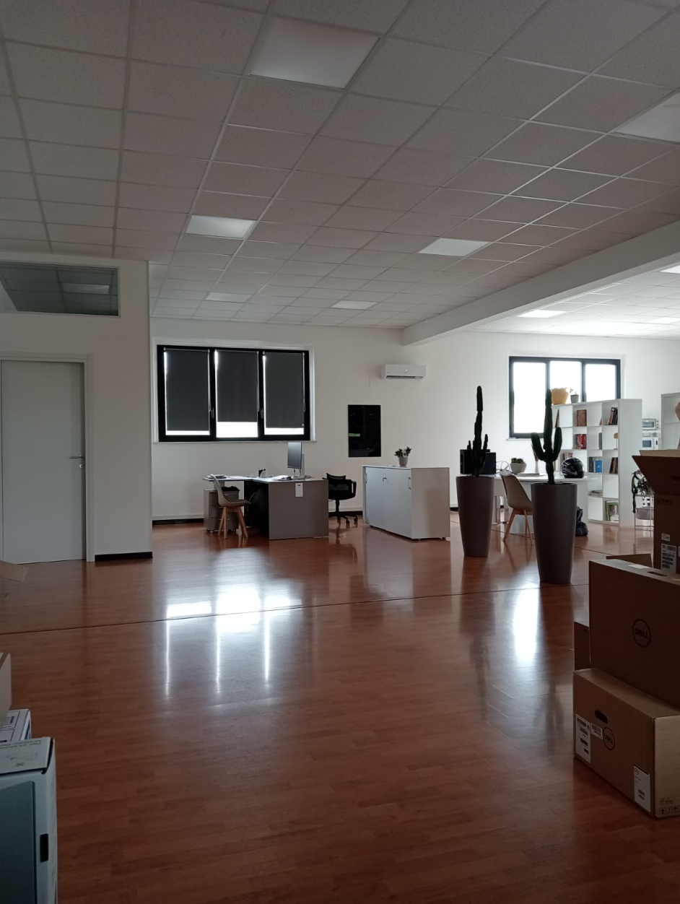
First Impressions:
As soon as I arrived at the company, I thought it would be difficult to adapt to the situation and to understand how work goes because I had never dealt with anything different from school.
After a short time, I was able to adapt, thanks also to the colleagues who work there and to my PCTO partner, with whom I got along very well.

Slide 3
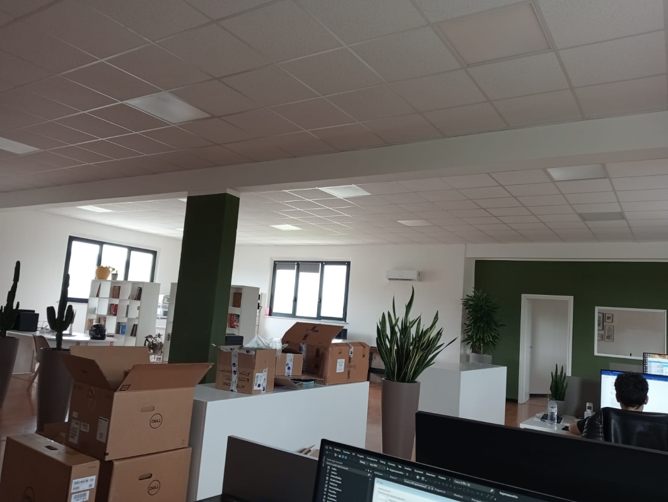
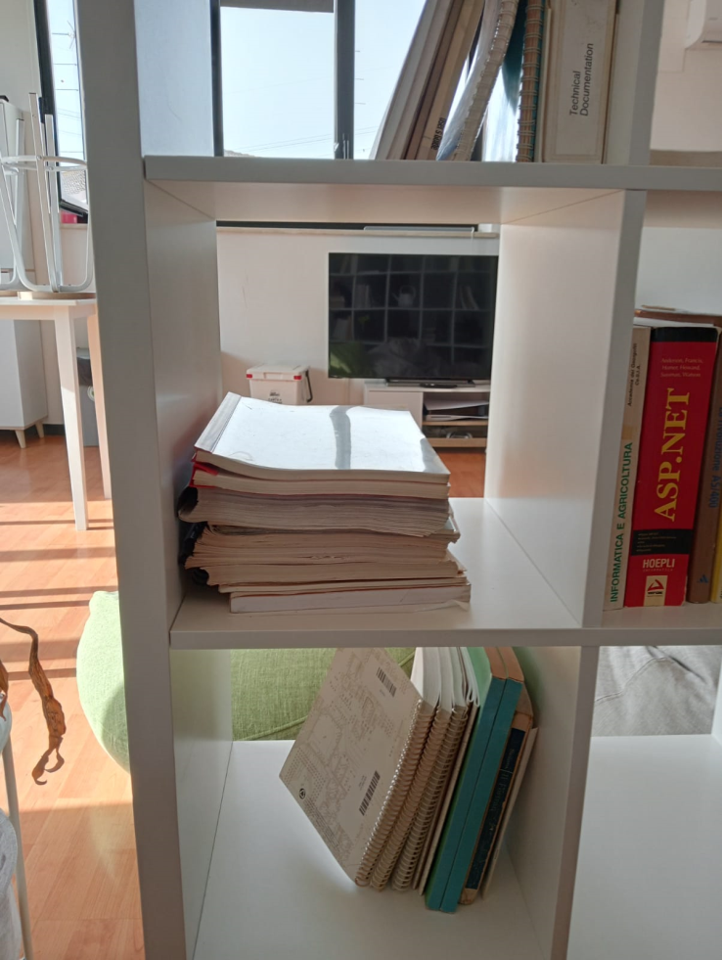
The place:
The place was so nice, I really enjoied the period I worked there. There were lots of things to do when we were on break.
One of the things I liked more was the lunch break in which we all had our lunch togheter and it was the perfect time to talk and to socialize.

Slide 4
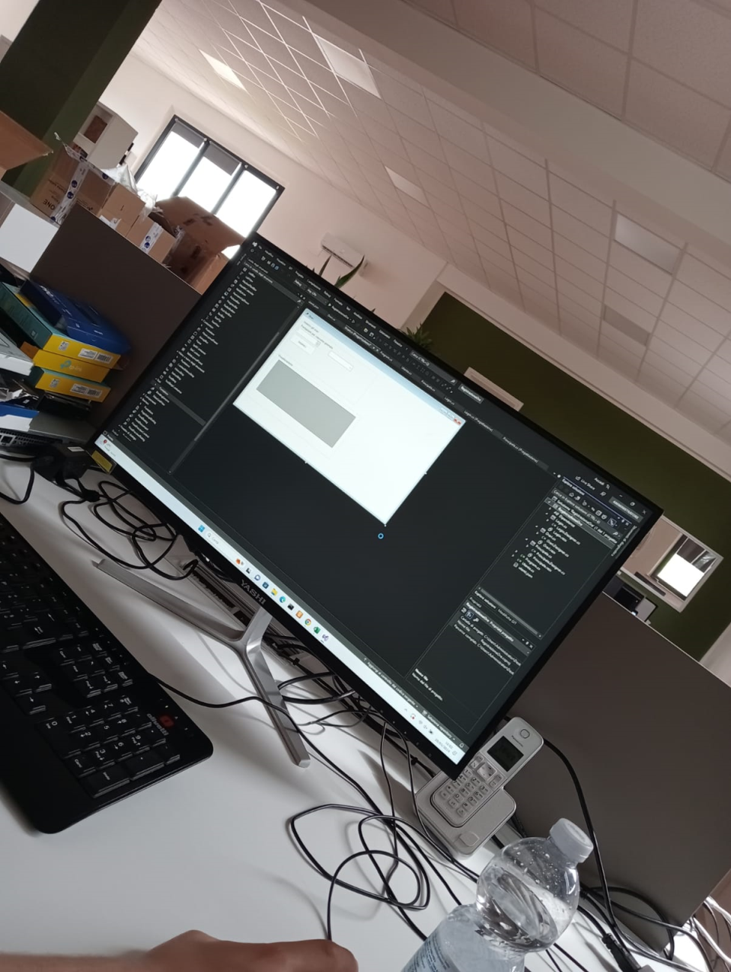
The work:
In that period of time the task we were asked to do was a C# project to help the company sign the daily hours of work without counting the holidays
They had a request for us to color all the Saturdays in blue and the Sunday in red.
We completed it even with lots of difficulties but we did our best and the results were good.

Slide 5
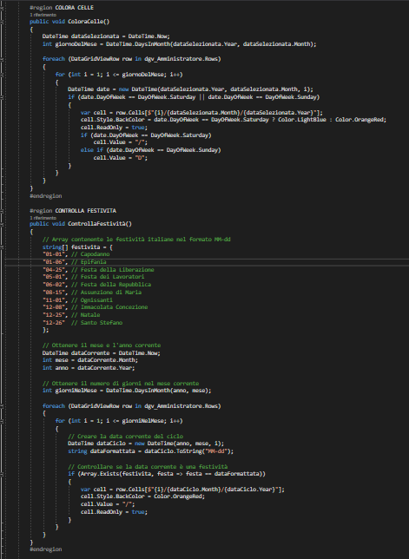


The work:
To accomplish the goal we were given we used a newer version of VisualStudio and we learned new things thanks to the support of the colleagues there and of the IA called ChatGPT.

Slide 6
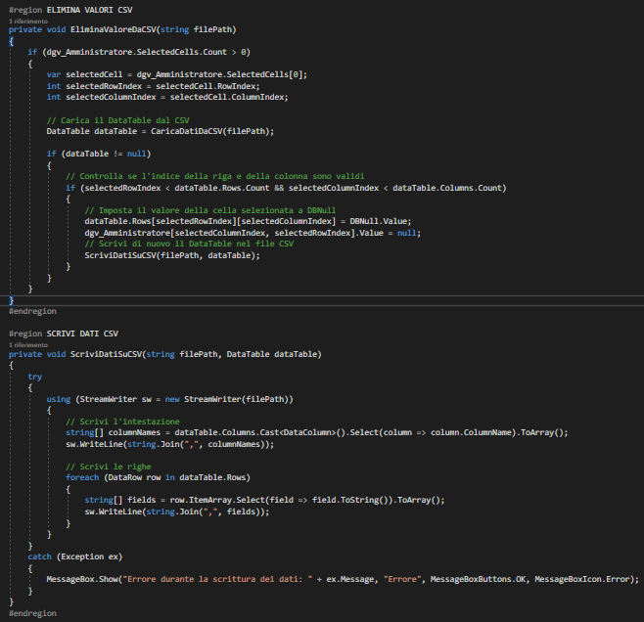
Relationships and difficuties:
The tutor was really nice with us and he helped us controlling and doing tests of the project when he saw us stuck in something. He helped a lot because he gave us lots of tips and very usefull advices.
We found some difficulties because we had to face lots of new situations and we didn’t know how to use them or how set them up.

Slide 7
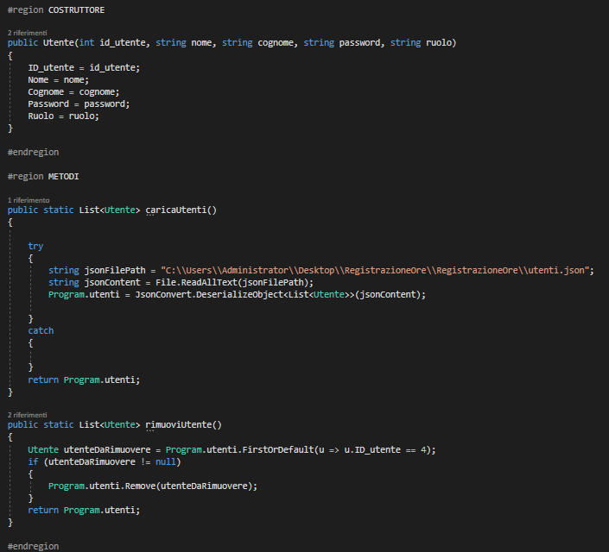
Tools and Devices:
We received a worksheet with all the details of the task we had to complete, a PC with a monitor, keyboard, and mouse at our workstation, which changed between the first and second period. At the beginning of the second period, we indeed had to set it up and prepare it to continue the work.
We had a sheet with all the details of the task we had to complete, and this is another part of the code that we created:

Slide 8
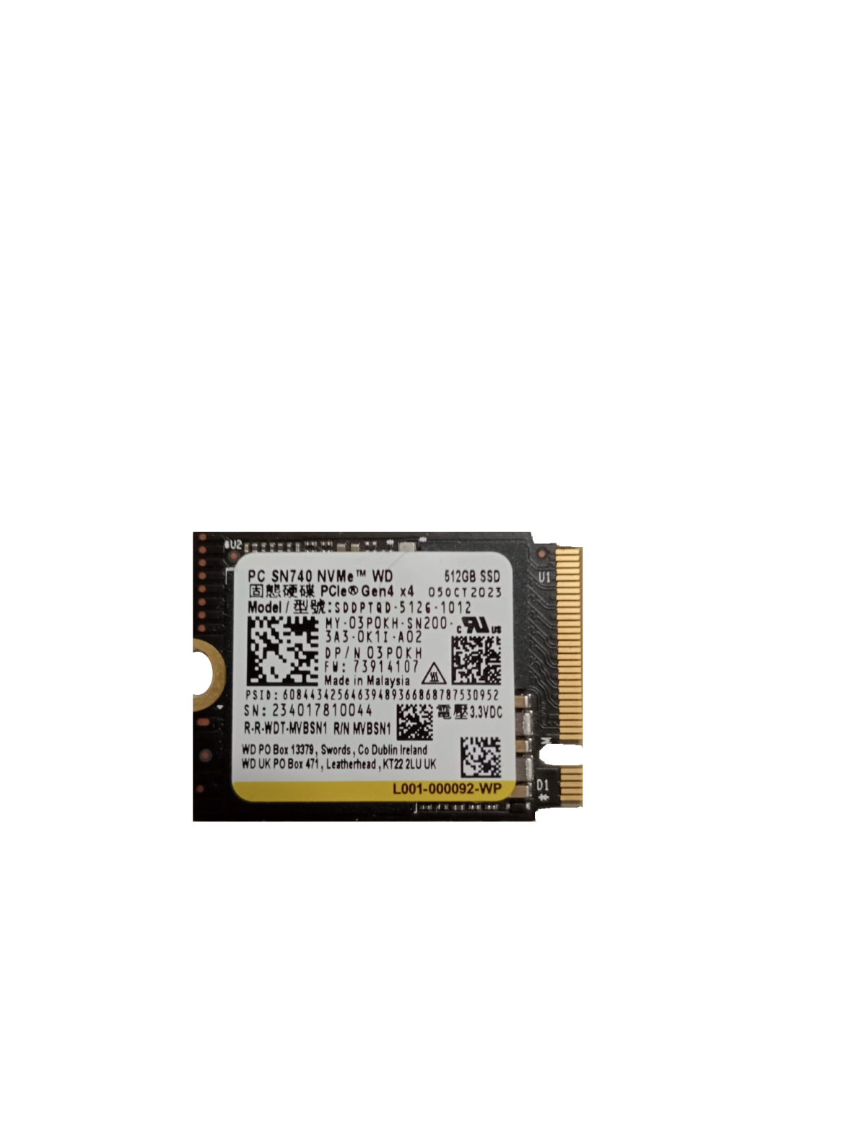
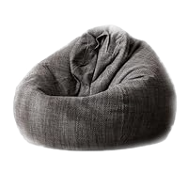
Rest time and Gifts:
During our break time, we could sit and lie down on bean bags or take a walk around the place, which was really relaxing and very helpful for resting.
At the end of the first period our PCTO tutor gifted us with a SSD of 512GB and he gave us the grades of the period.

Slide 9


My future expectations:
Thanks to this experience I understood that I really like lots of things that work has to offer.
I am reevaluating the idea to study at the university beacuse I like a lot sports so I am thinking to go to the Sport Science University in Urbino and I think that during this fifth year in school I will make up my mind.

Slide 10
A Week at School:
Due to having to repeat the school year, during the week when the fifth-year students had their PCTO, I was asked to stay at school and contribute to a different kind of hands-on activity.
The task:
Together with two other students, I helped the school prepare the computer labs — installing and uninstalling software on the PCs across both school buildings.
What I discovered:
I learned how the school prepares itself before re-opening to students, and I got to use lab management tools that are normally only available to teachers.
Thanks to these tools, our small group managed to complete all the assigned tasks much faster than expected — a real lesson in how the right software makes all the difference.

Slide 11
Reflections:
Teamwork:
Working as a small team made a big difference. We coordinated the workload across the two school buildings and helped each other whenever something was unclear.
No photos, but strong memories:
Unfortunately my phone was broken that week so I couldn’t take any pictures. But I will definitely remember everything I did and learned during those days.
Overall experience:
Even though this week was different from a traditional PCTO, it still taught me a lot. I saw a side of school I had never seen before, and I understood how much work goes into keeping everything running behind the scenes.
It was a valuable and unique experience that I am glad to have had.

Slide 12

Final considerations:
In the end I found this experience really useful and I loved it. I learned lots of things that I dint’t know and I had a really good time with everyone. This activity can help so much people and I think the school should continue to have students do it.
I really appreciated the time spent in the company and it also helped me to develop in the work place.
It was such a great experience for me. I loved it and I hope that I can continue to do it.
Thomas Martelli

