Slide 1

Web Scraping Project TVs on Flipkart
Team Members
k.s.md.Muthaheer ,
T.Dinesh Naidu
13/09/2025

Slide 2


PROBLEM STATEMENT
Flipkart lists thousands of TVs with varying brands, prices, features, and discounts.
Consumers face decision fatigue because of too many options.
Businesses (retailers & brands) want market insights to adjust pricing, discounts, and product positioning.
Use Case
By scraping Flipkart TV data, we create a structured dataset.
Dataset helps in:
Consumers → Make better decisions (best price-to-rating products, brand comparisons).
2

Slide 3
Businesses → Identify competitors, popular screen sizes, discount strategies.
Analysts → Extract insights on pricing trends, demand patterns, and features.

Slide 4
: Tools & Libraries For Web Scraping EDA
Python (3.12)+ Jupyter Notebook
Python libraries ,
For data extract : BeautifulSoup (Web Scraping), requests, re (Regular Expressions), pandas, NumPy.
For data analysis : Pandas , NumPy.
For data visualization : Matplotlib, Seaborn.
4

Slide 5


DATASET OVERVIEW
DATASET SOURCE
DATASET SHAPE
Scraped data from https://www.flipkart.com/ using BeautifulSoup (web scraping)
984 rows x 17 columns
KEY COLUMNS
'brand', 'model', 'resolution', 'display_type', 'smart_tv_platform', 'ratings', 'number_of_reviews', 'model_id', 'launch_year', discounted_price', 'original_price', 'discount', 'offer_tagline', warranty_year', 'size_cm', 'size_inch'
'
5

Slide 6
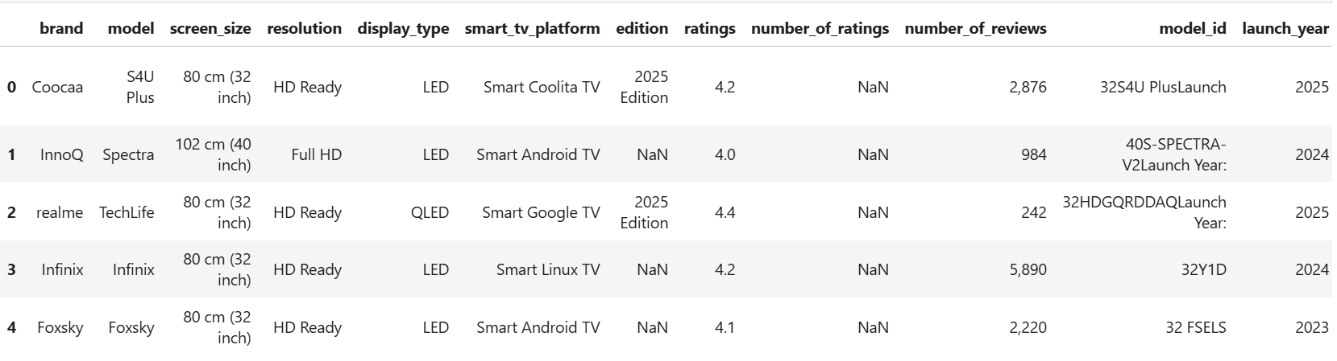
Before cleaning data
-----------------------------------------------------------------------
--------------------------------------------------------------------------------------------------------------

Slide 7


Analyzing Data
COLUMN CLEANING
Column name: discount
The discount column originally Non-numeric parts like “% off” or “Lowest Price” were cleaned → now only numeric values remain (e.g., 47).
Column name: size_cm & size_inch
The size_cm & size_inch screen size of the TV in centimeters extracted from the original text field by removing “cm” & TV in inches extracted from inside the brackets “inch”
Column name: original_price
The original_pricecolumn contained this ₹ is a currency symbol (Indian Rupee) — not needed for calculations
After removing ₹ and comma, we get: 13999.0 into float type
7

Slide 8
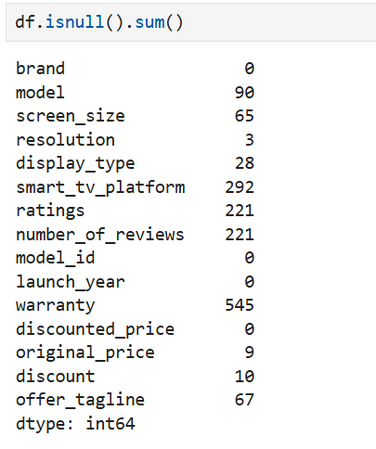
Check Null Values

Slide 9
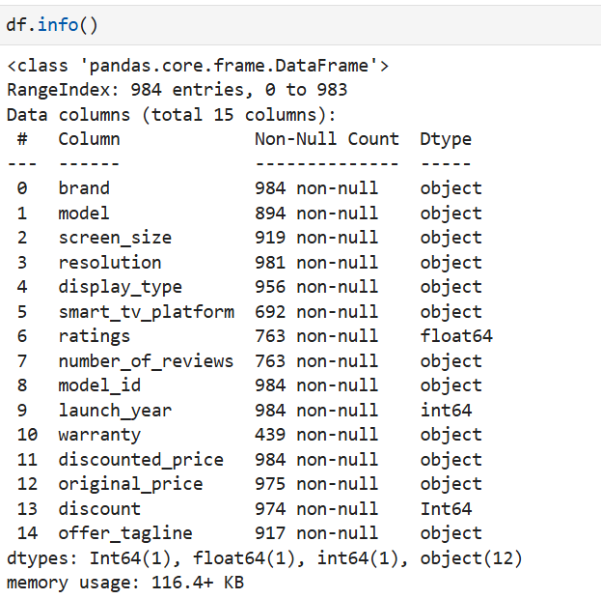
Summary of your DataFrame:

Slide 10
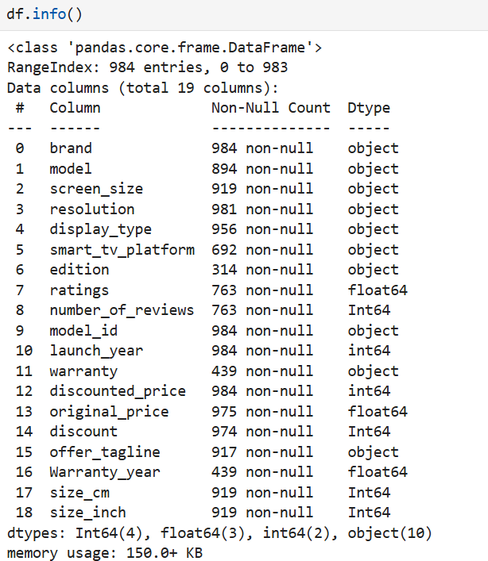
Verified types using: df.info()

Slide 11
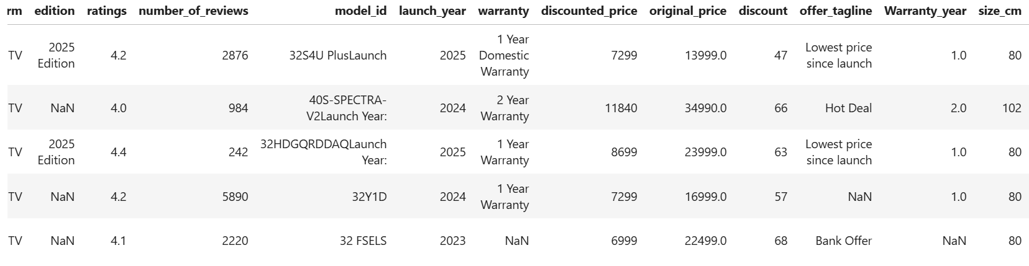
After cleaning data

Slide 12
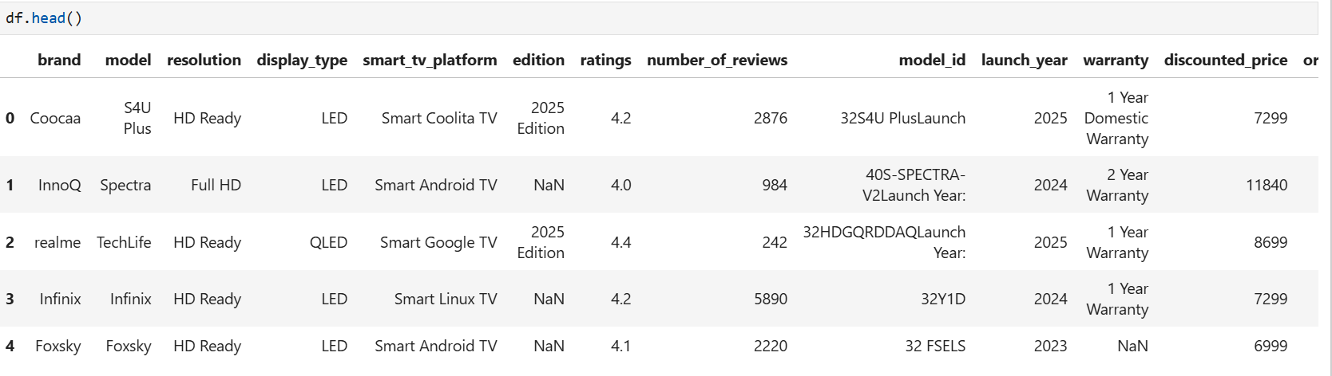
First 5 records

Slide 13
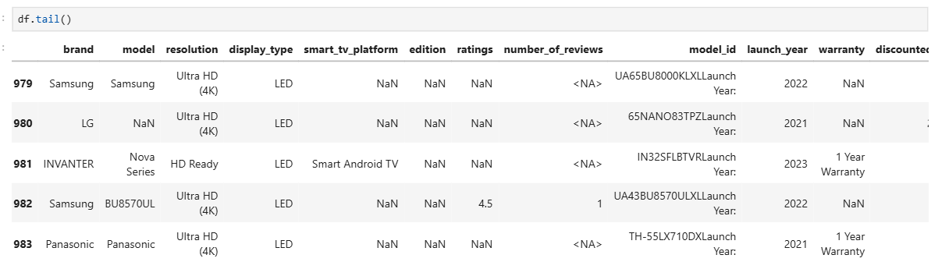
Last 5 records

Slide 14

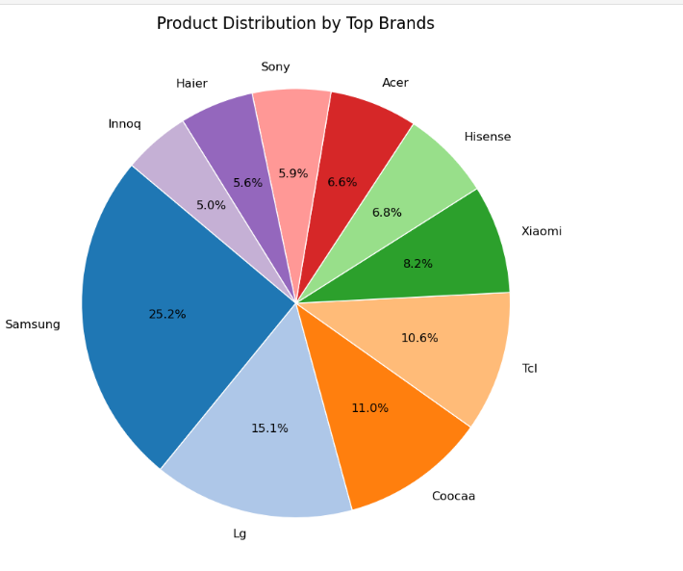
Data visualization
Pie chart analysis
Samsung leads with 25.2%indicating strong market presence and product volume.
LG (15.1%), Coocaa (11.0%), and TCL (10.6%) follow, forming a competitive mid-tier.
Xiaomi, Hisense, Acer, Sony, Haier, and Innoq each hold between 5% and 8%, showing moderate representation.
14

Slide 15
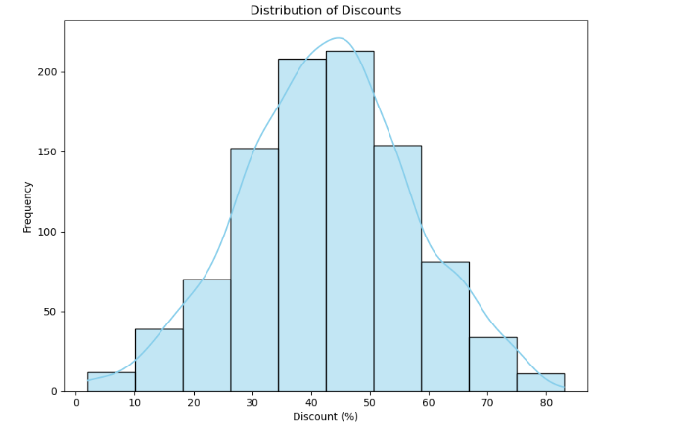
The highest concentration of discounts falls between 40% and 50%, forming a clear peak — suggesting this is the most common promotional range.
Very low discounts (0–10%) and extremely high discounts (70–80%) are rare, indicating limited use of minimal or aggressive pricing
The distribution is centered and slightly skewed, showing a tendency toward moderate discounts.
15

Slide 16
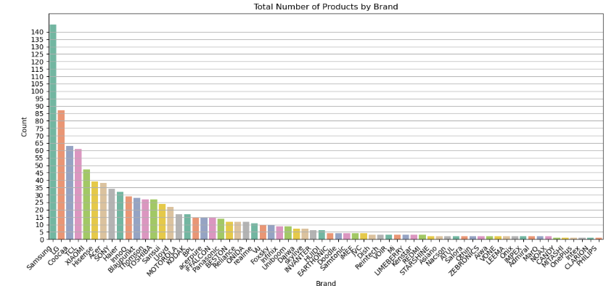

Slide 17
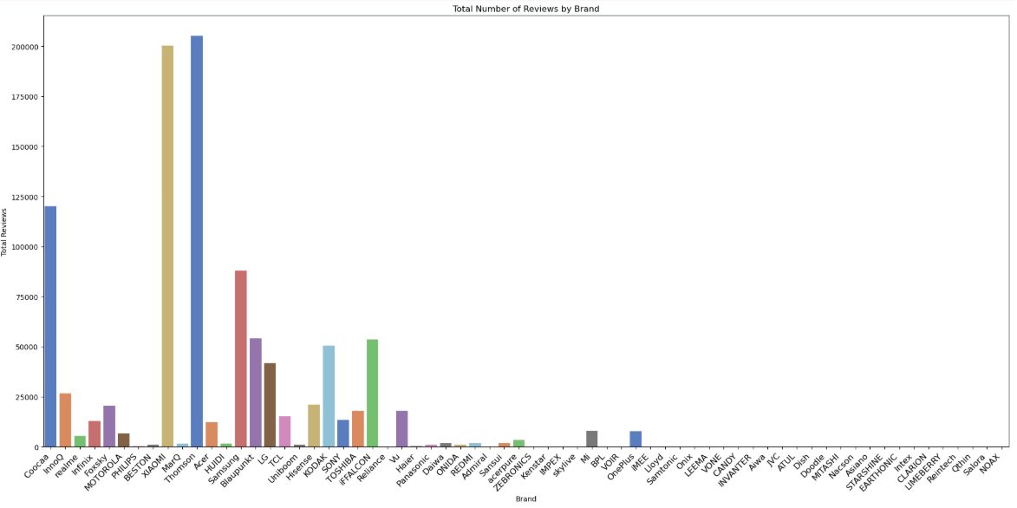

Slide 18
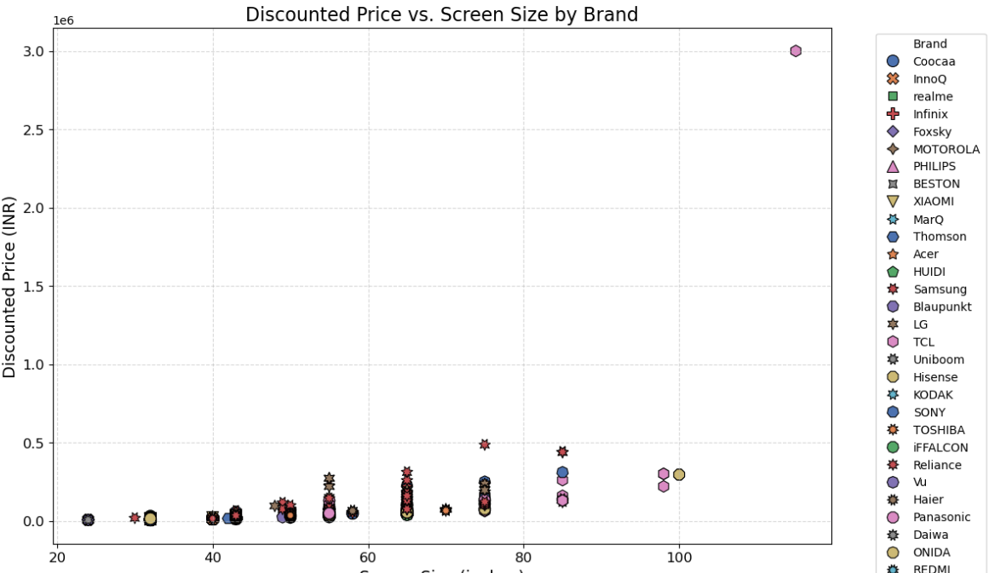

Slide 19
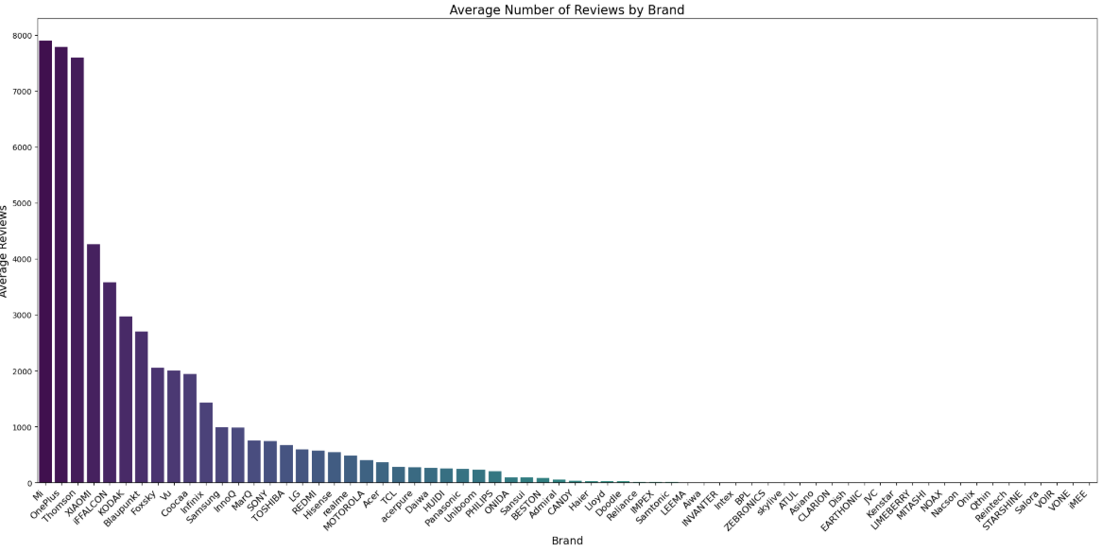
The Mi stands out with the highest average reviews, indicating strong consumer interest and possibly high product satisfaction or visibility.
The gradient color scheme (dark purple to light blue) enhances visual clarity, with darker bars representing higher engagement levels
One plus and Thomson follow closely to forming competitive cluster of brands with consistent customer feedback
19

Slide 20
Summary of Observations
Goal: Analyze Flipkart TV listings to uncover pricing, brand, and feature trends.
Clean Data: Removed irrelevant columns and handled missing or inconsistent values.
Prepare Data: Extracted screen size, resolution, warranty, and converted prices to numeric format.
Analyze: Explored relationships between price, rating, brand, and features.
Visualize: Used boxplots, histograms, and bar charts to highlight patterns and outliers..
Insights: Found that 43" Smart TVs dominate, Mi offers best value, and price doesn’t guarantee high ratings.
20

Slide 21

Presented by:
k.s.md.Muthaheer ,
T.Dinesh Naidu

