Slide 1

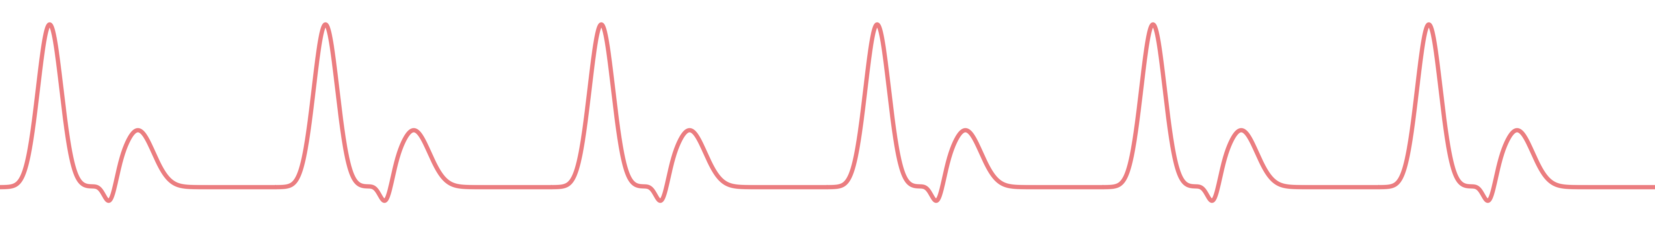
SPANDAN
Contactless heart-rate and SpO₂ estimation from facial video,
using classical digital signal processing
Bayezid Rahman · Lubaba Tasnia Khan · Abrar Jawad · Mohammad Ramis Isfar
Group 07 · ID 2206017–20 · Section A
Supervisor: Prof. Dr. Md. Kamrul Hasan · Dept. of EEE, BUET

Slide 2

01
Problem and Approach
Why contactless vitals, and how Spandan turns a face on camera into a pulse
Spandan · Group 07 · EEE 312 DSP I Laboratory · BUET
Problem and Approach
2

Slide 3




01 · PROBLEM AND APPROACH
Motivation
What a camera changes
A pulse oximeter probe is a small thing to wear — until you need one on every bed, every night, for weeks.
Nothing touches the patient
Skin colour changes with every heartbeat — invisible to the eye, recoverable from video.
Wired probes and finger clips irritate skin, tangle with bedding, and get pulled off by confused or sleeping patients.
Runs on hardware already in the room
A phone or a ward camera, not a dedicated medical sensor.
Old-age homes and general wards rarely have the staff to re-attach a sensor every time it slips.
Built to know its own limits
Every estimate ships with a confidence signal — it refuses to guess when the signal is bad.
A standard camera already sits above most beds — in a ward, a clinic, or a phone on a stand.
Spandan · Group 07 · EEE 312 DSP I Laboratory · BUET
Problem and Approach
3

Slide 4




01 · PROBLEM AND APPROACH
Objectives
Build the pipeline
Validate at scale, honestly
ROI extraction through wavelet denoising, CHROM/POS pulse combination, FFT-based heart rate, and calibrated SpO₂ — end to end in MATLAB.
LOSO cross-validation across 3 public datasets plus a self-collected BUET set — report the misses, not just the wins.
Run it in real time
Improve waveform quality
Port the validated pipeline to Android and hit interactive frame rates on a mid-range phone.
The improvement our supervisor asked for: recover dicrotic-notch morphology, not just a heart-rate number.
Spandan · Group 07 · EEE 312 DSP I Laboratory · BUET
Problem and Approach
4

Slide 5
01 · PROBLEM AND APPROACH
Signal Processing Pipeline
01
02
03
ROI extraction
Wavelet denoising
Detrend and bandpass
Face landmark tracking isolates the forehead region every frame; spatial mean RGB forms three raw traces.
3-level db4 discrete wavelet transform with Donoho–Johnstone thresholding removes broadband noise before any filtering.
Linear detrend, then zero-phase bandpass at 0.7–4 Hz (42–240 bpm) isolates the cardiac band.
04
05
06
Pulse extraction
FFT to heart rate
SpO₂ estimation
CHROM and POS project the three colour channels onto a motion-resistant pulse direction; POS is the production default.
Welch power spectral density of the pulse signal; the dominant peak in-band gives instantaneous heart rate.
Ratio-of-ratios of the AC/DC components in the red and blue channels, calibrated against fingertip-oximeter ground truth.
Spandan · Group 07 · EEE 312 DSP I Laboratory · BUET
Problem and Approach
5

Slide 6

01 · PROBLEM AND APPROACH
Theoretical Foundation: What a Camera Actually Sees
Every rPPG method starts from the dichromatic reflection model — light reflected from skin splits into a cardiac-modulated term and a motion/noise term:
x(t) = s_{ₐ}(t)·p̂ + m(t)·d̂ + n(t)
cardiac · chromatic direction + motion / illumination + noise
CHROM and POS
One cardiac signal, two uses
A fixed (CHROM) or adaptive (POS) projection suppresses the motion/illumination term while keeping the cardiac one. POS wins on every metric in our evaluation — 7.22 vs. 7.83 bpm MAE — so POS is the production default.
A tight 0.7–4 Hz band gives the cleanest heart rate, but flattens the dicrotic-notch transient. So heart rate reads from the narrow band, while waveform shape reads from a separate, wider, confidence-gated analysis (Slide 9).
Why this matters: the dichromatic model treats the cardiac term as one signal. It's really two, sharing a frequency — Slide 8 unpacks this, and why some “obvious” fixes (Annex) don't help in practice.
Spandan · Group 07 · EEE 312 DSP I Laboratory · BUET
Problem and Approach
6

Slide 7
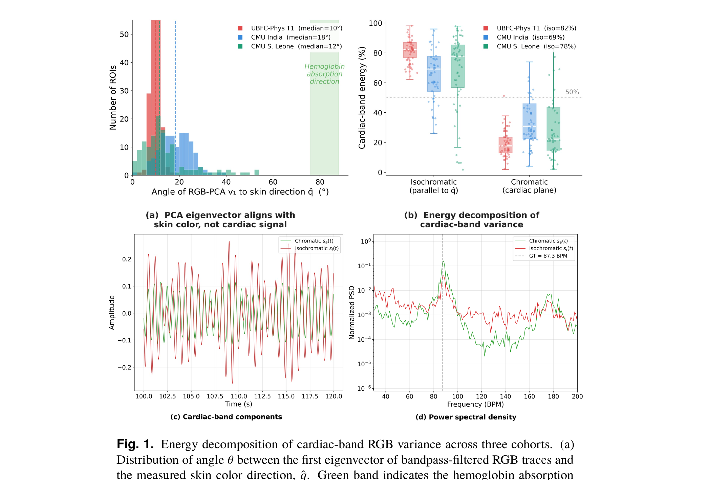
01 · PROBLEM AND APPROACH
The Signal Is Really Two Signals
The cardiac term s_{ₐ}(t)·p̂ conflates two physically distinct signals: a chromatic pulsation from haemoglobin absorption, and an isochromatic pulsation from ballistocardiographic surface motion. Every method assuming one pulse direction — POS, CHROM, and others — is quietly mixing both.
What the data shows — three cohorts (UBFC-Phys, CMU-rPPG India/Sierra Leone)
Isochromatic energy dominates the cardiac band: 69–83% of variance at the median, across all three cohorts.
It carries lower phase fidelity than the chromatic component — real, but noisier.
Fig. reproduced from Kaur, Lakshminarayanan & Saini, “Missed isochromatic cardiac pulsation in remote photoplethysmography,” Biomedical Optics Express 17(7):3832, 2026 (doi.org/10.1364/BOE.599752).
This is why waveform-shape recovery needs its own confidence check (Slide 9), separate from heart rate.
We tested a projection that explicitly removes the isochromatic direction (Annex). It did not outperform production once wavelet denoising and the confidence gate were in place.
Spandan · Group 07 · EEE 312 DSP I Laboratory · BUET
Problem and Approach
7

Slide 8
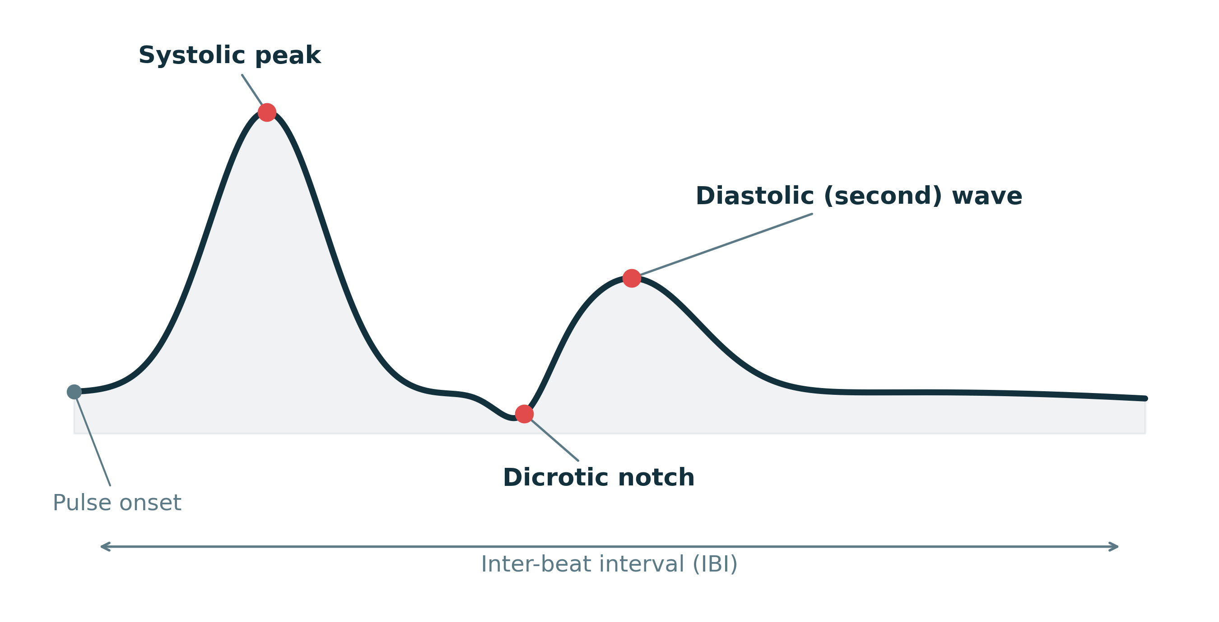


01 · PROBLEM AND APPROACH
Waveform Quality: A Filter That Knows When to Doubt Itself
Our approach
Widen the band, add a harmonic comb
A separate 0.5–8 Hz analysis with an adaptive harmonic comb, tuned purely to expose notch structure — heart-rate extraction never touches this path.
Score the result before trusting it
Every candidate notch gets a confidence score from its own detection statistics — measured per subject, not assumed.
Gate on a validated threshold
Reference PPG morphology — the target our supervisor asked us to recover, not just a heart-rate number.
Above 0.3 confidence, keep the harmonic-filtered morphology. Below it, substitute a fixed Gaussian(0.15) filter instead.
The single most validated improvement in this project — full numbers on Slide 14. It costs nothing at inference beyond one confidence check, and never lets a low-confidence estimate pass as good.
Spandan · Group 07 · EEE 312 DSP I Laboratory · BUET
Problem and Approach
8

Slide 9
01 · PROBLEM AND APPROACH
The Android Application
What's on screen
● LIVE · GOOD SIGNAL
Live signal chart
The recovered pulse waveform streams in real time so a clinician can sanity-check it visually, not just trust a number.
130
BEATS PER MINUTE
A status pill, not just a number
Live / Low-signal / No-face states come straight from the same confidence machinery used in the MATLAB pipeline — nothing new was invented for the phone.
96.81%
On-device, no cloud round-trip
SpO₂ ESTIMATE
The full CHROM/POS + wavelet + FFT pipeline runs natively on the phone at 21.4 fps — no video ever leaves the device.
Estimate only — not a calibrated device
Spandan · Group 07 · EEE 312 DSP I Laboratory · BUET
Problem and Approach
9

Slide 10

02
Results
What the pipeline actually achieves, measured honestly across four datasets
Spandan · Group 07 · EEE 312 DSP I Laboratory · BUET
Results
10

Slide 11
02 · RESULTS
Validation Protocol
Leave-one-subject-out (LOSO) cross-validation across three public datasets plus a self-collected BUET set — no subject's data trains and tests the same model.
Dataset | Subjects used | Ground truth | Recording context
UBFC-rPPG Dataset 1 | 5 | Contact PPG + SpO₂ | Laboratory, static, good lighting
UBFC-rPPG Dataset 2 | 33 of 42 usable | Contact PPG | Laboratory, natural motion tasks
VIPL-HR | 107 | Contact PPG, 3 devices | Multiple head poses, illumination, sensors
Self-collected (BUET) | Week 7 cohort | Fingertip pulse oximeter | Our own ward-style test set
Dataset
Subjects used
Ground truth
Recording context
Why LOSO: a model that has never seen a subject's face or physiology during training is a much harder — and much more honest — test than a random train/test split. Every accuracy number on the following slides is a pooled LOSO result, not a best-fold cherry-pick.
Spandan · Group 07 · EEE 312 DSP I Laboratory · BUET
Results
11

Slide 12
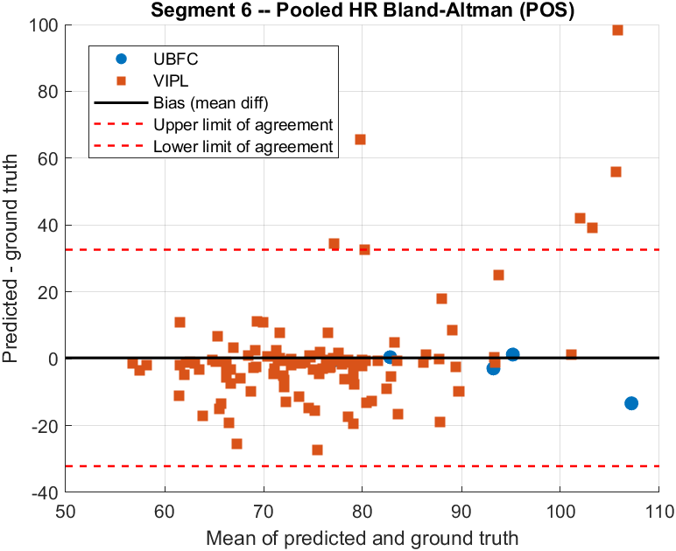
02 · RESULTS
Heart Rate Accuracy
Method
MAE (bpm)
RMSE (bpm)
Corr.
POS (production) | 7.22 | 10.85 | 0.62
CHROM (comparison) | 7.83 | 11.87 | 0.53
Why POS over CHROM
POS's adaptive projection tracks changing skin-tone and illumination better than CHROM's fixed coefficients — the gap holds across every metric, so POS is the production default.
db4 wavelet denoising runs before either projection — part of the production path, materially reducing pooled error vs. a no-wavelet baseline (full ablation in Annex).
Pooled Bland–Altman, POS, n=112 (UBFC + VIPL-HR), LOSO.
Spandan · Group 07 · EEE 312 DSP I Laboratory · BUET
Results
12

Slide 13
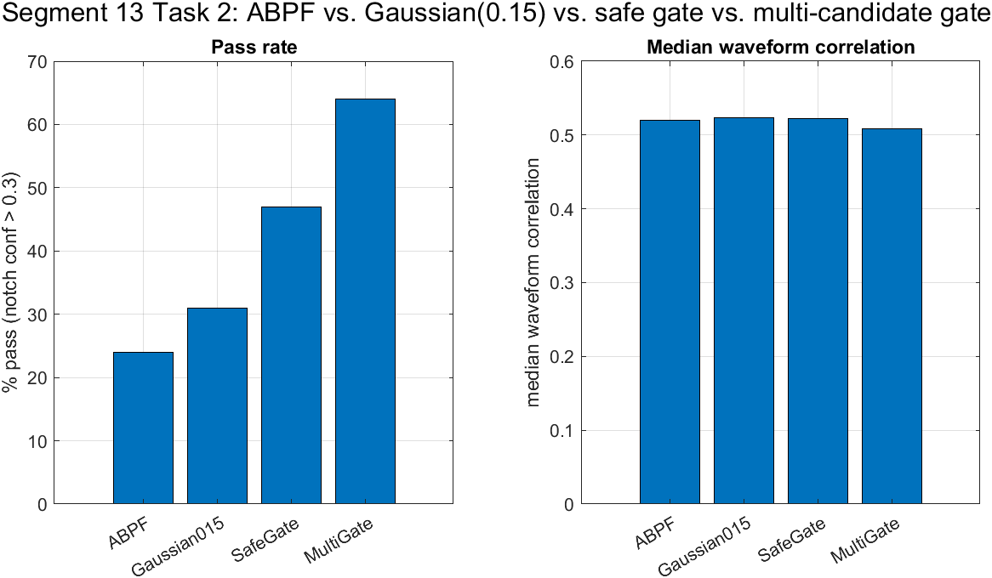
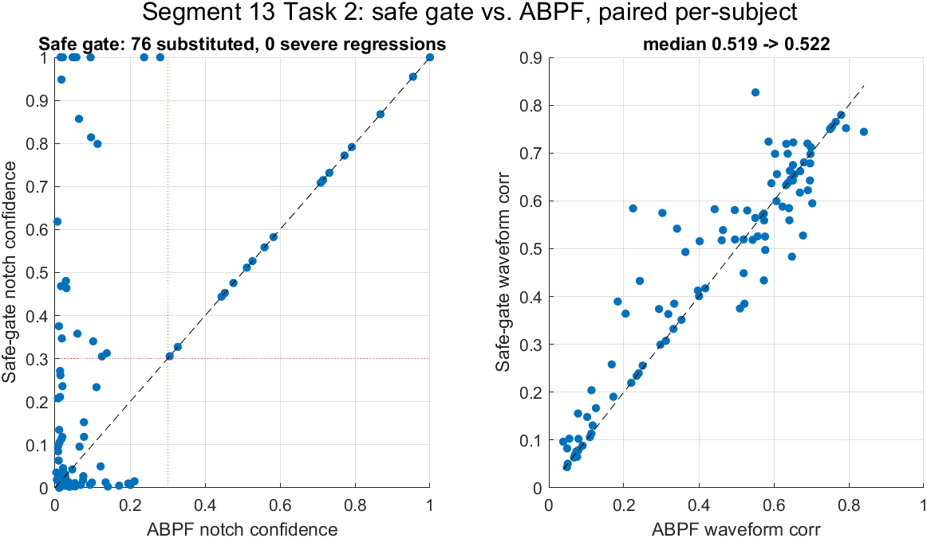
02 · RESULTS
The Confidence Gate: Our Strongest Validated Result
Pass rate and waveform correlation across gate variants, n=133.
Per-subject: safe gate vs. ABPF alone, notch confidence and waveform correlation.
24% → 47%
0
45% → 58%
Notch-detection pass rate
(harmonic filter alone → confidence-gated)
Severe regressions
across 133 subjects, 76 substituted
Held out on an independent 42-subject
split — the gain generalises
The pass-rate jump is free — median waveform correlation barely moves (0.519 → 0.522); no accuracy is traded away to get it.
Spandan · Group 07 · EEE 312 DSP I Laboratory · BUET
Results
13

Slide 14
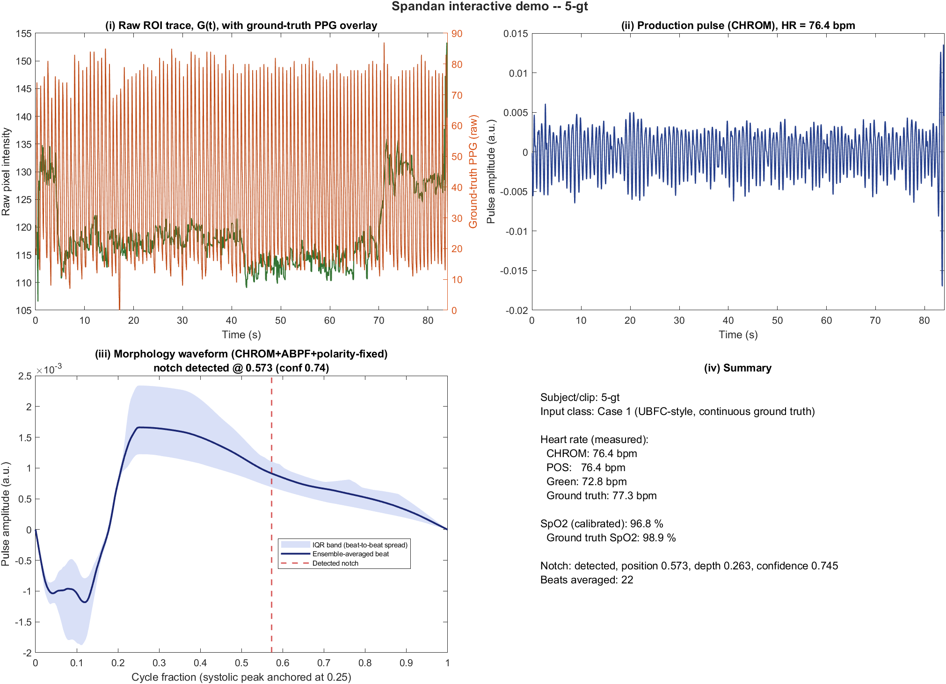
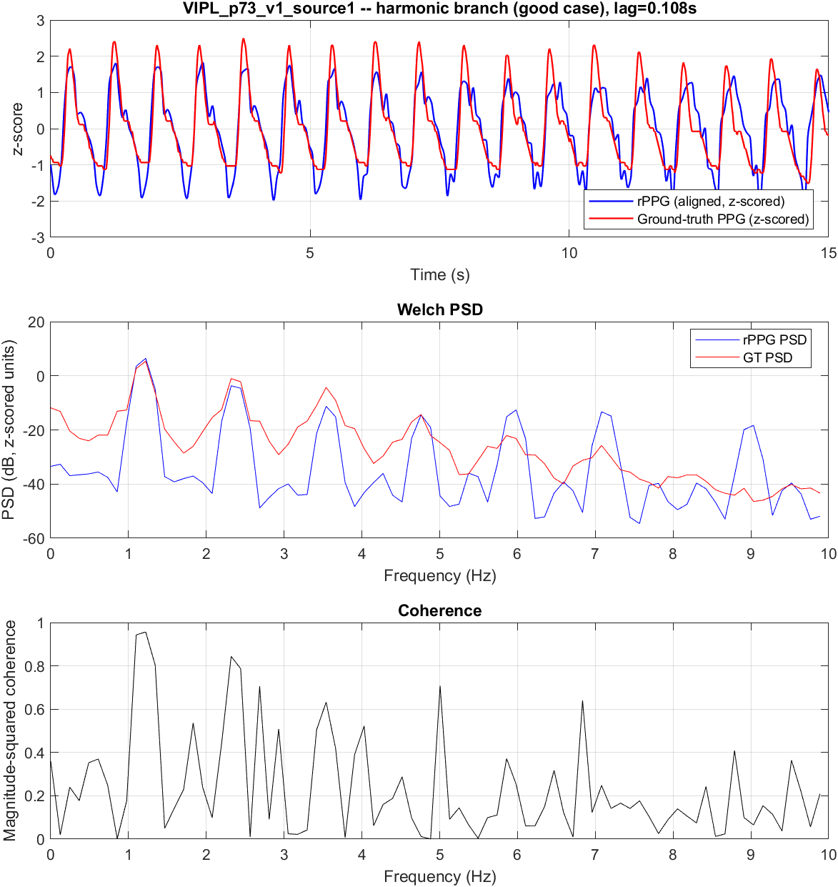
02 · RESULTS
The Pipeline, on Real Data
Live diagnostic, one UBFC subject: ROI trace, production CHROM pulse, recovered morphology (notch conf. 0.745), HR 76.4 vs. 77.3 bpm GT, SpO₂ 96.8 vs. 98.9%.
A high-confidence VIPL case: waveform tracks ground truth, PSD peaks align, coherence >0.9 near 1.2 Hz.
Spandan · Group 07 · EEE 312 DSP I Laboratory · BUET
Results
14

Slide 15
02 · RESULTS
On-Device Performance
21.4 fps
130 bpm
96.81 %
5.49 bpm
Sustained frame rate,
mid-range Android phone
Live heart-rate
reading in the demo
Live SpO₂ estimate
in the demo
Tick-to-tick jitter
(lower is steadier)
The full pipeline — face tracking, wavelet denoising, CHROM/POS, FFT, ratio-of-ratios SpO₂, and the confidence gate — runs natively on-device. No frame ever leaves the phone. At 21.4 fps the system comfortably keeps pace with a 0.7–4 Hz cardiac band (Nyquist needs only ~8 fps), leaving headroom for the wider harmonic-filter analysis alongside it.
Spandan · Group 07 · EEE 312 DSP I Laboratory · BUET
Results
15

Slide 16
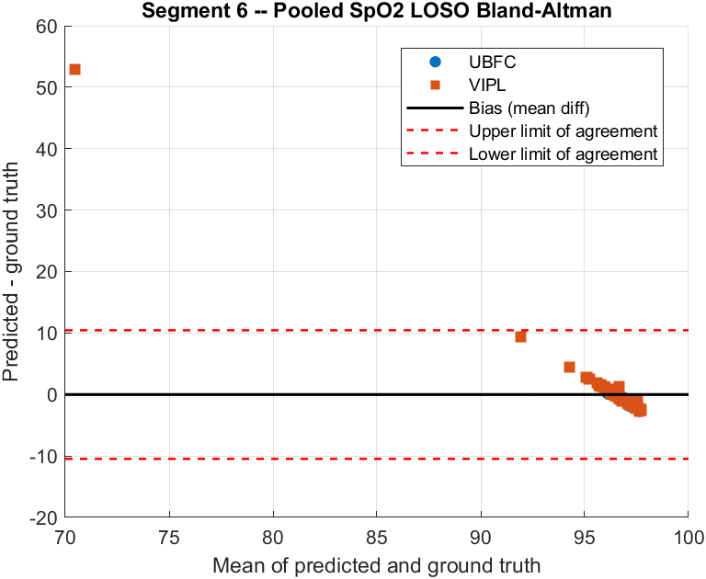

02 · RESULTS
SpO₂: An Honest Limitation
1.9%
LOSO Mean Absolute Error
We say this plainly: our ratio-of-ratios calibration does not beat the naive strategy of always guessing the training-set mean SpO₂. The signal is real — the red/blue AC-DC ratio does track true SpO₂ in-band — but the calibration curve isn't yet subject-independent enough to trust clinically.
We report this as a labelled “estimate only” in the app, not a calibrated reading — a deliberate design choice, not an oversight.
Pooled LOSO Bland–Altman, SpO₂ (UBFC + VIPL).
Spandan · Group 07 · EEE 312 DSP I Laboratory · BUET
Results
16

Slide 17
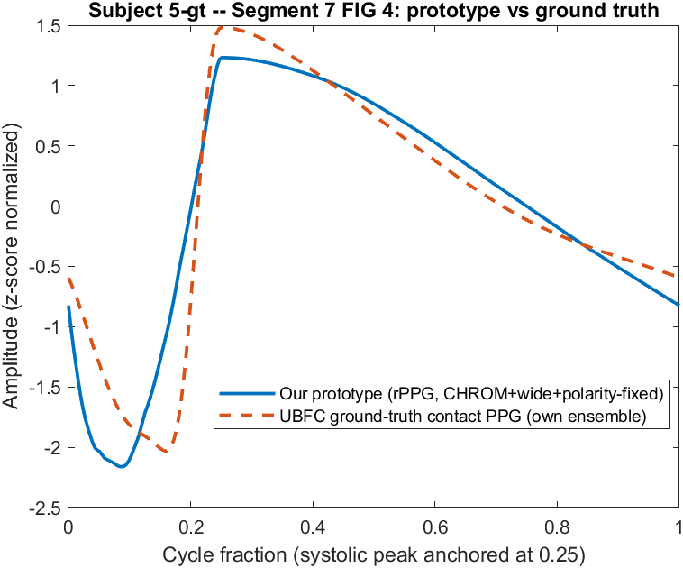
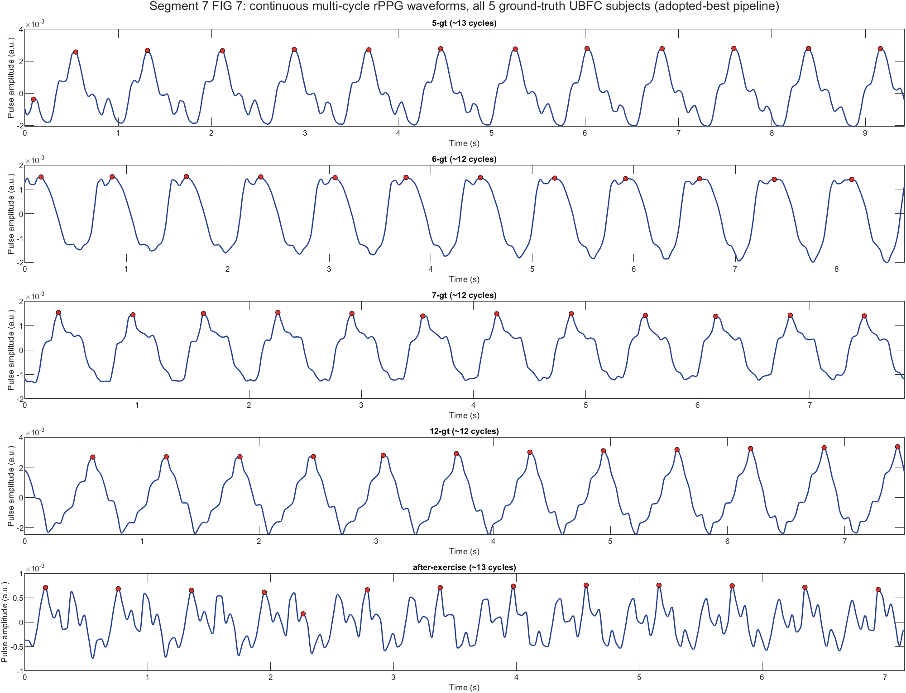
02 · RESULTS
Pipeline vs. Ground Truth: The Overlay
Pipeline-extracted pulse (blue) vs. UBFC contact-PPG ground truth (red, dashed) — one cardiac cycle, subject 5-gt.
Recovered morphology template for all 5 ground-truth subjects (waveform Pearson r vs. GT: 0.88–0.96).
Across all 5 in-house ground-truth subjects: waveform correlation 0.88–0.96 (mean 0.93); heart-rate error under 3 bpm for 4 of 5. The fifth — recorded post-exercise — is a known outlier, examined next.
Spandan · Group 07 · EEE 312 DSP I Laboratory · BUET
Results
17

Slide 18
02 · RESULTS
Ground-Truth Validation, Subject by Subject
Every subject in our self-collected ground-truth set — no cherry-picking, all 5 recordings shown.
Subject
HR: ours / GT (bpm)
HR error
SpO₂: ours / GT (%)
Waveform r
5-gt
76.4 / 77.3
0.91
96.8 / 98.9
0.94
6-gt
83.0 / 82.6
0.45
97.9 / 96.5
0.93
7-gt
91.8 / 94.7
2.91
98.0 / 96.4
0.88
12-gt
95.8 / 94.6
1.24
99.8 / 96.0
0.93
after-exercise
100.5 / 113.9
13.35
96.8 / 98.0
0.96
The post-exercise recording is the one clear outlier: motion during exercise disrupts heart-rate tracking (13.35 bpm error) far more than it disrupts recovered pulse morphology — its waveform correlation, 0.96, is the highest of the five.
Spandan · Group 07 · EEE 312 DSP I Laboratory · BUET
Results
18

Slide 19
02 · RESULTS
Accuracy Across Datasets: Heart Rate and SpO₂
Every subject, pooled by dataset — LOSO cross-validation, not a best-fold number.
Heart rate (POS, production)
SpO₂ (ratio-of-ratios, LOSO)
Scope
N
MAE
RMSE / r
Scope
N
MAE
RMSE / r
Pooled
112
7.22
10.85 / 0.62
Pooled
112
1.85
5.31 / −0.38
UBFC
5
3.77
6.15 / 0.94
UBFC
5
0.92
1.34 / 0.05
VIPL-HR
107
7.38
11.02 / 0.58
VIPL-HR
107
1.90
5.43 / −0.38
Reading this honestly: HR accuracy is strong and consistent (pooled r=0.62, tighter still on laboratory-grade UBFC). SpO₂'s negative pooled correlation, and its thin UBFC sample (n=5 — directional signal only, per our own reliability audit), are exactly why we report SpO₂ as a labelled estimate, not a clinical reading (Slide 17).
Spandan · Group 07 · EEE 312 DSP I Laboratory · BUET
Results
19

Slide 20
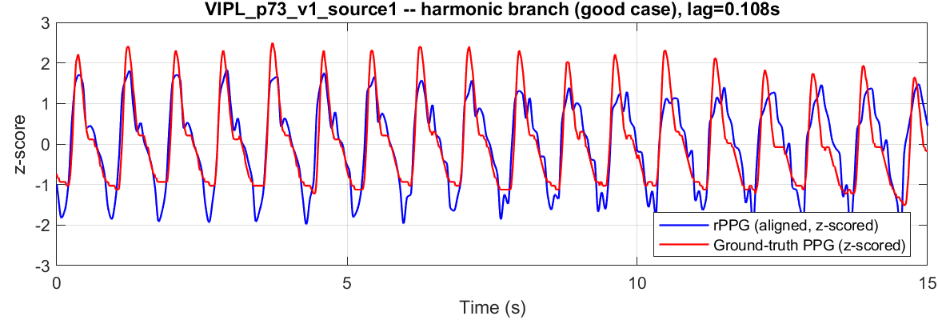
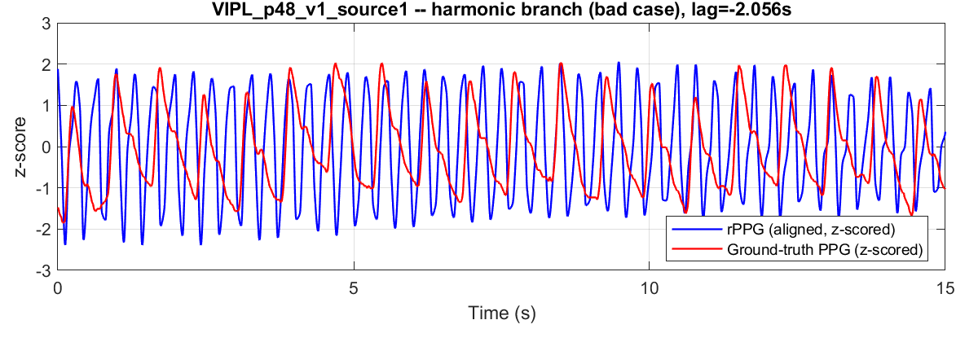
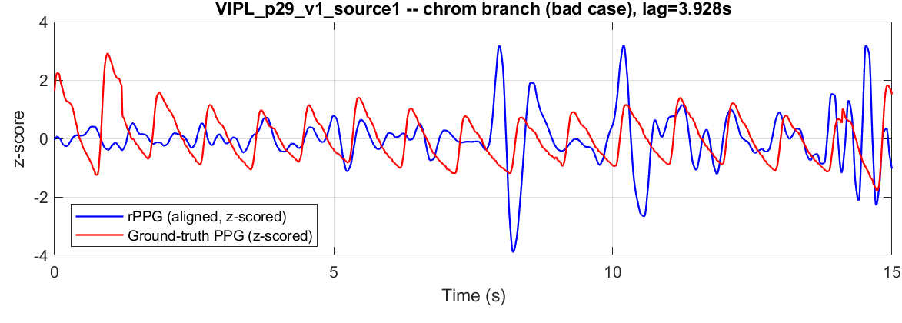
02 · RESULTS
VIPL-HR: Extraction, Case by Case
Good case (same trace as Slide 14) — tracks ground truth almost cycle-for-cycle.
A harder case — the harmonic-filtered pulse locks onto the wrong beat rate.
A CHROM-combiner case — misaligned trace, part of why POS is the production default.
107
7.38 bpm
r = 0.58
VIPL-HR subjects validated
(v1, single-camera scenario)
Pooled LOSO MAE, heart rate
(POS + wavelet denoising)
vs. ground truth, LOSO
(current production pipeline)
Same POS + wavelet-denoising settings as Slide 19's pooled table — real per-subject traces, not just averaged numbers.
Spandan · Group 07 · EEE 312 DSP I Laboratory · BUET
Results
20

Slide 21

03
Bedside Outcome
What a working, honest system means where it would actually be used
Spandan · Group 07 · EEE 312 DSP I Laboratory · BUET
Bedside Outcome
21

Slide 22



03 · BEDSIDE OUTCOME
Expected Outcome
Nothing added to the patient
The same camera already used for observation doubles as the sensor.
Runs on hardware already present
A ward camera or a phone on a stand — no new capital equipment.
A continuous trend, with an honest alert
Flags deterioration trends over time; not a certified diagnostic monitor, and doesn't claim to be.
A single ward camera watches the bed — the pulse trace is read from the same feed, nothing added to the patient.
Refuses to guess
When confidence drops — poor lighting, motion, no face — the app says so instead of showing a number.
Spandan · Group 07 · EEE 312 DSP I Laboratory · BUET
Bedside Outcome
22

Slide 23
03 · BEDSIDE OUTCOME
Clinical Viability: What the Literature Actually Shows
Independent clinical studies of camera-based vital-sign monitoring — agreement varies a lot by setting, and we show that variation rather than the single best number.
Study
Setting
Key result
Cramer et al., J. Clin. Monit. Comput. 40(5), 2026
ICU, 35 patients, 683.6 h continuous
HR bias 2.1 bpm (wide limits); RR bias −2.4 br/min
Camera multi-parameter ICU platform, IEEE J. Biomed. Health Inform., 2025–26
ICU, two centres (double-centre study)
HR MAE 1.89 bpm
CCTV-based ICU monitoring, IEEE Internet of Things J. 11:5781, 2024
ICU ward, existing hospital CCTV
Feasibility on infrastructure already installed
West et al., Emerg. Med. Australas. 38(4), 2026
Emergency dept. walk-ins, n=288
SpO₂ bias −0.01% (narrow); HR bias −5.23 bpm (wide)
Reading across all four: agreement is good in controlled ICU settings and widens sharply in an uncontrolled emergency department — the same pattern our own results show between laboratory (UBFC) and in-the-wild (VIPL) data.
Spandan · Group 07 · EEE 312 DSP I Laboratory · BUET
Bedside Outcome
23

Slide 24

04
Plan, Cost and Impact
Curriculum fit, where the schedule actually stands, and what this costs to build
Spandan · Group 07 · EEE 312 DSP I Laboratory · BUET
Plan, Cost and Impact
24

Slide 25
04 · PLAN, COST AND IMPACT
Course and Program Outcome Alignment
Per the BUET EEE OBE curriculum (Course 20.41, EEE 312) — mapped to what Spandan actually delivered, not a generic checklist.
CO
PO(s)
Outcome
How Spandan demonstrates it
CO1
PO(a), PO(e)
Implement DSP algorithms in software
The full pipeline — wavelet, CHROM/POS, FFT — built and iterated in MATLAB
CO2
PO(d)
Compare theory vs. experiment
LOSO accuracy measured against contact-PPG and pulse-oximeter ground truth on 4 datasets
CO3
PO(c), PO(i)
Design filters to spec, as a team
Confidence-gated harmonic filter designed, tuned and validated jointly across the group
CO4
PO(c), PO(l)
Design for a real-world problem, responsibly
Contactless monitoring for wards / old-age homes; lifelong-learning habit of citation-checked literature review
CO5
PO(h)
Apply ethics in the project
Public/consented datasets only; self-collected data gathered with informed consent from participants
CO6
PO(i)
Work effectively as a team
Three-person team, joint MATLAB → Android port
CO7
PO(j)
Report and present effectively
This defense, the written report, and the Android demo video
Spandan · Group 07 · EEE 312 DSP I Laboratory · BUET
Plan, Cost and Impact
25

Slide 26

04 · PLAN, COST AND IMPACT
Project Timeline & Validation Scale
W1–2
Literature review, dataset setup, ROI extraction
W3
Wavelet denoising, detrend, bandpass
W4
CHROM/POS combination, FFT heart rate, SpO₂ calibration
W5
Pooled LOSO validation, 112 subjects; harmonic-filter + confidence gate
W6
Android real-time port; held-out generalisation check (42 subjects)
W7
Self-collected BUET set; report, user manual, demonstration video
Where we actually stand: the pipeline, validation (133 subjects across 3 datasets) and Android port are complete. Week 7 is the self-collected BUET set, the written report, and this demonstration — not a system still being built.
Spandan · Group 07 · EEE 312 DSP I Laboratory · BUET
Plan, Cost and Impact
26

Slide 27
04 · PLAN, COST AND IMPACT
Cost Estimation
Item
Note
Cost
Reference pulse oximeter
Fingertip, ground truth for the self-collected set
৳120
Report printing / binding
Final submission copies
৳250
Presentation / demo logistics
Defense-day materials
৳100
Android test device
Galaxy A35 — already owned
৳0
MATLAB R2024b
University licence
৳0
Datasets
UBFC public; VIPL granted on request
৳0
Total
৳770
Hardware and datasets are deliberately reused, not budgeted new — the design goal was a system that scales on infrastructure a ward already owns.
Spandan · Group 07 · EEE 312 DSP I Laboratory · BUET
Plan, Cost and Impact
27

Slide 28



04 · PLAN, COST AND IMPACT
Environmental and Societal Impact
Environment
Health and safety
Society and privacy
No disposable sensors, clips or adhesive pads per patient, per shift.
Removes a cross-infection vector (shared finger clips) between patients.
Camera-based monitoring raises real privacy questions — on-device processing means video never leaves the room.
Runs on hardware already deployed — no new manufacturing footprint per bed.
Confidence gating means a bad reading is withheld, not silently wrong.
Our own accuracy gap between light- and dark-skinned cohorts (isochromatic pulsation, Slide 8) means we can't yet claim equal performance across all skin tones — flagged, not hidden.
Spandan · Group 07 · EEE 312 DSP I Laboratory · BUET
Plan, Cost and Impact
28

Slide 29

04 · PLAN, COST AND IMPACT
Conclusion
7.22 bpm MAE, 21.4 fps, on-phone
POS-based heart rate validated across 112 subjects (LOSO), running natively on Android.
Our strongest validated result
The confidence-gated harmonic filter lifts notch-detection pass rate 24% → 47%, with zero severe regressions across 133 subjects — and it generalises to a held-out cohort.
SpO₂ reported honestly
LOSO calibration does not yet beat guessing the training mean — shipped as a labelled estimate, not a clinical claim.
What's left: Weeks 6–7
Our own Bangladeshi test set with pulse-oximeter ground truth, then the final report, user manual and demonstration video.
Spandan · Group 07 · EEE 312 DSP I Laboratory · BUET
Conclusion
29

Slide 30
Thank you
Questions on the filtering chain, the validation protocol, or the SpO₂ limitation are welcome.
Spandan · Group 07 · EEE 312 Digital Signal Processing I Laboratory · Dept. of EEE, BUET
Supervisor: Prof. Dr. Md. Kamrul Hasan · September 2026

Slide 31

Annex
Roads not taken — what we tried, what we learned, why it isn't in production
A1
cPACE: isochromatic-aware projection
Motivated by the isochromatic pulsation theory (Slide 8) — regressed vs. production once wavelet denoising + confidence gate were in place.
A2
Adaptive Kalman smoothing (RAKF)
Inspired by a published DWT+Kalman framework — added latency/complexity without a clear accuracy win for our real-time constraint.
A3
Filter-order and ROI sweeps
Bandwidth, filter-order and ROI-tracking variants tuned before settling on the shipped configuration.
Spandan · Group 07 · EEE 312 DSP I Laboratory · BUET
Annex
30

Slide 32

ANNEX A1
cPACE: Chrominance Phase-Aware Cardiac Eigenprojection
What it is: a subject-adaptive projection that explicitly suppresses the isochromatic direction, proposed alongside the isochromatic-pulsation theory (Slide 8) to recover a cleaner cardiac signal than POS/CHROM/OMIT/LGI/PBV/ICA.
Why we tested it: the source paper reports large gains on demographically hard cohorts (dark-pigmented skin, naturalistic recordings) — exactly the failure mode our own literature review flagged as a fairness risk.
What we found
We implemented cPACE against our own pipeline and re-ran the pooled LOSO evaluation. It did not outperform the production POS + wavelet-denoising + confidence-gate combination on our datasets — the subject-adaptive projection needs a calibration window that costs latency, and on our largely lighter-skinned cohorts the isochromatic contamination it removes was already smaller than on the dark-pigmented cohorts the original paper emphasises.
Kaur, Lakshminarayanan & Saini, “Missed isochromatic cardiac pulsation in remote photoplethysmography: detection, impact, and removal,” Biomedical Optics Express 17(7):3832, 2026. doi.org/10.1364/BOE.599752
Spandan · Group 07 · EEE 312 DSP I Laboratory · BUET
Annex
31

Slide 33
ANNEX A2
Denoising Context: Why Wavelets, Not Adaptive Kalman Smoothing
Our production denoiser: a 3-level db4 discrete wavelet transform with Donoho–Johnstone thresholding, run once, before any filtering. It is deterministic, cheap, and its contribution to pooled accuracy is shown on Slide 13.
RAKF — residual-based adaptive Kalman filtering
IIR phase distortion — filter-order choice
Debnath & Kim (PLOS ONE 21(1):e0340097, 2026) pair DWT denoising with a residual-based adaptive Kalman filter (DWT-RAKF), reporting 0.72–1.14 bpm MAE on PURE. We added a Kalman smoothing stage on top of our own wavelet output.
Lapitan et al. (Sci. Rep. 14:6546, 2024) show how IIR filter order and cutoff distort dicrotic-notch timing and depth in finger PPG — higher-order, narrower filters shift the notch measurably.
Result: the adaptive gain update added per-frame latency without a consistent accuracy gain on our cross-dataset LOSO evaluation — PURE-style lab recordings are far more stable than our VIPL/self-collected cohorts.
This shaped our confidence-gate design: rather than chase one “perfect” filter order, we accept a wider, phase-imperfect harmonic filter and let the confidence score — not filter order — decide whether a notch is trustworthy.
Spandan · Group 07 · EEE 312 DSP I Laboratory · BUET
Annex
32

Slide 34
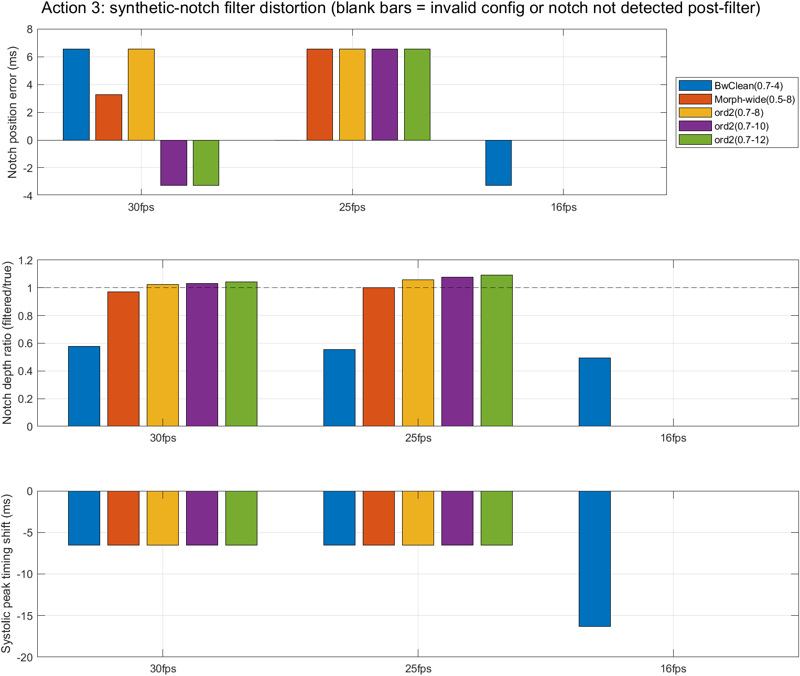
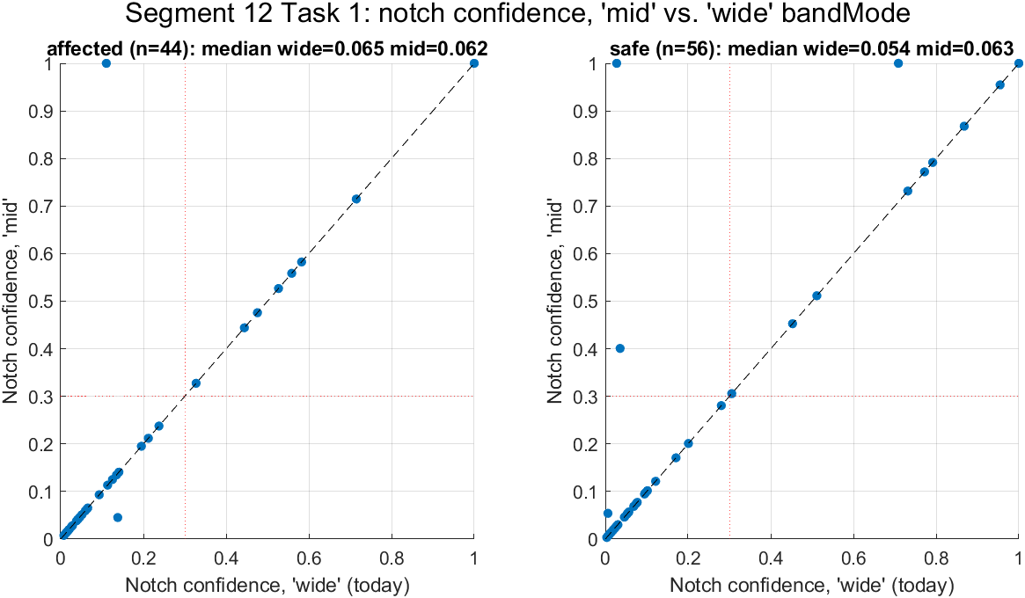
ANNEX A3
Filter and ROI Tuning Sweeps
Notch confidence was stable across band-mode choices (wide vs. mid) — confirming the confidence score itself, not the exact band, is what should gate acceptance.
Synthetic-notch distortion sweep across filter families, orders and frame rates — this and a matching notch-confidence sweep (right) shaped the final harmonic-filter configuration.
Also tuned, not shown: ROI tracking variants (KLT / face-mesh / hybrid), a template-collapse diagnostic, and a cubic-spline timing correction for VIPL's source-2 recordings.
Spandan · Group 07 · EEE 312 DSP I Laboratory · BUET
Annex
33

Slide 35
ANNEX
References
1.
Kaur, P., Lakshminarayanan, S., & Saini, J. (2026). Missed isochromatic cardiac pulsation in remote photoplethysmography: detection, impact, and removal. Biomedical Optics Express, 17(7), 3832. doi.org/10.1364/BOE.599752
6.
A ubiquitous platform for camera-based multi-parameter vital signs monitoring in hospital ICUs: a double-center clinical study. IEEE Journal of Biomedical and Health Informatics (2025–26). doi.org/10.1109/jbhi.2025.3620569
2.
Goda, M.Á. et al. (2024). pyPPG: a Python toolbox for comprehensive photoplethysmography signal analysis. Physiological Measurement, 45, 045001.
7.
Contactless patient care using hospital IoT: CCTV-camera-based physiological monitoring in ICU. IEEE Internet of Things Journal, 11, 5781 (2024).
3.
Debnath, U., & Kim, S. (2026). Advanced signal-processing framework for remote photoplethysmography-based heart rate measurement: integrating adaptive Kalman filtering with discrete wavelet transformation. PLOS ONE, 21(1), e0340097.
8.
West, C., Hopkins, H., Teague, S., et al. (2026). Reliability of contactless vital sign monitoring posttriage in emergency department walk-in patients: a single-site, prospective, observational, pilot study. Emergency Medicine Australasia, 38(4), e70323.
4.
Lapitan, D.G., Rogatkin, D.A., Molchanova, E.A., & Tarasov, A.P. (2024). Estimation of phase distortions of the photoplethysmographic signal in digital IIR filtering. Scientific Reports, 14, 6546.
9.
BUET Department of EEE. (2023). Undergraduate Outcome-Based Education Curriculum, Course 20.41 — EEE 312: Digital Signal Processing I Laboratory.
5.
Cramer, I., van Esch, R., Verstappen, C., et al. (2026). Clinical validation of video-based vital sign monitoring in the intensive care unit: a prospective cohort study. Journal of Clinical Monitoring and Computing, 40(5), 1113–1123.
Spandan · Group 07 · EEE 312 DSP I Laboratory · BUET
Annex
34

