Slide 1
The Building Adapter: Towards Quickly Applying Building Analytics at Scale Dezhi Hong, Hongning Wang, *Jorge Ortiz, Kamin Whitehouse University of Virginia, *IBM Research
Notes:
We saw several papers yesterday about "metadata normalization" that try to minimize the manual input required.
Today I will talk about our work.... as a *first step* towards normalization with *no* manual effort.

Slide 2
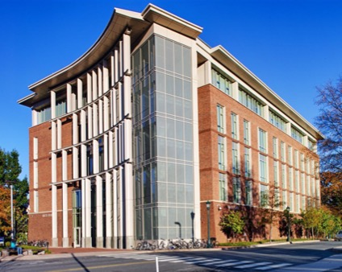
Notes:
Before getting to that, let me remind you why normalizing metadata is important.
We are working with a building management company called Trane, who has developed several powerful "analytics engines".
They want to sell these engines to customers based on the energy savings they can generate.

Slide 3
Challenge to Running an Engine
Hot Water Temp RMI328
Room328
Hot Water
Temperature
......
RMI401 Space Temperature
Room 530
Mixed Air Temperature
Zone 2 MAT RMI530
Notes:
But, as you saw yesterday, it is hard to map the points in a building to the inputs of an analytics engine.
Technicians with domain knowledge need to look at cryptic point names.
Often, they have to actually *visit* the building to "visually inspect" the points... in order to complete this mapping.

Slide 4
Challenge to Running an Engine
Hot Water Temp RMI328
Room328
Hot Water
Temperature
......
RMI401 Space Temperature
Room 530
Mixed Air Temperature
Zone 2 MAT RMI530
Notes:
This process can take a *week or more*... and makes it hard to sell analytics engines.
Techniques introduced from yesterday can significantly reduce this manual mapping process... but they don't eliminate it.
Trane must *still* investment in the customer before it can demonstrate value. This is *not* an easy route to sales.

Slide 5
Challenge to Running an Engine
Hot Water Temp RMI328
Room328
Hot Water
Temperature
......
RMI401 Space Temperature
Room 530
Mixed Air Temperature
Zone 2 MAT RMI530
Notes:
The customer wants to see the expected energy benefits before buying the analytics engine... but Trane can't show the energy benefits without investing a *week or more* of technician labor.

Slide 6
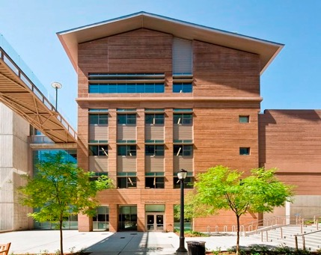
Notes:
We envision a world where a company like Trane would be able to apply their AEs to any building "instantaneously" so that customers can easily see if they want to buy it.
In fact, many analytics engines could effortlessly be applied to the 100's of millions of commercial buildings across the globe. People can choose the engine that works best for their building, and buy that one. This would create a "market" for AEs.

Slide 7
Hot Water Temp RMI328
Room328
Hot Water
Temperature
......
RMI401 Space Temperature
Room 530
Mixed Air Temperature
Zone 2 MAT RMI530
Notes:
However, to achieve this vision, we need to completely eliminate the human from the mapping process.
Even if the resulting process only produces an approximate mapping, it would still be helpful in producing an analytics market.

Slide 8
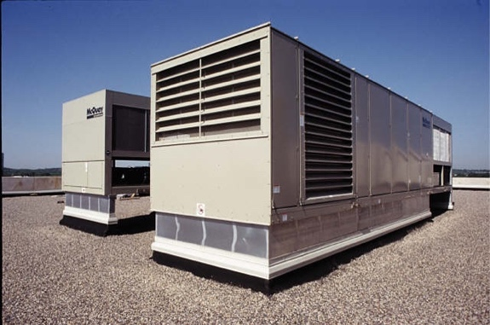
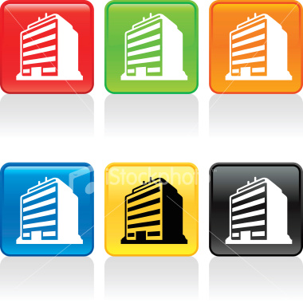


Notes:
The "key insight" behind our solution is that a company like trane will already have many full-labeled buildings.
Given a new bdlg, though no two b are identical, most b are similar to another in one way or another.
For example, one pair of b may have a similar mechanical system while another pair has similar natural light and lighting system. These similarities result in similar values in the raw data streams themselves.

Slide 9
Notes:
Our hypothesis is that we can *automatically* infer the metadata structure of one b given the known metadata structure of another b, even if the two are not exactly identical.
If we have more than one labeled b, that inference will only *get better*.
Next let me walk you thru the detail of our solution.

Slide 10
Transfer learning can eliminate manual labeling from mapping the point names to their types in buildings
Hypothesis

Slide 11
Insight
Labeled Source
Unlabeled Target
Zone1 Temp RMI328
Zone2 Temp RMI304
......
SDH_SF1_R282_RMT
SDH_SF2_R517_RMT
......
Notes:
often we have labeled bldgs to use for prediction of a new bldg
one src of info is pn, a good indicator of type within building but less consistent across
another is data, have sim for same type across bldgs, such as temp 60-70
combine the strength of fd and fn

Slide 12
Transfer Learning
Labeled Source
Unlabeled Target
SDH_SF1_R282_RMT
Probably a mistake!
SDH_SF1_R282_RMT
Notes:
adopt the setting of transfer learning
first learn the characteristics of data from one bldg and apply to the target
these data features can label points, but not perfectly
We want to use the regularity in pn to measure confidence of these labels, bc we believe pt is a good indicator within a bldg.

Slide 13
Step I: Encapsulate Knowledge from Source
Source Building
Target Building
f₁
f₂
…..
Notes:
learn f from src with data
one cannot work well on all due to inductive bias
we train a couple of diff f
how to combine them?
need gt to evaluate the qaulity of f
but no gt

Slide 14
Step II: Clustering on Names in Target Building
Source Building
Target Building
f₁
f₂
Notes:
thus using Fn clusters to approximate

Slide 15
Step III: Weighted Sum Prediction
Source Building
Target Building
Larger weight!
f₁
f₂
Notes:
next step, we want to the use these c structures to help measure the confidence of each f
we apply each f to label the same population
compare to the cluster structure

Slide 16
Step III: Weighted Sum Prediction
Source Building
Target Building
Larger weight!
f₁
f₂

Slide 17
Data Feature
Min,
Max,
…
MIN = [min¹, min², …, min^{N}]
F = [
min(MIN), max(MIN),
median(MIN), var(MIN)
...
]
1
2
…
N

Slide 18
Name Feature
Zone Temp 2 RMI204
keep alphabets
Zone TMP 1 RMI328
{zone, temp, rmi}
k-mers: ABCDEFG -> ABC, BCD, CDE… (k=3)
{zon, one, tmp, rmi}
frequency
count
{zon, one, tem, emp, rmi}
(1,1,0,0,1)
Notes:
for each sensor name, take out nums

Slide 19
Classifier Weighting
Classifier 1
Classifier 2

Slide 20
Classifier Weighting
5/5
2/5
w
# of Common Examples
Total # of Unique Examples
Sim =
Classifier 1
Classifier 2

Slide 21
Thresholding on Weight
# of Common Examples
Total # of Unique Examples
Sim =
Classifier 1
Classifier 2
Sim
> delta

Slide 22
Non-parametric Bayesian Clustering
Notes:
We use GMM, to avoid k then sue NPBC

Slide 23
Evaluation Dataset
3 buildings on 2 campuses
2700+ points
22 types
7 days data
Building A
Building B
Building C

Slide 24
Mapping Accuracy and Coverage
Train on building A and test on building B
Run on three pairs of buildings
Repeat with different weight thresholds
Classifiers - Random Forest, Logistic Regression and SVM
Metrics
- Coverage
- Accuracy
Notes:
to see how it works

Slide 25
Mapping Accuracy (Acc) and Coverage (Cov)
Percentage
Empirically, a threshold around 0.4 can strike a balance btw Acc and Cov
Notes:
The mean similarity reflects confidence
Thresholding on the confidence filters out less confident predictions -> acc up and cov down
Why asymmetric + why some unlabeled

Slide 26
Transfer from A to C
Notes:
Major classes got classified
Can be a base for useful analysis

Slide 27
Combining the two Approaches
Combo: start with fully automated, then switch to active learning
AL Only: simply run active learning
AL Only
Notes:
The diff might look small

Slide 28
Combining Multiple Buildings as Source
More Sources, More Promising!
Notes:
2-3% inc in acc, 2-9% inc in cov
this experiment helps interpret previous results: more srcs give better performance
-> larger diff on previous combo case

Slide 29
Discussion
More buildings as source
Customized data features
Better weighting function
What level of accuracy needed for analytics
Notes:
More bldgs make f more robust to mislabels and offsets in data
Fd is the botteneck
W_f increases cov

Slide 30
Related Work
Bharttacharya et. al – BuildSys’15
Gao et. al – BuildSys’15
Schumann et. al – BuildSys’14
Hong et. al – CIKM’15
Minimizes manual effort
within a building
Notes:
All requires human labeling

Slide 31
Conclusion
Leveraged the complementary attributes of sensors
Developed techniques to automatically map point names
Experimental results on three buildings show the promise of approach

Slide 32
Thanks
Questions?

