Slide 1
Towards Automatic Spatial Verification of Sensor Placement
Dezhi Hong ^{* +}
Jorge Ortiz ⁺
Kamin Whitehouse * ^
David Culler ⁺
*University of Virginia
⁺UC Berkeley
^ Microsoft Research

Slide 2

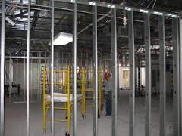
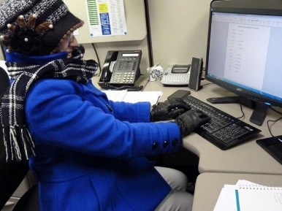

Evolution of Buildings

Slide 3
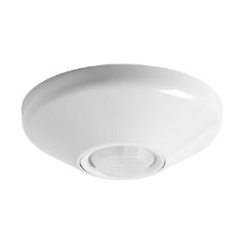
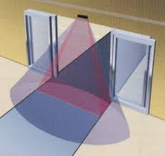
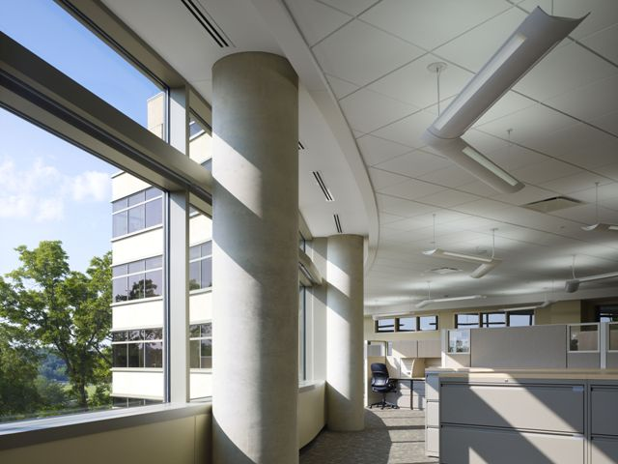
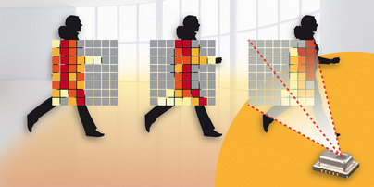
Evolution of Buildings

Slide 4
Hypothesis
The physical boundary between rooms
is detectable as a statistical boundary in the data.

Slide 5
Challenge
Temp from different rooms
Humidity/CO2 from same room

Slide 6
Approach
Temp from different rooms
Humidity/CO2 from same room

Slide 7
Approach
Temp from different rooms
Humidity/CO2 from same room

Slide 8
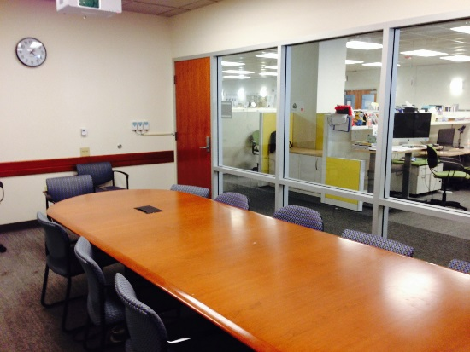
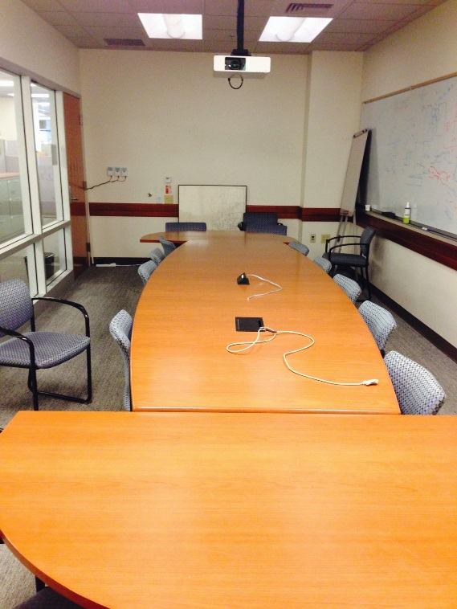
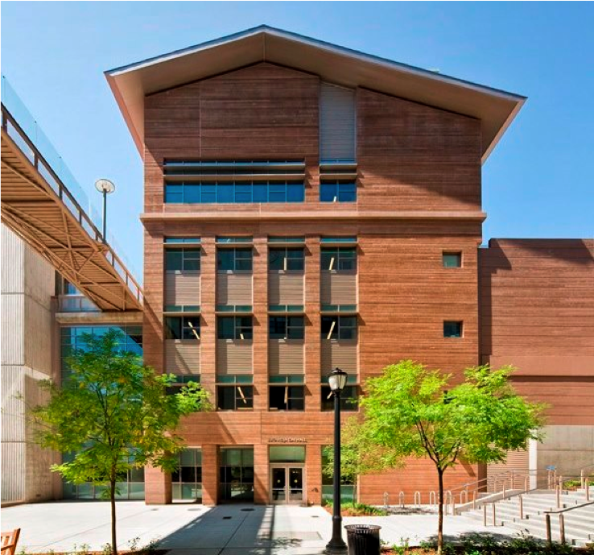
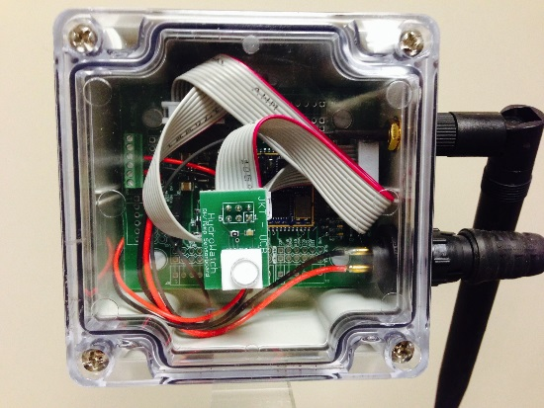
Data Set
5 rooms, 3 sensors/room
Sensor type: temperature, humidity, CO₂
Over a one-month period

Slide 9
Inter/Intra Correlation
CDF
In the same room
In different rooms!
correlation coefficient
correlation coefficient
Notes:
For each room, compute the pairwise corrcoefs over different time spans, and accumulate to get two distributions for the two population, aka, intra and inter
An arbitrary cut-off threshold will split the distribution: the part on the right of the threshold will be considered as in the “same” room, likewise, the part on the left of the line will be clustered as in different rooms.

Slide 10
Threshold Analysis
Mid band correlation
Raw data traces

Slide 11
Convergence

Slide 12
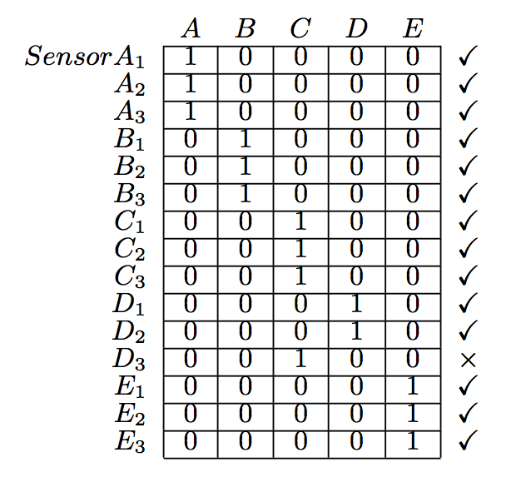
Clustering
14/15 correct = 93.3%
*A-B-C-D-E is used to denote the ground truth location of sensors
Notes:
A-B-C-D-E denotes the ground truth -- where each sensor is

Slide 13
Clustering
Mid-band Frequencies
12/15 correct = 80%
Raw data traces
8/15 correct = 53.3%

Slide 14
Future Work
Extended from 5 rooms to ~100 rooms
It didn’t work ☹
Open questions:
What new techniques can improve results?
What is the boundary that can be found?

Slide 15
Related Work
Strip, Bind, Search - IPSN’13
Fontugne, et al
Smart Blueprints - Pervasive’12
Lu, et al
SMART - Ubicomp’12
Kapitanova, et al
Wireless Snooping Attack – UbiComp’08
Srinivasan, et al
Notes:
IPSN’13 work takes the advantages of EMD and re-aggregate the IMFs based on separated bins. They build a reference model out of the EMD+IMF analysis and raise an alert when sensor readings deviate from the norm.
Pervasive’12 work (Lu) proposes a solution to constructing the sensor map in a home setting: first figure out the room arrangement with motion sensor data and then assign each sensor into a room.
Ubicomp’13 work (Kapitanova) formulates an approach by training the classifiers on historical sensor data and is able to detect sensor failure or movement.

Slide 16
Summary
A statistical boundary emerges in the early study on a small data set
The method may be empirically generalizable
Extensions and modifications to the solution are needed to verify the generalizability

Slide 17
Questions?
Thank You

Slide 18
Well…
The early promising results from a small data set are not conclusive due to
Location of the room
Usage of the room
# of rooms

Slide 19
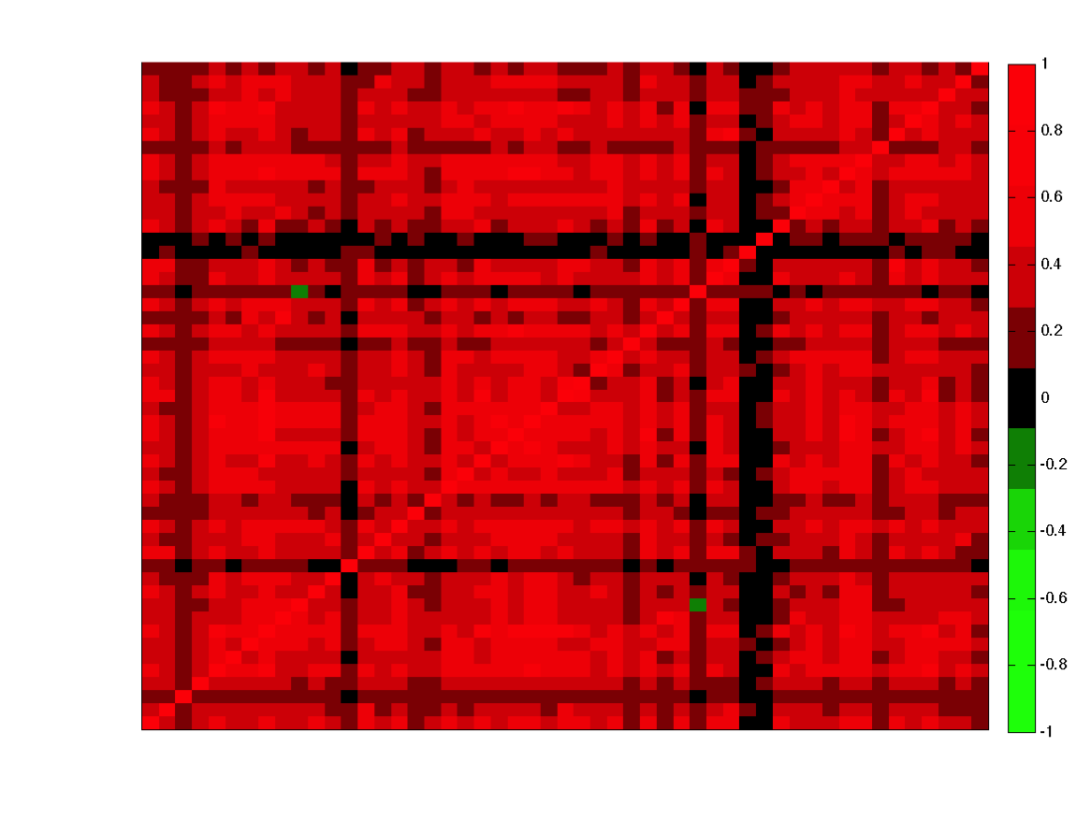
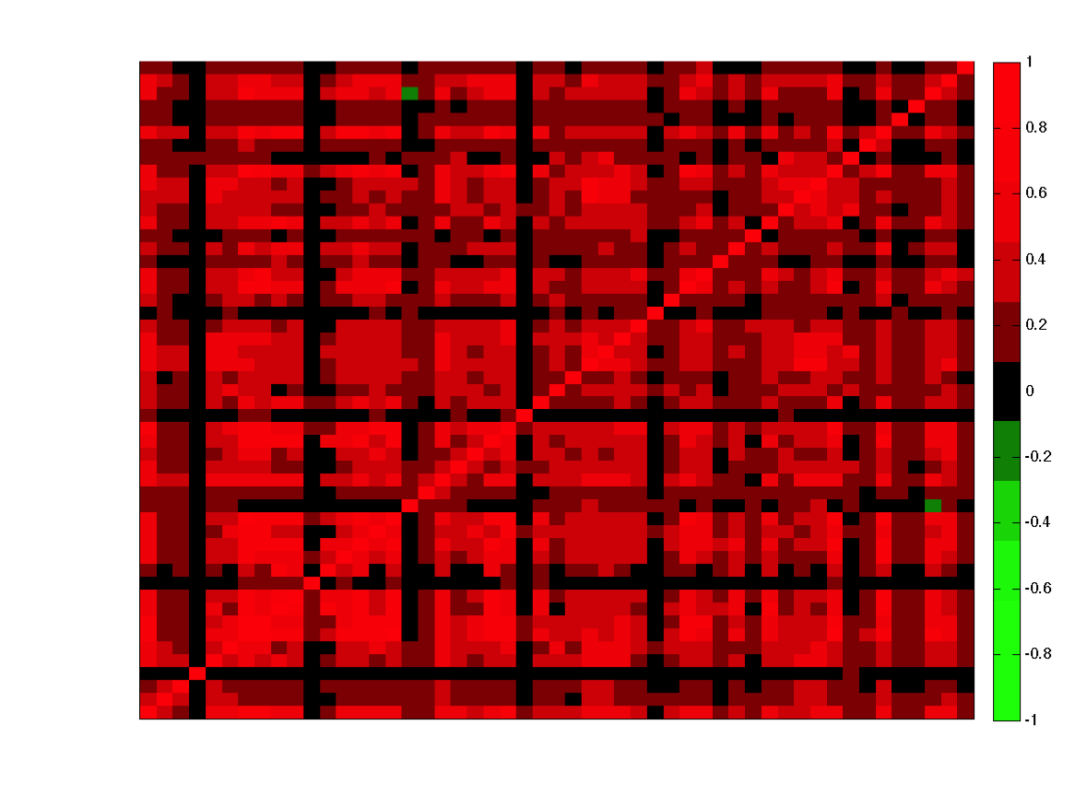
Questions@a large scale
“Noise” from the same type of sensors
Same type of sensors correlate highly
Corrcoef across rooms
Room ID
Room ID
Humidity
Temperature
*Both the X and Y axes are arranged by room ID in the same order
Notes:
New results from a larger data set expose some challenges (204 traces in 51 rooms)
Humidity and temperature in diff rooms across different floors are highly correlated in the mid-frequency IMF band, which poses barriers to the threshold-based clustering approach.

Slide 20
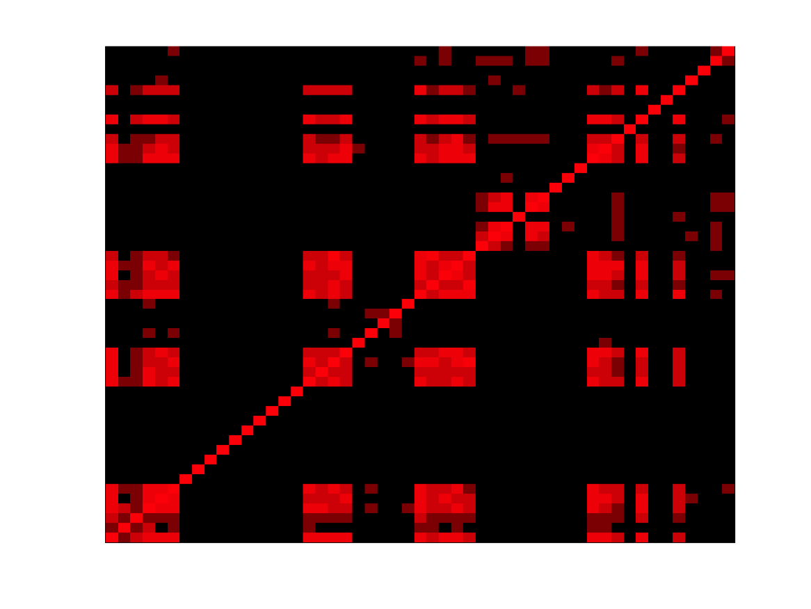
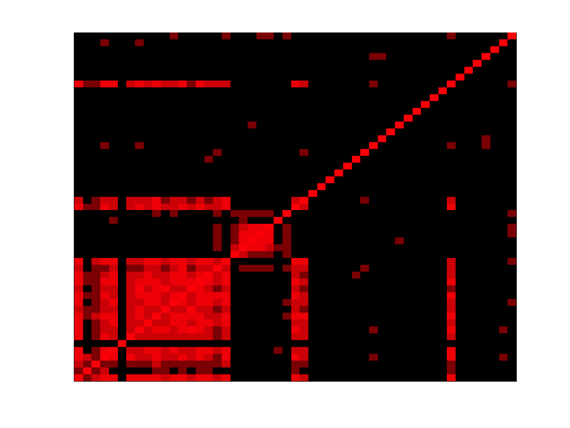
Questions@a large scale
Some “light” on light
False Negative!
By Room ID
By Orientation
Notes:
To show that humidity and temperature in diff rooms across diff floors are highly correlated in the mid-frequency IMF band, which poses difficulty on the threshold-based clustering approach

