Slide 1
A Feasibility Study: Mining Daily Traces
For Home Heating Control
Dezhi Hong, Kamin Whitehouse
University of Virginia

Slide 2
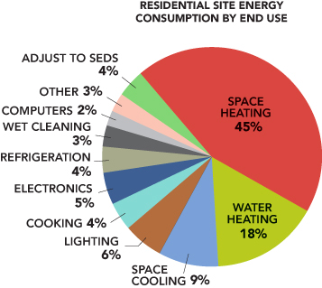
Motivation
Building Energy Data Book, 2011
U.S. Department of Energy
Notes:
54% of site energy consumption
43% of primary energy consumption

Slide 3
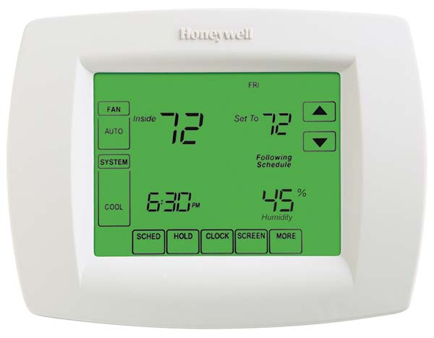
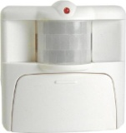
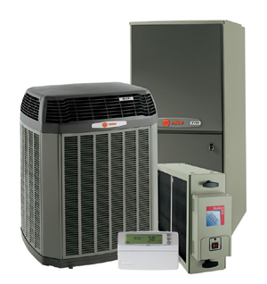



Smart Thermostat, SenSys’10
Temperature (ºF)
Fast reaction
Preheating
75
70
65
60
55
Home
Home
00:00
08:00
18:00
24:00
Notes:
Automatically turn ON/OFF to save energy

Slide 4
“How much energy can be saved
with better prediction of arrival times?”

Slide 5
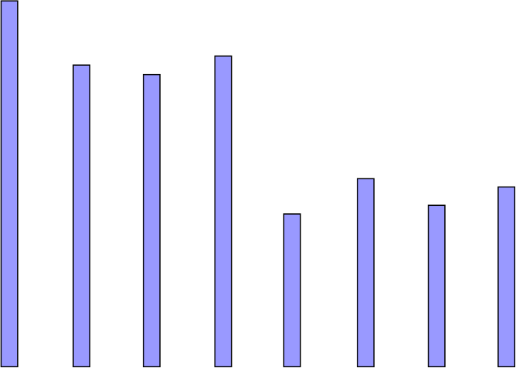
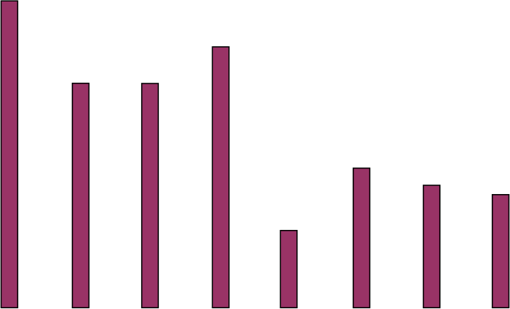
Energy Savings
60
Optimal
Energy Savings (%)
50
Smart
40
Optimal: 35.9%
30
Smart: 28.8%
20
10
0
A
B
C
D
E
F
G
H
Home Deployments
Notes:
space for improvement
Use information of a day, the GPS location info.
Smart Thermo as baseline

Slide 6
State of the Art
GPS Thermostat, Pervasive’09
  Estimate travel-to-home time
  Dynamically adjust heating
  Simple programmable and manual baseline
  6% savings

Slide 7
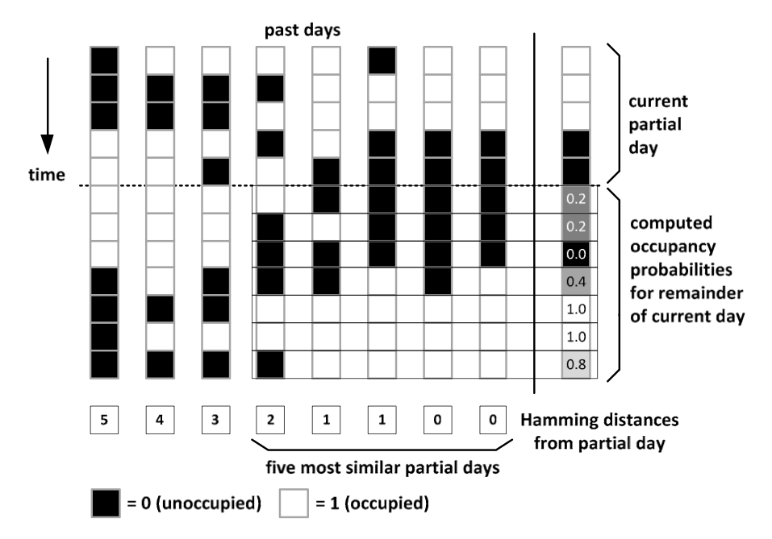
State of the Art
PreHeat, Ubicomp’11
  Compute the future occupancy Pr.
  A programmable baseline with fixed schedule
  Save 8%~18% gas

Slide 8


State of the Art
 | Info. outside home | History
GPS Thermostat
PreHeat Smart Thermostat
Our Approach

Slide 9
Rest of the talk
Approach
  Conditional model
Evaluation
  Arrival time prediction error
  Gross energy savings
  Miss time

Slide 10



Approach Overview
12am
9am
6pm
7pm
12am
  time@leave the HOUSE
  time@leave the OFFICE
  allow error range ε
……
……
……
Home
Work
Home

Slide 11
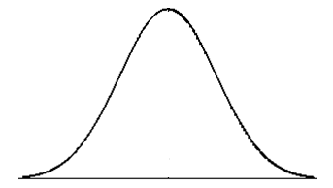
Approach
Conditional Model
  time@leave the HOUSE
  time@leave the OFFICE
  different error range ε
Prediction error in arrival time
Error Distribution
-200 min
0 minute
200 min
Notes:
Conditional model looks for similar days
An object weave everything up

Slide 12
Data Source
Yohan Chon et.al Ubicomp’12
Continuously run in background
Ground truth is manually labeled
4 persons, 120~140 days
Notes:
Pre-process

Slide 13
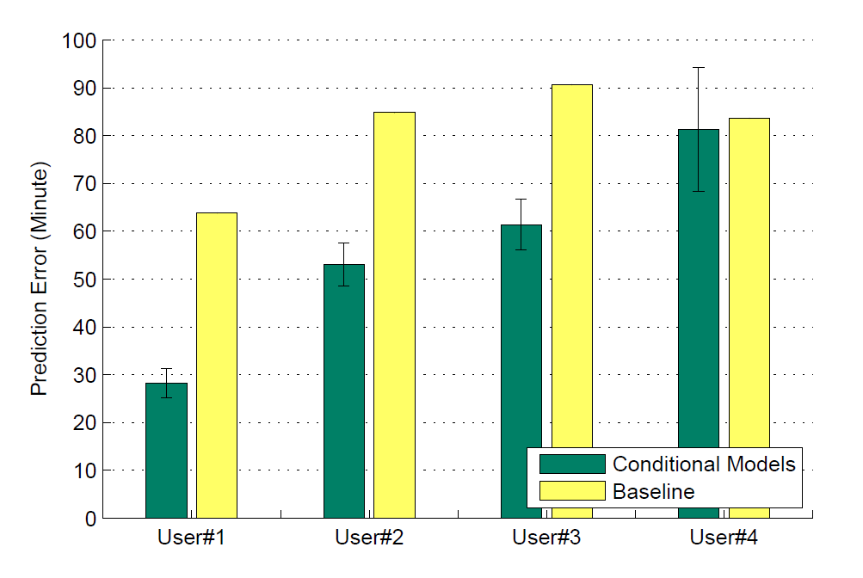
Evaluation
Error of Arrival Time Prediction
2.7%~55.8%
lower errors
Notes:
We might make both early and late predictions

Slide 14
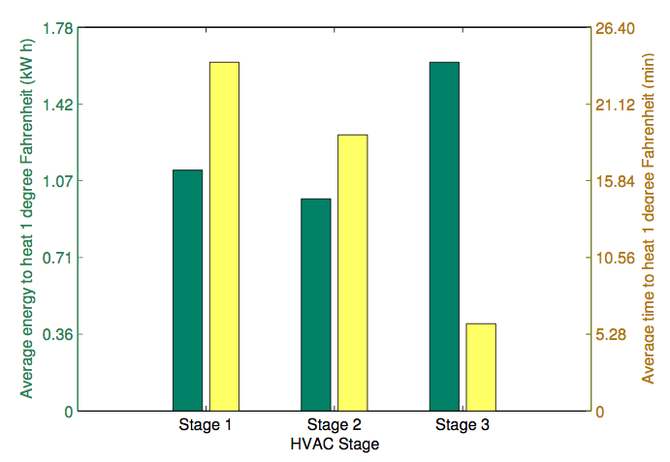
Evaluation
Different Heating Stages
Smart Thermostat, Sensys’12
Preheat
24 min + 1.1 kWh
Maintain
18 min + 0.9 kWh
React
6 min + 1.6 kWh
Notes:
In stage 2, which is maintaining the temperature in the house, we assume the temp drops by 1 degree in 18 minutes, which makes the HVAC operate at a 0.5 duty-cycle rate
Early and late predictions waste energy in diff stages

Slide 15
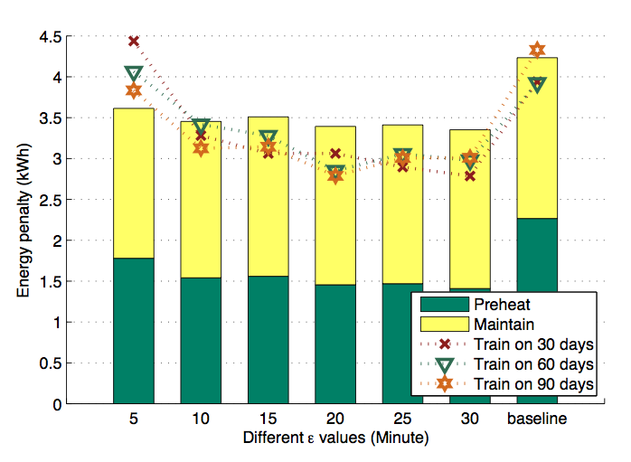
Evaluation
Energy Savings and # of Training Days
8.3% to 27.9%
savings than baseline
Notes:
Converge
Small diff from optimal epsilon

Slide 16
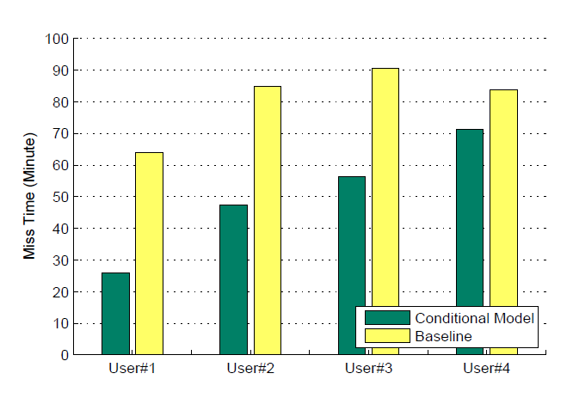
Evaluation
Miss Time
14.9%~59.2%
reduction in miss time
Error Distribution
-200 min
0 minute
+200 min

Slide 17
Take-Aways
Mining Daily Mobility Traces
Energy Savings
Notes:
----- Meeting Notes (4/5/13 13:59) -----
move to approach
like outline

Slide 18
Conclusions
Daily mobility traces
A conditional model, we achieve
  potential savings: 8.3%~27.9%, on average
  miss time: 14.9%~59.2% reduction
Future Work
  Seasonal weather change
  Other locations in GPS trajectory

Slide 19
Q & A
Thank you!

