Slide 1
Scalable Analytics Project
LSH – Plagiarism Detection
Dana Tabatabaie Irani ​
Faroukh Davouzov​
Youri Langhendries​
​

Slide 2
Table of Contents
Research questions
Datasets
Preprocessing
LSH
Evaluation
Scalability
Socio-ethical concerns
Conclusion

Slide 3
Research Questions
RQ1: How effective is LSH in detecting plagiarism?
H1: LSH is highly effective in detecting plagiarism due to efficient similarity searches.
RQ2: Which shingling approach is most suitable?
H2: Character-based shingling approaches are more suitable as they capture general patterns.
RQ3: Which benefits does preprocessing offer?
H3: Preprocessing improves accuracy and efficiency by reducing noise and document size.
RQ4: How does summarising documents affect the performance of an LSH tool?
H4: Summarising leads to a justified trade-off between performance and efficiency.

Slide 4
Research Questions
RQ1: How effective is LSH in detecting plagiarism?
H1: LSH is highly effective in detecting plagiarism due to efficient similarity searches.
RQ2: Which shingling approach is most suitable?
H2: Character-based shingling approaches are more suitable as they capture general patterns.
RQ3: Which benefits does preprocessing offer?
H3: Preprocessing improves accuracy and efficiency by reducing noise and document size.
RQ4: How does summarising documents affect the performance of an LSH tool?
H4: Summarising leads to a justified trade-off between performance and efficiency.

Slide 5
Research Questions
RQ1: How effective is LSH in detecting plagiarism?
H1: LSH is highly effective in detecting plagiarism due to efficient similarity searches.
RQ2: Which shingling approach is most suitable?
H2: Character-based shingling approaches are more suitable as they capture general patterns.
RQ3: Which benefits does preprocessing offer?
H3: Preprocessing improves accuracy and efficiency by reducing noise and document size.
RQ4: How does summarising documents affect the performance of an LSH tool?
H4: Summarising leads to a justified trade-off between performance and efficiency.

Slide 6
Research Questions
RQ1: How effective is LSH in detecting plagiarism?
H1: LSH is highly effective in detecting plagiarism due to efficient similarity searches.
RQ2: Which shingling approach is most suitable?
H2: Character-based shingling approaches are more suitable as they capture general patterns.
RQ3: Which benefits does preprocessing offer?
H3: Preprocessing improves accuracy and efficiency by reducing noise and document size.
RQ4: How does summarising documents affect the performance of an LSH tool?
H4: Summarising leads to a justified trade-off between performance and efficiency.

Slide 7
Datasets
Criteria
2 Document Types: original and suspicious
Labelled Data: ground truth document
Identified Datasets
English Wikipedia Articles
PAN Plagiarism Corpus Dataset
Java Dataset

Slide 8
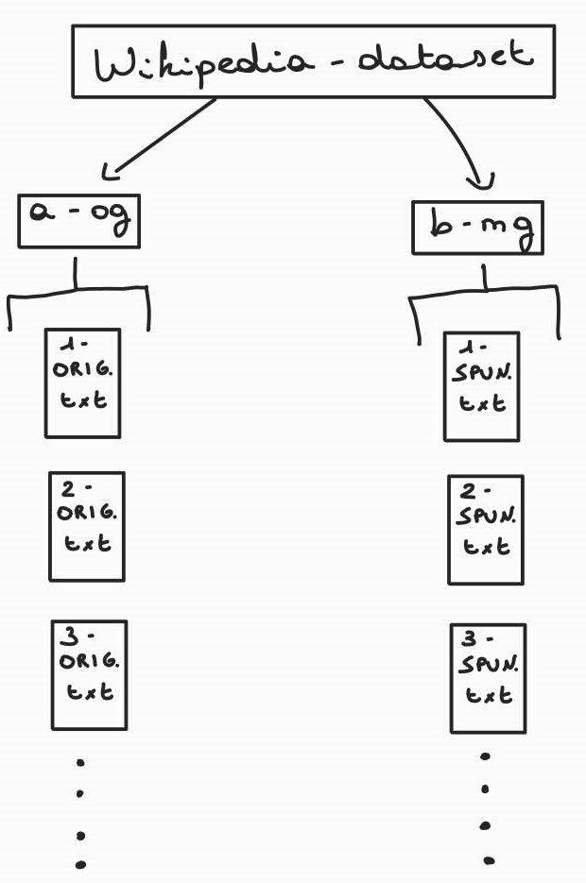
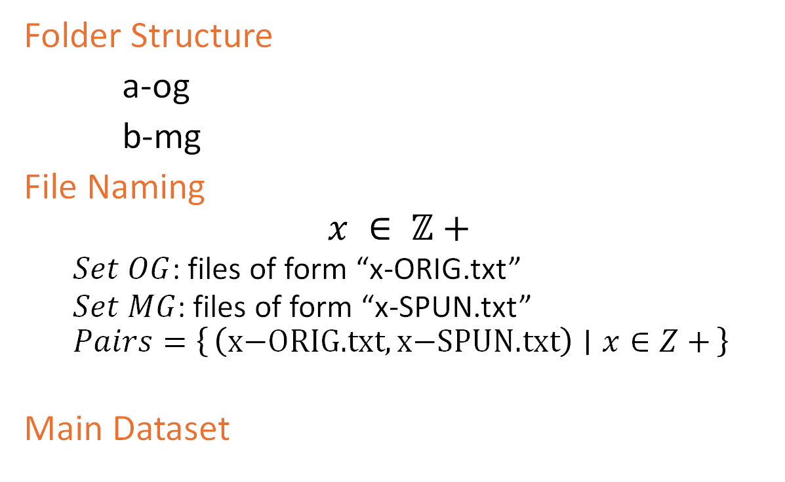
Wikipedia Dataset
Folder Structure
a-og
b-mg
File Naming
$$x ∈ ℤ+$$
$Set OG$: files of form “x-ORIG.txt”
$Set MG$: files of form “x-SPUN.txt”
$$Pairs=\left\{\left(\text{x}\text{−}\text{ORIG}\text{.}\text{txt},\text{x}\text{−}\text{SPUN}\text{.}\text{txt}\right) ∣ x∈Z+\right\}$$
Main Dataset

Slide 9
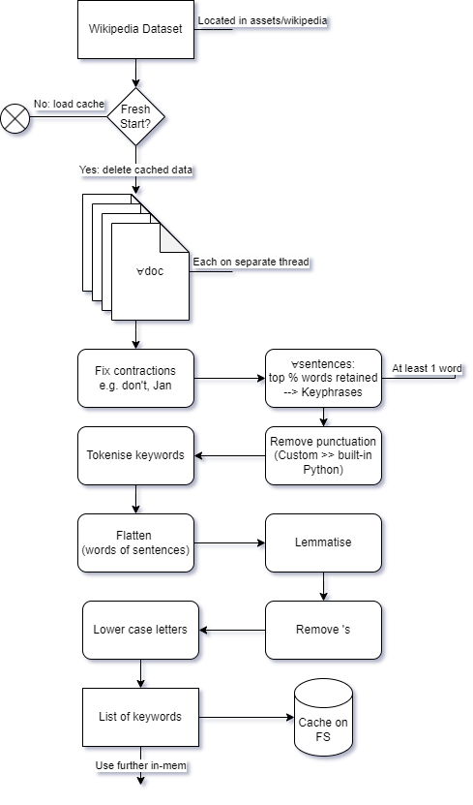
Preprocessing
List of Keywords cached on FS
Also used for paraphrasing:
# 20% probability for each word to be paraphrased
for i in range(PARAPHRASE_COUNT):
paraphrased_data = paraphrase_keywords(data)
cache_result(paraphrased_data)

Slide 10
LSH Model
Optimise model with exhaustive grid search over:
SHINGLE_SIZE,
WINDOW_STEP,
N_HASH,
N_BANDS,
K
Tokens can be words or characters
if WORD_BASED:
word_based_shingle(docs)
else
character_based_shingle(docs)

Slide 11
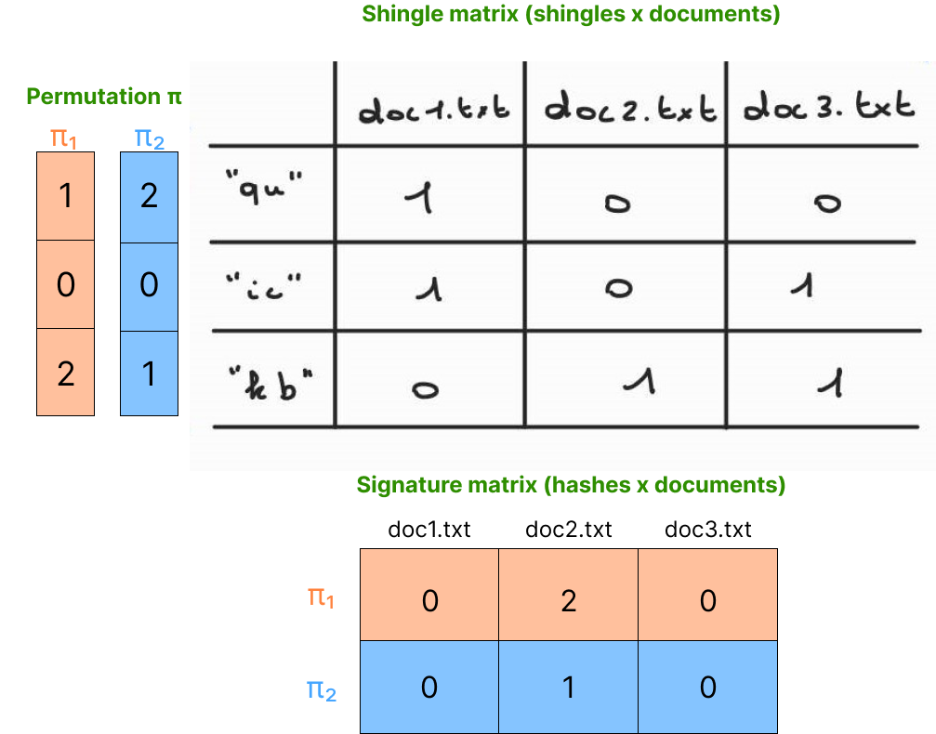
LSH Model - Shingling
Convert documents to sets of tokens
Implement sparse matrix to reduce memory overhead
For each shingle in a document, add a 1 to the matrix
Compress shingles to reduce size

Slide 12
LSH Model - MinHashing
Convert large sets to small signatures preserving similarity
One-pass implementation
Broadcasting to update hashes of each document
757% performance increase (150 documents of corpus data)
sig[:, docs_with_shingle_indices] = np.minimum(
sig[:, docs_with_shingle_indices], hashes[:, np.newaxis]
)
Notes:
from 120s to 14s

Slide 13
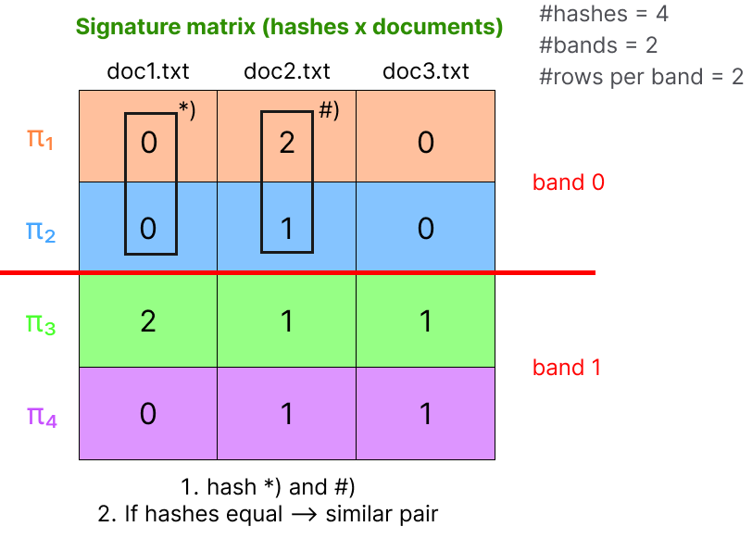
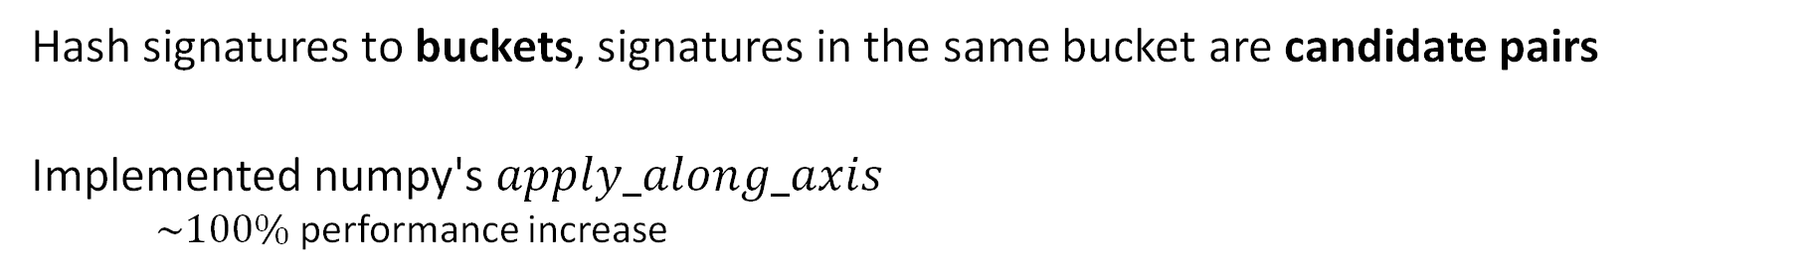
LSH Model - LSH
Hash signatures to buckets, signatures in the same bucket are candidate pairs
Implemented numpy's $apply_along_axis$
$\sim 100\%$performance increase
Note
(1): Filter out pairs: (doc₁, doc₁_para₂).
(2): Change (doc₁_para₂, doc₁_source) pairs to
(doc₁, doc₁_source)
Notes:
90 seconds to 0.05 seconds.

Slide 14
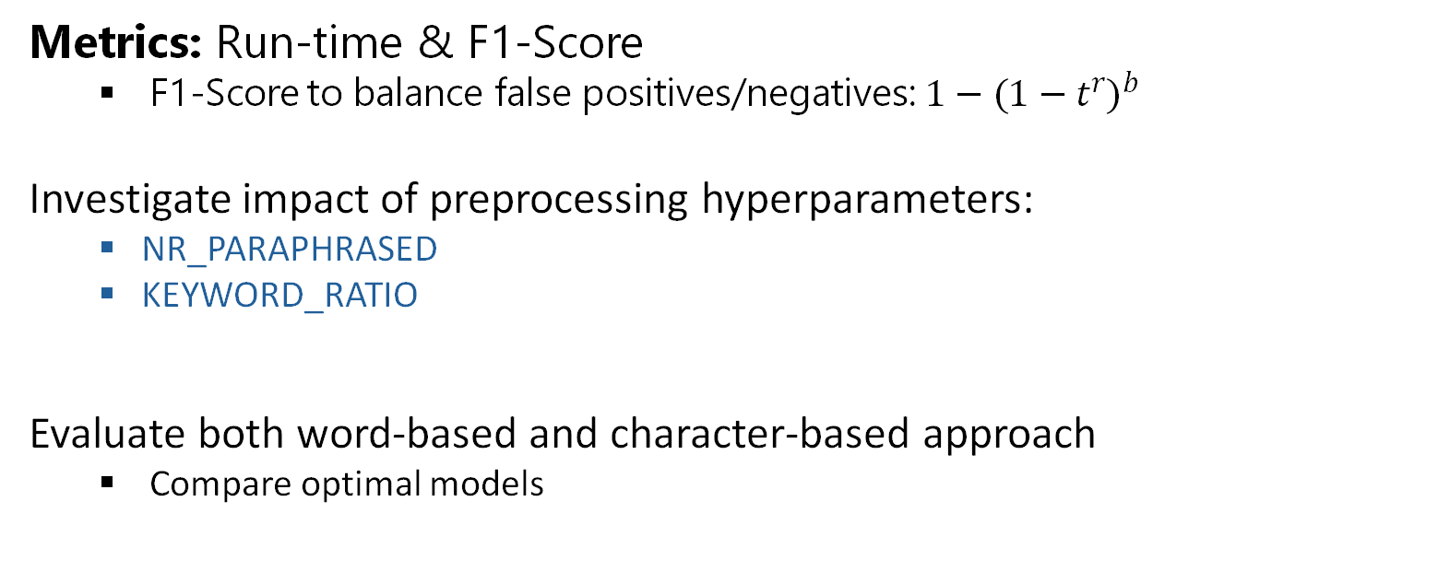
Evaluation
Metrics: Run-time & F1-Score
F1-Score to balance false positives/negatives: $1−(1−tr)b$
Investigate impact of preprocessing hyperparameters:
NR_PARAPHRASED
KEYWORD_RATIO
Evaluate both word-based and character-based approach
Compare optimal models

Slide 15
Evaluation - Raw data
No preprocessing: No stop-word removal, full sentences, no additional versions
Word-based approach
Run-time: 16s
F1-score: 0.58
Character-based approach
Run-time: 14s
F1-score: 0.56
VS.
Note
Results are from best F1 scores.

Slide 16
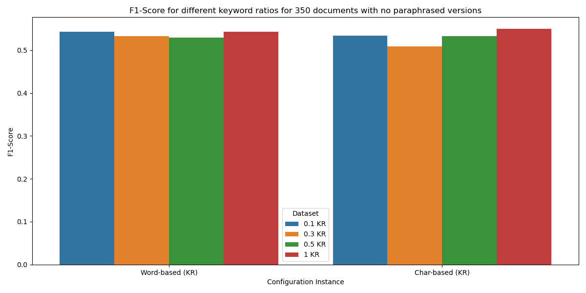
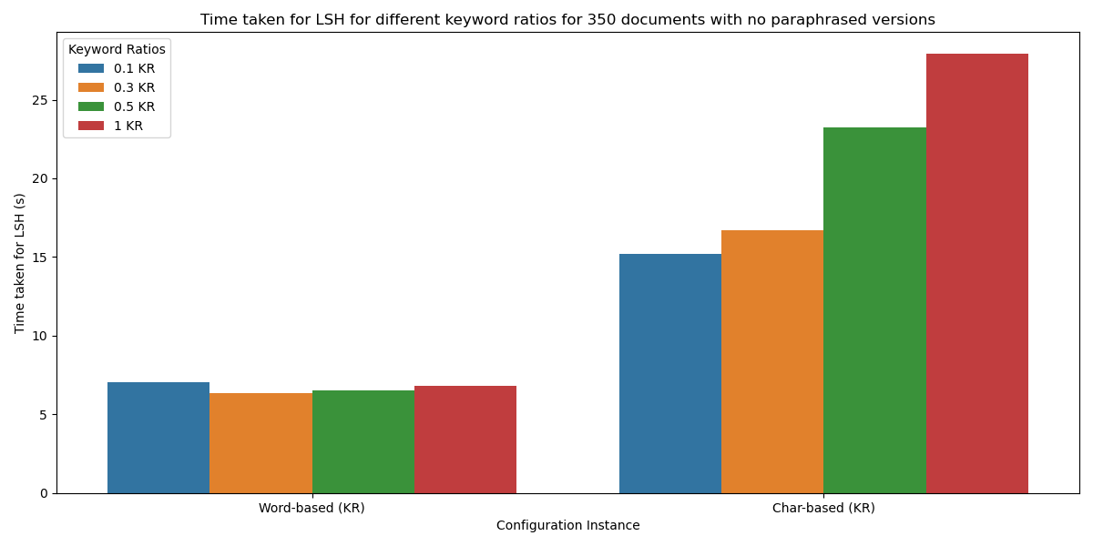
Evaluation - Varying Keyword Ratio
Word-based takes 5x less time with similar F1-scores

Slide 17
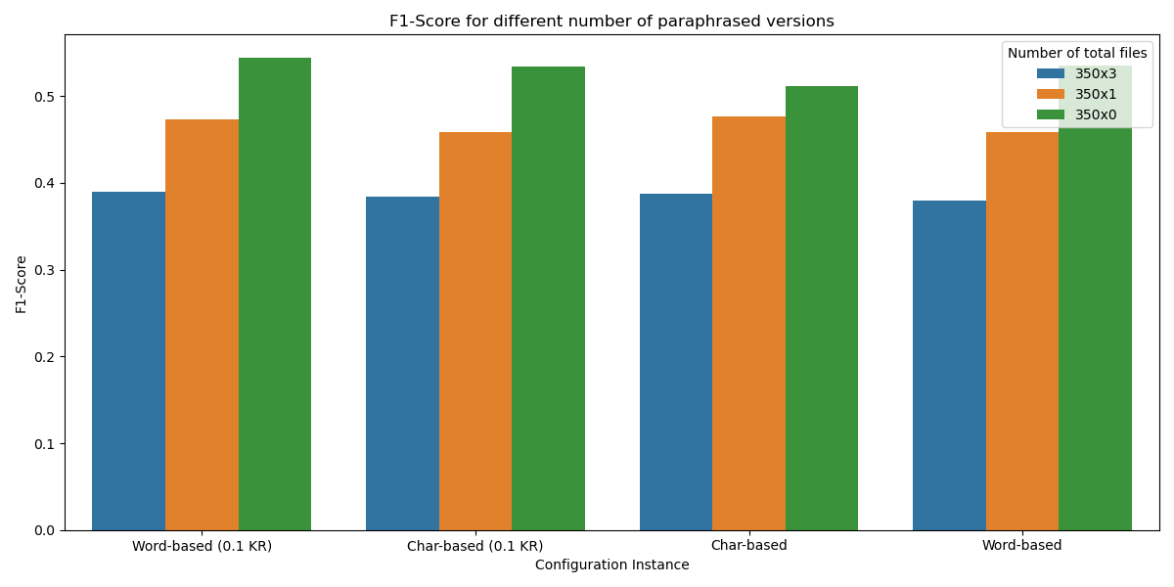
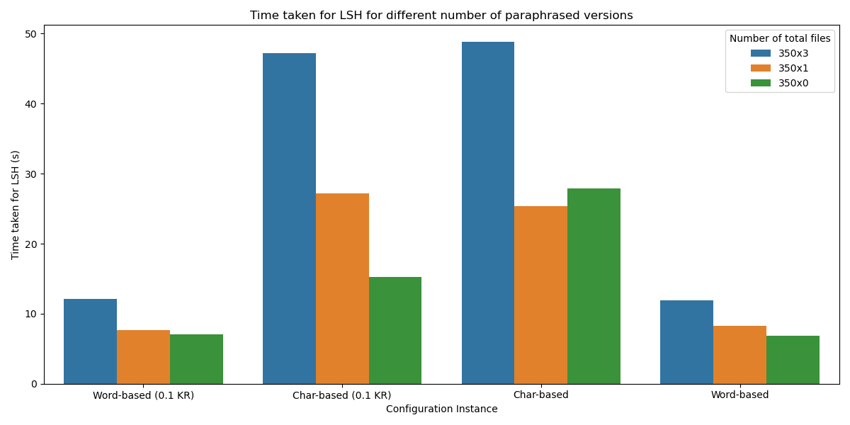
Evaluation - Number of Paraphrased Versions
Negative correlation with F1-Score and run-time
Additional versions creates unwanted pairs

Slide 18
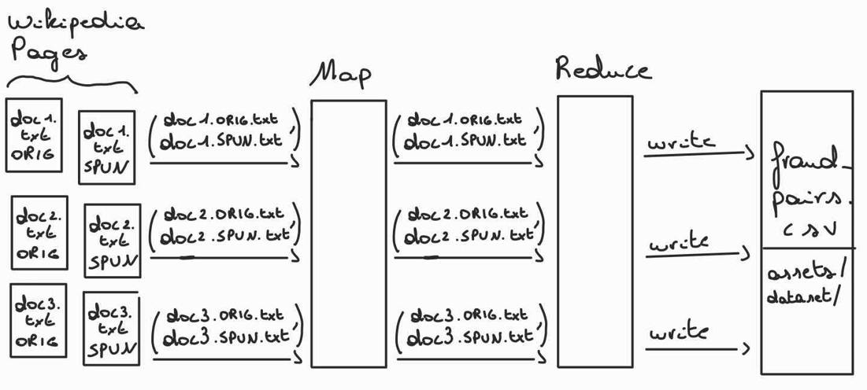
Scalability - Data Extraction

Slide 19
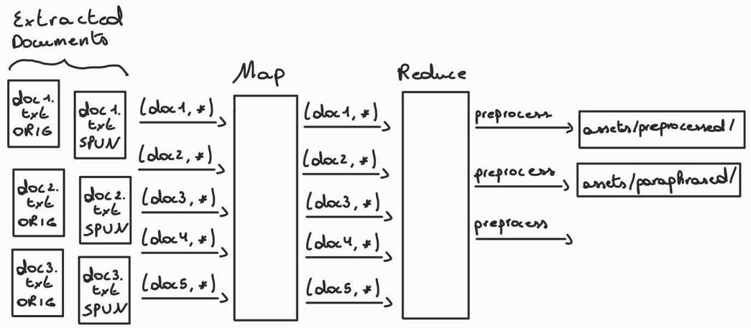
Scalability - Preprocessing

Slide 20
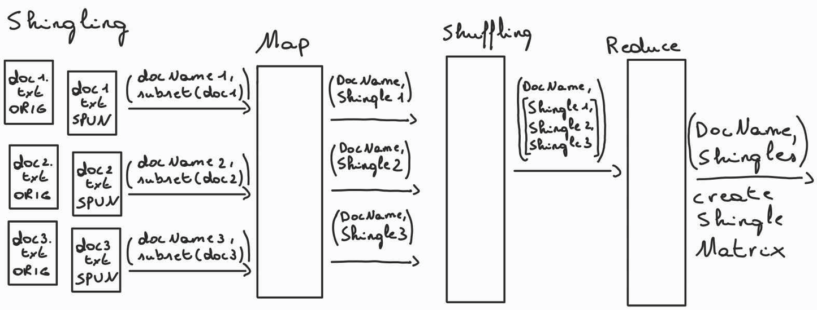
Scalability - Shingling

Slide 21
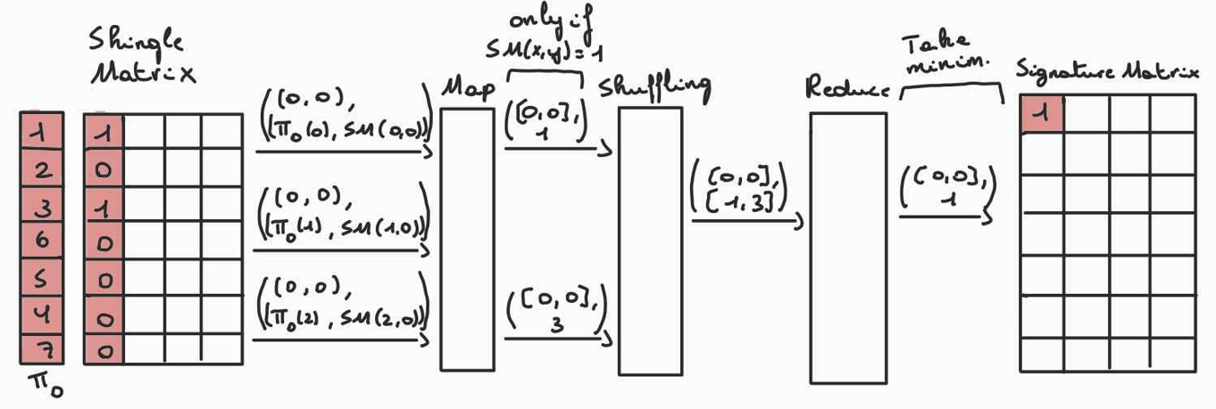
Scalability - MinHashing

Slide 22
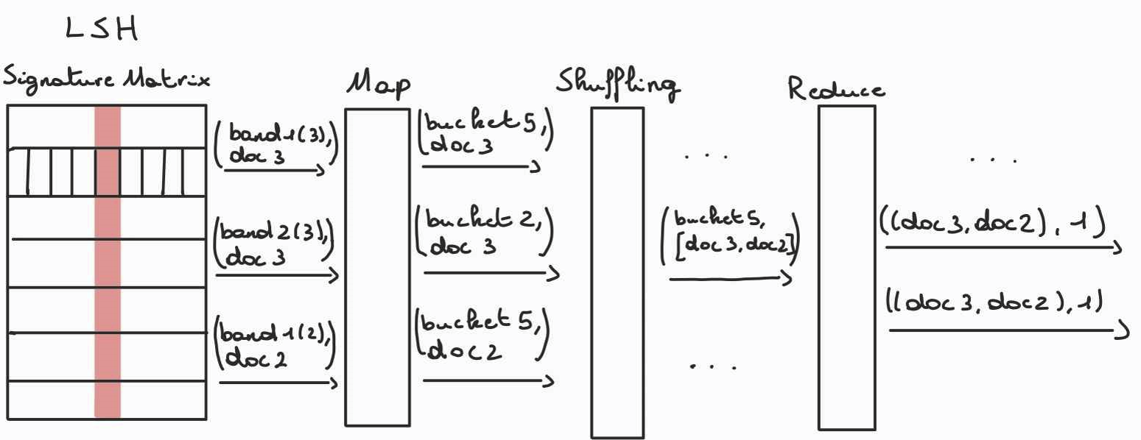
Scalability - LSH

Slide 23
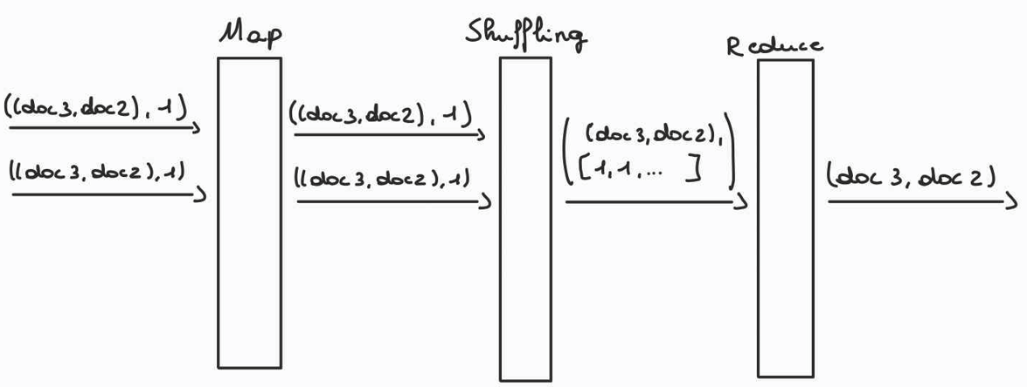
Scalability - LSH

Slide 24
Socio-ethical challenges
Privacy and Data Security
Data encryption, anonymization techniques
Fairness and bias
Preprocessing, tokenization
Lack of transparency
Document, explain algorithm
Notes:
Privacy and Data Security
Implementing LSH-based plagiarism requires handling large datasets with sensitive or private information. It could raise concerns about privacy and data security. That is why as mitigation we could use robust data encryption and anonymization techniques.
Fairness and Bias
To have less bias and make it fairer, because students or other people could rephrase a word in multiple ways or add extra stop words etc... Because we preprocess and tokenize our keywords, we don’t have this problem.
Transparency and Accountability
Another concern could be the lack of transparency in how the plagiarism detection algorithm works. This could lead to mistrust. That is why a clear documentation and explanation of the working of the algorithm such as how it processes and analyses data would lessen this.

Slide 25
Conclusion
LSH is effective in identifying near-duplicates
Word-based approach 5x faster with similar accuracy
Theoretically, preprocessing reduces size and noise with no significant effect on F1-Score
Number of paraphrased versions negative correlation with run-time & accuracy
Reducing keyword ratio reduces run-time by 50% without compromising accuracy

