Slide 1
Chapter 2
Problem Solving and Algorithm
BIC 10204 : ALGORITHM AND PROGRAMMING

Slide 2




Introduction to Computer Programming
PROGRAMMING COMPONENT
HISTORY
PROGRAMMING LANGUAGES
DEVELOPMENT LIFECYCLE

Slide 3
Introduction to Computer Programming
Maintain & Update
Problem
Test & Verify
Analysis
Implement
Design
DEVELOPMENT LIFECYCLE

Slide 4

Problem
Gain a clear understanding of what are required for its solution.
What is the problem?
State the problem clearly
Is it possible to solve the problem with programming?
PROBLEM

Slide 5
Problem
EXAMPLE 1
Identify the problem
PROBLEM
Given the value of x is 10 and a is 12,
find the result of the following equation:
y = 2x + a - 6
How to solve the problem?

Slide 6
Problem
EXAMPLE 1
Given the value of x is 10 and a is 12,
find the result of the following equation:
y = 2x + a - 6
Problem:
Data:
Solution:
Find the value of y.
x = 10, a = 12
Calculate y
SOLUTION

Slide 7

Analysis
Input
data
IPO
Analyze problem
Process
requirements/constraints
Output
desired results

Slide 8
Analysis
EXAMPLE 1
Given the value of x is 10 and a is 12,
find the result of the following equation:
y = 2x + a - 6
Input
data
x = 10, a = 12
Replace x and a
y = 2x + a - 6
Process
Requirements/constraints
Analyze problem
Output
Desired results
Value of y

Slide 9
Example 2
Uncle Chen wants to buy 5 cans of paint from
Linda’s shop. The price for each of the paint can is RM 15.60. Calculate the total price of all
the paint cans.
PROBLEM |  | ANALYSIS
Problem |  | Input
Data |  | Process
Solution |  | Output
What is the price for 5 cans of paint?
1 can paint = RM 15.60
No. of cans = 5
1 can paint = RM 15.60
Total price cans of paint = RM 15.60 x 5
Calculate the total price
Total price 5 cans of paint

Slide 10
Example 3
Madam Sue needs to determine her students grade for programming subject based on the mark scored during final examination. The ‘A’ grade will be given if the mark scored is between 85 to 100. If a student has scored 90 marks, what is the grade should Madam Sue give to the student?
PROBLEM |  | ANALYSIS
Problem |  | Input
Data |  | Process
Solution |  | Output
What is the grade for student who scored 90 marks
Mark = 90
Student marks
A = if 85 < mark < 100
Determine grade based on marks
Grade for students with 90 marks

Slide 11
Exercise 1
Given the following formula, calculate the porosity of rock pure volume = 12.5 while total rock volume = 55:
porosity = (pure volume /total rock volume) x 100%
Specify and analyze the problem

Slide 12
Exercise 1
Given the following formula, calculate the porosity of rock if the pure volume = 12.5 while total rock volume = 55:
porosity = (pure volume /total rock volume) x 100%
Specify and analyze the problem
PROBLEM |  | ANALYSIS
Problem |  | Input
Data |  | Process
Solution |  | Output
How to know the porosity of rock?
Pure volume = 12.5 total rock volume = 55
Pure volume and total rock volume
Porosity = (pure volume/total rock volume) x 100%
Determine the porosity of rock
Porosity of the given pure volume and total rock volume

Slide 13
Exercise 2
Compute and display the total cost of apples,
if given the number of pounds of apples purchased and the cost of apples per pound

Slide 14
Exercise 2
Compute and display the total cost of apples,
if given the number of pounds of apples
purchased and the cost of apples per pound
PROBLEM |  | ANALYSIS
Problem |  | Input
Data |  | Process
Solution |  | Output
What is the total cost of apples purchased?
No. of pounds of apples purchased and cost per pound
No. of pounds of apples purchased and cost per pound
Total cost of apples = no. of pounds x cos per pound
Determine the total cost of apples
Total cost of apples for the given no. of pounds of apples and the cost per pounds

Slide 15

Design
Solve problem
Algorithm
List of steps
Design algorithm
develop
Verify it solves the problem

Slide 16
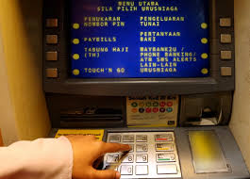
Real System Example
List of steps
Insert ATM card
Select language
Enter pin number
Select withdrawal
Enter amount of money to withdraw
Get returning bank
card
Obtain receipt/money
BANK
ATM

Slide 17



Techniques to Design
Pseudocode
Flowchart

Slide 18
Simple codes which resembles program code that will be written during implementation phase (program coding)
Natural Language
A text-based design tool that helps programmers to develop algorithm
Pseudocode

Slide 19
Consists of a statement of instructions in sequence.
Every steps consists of keyword which explain the actions/
operation/process to be executed by computers
Pseudocode Rules
Every steps should be written in different steps, if continued, the next row must be indented.
Can use if/else for conditional statement and while, do/while and for repetition statement
Every steps should use clear statements and easy to understand.
Use start to represent the beginning of the operation and end to show the end of the operation.

Slide 20
Example 1
Given the value of x is 10 and a is 12,
find the result of the following equation:
y = 2x + a - 6
Input
data
Pseudocode?
x = 10, a = 12
start
read the value of x
read the value of a
compute the value of y as y = 2x + a -6
display/print the value of y
end
Process
Requirements/constraints
Replace x and a
y = 2x + a - 6
Output
Desired results
Value of y

Slide 21
Example 2
Uncle Chen wants to buy 5 cans of paint from
Linda’s shop. The price for each of the paint can is RM 15.60. Calculate the total price of all
the paint cans.
Pseudocode?
ANALYSIS
Input
Process
Output
1 can paint = RM 15.60
No. of cans = 5
start
set price as 15.60
read the number of cans
compute the total price as price per can
times by number of cans
display/print the total price
end
Total price cans of paint = RM 15.60 x 5
Total price 5 cans of paint

Slide 22
Example 3
Madam Sue needs to determine her students grade for programming subject based on the mark scored during final examination. The ‘A’ grade will be given if the mark scored is between 85 to 100. If a student has scored 90 marks, what is the grade should Madam Sue give to the student?
Pseudocode?
ANALYSIS
Input
Process
Output
start
read the student mark
if mark is greater than 85 and mark
is less than 100, then
set grade as A
display/print the grade
end
Mark = 90
A = if 85 < mark < 100
Grade for students with 90 marks

Slide 23
Exercise 1
Given the following formula, calculate the porosity of rock if the pure volume = 12.5 while total rock volume = 55:
porosity = (pure volume /total rock volume) x 100%
Specify and analyze the problem
Pseudocode?
ANALYSIS
Input
Process
Output
Pure volume = 12.5 total rock volume = 55
start
read the number of pure volume
read the total rock volume
compute the value of total porosity as
total porosity = (number of
pure volume divided by total rock volume)
times by 100%
display/print the total porosity
end
Porosity = (pure volume/total rock volume) x 100%
Porosity of the given pure volume and total rock volume

Slide 24
Exercise 2
Compute and display the total cost of apples,
if given the number of pounds of apples
purchased and the cost of apples per pound
Pseudocode?
ANALYSIS
Input
Process
Output
No. of pounds of apples purchased and cost per pound
start
read the number of apples purchased
read the cost of apples per pound
compute the total cost as number of
apples purchased
times by cost of apples per pound
display/print the total cost
end
Total cost of apples = no. of pounds x cos per pound
Total cost of apples for the given no. of pounds of apples and the cost per pounds

Slide 25
Exercise 3
A box has height, width and length.
Write the pseudo code to calculate the volume of a box.
Pseudocode?
ANALYSIS
Input
Process
Output
height
width
length
start
read the height
read the width
read the length
compute the box volume as height
times by width times by length
display/print the total volume of box
end
Box volume = height x width x length
Total volume of box

Slide 26
Exercise 4
Write the pseudo code to calculate salary of
an employee for a month.
Pseudocode?
ANALYSIS
Input
Process
Output
Salary per day
No of day per month
start
read the salary per day
read the no. of day per month
compute the total salary as salary per day
times by no. of day per month
display/print the total salary
end
Salary = salary per day x no. of day per month
Total salary

Slide 27
1. Helps to visualize the content/steps better or to find flaws in process
2. Illustrate the steps in the process
Symbol
Schematic representation of an algorithm or process
Flowchart

Slide 28
 | Start/Stop The terminator symbol marks the starting or ending point of the system. It usually contains the word "Start" or "End."
 | Action or Process A box can represent a single step ("add two cups of flour"), or and entire sub-process ("make bread") within a larger process.
Flowchart Symbols

Slide 29
 | Decision A decision or branching point. Lines representing different decisions emerge from different points of the diamond.
 | Input/Output Represents material or information entering or leaving the system, such as customer order (input) or a product (output).
Flowchart Symbols

Slide 30
 | Flow Line Lines indicate the sequence of steps and the direction of flow.
 | Connector Indicates that the flow continues where a matching symbol (containing the same letter) has been placed.
Flowchart Symbols

Slide 31
 | Off Page Indicates that the process continues off page.
 | Database Indicates a list of information with a standard structure that allows for searching and sorting.
Flowchart Symbols

Slide 32
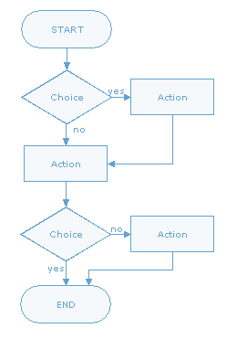
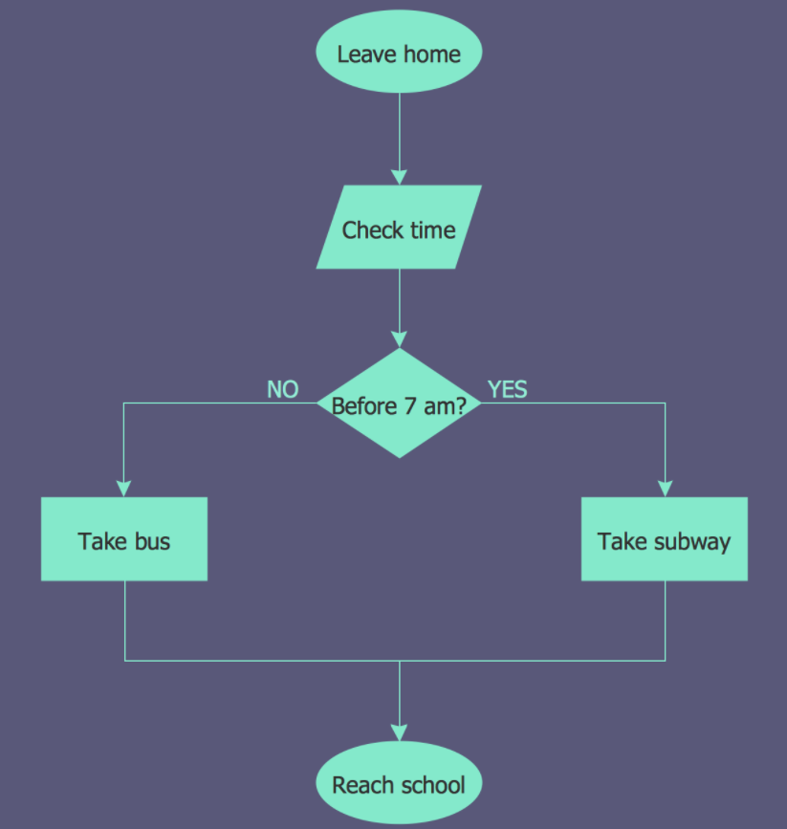
Example Flowchart

Slide 33
Example 1
Given the value of x is 10 and a is 12,
find the result of the following equation:
y = 2x + a - 6
Pseudocode?
start
read the value of x
read the value of a
compute the value of y as y = 2x + a -6
display/print the value of y
end

Slide 34
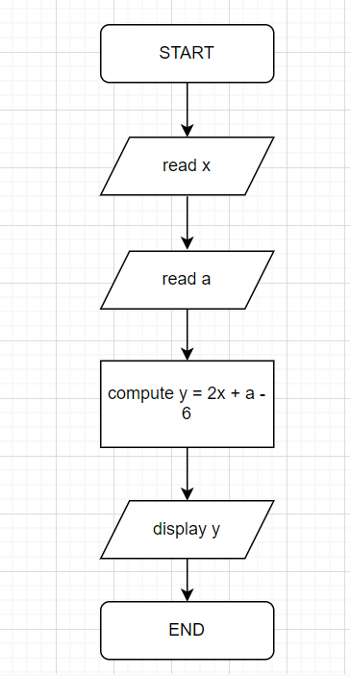
Example 1
Given the value of x is 10 and a is 12,
find the result of the following equation:
y = 2x + a - 6
Pseudocode?
start
read the value of x
read the value of a
compute the value of y as y = 2x + a -6
display/print the value of y
end

Slide 35
Example 2
Uncle Chen wants to buy 5 cans of paint from
Linda’s shop. The price for each of the paint can is RM 15.60. Calculate the total price of all
the paint cans.
Pseudocode?
start
set price as 15.60
read the number of cans
compute the total price as price per can
times by number of cans
display/print the total price
end

Slide 36
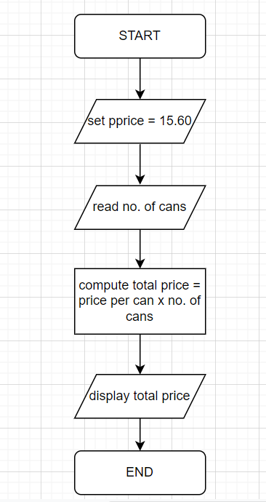
Example 2
Uncle Chen wants to buy 5 cans of paint from
Linda’s shop. The price for each of the paint can is RM 15.60. Calculate the total price of all
the paint cans.
Pseudocode?
start
set price as 15.60
read the number of cans
compute the total price as price per can
times by number of cans
display/print the total price
end

Slide 37
Example 3
Madam Sue needs to determine her students grade for programming subject based on the mark scored during final examination. The ‘A’ grade will be given if the mark scored is between 85 to 100. If a student has scored 90 marks, what is the grade should Madam Sue give to the student?
Pseudocode?
start
read the student mark
if mark is greater than 85 and mark
is less than 100, then
set grade as A
display/print the grade
end

Slide 38
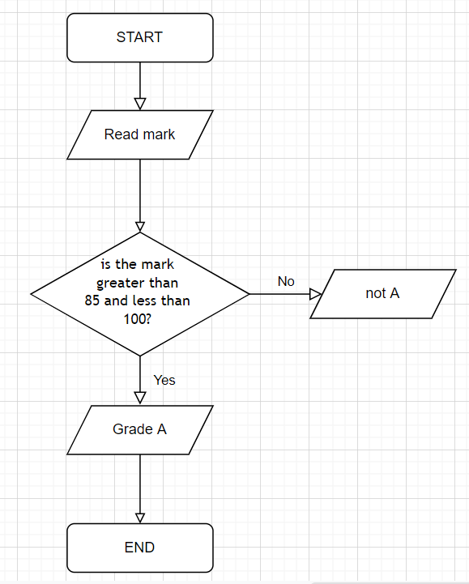
Example 3
Madam Sue needs to determine her students grade for programming subject based on the mark scored during final examination. The ‘A’ grade will be given if the mark scored is between 85 to 100. If a student has scored 90 marks, what is the grade should Madam Sue give to the student?
Pseudocode?
start
read the student mark
if mark is greater than 85 and mark
is less than 100, then
set grade as A
display/print the grade
end

Slide 39
Exercise 1
Given the following formula, calculate the porosity of rock if the pure volume = 12.5 while total rock volume = 55:
porosity = (pure volume /total rock volume) x 100%
Specify and analyze the problem
Pseudocode?
start
read the number of pure volume
read the total rock volume
compute the value of total porosity as
total porosity = (number of
pure volume divided by total rock volume)
times by 100%
display/print the total porosity
end

Slide 40
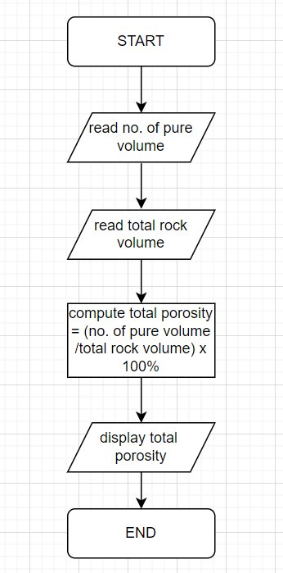
Exercise 1
Given the following formula, calculate the porosity of rock if the pure volume = 12.5 while total rock volume = 55:
porosity = (pure volume /total rock volume) x 100%
Specify and analyze the problem
Pseudocode?
start
read the number of pure volume
read the total rock volume
compute the value of total porosity as
total porosity = (number of
pure volume divided by total rock volume)
times by 100%
display/print the total porosity
end

Slide 41
Exercise 2
Compute and display the total cost of apples,
if given the number of pounds of apples
purchased and the cost of apples per pound
Pseudocode?
start
read the number of apples purchased
read the cost of apples per pound
compute the total cost as number of
apples purchased
times by cost of apples per pound
display/print the total cost
end

Slide 42
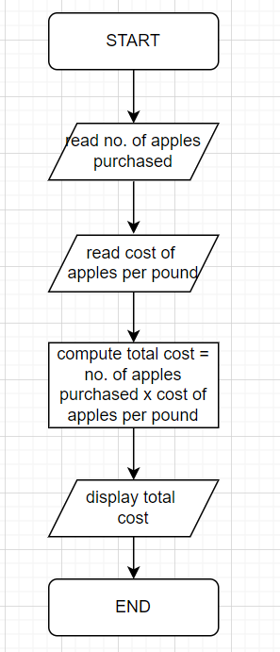
Exercise 2
Compute and display the total cost of apples,
if given the number of pounds of apples
purchased and the cost of apples per pound
Pseudocode?
start
read the number of apples purchased
read the cost of apples per pound
compute the total cost as number of
apples purchased
times by cost of apples per pound
display/print the total cost
end

Slide 43
Exercise 3
A box has height, width and length.
Write the pseudo code to calculate the volume of a box.
Pseudocode?
start
read the height
read the width
read the length
compute the box volume as height
times by width times by length
display/print the total volume of box
end

Slide 44
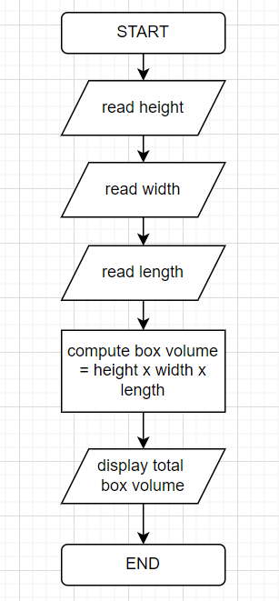
Exercise 3
A box has height, width and length.
Write the pseudo code to calculate the volume of a box.
Pseudocode?
start
read the height
read the width
read the length
compute the box volume as height
times by width times by length
display/print the total volume of box
end

Slide 45
Exercise 4
Write the pseudo code to calculate salary of
an employee for a month.
Pseudocode?
start
read the salary per day
read the no. of day per month
compute the total salary as salary per day
times by no. of day per month
display/print the total salary
end

Slide 46
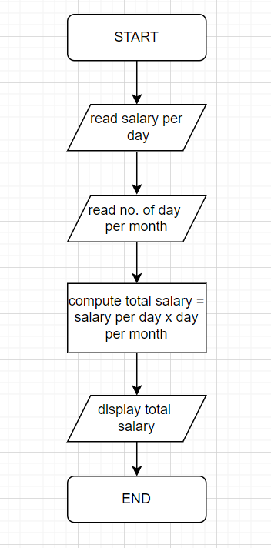
Exercise 4
Write the pseudo code to calculate salary of
an employee for a month.
Pseudocode?
start
read the salary per day
read the no. of day per month
compute the total salary as salary per day
times by no. of day per month
display/print the total salary
end

Slide 47
REFERENCES
Tan, H.H. dan D’Orazio, T.B. 1999. “C Programming for Engineering & Computer Science”. McGraw-Hill International Editions. Call number: QA76.73 .C15 .T36 1999.
Hanly, J. R. dan Koffman, E.B. 2010. “Problem Solving and Program Design in C ”. Pearson Education.
Deitel, P. J. & Deitel H.M. 2010. “C How to Program”. 6th ed.. Pearson Education Inc. Call number: QA76.73.C15 .D45 2010.
Goyal, A. K. 2008. “The C Programming Language”. Alpha Science. Call number: QA76.73.C15 .G69 2008.

