Slide 1
In-Class Competition Tutorial
GCI World 2026 September

Slide 2
Agenda
What is In-Class Competition?
How to Submit

Slide 3




(Recap) Course Completion Requirements
You will be evaluated on the following assignments:
Total
Completed
Honors
Outstanding
Attendance Surveys
14
7+
7+
Selected Students (based on overall scores)
24
points
14+
points
14+
points
Homework
(=8 HW)
*3 points max,
2 points if late
Final Assignment
1
Pass
TOP 10%
You need to participate in the competition to become Honors/Outstanding Student.
AND
1
(optional)
TOP 20%
Competition

Slide 4
What is In-Class Competition?

Slide 5
About In-Class Competition
Students compete with one another based on their scores through In-Class Competition
Do your best to achieve a high ranking!!!
*During the competition, public leaderboard will be visible. After the deadline, we will conduct the final evaluation on a separate private leaderboard.
Leaderboard
RANK
NAME
SCORE
🏆
25UT_Luffy
0.74838
2
25UT_Naruto
0.74114
3
25UT_Tanjiro
0.73355

Slide 6
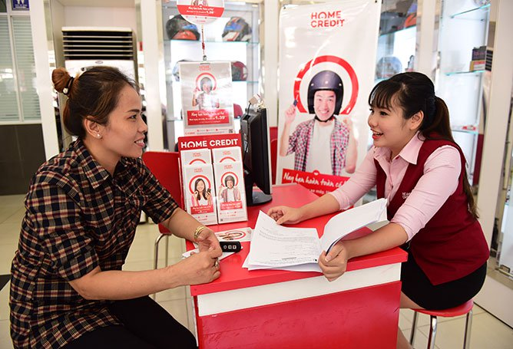
About In-Class Competition
The in-class competition is modified version of the “Home Credit Default Risk” competition originally held on Kaggle.
Your task is to build a model to predict the probability of customer loan default based on the provided customer data.
Source: Kaggle, “Home Credit Default Risk” — Image: Home Credit Group
https://www.kaggle.com/competitions/home-credit-default-risk/overview/description

Slide 7
Submission Deadline
Deadline: November 20th 1:00 AM UTC
Submissions open: October 2nd 11:00 AM UTC

Slide 8
How to Get Started

Slide 9
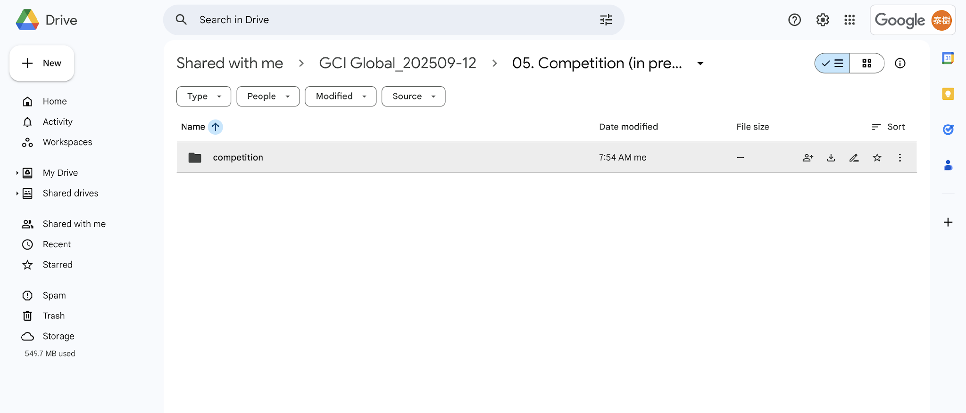
1. Download the materials
Download the “competition” folder from the class materials
Download the “competition” folder to your local PC.
It should download as a ZIP file.

Slide 10
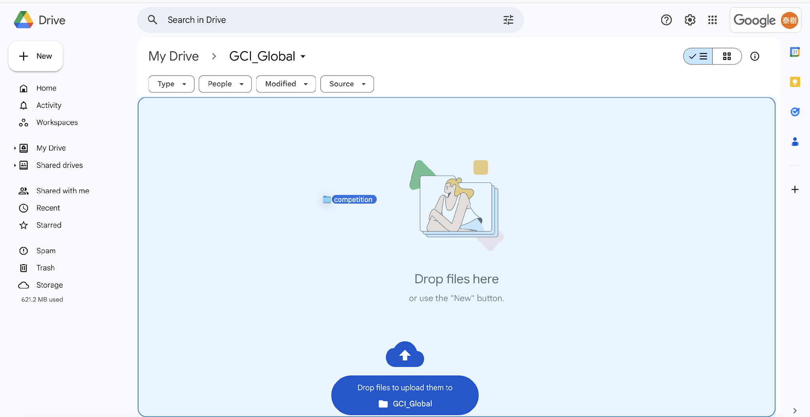
2. Upload the materials to your Google Drive
Unzip the downloaded ZIP file.
Then, upload the “competition” folder to your MyDrive.
(It can be anywhere in your MyDrive, but you will need to adjust the PATH accordingly later)
Upload the “competition” folder from your local PC

Slide 11
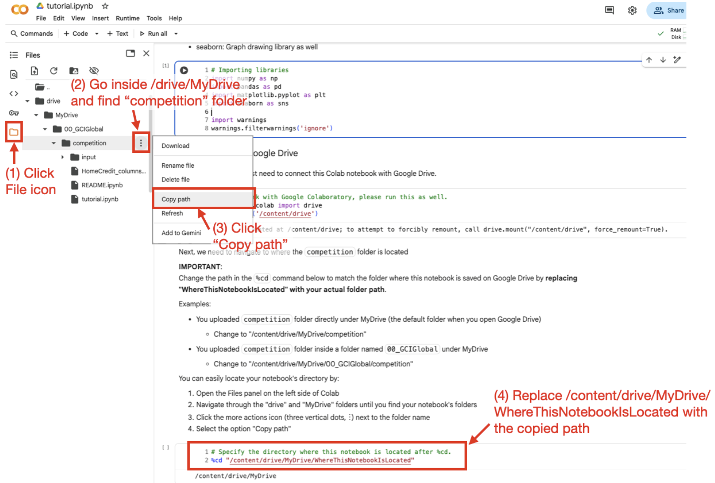
3. Open the tutorial.ipynb inside “competition” folder
Scroll down a bit and change the PATH so that it points to the directory where you uploaded the “competition” folder

Slide 12
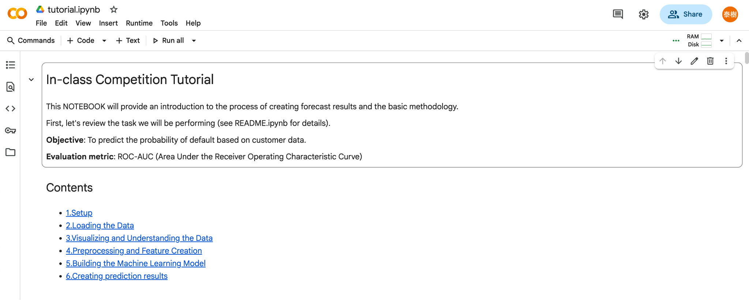
4. Run the tutorial to create submission.csv
Please run all the cells in“tutorial.ipynb” to create “submission.csv”
You can run all the cells from here
Run “tutorial.ipynb” to create “submission.csv”

Slide 13
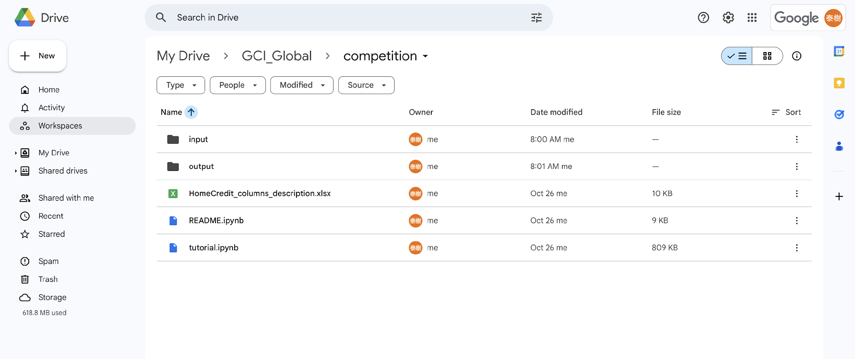
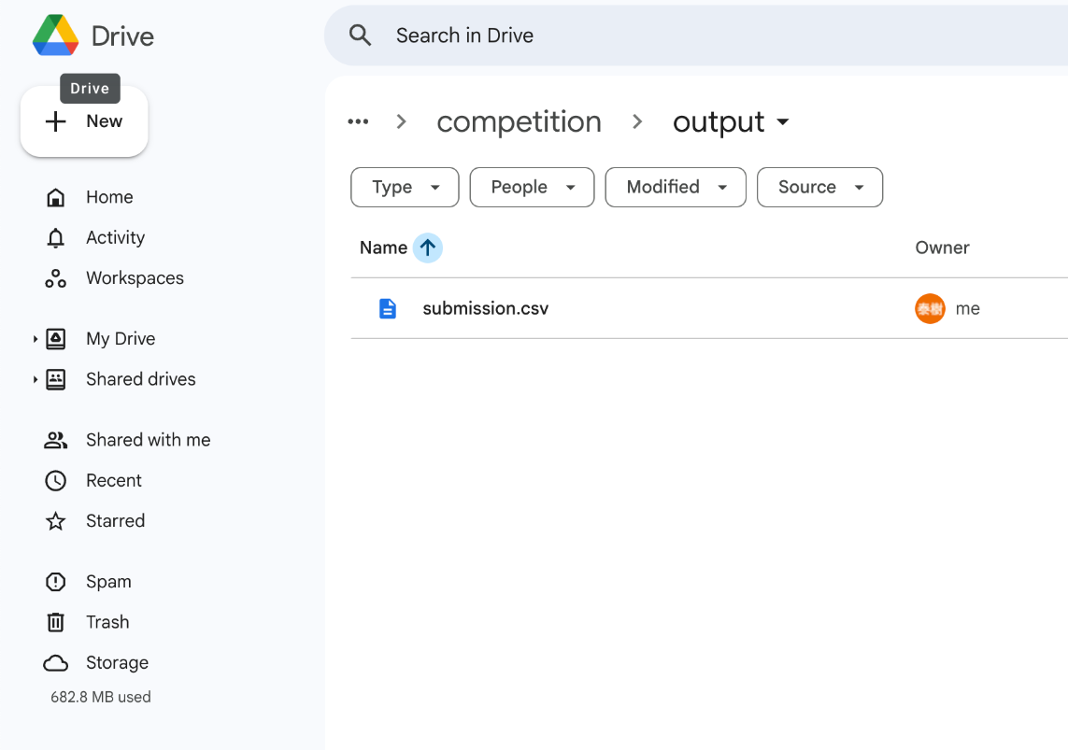
5. Download the submission.csv
You will find a new folder named “output”. Download the “submission.csv” inside the folder.
Go inside the “output” folder and download “submission.csv” to your local PC

Slide 14
How to Submit

Slide 15
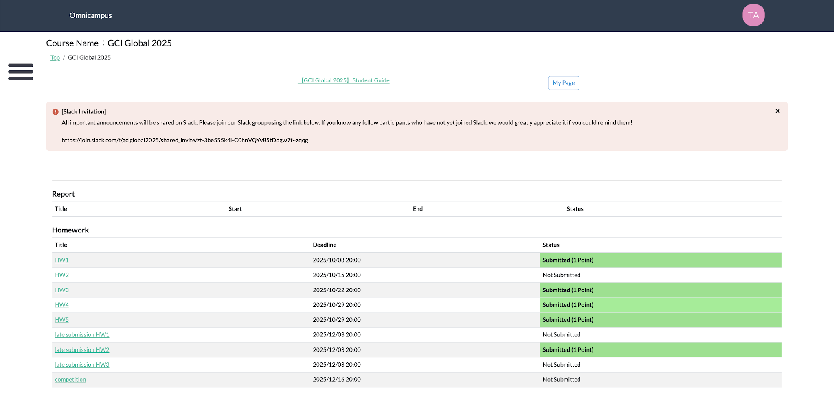
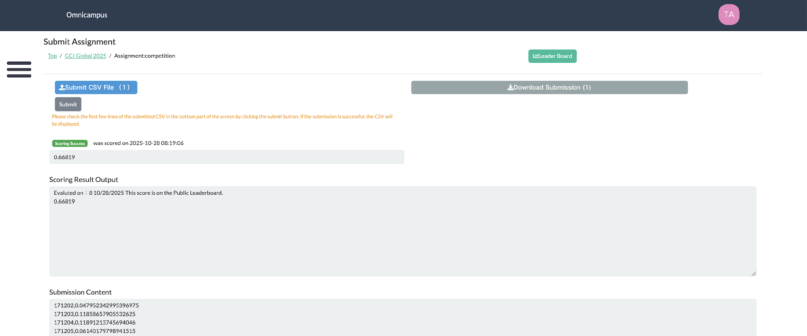
Submit on Omnicampus
Login to Omnicampus to submit your prediction and see the score.
Check the leaderboard from here
2. Click blue button and select the CSV file you want to submit
3. Click “Submit”
1. Click “Competition”

Slide 16
How to Submit Your Code
(if aiming for Honors/Outstanding)

Slide 17
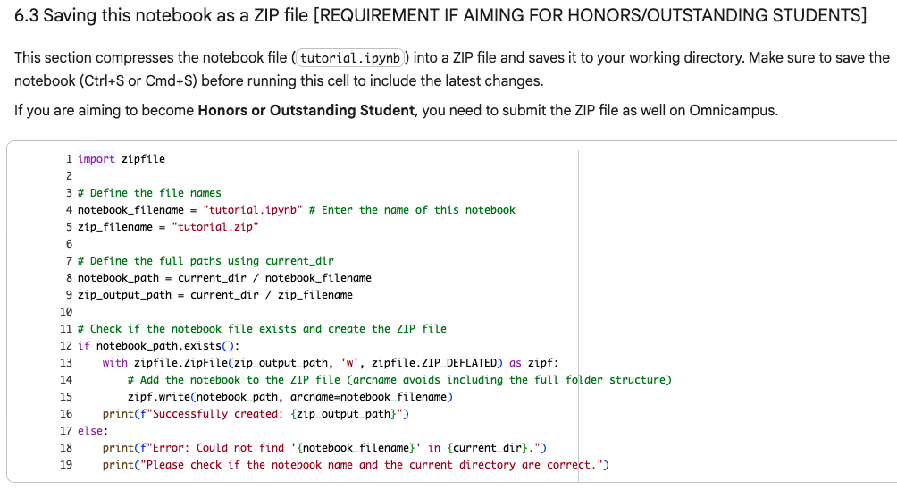
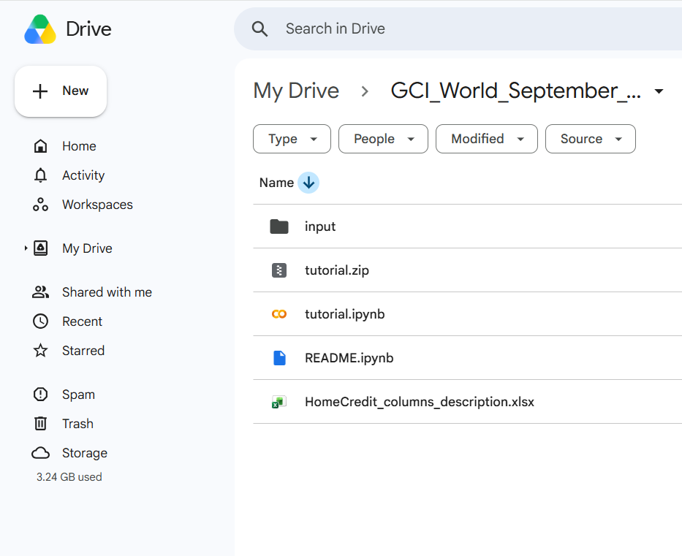
Submitting Your Code (e.g. Colab)
If you are aiming to get selected as Honors/Outstanding Students, you MUST submit your code as well.
e.g. if you are writing your code using “tutorial.ipynb”.... 👇
1. Run the last cell in “tutorial.ipynb”
2. Download “tutorial.zip”
to your local PC

Slide 18
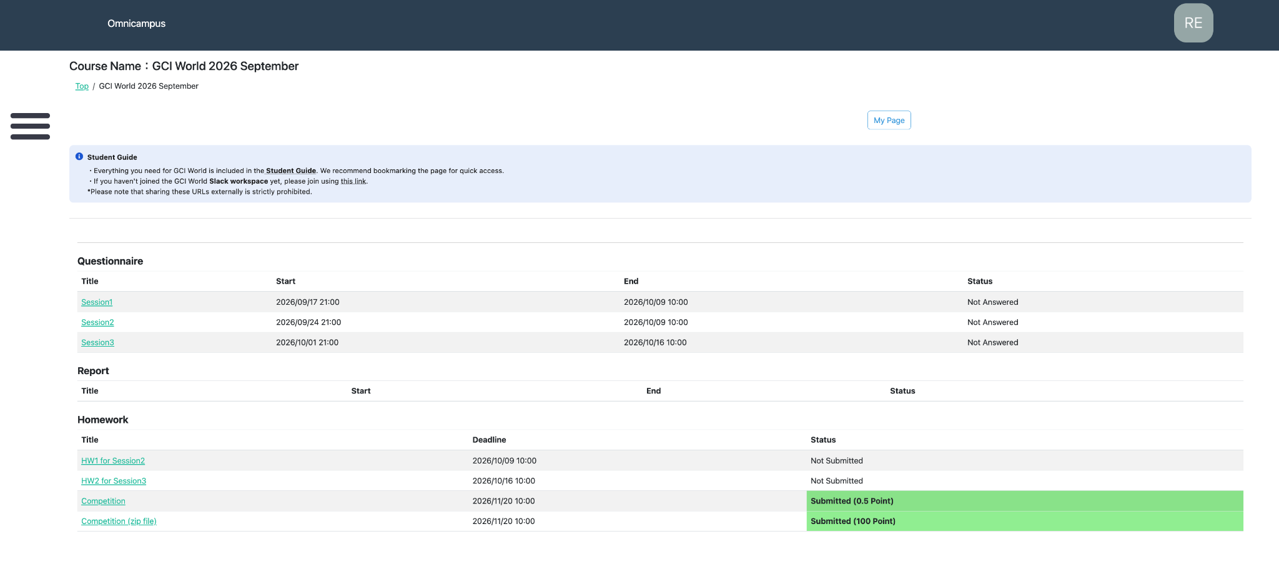
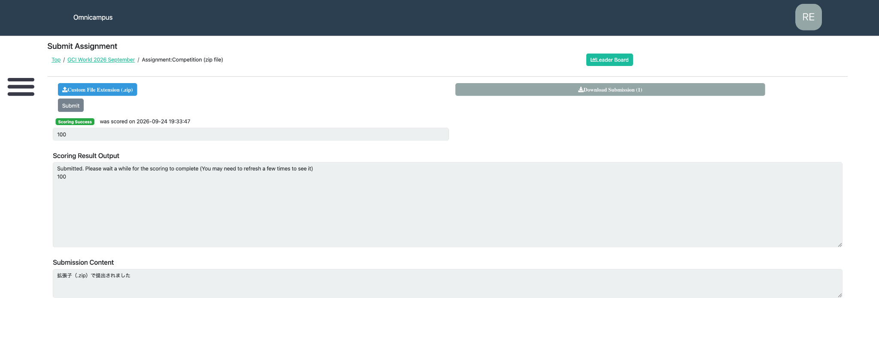
Submitting Your Code (e.g. Colab)
If you are aiming to get selected as Honors/Outstanding Students, you MUST submit your code as well.
4. Click blue button and select the ZIP file you want to submit
5. Click “Submit”
3. Click “Competition (.zip)”

Slide 19
Submission Deadline
Deadline: November 20th 1:00 AM UTC
Submissions open: October 2nd 11:00 AM UTC

Slide 20
Next Steps
You can use the “tutorial.ipynb” to customize your model.
Read the README.ipynb in “competition” folder for the details and rules of the competition.
Take a look at “HomeCredit_columns_descriptions.xlsx” for details about the dataset.

Slide 21
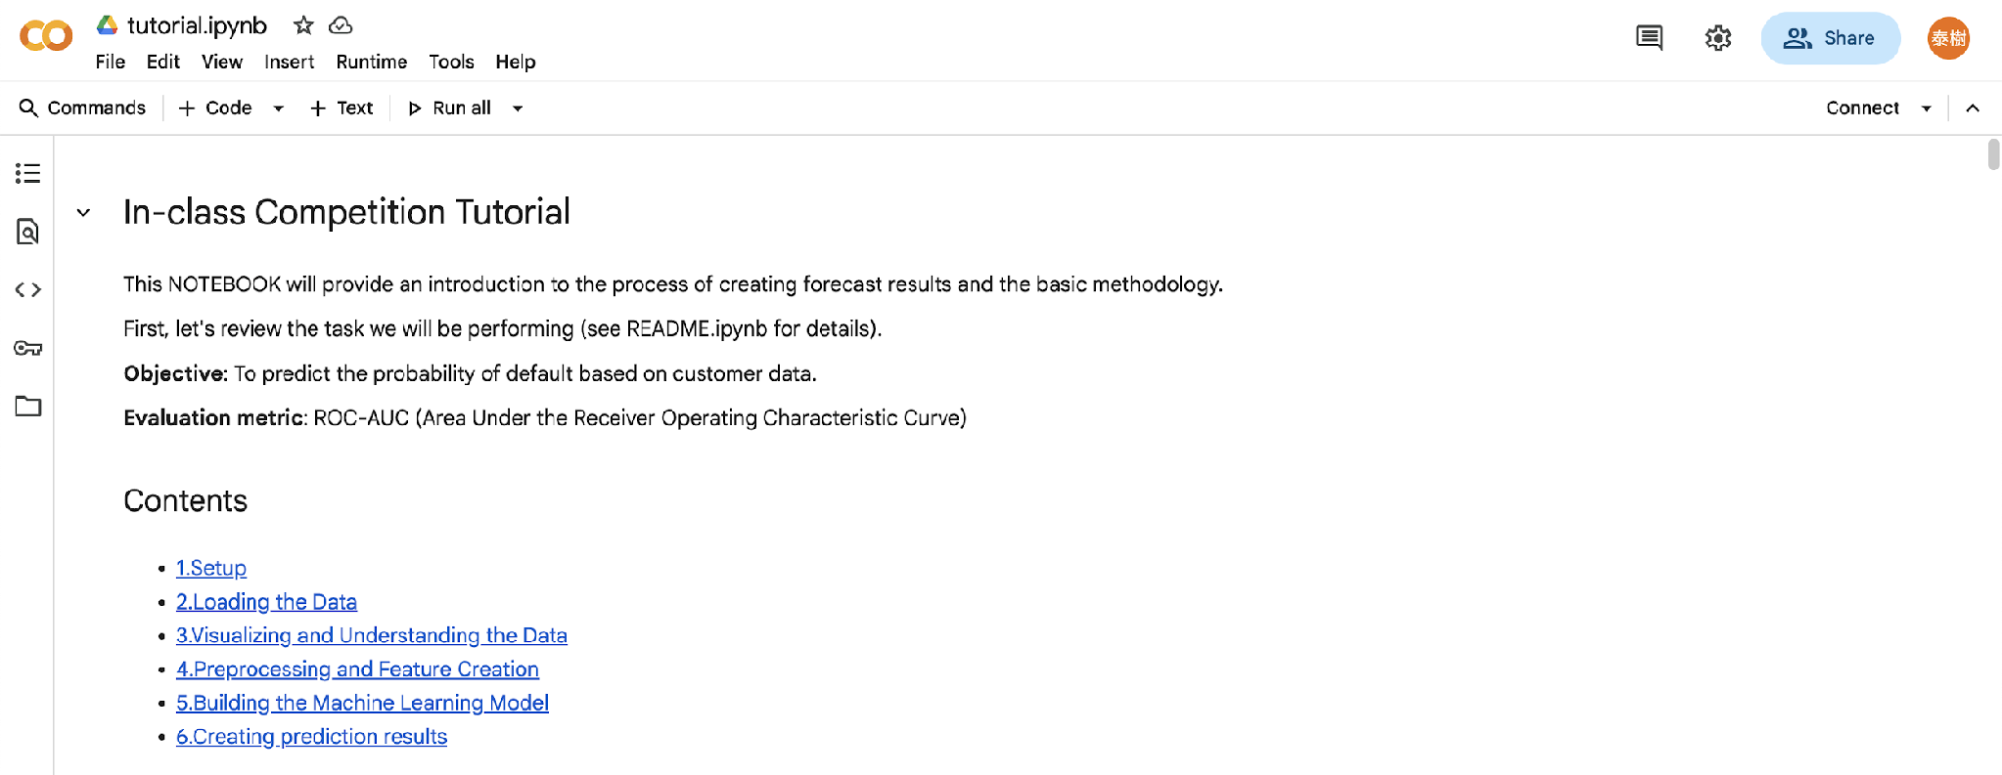
Note: About the tutorial.ipynb
The tutorial.ipynb notebook is a simple baseline designed for beginners.
By running it, you can generate a CSV file ready for submission to Omnicampus.
You can improve the score by adding more features, changing the model, and tuning the hyper-parameters.

Slide 22
Competition Workflow (How to improve your model)
Repeat
Submit the baseline code
Add a new feature
Change your model
Tune your model
Create new features
Step 1
Just run the baseline, and you can submit the baseline code to join the competition!
Step 2
Add more features. Use visualizations to understand the data better.
Step 3
Try a new model, like AdaBoost, XGBoost, CatBoost or LightGBM, or an ensemble of them (advanced).
Step 4
Tune the hyper-
parameters of the model using grid search or Optuna (advanced).
Step 5
Create new features from existing ones. It can be something meaningful, or all possible cross features (advanced).

