Slide 1
A Middleware Implementation for a Novel Vertical Cloud Architecture
Presented by Gabriel Loewen

Slide 2
Outline
Introduction
Architecture
Middleware API
Supporting Compute Services
Supporting Metadata Aggregation
Interfacing
Conclusion
Future Work

Slide 3
Introduction
Cloud computing is defined as a set of architectures that provide resources to users in a way that is scalable, on-demand, and elastic
General purpose architectures can be adapted to many different organizations
Vertical cloud architectures focus on a subset of services in a specific market

Slide 4
Introduction
Storage
Server
Cloud Interface
Storage Controller
Node Controller
Network
Network
Compute Node
Switch
Switch
Compute Node
Storage Node
Client
Client
Client
Client
Client
Client/Server Architecture
Cloud Architecture

Slide 5
Introduction
Cloud middleware allows for ease of resource management
The middleware interacts with the resources available in each node by making them accessible to users

Slide 6
Introduction
Goals for vertical cloud middleware
Simplified communication structure
Event-driven mechanism
Low overhead
Currently available general purpose middleware solutions typically utilize SSH for managing processes remotely
Increased overhead
Manual RSA keysharing mechanism

Slide 7
Introduction
Middleware services are executed on each node
Users interact solely with controller interface
Users
Controller
Aggregator
Compute
CPU and memory
Compute
CPU and memory
Storage
Storage Volumes
Storage
Storage Volumes
Middleware

Slide 8
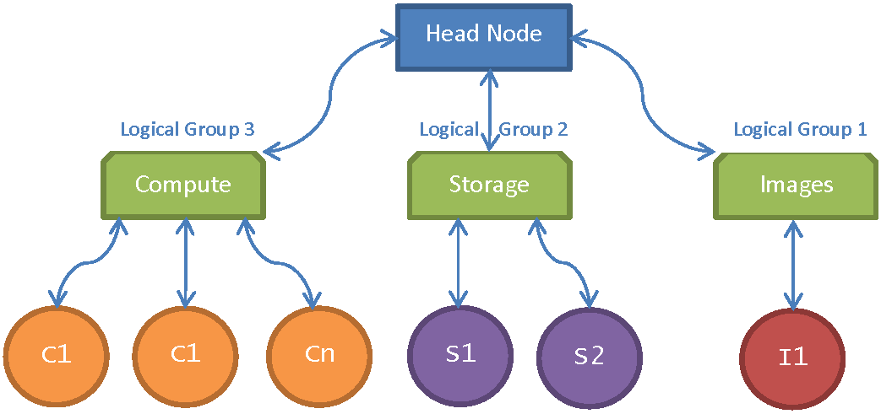
Architecture
Publisher/Subscriber model using logical groups
Compute, Storage, and Image repo servers register with controller or head node

Slide 9
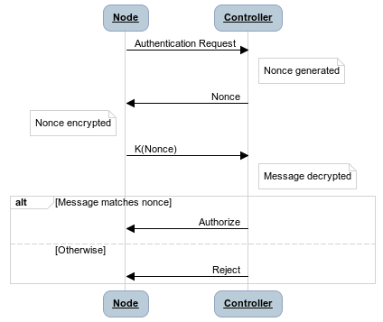
Architecture
Node registration with authentication
Prevents unauthorized intruders from posing as cloud servers
Challenge/Response mechanism with nonce

Slide 10
Architecture
Communication structure uses TCP socket connections
Controller node uses predefined port known by all legitimate nodes
Each non-controller node uses random port
Controller can send messages to individual nodes or to logical groups of nodes

Slide 11
Middleware API
NetEvent API – triggering events over a private network
Started and finished development of API this semester
Not fully implemented. Requires services to be built
Utilizes TCP connections between controller and slave nodes

Slide 12
Middleware API
Written as a Python module
Create NetEvent service
Register events
Join a logical group
Locate the controller node
Implement event functions
from NetEvent import *
def main() :
# Create NetEvent object
netEvent = NetEvent()
# Register events
netEvent . registerEvent (‘MYEVENT’, myEvent)
# Set the logical group name
netEvent . associateGroup ('COMPUTE')
# Find and connect to controller node
netEvent . findController ()
def myEvent(params):
# Do something
return -1
main()

Slide 13
Middleware API
Locating controller node:
Linear search on fourth octet of predetermined subnet address range
Example: 10.10.1.1 to 10.10.1.255
Query each host with challenge/response
Unavailable hosts are ignored
First successful response establishes connection

Slide 14
Supporting Compute Services
libvirt provides interface with KVM or Xen hypervisor
Python bindings allow compute node service
from NetEvent import *
Import libvirt
...
def instantiate(params):
vmName = params[0]
conn = libvirt.open("qemu:///system")
if (conn == None):
return -1
try :
vm = conn.lookupByName(vmName)
vm.create ()
except:
return -1
# Parse the MAC address from the virtual machine
# connection and then use ARP to get the IP address
return getIPAddr(vm)
Connect to hypervisor
Lookup virtual machine
Instantiate vm
Return IP address of vm

Slide 15
Supporting Metadata Aggregation
Retrieve information from nodes and groups
IP address, Operating System, Kernel
Total RAM, Free RAM, CPU Utilization
def utilization(params):
# Get memory utilization
memInfo = open('/proc/meminfo','r')
memtotal = memInfo.readline().split(':')[1].strip().split()[0]
memfree = memInfo.readline().split(':')[1].strip().split()[0]
memInfo.close()
# Get CPU load averages
loadAvg = open('/proc/loadavg', 'r')
data = loadAvg.readline().split()
loadAvg.close()
oneMin = data[0]
fiveMin = data[1]
fifteenMin = data[2]
retVal = memtotal + ":" + memfree + ":" + oneMin + ":" + fiveMin + ":" + fifteenMin
return retVal

Slide 16
Interfacing
Controller node hosts PHP server
PHP script communicates with NetEvent locally
Webserver renders content
Relays information and provides interface with resources in cloud

Slide 17
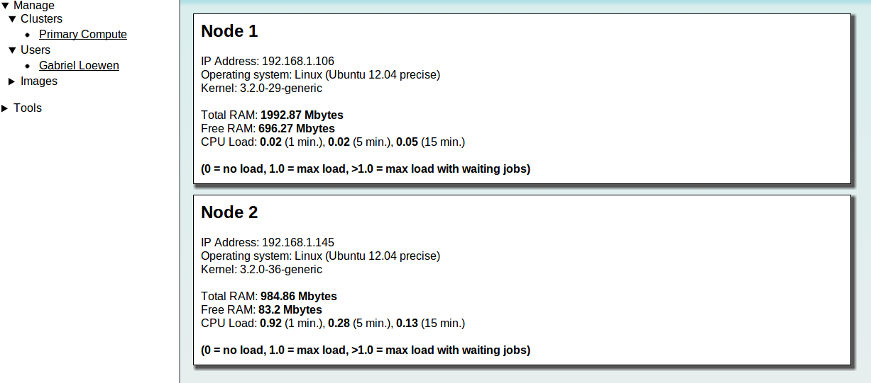
Interfacing
Example: Metadata aggregation interface.
Each node in the ‘Primary_Compute’ cluster is polled for data and displayed for the user.

Slide 18
Conclusion
The NetEvent API allows for the implementation of middleware services
Supports compute services, storage services, metadata aggregation, and more
Utilizes publisher/subscribe event-driven model
Current solutions use remote process execution over SSH

Slide 19
Future Work
Performance benchmark
Average time duration for authentication mechanism
Average turnaround time for triggering events
Investigate other authentication mechanisms
Algorithm for load balancing of virtual machines

Slide 20
Questions?

