Slide 1

Department of Computer Science and Engineering
Disaster Tweet Information Network: Understanding Hashtag Co-occurrence Patterns for Emergency Response Coordination
Submitted as a part of Formative Assessment for the course
Social Networks and Analytics.
Presented by | Presented by | Presented by
1 | ENG22CS0063 | Gowthami S
2 | ENG22CS0140 | S G Sumanth
3 | ENG22CS0141 | S Nithin
4 | ENG22CS0284 | D V S Lakshmi

Slide 2
Objectives
Conduct end-to-end social network analysis on disaster tweets to:
  Understand how disaster information networks function
  Uncover structural patterns in hashtag usage
  Extract meaningful insights for emergency response
  Identify critical infrastructure hashtags
  Map information flow during disasters

Slide 3
Introduction
Disaster communication on Twitter relies on hashtag networks to organize and disseminate critical information. This project analyzes 8,562 disaster tweets to understand how hashtags interconnect, identify communication bottlenecks, and reveal patterns that can improve emergency response coordination.
Socio-Economic Importance:
  Real-time Crisis Response: Understanding hashtag networks helps emergency services coordinate faster
  Resource Allocation: Identifies which communication channels to prioritize during emergencies
  Cross-Disaster Learning: Reveals patterns that transfer between different disaster types
  Public Safety: Improves how warnings and updates reach vulnerable populations

Slide 4
Methodologies
1.Dataset Collection
2.Data Cleaning and Pre-processing
3.Network Construction & Visualization
4.Network Analysis
5.Insights & Interpretation
6.Presentation of Results

Slide 5
Dataset Collection
  Source: Disaster Tweet Detection (GitHub)
  Size: 8,562 tweets (5 columns: id, keyword, location, text, target)
  Labels: 1 = disaster tweet, 0 = non-disaster tweet
  Network: 287 unique hashtags, 1,456 co-occurrence edges
  Type: Hashtag co-occurrence network (undirected, weighted)
Columns description :
1. id - Unique tweet identifier
2. keyword - Keyword from tweet (if any)
3. location - User location (if provided)
4. text - Full tweet text
5. target - 1 = disaster, 0 = non-disaster

Slide 6
Data Cleaning & Pre-processing
Python Script for Data Cleaning -
Cleaning Steps:
  Load data
import pandas as pd df = pd.read_csv('datasets/train.csv')
  Extract hashtags
import re def extract_hashtags(text):
if pd.isna(text): return []
return [tag.lower() for tag in re.findall(r'#\str(text))]
df['hashtags'] =df['text'].apply(extract_hashtags)
3.Remove duplicates
# Remove duplicate rows df = df.drop_duplicates(subset=['text'])
# Later, remove duplicate edges edge_df = edge_df.drop_duplicates(subset= ['Source', 'Target'])

Slide 7
Data Cleaning & Pre-processing
  Normalize node labels
# Hashtags already lowercase in extraction step
# Remove special characters
if needed def clean_hashtag(tag): return re.sub(r'[^a-z0-9]', '', tag)
  Handle missing data
# Remove tweets with no hashtags
df = df[df['hashtags'].apply(len) > 0]
  Create edge list
# See full script in create_gephi_network.py provided earlier
# Creates edges.csv and nodes.csv
  Resulting Data Files -
edges.csv format:
Source, Target, Type, Weight, disaster_count, disaster_ratio
#fire, #emergency, Undirected, 45, 32, 0.71
#flood, #houston, Undirected, 28, 28, 1.0
nodes.csv format:
Id, Label, Frequency, disaster_count, non_disaster_count, disaster_ratio
#emergency,#emergency, 234, 178, 56, 0.76
#fire, #fire, 156, 134, 22, 0.86

Slide 8
Network Construction & Visualization
We constructed a hashtag co-occurrence network using all tweets in the dataset.
How the Network Was Formed
  Nodes represent unique hashtags.
  Edges connect hashtags that appear together in the same tweet.
  Edge Weight indicates how many times two hashtags co-occur across all tweets.
Node Attributes Computed
  For every hashtag, we calculated:
Frequency – how many tweets contain the hashtag
  Disaster Count – number of times it appears in disaster-labelled tweets
  Non-disaster Count – number of times it appears in non-disaster tweets
  Disaster Ratio – disaster_count / total frequency
Node Type based on disaster tendency:
  Disaster hashtag: ratio ≥ 0.8
  Mixed hashtag: 0.2 ≤ ratio < 0.8
  Non-disaster hashtag: ratio < 0.2
Two files were generated:
  nodes.csv — containing all hashtag statistics
  edges.csv — containing co-occurrence relationships between hashtags

Slide 9
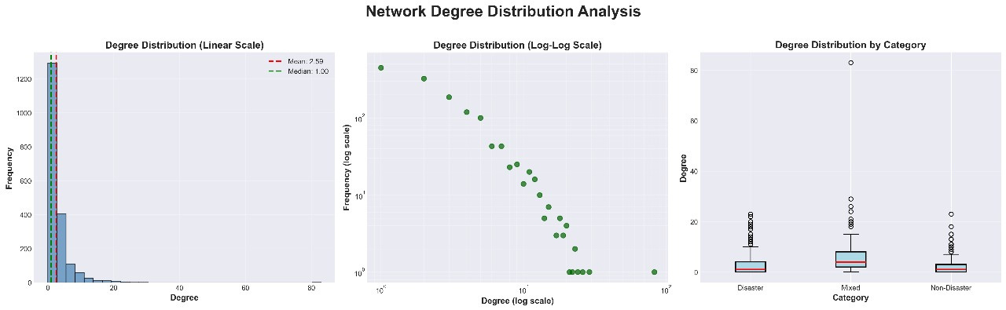
Network Degree Distribution Analysis

Slide 10
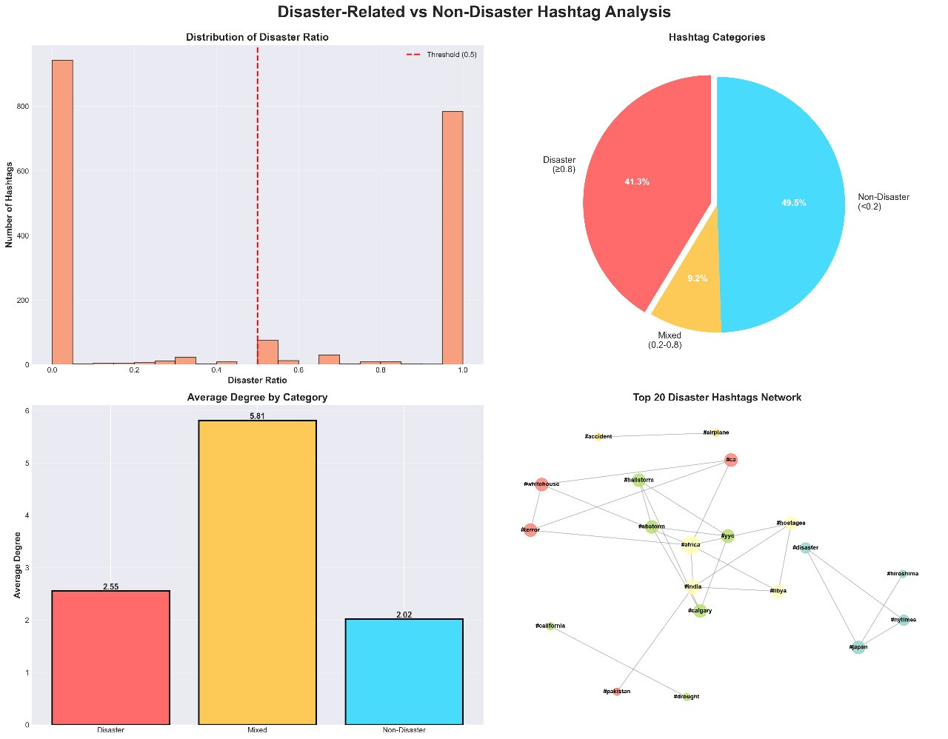
Disaster VS Non Disaster Related Analysis

Slide 11
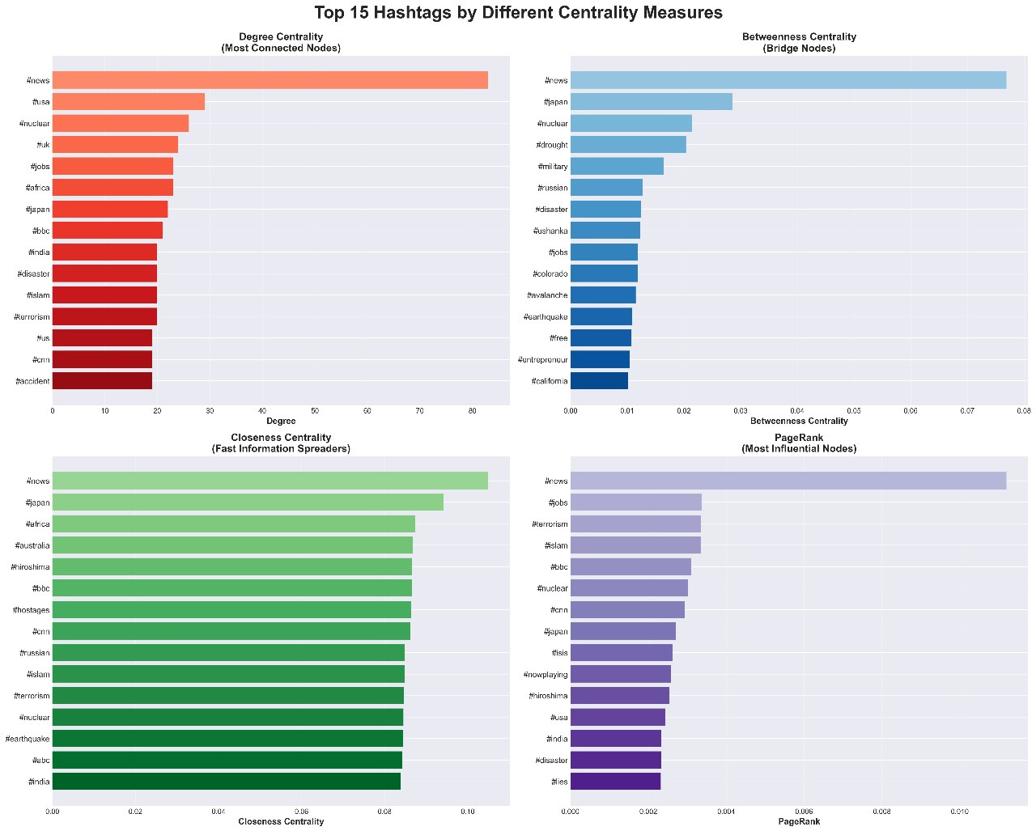
Top Hastags By Different Centrality Measures

Slide 12
Network Statistics
• Network Density: 0.0013
• Largest component: 656 nodes
• Average Degree: 2.59
• Network Diameter: 13
• Average Path Length: 5.7679
• Average Clustering Coefficient: 0.4340
• Transitivity: 0.5122

Slide 13
Network Analysis
1. Degree Centrality
  Average Degree - 2.588
  Interpretation: Hashtags with high degree centrality are frequently co-used with many other hashtags
2. Betweenness Centrality
  Network Diameter - 13
  Average Path Length - 5.74666691373352
  Interpretation: High betweenness hashtags connect different disaster-type communities
3. Closeness Centrality
  Interpretation: Hashtags that can reach others through shortest paths
4. Eigenvector Centrality / PageRank
  #news - PageRank: 0.011195, Degree: 83
  Interpretation: Hashtags connected to other important hashtags
5. Community Detection
  Algorithm: Louvain Method (modularity-based)
  Modularity - 0.904
  Number of Communities - 814
  Interpretation: Clusters represent different disaster types or themes

Slide 14
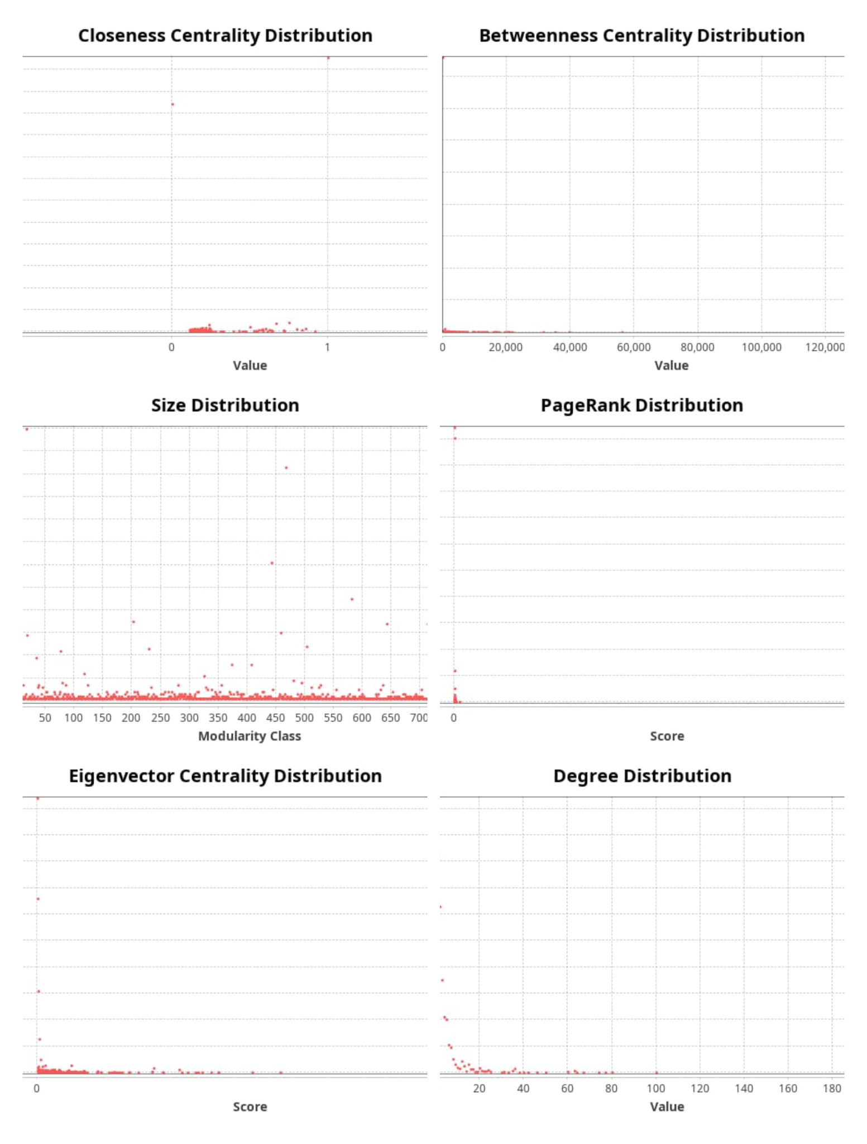

Slide 15
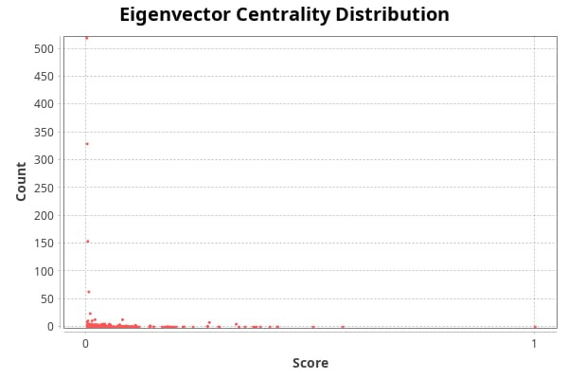
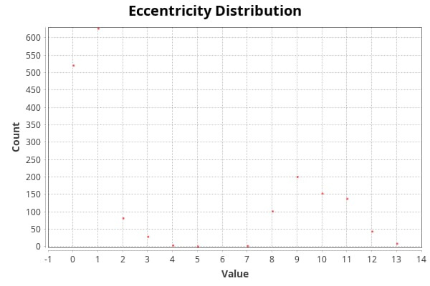

Slide 16
KEY FINDINGS:
  Total Nodes: 1926
  Total Edges: 2492
  Network Density: 0.0013
  Average Degree: 2.59
  Number of Communities: 811
  Clustering Coefficient: 0.4340
  Disaster-related Hashtags (≥80%): 796
  Non-disaster Hashtags (<20%): 953
The hashtag network contains 1926 nodes and 2492 edges, forming a large but very sparse structure with a low density of 0.0013. This means that most hashtags rarely appear together, and on average, each hashtag connects to only about 2–3 others. The network also contains 811 separate communities, showing that conversations are highly fragmented into many small topic clusters. Despite the sparsity, the clustering coefficient of 0.4340 indicates that when hashtags do co-occur, they tend to form tight local groups.
Insights & Interpretation

Slide 17
TOP 10 NODES BY DEGREE
Label Degree PageRank
#news 83 0.011195
#usa 29 0.002432
#nuclear 26 0.003021
#uk 24 0.001909
#jobs 23 0.003374
#africa 23 0.002071
#japan 22 0.002713
#bbc 21 0.003102
#india 20 0.002339
#disaster 20 0.002329
In terms of content distribution, 796 hashtags are strongly associated with disaster-related tweets, while 953 are primarily non-disaster.This balance highlights the presence of both categories and suggests that network-based features can meaningfully support disaster classification tasks.

Slide 18
TOP 5 MOST INFLUENTIAL HASHTAGS (by PageRank):
#news - PageRank: 0.011195, Degree: 83
#jobs - PageRank: 0.003374, Degree: 23
#terrorism - PageRank: 0.003345, Degree: 20
#islam - PageRank: 0.003342, Degree: 20
#bbc - PageRank: 0.003102, Degree: 21
  Among all hashtags,#news emerges as the dominant hub, having the highest degree (83) and the highest PageRank score.
  Other widely connected hashtags include #usa, #uk, #jobs, #africa, and #india, which appear across diverse topics.
  When looking at influence, the top hashtags by PageRank are #news, #jobs, #terrorism, #islam, and #bbc—indicating that they play a crucial bridging role across different communities.

Slide 19
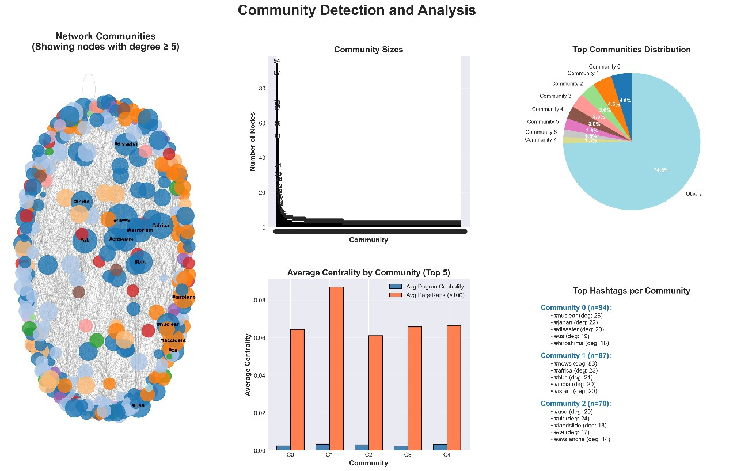
Insights & Interpretation

Slide 20
References
Github Dataset
https://github.com/Tek-nr/Disaster-Tweet-Detection/
Tools and Environment Used:
VS Code (for coding, analysis, and visualizations)
Libraries - Pandas, NumPy, Matplotlib, Seaborn, NetworkX
Visualization Tool - Gephi
Books / Theory References:
Newman, M. E. J. (2010). Networks: An Introduction.Bruns & Burgess (2011). "#ausfloods and @QPSMedia: Crisis Communication on Twitter"
Starbird & Palen (2011). "Voluntweeters: Self-Organizing by Digital Volunteers"

