Slide 1

Bandgap Voltage Reference
Marc Christiansen
Jackson Pugh
Krish Ramkumar

Slide 2
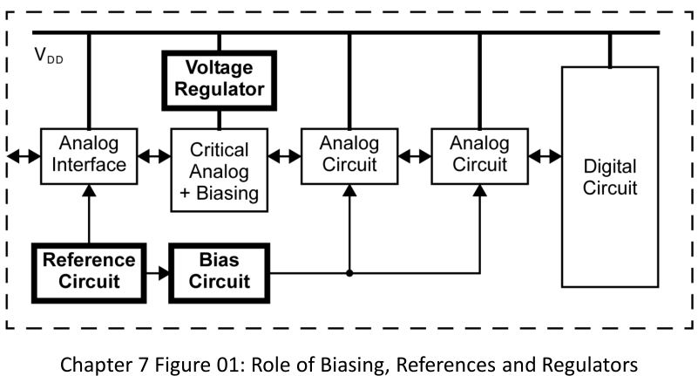
Project Description
Overview:
Provide a fixed output voltage
Supply constant voltage to the analog interface and biasing circuitry
Applications:
ADC/DAC
Voltage Regulator
Measurement and Control Systems

Slide 3
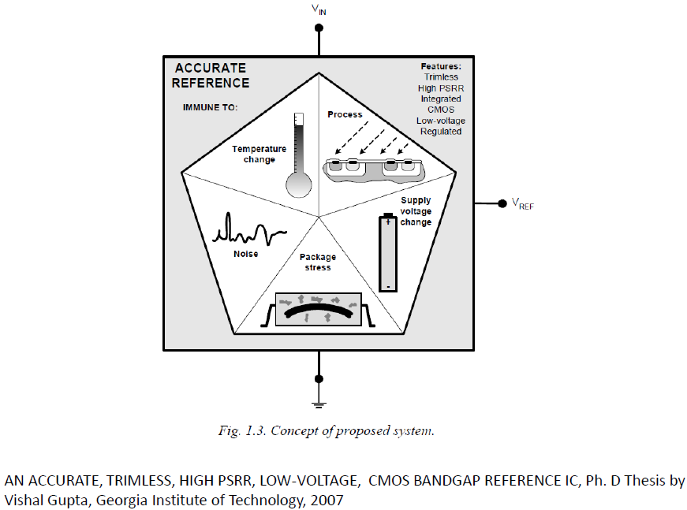
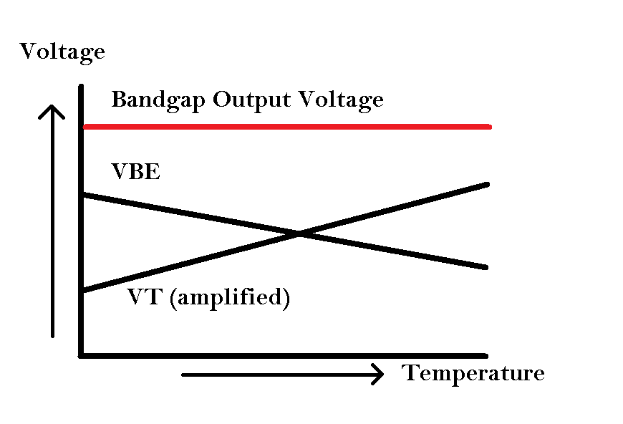
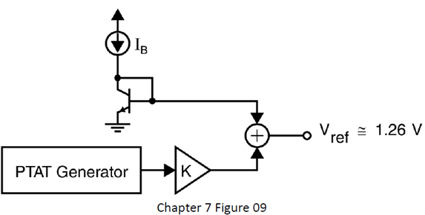
Project Objectives
Main design goals:
Minimize reference voltage TC
Minimize VDD dependence

Slide 4
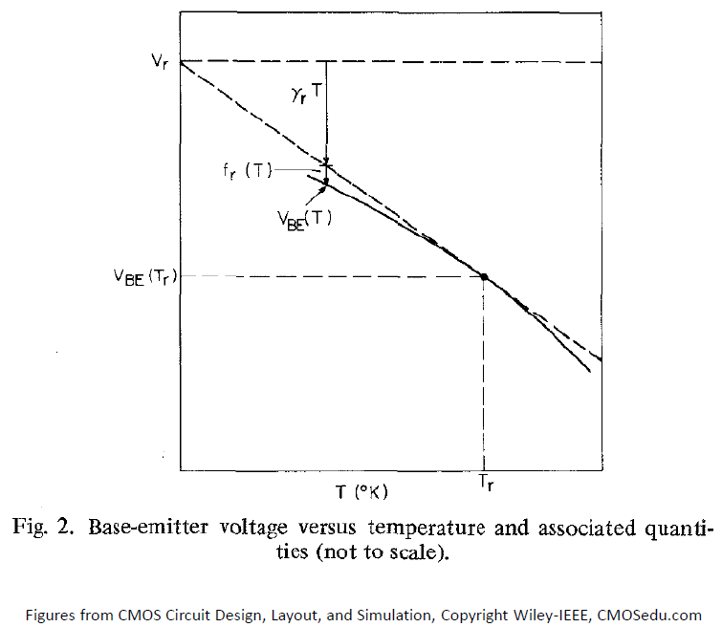
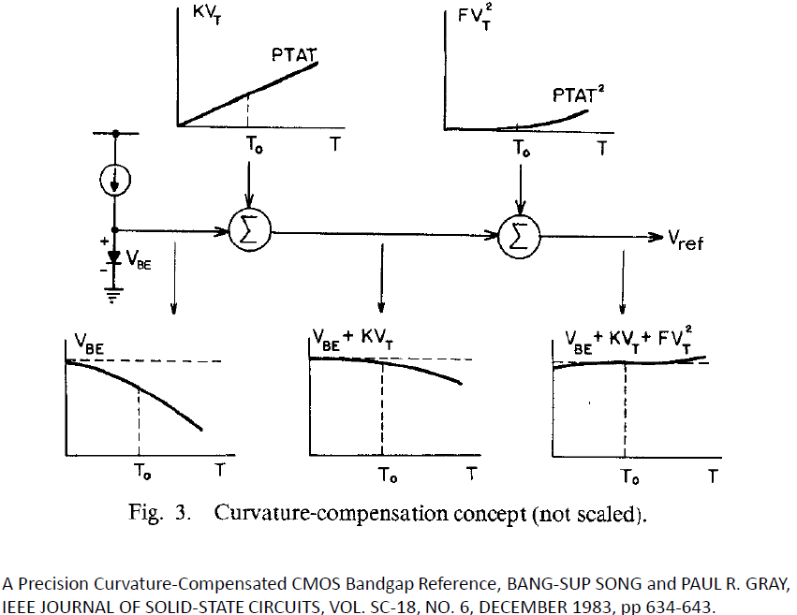
Design challenges
Challenges:
TC cannot be made very low by first order design
Curvature Compensation Effect
Op Amp offset voltage
Input base current

Slide 5
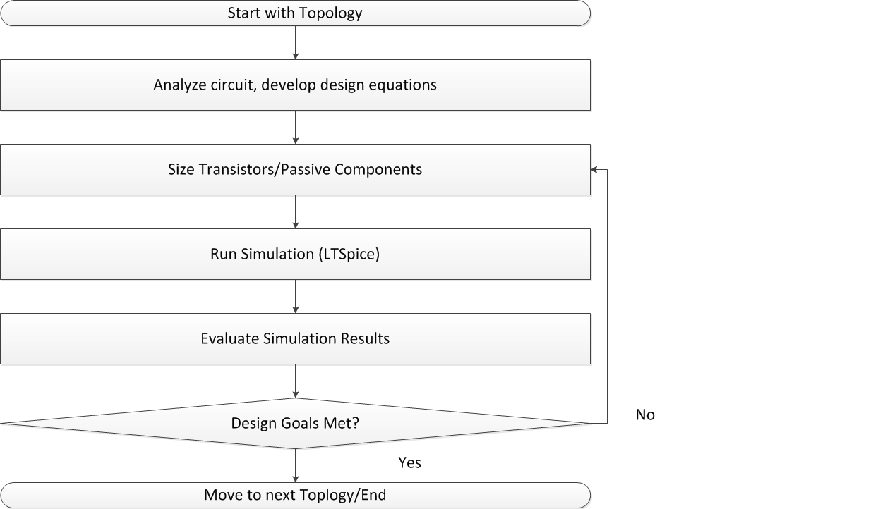
Methodology

Slide 6
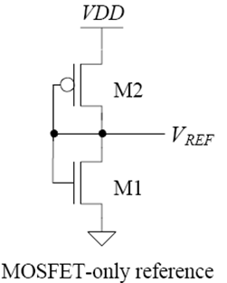
Topology
Four Different Designs:
Basic Voltage Divider

Slide 7
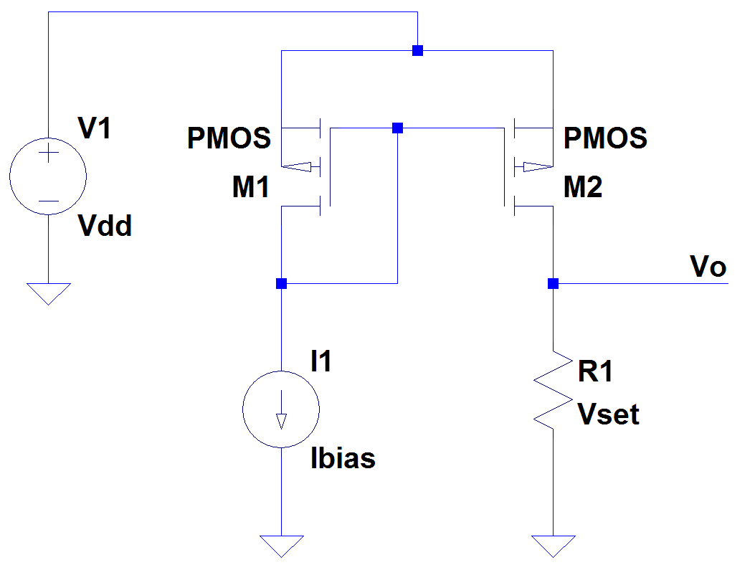
Topology (cont.)
Current-Resistor Voltage Reference (IRVR)

Slide 8
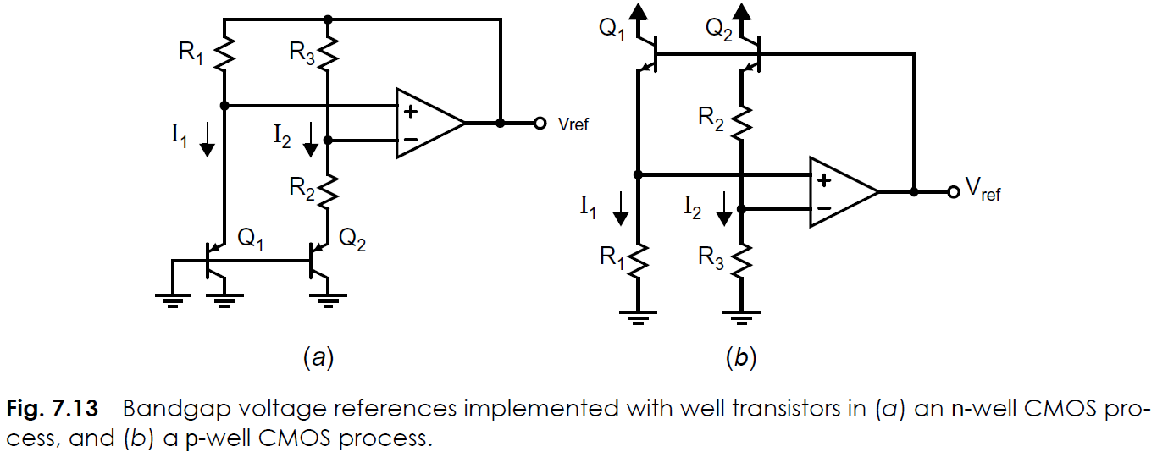
Topology (cont.)
CMOS Bandgap Voltage Reference

Slide 9
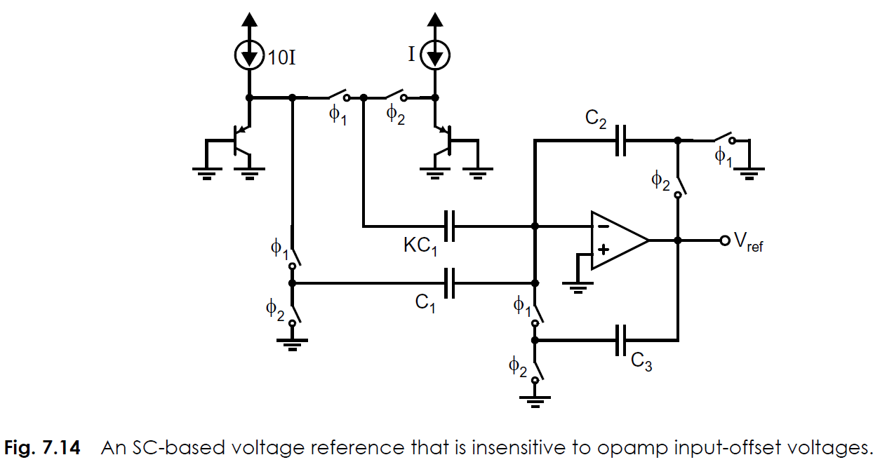
Topology (cont.)
SC-based Voltage Reference

Slide 10
Process and Tools
Process
See Table 1.5 (further research required)
Vertical CMOS well transistors (parasitic BJTs)
Simulation and Design Tools
LTSpice IV (SwitcherCAD III)
MATLAB R2011b
Electric VSLI Design System

Slide 11
Planning
Week | Task
Week 7 | Project assigned
Week 8 | Study the design options
Week 9 | Schematic entry and simulation
Week 10 | Final write up
Week 11 | Final Presentation

Slide 12
Questions/Comments

