Slide 1

Bandgap Voltage Reference
Marc Christiansen (Undergrad)
Jackson Pugh (Undergrad)
Krish Ramkumar (Grad)
Project Final Presentation
Fall 2012
Dec 5, 2012

Slide 2
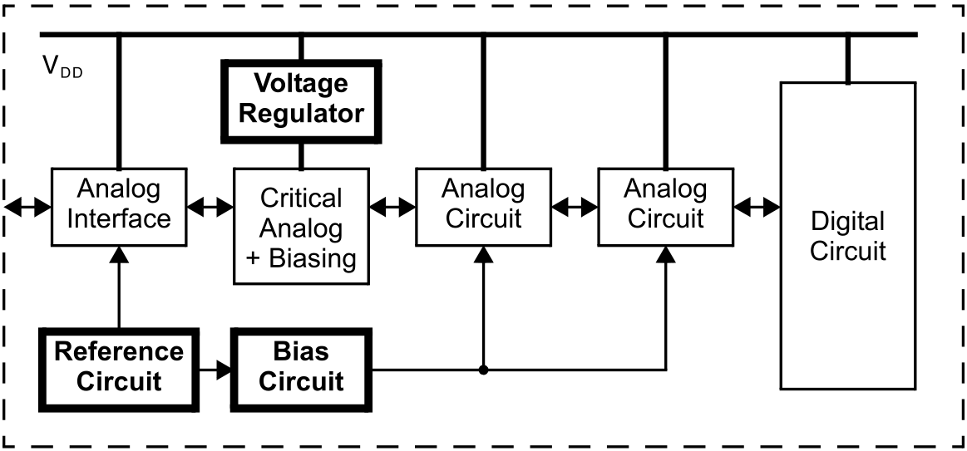
Block Diagram of the Project Setup
Show the overall project components and their connectivity at a high level
Using block diagram only
Not at device level

Slide 3
Process and Tools used
Process
0.18µm CMOS technology
Vertical CMOS well transistors (parasitic BJTs)
Simulation and Design Tools
LTSpice IV (SwitcherCAD III)
MATLAB R2011b
Electric VSLI Design System

Slide 4
Design Steps Followed
Give the work flow on different design options in addition to the final design (Op Amp Design has only 1 option):
EX: For BGR, starting with basic voltage divider, it will be shown how Vout depends on Vss and Temperature
This item may need more than one page/foil; add as you need to describe the major design steps

Slide 5
Live Demonstration
Please show live simulation results from simulation tool for each design type/step:
EX: from LTSpice, show the schematics and then run the simulation and show the waveforms
EX: from Electric, show the layout

Slide 6
Results/Discussion
Summarize/list the output
Discuss the results

Slide 7
Design challenges Faced
Share the challenges that were faced during design of the project:
And how you resolved them
EX: Tool issue

Slide 8
Q & A

