Slide 1
RETRO FPS REVIVAL • 1998 GOLDSRC SPIRIT
PROJECT G1
Original Sci-Fi Story & Fully Scripted Procedural Asset Pipeline in Unity
Presenter: [STUB: Speaker Name / Team Lead] | Date: July 2026 | Build Version: 2022.3 LTS
Notes:
Welcome everyone to the Project G1 presentation. Introduce yourself and set the stage: Project G1 is a homage to classic 1998 retro action shooters, built with a modern programmatic pipeline in Unity and Blender.

Slide 2
VISION & DESIGN GOALS
Executive Summary & Core Pillars
1. Retro Aesthetic
• 1998 GoldSrc Heritage
Captures the atmosphere of Half-Life 1 with low-poly geometry and industrial environments.
• Wear & Grime Pipeline
Dynamic procedural texture masks multiplying color tints directly in standard shaders.
• Share Tech Mono HUD
Authentic retro amber UI elements and tactile visual feedback.
2. Authentic Gameplay
• GoldSrc Physics Engine
True air acceleration, 30-ups caps, bunnyhopping, coyote time, and HEV sprint.
• Tactical Combat & ADS
5 core weapons + grenades with ADS zoom, recoil scaling, and secondary fire modes.
• Vehicle Integration
24 arcade trucks across an 800x800m open sprawl for seamless traversal.
3. 100% Procedural Engine
• Blender Scripted Assets
Zero manual 3D modeling — every character, weapon, vehicle, and building is code.
• Procedural Audio & Speech
Math-synthesized retro sound effects + eSpeak NG automated dialogue pipeline.
• Self-Correcting Layouts
Automated placement validation and dynamic interior room audio acoustics.
Notes:
Highlight the three pillars: Retro Aesthetic (not cheap, but curated low-poly asset construction), Authentic Gameplay (Quake/HL movement), and 100% Procedural Engineering (code-driven pipeline).

Slide 3
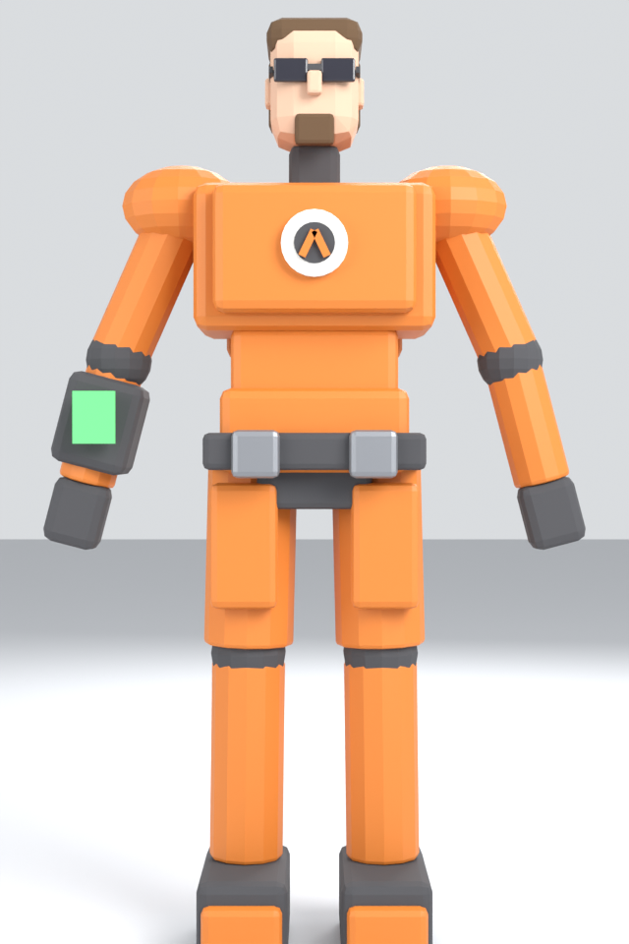

STORY & WORLD BUILDING
Narrative Loop & Character Lore
The Anomaly Loop Premise
• The Threshold Event
You play as a Senior Test Engineer surviving a catastrophic portal experiment failure at Corvus Facility.
• The Anchor & The Loop
The Threshold isn't a door to a place—it's a loop of every past failure. You survive because you are the Anchor.
• The Aliens as Echoes
Hostile creatures are the time-folded remains of past iterations trapped in the loop.
• The Auditor's Motive
The man in the suit audits the loop for an interdimensional bureaucracy harvesting endless catastrophes.
• Branching Finale Choice
Step through the Threshold ring (Loop resets) OR destroy the resonance emitters (Collapse loop & unmake the Anchor).
Left: The Hazard Suit (Anchor) | Right: The Auditor
Notes:
Explain the core lore twist: The protagonist is the Anchor keeping the disaster alive, and the Auditor harvests the catastrophe. The player's first weapon (crowbar) is what destroys the loop at the end.

Slide 4
PROCEDURAL ART PIPELINE
Code-Driven Asset & Modeling Pipeline
Blender Python Scripting Engine
• Zero Manual Sculpting
Characters built via elliptical tapered lofts (oval()), layered armor plates, and sealed helmets.
• Asymmetric Equipment
Wrist computers, bracers, and uneven pouches avoid the artificial look of mirrored low-poly models.
• Wear & Grime Mask Baking
Bakes dirt masks off ambient occlusion and height rather than pointiness, preventing edge bleaching.
• Standard Shader Integration
White-to-grime mask multiplies cleanly over faction tint colors in Unity standard shaders.
• Rigging & Animation
Automated bone weights and skeleton generation preserving classic 1998 animation clips.
[STUB / PLACEHOLDER]: BLENDER DEMO / PIPELINE DIAGRAM
Insert a video clip or flow diagram showing: 1. python build_character.py execution 2. Automated mesh generation in Blender 3. Dirt mask texture baking 4. Direct Unity FBX + Material import flow
Notes:
Highlight why code-driven modeling matters: reproducible builds, instant variation tuning, automated UV mask baking without mudding albedo tints.

Slide 5
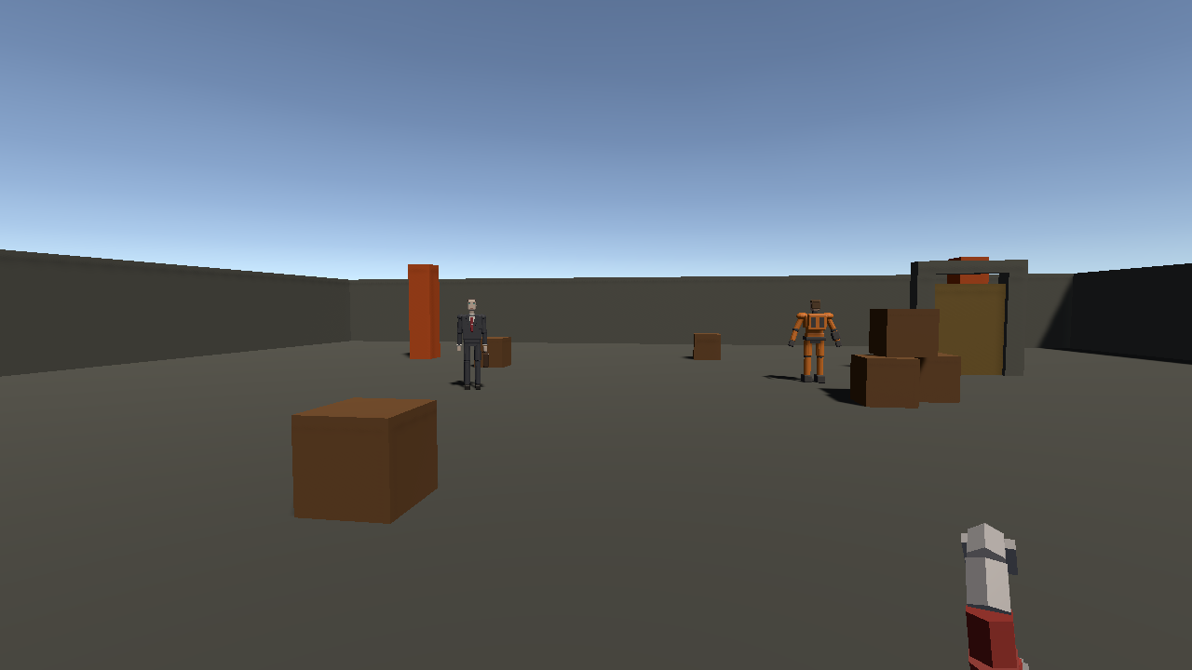
GAMEPLAY & PHYSICS
Authentic GoldSrc Movement & Sprint Dynamics
HL1 Physics & Sprint Metering
• Quake-Lineage Acceleration
Converts exact GoldSrc units to meters: strafe air steering, bunnyhop speed preservation.
• HEV Auxiliary Power Sprint
Hold Shift to sprint at 12.6 m/s (up from 8.1 m/s), draining an 11-second auxiliary cell.
• Tactical Sprint Resource
Meter locks out when depleted; UI bar pulses red. Metered movement turns open-field crossing into a tactical risk.
• ADS Zoom & Sway Tuning
Hold RMB narrows FOV to 46°, reduces spread by 66%, dampens sway, and scales walk speed.
• Full Crouch & Coyote Time
Smooth crouch height transitions and jump window forgiveness for precise platforming.
In-Engine Gameplay POV: Retro Amber HUD, Sprint Bar & Reticle
Notes:
Explain how movement feeling is identical to 1998 GoldSrc engine. Sprinting is metered so crossing open terrain requires strategic decision making.

Slide 6
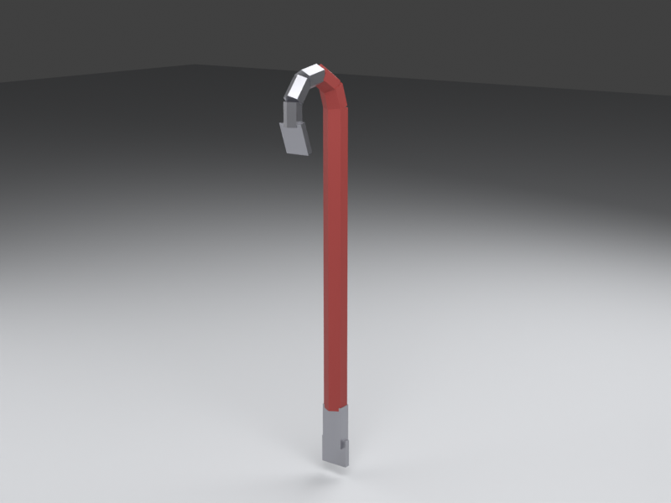
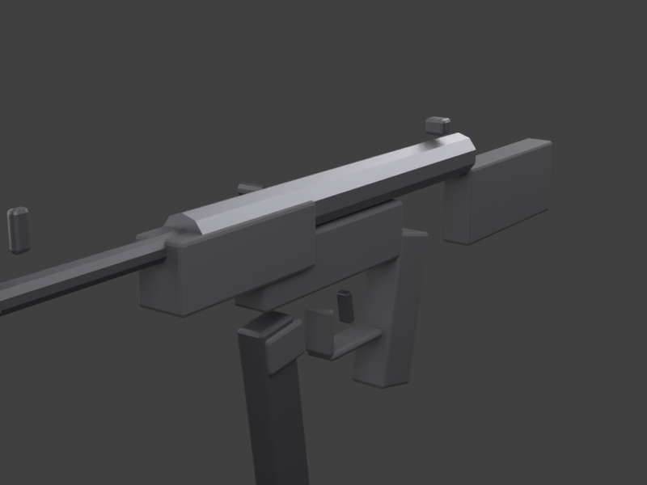
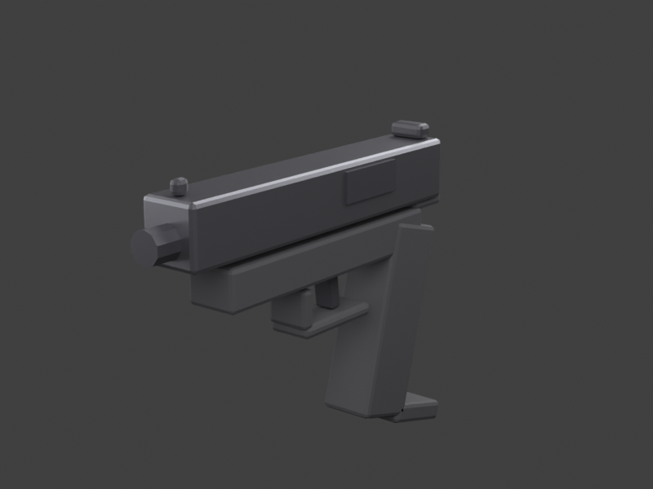
WEAPONS & COMBAT
Retro Firearms Arsenal & Secondary Fires
Crowbar & 9mm Pistol
• Crowbar: Charged heavy swing (2.5x dmg + knockback).
• Pistol: 17-round mag, 3-round burst secondary fire.
Shotgun & SMG 40mm
• Shotgun: Per-shell reload, double-barrel blast.
• SMG: High rate of fire, integrated 40mm grenade launcher.
.357 Magnum & Grenades
• Magnum: Heavy revolver cylinder state machine.
• Grenades: Cookable fuses, shockwave rings & shrapnel.
Notes:
Detail the 5 weapons + grenades. Every weapon has animated slides/cylinders and custom secondary fire modes. Crowbar charged swing deals knockback.

Slide 7
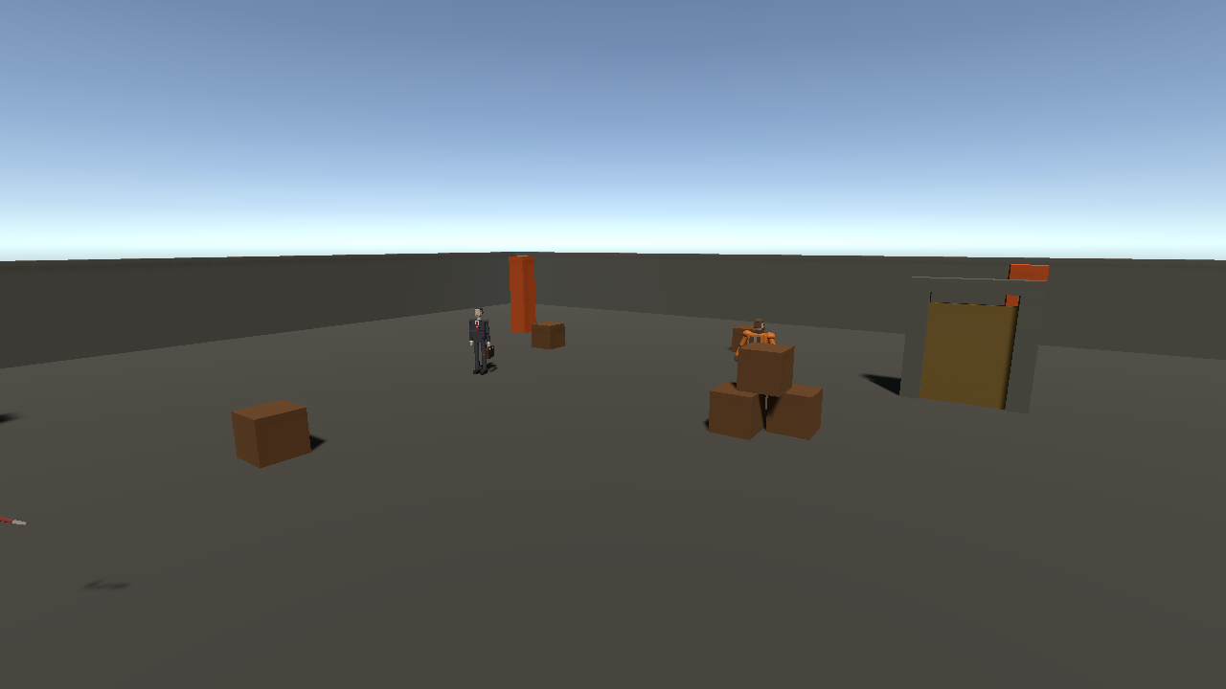
WORLD & VEHICLES
800x800m Corvus Sprawl & Drivable Fleet
Corvus Sprawl Base Architecture
• 50+ Enterable Interiors
Hollow building structures with door cutouts, multi-floor storeys, rooftop catwalks.
• Military Base Layout
280m runway, 3-storey control tower, 6 ammo igloos, tank workshop, trench combat zones.
• 24 Parked Drivable Trucks
Trucks spaced every 80m across ring roads. Approaching within 5m displays [E] DRIVE prompt.
• Arcade Vehicle Physics
Predictable raycast + body-force physics optimized for high-speed ramp and berm terrain traversal.
• Interior Audio Acoustics
G1InteriorSpace dynamically scales reverb duration (0.5s to 2.5s) and outdoor sound occlusion.
Overview map rendering: Corvus Sprawl district layout & interior spaces
Notes:
Explain the vehicle traversal system: 24 trucks ensure you are never more than 80m from a vehicle. Driving is noisy and draws enemy fire, balancing mobility vs stealth.

Slide 8
PROCEDURAL AUDIO & VOICE
Zero External Audio: Pure Math SFX & eSpeak NG
Math SFX & Automated Voice Casting
• 100% Procedural SFX
Gunshots, explosions, pickup hums, door hydraulics, and footstep impacts generated from raw math.
• eSpeak NG Automated Voice
Python script parses C# dialogue strings, generating voice clips per character profile.
• Script-As-Single-Source
C# code defines dialogue lines. Rewording a line automatically mints a new clip with zero voice drift.
• Typewriter Pacing Sync
Dialogue typewriter automatically scales display speed to match audio clip duration.
• Formant Fallback Engine
Unvoiced fallback blips 6 formant-synthesized vowels, sounding like rapid radio chatter.
10 Distinct Voice Profiles
• The Commander / Chief
Low, barking, authoritative military cadence.
• Signals Tech
Rapid-fire delivery at 3.4 words per second.
• The Auditor
Unbothered, flat, sinister bureaucracy drawl.
• The Echo
Croaking, slowed to 1.6 words/sec, dragged out of a time-folded body.
• Suit V.I.
Monotone, even, synthetic tactical guidance.
Notes:
Demonstrate the procedural speech: C# is the single source of truth for all text and voice audio clips. eSpeak NG generates voice files upon build.

Slide 9
ENEMY AI & THREAT DIRECTOR
GOAP Tactical AI & L4D2-Style Horde Pacing
Squad Tactical AI (HECU Soldiers)
• GOAP-Lite Decision Planner
Fighters evaluate threat distance, cover safety, ammo, and squad flanking maneuvers.
• Geometry-Derived Firing Cover
Map generator extracts fire steps, sandbag walls, and slit openings directly from geometry.
• Dynamic Cover Re-evaluation
Soldiers claim cover, fire from slits, and abandon compromised positions when flanked.
• Pruned Reachability Check
Post-bake validation removes buried/unreachable nodes so AI never gets stuck.
Horde Pacing & Boss Mechanics
• L4D2-Style ThreatDirector
Paces zombie & alien spawns dynamically based on player stress and location.
• Bio-Scanner Radar (Q)
Sweeps 150m radius, marking survivor contacts and reporting bearings to unknown signals.
• HECU Gunship Boss (Level 2)
Strafing machine-gun sweeps, 3-rocket salvos, and destructible rotor physics.
• Threshold Anomaly Boss (Level 3)
Multi-phase portal breach fight requiring resonance emitter destruction.
Notes:
Explain AI intelligence: HECU soldiers use real geometry cover (sandbag slits, trench steps). ThreatDirector prevents monotonous enemy spawning.

Slide 10
CAMPAIGN & LEVEL DESIGN
3-Level Campaign Arc & Chapter Spine
Level 1: Corvus Annex
• Facility Breach
Locker Room → Lab Corridor → Control Room → Industrial Hall.
• HECU Ambush
First combat encounter against military containment squads.
• Alien Breach Zone
Xen portal leaks and horror atmosphere leading to the emergency elevator.
Level 2: Quarantine Zone
• Outdoor Complex
Toxic hazard zones, jump pads, and long-range squad engagements.
• Vehicle Warfare
Drive trucks across 800m open ground between districts.
• Gunship Boss Fight
Destructible rotor battle against heavy assault helicopter.
Level 3: Threshold Anomaly
• Portal Breach
Dimensional collapse chamber filled with time-folded echoes.
• Resonance Emitters
Destroy three emitter towers holding the anomaly ring open.
• The Final Choice
Step through to reset the loop OR destroy emitters to unmake the Anchor.
Notes:
Walk through the campaign progression: from indoor horror facility (L1) to open vehicle combat (L2) to dimensional anomaly climax (L3).

Slide 11
QA & OBSERVABILITY
Built-in Developer Sandbox & Telemetry
Developer Controls & Testing Range
• Weapon Testing Range
Dedicated scene for testing weapon spread, recoil, and damage values.
• God Mode & Infinite Ammo (G)
Unkillable state tied with auto-replenishing magazines and HUD infinity symbol.
• 3D Fly / Noclip Mode (V)
Free camera traversal across the 800m map to inspect geometry and AI paths.
• Mob Spawner Toolbox (TAB)
Dynamically spawn Zombies, HECU Soldiers, Squads, Hordes, or Bosses on demand.
• Instant Reset (F5)
Reload active scene instantly for rapid playtesting iteration.
Observability & Build Verification
• F3 Telemetry Overlay
Live FPS, draw calls, memory usage, AI state counters, and ThreatDirector stress levels.
• AI State Gizmos
In-editor visual rays for target line-of-sight, cover node claims, and pathfinding.
• G1VerifyBuild Headless Tool
Automated headless check verifying map contact coordinates aren't inside solid blocks.
• G1SelfTest Play Mode Tool
Automated arm playtest script testing map relocation and door triggers.
Notes:
Emphasize QA readiness: The game includes built-in observability tools (F3 overlay, TAB mob spawner, headless automated verification) to ensure build quality.

Slide 12
TECHNICAL STACK
Unity Engine Integration & Dependencies
Engine & Build Baseline
• Unity 2022.3.62f3 LTS
Built-in Render Pipeline for classic 1998 lighting and retro shader compatibility.
• Classic Input Manager
Standardized keyboard/mouse binding mapping with smooth mouse look smoothing.
• Git LFS Tracking
All model binaries (*.fbx) tracked via Git LFS to prevent empty pointer imports.
• Procedural Scene Builders
G1SceneBuilder, G1CampaignBuilders, G1MenuBuilder rebuild scenes from scratch code.
External Pipeline Tools
• Blender 4.x / 5.x
Used in headless mode to run python scripts for characters, weapons, vehicles, and maps.
• eSpeak NG Speech Engine
Synthesizes character dialogue audio directly into committed .wav files.
• Cross-Session Save System
JSON-serialized player progress stored in persistentDataPath.
Notes:
Review tech stack requirements: Unity 2022.3 LTS with Built-in Render Pipeline, Blender 4.x/5.x for asset generation, eSpeak NG for voice audio.

Slide 13
ROADMAP & MILESTONES
Current Status & Future Milestones
Completed Features [COMPLETED]
• ✓ Full 5-Weapon Arsenal & ADS
Crowbar, Pistol, Shotgun, SMG, Magnum + grenades with secondary fire.
• ✓ 3-Level Campaign Generation
Corvus Annex → Quarantine Zone → Threshold Boss Arena.
• ✓ Drivable Truck Fleet & Sprawl
24 arcade trucks across 800m map with enterable interiors.
• ✓ Procedural Audio & Voice Clips
Math SFX + eSpeak NG synthesized voice actor pipeline.
• ✓ Branching Cinematic Finale
Stabilize or Collapse the loop ending choices.
Future Milestones [IN PROGRESS]
• ▶ Advanced Boss Mechanics
Multi-phase alien boss attack patterns and shield disruption mechanics.
• ▶ Serialized State Saving
Complete cross-session inventory and objective save serialization.
• ▶ Procedural Seed Modding
Exporting/importing custom level seeds for infinite map generation.
• ▶ Community Modding Kit
Exposing Blender python asset builder parameters to mod creators.
Notes:
Summarize roadmap accomplishments: Core campaign, weapons, trucks, audio, and ending choices are done. Future focus is on boss mechanics and seed modding.

Slide 14
LIVE DEMO & STUBS GUIDE
Guidelines for Presenter & Live Demonstration
[STUB / PLACEHOLDER]: LIVE DEMO STEPS (3 MINS)
1. Launch Unity 2022.3 LTS & open TestScene 2. Press Play and showcase HL1 movement (strafe jump / sprint) 3. Press [TAB] to spawn HECU Squad vs Zombies 4. Enter truck with [E] and drive through workshop 5. Demonstrate ADS RMB aim and secondary fire burst
[STUB / PLACEHOLDER]: SLIDE CUSTOMIZATION STUBS
Replace the following placeholders before client/team presentation: • Slide 1: Presenter Name & Team Title • Slide 4: Optional video of Blender script generating character • Slide 11: Real benchmark performance graph (FPS on target GPU) • Q&A Slide: Contact info / Git repository link
Notes:
Use this slide as a reference during presentation rehearsal. Conduct the 3-minute live demo showing movement, spawner, and truck driving.

Slide 15
PROJECT G1 • RETRO FPS
THANK YOU! QUESTIONS & DEMO
Repository: https://github.com/Thundercok/Project-G1
Documentation: docs/architecture.md | docs/story.md | docs/asset-pipeline.md
[STUB: Insert Team Contact Info / QR Code / Live Demo Links Here]
Notes:
Thank the audience and invite questions or live playtesting of Project G1!

