Slide 1

Exploratory Data Analysis on Credit Risk Dataset
Name: Ragasudha Batch: 467

Slide 2
Overview of the Project Agenda:
Introduction
Dataset Overview
Data Cleaning & Preparation
Non-Visual Analysis
Univariate Analysis
Bivariate Analysis
Insights & Conclusion

Slide 3
Introduction
Banks and financial institutions face losses when borrowers fail to repay loans.
Exploratory Data Analysis (EDA) is used to understand borrower behavior and financial risk.
The goal of this project is to analyze borrower and loan data to identify patterns that lead to loan default.

Slide 4
Why This Project?
Why I Chose This Dataset
Loan default prediction is a real-world business problem
Used in banks, NBFCs, fintech companies
Highly relevant for:
Data Analysts
Risk Analysts
Fraud Detection Systems

Slide 5
Dataset Information
Dataset Name: Credit Risk Dataset
Source: Kaggle
Dataset Size:
Rows : ~32,000+
Columns : 12
Data Types : Numerical & Categorical

Slide 6
Understanding the Dataset
Important Columns:
person_age – Age of borrower
person_income – Annual income
loan_amnt – Loan amount
loan_int_rate – Interest rate
loan_grade – Credit grade
loan_intent – Purpose of loan
person_home_ownership – Housing status
Target Variable:
loan_status (0 = Non-Default, 1 = Default)
Initial Observations:
Both financial and personal features are present
Suitable for analyzing credit risk

Slide 7
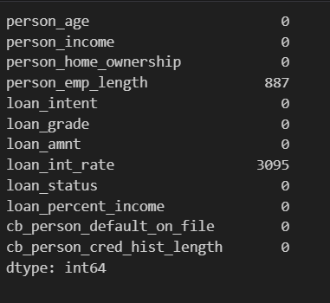
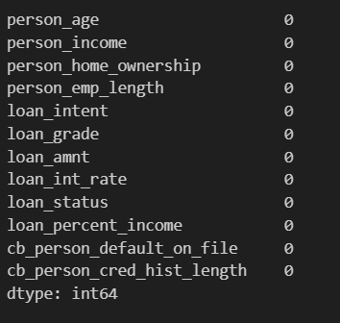
Data Cleaning & Preparation
Libraries Used:
Pandas – Data loading and manipulation
NumPy – Numerical operations
Matplotlib – Data visualization
Seaborn – Statistical plots
Checked dataset shape and structure
Checking Duplicate Values
Duplicate records were checked across the dataset.
Duplicate rows were found and the dupliactes records were dropped.
Checking Null Values
Missing values found in loan_int_rate and person_emp_length.
Median imputation was used

Slide 8
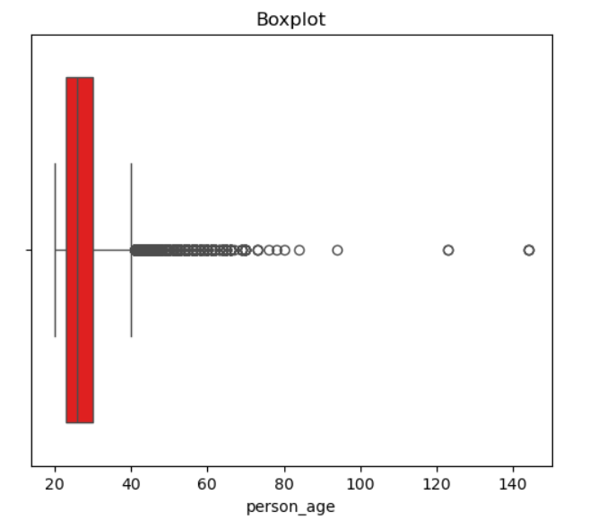
Univariate Analysis
Analysis of individual variables to understand their distribution and overall behavior.
Plots Used
Pie Chart – to show category proportions
Box Plot – to examine numerical spread and outliers
Hist Plot – Histogram help in identifying data distribution, skewness, and concentration of values.
Observations:
Most borrowers fall within the working-age range, showing the loans are taken mainly by economically active people.
A few very young and very old borrowers appear as outliers.
The age distribution is not extremely skewed, meaning loans are spread across different age groups.

Slide 9
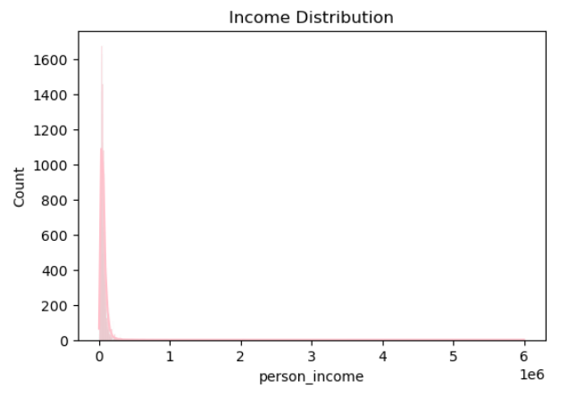
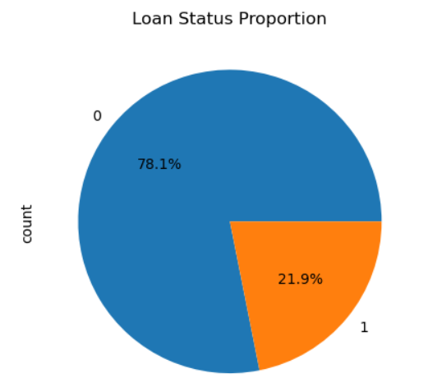
Observations:
Income is right-skewed.
Most borrowers earn in low to medium income range.
Few high-income borrowers raise the average income.
Observations:
Majority of loans are non-default.
Dataset is imbalanced,which reflects real-world banking data.
Even though defaults are fewer, they are critical for credit risk analysis.

Slide 10
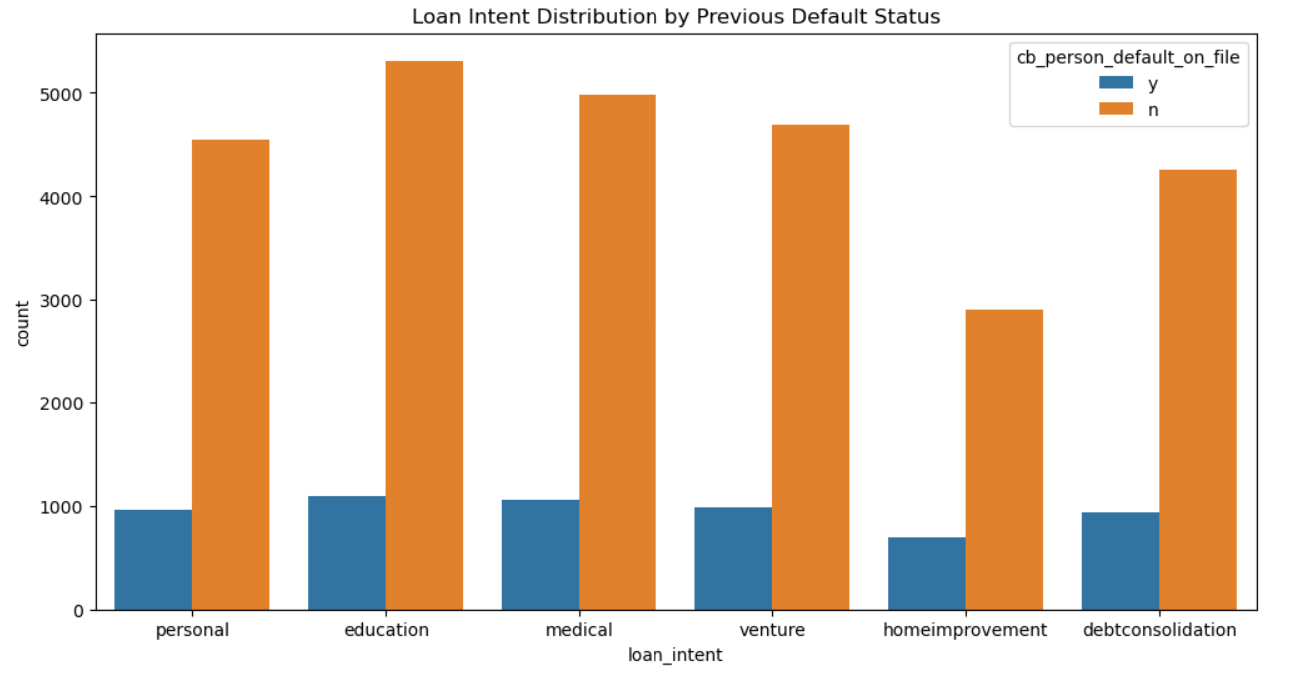
Bivariate Analysis
Analysis of the relationship between two variables to identify patterns or associations.
Plots Used
Count Plot – to compare categorical variables
Scatter Plot – to study relationships between numerical variables
Bar plot – to compare numerical values across categories
Observations:
Borrowers with a previous default on record are more common in medical and education loans.
Loan purpose is closely related to borrower credit history and risk behavior.

Slide 11
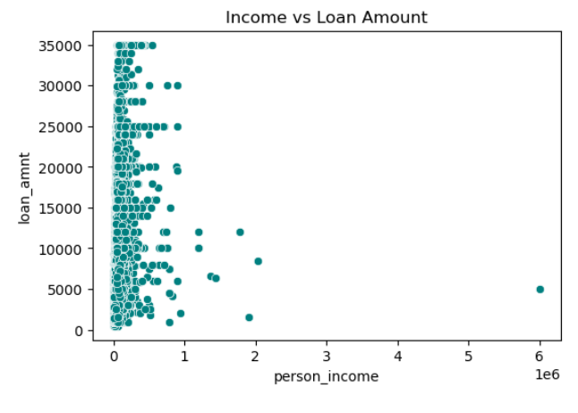
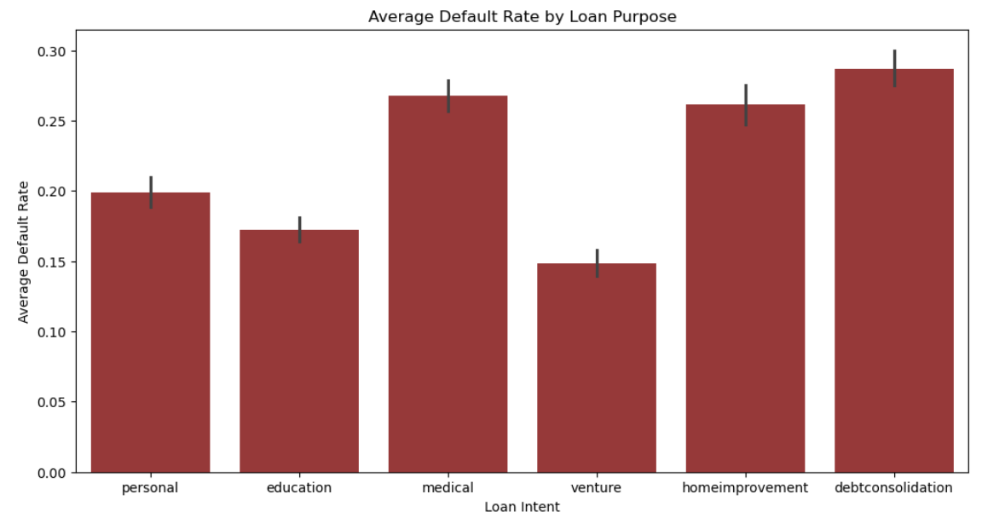
Observations:
Higher income borrowers take larger loans.
Lower income borrowers are concentrated around smaller loan amounts.
Bank considers income while approving loan size.
Observations:
Medical and debtconsolidation loans have higher average default rates.
Education and venture loans show lower default rates.
Loan purpose strongly influences repayment behavior.

Slide 12
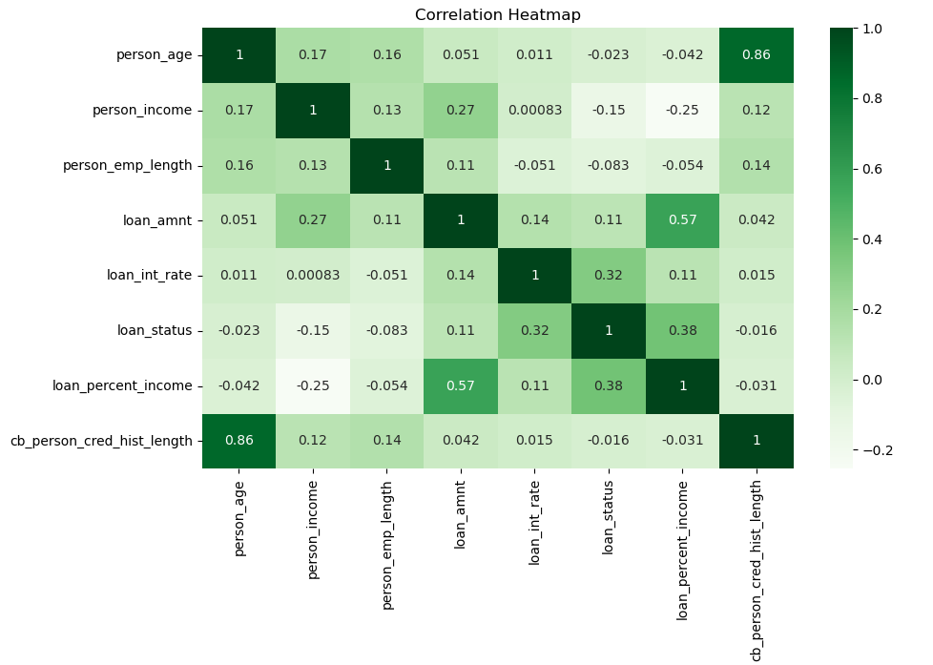
Multivariate Analysis
Multivariate analysis involves three or more variables analyzed together to understand complex interactions.
Graphs Used
Pair Plot
Correlation Heatmap
Observations:
Loan percent income strongly impacts default.
Interest rate increases default risk.
Credit history reduces default risk.
Income is positively related to loan amount.

Slide 13
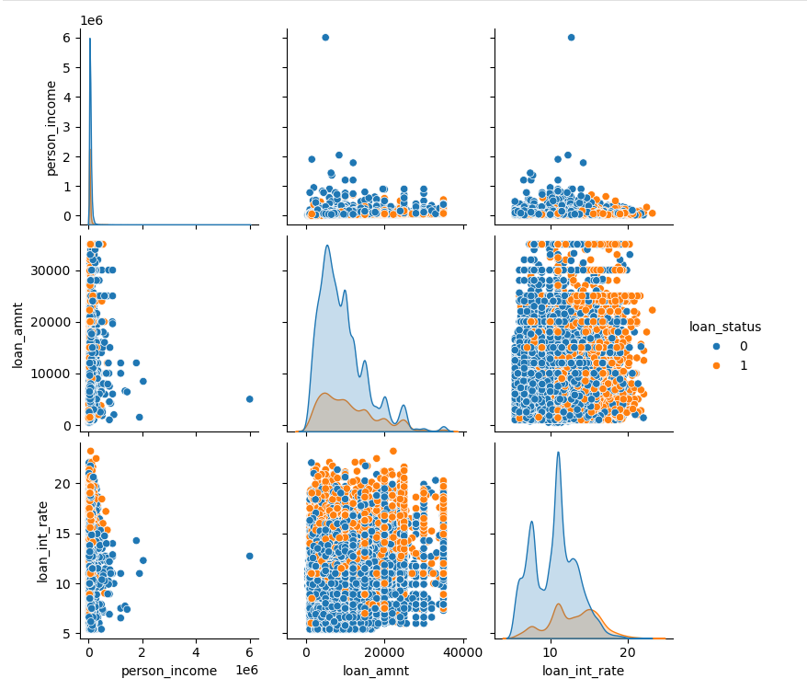
Observations:
Income and loan amount are positively related.
High interest rates align with defaults.
Clear separation between risky and safe borrowers.

Slide 14
Insights
People who take big loans compared to their income are more likely to default.
Borrowers with high interest rates and low loan grades have higher risk.
People with higher income, longer credit history, and home ownership repay loans better.
Conclusion
This project analyzed loan and borrower data using Exploratory Data Analysis.
The data was cleaned and then studied using univariate, bivariate, and multivariate methods.
Loan burden, interest rate, and credit history were found to be the main factors affecting loan default.
Income alone is not enough to predict whether a borrower will repay a loan.

Slide 15

THANK YOU

