Slide 1
PROJECT BOOKSTORE
Publisher
REPORT
Course: PQ-JDEV-B001
Member:Ng Thanh Ng Duy
Last updated: 15/08/2019

Slide 2
CONTENTS
1. OVERVIEW
1.1 DESCRIPTION
1.2 SUPPORTING TOOL
1.3 MODULE DETAIL IS USED
2. ARCHITECTURE OVERVIEW
2.1 CONFIGURING THE DATABASE
2.2 SPECIFYING TABLES
3. FUNCTION LIST

Slide 3
1. OVERVIEW
1.1 DESCRIPTION
Develop a book list module that publisher books by topic, allowing users to select topics according to their interests.
This is an indispensable function in all commercial websites to help optimize time as well as book management for managers.

Slide 4
1. OVERVIEW
1.2 SUPPORTING TOOL
DEVELOPING SOFTWARE |  | Eclipse, Apache Tomcat v8.5, MySQL Sever v5.6, GitHub.
FRONT - END LANGUAGE FRAMEWORK |  | HTML5, CSS3, Javascript, Bootstrap3,Angularjs.
BACK - END LANGUAGE FRAMEWORK |  | Java, JSP, spring ORM, spring AOP, spring MVC, spring CORE, Hibernate.

Slide 5
1. OVERVIEW
1.3 MODULE DETAIL IS USED

Slide 6
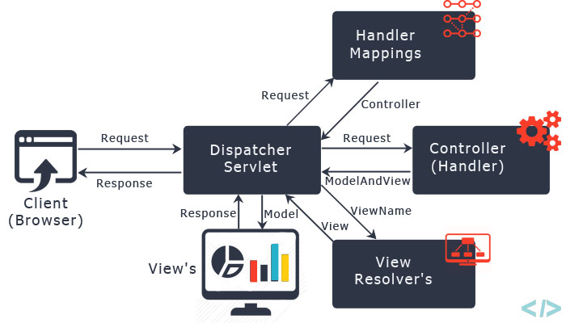
2. ARCHITECTURE OVERVIEW

Slide 7
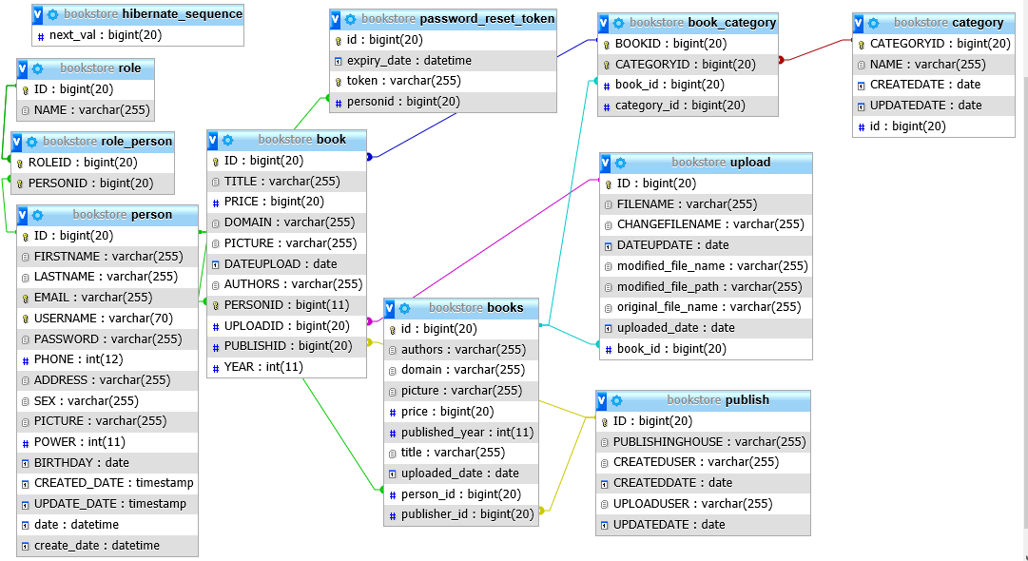

2. ARCHITECTURE OVERVIEW
2.1 CONFIGURING THE DATABASE

Slide 8
2. ARCHITECTURE OVERVIEW
2.1 CONFIGURING THE DATABASE of TABLE Publisher
Name Category | Description
ID | ID của nhà xuất bản và là duy nhất
PUBLISHINGHOUSE | Tên của nhà xuất bản
CREATEDUSER | Người them nhà xuất bản
CREATEDDATE | Ngày thêm
UPLOADUSER | Người tạo
UPDATEDATE | Ngày chỉnh sửa

Slide 9
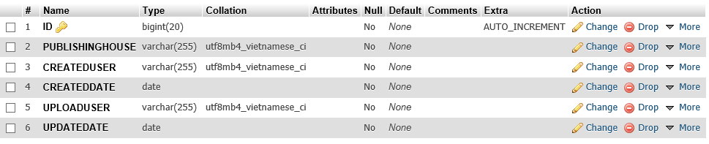

2. ARCHITECTURE OVERVIEW
2.2 SPECIFYING TABLES

Slide 10
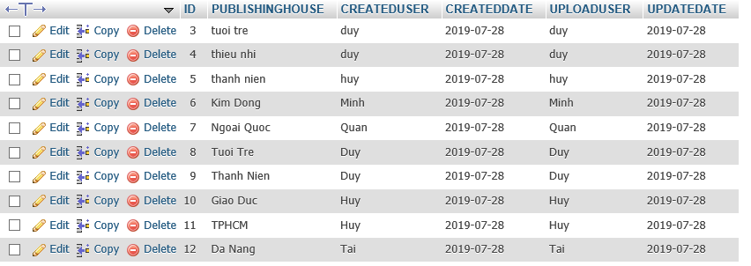

2. ARCHITECTURE OVERVIEW
2.2 SPECIFYING TABLES

Slide 11
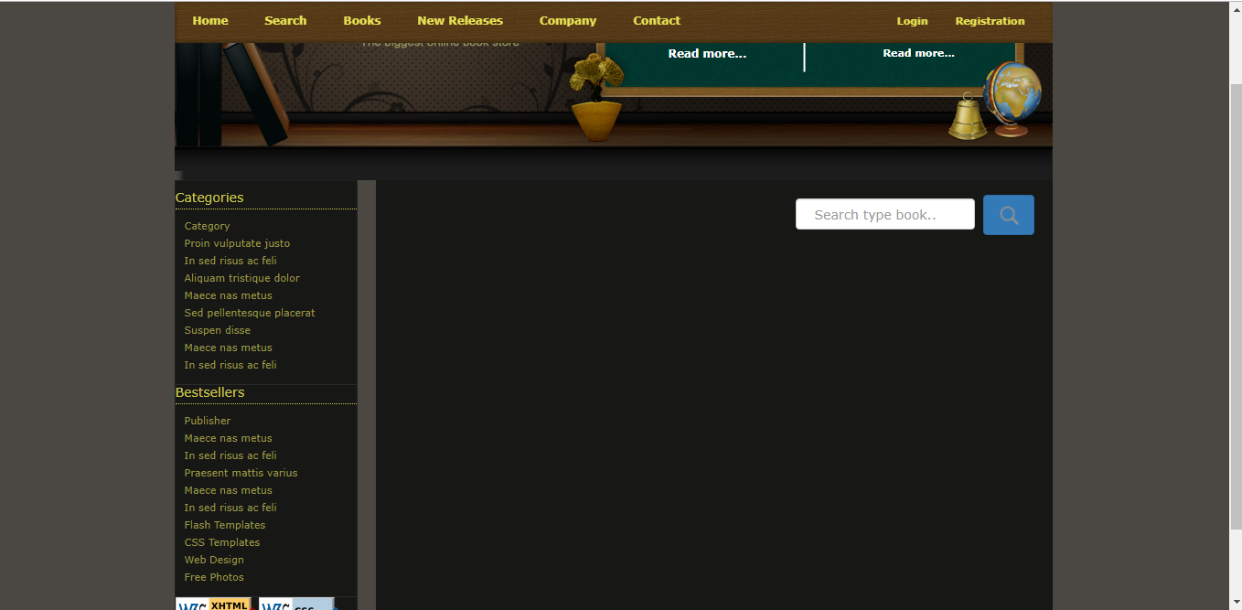
3. FUNCTION LIST
MENU_HOME

Slide 12
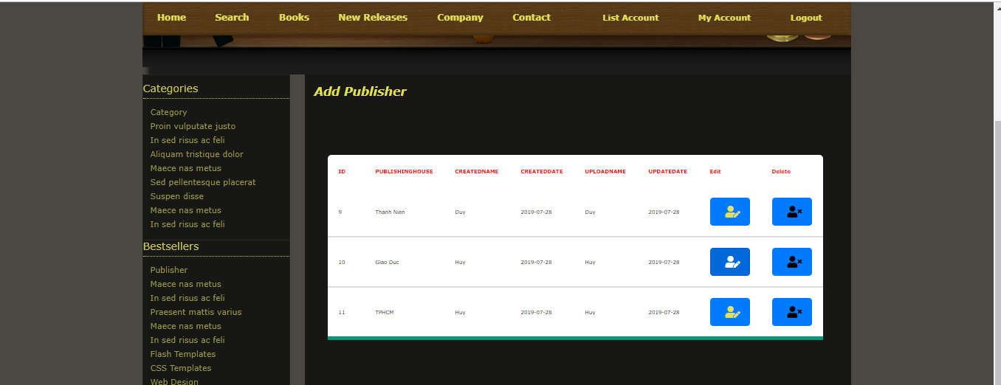
3. FUNCTION LIST
SUBMENU

Slide 13

3. FUNCTION LIST
THE INITIAL SCREEN LIST OF THE PUBLISHER
1.Add Publisher to add a new publisher
2. DETAIL FUNCTION is show detail of selected item.
3. REMOVE FUNCTION is delete selected item

Slide 14
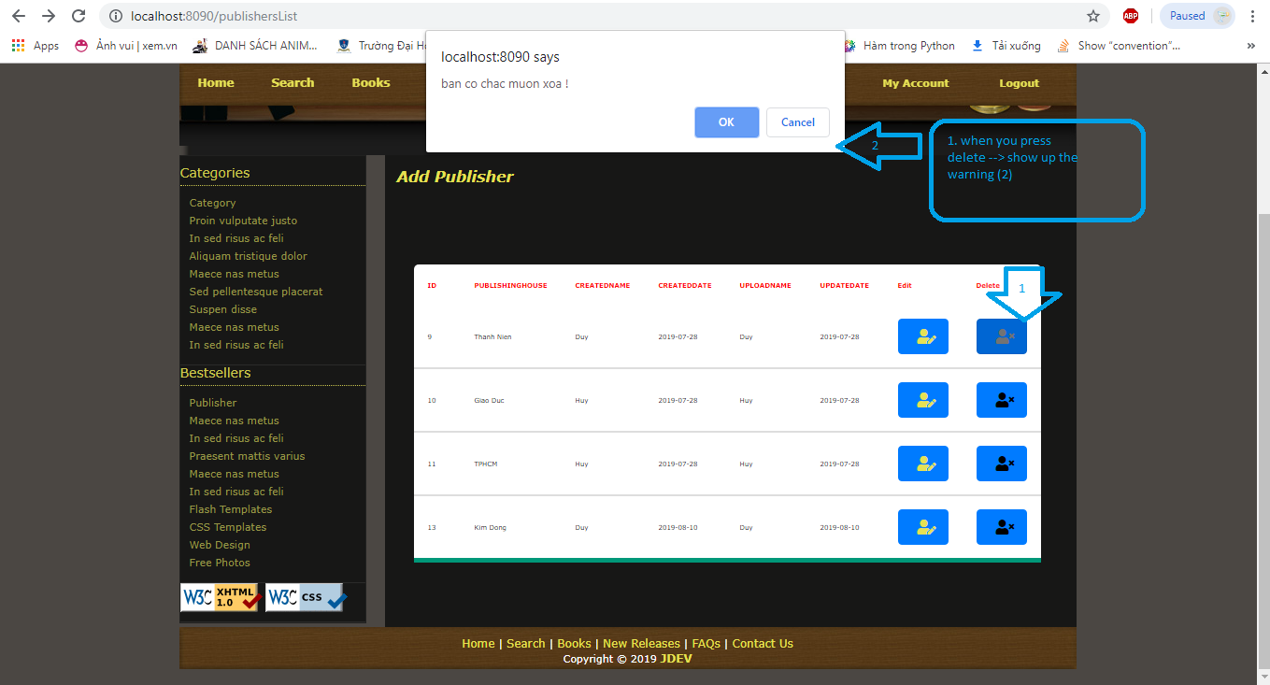
3. FUNCTION LIST
DELETE
when you press delete
-> show up the warning (2)
1
2

Slide 15


