Slide 1



Neural Sequence Labeling based
Sentence Segmentation for Myanmar Language
Ye Kyaw Thu, Thura Aung and Thepchai Supnithi

Slide 2
Table of Content
Introduction
Related Works
Corpus Development
Methodology (NCRF⁺⁺)
Experimental Setup
Results and Discussion
Conclusion

Slide 3
Introduction
The task of segmenting text into sentences that are independent units and grammatically linked words
In the formal Myanmar language, sentences are grammatically correct and typically end with a "။" pote-ma.
Informal language is more frequently used in daily conversations with others due to its easy flow.
There are no predefined rules to identify the ending of sentences in informal usages for the machine itself.
Some of the applications based on conversations, e.g, Automatic Speech Recognition (ASR), Speech Synthesis or Text-to-Speech (TTS), and chatbots, need to identify the end of sentences.

Slide 4
Related Works
Win Pa Pa, Ye Kyaw Thu, Finch,A. , Sumita, E.: Word Boundary Identification for Myanmar Text Using Conditional Random Fields, In Zin, T., Lin, JW., Pan, JS., Tin, P., Yokota, M., (eds) Genetic and Evolutionary Computing. GEC 2015. Advances in Intelligent Systems and Computing, vol 388. Springer, Cham (2016).
Ye Kyaw Thu, Finch, A., Sagisaka, Y., Sumita, E.: A Study of Myanmar Word Segmentation Schemes for Statistical Machine Translation, In Proceedings of the 11th International Conference on Computer Applications, pp. 167-179, Yangon, Myanmar (2013).

Slide 5
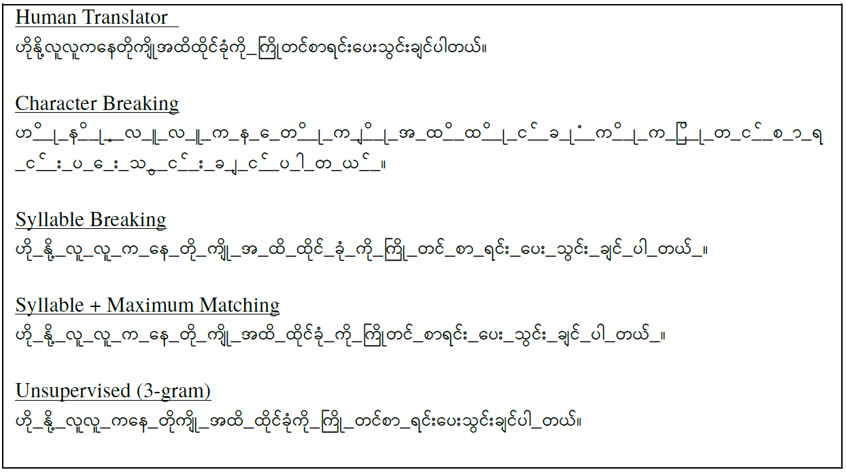
Related Works
Fig 1. Different segmentation methods for a Myanmar sentence (Ye Kyaw Thu et al., 2013)

Slide 6
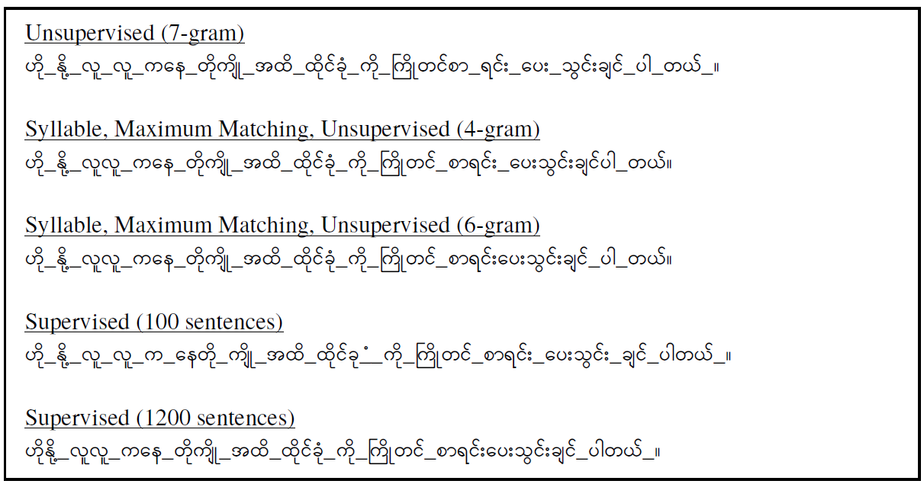
Related Works
Fig 2. Different segmentation methods for a Myanmar sentence (Ye Kyaw Thu et al., 2013)

Slide 7
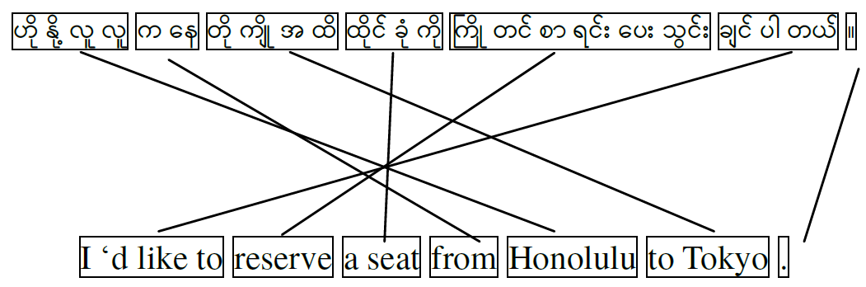
Related Works
Fig 3. A syllable-to-word aligned Myanmar-English sentence pair (Ye Kyaw Thu et al., 2013)

Slide 8
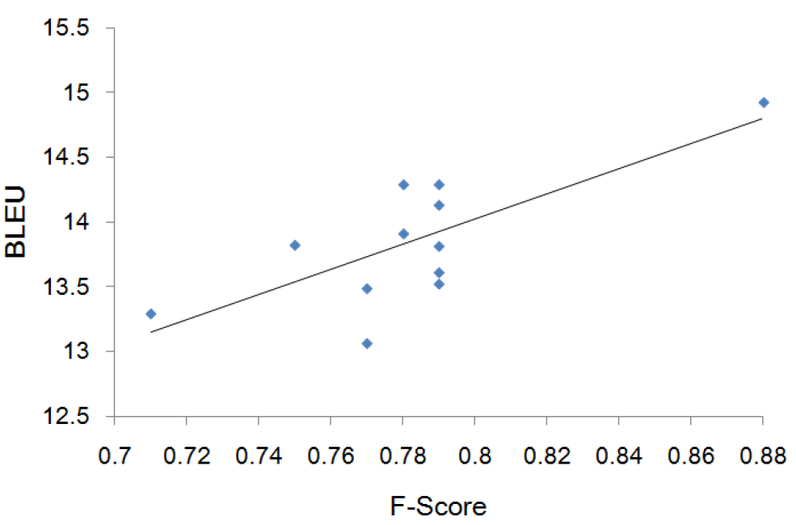
Related Works
Fig 4. The correlation between BLEU and segmentation F-score for my-en (Ye Kyaw Thu et al., 2013)

Slide 9
Related Works
Sadvilkar, N., Neumann, M.: PySBD: Pragmatic Sentence Boundary Disambiguation, In Proceedings of Second Workshop for NLP Open Source Software (NLPOSS), Association for Computational Linguistics, pp. 110-114. (2020)
Authors introduced a multilingual rule-based sentence segmentation tool called PySBD in which Myanmar sentence segmentation is available but it is only useful for formal usages because sentence segmentation is based on the sentence delimiter "။" pote-ma, which is not used in informal communications.

Slide 10
Corpus Development (mySentence)
Myanmar NLP researchers are facing many difficulties arising from the lack of resources; in particular parallel corpora are scarce.
For this reason, we annotated text data manually with mySentence tag information.
The myPOS corpus version 3.0 consists of 43,196 meaningful word sequences written in formal and informal formats from various domain areas and the whole corpus has already been word-segmented manually.
We also collected Myanmar sentences and paragraphs from different online resources such as Facebook and Wikipedia and from the short stories available on Facebook pages.

Slide 11
Corpus Development (mySentence)
Data Resources | sentences | paragraphs
myPOS version 3.0 Covid QandA Facebook posts Wikipedia articles Nay Win Myint’s short stories Nikoye’s short stories Maung Zi’s myth stories | 40,191 1,000 93 2,780 220 327 2,516 | 2,917 1,350 672 1,060 1,150 735 581
Total | 47,127 | 8,465
Table 1. Statistics of sentence segmentation dataset

Slide 12
Corpus Development (mySentence)
Tag | Frequency | Proportion
B E N O | 47,264 48,690 137,592 436,942 | 7.24% 7.33% 20.46% 64.97%
Table 2. Statistics of tags in the mySentence corpus.

Slide 13
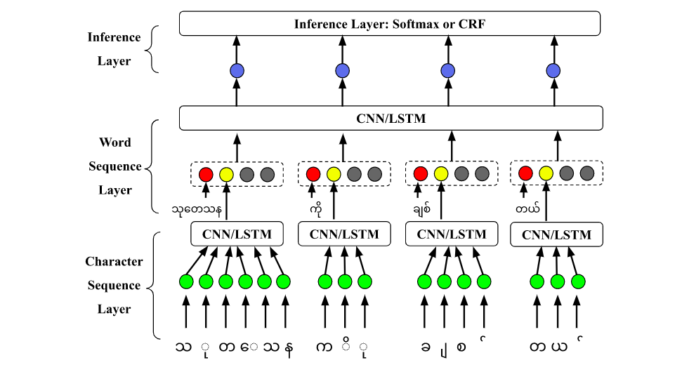
Methodology (NCRF⁺⁺)
Fig 5. NCRF++ for a Myanmar language sentence example

Slide 14
Methodology (NCRF⁺⁺)
Embedding Layer: The input sequences (like words in a sentence) first get represented as embeddings. These can be word embeddings like Word2Vec, GloVe, or character embeddings for character-level information.
Encoder Layer: After getting the embeddings, they are passed through an encoder, typically a recurrent neural network (RNN), long short-term memory (LSTM), or a gated recurrent unit (GRU). This helps capture contextual information of the sequence.
CRF Layer: On top of the neural network structure, a CRF layer is applied. CRFs help in ensuring that the sequence of labels output by the model is coherent. Instead of just predicting each label independently, the CRF layer takes into account the surrounding labels to make a decision.

Slide 15
Experimental Setup
 | sentence | sentence + paragraph
train validation test | 40,000 2,414 4,712 | 47,000 3,079 5,512
Table 3. Dataset splitting for the experiments.

Slide 16
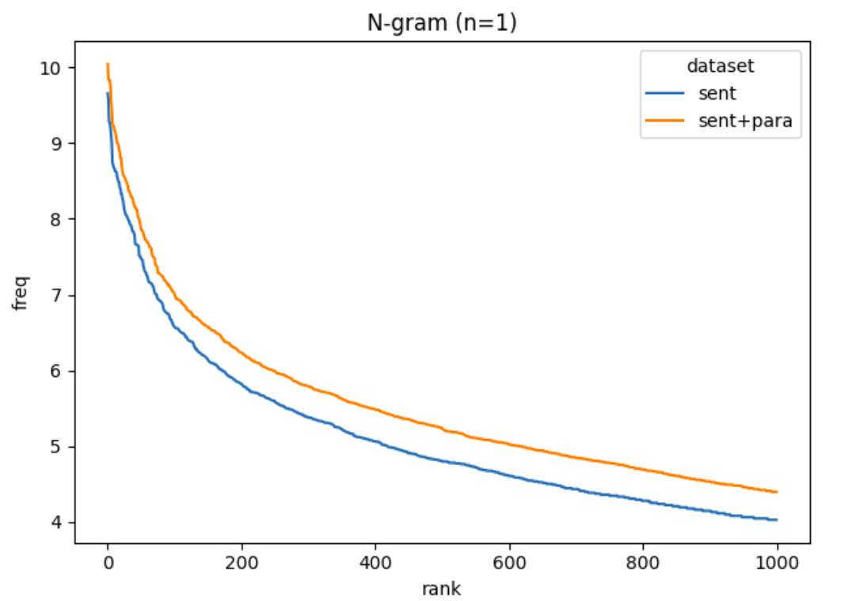
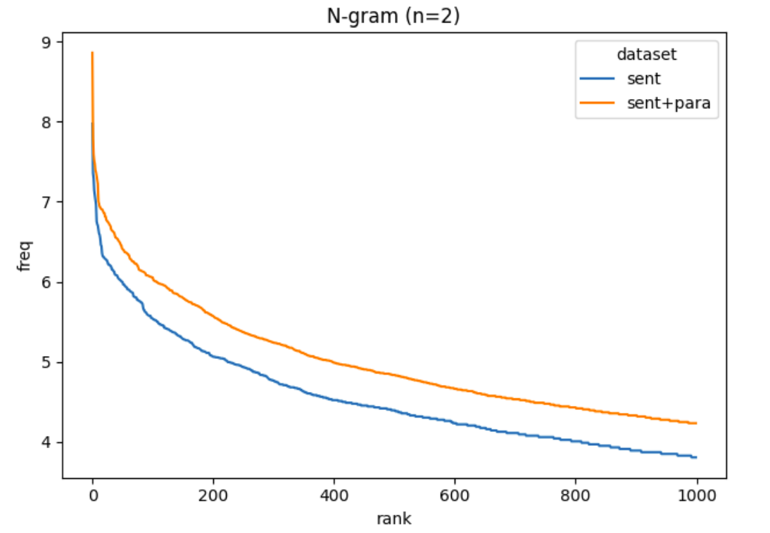
Experimental Setup
The word distribution with Zipf’s law between two datasets measured with top 1,000 words for 1-gram and 2-gram are as shown in Fig 6.
The Zipf curves for the two datasets are almost identical and show the similarity of word distributions.
Fig 6. Zipf’s law distributions in 1-gram and 2-gram analysis of word between sentence only and sentence+paragraph datasets.

Slide 17
Experimental Setup
Parameter | Value | Parameter | Value
char emb size | 30 | word emb size | 50
char hidden | 50 | word hidden | 200
CNN layer | 4 | CNN kernel size | 3
dropout rate | 0.5 | batch size | 10
L2 regularization λ | 1e-8 | learning rate decay | 0.05
epochs | 100 | optimizer | SGD
Table 4. Hyperparameters used in experiments.

Slide 18
Results and Discussion
 | Test Data | wCNN + Softmax | wCNN + CRF | wLSTM + Softmax | wLSTM + CRF
NoChar | sent sent + para | 99.92 93.58 | 99.95 93.63 | 99.95 93.63 | 99.95 93.63
cCNN | sent sent + para | 99.95 93.63 | 99.95 93.63 | 99.95 93.63 | 92.02 87.65
cLSTM | sent sent + para | 99.95 93.63 | 99.95 93.63 | 99.95 93.63 | 99.91 93.59
Table 5. Accuracy % comparison of sentence-level models
(c = Character, w = Word, sent = sentence and para = paragraph)
The bold results show the highest accuracies achieved in each test data.

Slide 19
Results and Discussion
 | Test Data | wCNN + Softmax | wCNN + CRF | wLSTM + Softmax | wLSTM + CRF
NoChar | sent sent + para | 99.41 96.82 | 99.49 96.25 | 99.44 97.40 | 86.44 96.61
cCNN | sent sent + para | 99.26 96.87 | 99.27 96.17 | 74.81 74.69 | 86.44 83.13
cLSTM | sent sent + para | 99.66 96.36 | 99.49 96.04 | 99.49 97.29 | 99.56 96.61
Table 6. Accuracy % comparison of sentence+paragraph-level models
(c = Character, w = Word, sent = sentence and para = paragraph)
The bold results show the highest accuracies achieved in each test data.

Slide 20
Results and Discussion
Freq | Confusion Pair (REF ⇒ HYP)
7078 1951 1229 1224 48 | N ⇒ O O ⇒ N E ⇒ O B ⇒ O B ⇒ N
Table 7. The Top 5 confusion pairs of sent cCNN+wLSTM+CRF model
tested on sent+para test data (87.65% accuracy)

Slide 21
Results and Discussion
According to the comparison of twelve NCRF++ architectures trained and tested on both sentence and sent+para data, we can see that the word LSTM with softmax inference layer and no character representation layer had the best accuracy with sent-level (99.95%) as well as sent+para-level (97.40%) data.
According to the error analysis, most of the errors occurred because the models falsely recognized "O" tags, which have the highest proportion in the dataset.

Slide 22
Conclusion
Feature Learning: Unlike traditional CRFs that require manual feature engineering, NCRF⁺⁺ can automatically learn features.
End-to-End: The model can be trained in an end-to-end fashion, which simplifies the process and can lead to better results.
Flexibility: NCRF++ provides flexibility to use various types of embeddings and neural architectures.
Performance: The integration of deep learning and CRFs often leads to state-of-the-art results in sequence labeling tasks.

Slide 23
Conclusion
In the future, we will investigate the impact of pre-trained word embeddings on this sequence labeling based sentence segmentation task with different embedding settings for a low-resource language-Myanmar.
We make all our configuration files, code, data, and models publicly available (https://github.com/ye-kyaw-thu/mySentence).

Slide 24
Thank you!
Cảm ơn!

