Slide 1
Capstone Project-3
Company Bankruptcy Prediction -Turab Ahmed

Slide 2
Topics for discussion
Defining the Problem Statement
Data Summary
EDA
Feature Engineering
Feature Selection
Preparing Dataset for applying the model
Applying Models
Model validations

Slide 3

Problem Statement
Estimating the risk of corporate bankruptcies is of large
importance to creditors and investors. There are large indirect
and direct costs associated with financial distress and Corporate
bankruptcies can have serious effects both locally and globally
on employees, investors, customers, suppliers and their financiers are all affected when a company disappears. In some cases, a corporate bankruptcy can cause an entire industry to suffer.
Here, I’ll be building a model to predict whether a company bankrupt or not depending on the available dataset.

Slide 4
Data Pipeline
EDA:- We did some Exploratory Data Analysis on the data to Analyze most of the information.
Data Preprocessing:- Company Bankruptcy data contains class imbalance and we have used SMOTE(Synthetic Minority Over-sampling Technique) to balance the data with equal number of classes. Then we used MinMax Scaler Transformation to make the data with same units.
Model Creation: Once we have analyzed the data and preprocessing the data, next will be building the model to predict the Company Bankruptcy. We will start from the simple model and apply different classification models to predict the same and decide which gives us a good accuracy.

Slide 5
Data Summary
Df:- This variable holds all the original data such as Bankrupted?, Cash flow ,Tax rate and so on. This variable holds 6819 rows and 96 columns
Df_copy: This dataset contains manipulation of original dataset(Df). Handling the class imbalance and applying the model is done through this dataset. This variable holds 13k+ rows and 66 columns.

Slide 6
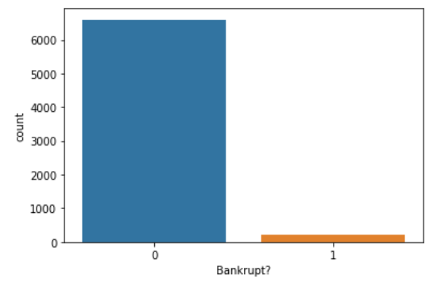
EDA- Target variable
About 6599 rows of data are not
Bankrupted
About 220 rows of data are bankrupted.
This shows us clearly that the class is
imbalanced, we must make use of
SMOTE under oversampling technique
to make the class balance before
applying the model.

Slide 7
Multicollinearity validation and Feature selection
When checked the correlation between the variables, there was a multicollinear relationship exists among many of the independent variable.
The model will not give us a good result when we trained with multicollinearity, so removing the independent variable which has a correlation value of greater than or equal to 0.89 (89%) with another independent variable.
About 30 variables fall in the category of 89% and above strongly correlated with another variable, so removed all those 30-variable data
Now, this data(65 columns) is considered as the features to be applied for model training and validations.

Slide 8
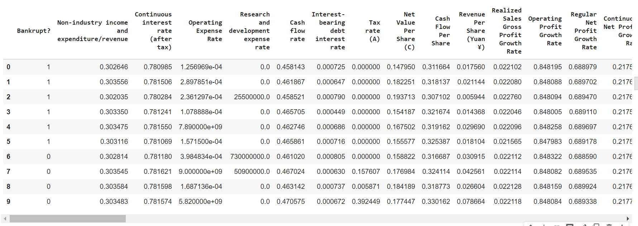
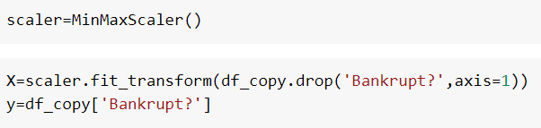
Viewing the dataset.

Slide 9
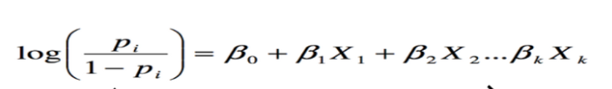


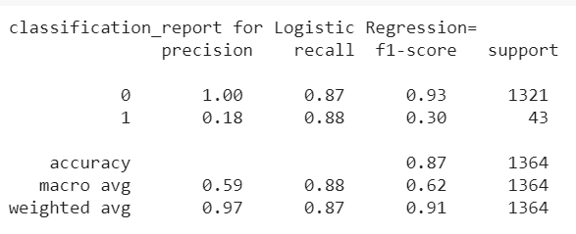
Logistic Regression
We’ll first apply logistic regression method on our data.
The training score and Testing score is 88% and 87% respectively.
Below is the classification report for the model,

Slide 10
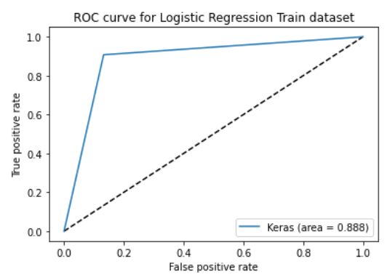
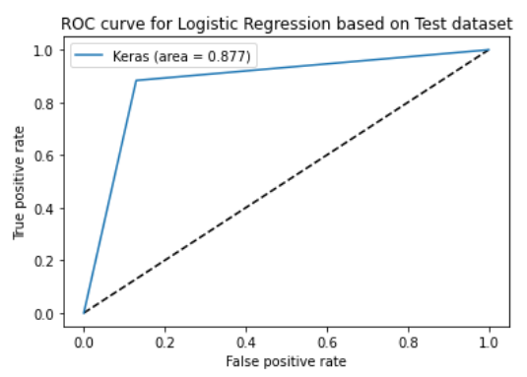
Roc_Auc score/curve for the training dataset is 89% and for testing dataset is 87%

Slide 11
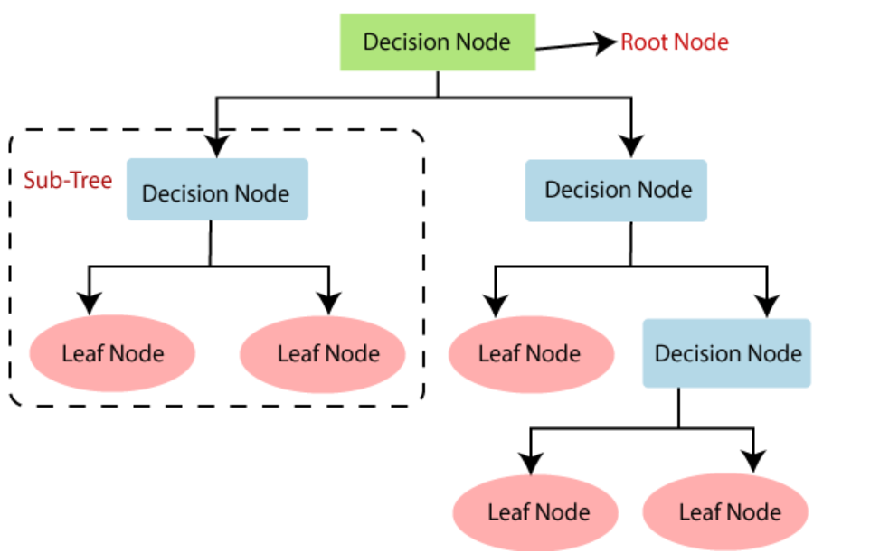
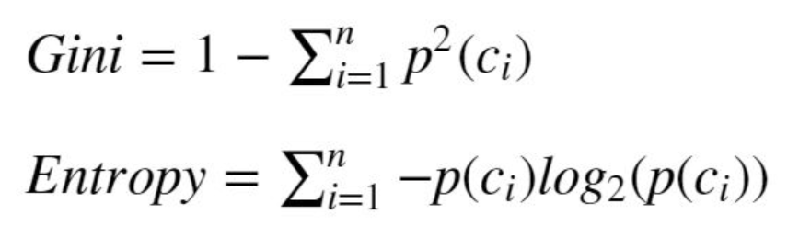
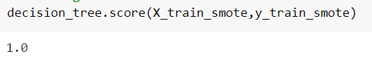

Decision Trees
Next, we’ll apply Decision Trees to our data. It uses Information gain to split the data and form as a tree
The training score is 100% and testing score is 93% for decision tree.

Slide 12
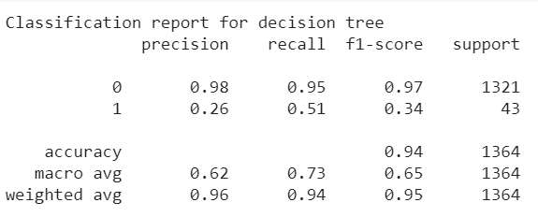
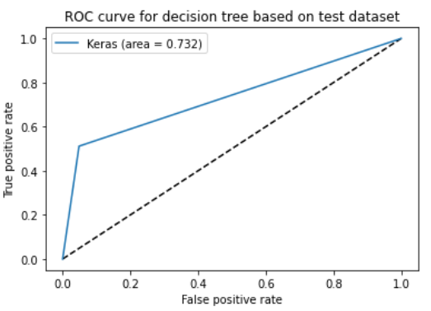
Classification report for decision tree.
The Roc curve for the training dataset is 73%.

Slide 13
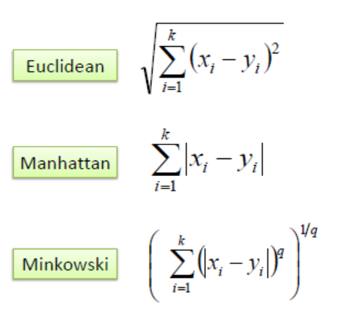


K Nearest Neighbor classifier
KNN uses Euclidean or Manhattan from Minkowski equation to calculate nearest point.
The training score for KNN is 95% and test score is 86%.

Slide 14
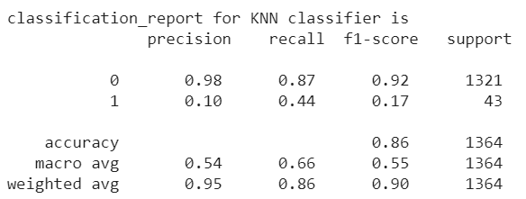
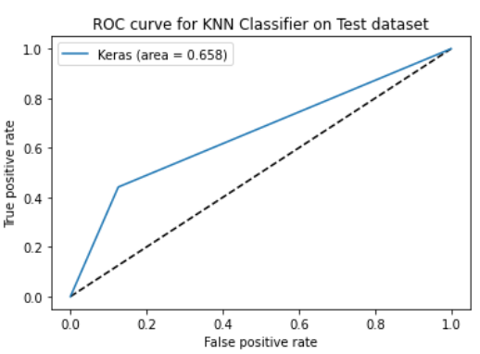

Slide 15
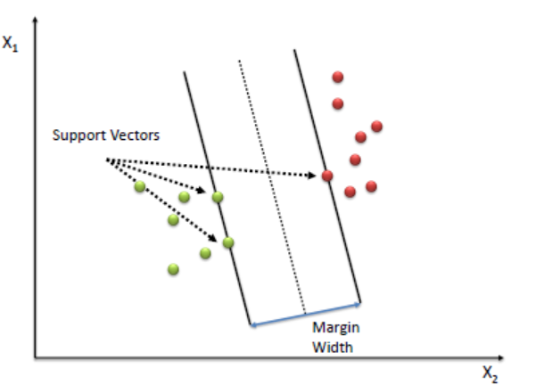
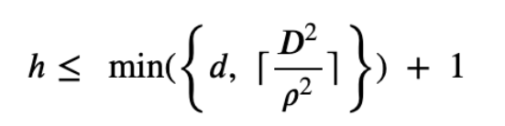


Support vector machine model
The algorithm creates a line or a hyperplane which separates the data into classes and looks for the data which have large marginal width.
SVM training and testing scores are 91% and 88% respectively.

Slide 16
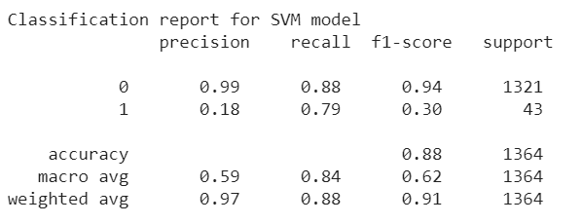
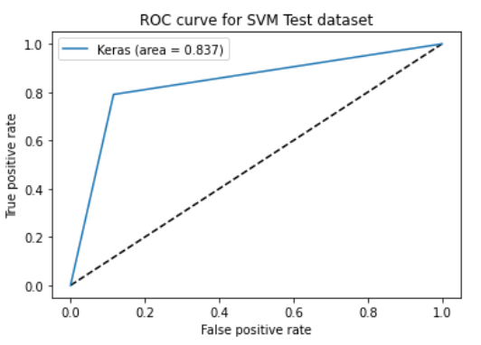

Slide 17
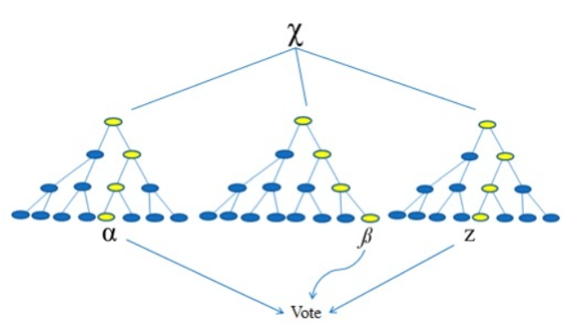
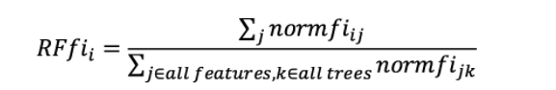


Random Forest
Random Forest is an ensemble bagging technique.
The Random Forest training score is 100% and testing score is 95%

Slide 18
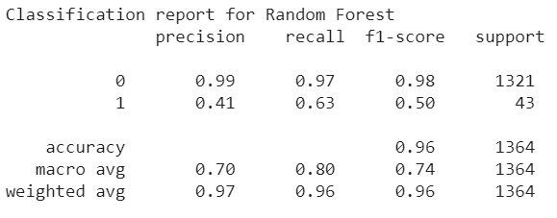
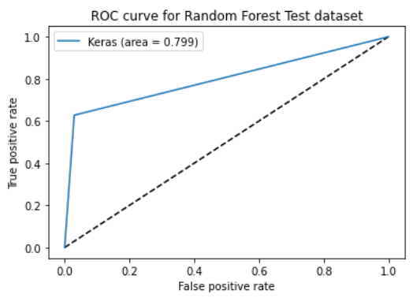

Slide 19
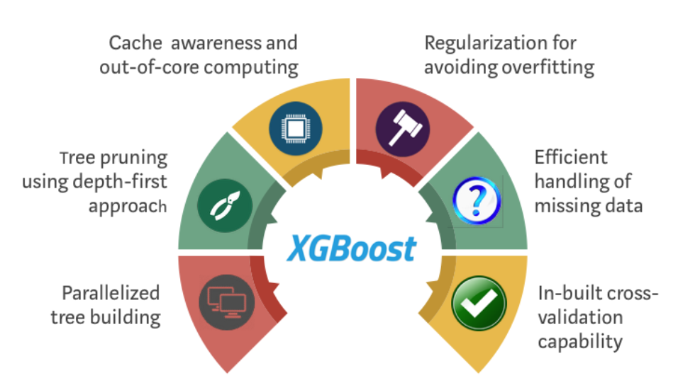



XGBoost Classifier
XGBoost is an ensemble boosting technique.
The training score is 97% and testing score is 93% for XGBoost.

Slide 20
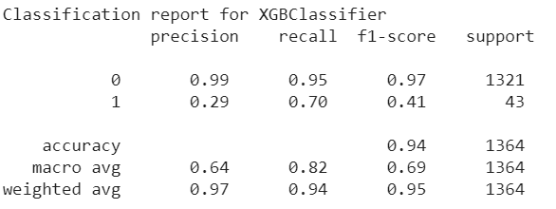
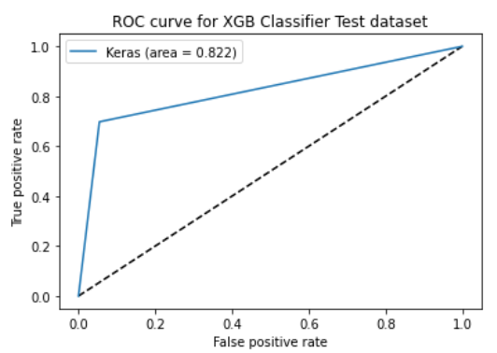

Slide 21
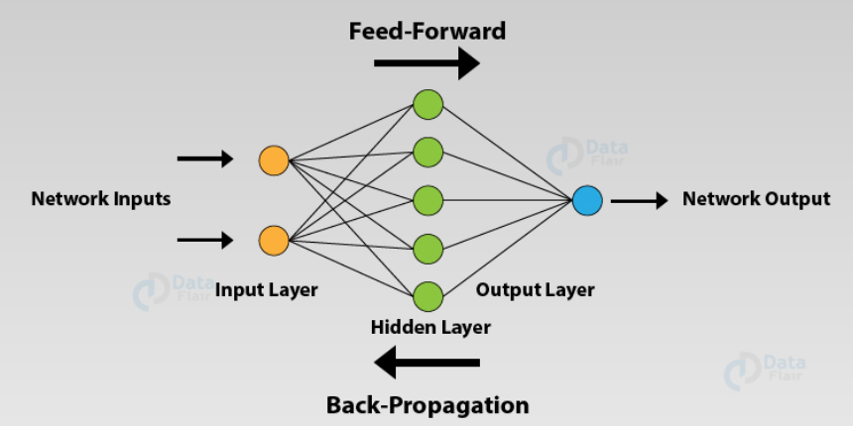
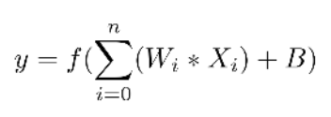
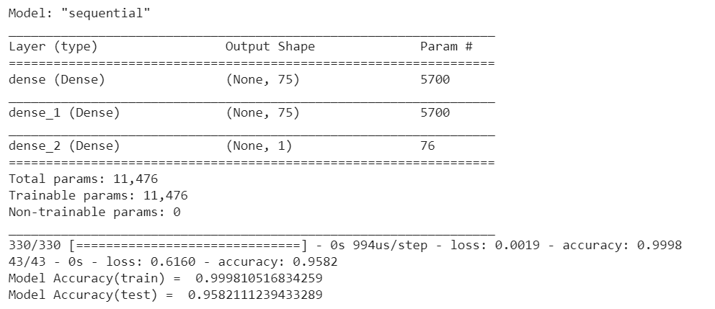
Aritificial Neural Network
Neural networks are complex models, which try to mimic the way the human brain develops classification rules.

Slide 22
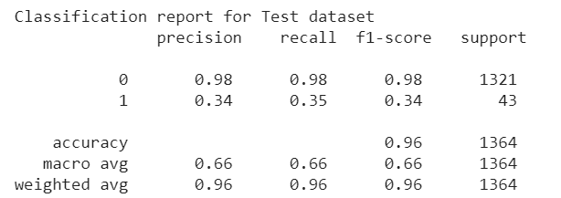
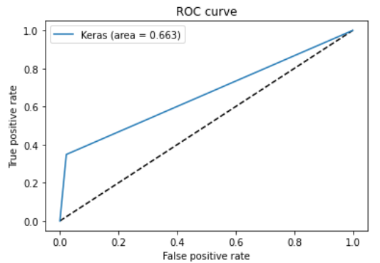

Slide 23
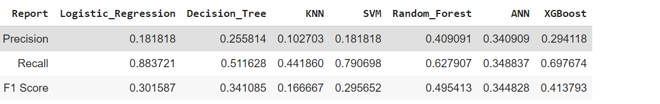
All Models report metric

Slide 24
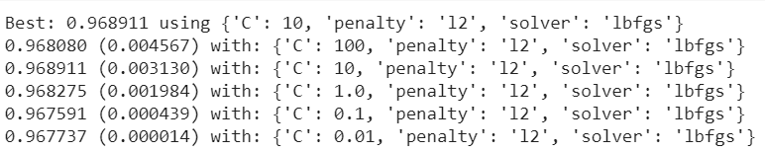

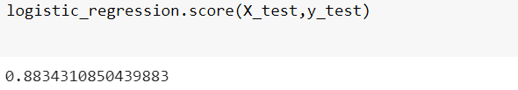
Hyper Parameter Tuning for Logistic Regression
For hyper parameter tuning, Gird search cross validation is used with cv=5. The best regression strength comes out to be with C=10

Slide 25
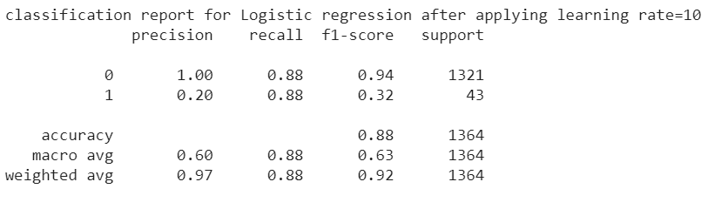
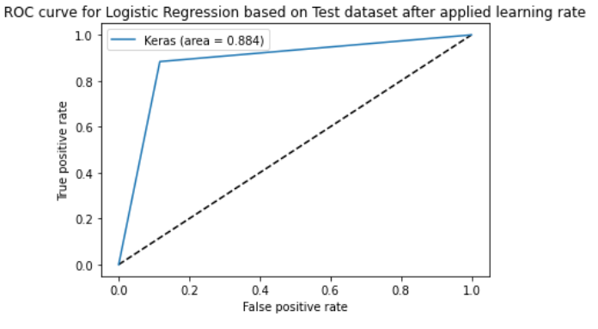

Slide 26
Conclusions
We have a dataset of Company Bankruptcy of 6819 rows and 96 columns.
Multicollinearity exists among independent variables, when it is not treated our model will perform poorly, so the independent variables which are strongly correlated with other independent variables are dropped. Which resulted in dropping of 30 columns. The dataset becomes 6819*66. This dataset becomes the features to be applied in the models
The dataset has imbalanced data on the target variable, so oversampling method of SMOTE is used to balance the data. Which resulted in 13,638 rows and 66 columns.
We have used MinMaxScaler transformation to our dataset to make it as same units.
Applied Logistic Regression with Maximum iteration=1000 and default regression strength(C=1.0), the model able to Recall 88.37%.
Next, tried with Decision Trees model with ‘Gini’ criterion, the model able to recall only 51.16%.
Next, applied K Nearest Neighbor with Euclidean and Manhattan distance, the model able to produce a recall of 44.18%, which is still lower than Logistic regression
Next, applied Support Vector Machines, the model able to produce the recall score of 79.06%.

Slide 27
Conclusions (continuation)
Next, applied with Random Forest Classifier, the model able to produces a recall score of 62.79% only.
Next, tried with XGBoost(Extreme Boost) Classification, the model able to produces a recall score of 69.76% only.
Next, tried with Artificial Neural Network with 76 input layers, 76 hidden layers and 1 output layer, the model able to produces a recall score of 34.88%.
By comparing all the models, Logistic Regression model gives us very good recall score of 88.37%
We applied Grid Search Cross Validation to Logistic Regression with cv=5 for further improvement on the accuracy, grid search cv gives us the regression score of C=10 to get good result. This produced a recall score of 88%
With that we have build a model which predicts Company Bankruptcy prediction with 88% of Recall using Logistic Regression.

