Slide 1
Capstone Project-4
Customer Segmentation

Slide 2
Topics:-
Defining the problem statement
Data Summary
EDA
RFM(Recency, Frequency, Monetary)
Feature Engineering
Feature Selection
Preprocessing and Scaler transformation
Choosing the number of optimal clusters
Applying the model.

Slide 3
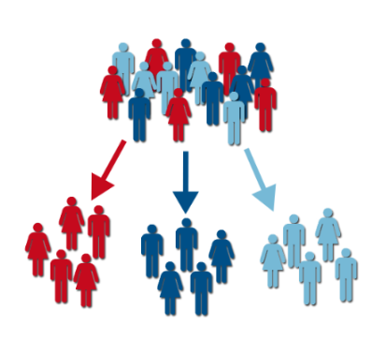
Problem Statement:-
Customer segmentation is the practice of dividing
a company's customers into groups that reflect
similarity among customers in each group.
The goal of segmenting customers is to decide
how to relate to customers in each segment in
order to maximize the value of each customer to
the business.
Here, I will apply clustering algorithm to segment the customers.

Slide 4
Data Summary:-
The dataset contains transactions occurred between 01/12/2010 and 09/12/2011.
Number of observation: 541,909
Number of features: 8
Number of transaction:22,190
Number of customers: 4,372
Number of products:3,684

Slide 5
Data Understanding:-
InvoiceNo: Invoice number. Nominal, a 6-digit integral number uniquely assigned to each transaction. If this code starts with letter 'c', it indicates a cancellation.
StockCode: Product (item) code. Nominal, a 5-digit integral number uniquely assigned to each distinct product.
Description: Product (item) name. Nominal.
Quantity: The quantities of each product (item) per transaction. Numeric.
InvoiceDate: Invoice Date and time. Numeric, the day and time when each transaction was generated.
UnitPrice: Unit price. Numeric, Product price per unit in sterling.
CustomerID: Customer number. Nominal, a 5-digit integral number uniquely assigned to each customer.
Country: Country name. Nominal, the name of the country where each customer resides.

Slide 6
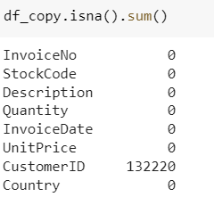
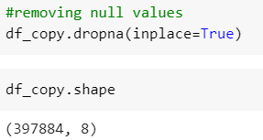
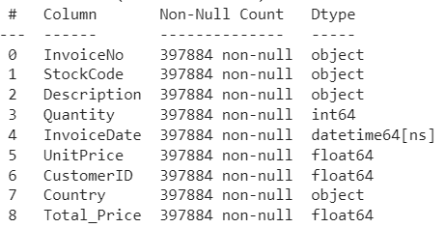
Null values treatment:-

Slide 7
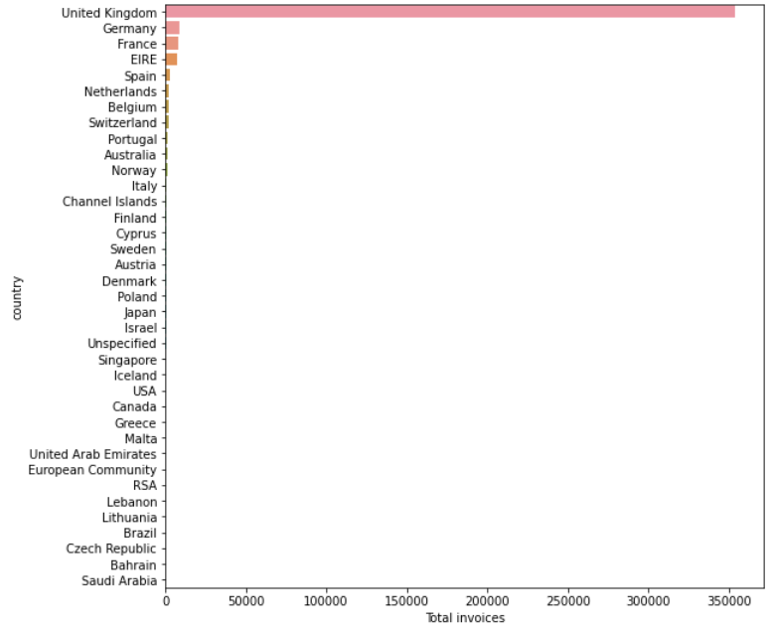
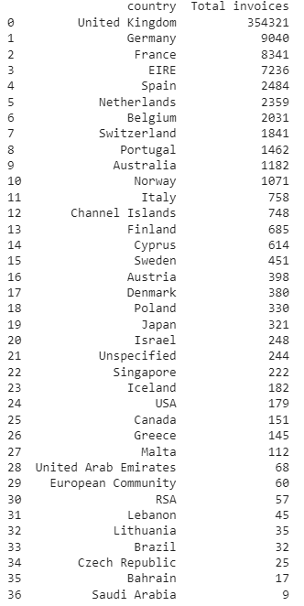
Exploratory Data Analysis (EDA):-

Slide 8
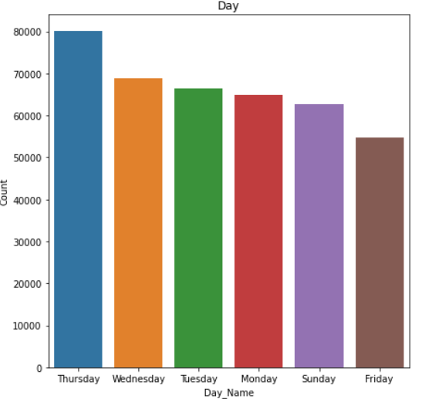
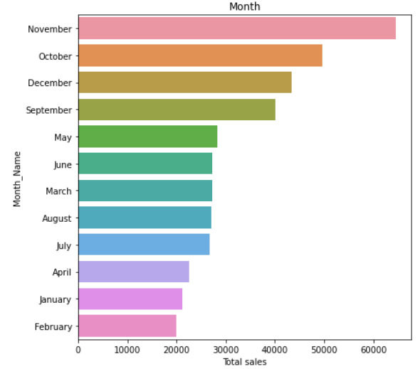

Slide 9
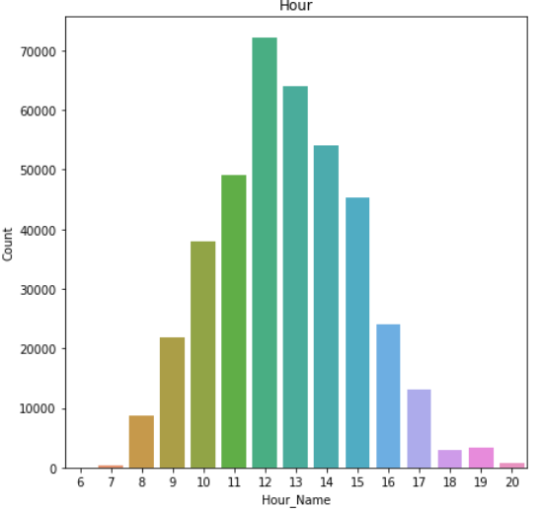
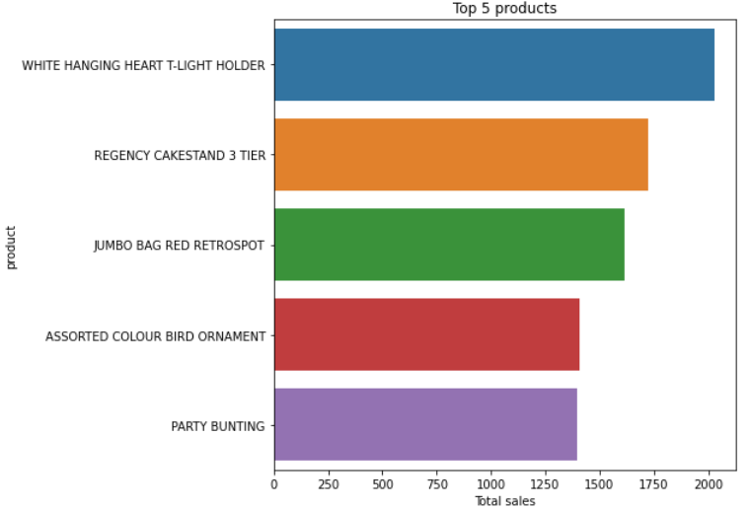

Slide 10
Recency, Frequency, Monetary(RFM):-
Recency, frequency, monetary value is a marketing analysis tool used to identify a company's or an organization's best customers by measuring and analyzing spending habits. We will assign best score as ‘1’ and worst score as ‘4’ for RFM metrics.
Recency- Most recent purchase by customer. This is calculated by the number of days between present date and date of last purchase of the customer.
Frequency- How many times the customer purchased. This is Calculated by the number of orders for each customer.
Monetary- How much revenue generated through the customer. This is Calculated by the sum of purchase price for each customer

Slide 11
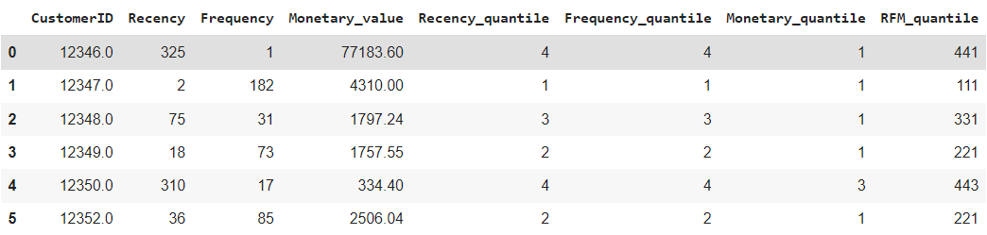
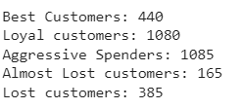

Slide 12
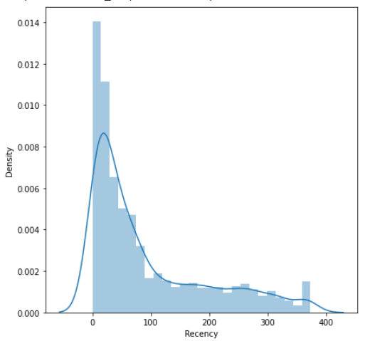
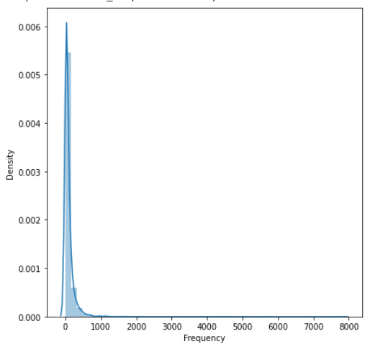
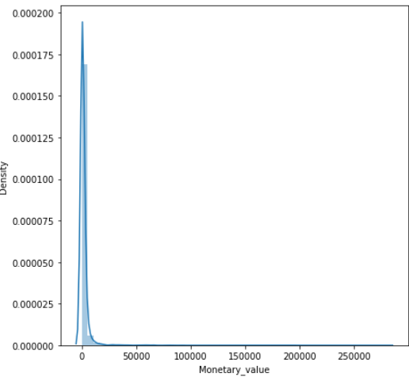
Feature Engineering and Selection:-

Slide 13
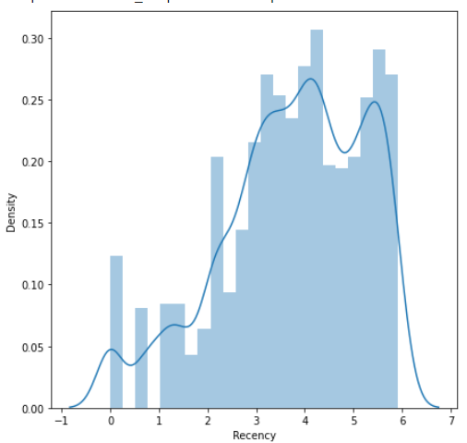
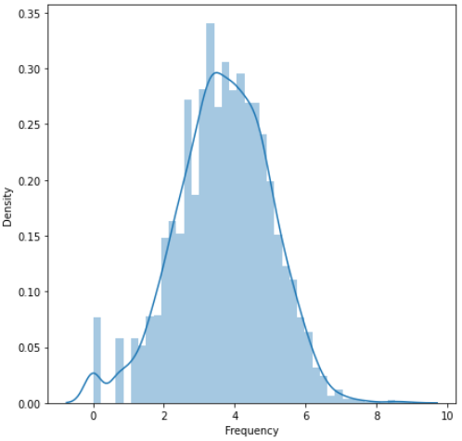
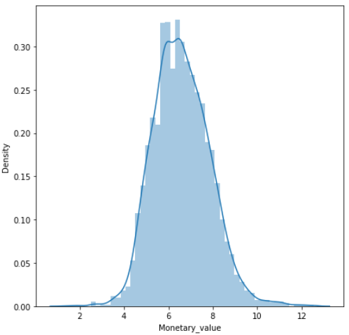
After applying Log transformation

Slide 14


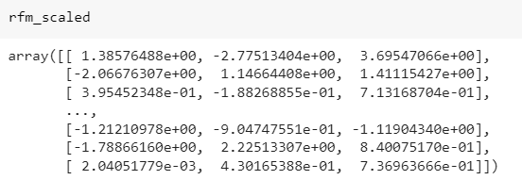
Data Preprocessing:-

Slide 15
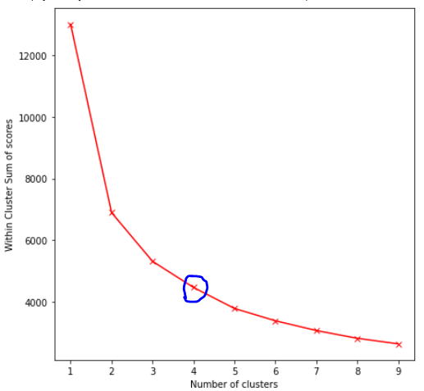
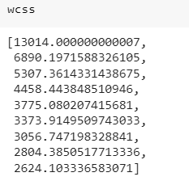
Finding Number of Optimal Clusters:-

Slide 16
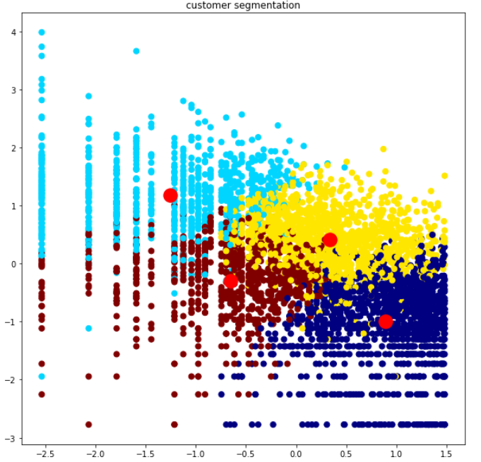
Applying K-Means Clustering:-

Slide 17
Conclusions:-
We have a dataset of 541,908 rows and 8 columns.
The dataset contains transactions occurred between 01/12/2010 and 09/12/2011.
The dataset contains ‘Null’ values of 132,220 rows, which we have dropped. After dropping the dataset contains 397,884 rows.
Then we performed Exploratory data analysis. Through EDA, we came to know that the dataset contains total of 37 countries, where UK tops the list with 300k+ invoices and Saudi Arabia at the bottom with only 9 invoices.
The most selling products are ‘White Hanging heart T-light holder’, ‘Regency Cake Stand’ and ‘Jimbo bag red retrospect’
When analyzed based on hourly bases, noon session is where most invoices generated, particularly between 12 PM and 3 PM
When analyzed based on day, ’Thursday’ is the most invoices generated day.
When analyzed based on month, ’November’ month is the most invoice generated month.

Slide 18
Conclusions (Continuation):-
Then, we applied Recency, Frequency and Monetary value metrics
We given number ‘1’ for best score and ‘4’ for worst score in RFM metrics
Based on RFM, the count of best customers are 440, Loyal customers are 1080, Aggressive spenders are 1085, Almost lost customers are 165 and Lost customers are 385.
For applying the model, the dataset must be symmetrical in shape for good results, when we look at distribution plot of our data, it was rightly skewed so we introduced Log transformation to result in symmetrical data.
For data transformation, we used Standard scaler transformation.
Then, we used Elbow method to determine number of optimal clusters. Which gave as cluster value-4.
By using k-means clustering, we were able to segment the customers in to 4 groups.

