Slide 1
Capstone Project-2
NYC Taxi Trip Duration -Turab Ahmed

Slide 2
Topics for discussion
Defining the Problem Statement
Data Summary
EDA
Feature Engineering
Feature Selection
Preparing Dataset for applying the model
Applying Models
Model validations

Slide 3
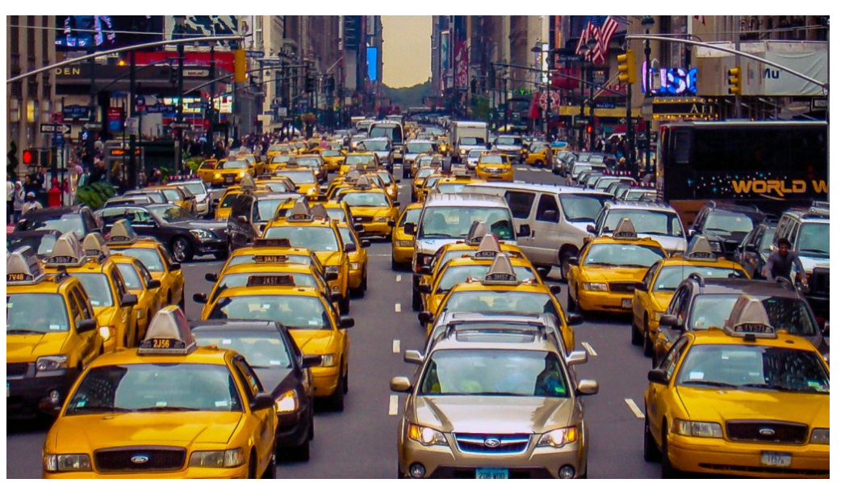
Problem Statement
A typical taxi company faces a common problem of efficiently
assigning the cabs to passengers so that the service is smooth
and hassle free. One of main issue is determining the duration
of the current trip so it can predict when the cab will
be free for the next trip.
The data set contains the data regarding several taxi trips and its duration in New York City. I will now try and apply different techniques of Data Analysis to get insights about the data and determine how different variables are dependent on the target variable Trip Duration.

Slide 4
Data Pipeline
Data Preprocessing:- NYC Taxi Trip data contains outliers and we have removed the outliers in the first step. Then converting the categorical/object datatype variables to numerical representation and selecting features from numerical data which makes easier for the model to learn.
EDA:- We did some Exploratory Data Analysis on the data to Analyze most of the information.
Model Creation: Once we have analyzed the data, next will be building the model to predict the taxi trip duration. We will start from the simple model and apply different regression models to predict the same.

Slide 5
Data Summary
Df:- This variable holds all the original data such as id,Vendor_id, pickup_datetime, dropoff_datetime, trip_duration and so on. This variable holds 1.4 Million+ of rows
Df_copy: This dataset contains manipulation of original dataset(Df). Handling the outliers and applying the model is done through this dataset. This variable holds 1.3 Millions+ of rows

Slide 6
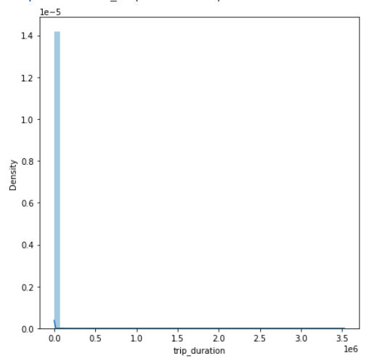
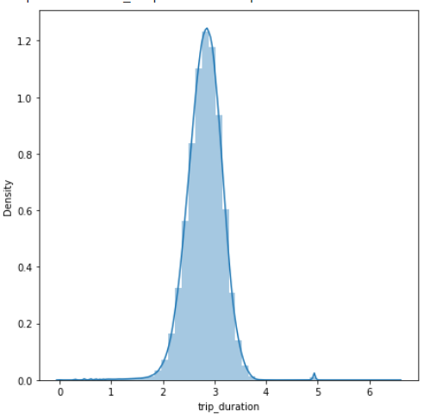
EDA- Univariate Analysis
Original Data (Trip_Duration)
After Applying log transformation

Slide 7
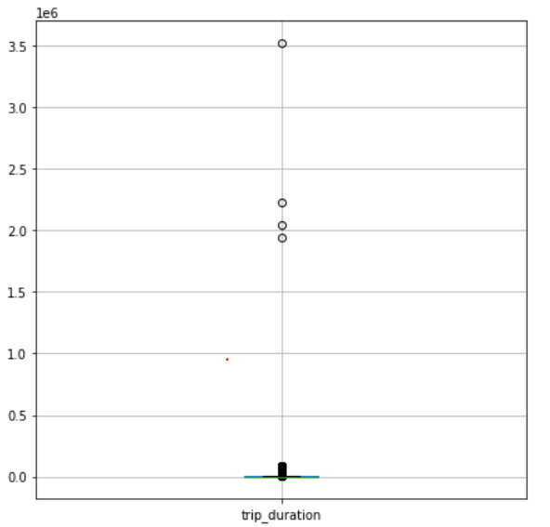
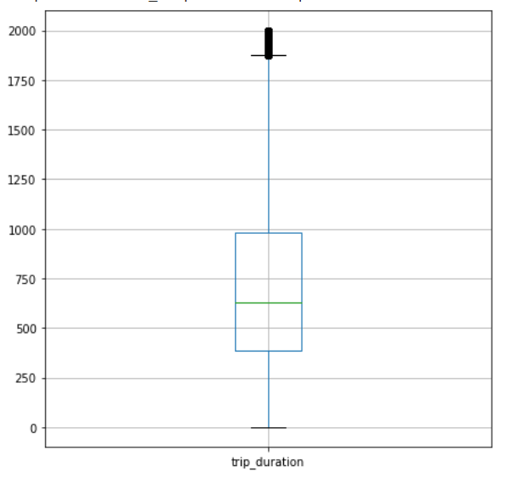
EDA (Continuation)-
Original Data
After removing outliers in Trip_duration

Slide 8
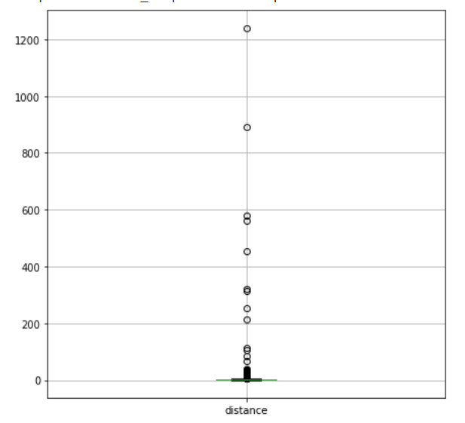
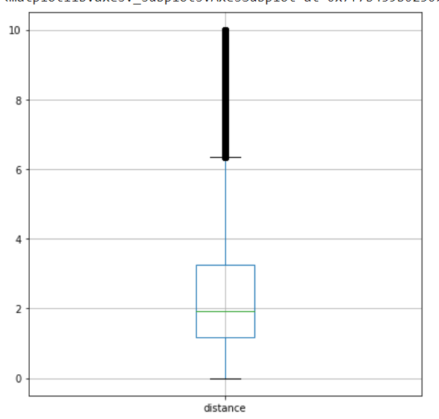
After outlier removal(distance)
Before outlier removal

Slide 9
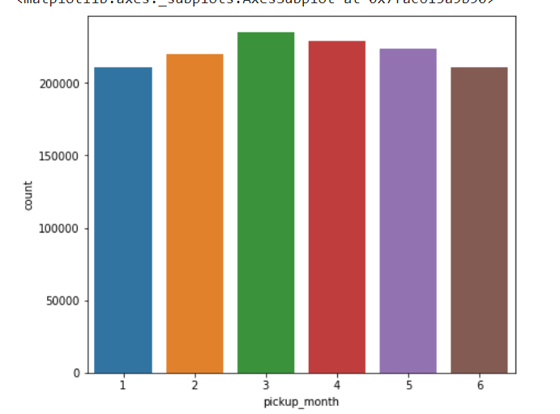
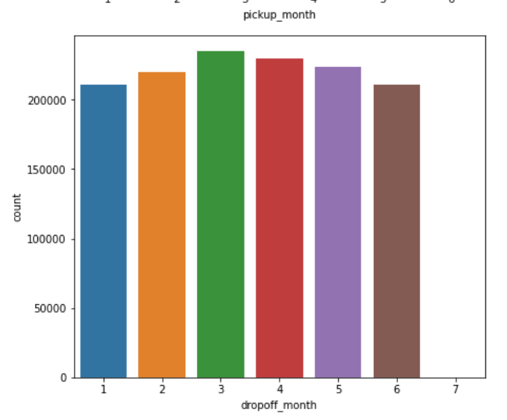
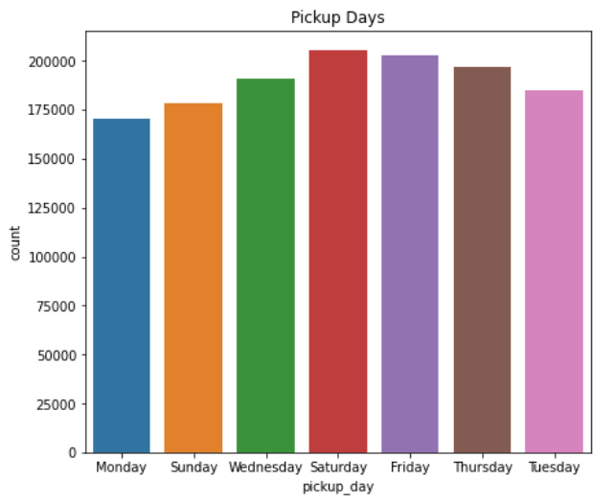
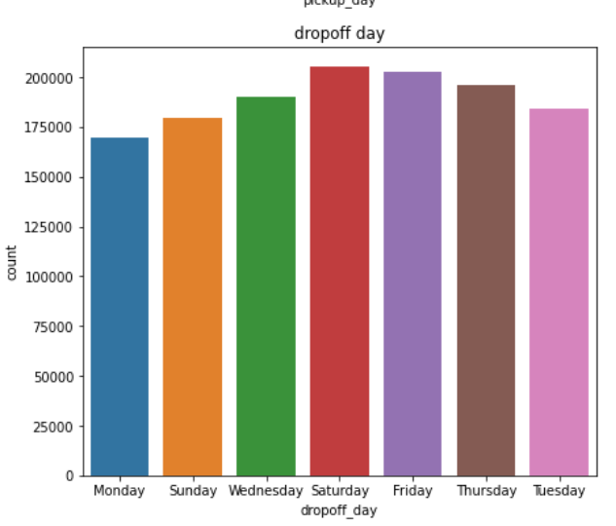
EDA- Bivariate Analysis

Slide 10
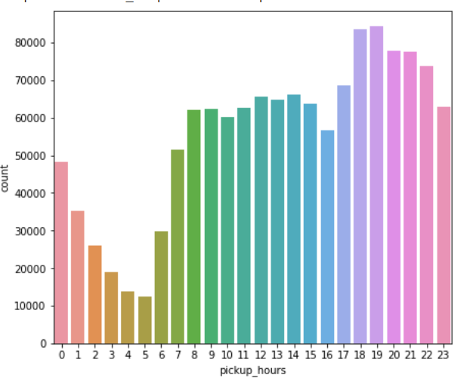
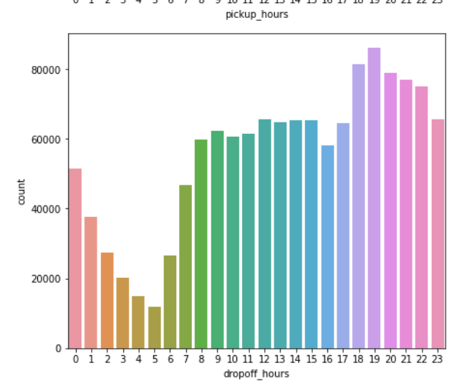
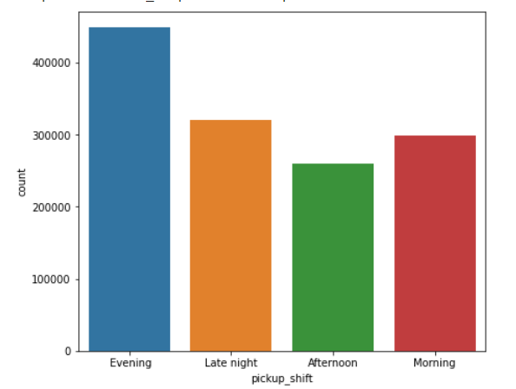
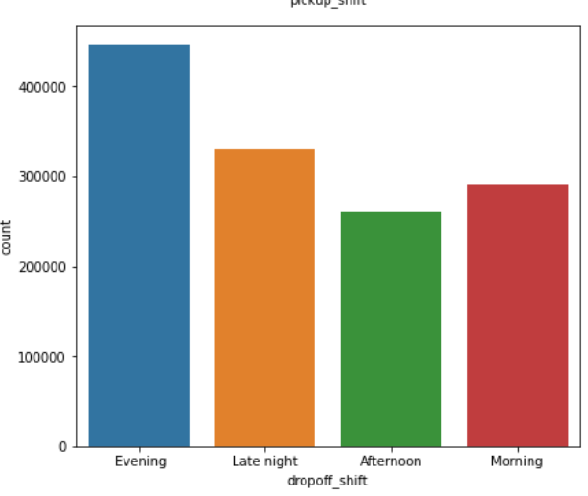

Slide 11
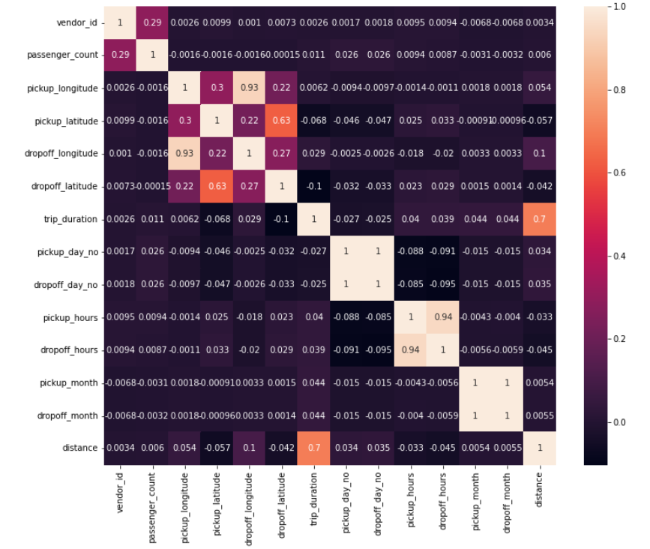
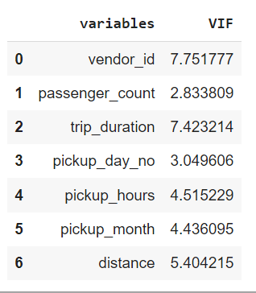
Correlations and VIF

Slide 12
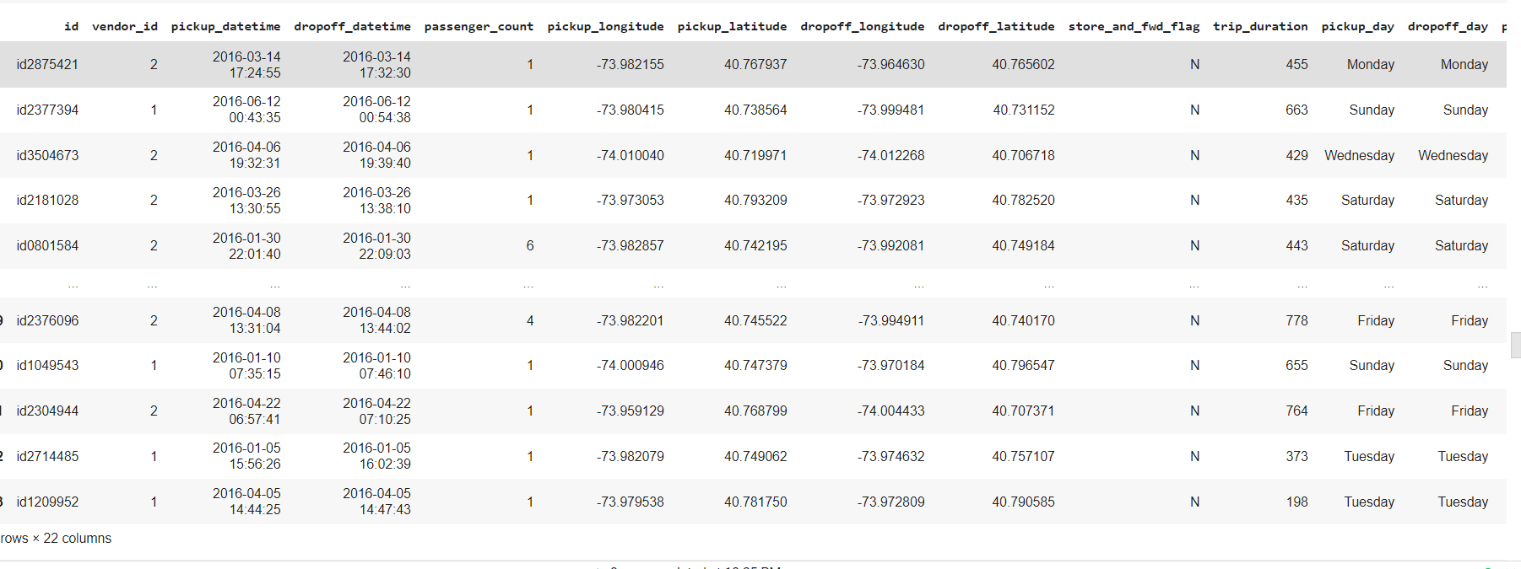

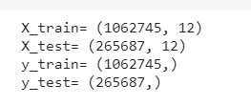
Training and Testing

Slide 13
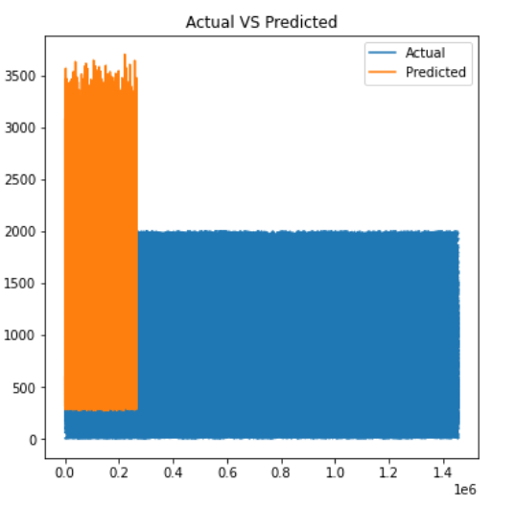
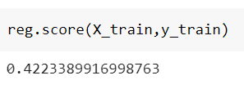
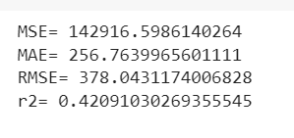
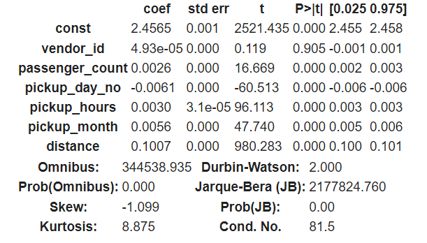
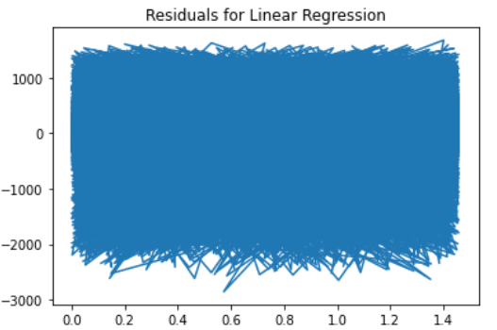
Linear Regression Model and Validation

Slide 14
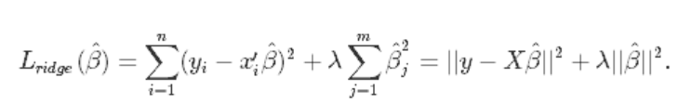
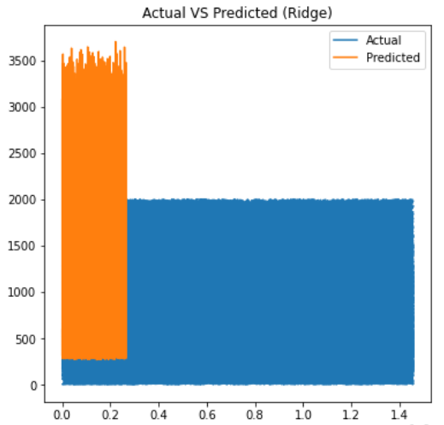

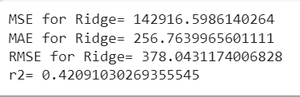
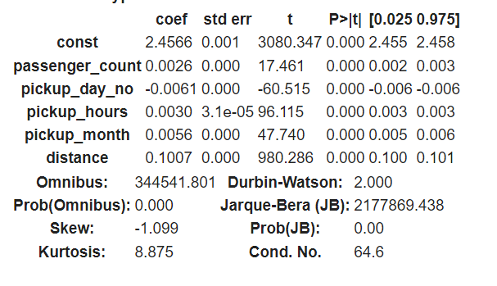
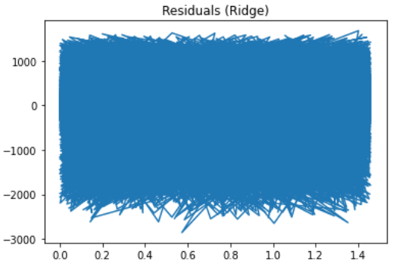
Ridge Regression With Validation

Slide 15
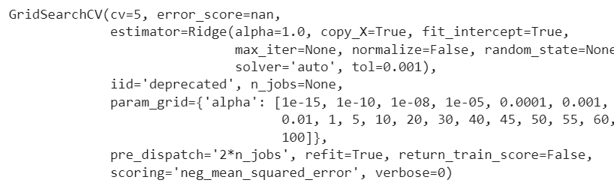
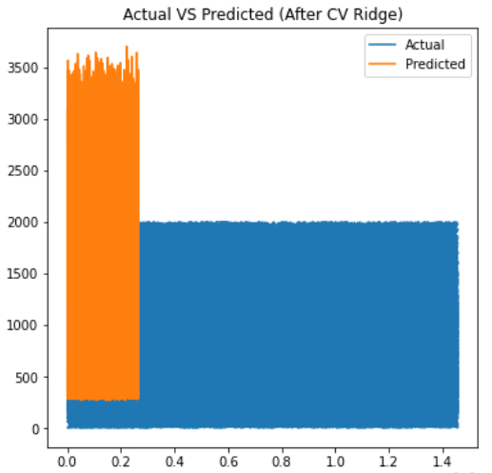
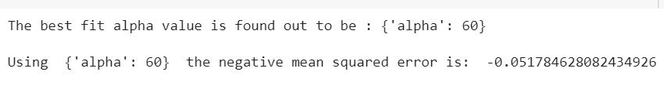


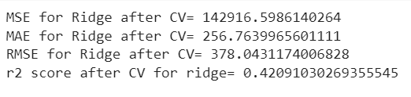
Applying Grid Cross Validation for Ridge

Slide 16
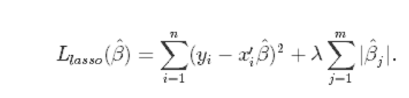
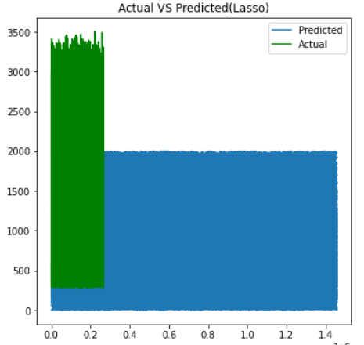

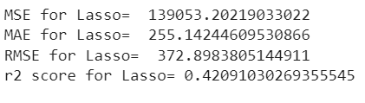
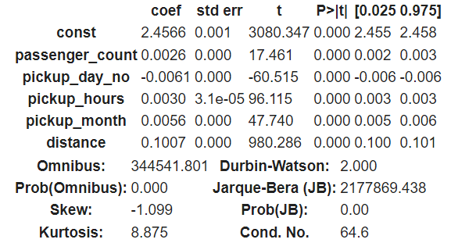
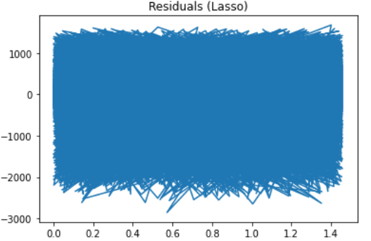
Lasso Regression and validation

Slide 17
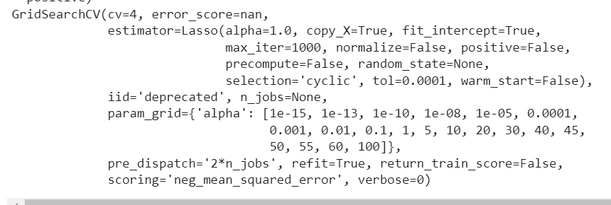
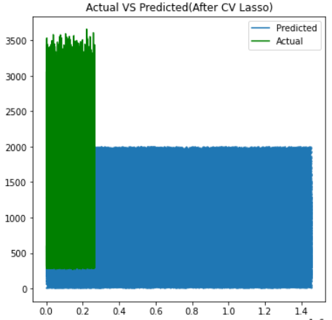
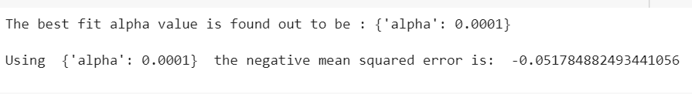
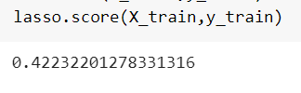
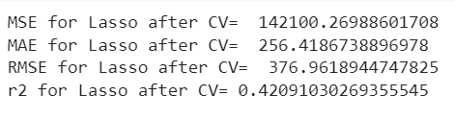
Grid Cross Validation for Lasso

Slide 18
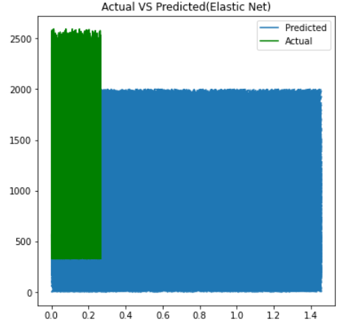
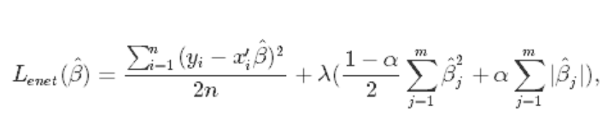

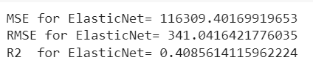
Elastic Net Regression

Slide 19
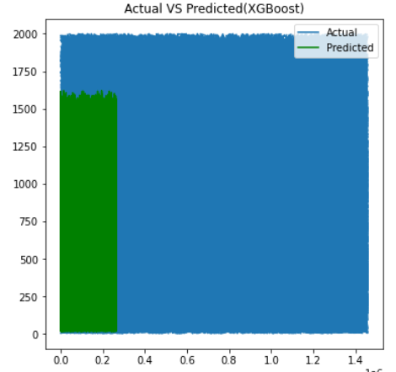
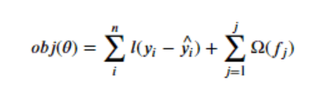
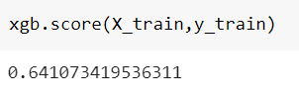
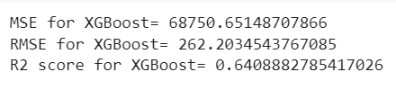

XGBoost Regressor and validation

Slide 20






Cross Validation for XGBoost Regressor

Slide 21
Conclusion
We got 1.4 million+ of data which contains outliers, we have removed the outliers and applied training for 1 Million on training and 20k for training to predict the trip duration
From the EDA, the pickup and drop-off of the trip is peak at 5PM-7PM(Evening Shift) and most of the trips are taken on Saturdays.
We applied Linear regression model to our training and testing data, where the R2 score result is 42.09% which is not good for predicting and it doesn’t show any sign of homoscedasticity.
We applied Ridge regression with lambda=0.01 and the model gives R2 score result of 42.09%. Then using GridCV cross validation we found that best regression strength to apply is 60, we increased the regression strength of the model with lambda=60,but still the result stayed same with 42.09%
Next, we applied Lasso regression with lambda=0.005 with maximum iteration of 3000 which yield a result of R2 score=42.09%, then we apply Grid CV for Lasso and it recommended to apply with 0.001, the result came out to be 42.09% which is no improvement.
Then we applied ElasticNet regression which combines both Ridge and Lasso, this model gives us only 40.98% so we moved to the next model.
Finally, we applied XGBoost Regressor and this model gives 64.08% of R2 score, for further improvements we applied Grid CV which gives learning rate=0.9. When we apply the learning rate(eta)=0.9 there was no improvement on the result, which stayed at 64.08%.

