Slide 1

Modern CMake for embedded
Standing on the shoulders of giants

Slide 2
Modern CMake for embedded
Jason Turner’s: The Ultimate Cmake
and
Kris Jusiak’s: Implementing a web game in C++14

Slide 3
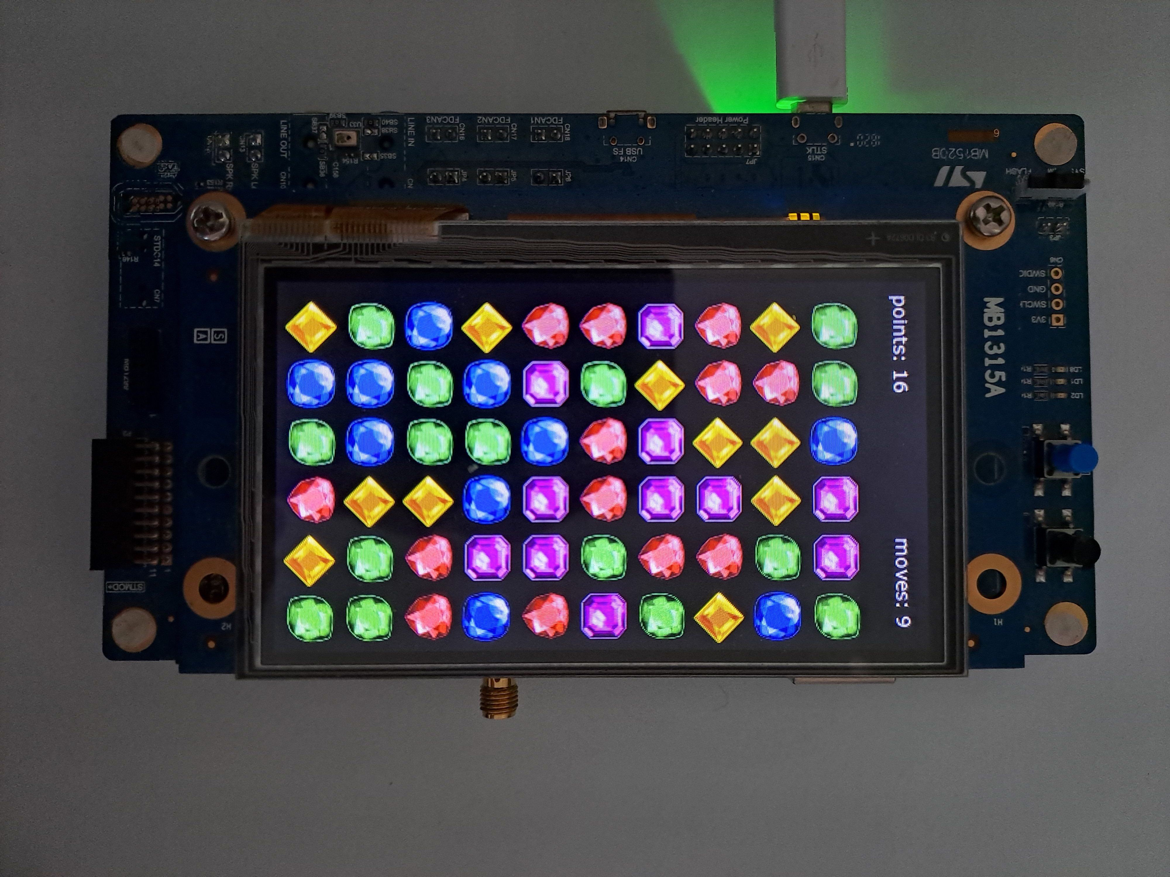
Match-3 GAME
STM32H735

Slide 4
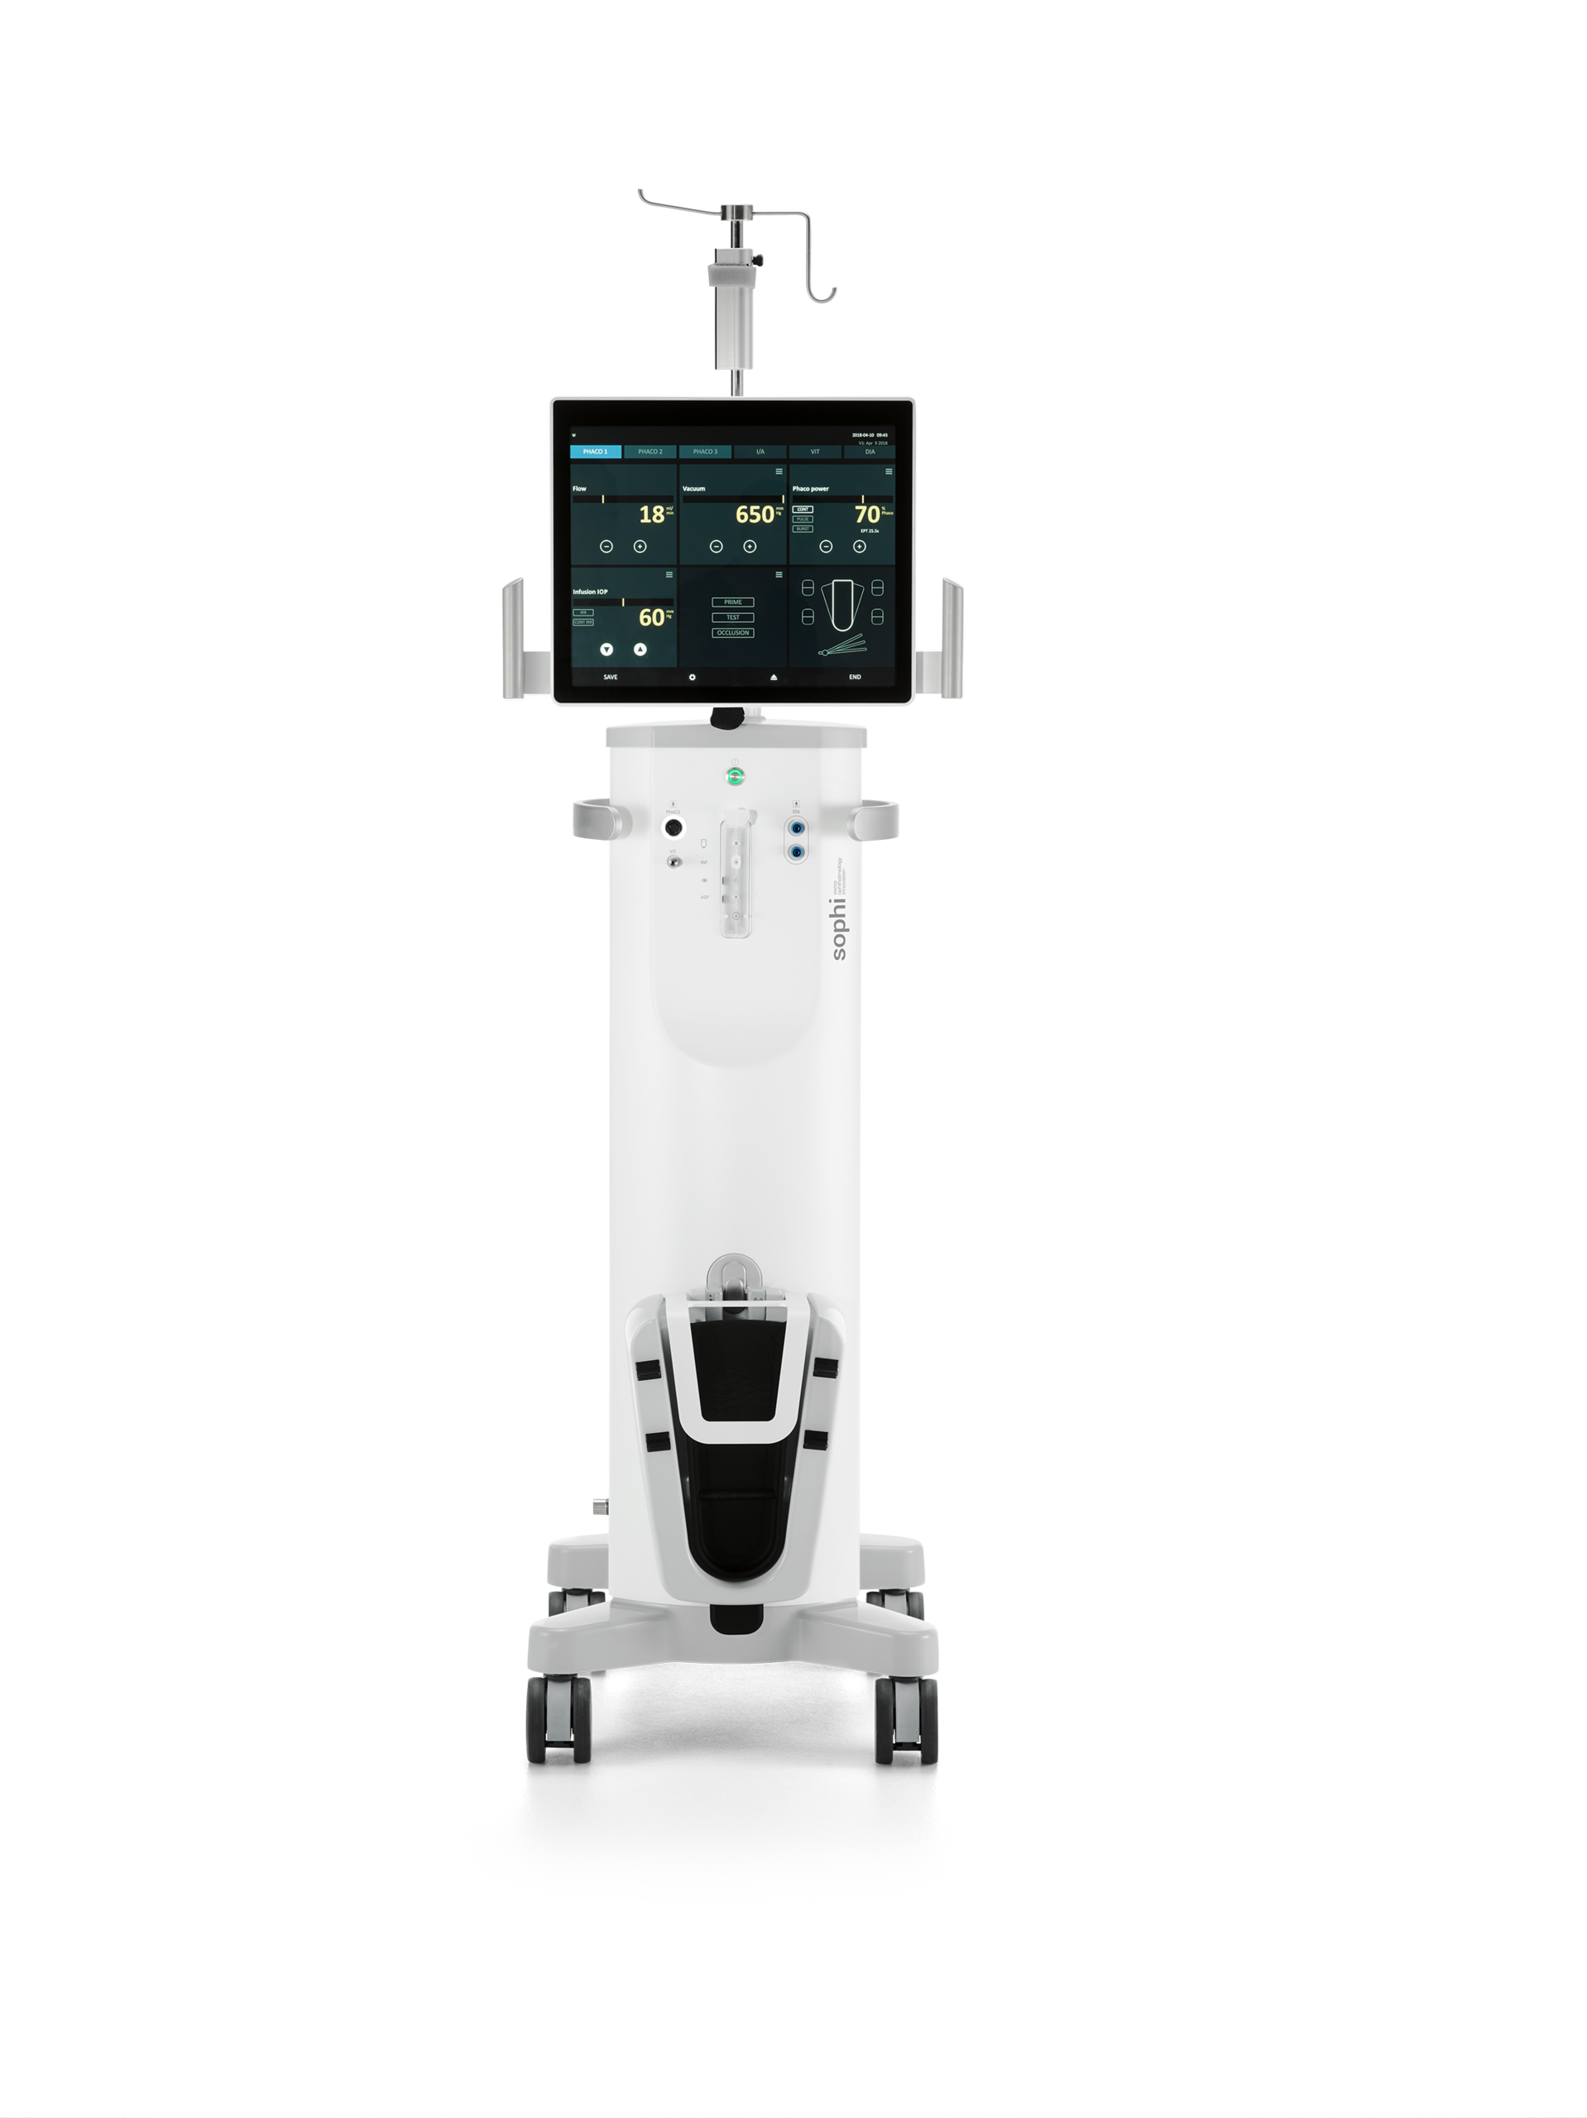
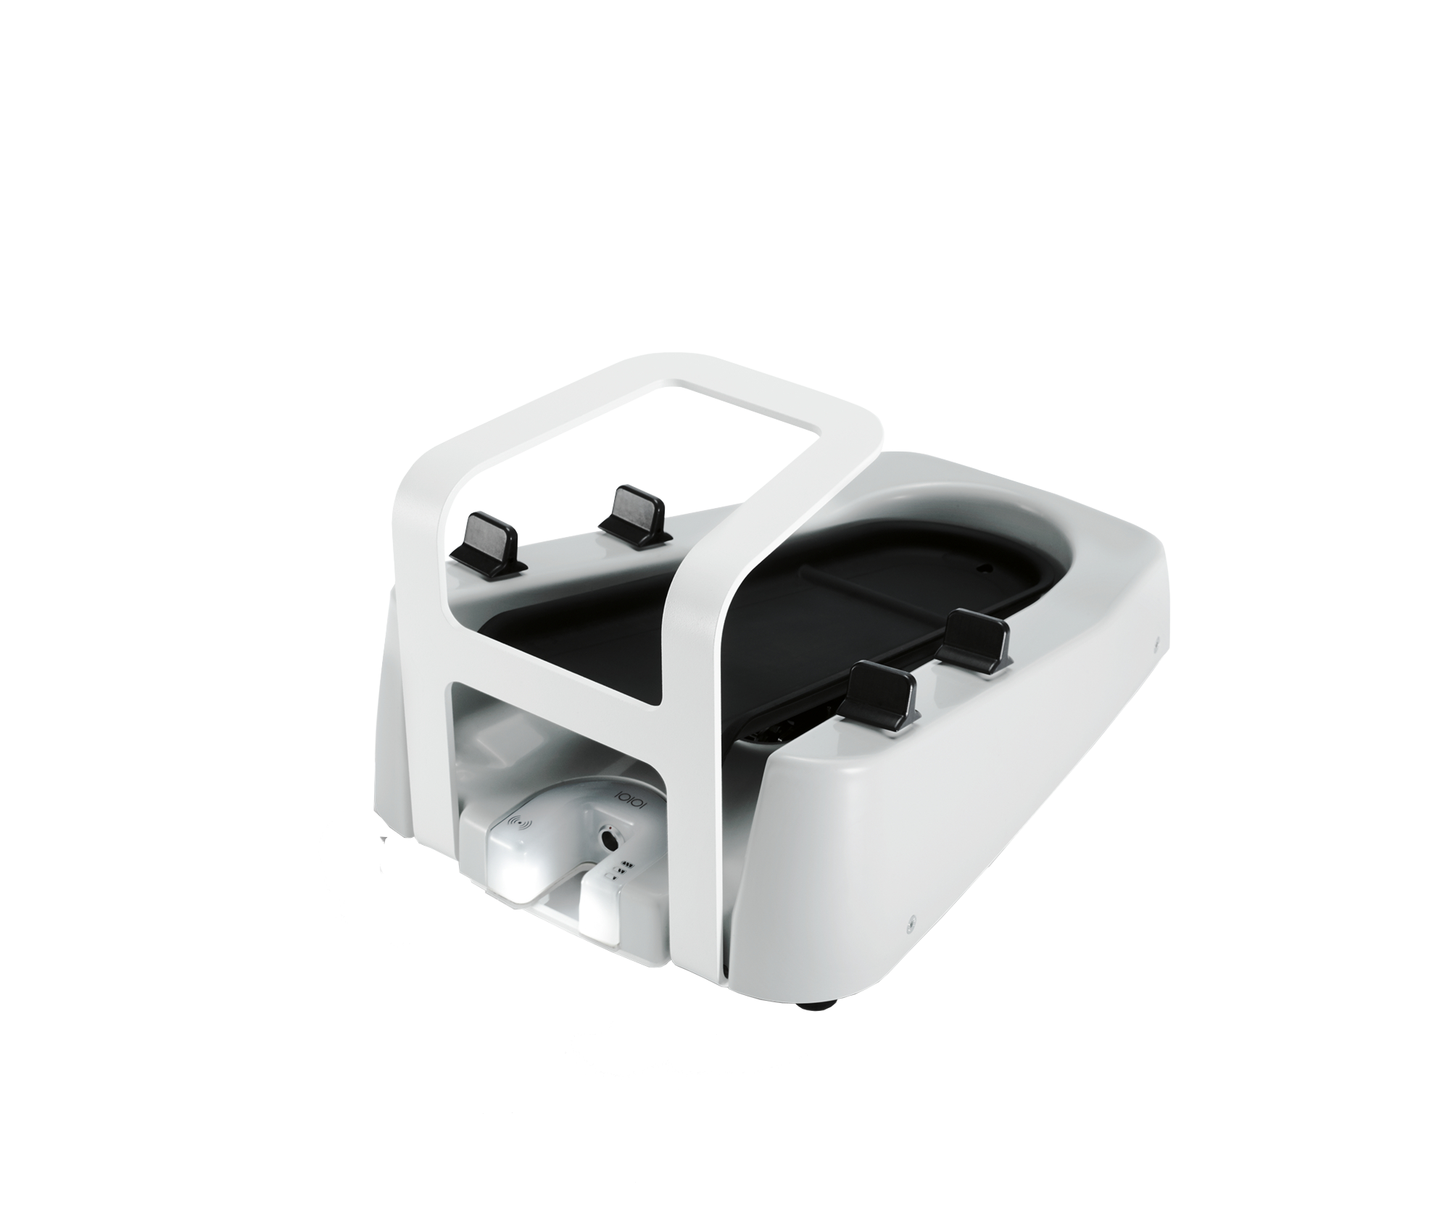
This AG

Slide 5
Modern CMake for embedded
Requirements:
- Easy to extend
- multiplatform
- high quality of new source code
- dependency management

Slide 6
Modern CMake for embedded
Dependencies:
- boost di
- boost sml
- Ranges v3
- TouchGFX

Slide 7
Modern CMake for embedded
Use target_… functions from CMake
- target_link_library
- target_include_directories

Slide 8
Modern CMake for embedded
github.com/Thurnheer/match3_embedded

