Slide 1
Random number generator in MOLSIM
Christian Strauch
23.02.2023

Slide 2
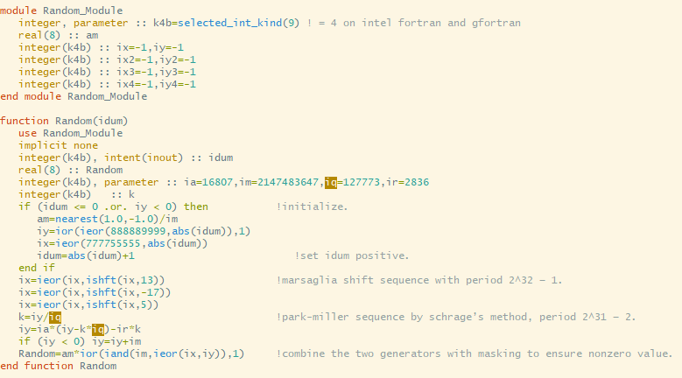
Function written in Fortran
Principle idea:
One Random number is generated by a Marsaglia shift
A second random number is generated by a Park-Miller sequence
Final random number is generated by a combination of these two random numbers

Slide 3

Initialization
Nearest: gives us the closest number to argument one in the direct of the sign in argument two. In our case 0.999999999999999
im=2^31-1: this is the biggest number which can described by integer 32-Bit data-type
First generation of random numbers iy and ix dependent on the seed idum

Slide 4

Marsaglia shift
Ishft: shifts the binaries 13 positions in right direction
Simple example: 165 in binary: 10100101
Ishft(165,2): 00101001 and this is 41
Ieor: compares each position of two binary numbers. If one digit is a 1, than the digit of the resulting binary is also one, otherwise 0:
Example: ieor(165,41): 10100101
00101001
result 10001100 = 140

Slide 5

Park-Miller sequence by Schrage‘s method
K is an Integer => iy – k*iq is mod(iy,iq)
First term is ia*mod(iy,iq)
Second term is ir/iq*iy while ir/iq < 1
New iy negative if old iy large or first term zero
Ia is a primitive root modulo im
ir = mod(im,ia)
iq = (im – ir) / ia

Slide 6
Combination
Iand: bitwise comparison 1 and 1 results in 1, otherwise 0
ior ensures that the number is not zero
Resulting number is between ]0,im]
Will be multiplied with am; am = 0.999999999999999/im
Final random number is between ]0,0.999999999999999]

