Slide 1
Mersenne Twister

Slide 2
Applications
Used as default PRNG in various software:
APL
IDL
R
Ruby
Free Pascal
PHP
Python (also available in NumPy, however the default was changed to PCG64 instead as of version 1.17)
CMU Common Lisp
Embeddable Common Lisp
Steel Bank Common Lisp
Julia (up to Julia 1.6 LTS, still available in later, but a better/faster RNG used by default as of 1.7)
And other applications:
Microsoft Excel
GAUSS
gretl
Stata
SageMath
Scilab
Maple
MATLAB
Mathematica
C++ library

Slide 3
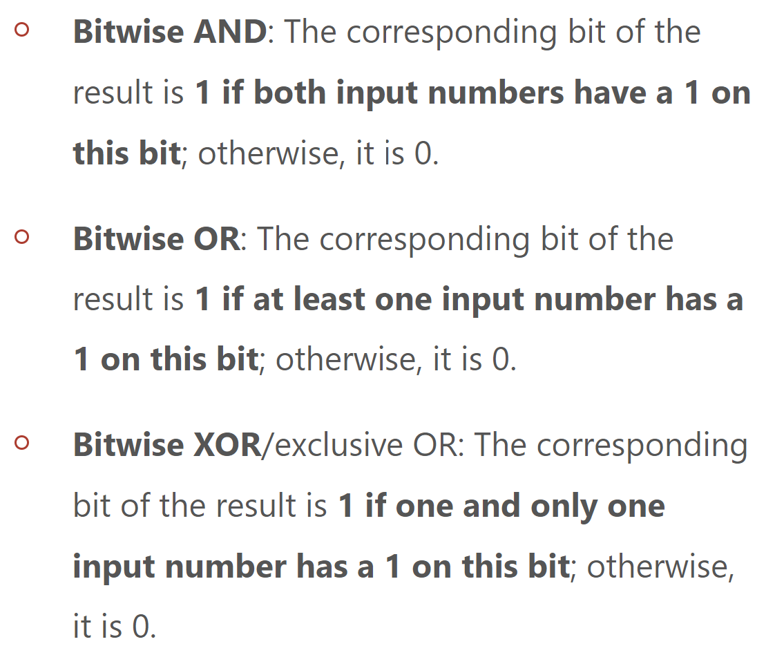
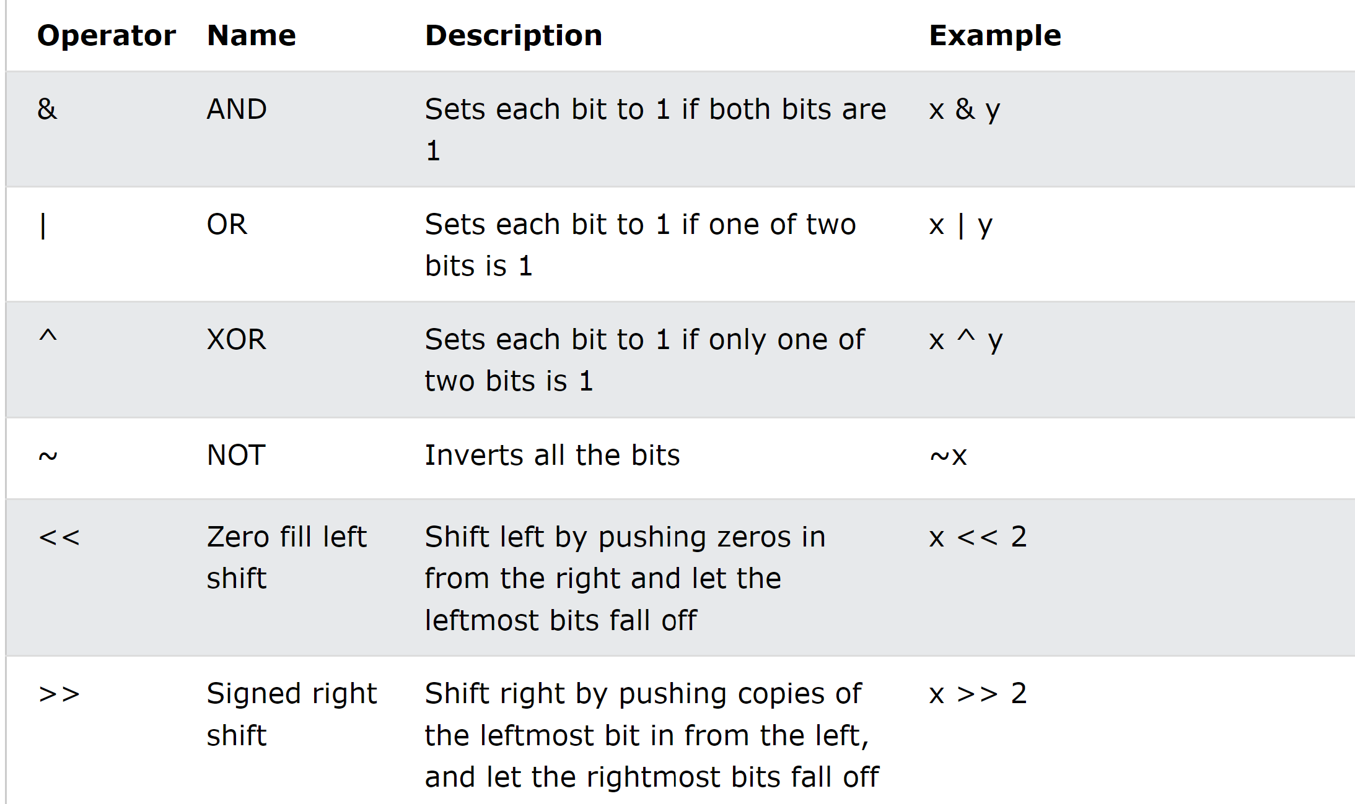
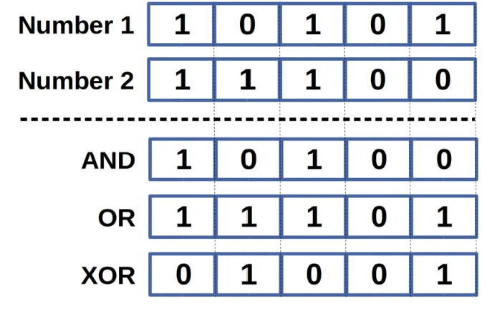
Bitwise operator

