Slide 1

Image to Spreadsheet Web Application Using OCR
Presented By:-
T. Sai Manoj - 22WU0104120
M. Dheeraj - 22WU0104067
L. Sujith Reddy - 22WU0105035
Supervised by:-
Dr. Resham Raj Shivwanshi,
Assistant Professor

Slide 2
Introduction
Many organizations still store important table data in printed documents or scanned images, requiring slow and error-prone manual entry into spreadsheets.
Handling large volumes of tables from invoices, attendance sheets, and records makes the problem even more time-consuming.
Our project automates this process by converting table images into clean, editable spreadsheet data using computer vision and OCR.
Through a simple web interface, users can upload an image and instantly receive an accurate table that can be reviewed and exported.

Slide 3
Problem Statement
Manual Data Entry Bottleneck: Organizations still re-enter table data from printed forms, PDFs, and photos, leading to high time consumption and frequent human errors.
Low OCR Accuracy: Existing tools struggle with poor image quality, skewed/handwritten tables, and inconsistent layouts, resulting in inaccurate extractions that need heavy manual correction.
High Cost & Limited Options: Commercial table-extraction solutions are expensive, closed-source, and offer limited customization, making them inaccessible for many organizations.
Inefficient Processing: Current workflows involve repeated review and validation steps, delaying data availability and increasing operational costs significantly.

Slide 4
Literature Review
Existing Solution | Key Features | Strengths | Limitations | Gap Our Project Addresses
Commercial Tools (AWS Textract, Google Vision) | Cloud-based OCR, table detection, multi-language support | High accuracy (90%+), handles complex layouts, well-maintained | Expensive, proprietary, limited customization, privacy concerns with cloud upload | Open-source alternative, cost-effective, customizable for specific use cases
Open-Source Libraries (img2table, Camelot) | Python-based, CLI interface, table extraction from PDFs/images | Free, transparent code, community support | CLI-based (not user-friendly), lower accuracy (70-75%), limited UI, no web interface | Interactive web application, improved accuracy (85%+), user-friendly interface, editable grid
Classical Computer Vision (OpenCV + Hough Lines) | Line detection, morphological operations, manual tuning | Fast processing (<1 sec), no deep learning dependency, interpretable | Fails on poor image quality, handwritten tables, skewed images, low accuracy (60-70%) | Comparison with deep learning models, robust preprocessing pipeline
Deep Learning Models (TableNet, DETR) | CNN-based & transformer-based table detection, end-to-end learning | High accuracy (85%+), handles varied table structures, learns from data | Requires large annotated datasets, computationally expensive, black-box nature, long training time | Hybrid approach combining classical + DL, systematic model comparison, transparent evaluation metrics

Slide 5
Objectives
Build an end-to-end web application that converts table images into clean, editable spreadsheet data with high accuracy.
Develop a robust preprocessing and table-detection pipeline to handle different table structures and image qualities.
Implement reliable cell segmentation and OCR with confidence scoring to highlight and correct low-confidence cells.
Create a user-friendly web interface with an editable grid and export options (CSV, Excel, JSON) for seamless workflow integration.
Current Status:
All objectives are currently in the planning and design phase. Technical specifications and architecture are finalized, and implementation will begin next week.

Slide 6
Novelty
Hybrid Detection Approach: Combines classical Hough-line methods with deep-learning models to accurately detect both simple and complex tables.
User-Friendly Web Application: Offers an interactive, editable web interface with easy export options for corrected table data.
Transparent & Customizable Pipeline: Provides a fully open-source, configurable workflow that can be adapted to different table types and domains.
Real World Validation: Ensures robustness through testing on 200+ diverse table images with confidence scoring for low-quality cells.
End-to-End Production-Ready System: Delivers fast image-to-spreadsheet conversion (<5 seconds) for printed and handwritten tables without requiring AI expertise.

Slide 7
Proposed Methodology
Image Upload – User uploads table image (JPG/PNG).
Preprocessing – Grayscale, denoise, enhance contrast, binarize, deskew.
Table Detection – Detect boundaries, rows, columns using Hough Lines / TableNet / DETR.
Cell Segmentation – Split table into individual cells and map row–column positions.
Text Extraction – Tesseract reads text, assigns confidence, flags low-confidence cells.
Web UI & Export – Editable table shown in browser; export as CSV/Excel/JSON.
Final Output – User receives clean, editable spreadsheet.

Slide 8
Tools & Technologies
Programming Language: Python
Libraries: OpenCV 4.8+, NumPy, Pandas, Pillow, PyTorch, Tesseract
Web Application Framework: Streamlit (frontend) / Flask (backend alternative)
Algorithms & Techniques: Laplacian Variance, CLAHE, Otsu Thresholding, Gaussian Filtering, Hough Transform, CNN-based Detection
OCR Engine: Tesseract , EasyOCR
Frontend Tools: HTML5, CSS3, JavaScript, Handsontable (editable grid)
Backend & Deployment: Gunicorn, Git/GitHub

Slide 9
Future Scope
Core Pipeline Development: Implement the end‑to‑end image processing pipeline, including preprocessing (denoising, contrast enhancement, binarization, deskewing), classical Hough line–based table detection, and cell extraction with structured coordinate mapping.
OCR Integration & Accuracy Tuning
Web Application Development

Slide 10
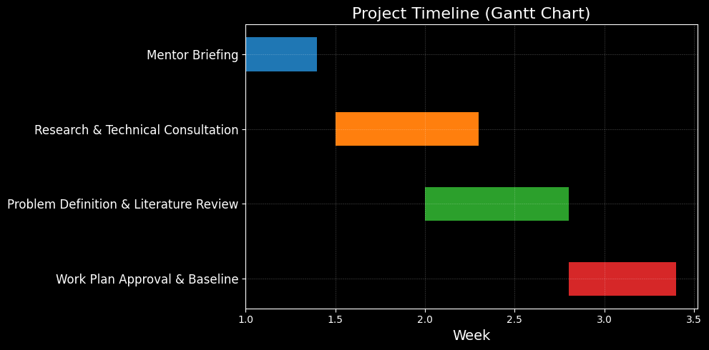
Work Plan

Slide 11
References:-
Zhang, X., Li, Y., Kumar, A., Chen, H. Document image quality assessment using deep neural networks. Digital Signal Processing 149 (2024)
Nanonets. Table Extraction Using LLMs: Unlocking Structured Data from Documents. Nanonets Blog (2024)
Pal, S., Pramanik, A., Sarkar, R. MG-AttentionNet: A novel multi-granularity attention-based deep neural network for image classification. Neurocomputing 564 (2024)
Unstract. Best PDF OCR Software. (2024)

Slide 12
Thank you

