Slide 1
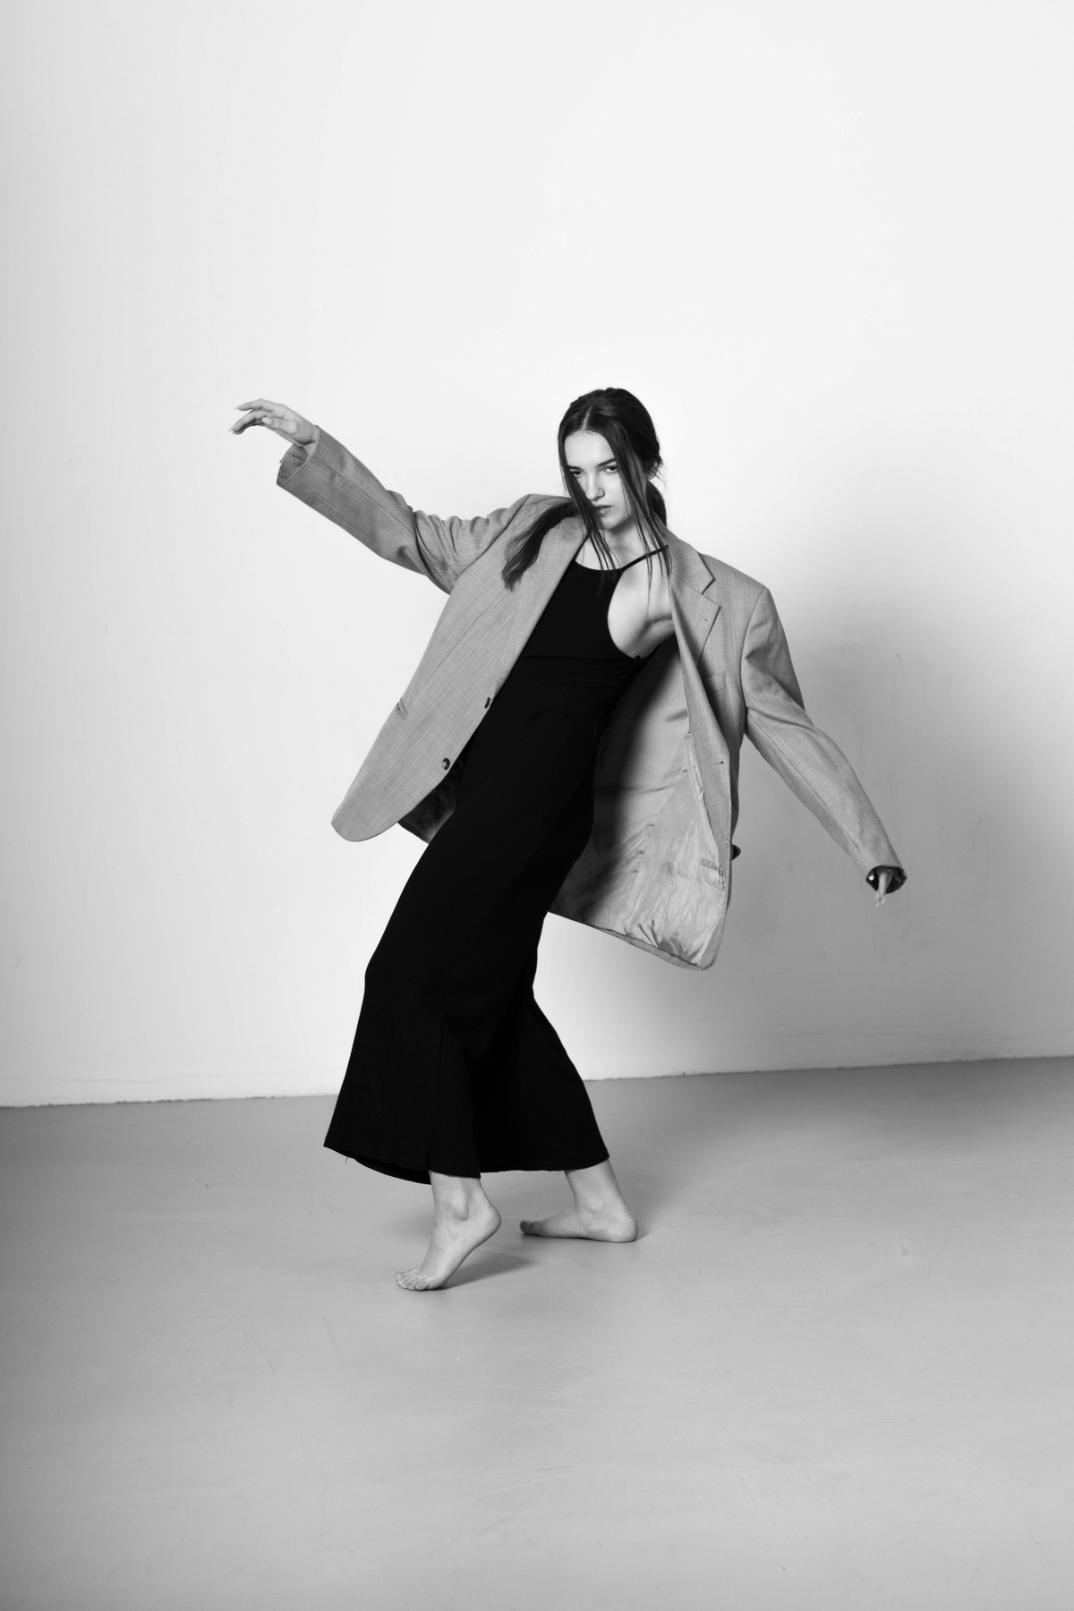


BB’S STORE Seasonal Report
Presented by Tien Le
SALES PERFROMANCE ANALYSIS & DEVELOPMENT SOLUTION

Slide 2
EXECUTIVE SUMMARY
01
OBJECTIVE
Analyse sales performance
Address the existing problems and causes
Develop strategies to tackle those problems
02
PROBLEM
Revenue is dominated by certain factors
Increased traffic and conversion rates failed to drive more purchases or revenue
Weak upsell capability
03
RECOMMENDATION
Diversify revenue sources
Utilize golden hours for shopping
Boost upsell potential capability

Slide 3


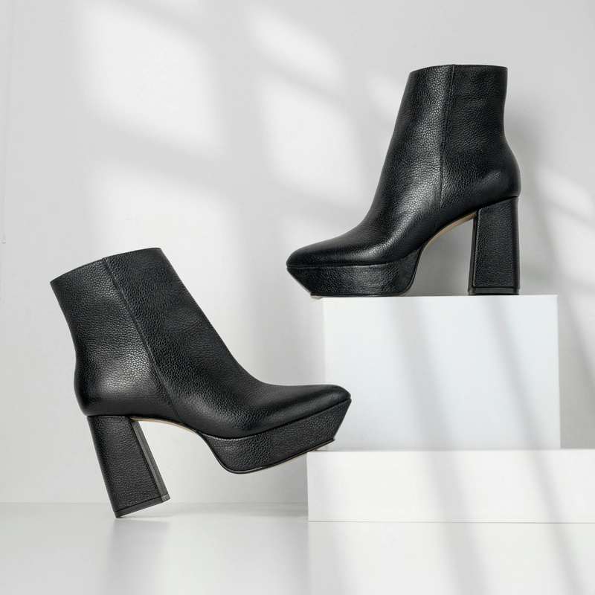

For many years, BB STORE’S has built up a good reputation as a fashionable and affordable women's clothing brand. BB STORE’S offers various product types, from daily casual clothes to elegant dresses and party attire. Target customers of BB are women between 25 and 34, who look for modern, timeless and minimalist designs.
However, BB STORE’S is now facing stagnation in growth due to the lack of innovative and suitable strategies. Therefore, the performance data from January 1 to May 26 is collected for further analysis and prescription.
about bb’s store
Background
Key isssues
Analysis
Recommendation
Appendix

Slide 4
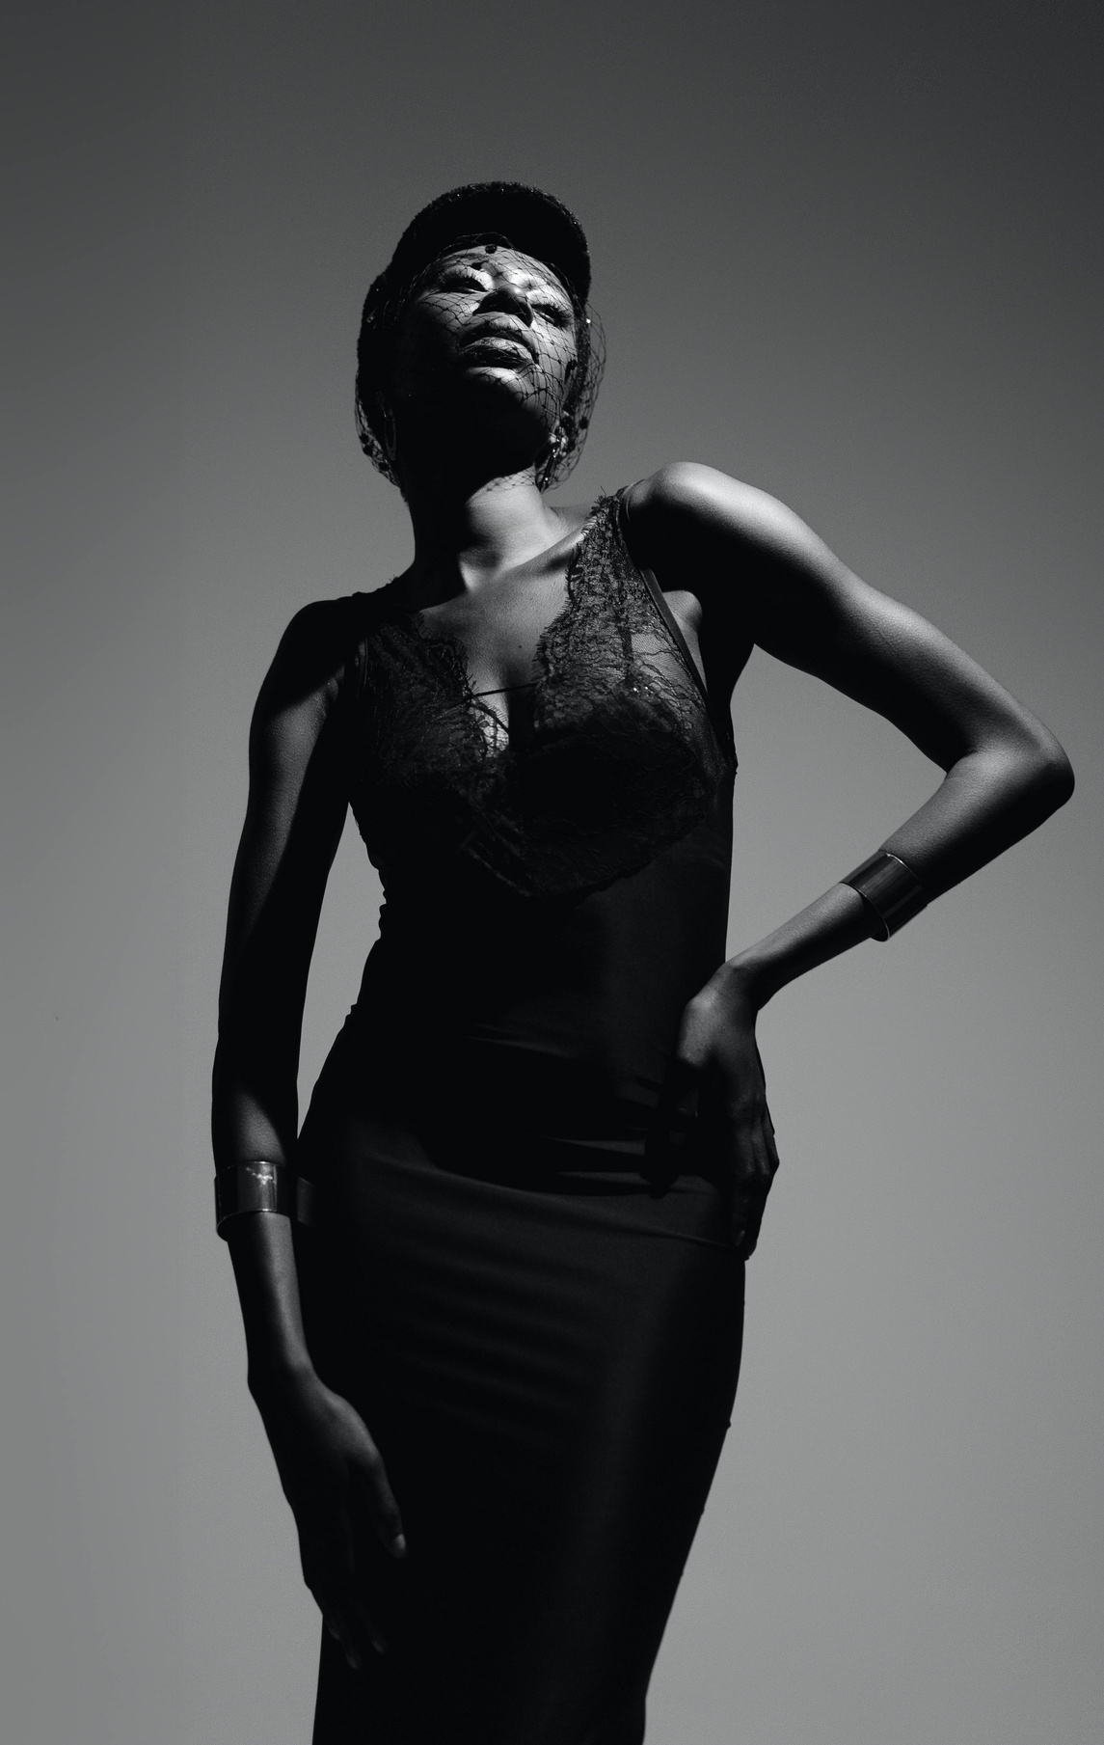
KEY ISSUES
Domination of certain factors to revenue
Failure of Traffic and Conversion Rates in driving more purchases
Ineffective utilization of weekends and golden hours for shopping
Background
Key issues
Analysis
Recommendation
Appendix

Slide 5
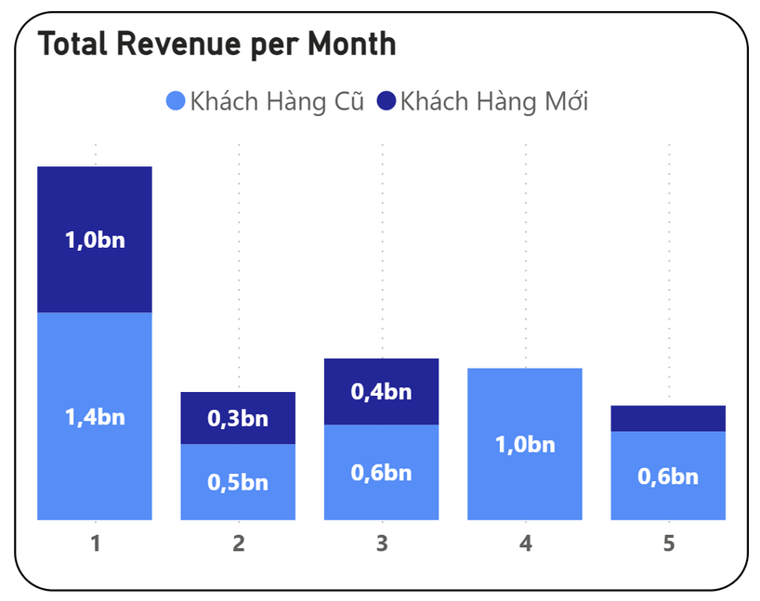
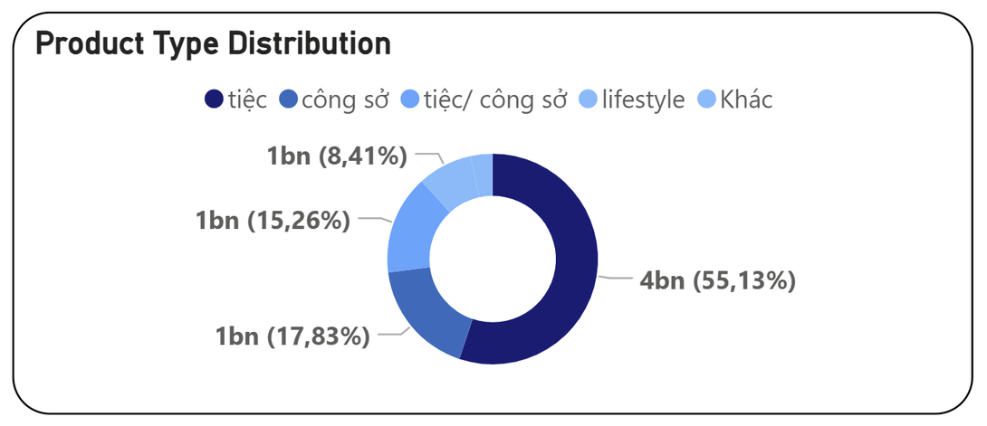
CERTAIN FACTORS AFFECT REVENUE HEAVILY
Over half of the revenue is from “Tiec” type. Everyday records purchases of product for “Tiec” and 62% purchases include product from this type.
Most of the revenue is generated by returning customers. Especially in April, there are no transactions coming from new customers.
Background
Key isssues
Analysis
Recommendation
Appendix

Slide 6
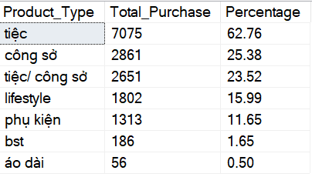
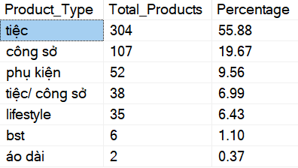
CERTAIN FACTORS AFFECT REVENUE HEAVILY
As there are more options for customers in a particular type, that type may drive more revenue than others.
The number of purchases has a positive correlation with the revenue. The most revenue comes from “Tiec” type products can be explained by customer preferences and also the large amount of products (SKU_1) from that type.
Background
Key isssues
Analysis
Recommendation
Appendix

Slide 7
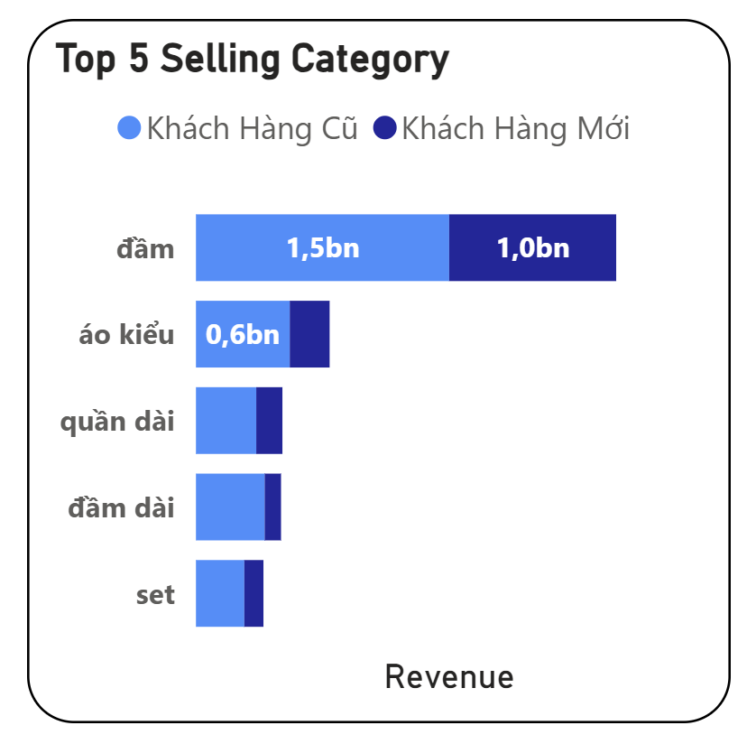
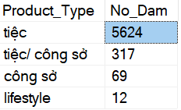
CERTAIN FACTORS AFFECT REVENUE HEAVILY
“Dam” contributed the most revenue because the product had designs for numerous purposes, from casual to professional ocassions.
“Dam” category clearly generated double the amount of revenue from the second-lead category which is “ao kieu”
Background
Key isssues
Analysis
Recommendation
Appendix

Slide 8
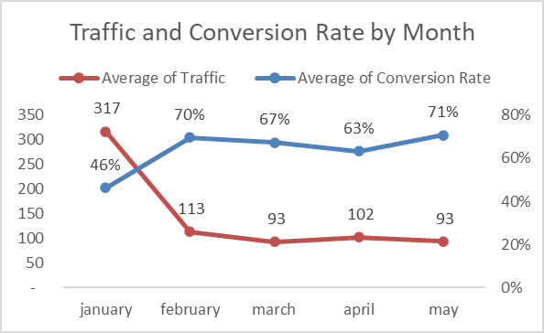
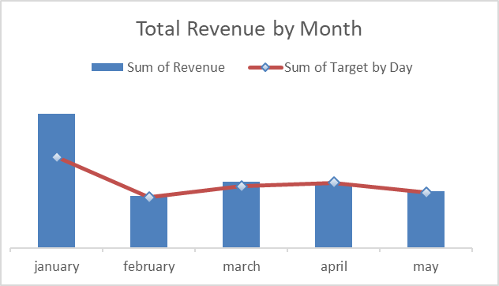
INCREASED TRAFFIC AND CONVERSION RATES FAILED TO DRIVE MORE PURCHASES OR REVENUE
February recorded the poorest revenue as there are fewer days in this month and also a record of one week was deducted because of Tet holiday.
Even though January has the highest traffic and revenue, it has the lowest CR. This can be explained by the Tet effect, when people tends to spend more on holidays.
Background
Key isssues
Analysis
Recommendation
Appendix

Slide 9
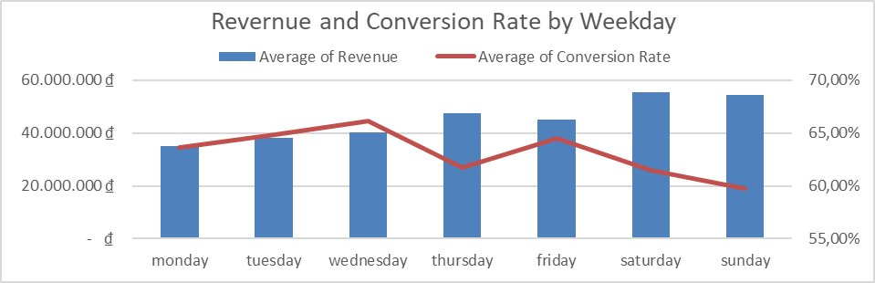
INCREASED TRAFFIC AND CONVERSION RATES FAILED TO DRIVE MORE PURCHASES OR REVENUE
The “high Revenue - low CR” also applied on weekdays. Wednesday experienced the highest CR of 66% but generated only mid revenue compared to others. On weekends and Thursdays, the CR was relatively lower but created the most revenue. This implies that the proportion between visitors and buyers was less than that of on Wednesday.
Background
Key isssues
Analysis
Recommendation
Appendix

Slide 10
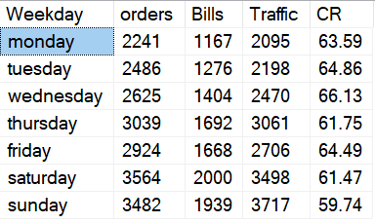
INCREASED TRAFFIC AND CONVERSION RATES FAILED TO DRIVE MORE PURCHASES OR REVENUE
Lower CR does not imply lower in amount of orders. As for Thursday, Saturday and Sunday, there were more orders, bills and traffic that are recorded. The closer it gets to the weekend, the more traffic the store attracts. The stores should allocate resources and plan certain strategies to take advantage of this naturally increased traffic.
Background
Key isssues
Analysis
Recommendation
Appendix

Slide 11
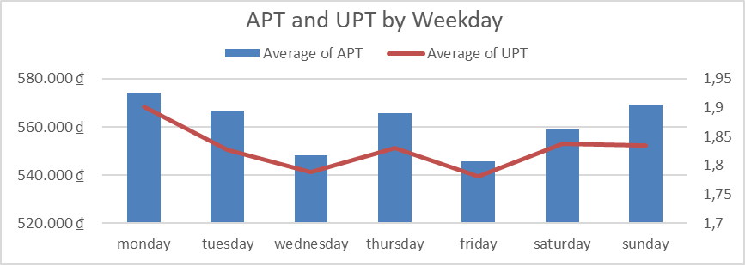
WEAK UPSELL CAPABILITY
UPT was below 2 units across all weekdays, which was quite low compared to the fashion retail benchmark (2.2–2.5). There was a noticeable drop in UPT and APT during the middle of the week. This currently shows that the store did not have a mechanism to attract customers on these “quiet” days.
Background
Key isssues
Analysis
Recommendation
Appendix

Slide 12
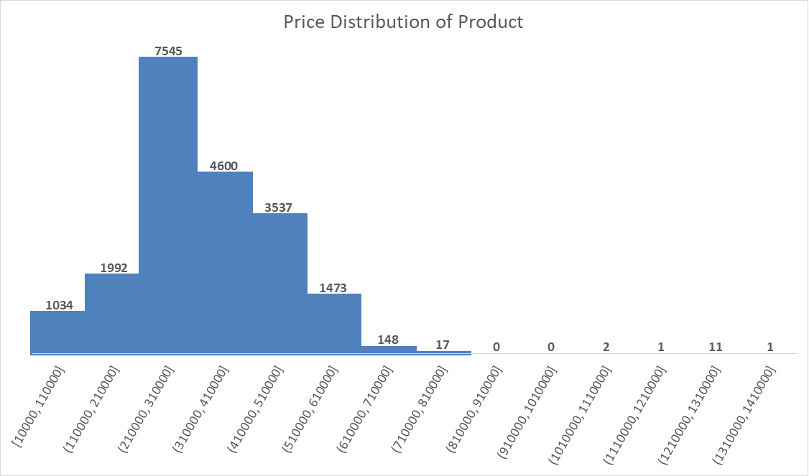
WEAK UPSELL CAPABILITY
Most of the product’s price is from 210K to 310K, but the APT was around 550K and UPT around 1,8. This can be understood that customers were buying 2 items at this price range, rather than buying a more expensive product. Therefore, if the store can push the ASP by upselling, the revenue would be higher without the need for more customers or orders.
Background
Key isssues
Analysis
Recommendation
Appendix

Slide 13
TURN VISITORS TO CUSTOMERS & DIVERSIFY PRODUCTS IN POTENTIAL TYPES
PREPARATION
Study customers’ shopping behavior and preferences for developing suitable promotions
Plan and design new collections in the best-selling category
Contact suppliers for more products and variations in other potential types (‘Cong so’, ‘Lifestyle’)
IMPLEMENTATION
Run social media campaigns to attract awareness and online traffic
Offer bundle deals and discounts for the first purchase and low-performing products
Available staff for the introduction of new products and styling advice.
MEASUREMENT
Track traffic, Conversion Rate and proportion of purchases made by new customers vs returning customers
Collect customer feedback about shopping experience and product quality
Growing demand for sustainable fabrics
Preference for flexible payment options
High engagement with seasonal promotions
Background
Key isssues
Analysis
Recommendation
Appendix

Slide 14
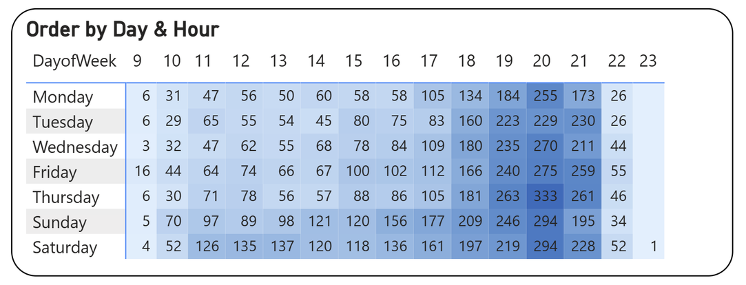
ULTILIZE GOLDEN HOURS FOR SHOPPING
PREPARATION
Prepare inventory of top products in 7:00 - 9:00 p.m
Make combos of best-selling products and others
Allocate more staff in store during this busy period
IMPLEMENTATION
Promote limited-time offers through ads
Display the remaining stock to push the FOMO effect
Additional gifts or coupons for high value orders
MEASUREMENT
Track revenue during this period and its percentage of contribution to daily revenue
Analyse APT and UPT before and after
Growing demand for sustainable fabrics
Preference for flexible payment options
High engagement with seasonal promotions
Background
Key isssues
Analysis
Recommendation
Appendix

Slide 15
BOOST UPSELL CAPABILITY
PREPARATION
Identify purchasing patterns: products that are usually purchased together, APT & UPT for each category and type
Create full-set outfits that are lower in price when purchasing individually
Train staff on recommendation and styling advice for customers
IMPLEMENTATION
Introduce promotions such as: Buy 2 get 10% off
Place mannequins with full outfits in noticeable places in shop
Arrange products based on outfit combinations and looking good when mix-match
MEASUREMENT
Compare sales performance before and after implementation
Track UPT, APT, average items per bill, adoption rate of bundle purchases
Growing demand for sustainable fabrics
Preference for flexible payment options
High engagement with seasonal promotions
Background
Key isssues
Analysis
Recommendation
Appendix

Slide 16
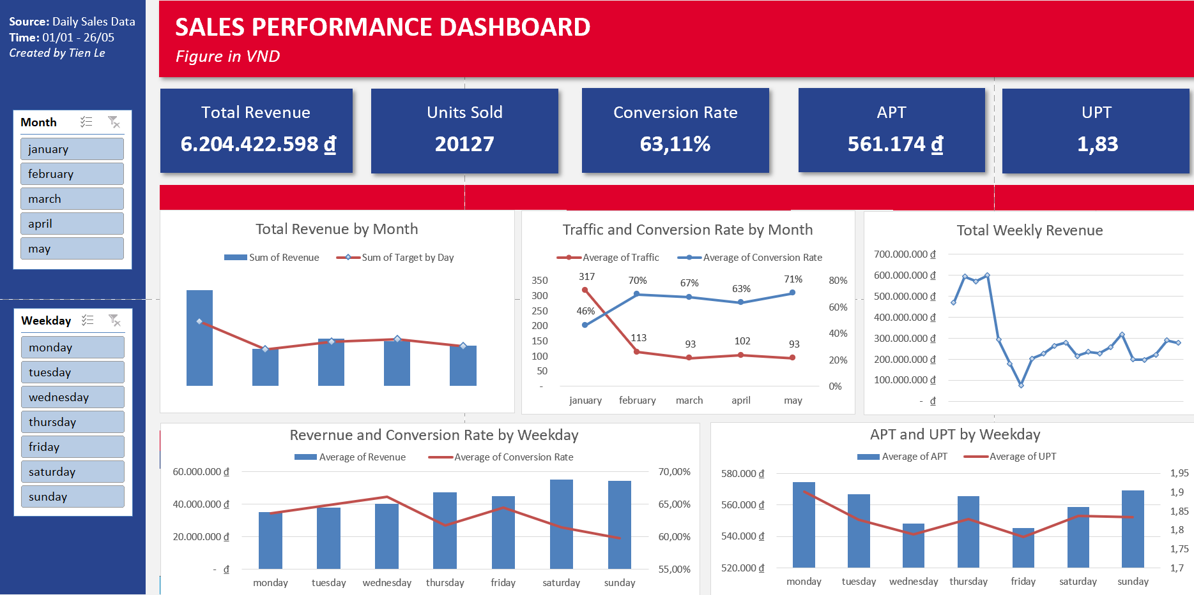
Background
Key isssues
Analysis
Recommendation
Appendix

Slide 17
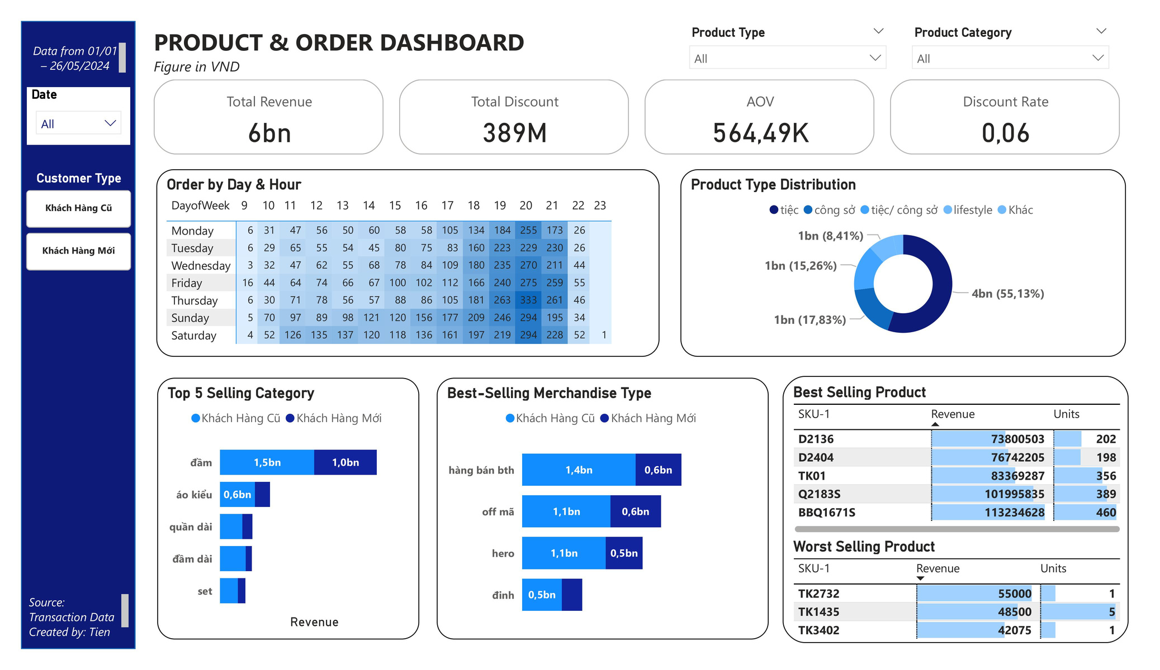
All project files are available in this GitHub repository
Background
Key isssues
Analysis
Recommendation
Appendix

