Slide 1

Internship Program 2023
Netplus IT Company Limited
12.3.2024

Slide 2

Member List
Thwin Htoo Aung | 6IST-1
Myint Cho Cho Kyaw | 6IST-4
Chan Min Ko | 6IST-6
Than Than Soe | 6IST-11
Mabu Phong | 6IST-21
Hein Htet Naung | 6IST-19
Bhone Pyae Kyaw | 6IST-32

Slide 3

Table of contents
01
03
02
04
About Company
Systems What we learned
Company Services
Internship Summary

Slide 4

About Company
Company name - Netplus IT Company limited
CEO - U Win Cho Oo
Location - Mandalay
This company mainly works IT and ELV
system solution services.

Slide 5
What are ELV systems?
Extra low voltage systems which operates in voltage not exceeding 35V (or 60V ripple free DC)
Include CCTV system, fire alarm system, PABX, MATV etc
ELV systems are essential to a building's physical security

Slide 6
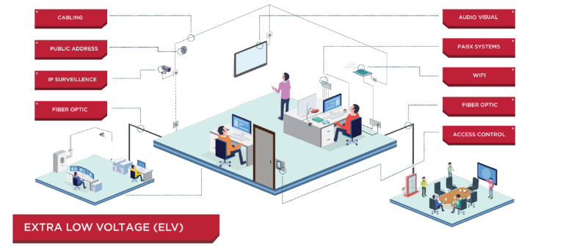
ELV Systems

Slide 7
What have we learned?
This company had an impressive track record of successful projects and we did our internship in Cherry Land Hospital construction located in Pyin Oo Lwin.
The hospital structure has four levels plus basement.
Our contributions included configuring essential systems such as fire alarms, CCTV, Wi-Fi, PABX, MATV, and PA systems, ensuring the hospital's operational efficiency and safety.

Slide 8
WiFi
How Construction WiFi Works
Most people think “WiFi” and the “internet” are the same thing, but there is actually a difference between the two.
WiFi is a technology that connects things wirelessly, whereas the internet is the part that data is sent and received through.
In a construction site, there have a few different “access points”, which works like routers and are spread out around the site to make sure people can connect to the WiFi from any location.
And there have a microwave internet connection coming in that those access points are connected to.

Slide 9
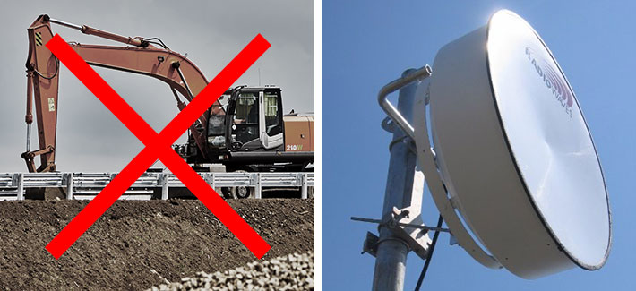
WiFi Cont’d
Choosing The Internet Connection
Before installing access points to give a construction site WiFi, we need to first choose an internet connection.
Fibre Leased Lines
Microwave Internet

Slide 10
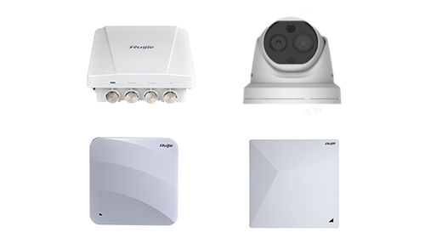
WiFi Cont’d
Networking
Switching: Cisco SG 350,SG 500
Core Router: Mikrotik
WiFi: Rujie Access Point 30+AP
In Basement : WiFi AP 04 Nos
In Level1 : WiFi AP 07 Nos
In Level2 : WiFi AP 08 Nos
In Level3 : WiFi AP 05 Nos
In Level4 : WiFi AP 04 Nos

Slide 11

MATV, CATV
What is MATV?
MATV stands for Master Antenna Television, and it refers to a system that distributes television signals to multiple receivers within a building.

Slide 12
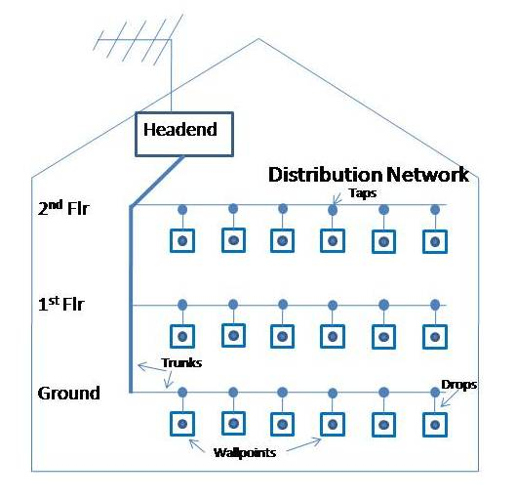
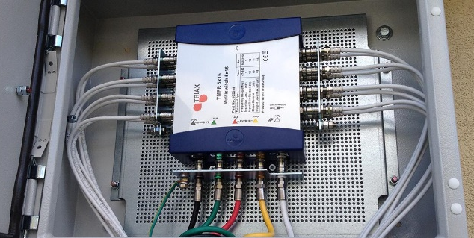
MATV Cont’d
It's commonly used in hotels, apartment buildings, hospitals, schools, and so on.
MATV systems are designed to provide multiple users within a building without the need for individual antennas or satellite dishes for each unit.
Apply these components: Antenna, Headend Equipment(amplifiers, modulators, demodulators, multiplexers), Distribution Network, TV Receivers,

Slide 13
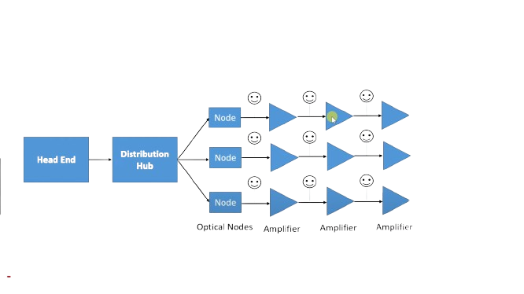
MATV, CATV
What is CATV?
CATV stands for Community Antenna Television, although it's often referred to as Cable Television.
CATV is a system that delivers television programming to consumers via radio frequency signals transmitted through coaxial cables or, in some cases, fiber-optic cables.

Slide 14
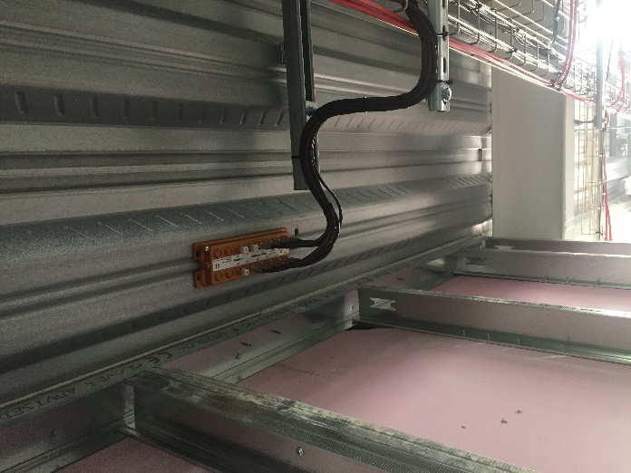
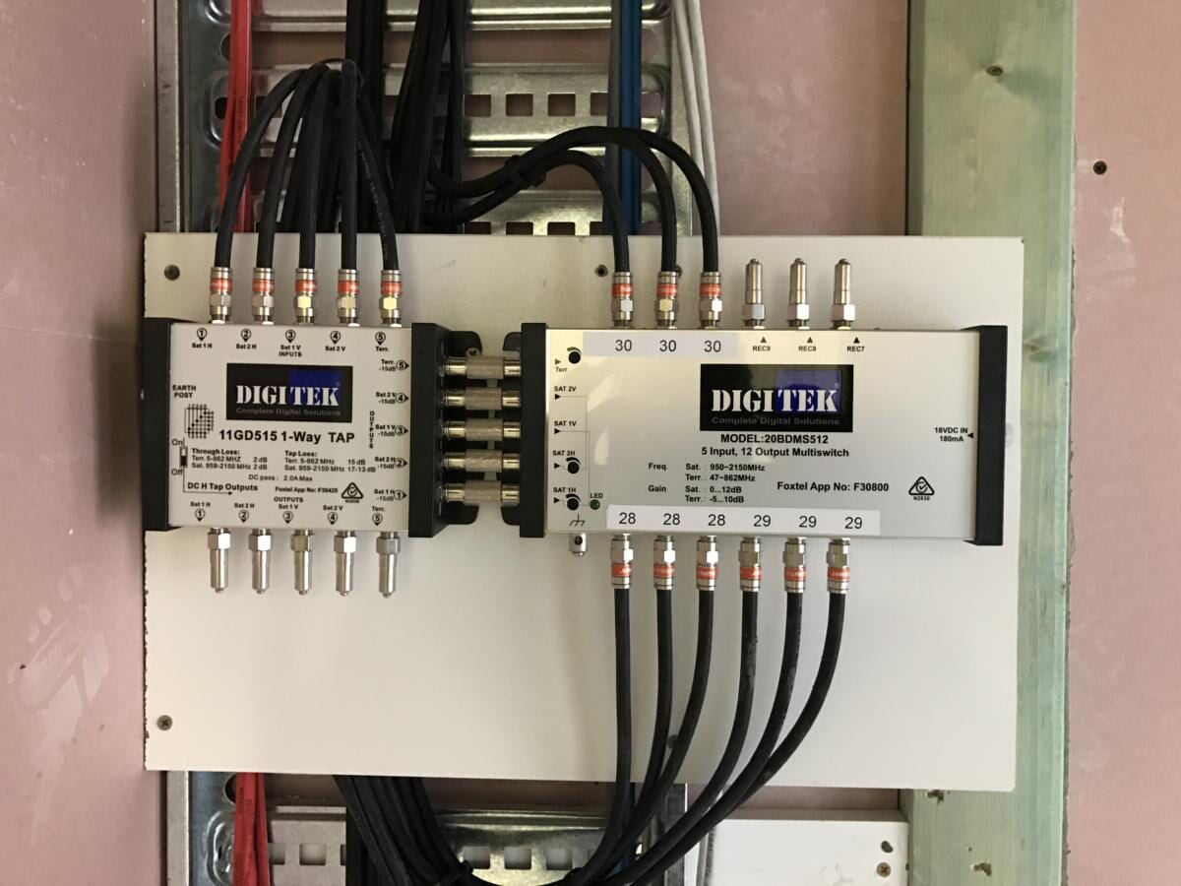
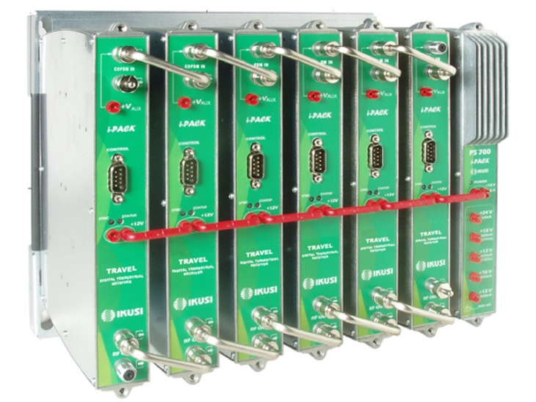
CATV Cont’d
MATV in Cheery Hospital
-12 Channels for 80 Rooms

Slide 15
What is IP camera?
An IP camera (Internet Protocol Camera) is a type of security camera that receives video data and sends video footage via an IP network. It is also known as network camera or IP security camera, often used as remote monitoring and management tools in many sectors and environments to protect the property or monitor home, business, or public security. Connected with other devices such as network video recorders and displays via a network, IP cameras allow you to monitor specific areas from any remote location, bringing much convenience to our daily lives.
How Does An IP Camera Work?
IP cameras work the same way as digital cameras to capture high-quality images. What sets them apart is the capability of IP cameras to compress those files and automatically transmit them to a network video recorder (NVR) via a network. Usually, IP cameras are connected to the network via ethernet cable with a broadband modem or router, or wirelessly via a Wi-Fi router.

Slide 16
Difference between Dahua IPC-HDW1431T1-S4 and IPC-HFW4431T-S-S4
The IPC-HDW1431T1-S4 is a dome camera,typically used for indoor installations.
The IPC-HFW4431T-S-S4 is a bullet camera,commonly employed for outdoor surveillance.

Slide 17
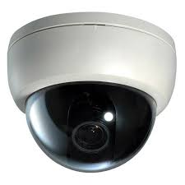
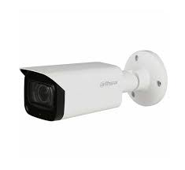
Type Dome Camera Bullet Camera
Outlook
Installation | Mounted to ceiling | Mounted to walls/ceilings
Pros | Wide field of view; Discrete look; Less intrusive than bullet and turrent cameras; | Long-range vision; Easy to install or reposition; Less IR Bounce; More visible to scare off criminals;

Slide 18
Cont’d
Cons | Difficult to reposition once installed; Prone to IR bounce; Easy to get dust or fingerprints; | Easier to vandalize than dome and turret cameras; Limited monitoring angle;
Application | Schools, offices, homes, or small shops. | Schools, shops, industrial settings, traffic lights, and high crime areas

Slide 19
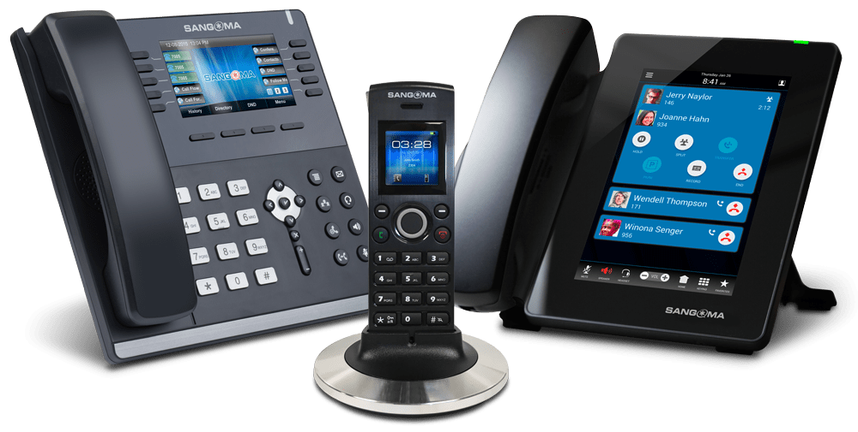
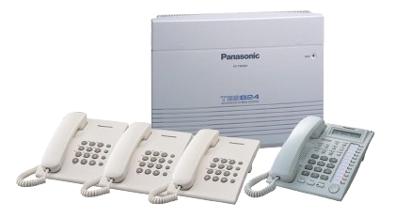
PABx
What is PABx?
PABX stands for Private Automatic Branch Exchange System. It is a business telephony system used for internal and external communication at a business.
Panasonic KX-TES824
Maximum configuration – 8 Analogue CO / 24 Extensions

Slide 20
Cont’d
A PABX system can lower the phone bill because many employees will be using the same phone line. Moreover, the employees will be able to make internal calls via short extension numbers.
With PABX, a company can run its own internal phone network using local extension numbers.
For outgoing calls, a PBX connects with the public telephone exchange. A traditional PBX has one or more external (trunk) lines. It has a fixed number of internal lines (extensions) connected to the trunk line.

Slide 21
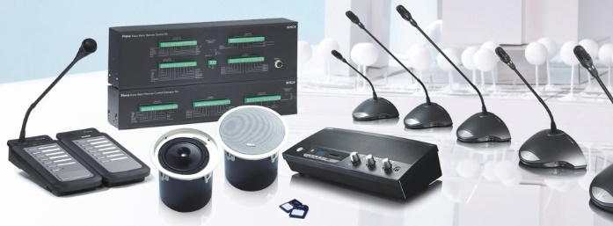
PA (Public Address System)
What is PA?
A public address system (PA system) is an electronic sound amplification and distribution system with a microphone, amplifier and loudspeakers, used to allow a person to speak to a large public.
It amplifies the input voice or sound and transfers it to a number of speakers at various places, simultaneously.

Slide 22
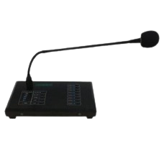
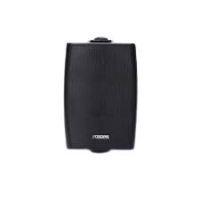
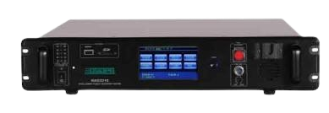
Cont’d
Hospital PA system products related:
MAG3210—Intelligent Public Address Center;
MAG1488—Remote Paging Selector;
DSP6061—PA Wall Mount Speaker;
DSP922—PA Ceiling Speaker;
DSP645—PA Balcony Speaker;
MAG3210
Intelligent Public Address Center Host
MAG1488
Intelligent Public Address Center Host
DSP6061
PA Wall Mount Speaker;

Slide 23
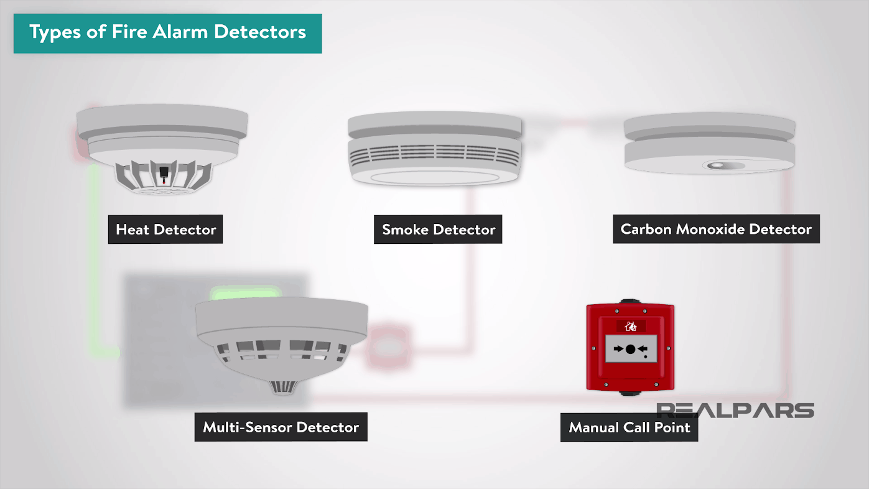
What is Fire Alarm System?
Fire Alarm System is designed to alert us to an emergency so that we can take action to protect ourselves, staff and the general public.
Two Common Fire Alarm Systems:
1. Conventional system
2. Addressable System
detectors are grouped into zones
indicate that there is a fire or fault within a zone.
suitable for smaller buildings with simpler layouts.
each has a unique address
identify the exact location of the device
more expensive than conventional system

Slide 24
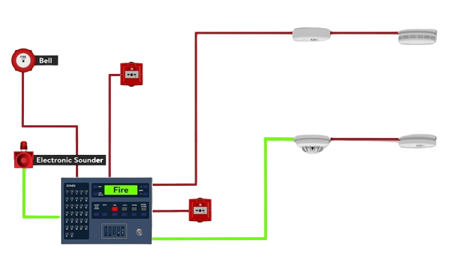
Conventional Fire Alarm System
Zone 1
Call Point
Smoke Detector
Zone 2
Zone 3
Control Pannel

Slide 25
Project Timeline & Schedule
Quotation and Proposal
Design
Piping and Cabling
Unit Mount and Devices Installation
Commissioning and Testing
Handover

Slide 26
Conclusion
Get new knowledge about ELV systems
ELV systems offer heightened energy efficiency, lower maintenance requirements, and reduced safety risks.
ELV systems are key to upgrading infrastructure and creating smarter.
ELV systems will become more common in the future.

Slide 27
Thanks
For your attention

