Slide 1



SOURCE CODING - FINAL PROJECT
ALGORITHMS FOR ENCODING AND DECODING
CD-QUALITY AUDIO SIGNALS BY MEANS
OF DPCM TECHNIQUE AND GOLOMB PROCEDURE.
Author:
Lorenzo Gasparollo
Professor:
Giancarlo Calvagno
26th July 2018

Slide 2


Motivation.
Basic notions.
Work on the assignment.
Simulations and results.
Conclusions.
Index
Table des matière
Trucs
Notes:
‹#›
‹#›
‹#›

Slide 3

Motivation
Why using a diffential coding scheme for the compression of an audio track?
Notes:
‹#›

Slide 4
Differential coding scheme
Idea:
exploit the correlation of source’s samples in order to predict each sample based on its past.
Then, encode and transmit the differences between the prediction and the sample value.
Notes:
‹#›

Slide 5
Audio track – a perpective
In acoustic: the "resonance" generated by the sounds leads to some sort of the "redundancy" (The sound repeats itself).
→This, in accordance to our intuition, implies also a repetition from a numerical point of view.
Notes:
‹#›

Slide 6
Motivation: answer
Why using a diffential coding scheme for the compression of an audio track?
→ The resonance and thus the relative redundancy, e.g. statistical correlation, can be conveniently exploited to increase the coding efficiency.
Notes:
‹#›

Slide 7
Table des matière
Trucs
BASIC NOTIONS
Notes:
‹#›
‹#›
‹#›

Slide 8
DPCM scheme
The differential pulse code modulation (DPCM) system is a differential encoding system.
DPCM system consists of the predictor and the quantizer and it can be, open or closed loop.
We will focus on the second one, as it will be treated throughout the report.
Notes:
‹#›

Slide 9
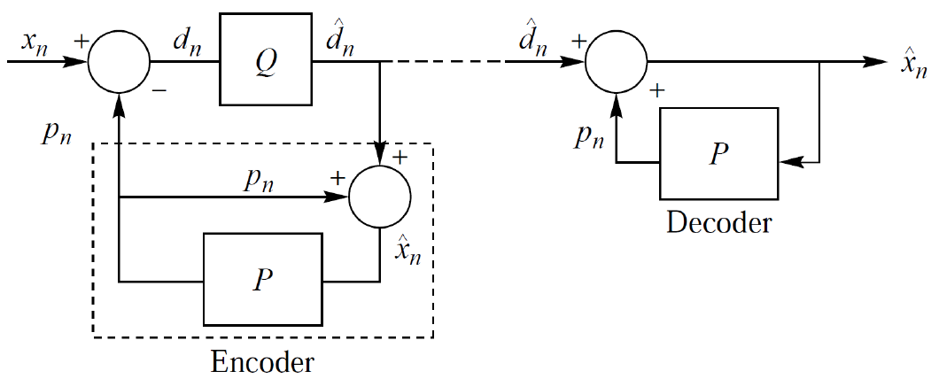
DPCM CLOSED LOOP SCHEME
Notes:
‹#›

Slide 10
Golomb technique
Golomb coding is a lossless data compression method, generally used for encoding natural numbers.
Golomb coding uses a tunable parameter m to divide an input value n into two parts: q, the result of a division by m, and r, the remainder.
The quotient is sent in unary coding, followed by the remainder in truncated binary encoding.
Notes:
‹#›

Slide 11
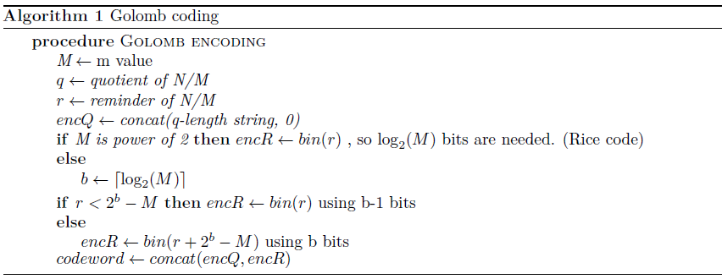
Golomb encoding- Pseudo code
1
Notes:
‹#›

Slide 12
Table des matière
Trucs
WORK ON THE ASSIGNMENT
Notes:
‹#›
‹#›
‹#›

Slide 13
Analysis
The system uses 2 techniques:
lossy (DPCM)
loss-less (Golomb coding).
We will consider:
a simple DPCM (C1).
DPCM with a basic version of the forward adapted predictor (C2).
Notes:
‹#›

Slide 14
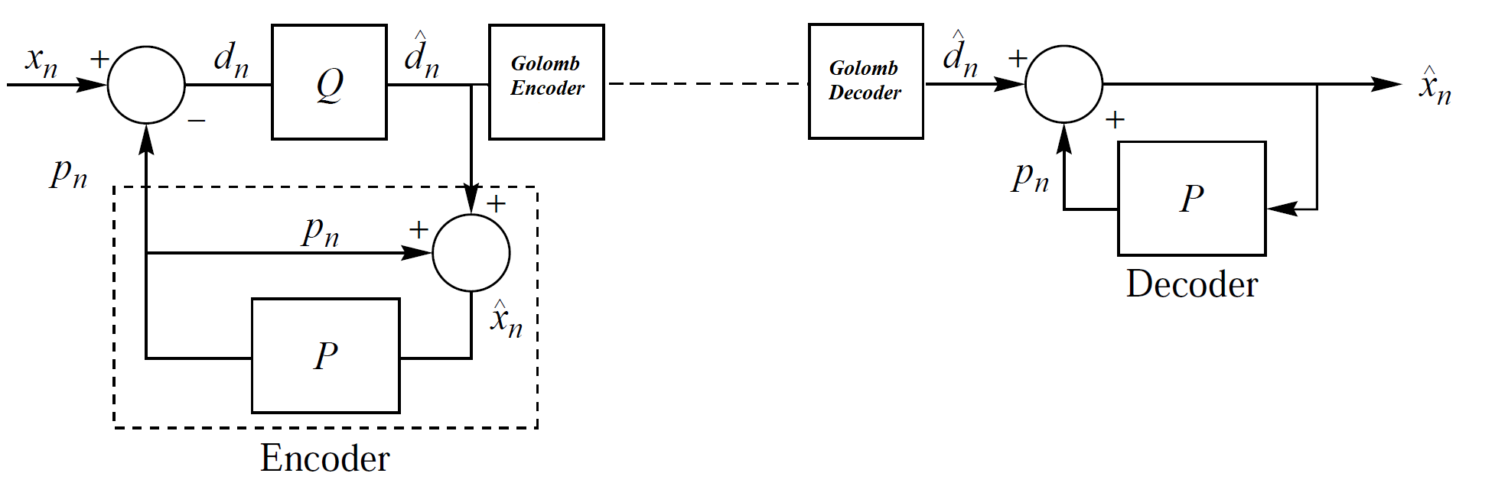
DPCM (C1)
Notes:
‹#›

Slide 15
DPCM (C1)
Let’s specify the quantizer and predictor properties!
Notes:
‹#›

Slide 16
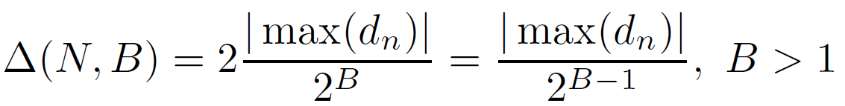
Analysis: quantizer - 1
We will consider a scalar, uniform, non adaptive quantizer, i.e., a quantizer in which:
• each input sample is quantized individually.
• the step size is constant.
• the quantizer does not adapt itself to the input statics over time.
In practice, the step size it is chosen:
– for the DPCM system as:
Notes:
‹#›

Slide 17
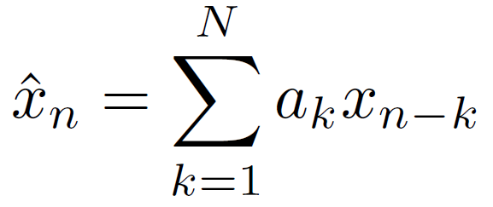

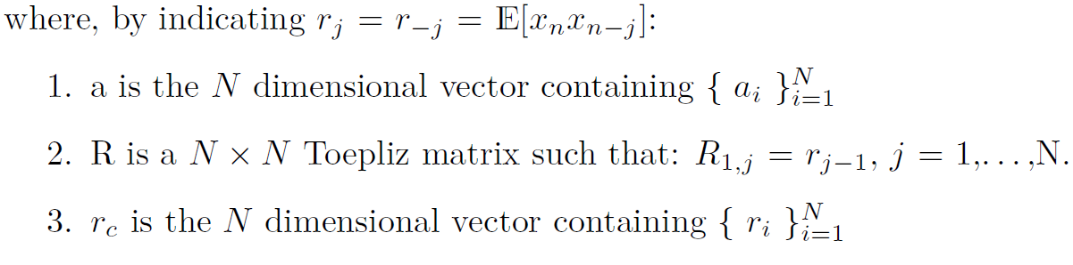
Analysis: predictor - 1
We consider a Optimal Linear Predictor of order N for a stationary, zero mean, discrete, time random process:
,
Notes:
‹#›

Slide 18
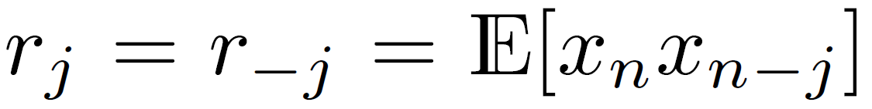
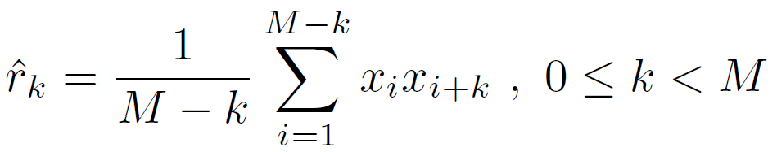
Analysis: predictor - 2
In practice it is not possible to know a-priori the the distribution of the source and so the autocorrelation values.
Given M data points, autocorrelation can be estimated as:
- It is crucial normalize the input signal, by subtracting this latter by its mean μ, which can be estimated before the encoding procedure.
Notes:
‹#›

Slide 19
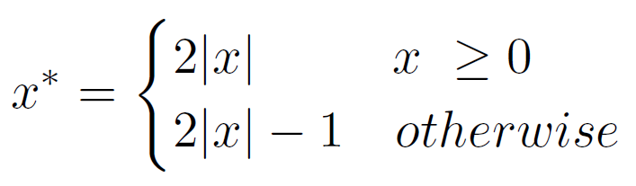
Analysis: Golomb encoder - 1
dn is assumed to be distributed as a two side geometric distribution. Golomb encoding can be used also for negative integers by mapping values as:
For a r.v. N ~ G(p) we have:
Notes:
‹#›

Slide 20
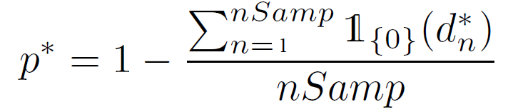

Analysis: Golomb encoder - 2
Let’s call dn* the positive version of dn through the previous map, assumed
to be distributed according to a geometric r.v. G(p) of parameter p.
We pick the estimate:
A typical choice of m is:
Notes:
‹#›

Slide 21
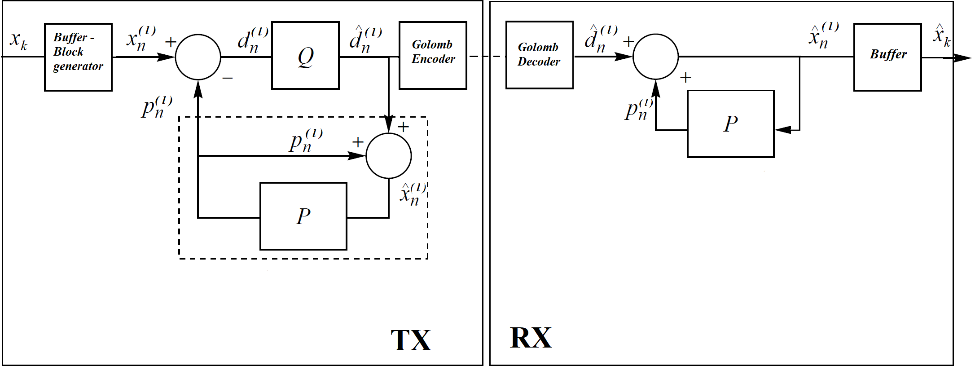
DPCM (C2)
Notes:
‹#›

Slide 22
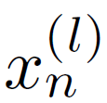
DPCM (C2)
Motivation: the source may be locally stationary over any significant length of the output but its the statistics may vary considerably. In this situation, it is better to adapt the predictor to match the local statistics.
In forward adaptive prediction, the input is divided into segments or blocks.
We can apply the same rationale as the previous analysis just by considering
as the input source of the DPCM (C1).
Notes:
‹#›

Slide 23
Table des matière
Trucs
SIMULATIONS AND RESULTS
Notes:
‹#›
‹#›
‹#›

Slide 24
Simulations
Simulations will take into account different degrees of freedom which can be summarized as:
type of scheme: (C1) or (C2).
predictor order (N).
quantization bits (B).
Genre of music.
It will be presented results obtained with a simple PCM and with the ones obtained by DPCM (C1) and (C2).
*For DPCM (C1) and DPCM (C2) it has been set the window size of 200ms and 30000 ms, respectively.
Notes:
‹#›

Slide 25
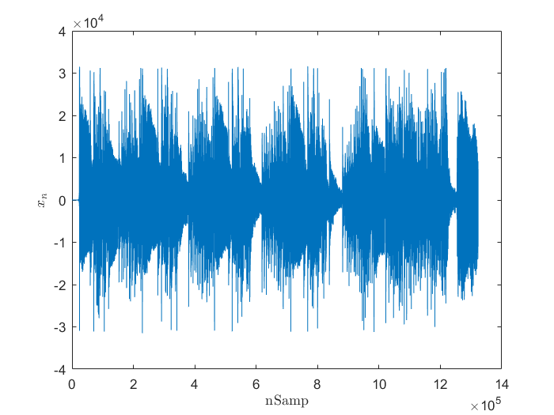

Paganini: Caprice No 5
Number of seconds considered: 30s.
Sampling frequency: 44100 Hz.
Notes:
‹#›

Slide 26
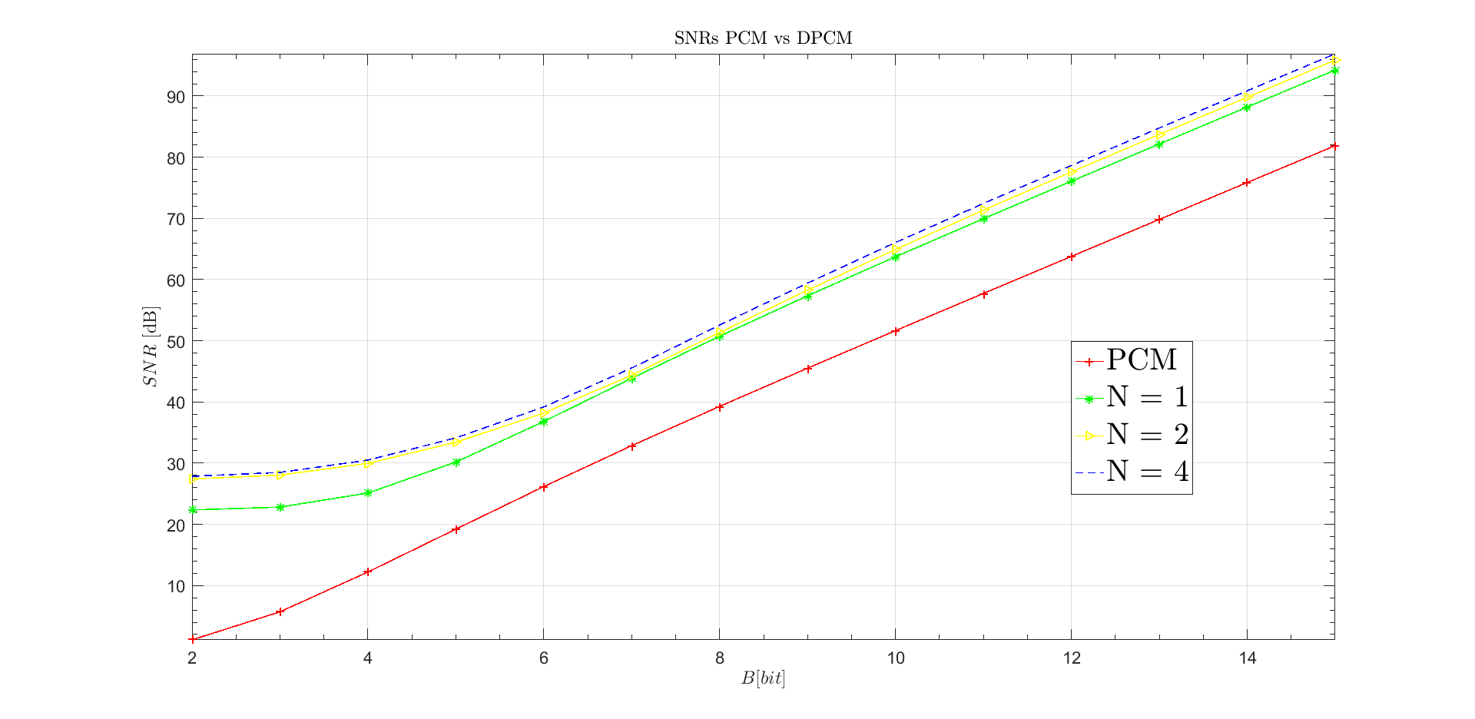
PCM vs DPCM (C1) - SNRs
Notes:
‹#›

Slide 27
PCM vs DPCM (C1) - SNRs
~ 3 bit
Notes:
‹#›

Slide 28
PCM vs DPCM (C1) - SNRs
~ 6 bit
Notes:
‹#›

Slide 29
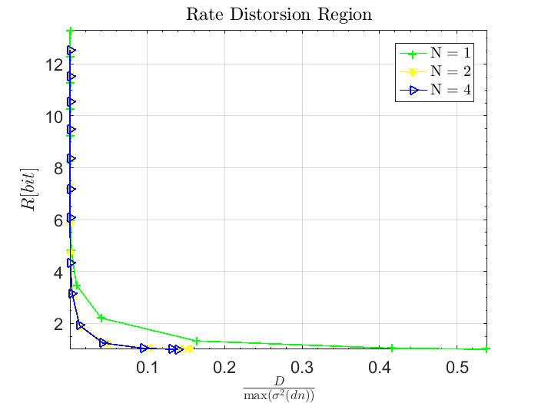
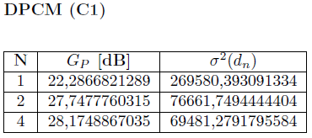
PCM vs DPCM (C1) – Rate/Distortion
Notes:
‹#›

Slide 30
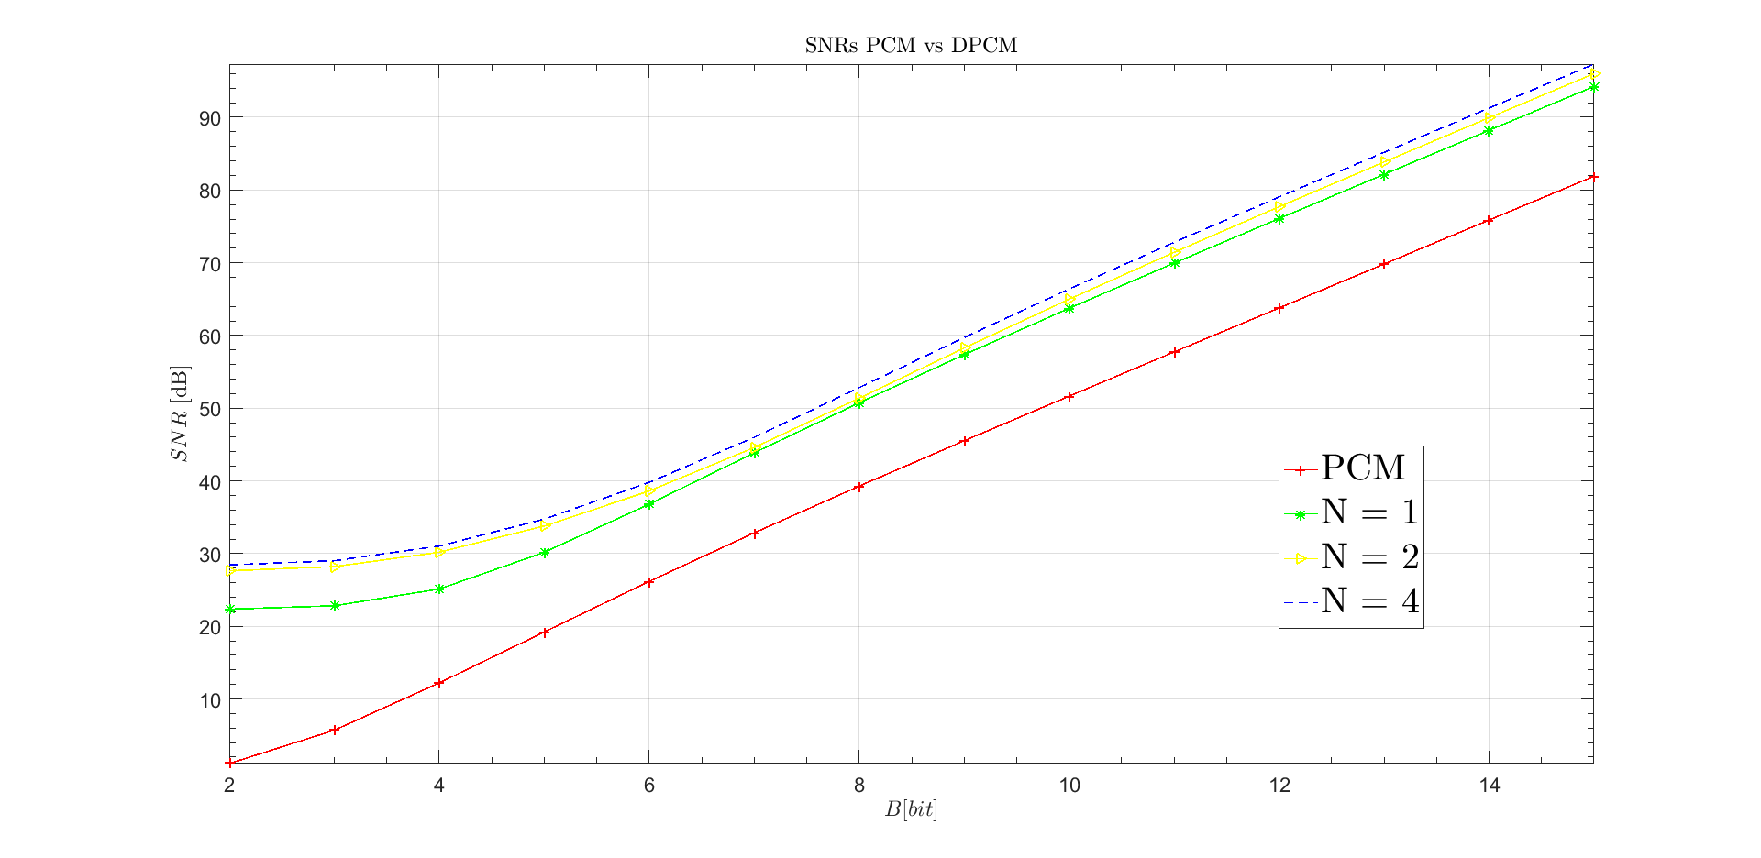
PCM vs DPCM (C2) – SNR
Notes:
‹#›

Slide 31
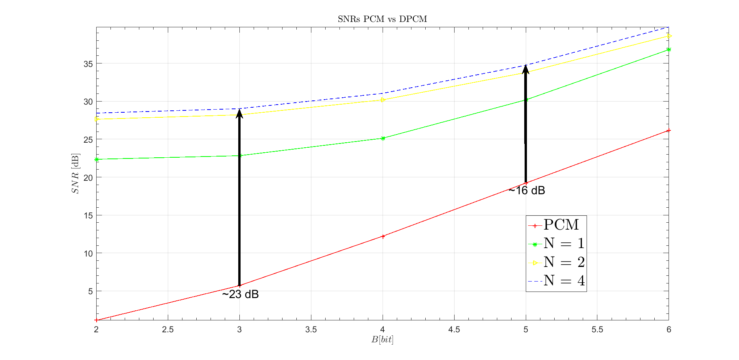
PCM vs DPCM (C2) – SNR
Notes:
‹#›

Slide 32
PCM vs DPCM (C2) – SNR
How that difference sounds?
PCM (B = 3)
DPCM (C2), N = 4 (B = 3)
Notes:
‹#›

Slide 33
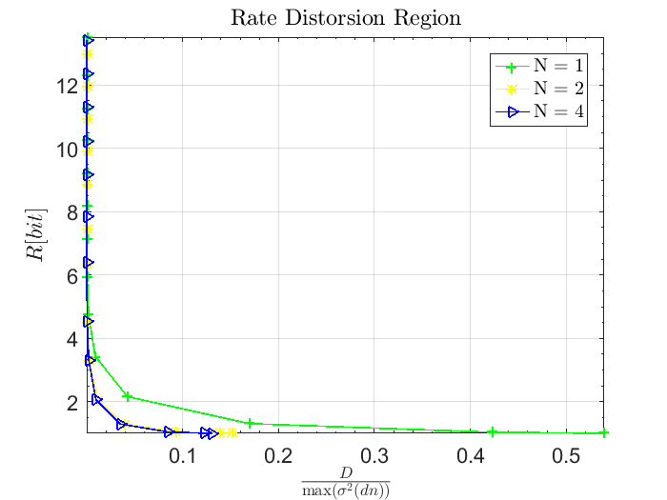
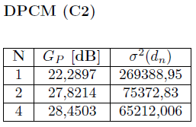
DPCM (C2) – Rate/Distortion
Notes:
‹#›

Slide 34
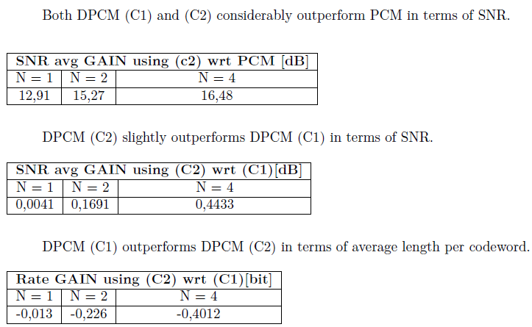
Paganini: caprice No 5 – Results
DPCM (C2) outperform DPCM (C1) in terms of prediction gain.
Notes:
‹#›

Slide 35
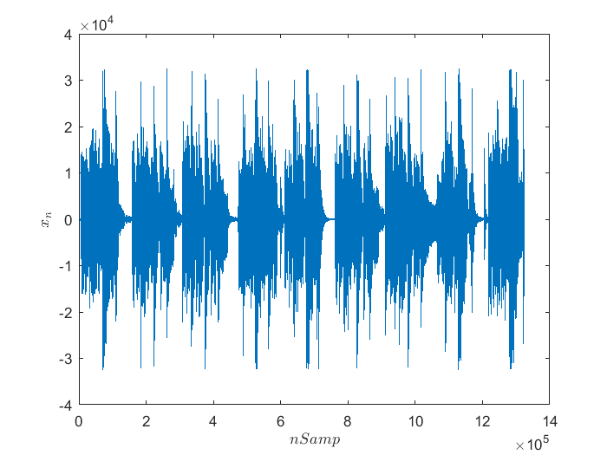
Adult Jazz: Am Gone
Number of seconds considered: 30s.
Sampling frequency: 44100 Hz.
Notes:
‹#›

Slide 36
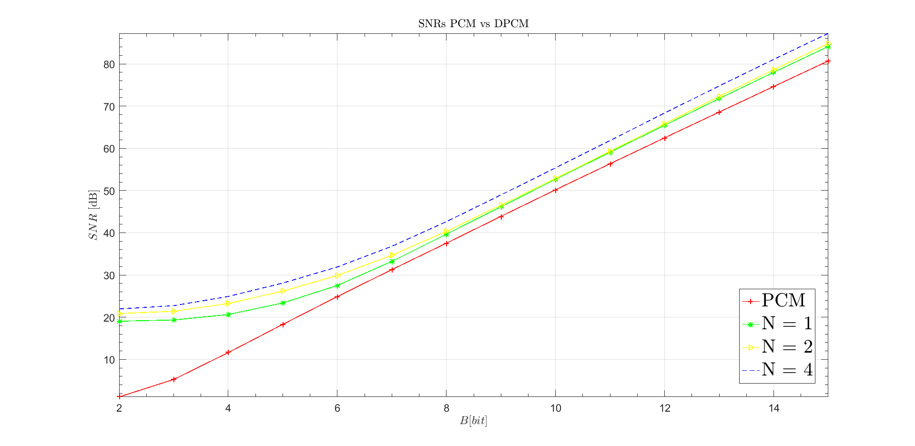
PCM vs DPCM (C2) – SNR
Notes:
‹#›

Slide 37
PCM vs DPCM (C2) – SNR
Notes:
‹#›

Slide 38
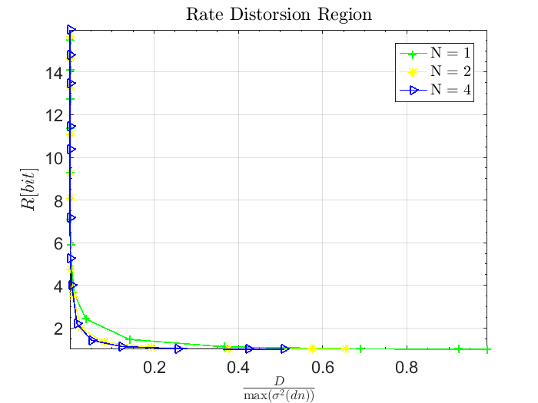
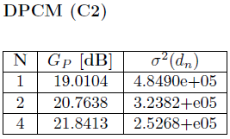
DPCM (C2) – Rate/Distortion
Notes:
‹#›

Slide 39
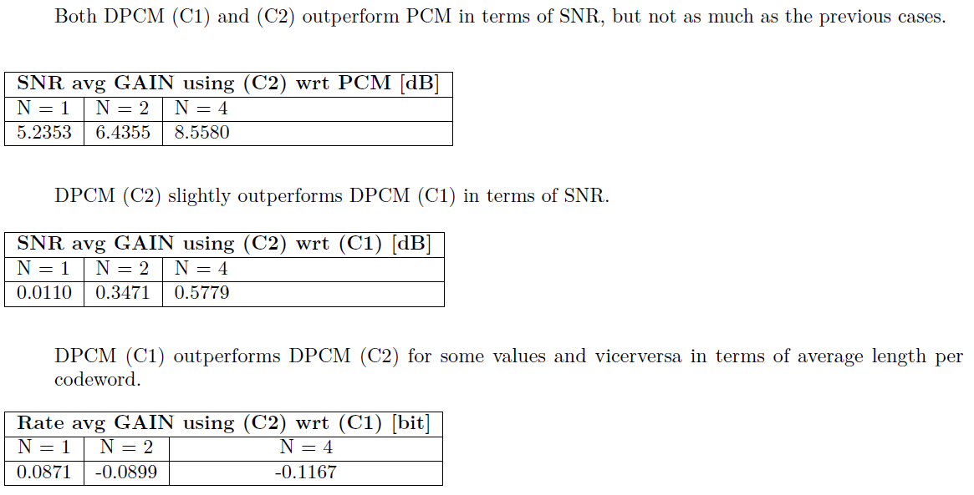
Adult Jazz: Am Gone – Results 1
Notes:
‹#›

Slide 40
Am Gone vs Caprice No 5
Caprice No 5
Am Gone
For B = 6
PCM:
PCM:
PCM:
DPCM (C2), N = 1:
DPCM (C2), N = 1:
DPCM (C2), N = 1:
Notes:
‹#›

Slide 41
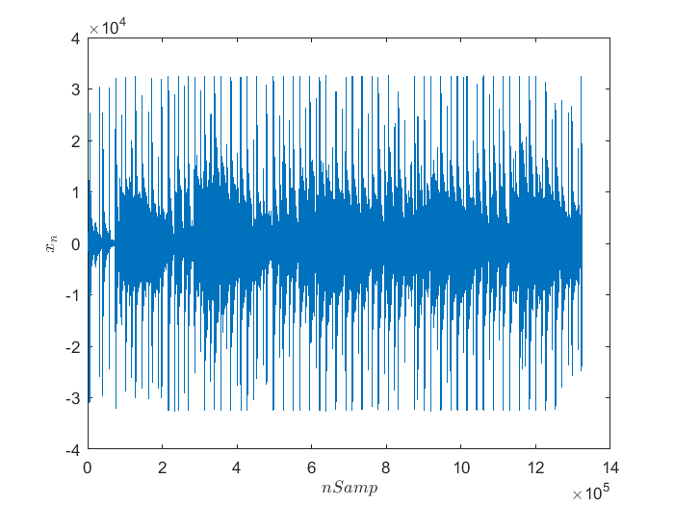
Radiohead: identikit.
Number of seconds considered: 30s.
Sampling frequency: 44100 Hz.
Notes:
‹#›

Slide 42
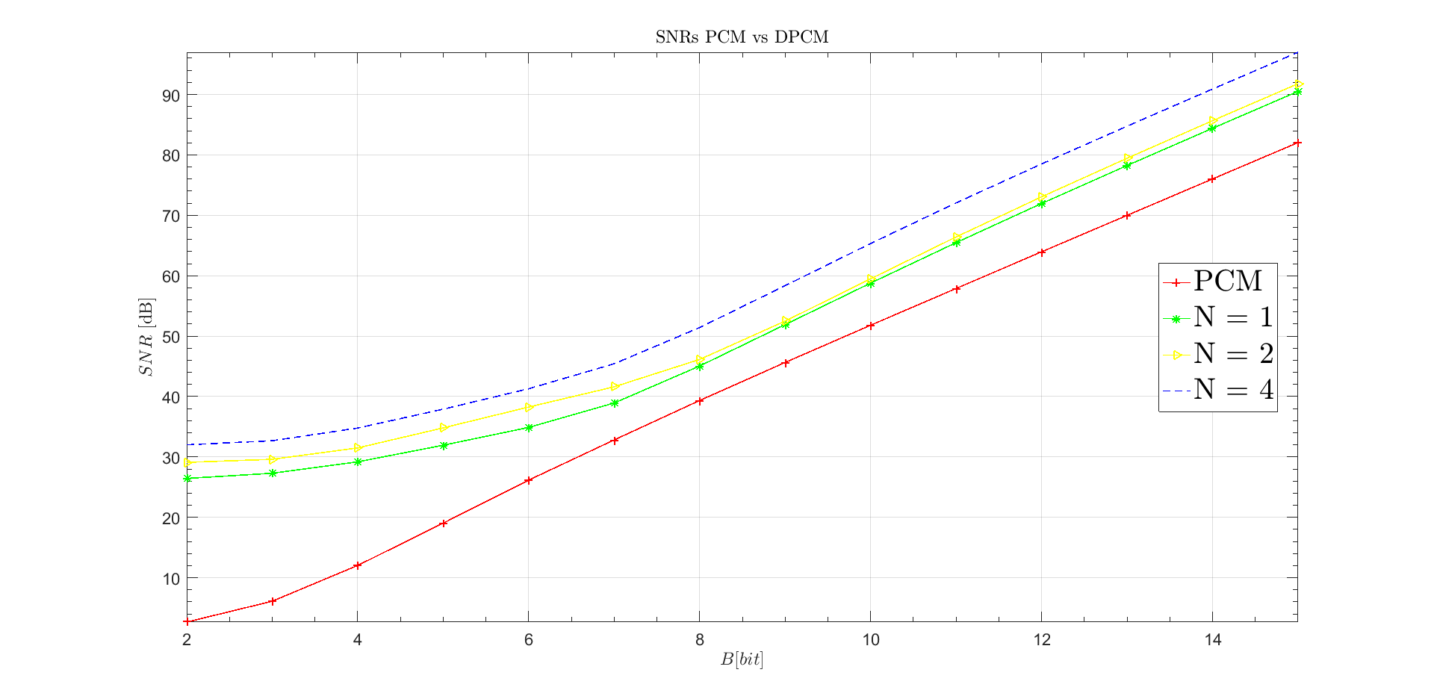
PCM vs DPCM (C2) – SNR
Notes:
‹#›

Slide 43
PCM vs DPCM (C2) – SNR
~ 30 dB
Notes:
‹#›

Slide 44
PCM vs DPCM (C2) – SNR
~ 5 bit
Notes:
‹#›

Slide 45
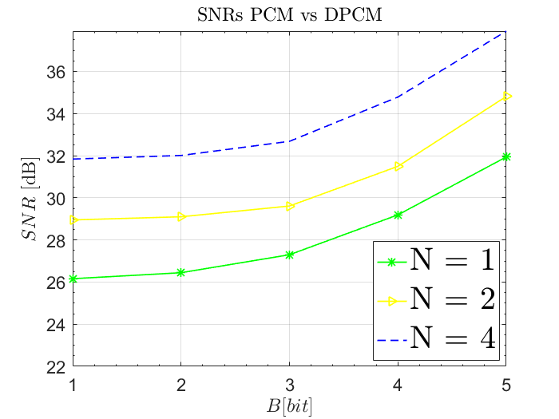
PCM vs DPCM (C2) – SNR
For B = 2
PCM:
~ 0 [dB/B]
~ 0,2 [dB/B]
DPCM (C2), N = 4:
Notes:
‹#›

Slide 46
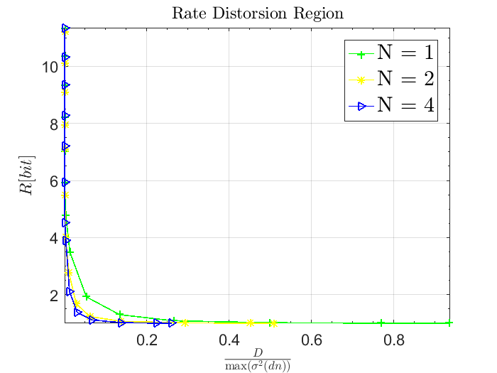
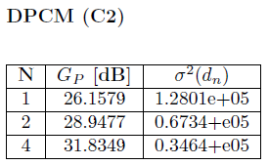
DPCM (C2) – Rate/Distortion
Notes:
‹#›

Slide 47
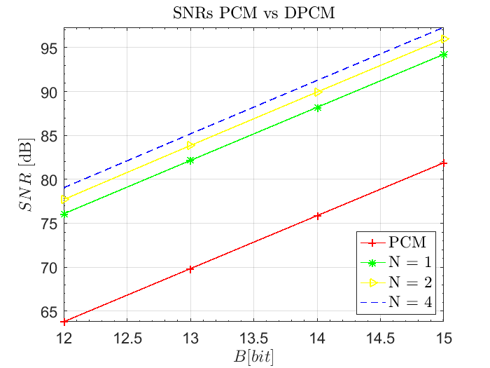
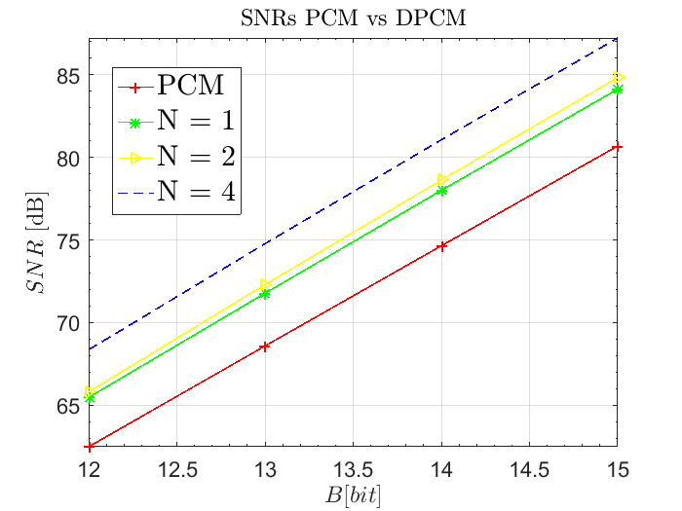
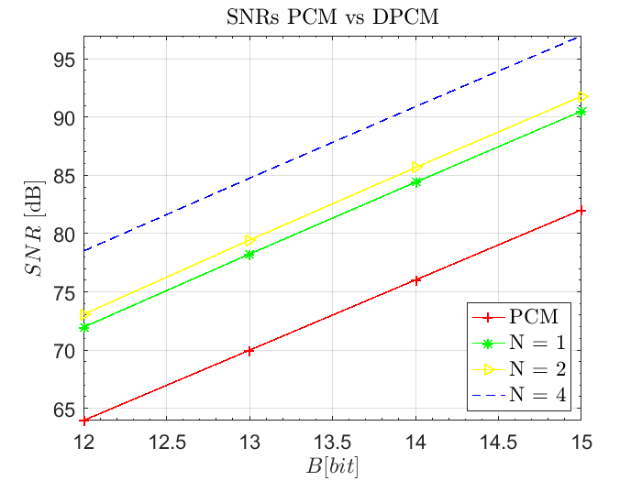
Am Gone vs Caprice No 5 vs Identikit
Caprice No 5
Am Gone
Identikit
Notes:
‹#›

Slide 48
Table des matière
Trucs
CONCLUSIONS
Notes:
‹#›
‹#›
‹#›

Slide 49
Table des matière
Trucs
THANKS FOR THE ATTENTION!
Notes:
‹#›
‹#›
‹#›

