Slide 1

EVE310 Lab 2
September 4, 2025

Slide 2
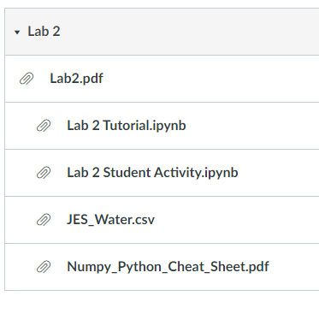
Announcements
Use the modules feature in Canvas to see relevant files:
Module will be published before lab
Quizzes will be available in the afternoon after lab
Tip: Good file storage/management is key for this class and coding/research in general! Create an EVE 310 folder on your computer with a separate subfolder for each lab. Store lab handouts, data, and activities here as soon as you download from Canvas.

Slide 3
Lab 2 Learning Objectives
Importing Data
Comments
Working with Packages
Arithmetic Operators
Variable Types
Arrays and Indexing
Other Tips: Indenting and Workspace Reset
Lab 2 Activity
Open the Lab 2 Tutorial Jupyter Notebook to follow along!

Slide 4
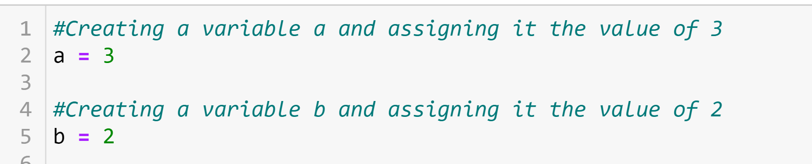
Comments in your Code
#= single line comment
‘’’ ‘’’ = multi line comments
Leave notes to yourself and others in your code
Any line that starts with # will be skipped by the computer, but humans can read it
Using ‘’’ ‘’’’
Notes:
You need to use # to use comment.
Comments are especially important when creating a script in spyder since there are no nice markdown cells like Jupyter Notebook.

Slide 5
Working with Python packages
The import Statement
import <package_name>
Ex: import numpy
You can also import an entire package under an alternate name:
import <package_name> as <alt_name>
Ex: import numpy as np
Most famous and useful Python packages (that we will use): NumPy, Pandas, Matplotlib, Seaborn, SciPy, Scikit-Learn
Notes:
NumPy: NumPy (Numerical Python) is a fundamental package for numerical computations in Python. It provides support for large, multi-dimensional arrays and matrices, along with a wide range of mathematical functions to operate on these arrays efficiently. NumPy forms the foundation for many other scientific computing and data analysis libraries in Python.
Pandas: Pandas is a powerful library for data manipulation and analysis. It provides data structures like DataFrames and Series, which allow you to work with structured data easily. Pandas simplifies tasks such as data cleaning, transformation, aggregation, and exploration. It's widely used for data preprocessing and analysis in data science workflows.
Matplotlib: Matplotlib is a popular plotting library that enables you to create a wide variety of static, interactive, and animated visualizations in Python. It provides a flexible interface for creating charts, graphs, histograms, and other types of visualizations. Matplotlib is often used in combination with other libraries for data analysis and presentation.
Seaborn: Seaborn is a statistical data visualization library built on top of Matplotlib. It provides a higher-level interface for creating attractive and informative statistical graphics. Seaborn comes with several built-in themes and color palettes that make it easy to create visually appealing visualizations for exploring data relationships.
SciPy: SciPy is an open-source library for mathematics, science, and engineering. It builds on top of NumPy and provides additional functionalities such as optimization, signal processing, linear algebra, integration, and more. SciPy is particularly useful for scientific and engineering applications where advanced mathematical and scientific algorithms are needed.
Scikit-Learn (also known as sklearn): Scikit-Learn is a machine learning library that provides a wide range of tools for various machine learning tasks, including classification, regression, clustering, dimensionality reduction, and more. It's designed to be user-friendly and follows a consistent API, making it easy to experiment with different machine learning algorithms and models.

Slide 6
Working with Python packages
The import Statement
import <package_name>
Ex: import numpy
You can also import an entire package under an alternate name:
import <package_name> as <alt_name>
Ex: import numpy as np
If you get a “ModuleNotFound” Error, it is because your editor cannot find the package.
Solution: Press Command+Shift+P (on mac) or Ctrl+Shift+P (on windows), type “select interpretor” in the box that appears, and select ”base” from the dropdown.
Notes:
NumPy: NumPy (Numerical Python) is a fundamental package for numerical computations in Python. It provides support for large, multi-dimensional arrays and matrices, along with a wide range of mathematical functions to operate on these arrays efficiently. NumPy forms the foundation for many other scientific computing and data analysis libraries in Python.
Pandas: Pandas is a powerful library for data manipulation and analysis. It provides data structures like DataFrames and Series, which allow you to work with structured data easily. Pandas simplifies tasks such as data cleaning, transformation, aggregation, and exploration. It's widely used for data preprocessing and analysis in data science workflows.
Matplotlib: Matplotlib is a popular plotting library that enables you to create a wide variety of static, interactive, and animated visualizations in Python. It provides a flexible interface for creating charts, graphs, histograms, and other types of visualizations. Matplotlib is often used in combination with other libraries for data analysis and presentation.
Seaborn: Seaborn is a statistical data visualization library built on top of Matplotlib. It provides a higher-level interface for creating attractive and informative statistical graphics. Seaborn comes with several built-in themes and color palettes that make it easy to create visually appealing visualizations for exploring data relationships.
SciPy: SciPy is an open-source library for mathematics, science, and engineering. It builds on top of NumPy and provides additional functionalities such as optimization, signal processing, linear algebra, integration, and more. SciPy is particularly useful for scientific and engineering applications where advanced mathematical and scientific algorithms are needed.
Scikit-Learn (also known as sklearn): Scikit-Learn is a machine learning library that provides a wide range of tools for various machine learning tasks, including classification, regression, clustering, dimensionality reduction, and more. It's designed to be user-friendly and follows a consistent API, making it easy to experiment with different machine learning algorithms and models.

Slide 7
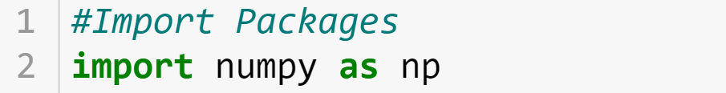
Working with Packages
Packages need to be imported before packages can be utilized
Name of Package
Alias, or nickname, assigned to that package within the script.
Note: whatever you put after the “as” is what is used to refer to the function.
Example:
a = np.array( [5,7,4] )
Output
Package reference
Function
Input
Notes:
Again, the first thing you need to do is to import the packages before using the packages’ functions in the script.
In the actual commend, you can use it like this example. A as an output or variable equals np, as a package reference, dot and array, as a function, and inputs. In this case, we need to use round and square bracket together to make an array of a list, we will come back to this point later.

Slide 8
Working with Packages
Packages need to be imported before packages can be utilized
Name of Package
Alias, or nickname, assigned to that package within the script.
Note: whatever you put after the “as” is what is used to refer to the function.
Example:
a = np.array([5,7,4])
Output
Package reference
Function
Input
If you spell the function incorrectly, you get a AttributeError.
KeywordError
Notes:
Again, the first thing you need to do is to import the packages before using the packages’ functions in the script.
In the actual commend, you can use it like this example. A as an output or variable equals np, as a package reference, dot and array, as a function, and inputs. In this case, we need to use round and square bracket together to make an array of a list, we will come back to this point later.

Slide 9
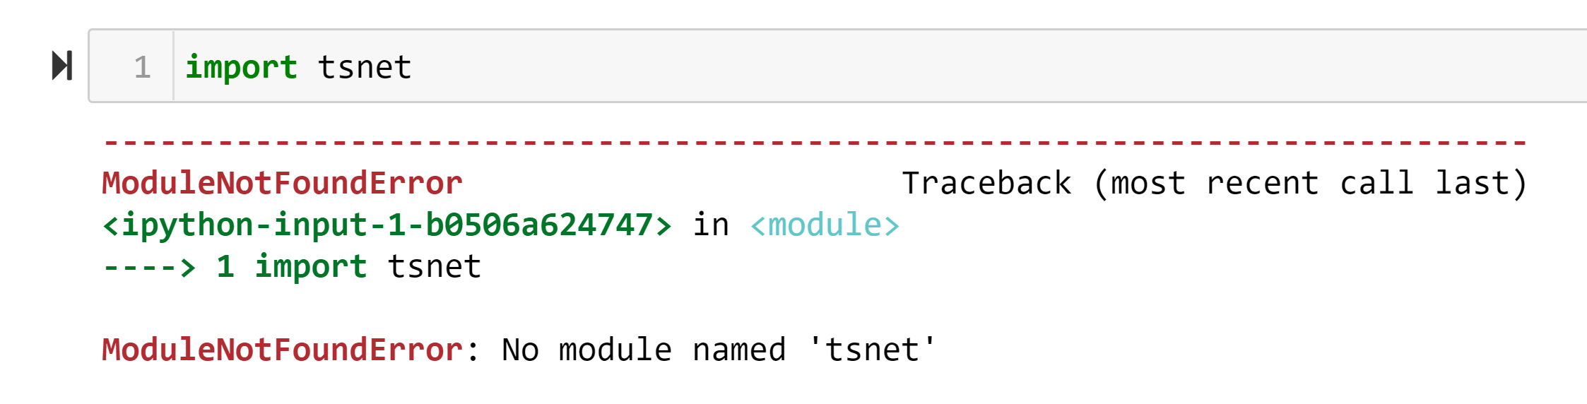
Installing a Python Package
Packages need to be installed on your computer before you can import them to your script
If you see the error below, it means the package needs to be installed
Notes:
TSNet is a Python package designed to perform transient simulation in water distribution networks.

Slide 10
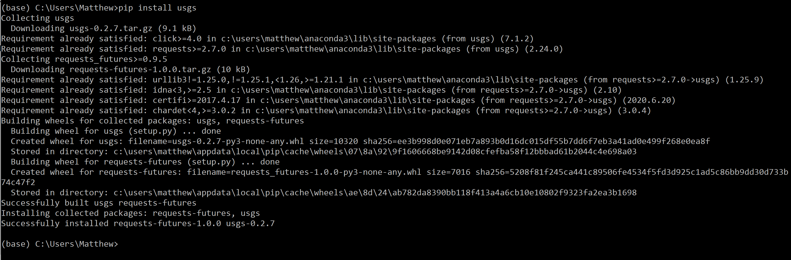
Installing a Python Package
Python packages must be installed before using them for the first time
To install a package, go to the Explorer in VSCode, right click and select “Open in New Integrated Terminal”, and use the following command in the terminal: pip install <package_name>
Step 1: Type “pip install usgs” (to import the usgs package)
Step 2: Wait for the necessary files to download (shouldn’t take too long)
Step 3:When you are able to type again into the Command Prompt/Terminal, you know you’re done installing
EVE310 Fall 2025 Lab 2
Notes:
PIP: Preferred Installer Program

Slide 11
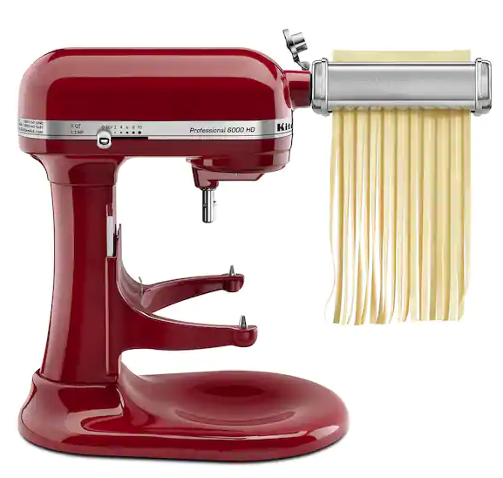
Difference between Installing and Importing
Install:
Downloading the files on to your computer
Use pip install <package name> in the command prompt
Only needs to be done once for each package
Import:
Making the package available for use in a script or notebook
Use import on python script/notebook
Needs to be done each time you use the package in a script or notebook
“Normal” Python
Package
Install: Buy the pasta maker from the store
Import: Put the pasta maker on the Kitchen Aid each time you use it
Notes:
In Python, importing a package or module is a way to make its functionality available in your current code or script. This approach has several benefits:
Modularity, Namespace management, Memory efficiency, Reduced load time.
Overall, the ability to import packages and modules on-demand is a key feature of Python that promotes code organization, maintainability, memory efficiency, and flexibility. It allows developers to efficiently manage and use the vast array of available libraries without cluttering their code with unnecessary functionality.

Slide 12
Variables: Different Types for Different Purposes
Numbers
Strings
List
Array
Dataframe

Slide 13
Individual Variables
Numbers: stores a single number
Strings: stores a sequence of characters as text
Single quotes around a string
See Links for more info and tutorials:
Numbers and strings: https://www.learnPython.org/en/Variables_and_Types
Notes:
There are 2 main types of individual variables: numbers and strings.
Numbers just numbers. Strings are a sequence of letters stored in a variable
To store a number: You need to put variable name on the left side "=" in the middle, Some value on the right, in this case we put the number 2. With this commend, we can say that b refers to the number 2.
To store a string, you need to use a single quote around each side of your string so that python knows it is a string.
If you want to know more about numbers and strings, you can go to this website.

Slide 14
Arithmetic operators
Assume variable a holds the value 10 and variable b holds the value 2, then:
Operator | Description | Example
+ Addition | Adds values on either side of the operator. | a + b = 12
- Subtraction | Subtracts right hand operand from left hand operand. | a – b = 8
* Multiplication | Multiplies values on either side of the operator | a * b = 20
/ Division | Divides left hand operand by right hand operand | a/ b = 5
** Exponent | Performs exponential (power) calculation on operators | a**b =100
Notes:
Here are some symbols to do basic math on number variables. (These do not work on strings because they are not numbers)
You cannot use a caret (^) to exponentiate.
asterisk (*)

Slide 15
Variable Types: Lists, Arrays, Dataframes:
List: Multiple numbers or strings
Arrays: Multiple numbers, commonly used for mathematical operations (NumPy package)
Dataframes: Similar to an array, with more functionality (Pandas package. Note: will explore dataframes more in depth during Lab 3)
Lists: https://www.datacamp.com/community/tutorials/lists-Python
Arrays: https://www.datacamp.com/community/tutorials/Python-NumPy-tutorial
Dataframes: https://www.datacamp.com/community/tutorials/Pandas-tutorial-dataframe-Python
Notes:
In many cases, using individual numbers for variables would not be appropriate and sometimes even not possible. Many real-world problems have a large amount of data that need to be processed simultaneously.
So we need other types of variables:

Slide 16


Standard Variable Types Summary
Numbers
Strings
List
Array
Dataframe
Individual Elements
(Individual eggs)
Groups of Elements
(Egg cartons)

Slide 17
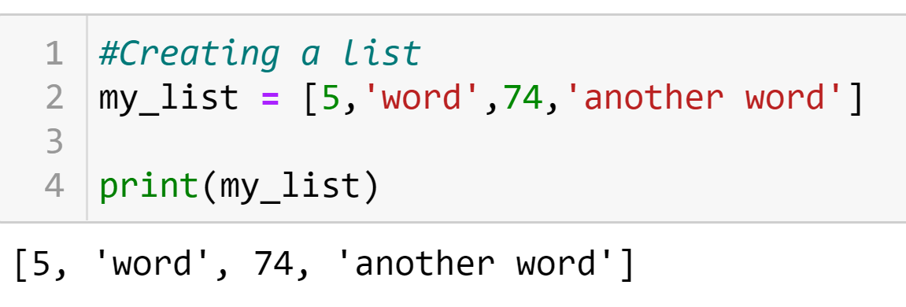
Creating a List
Square Brackets on either end
Name of the variable
Each element of the list separated by a comma
Note: lists cannot be used in mathematical operations
Notes:
A list is a variable that stores any type of data (numbers or strings). Here's an example of creating a list:
Here, we can see that each individual element of the list should be separated by a comma, and the whole thing should have a square bracket on each end.

Slide 18
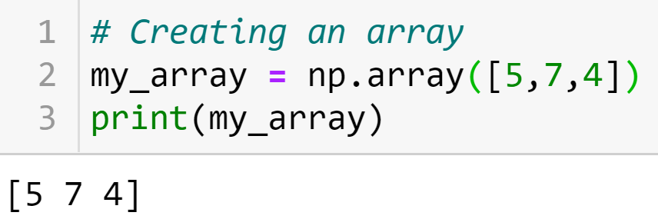
Creating a 1D Array (requires NumPy package)
my_array = np.array([5,7,4])
Output
Package reference
Function
Input
Notes:
Here's an example of an array. Creating arrays requires the numpy package (introduced above), and uses the array function. The array function takes a list by enclosing numbers with square brackets and turns it into an array by enclosing the list with round brackets. All values in an array must be numbers, no strings.

Slide 19

Indexing 1D Arrays and Lists
An array or list has multiple elements
Can use specific elements of the array or list by using an index
Array (or List): A box of eggs
Value: Contents of the egg
Index: Position of the egg in the box
Important! Python (unlike MATLAB) indexes from 0. Meaning that at the first position, the index = 0
Value: 5 7 4
Index: 0 1 2
Notes:
Again, an array or list has multiple elements.
We can retrieve elements in the array with indexing numbers which refers to specific locations.
The indexing starts at 0 in python, so the index 0 refers to the first value, 1 refers to the second value, and so on.

Slide 20



Indexing 1D Arrays and Lists
array
Indexing one element:
index
Value: 5 7 4
Index: 0 1 2
value
Indexing all elements in a range (ex: the first two values in the array):
X
only give the first value, because indexing is not inclusive of end value!
When selecting a range of elements, indexing is not inclusive, meaning it does not include the value associated with the end index.
now correctly gives the first two values
Notes:
The example here is indexing the array which we already created.
To Extract the first value of my_array, we can use index 0. Just need to put the name of variable followed by indexing number which is zero, enclosed by square brackets.
If you want to find values in a certain range, you can use colon. For example, to extract the first two values of the variable, we have to type 0:2 instead of 0:1 because indexing is not inclusive of end value.

Slide 21
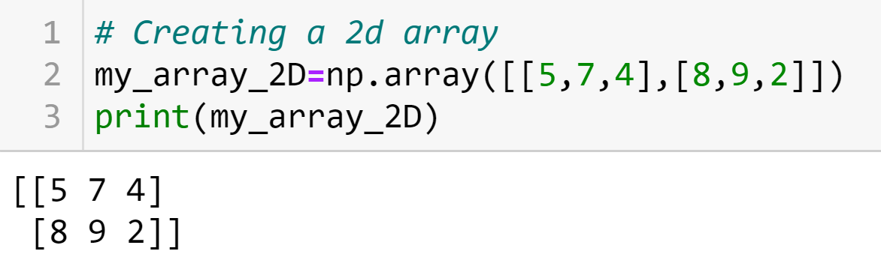
Indexing 2D Arrays and Lists
Creating a 2D Array:
First row
Second row
Value: 5 7 4
Index: [0,0] [0,1] [0,2]
Value: 8 9 2
Index: [1,0] [1,1] [1,2]
Indexing a 2D Array:
Row index
Column index
Colon means “all”
Notes:
We can index 2D arrays and lists as well.
To create the 2 dimensional array, we need to make the commend this way. In the round brackets after the function, which is array, there are square brackets around the whole thing, then individual square brackets around the values that will become each row in the array, with a comma in the middle. Each row in the array is entered as its own list.
To use indexing, we need to use 2 values to refer to the row and column of the value that we want to access, instead of indexing with only one value. Again, the values of the first row and first column start at 0.

Slide 22
Basic Computation with Arrays
Use NumPy functions to do basic computations with arrays
Examples of operations are: sum, max, min, and standard deviation
To use these functions, follow this format:
np.function_name(array) where the function_name is the name of the function and array is the variable name of the array
For example, if finding the minimum of the array called my_array, use:
np.min(my_array)
Other operations (same format):
Maximum: np.max(my_array)
Standard deviation: np.std(my_array)
Notes:
We can apply some basic functions for arrays.

Slide 23
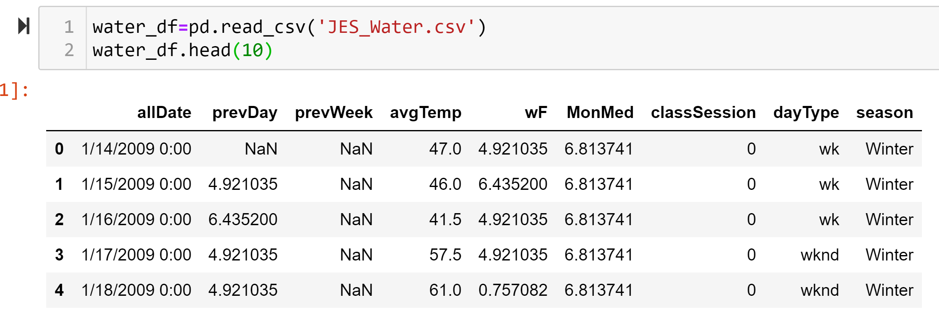
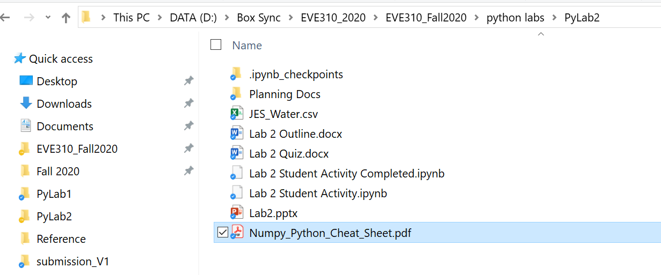
Importing Data
Python can import data from a file to be turned into a Python variable
For our purposes, the data file must be saved in the same folder as your Python script or notebook (see below)
Importing data uses the Pandas package and imports data to Python as a dataframe
(more on dataframes next time!)
Tip: Good file storage/management is key for this class and coding/research in general! Create an EVE 310 folder on your computer with a separate subfolder for each lab. Store lab handouts, data, and activities here as soon as you download from Canvas.
Data and notebook (or script) in the same folder
Notes:
To import data from a csv file, use the function read_csv from the pandas package. The data is imported into a variable type called a dataframe, which is like an array, but has more capabilities. Again, we'll learn more about dataframes next week.
In this example, the csv file JES_Water is imported, which contains its water consumption, and other information.

Slide 24
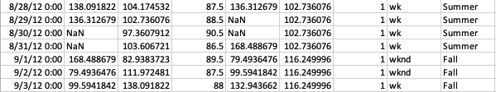
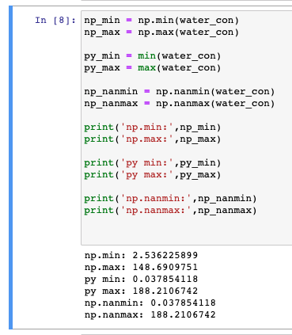
Let’s talk about NaN!
NaN: very common in real world data
np.min and np.max do not work with arrays with NaN values
min() and max() do not work if array starts with NaN values
Instead, use:
np.nanmin() and np.nanmax() are the most robust functions to handle NaNs
If we use np.min and np.max with this data, our answers will be incorrect!
Always inspect your data and spot check your work
Incorrect
Correct
Correct
More to come on data cleaning this semester!
Notes:
NaN (not a number) values are very common in real world data (coming from an error of a sensor, or a reporting error)
It's important to know if your data has NaN values, because this can impact which functions to use and how different functions perform.

Slide 25
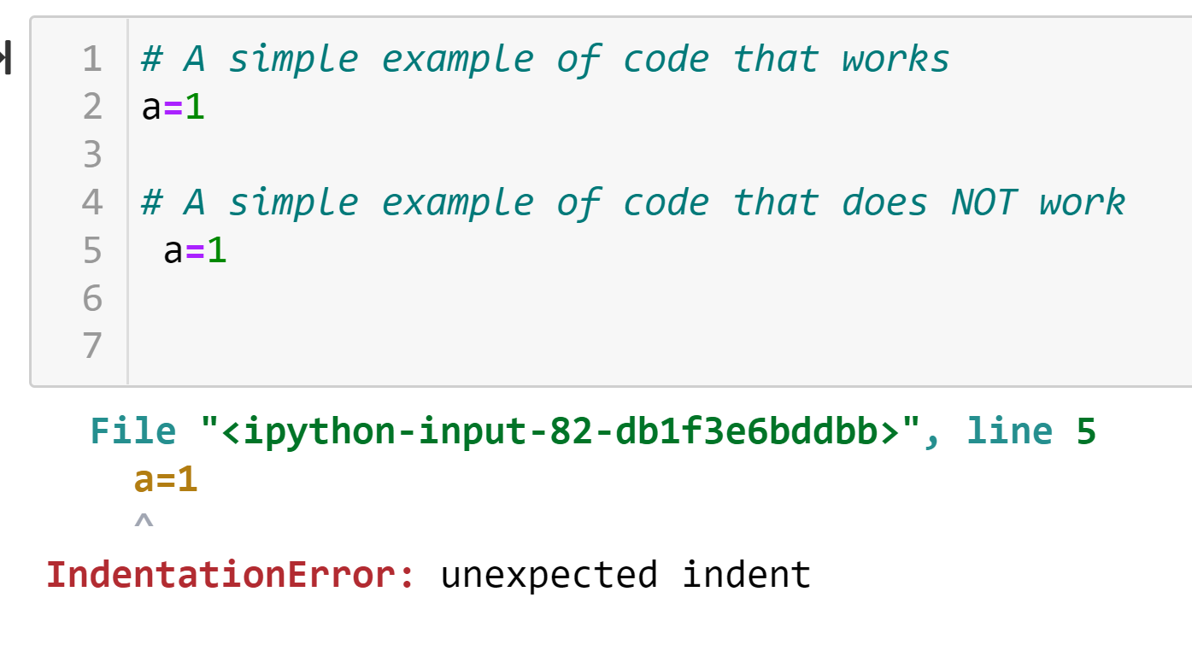
Indenting
Except for specific cases, Python expects there to be no indents or spaces when beginning a line of code
There is a space there
Notes:
You cannot put indents or spaces for the beginning of a line of code.

Slide 26

Resetting the Workspace
Sometimes you will want to run your code again and clear all existing variables in the workspace.
In a Jupyter Notebook, click the “ Restart” button on the top

Slide 27
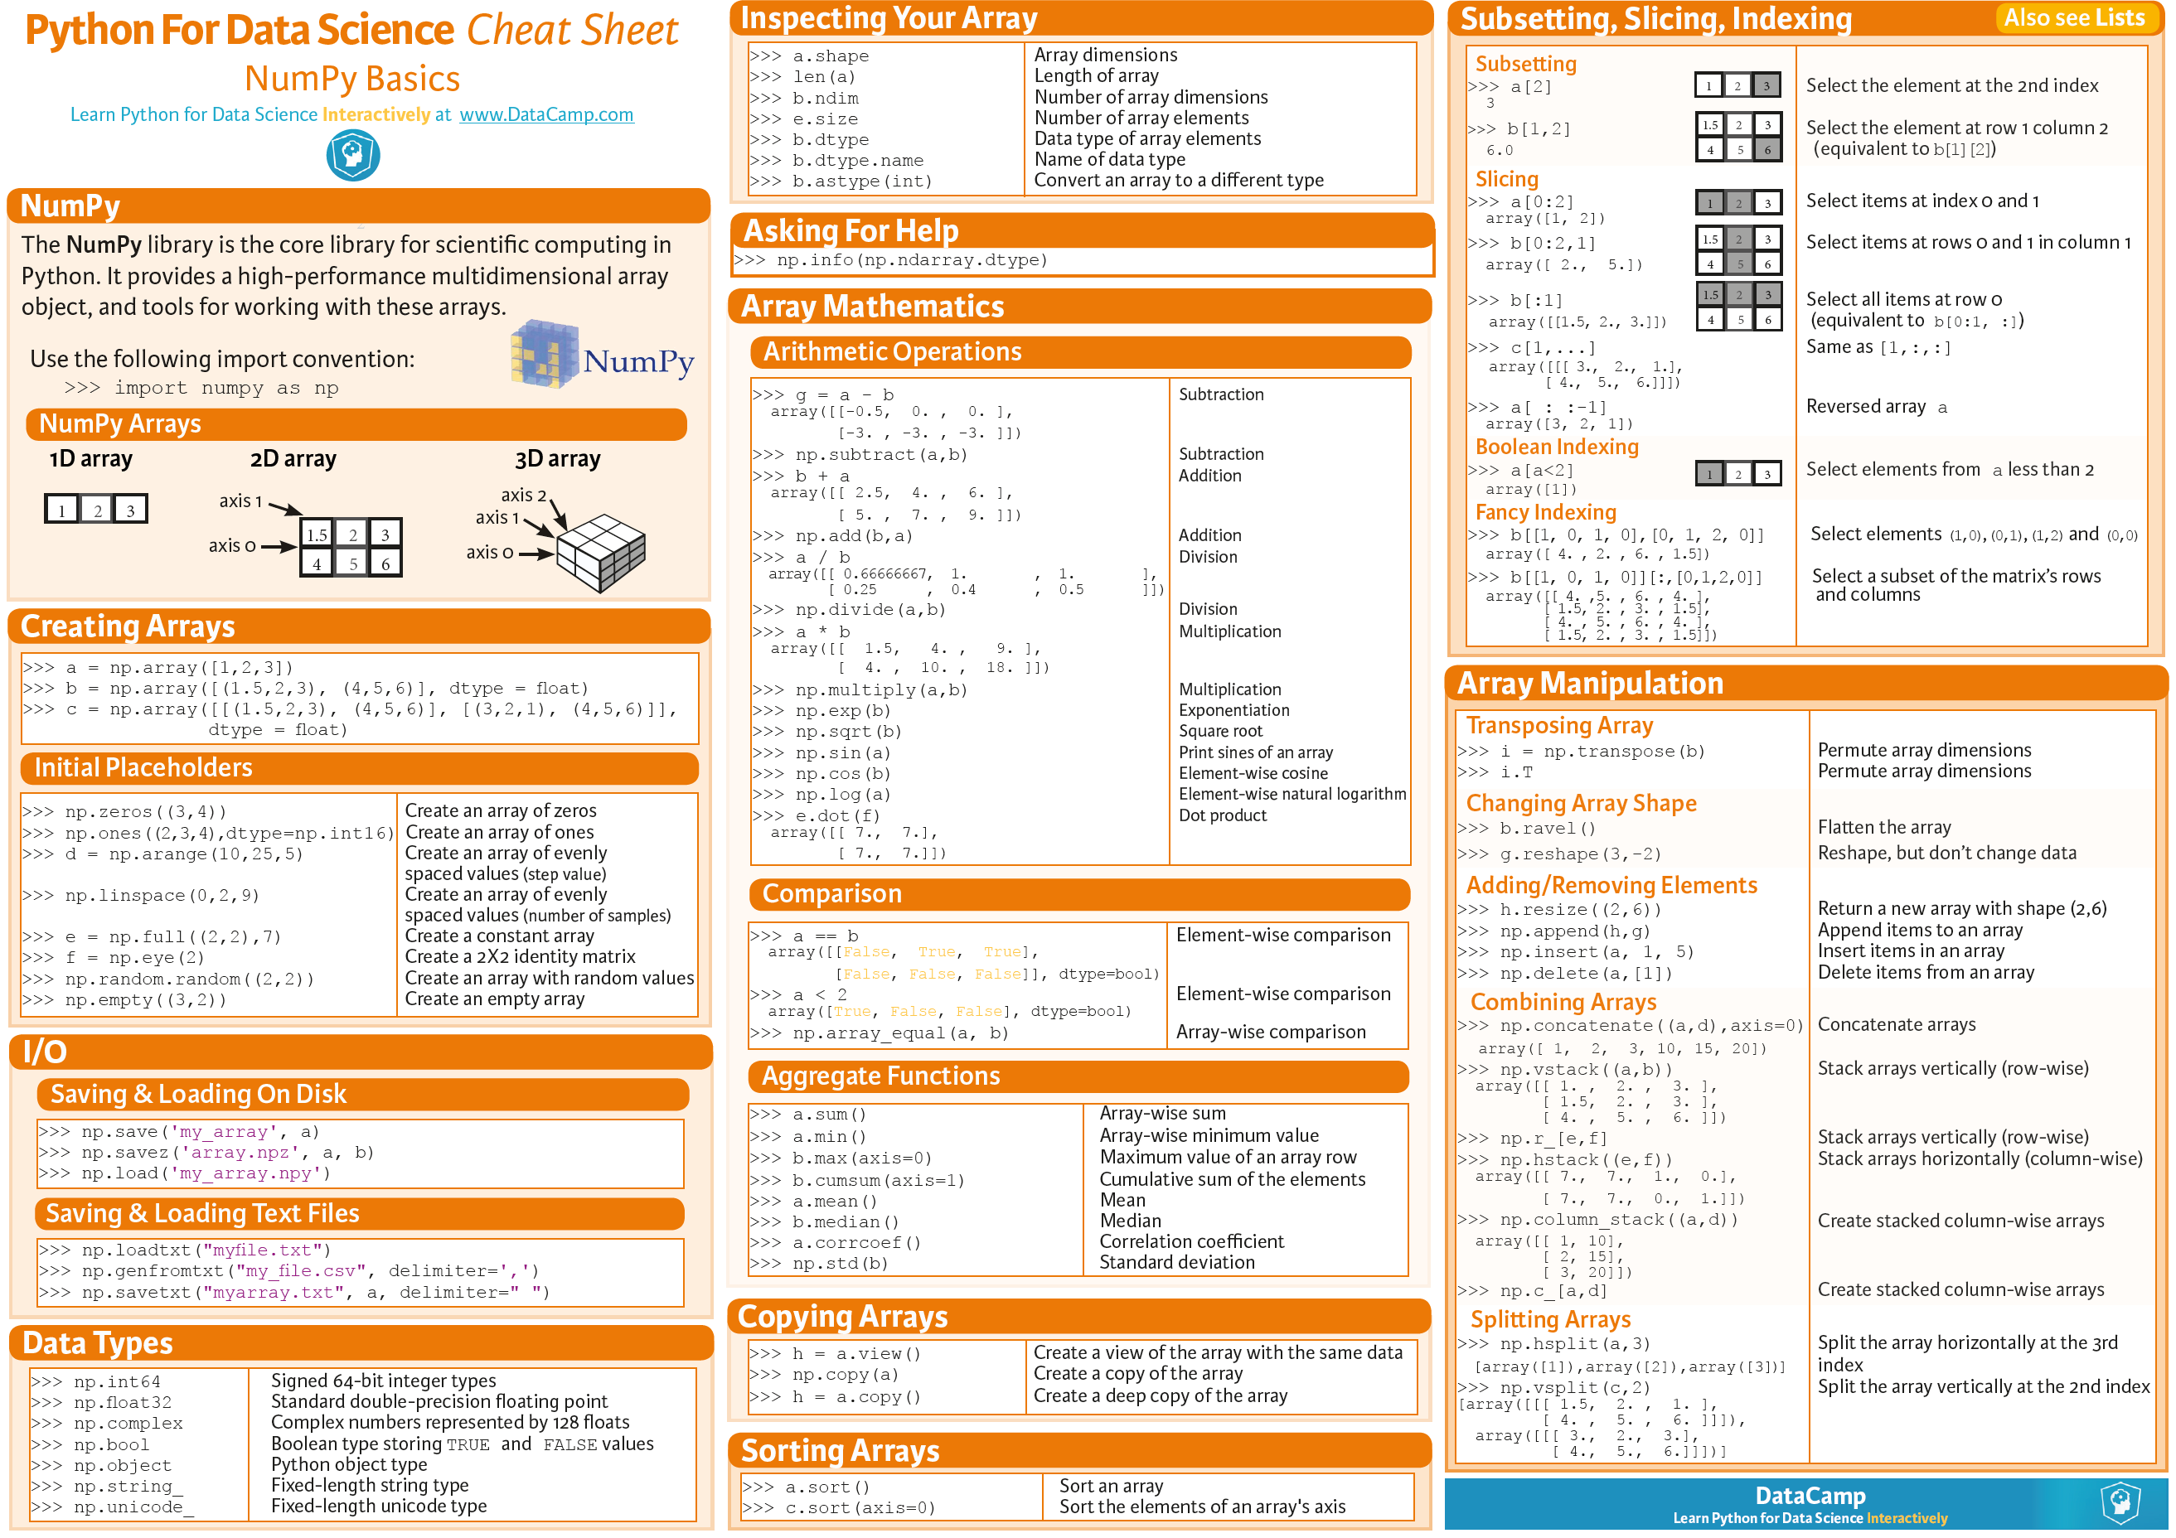
Look at the NumPy Cheat Sheet on Canvas

Slide 28
In Class Activity
Work through Lab 2 Student Activity notebook
We will reconvene at 2:45
Make sure you can complete the activity before taking the Lab 2 quiz. The quiz will ask you some questions about the activity and code outputs.
Self-Assessment (ungraded) on Canvas
Lab 2 Quiz due Friday, September 5, 11:59 pm

Slide 29
Recap
Comments
Working with Packages
Arithmetic Operators
Variable types
Arrays and Indexing
Importing Data
Other Tips: Indenting and Workspace Reset

