Slide 1

EVE310 Lab 4
September 25, 2025

Slide 2
Announcements
Lab 4 Quiz due Wednesday September 26 at 11:59 pm
Debugging

Slide 3
In-class Quiz
Self-Assessment for the in-person quiz is live.
A list of useful functions will be provided in the notebook.
AI assist and autocomplete will have to be turned off.

Slide 4
Learning objectives
Use Scipy package
Convert to datetime format
Creating graphics of data
Plot
Boxplot
Histogram
Save Plots to PDF or Image
Initial Exploratory Data Analysis
Notes:
SciPy is an open-source scientific computing library for Python that builds on the capabilities of NumPy. It provides a wide range of functions and tools for various scientific and engineering tasks, including optimization, signal processing, linear algebra, statistics, integration, interpolation, and more.
Exploratory Data Analysis (EDA) is a critical step in the data analysis process that involves visually and statistically summarizing, exploring, and understanding the main characteristics and patterns in a dataset. EDA helps analysts and data scientists gain insights into the data, identify potential relationships, anomalies, trends, and patterns, and guide further analysis and modeling decisions.

Slide 5
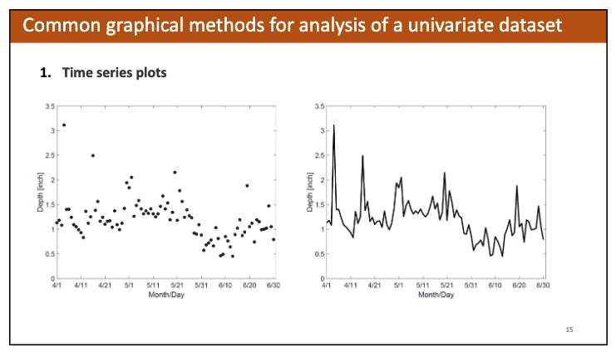
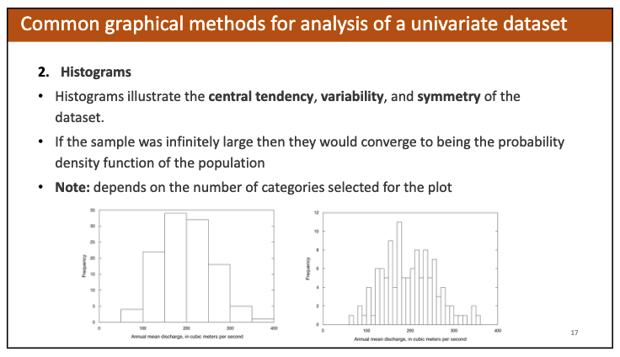
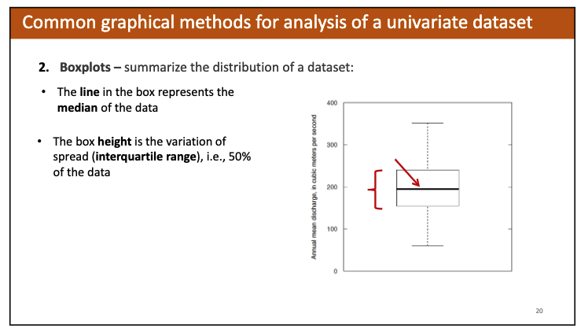
Remember back to Lecture 3

Slide 6
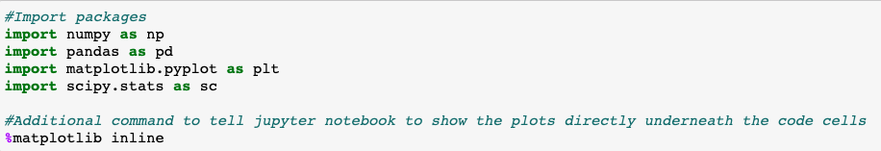
Start by importing the packages
2 New Packages: Matplotlib and SciPy
Matplotlib is used to create graphics from data
Scipy is used for scientific calculations and statistics
Use this line any time you are making a plot
Use this line only when using Jupyter Notebook, which tells the computer to show figures directly underneath code blocks

Slide 7
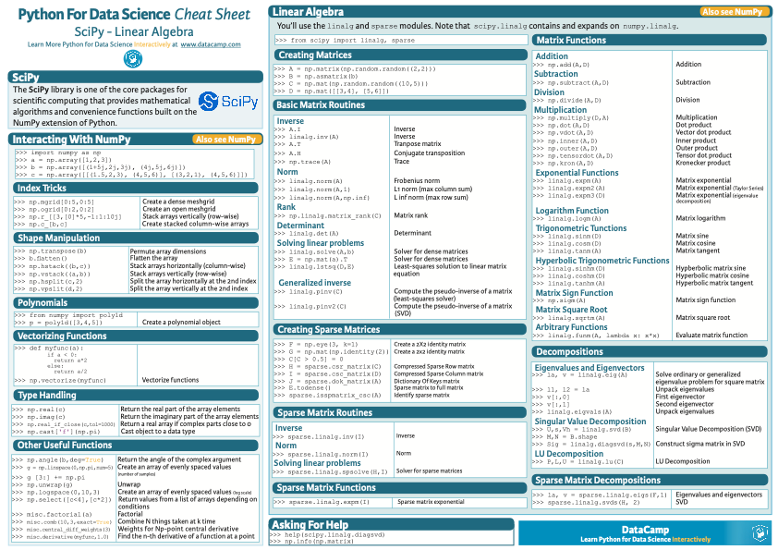
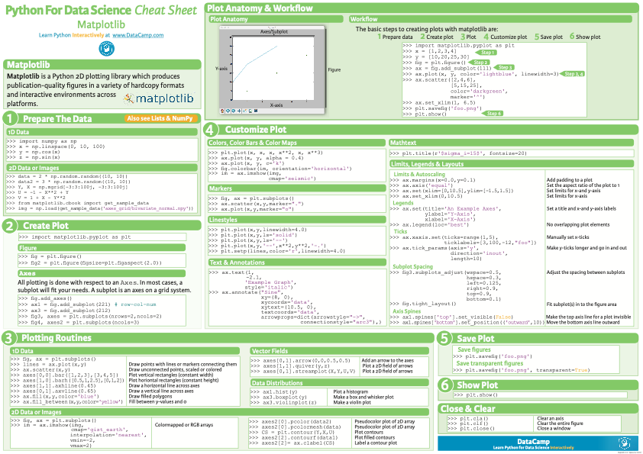
A Quick Review of our Packages
Package | General Purpose
NumPy | Algebraic Calculations
Pandas | Databases, real-world imported data (ex: sensor measurements)
Matplotlib | Creating plots
SciPy | Advanced statistical calculations
New cheat sheets in Canvas!

Slide 8
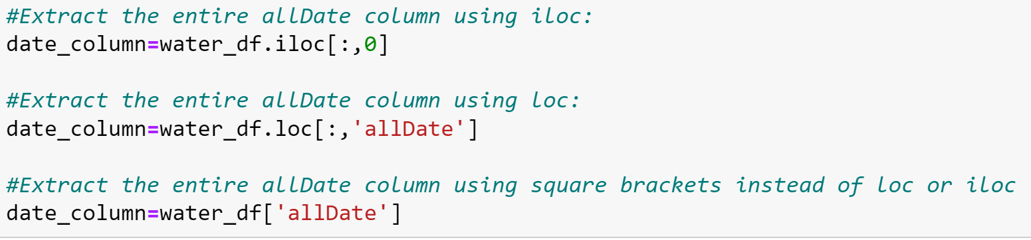
Easy way to refer to an entire column of a dataframe
loc and iloc allow you to index a dataframe similar to how you would index an array
You can specify a specific row you are interested in, or use a : to extract all rows
Another, simpler way to extract all rows of a column is to put the column name in square brackets after the name of the dataframe
The following lines are all equivalent:
The following slides will use this notation to refer to an entire column of a dataframe

Slide 9
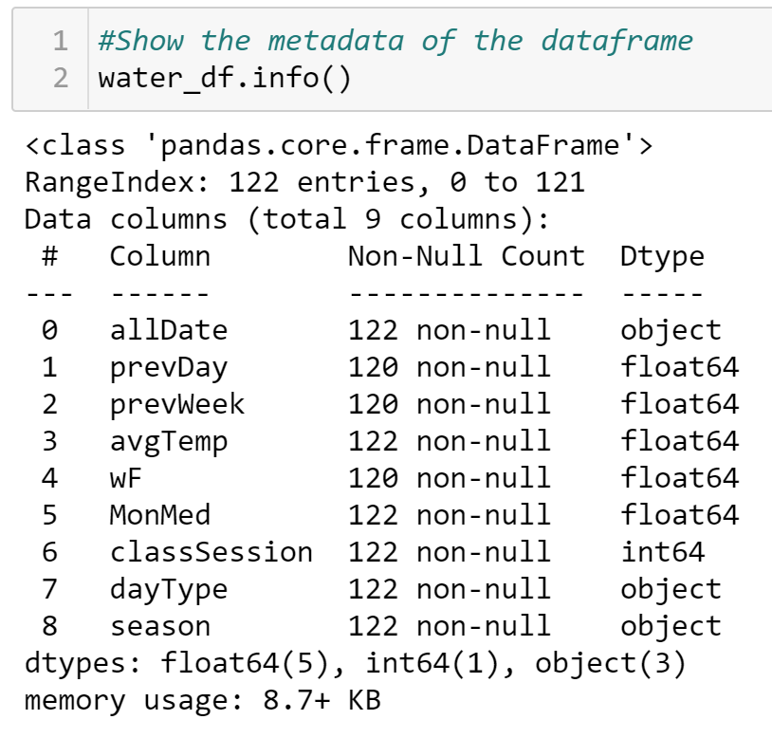
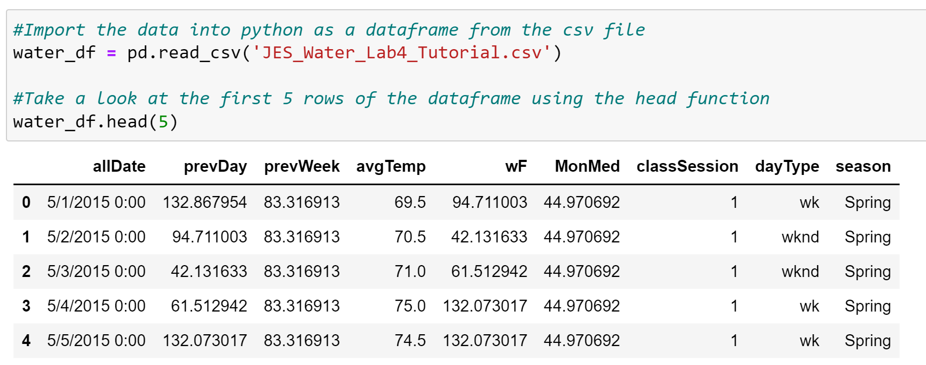
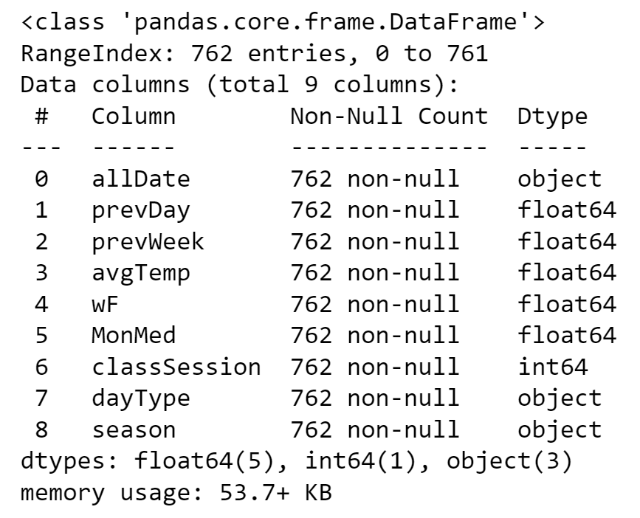
Begin by importing the data and checking the head and info
We can see that the allDate column clearly indicates a date, but the computer sees it as just text, as indicated by the type of “object” shown in the info.

Slide 10
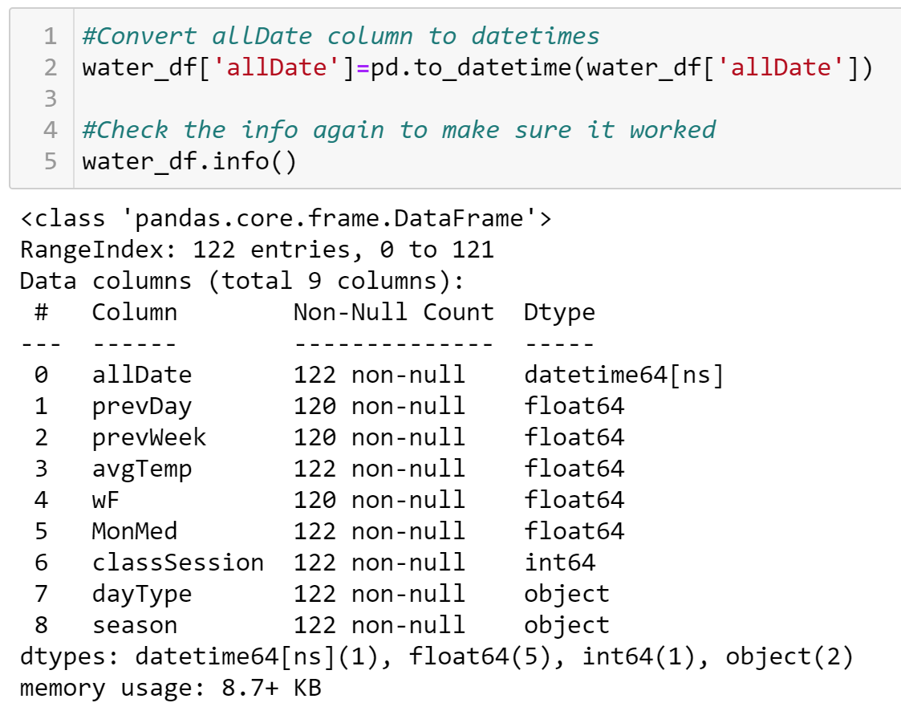
Convert allDate column to Datetime Format
Success!

Slide 11
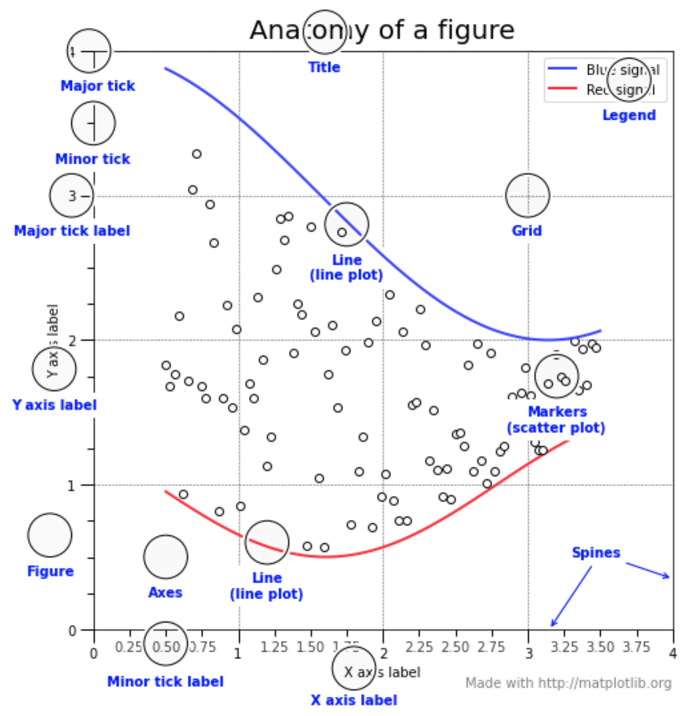
Let’s Get Plotting!
= Items we will cover today
Graphic from:
https://matplotlib.org/3.3.1/gallery/showcase/anatomy.html

Slide 12
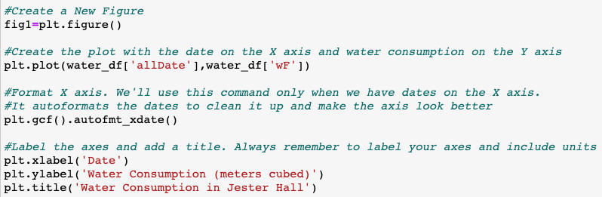
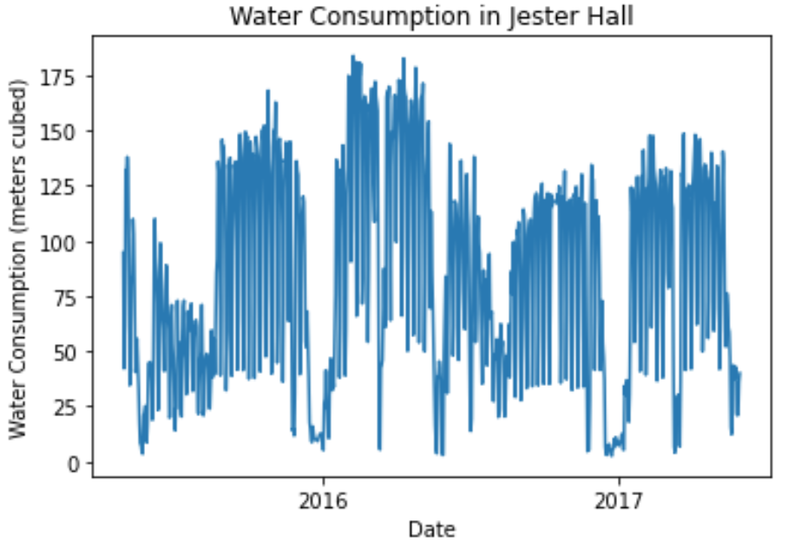
Elements of a figure
Create the figure handle
Display the data
Adjust display options
Add labels

Slide 13
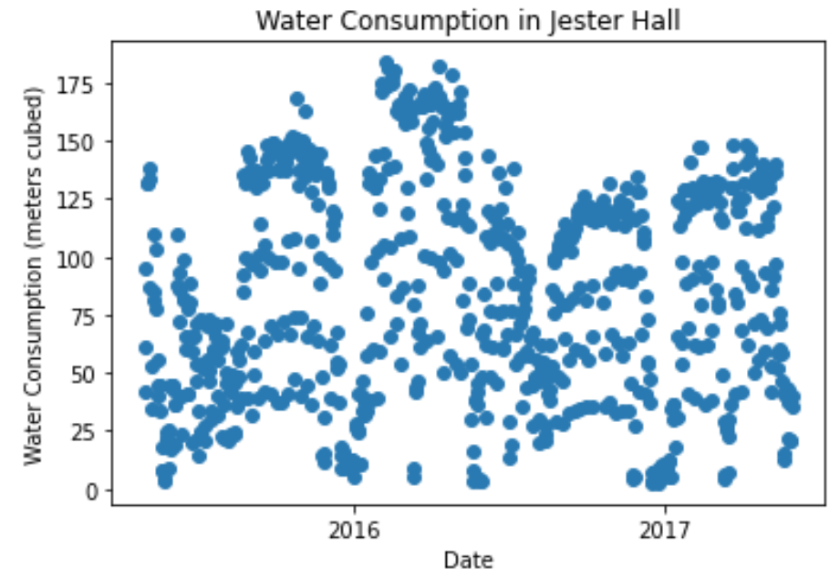
Variations within the plot function
Inputs should be a column vector (one column) of the same size
Plotted on the x axis
Plotted on the y axis
Add additional specifications to show dots for each data point instead of connected by a line
Specify markers as dots
Do not draw a line between points

Slide 14
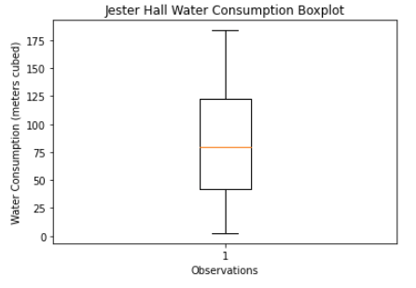
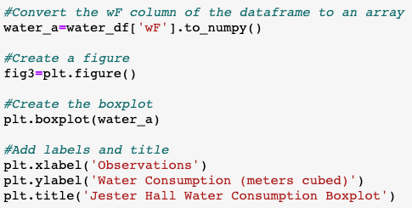
Boxplot
Matplotlib requires input to be a NumPy array without NaN values
Use plt.boxplot

Slide 15
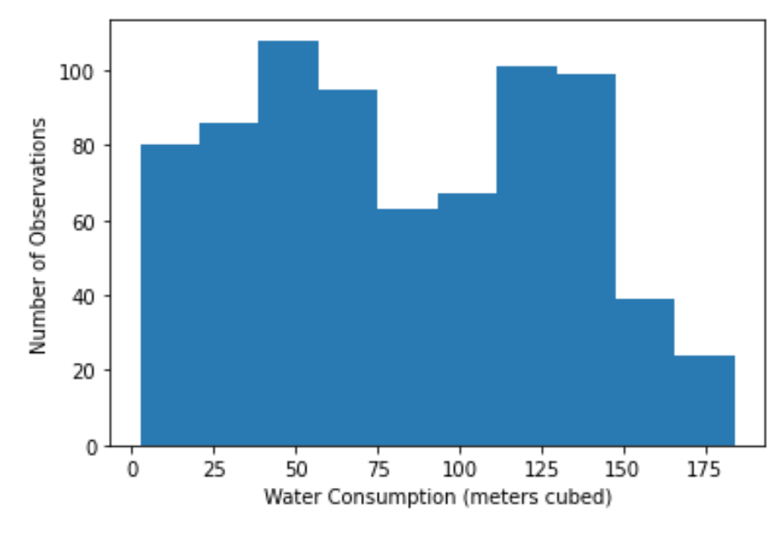
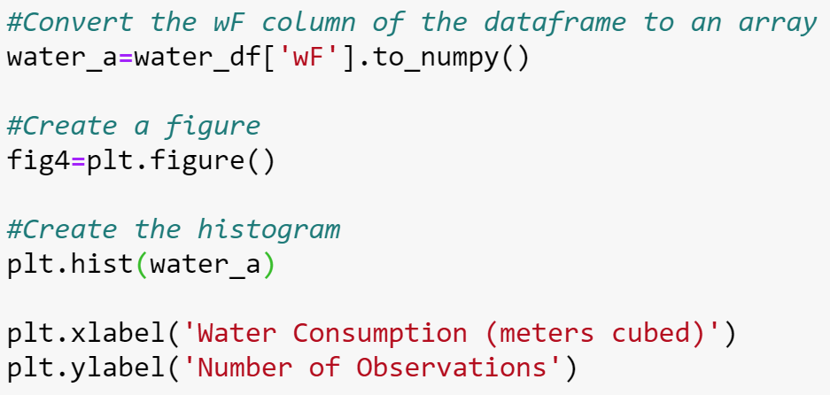
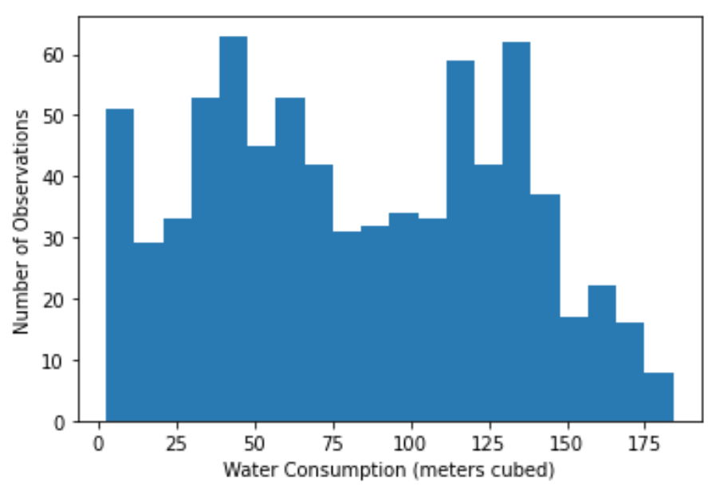

Histogram
Requires input to be a numpy array without NaN values
Use plt.hist
Default is for the number of bins to be automatically selected. We can specify the number of bins
Bin # automatically selected
Bin # of 20 specified

Slide 16
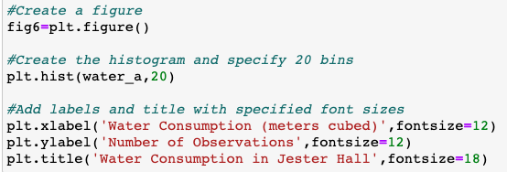
Controlling Font Size
If not specified, default font sizes will be used which might not be big enough/appropriate for your specific project
Specify the font size when creating labels and title
Default font size

Slide 17
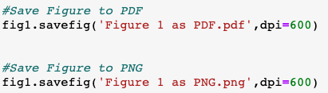
Save figures to PDF or PNG file
Save figures as a separate file to use for HW assignments, reports, etc.
DO NOT take screenshots of Python figures and put them in HW or reports!
Handle of figure that is already created
savefig function
String of the file name, ending with the file format
Resolution (dpi means dot per inch). It’s fine to always use 600 (default if not specified is 100).
1
2
3
4

Slide 18
Save figures to PDF or PNG file

Slide 19
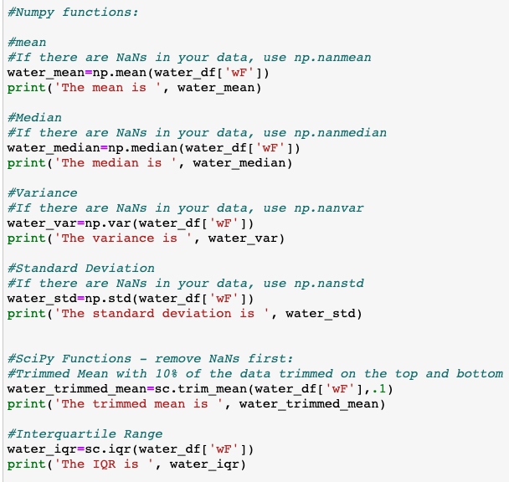
Summaries of Univariate Data
Uses the numpy package
Proportion of data to be trimmed from top and bottom (here, .1 means 10%)
Uses the scipy package
Notes:
Univariate data refers to a type of data analysis or dataset that involves only one variable. In other words, it focuses on examining and understanding the distribution, characteristics, and patterns of a single variable in isolation. Univariate analysis is often the starting point in data analysis and helps to uncover insights about a particular aspect of the data.
The interquartile range (IQR) is a statistical measure that quantifies the spread or dispersion of a dataset by focusing on the middle 50% of the data. It is calculated as the difference between the third quartile (Q3) and the first quartile (Q1) of a dataset. Quartiles divide a dataset into four equal parts, and the interquartile range gives a measure of how much the values in the middle half of the dataset vary.

Slide 20
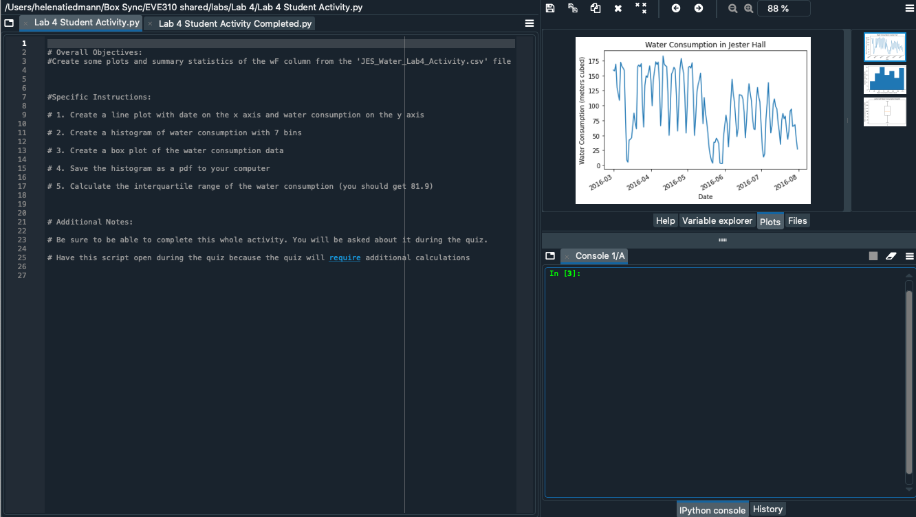

A Note about Plotting using Spyder
Each figure can show up as its own separate window
Make sure close each figure between attempts at running the code so you don’t get a bunch of figures on your screen!
You can view all figures on the “Plots” tab

Slide 21
In-class activity
Think about what steps you might need to take that are not explicitly asked of you in the assignment.
Work through Lab 4 Student Activity
Make sure you can complete the activity before taking lab quiz 4. The quiz will ask you some questions about the activity.

Slide 22
Learning objectives
Use Scipy Package
Convert to datetime format
Creating graphics of data
Plot
Boxplot
Histogram
Save Plots to PDF or Image
Initial Exploratory Data Analysis

