Slide 1

EVE310 Lab 5
October 9, 2025

Slide 2
Announcements
No graded Lab Quiz this week
Activity in Canvas (involves making some changes to the Lab 6 Tutorial code and observing how results are impacted)
Answer sheet for activity posted to self-check your work.

Slide 3
Learning objectives
Importing specific functions from a package
Splitting data between training and testing datasets
Creating linear regression models with Sklearn
Analyzing and plotting model results
Compute adjusted r-squared
Use one-hot encoding to include categorical variables

Slide 4
This lab is a direct extension of what you learned in Lecture 10 and the traffic example code you ran.

Slide 5

Importing Functions from a Package
Sometimes we want to import an entire package (like NumPy)
Sometimes, we only want to use a specific function from a package. We can import only that function using:
In practice, it looks like this:
When we use the LinearRegression function later, we can just use the function as is. Does not require anything before the function (compared to using the np.sum function where the np needs to be specified)

Slide 6
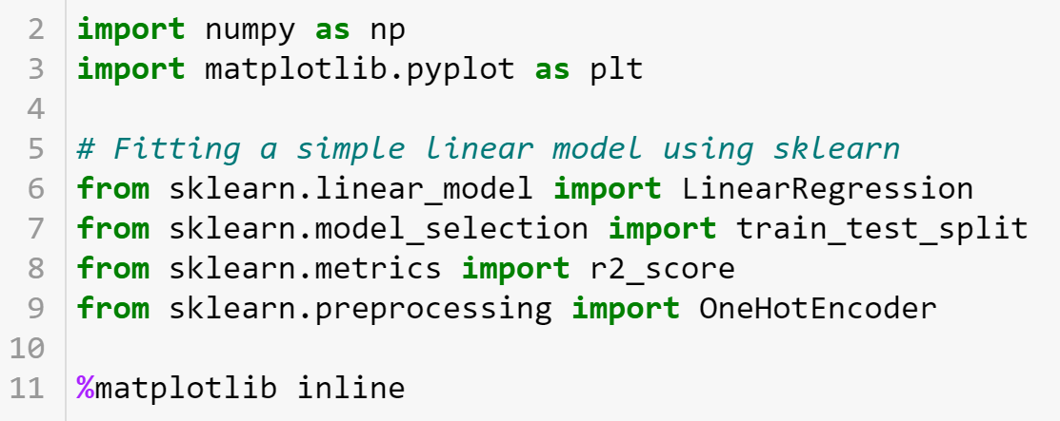
Importing Packages (and Functions from Packages)

Slide 7
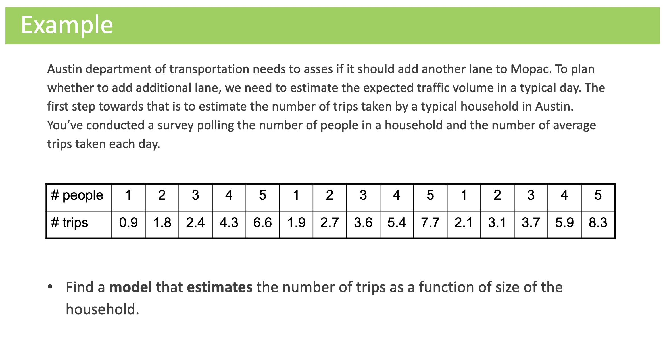

Slide 8
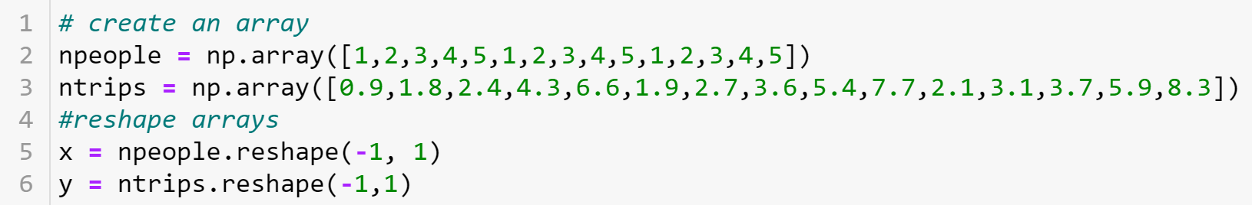
Import Data and reshape if necessary
If using data from a csv, here is where you would import it to a DataFrame
Notes:
Each element of the original npeople array has been placed into a separate row in the new 2D array. The -1 in reshape allows NumPy to automatically calculate the number of rows required based on the size of the original array.

Slide 9
Split Data between Training and Testing sets
Specify a random seed for reproducibility (ensures same split every time). Note: this does not always need to be done. Only when it makes sense in your context.
70% of x data
70% of corresponding y data
Full x dataset
Full y dataset
Proportion of data to be used in testing set
30% of x data
30% of corresponding y data
Notes:
Now let's split the data into a training set and a testing set. We will train out model on the training set and then use the test set to evaluate the model.

Slide 10
Split Data between Training and Testing sets
Specify a random seed for reproducibility (ensures same split every time). Note: this does not always need to be done. Only when it makes sense in your context.
70% of x data
70% of corresponding y data
Full x dataset
Full y dataset
Proportion of data to be used in testing set
30% of x data
30% of corresponding y data

Slide 11
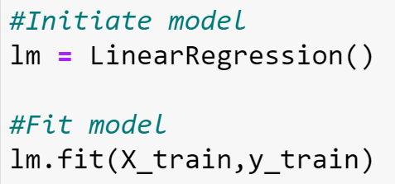

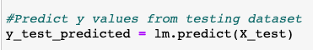
Create Model, Fit to Training Data, and Predict
Note: Later in the course, we will be using other types of models. The same process applies, but instead of using LinearRegression(), it will be a different type of model.

Slide 12
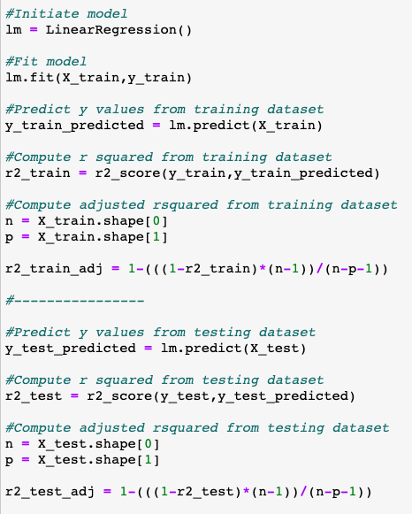
Quantify Model Error
Predict values from training, test datasets
R² using r2_score function that we previously imported
Adjusted R², see lecture slides for formula
Notes:
R2 measures the proportion of variance explained by the model but doesn't consider model complexity. Adjusted R2, on the other hand, adjusts R2 by penalizing unnecessary predictors, making it a more suitable measure when comparing models with different numbers of predictors.

Slide 13

Adjusted R-Squared
Adjusted R² ⁽see lecture slides for formula)
Remember the .shape function and indexing
n = 12, p = 1

Slide 14
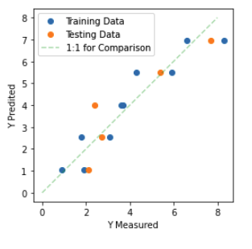
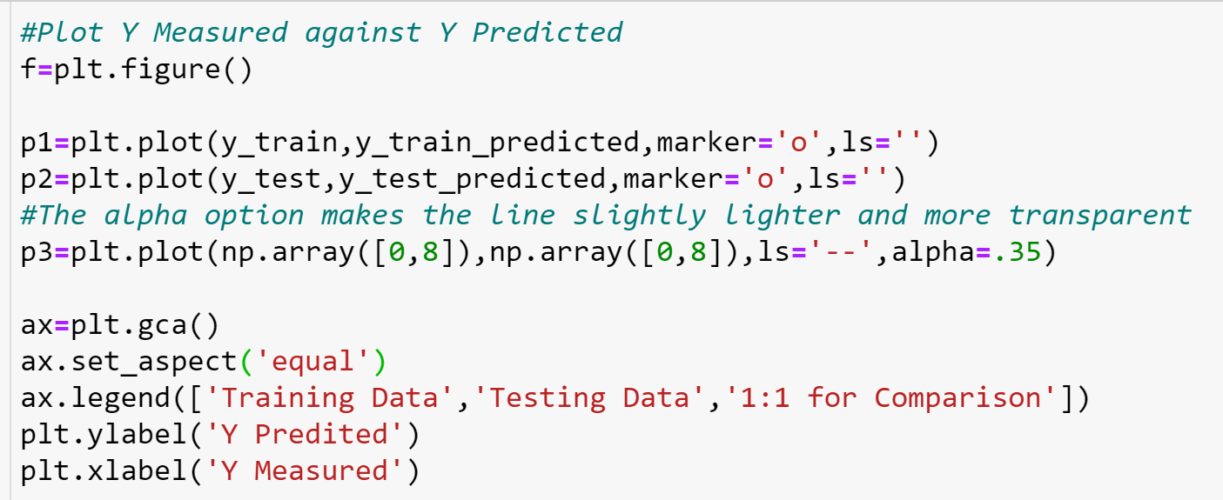
Quantify Model Error
Notes:
ax = plt.gca(): This line gets the current Axes (a subplot) of the current figure. plt is commonly used as an alias for matplotlib.pyplot, and gca() stands for "get current axes." It allows you to access and modify properties of the current subplot.
ax.set_aspect('equal'): This line sets the aspect ratio of the current Axes to 'equal'. Setting the aspect ratio to 'equal' means that the length of one unit in the x-direction will be the same as the length of one unit in the y-direction, ensuring that the plot is not distorted.

Slide 15
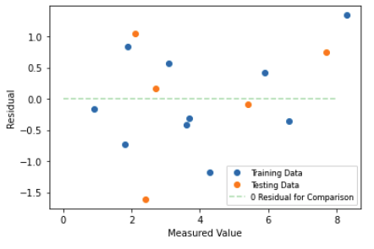
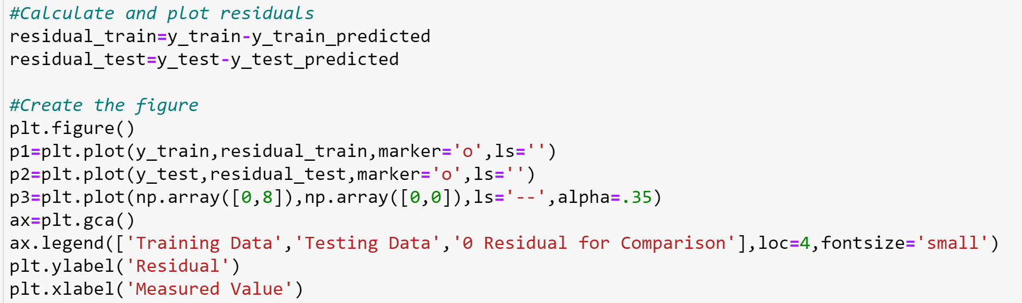
Quantify Model Error
Notes:
In this case, the plot looks like being scattered randomly, which is a good sign for the goodness of fit of the model.

Slide 16
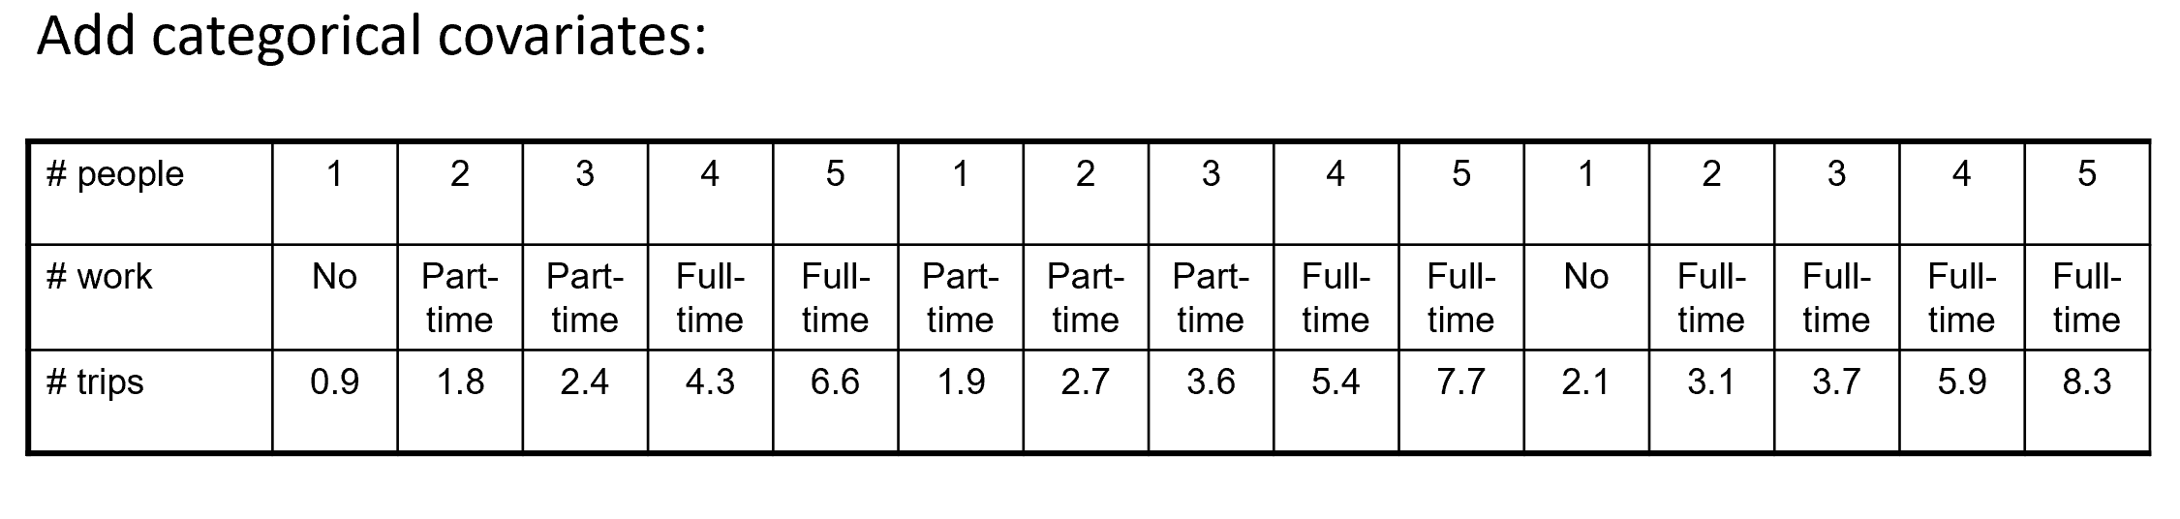
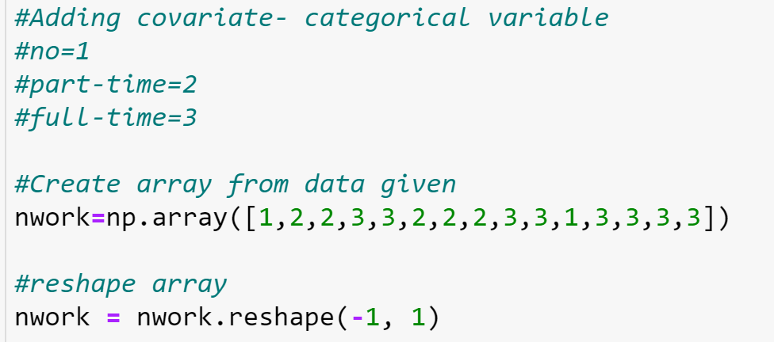
Creating a New Model to Include Categorical Variables
Step 1: Input the categorical array
Notes:
Assuming that we want to include a categorical variable, the type of work, for one additional predictor in the model. A vector called nwork is created to signify the manner in which people work- whether they work not at all, part-time, or full time. A vector nwork is created to contain this information: 1=no working, 2=part-time, and 3=full-time.

Slide 17
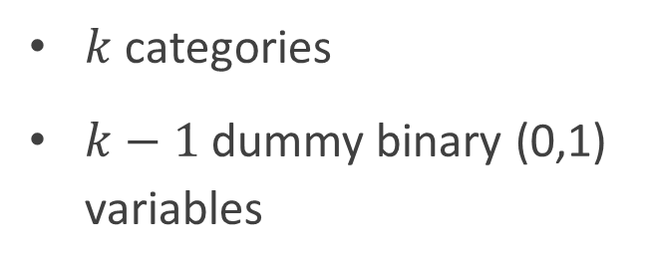
Dummy coding
Example:
Science = 1 & Math = 0, then Language = 0
Science = 0 and Math = 1, then Language = 0
Science = 0 and Math = 0, then Language = 1
Remove dependent variable
Recall: i.i.d.
Student | Favorite class |  | Student | Science | Math
1 | Science |  | 1 | 1 | 0
2 | Math |  | 2 | 0 | 1
3 | Science |  | 3 | 1 | 0
4 | Language |  | 4 | 0 | 0
5 | Math |  | 5 | 0 | 1
$k$ categories
$k−1$ dummy binary (0,1) variables
EVE310 Fall 2025 Lab 5
Notes:
Dummy coding, also known as one-hot encoding, is a technique used in linear regression and other statistical models to represent categorical variables as binary (0 or 1) variables. This is necessary because linear regression models, by default, work with numerical input data and rely on the assumption that the relationship between the dependent variable and the independent variables is linear. Categorical variables, which represent groups or categories, cannot be directly used in their original form because they don't have a meaningful linear relationship.

Slide 18
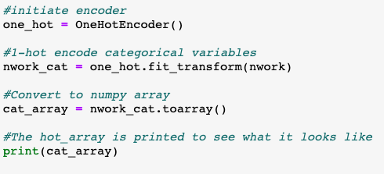
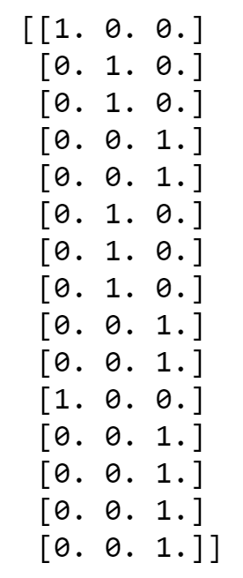
Introduce Dummy Variables
We only need 2 of the 3 columns
Step 2: Use 1-Hot encoding to create dummy variables
Notes:
Using k-1 binary variables for categorical variables is a common practice to avoid issues like multicollinearity, maintain independence, simplify interpretation, and improve model efficiency. The omitted category (kth category) serves as the reference point against which the effects of the other categories are compared.

Slide 19
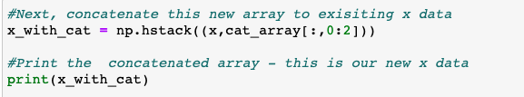
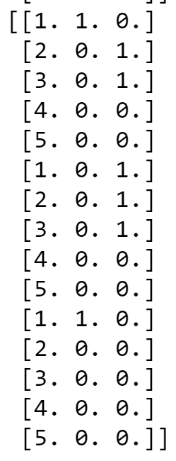
Concatenate Dummy Variables with Continuous Variables
Use only the first and second columns of cat_array, not all 3 (see previous slide)
Here is an example of using indexing that we learned earlier in the class!

Slide 20
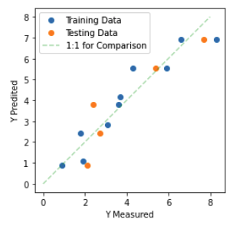
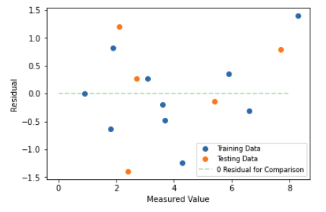
Repeat all previous steps with x-data which includes dummy variables for categorical variables

Slide 21
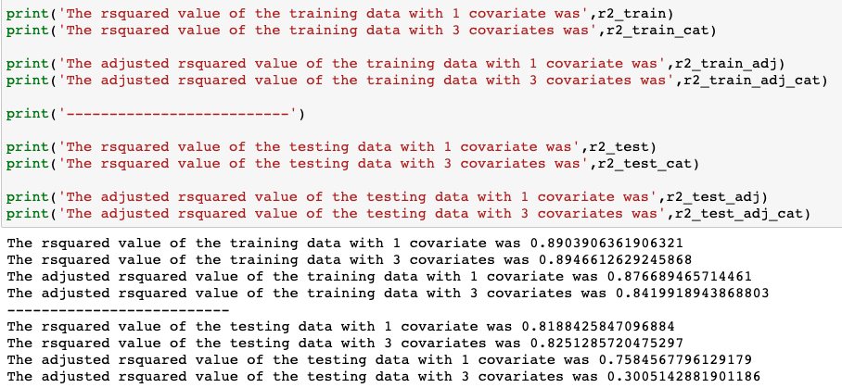
Compare R Squared Values

Slide 22
Activity

Slide 23
Recap
Today’s lab was about the mechanics of making a model and interpreting results - next week will be an extension of this.
Next week, we will learn how to implement scaling, outlier removal, and interaction terms.
Review these slides, the tutorial, activity, and activity answer key for next week.

