Slide 1

EVE310 Lab 8
October 17, 2023

Slide 2
Announcements
No lab quiz this week
There will be a lab quiz next week that incorporates both Labs 8 and 10 in two weeks

Slide 3
Learning objectives
Logical Operators
If Statements
For Loops

Slide 4
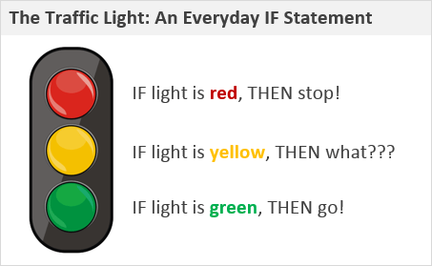
If Statement

Slide 5
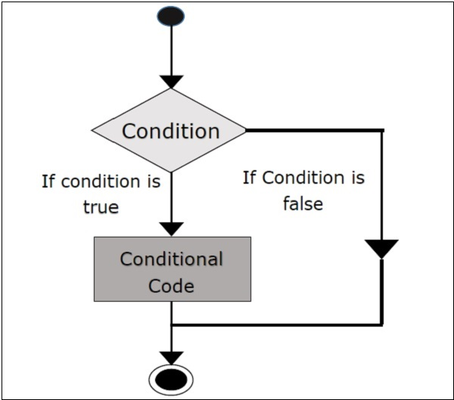
Diagram of an If Statement

Slide 6
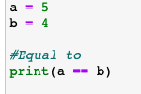
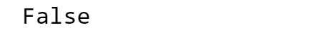
Logical Operators
Statements which ask a true or false question
Usually evaluate the relationship between two numbers
True means yes
False means no
Assign values
Asking Python: Is a equal to b?
The logical “truth value” of the statement

Slide 7
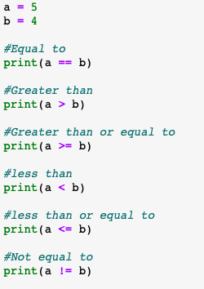
Common Logical Operators
The code snippet to the right contains other common logical operators

Slide 8
Beware the difference between = and ==
a = 5 and b = 4 assigns the value of 5 to a and 4 to b
a == b asks if the two variables are equal
In general, = assigns a value, and == asks if two values are equal
You do not need to always print a logical statement. Done here to see the output but most times, printing is not necessary.

Slide 9
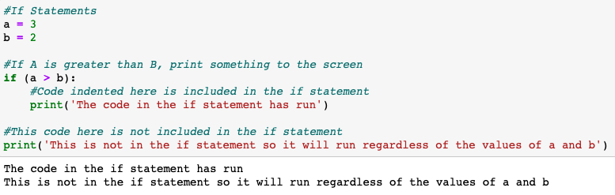
If Statements
Execute some code if a logical statement (that you specify) is true
“if” to initiate the if statement
Assign values
A logical statement inside parenthesis followed by a “:”
Code to be executed if the logical statement is true (note that it is indented)
Indented code
Code that is not included in the if statement

Slide 10
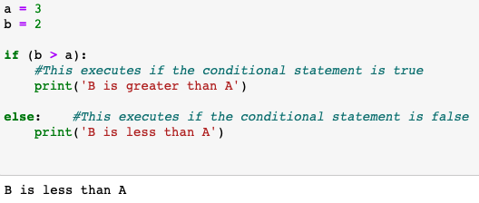
If-Else Statement

Slide 11
For Loop
Useful for tasks that are repetitive
Can condense many lines of code into very simple code
Can have loops within loops
We’ll start with some very simple tasks, and then work up to more complex ones

Slide 12

Quick Review of Variable Indexing
What would you type to index the second value of my_array?
(see lab 2)

Slide 13
Quick Review of Variable Indexing
my_array[1] will return the second value of my_array

Slide 14
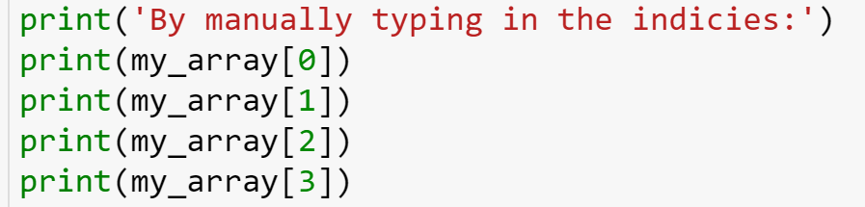
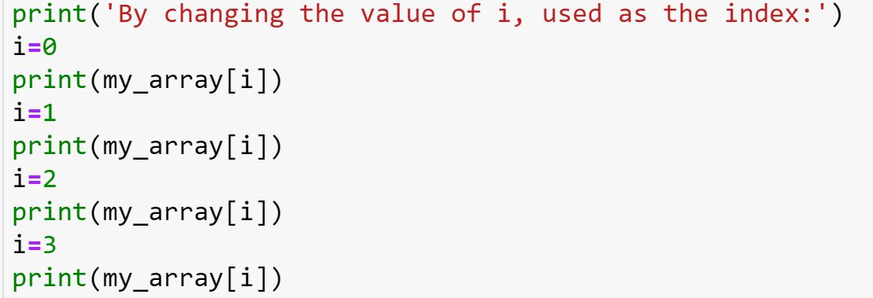
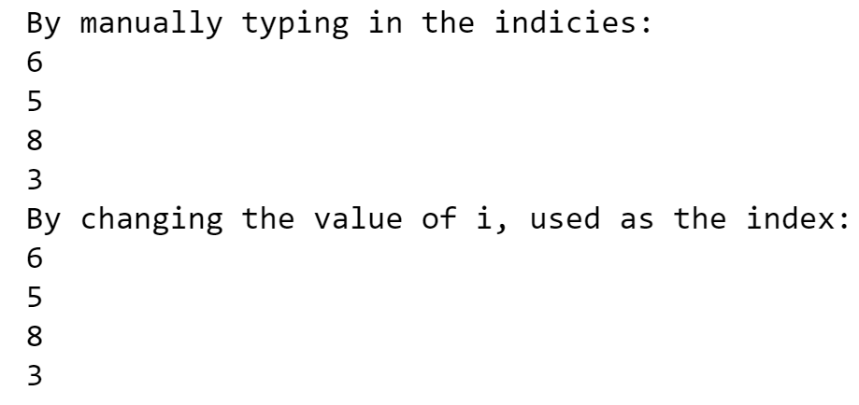
Suppose we wanted to print all of the values of my_array
Option 1
Option 2
Same Result

Slide 15
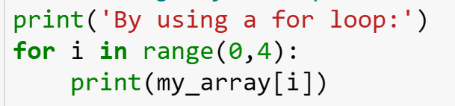
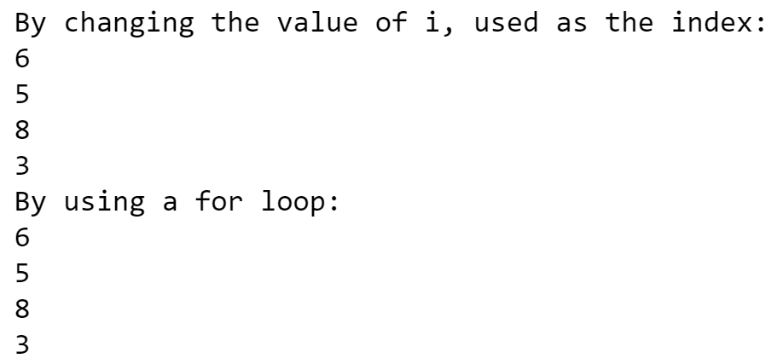
Suppose we wanted to print all of the values of my_array
Option 2
Option 3
Same Result

Slide 16

For Loop
Variable which will change values inside the for loop
The word “in” is always in the middle
The values that the variable i will take in each loop
Initiate the for loop
Ends with a “:”
range(0,4) means that I will take the value of each integer from 0 to 3
Loop will continue until all of the values of range(0,4) have been utilized

Slide 17
Another way to think about a for loop
Variable to be changed inside the loop
Instructions for how the variable i should change

Slide 18
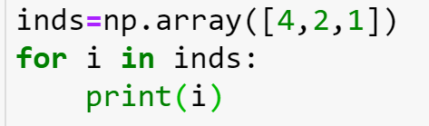
Consider the following examples

Slide 19
Coding Logic
Before you start coding, write out steps or make a flow chart/diagram on paper
Work through the logic of what you want the code to do
Identify inputs and outputs
Break tasks up into small steps
Focus on the overall process and logic (not specific syntax)

Slide 20
For Loop Logic Demonstration
Use a for loop to find the max value of the following array: [6, 5, 8,3]

Slide 21
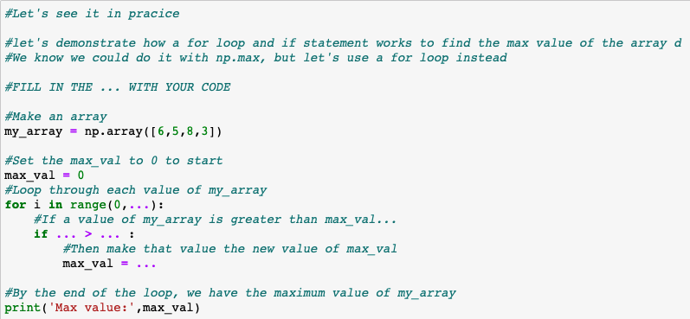
Using a for loop and if statement to find the max value of an array
Fill in the … to complete the code!
Be careful of spaces, :, (), [], and indentations
Notes:
… → “Ellipsis”

Slide 22
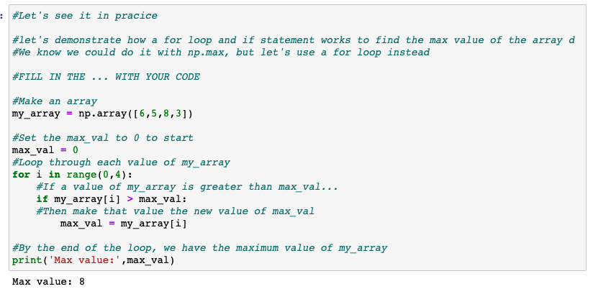
Using a for loop and if statement to find the max value of an array
Solution:

Slide 23
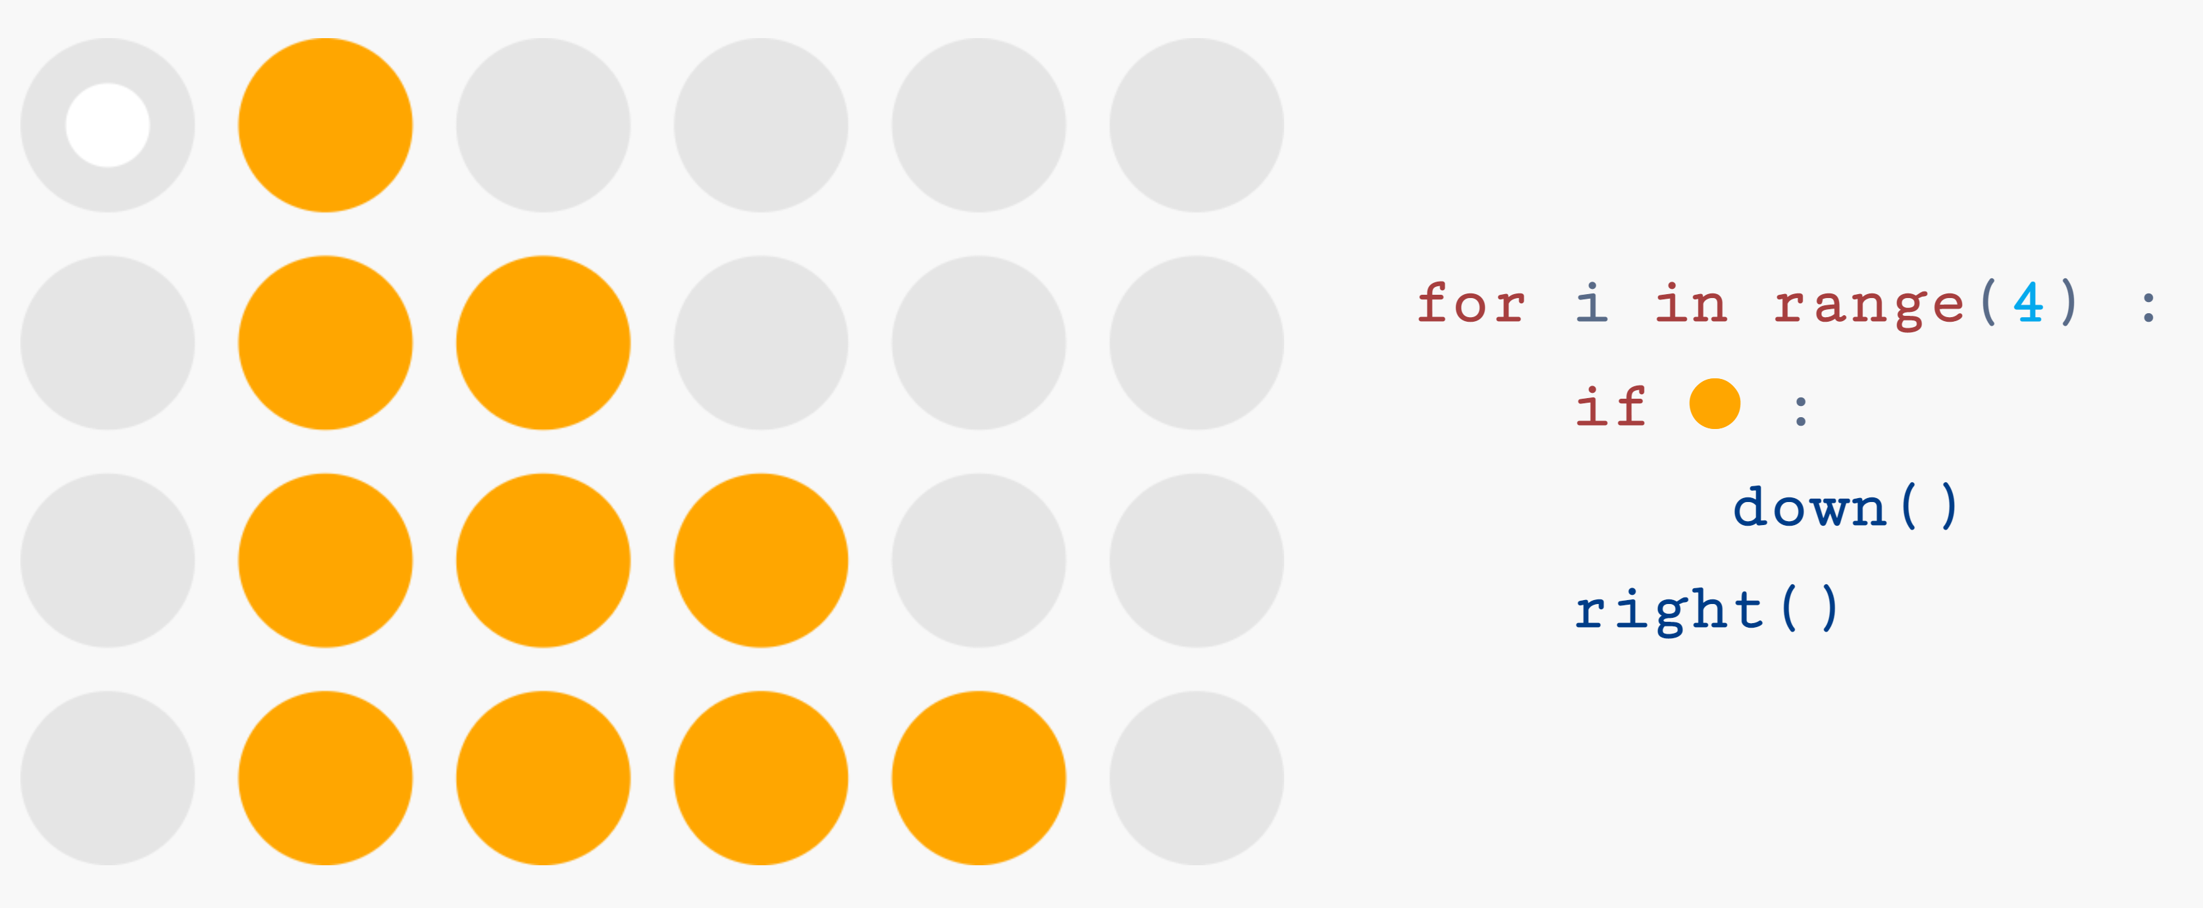
Online Game to help with intuition of if statements/for loops
https://compute-it.toxicode.fr/?hour-of-code&progression=python

Slide 24
In-class activity
Work through Lab 8 Student Activity
Tip for activity: Don’t immediately start typing code. Take a moment to think about what you are trying to do and how to do that. Then type some code.
Mid-Semester Survey for TA Certification (Thank you!): https://utexas.qualtrics.com/jfe/form/SV_a9jfRgUQG8PGAGW?TA=kk35355

Slide 25
If Statement Demonstration

Slide 26
For Loop
Variable which will change values inside the for loop
The word “in” is always in the middle
The values that the variable i will take in each loop
Initiate the for loop
Ends with a “:”
The range(0,4) means that I will take the value of each integer from 0 to 3

