Slide 1

EVE310 Lab 8
October 30, 2025

Slide 2
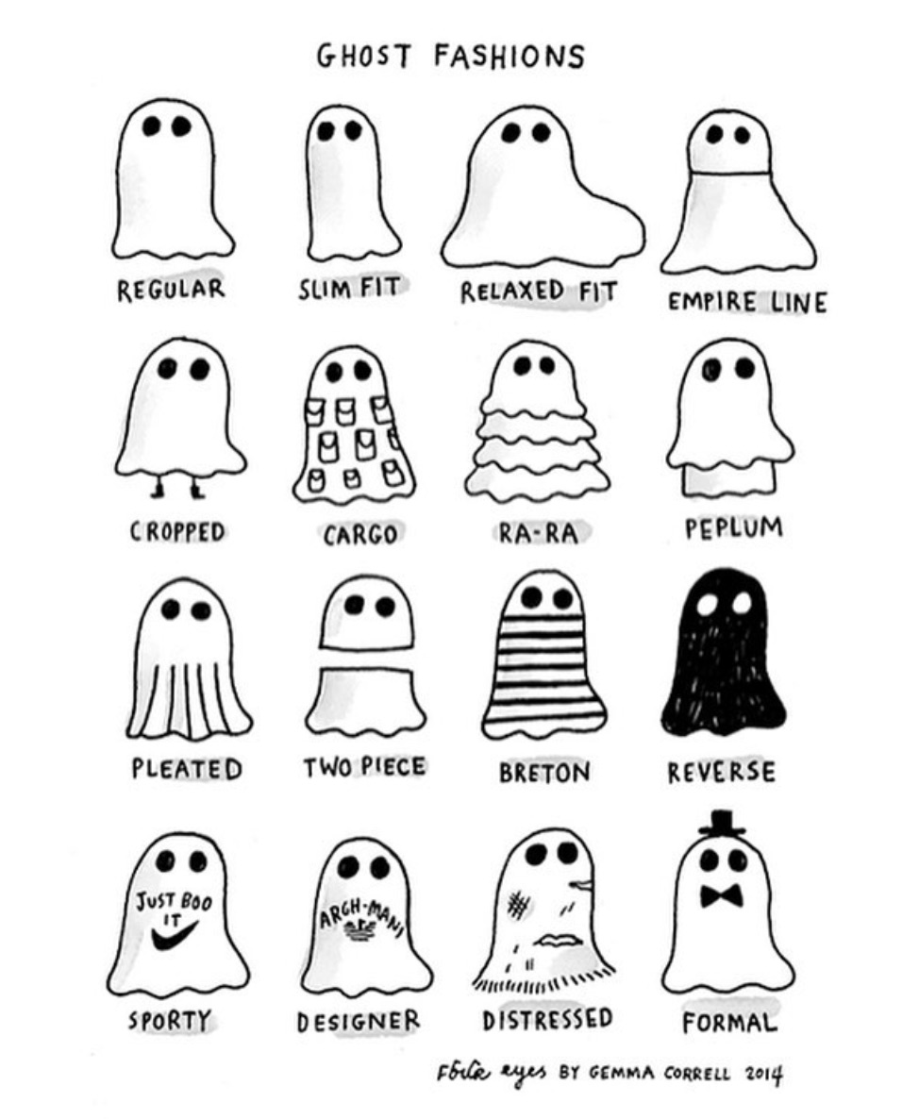
Happy Halloween!

Slide 3
Announcements
In-class coding quiz: 2 quizzes in 2 weeks of Nov. 10, and Nov 17.
Lab quiz 7+8 due Oct. 31, Friday 11:59PM.

Slide 4
Learning objectives
Logical Operators
If Statements
For Loops
Applying the above to a regression problem from class
Notes:
If statements are useful to run lines of code only if a certain condition is true.
For loops are usful to automate repetetitive tasks in a short amount of code.

Slide 5
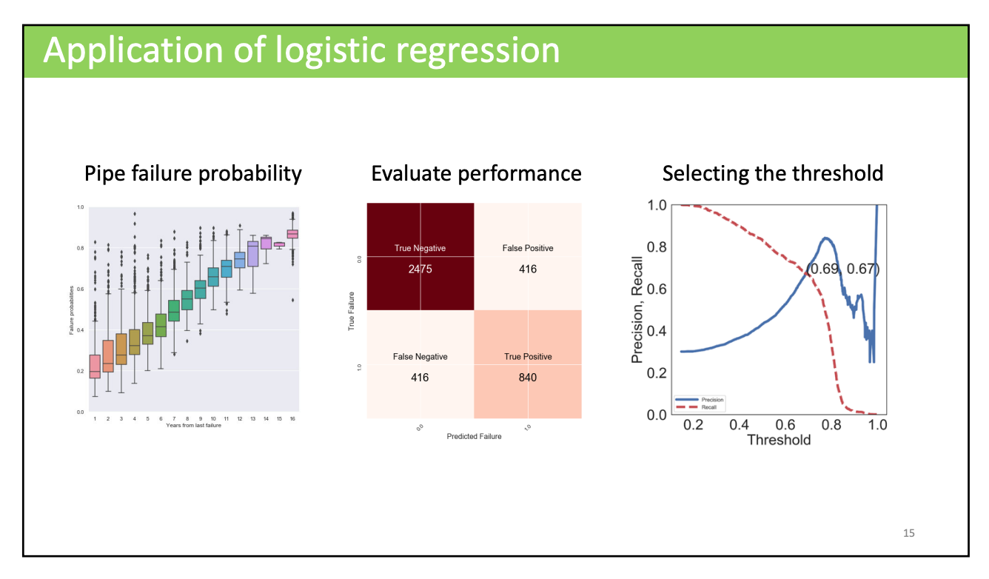
The problem
Lecture 18
Notes:
I believe that you discussed the logistic regression problem for the real world case, which was about pipe failures in Austin. So the first graph shows the correlation trend between years from the last failure and the probability of failures.

Slide 6
Choosing the right threshold

Slide 7
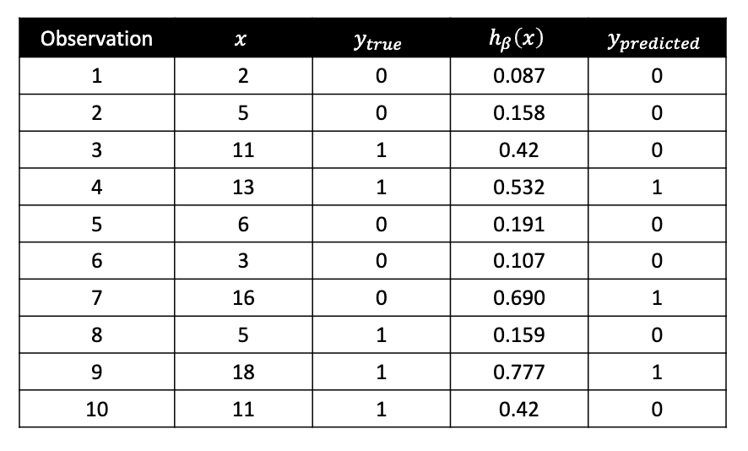
Let’s return to the Lecture 15-16 example:
What if we change the threshold?
How does that change y_{predicted}?
Lecture 16

Slide 8
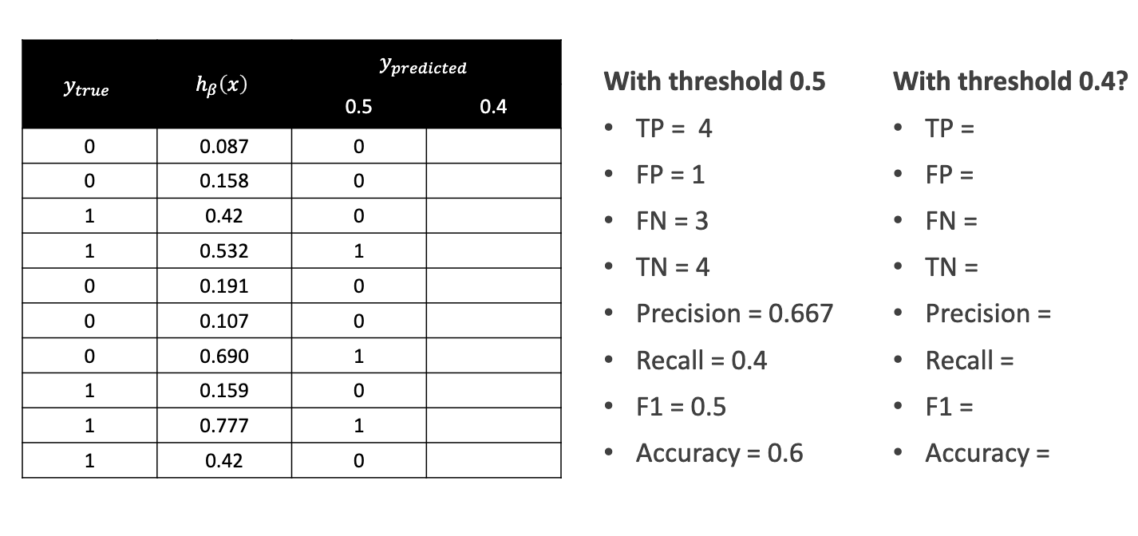
Changing the threshold
Lecture 16

Slide 9
What if we want to try many different thresholds?
How do we make a plot like this for different thresholds in our example without manually redoing the calculations many times?
With for loops!

Slide 10
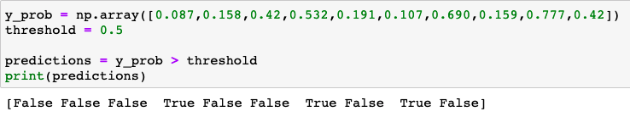

A trick with logical operators and classification
We can store the output of logical operators in a vector
Python prints this as True/False, but also stores it as 1/0
To Python, this is equivalent to: 0 0 0 1 0 0 1 0 1 0
Which means we can perform some mathematical functions on this vector (hint: like calculating precision or recall), and it will treat the values as 0 or 1!

Slide 11
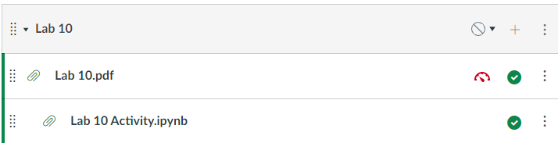
In-class activity
We will work through this together
Work through Lab 9 Activity, filling in the blanks
You will use a very similar solution in your homework!

Slide 12
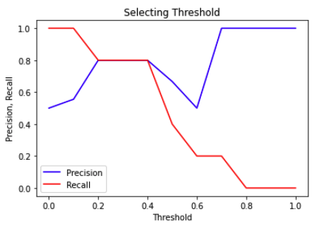
What threshold would you pick?
Notes:
The precision_score function calculates the precision of a classification model, which is the ratio of true positives to the sum of true positives and false positives. zero_division parameter: In cases where there are no true positives (i.e., the model hasn't correctly identified any positive cases), the precision would be undefined mathematically because you can't divide by zero.

Slide 13
Learning objectives
Logical Operators
If Statements
For Loops
Applying the above to a regression problem from class

