Slide 1

EVE310 Lab 9
November 4, 2025

Slide 2
Background
So far in this class, we have performed an analysis (plot, create a linear regression model, etc) on one file at a time.
Often times, there are multiple files that you would like to perform the same analysis on
The purpose of this lab is to show you how to repeat an analysis on multiple files just by clicking “run” once

Slide 3
Learning objectives
Create list of files in a directory (folder)
Perform analysis on all csv files in a directory

Slide 4
Problem Statement
Suppose you work for the UT Facilities Department and would like to analyze water consumption in each building by month
Your boss sends you 24 data files with water consumption information
You are asked to remove outliers and then create a boxplot by month of the water consumption in each building

Slide 5
Solution Approach
First, write the code to analyze one file at a time
Create a boxplot by month (Lab 4)
Remove Outliers (Lab 7)
Then, modify analysis to iterate over multiple files
Create list of files in a directory (folder)
Modify list to include only the files that end in .csv
Use list of .csv files to perform analysis

Slide 6
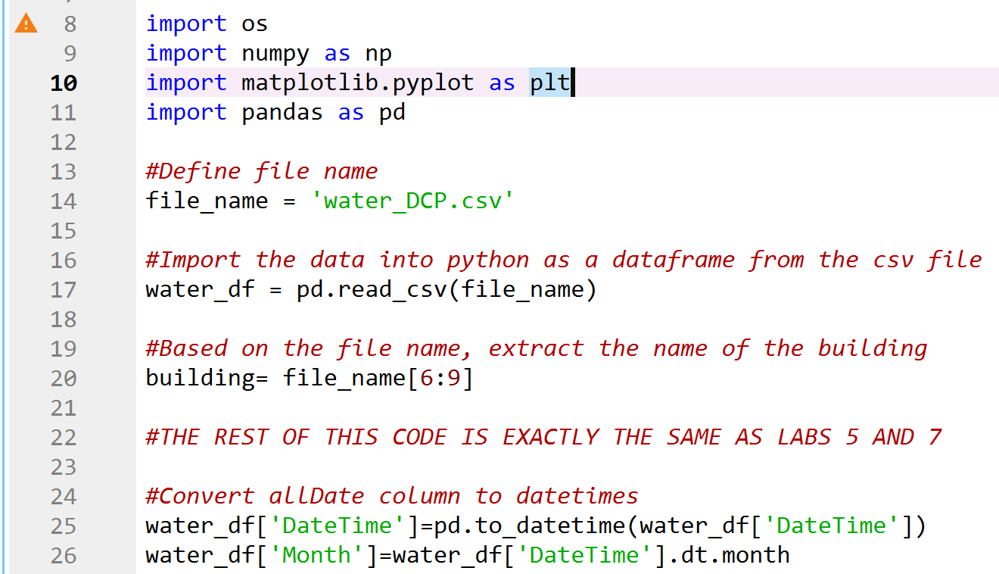
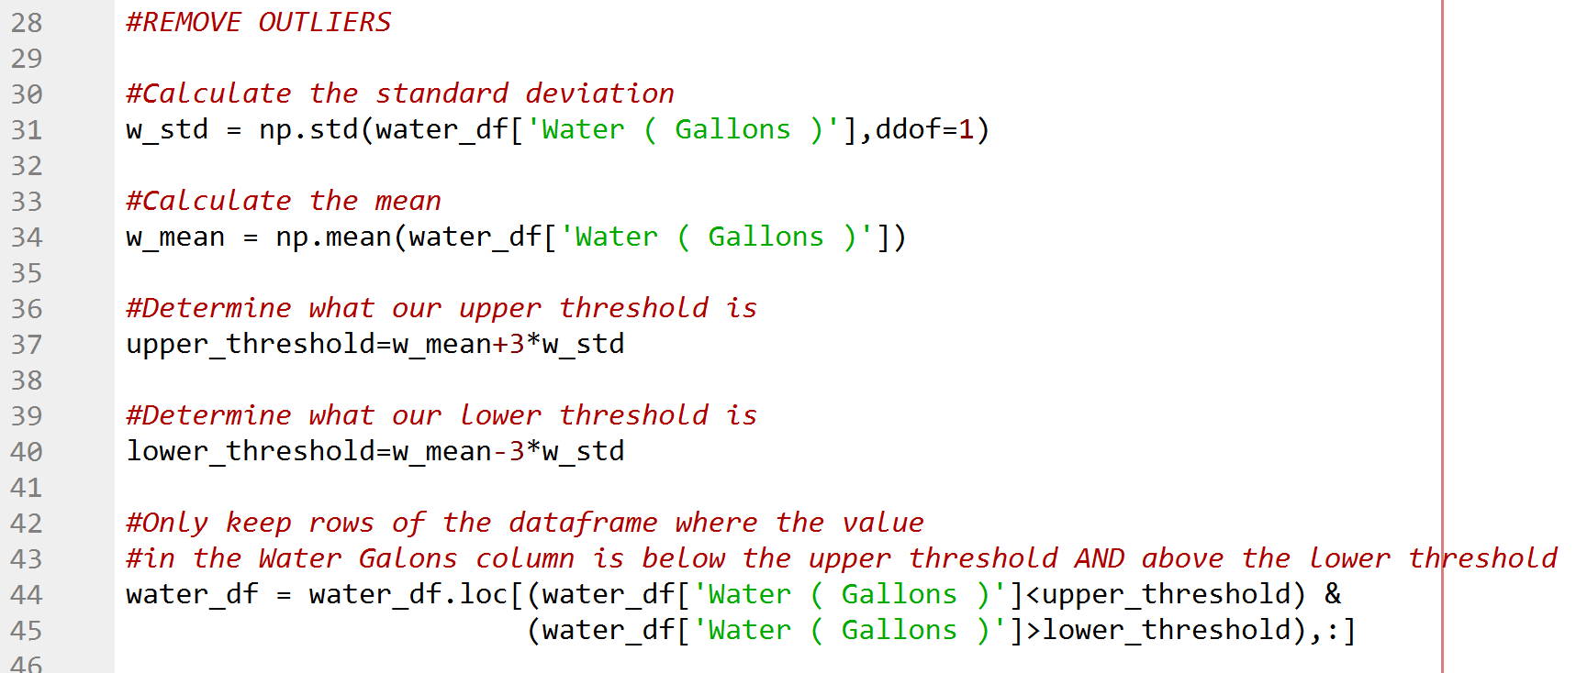
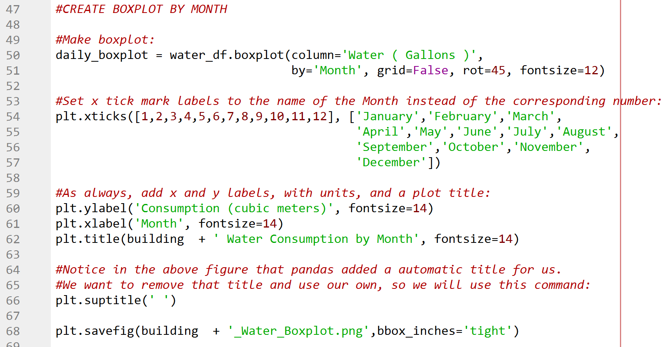
One File Solution Approach
See Lab 9 Example Single File.ipynb

Slide 7
One File Solution Approach
See Lab 9 Example Single File.ipynb
Only this would change to perform analysis on a different file

Slide 8
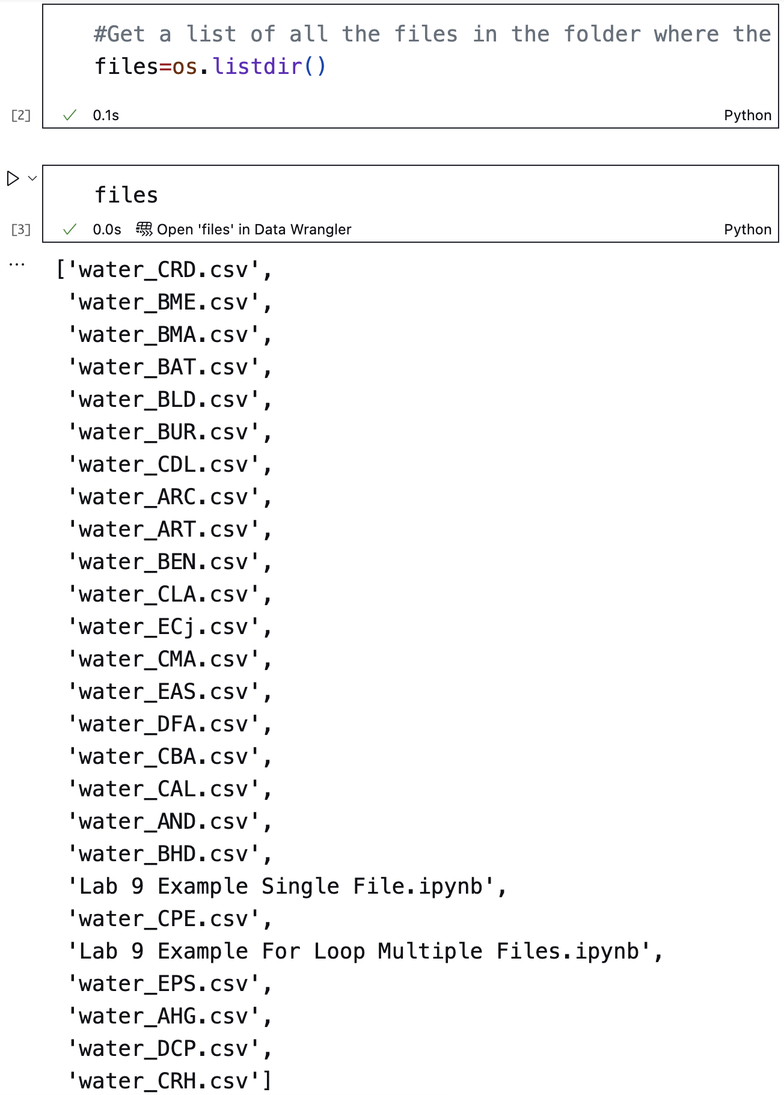
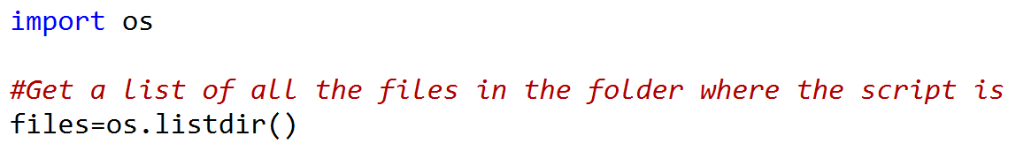
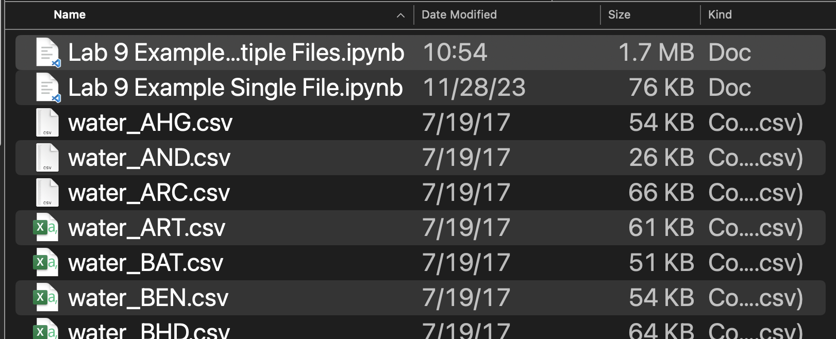
Create a list of files in a directory (folder)
Use os.listdir() to create a list of file names in the directory where they python script is located

Slide 9
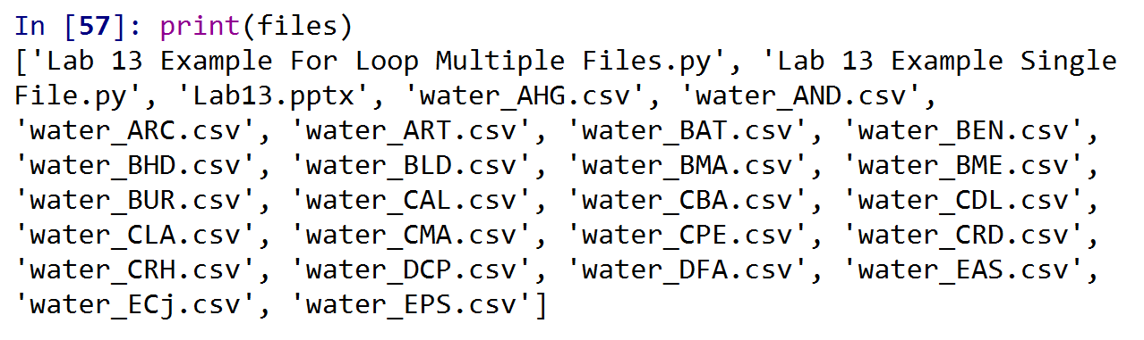
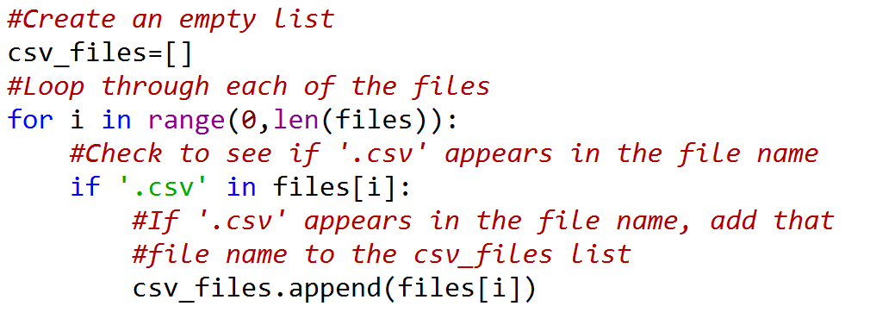
Keep only the files that are csv files
We do not want to try to import files that are not csv files
Use a for loop to keep only the files that are csv files

Slide 10
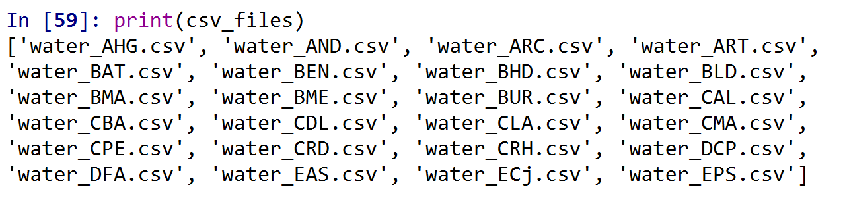
Keep only the files that are csv files (cont.)
Now, the variable csv_files only contains the csv files that we want to analyze

Slide 11
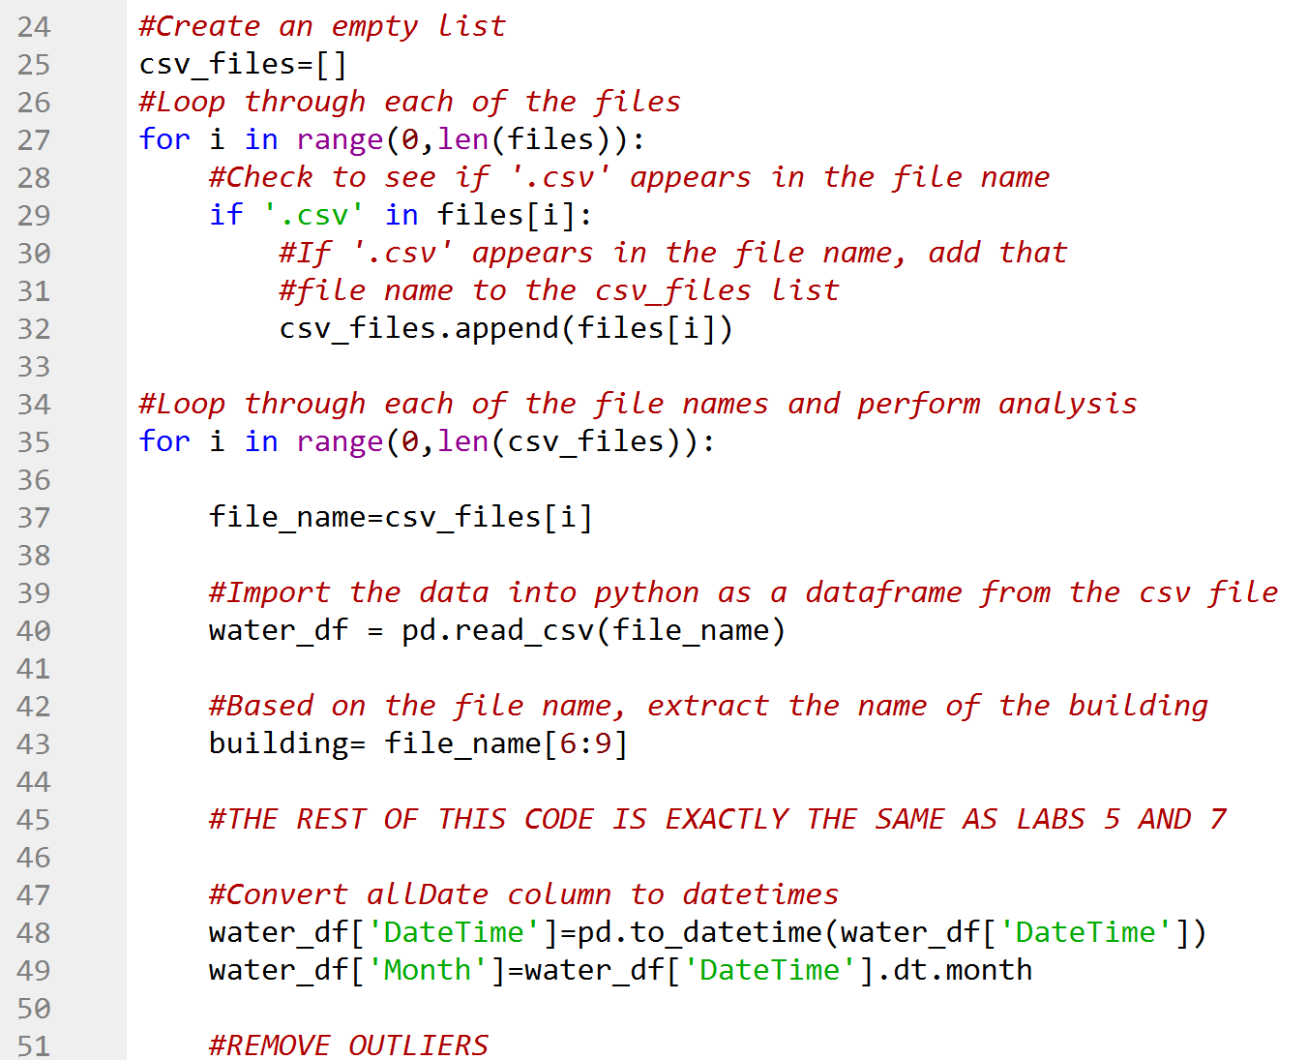
Use for loop and csv_files list in place of file_name variable
Now, the variable csv_files only contains the csv files that we want to analyze
Loop through the file names in this list
For loop, use the variable i as the index for each file name
Index csv_files to extract the file name
The rest of the analysis is the same as the single-file analysis, but inside the for loop

Slide 12
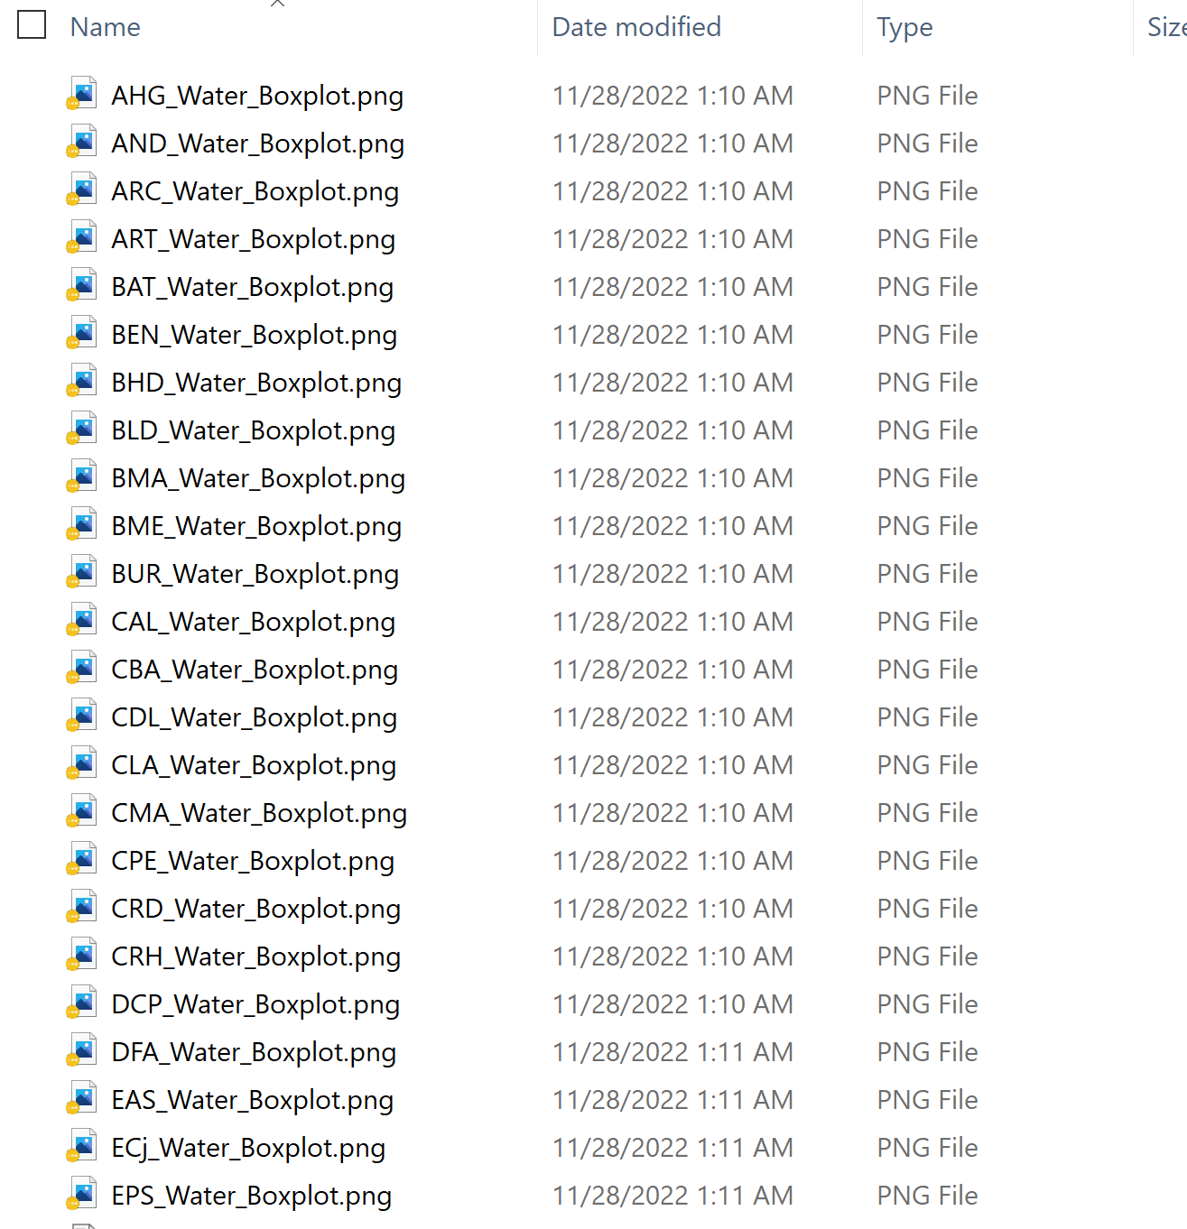
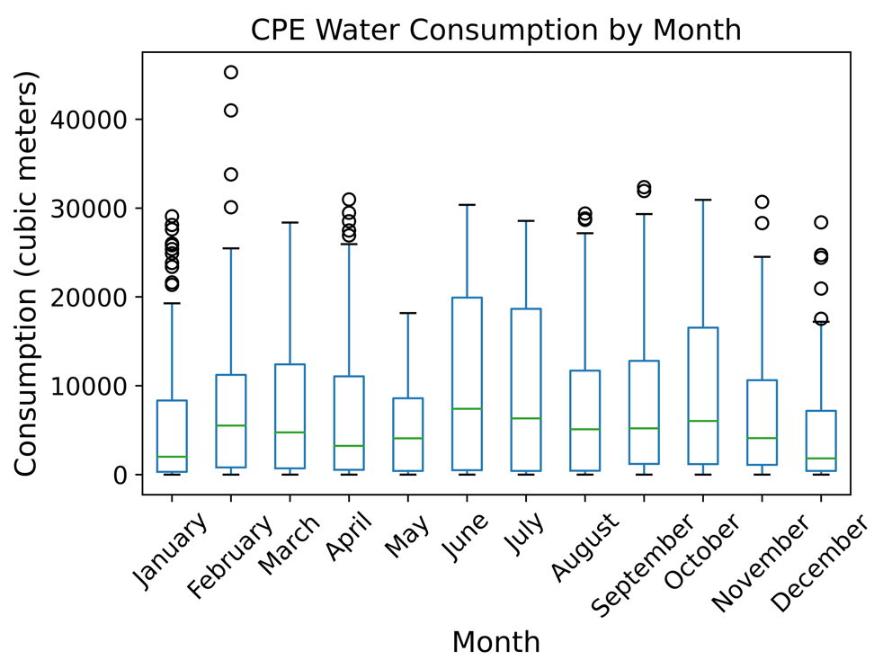
Results
Multiple printed boxplots
Only had to hit “run” once
If it takes a while, you can go eat lunch and have your plots made when you get back!
This example was for 24 files, but would work with many more

Slide 13
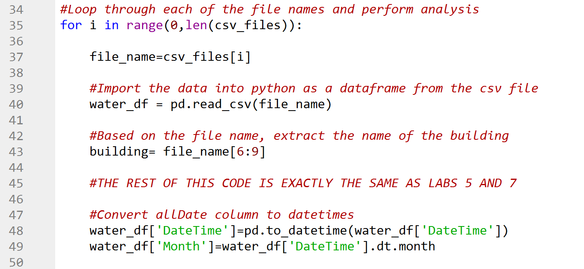
Important Caveats/Things to Remember (1)
For Loop Variable – do not use i as another variable
The variable i is used as the index for csv_files. If there is another for loop as part of the analysis, use a different variable as an index (j, k etc.)

Slide 14
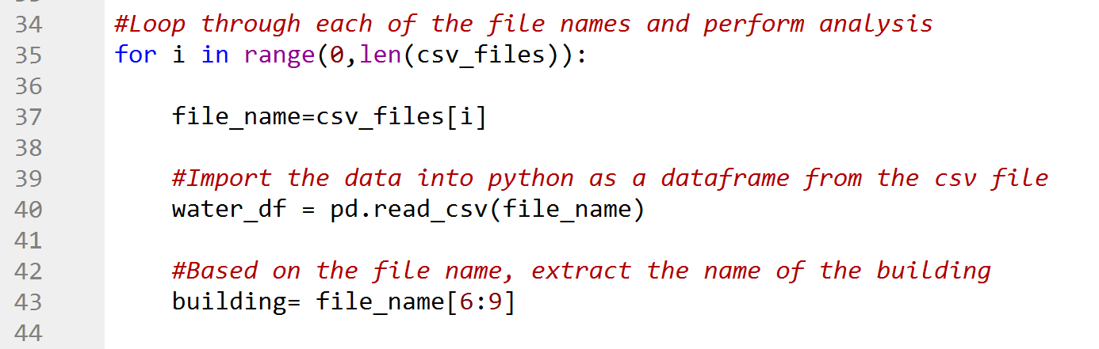
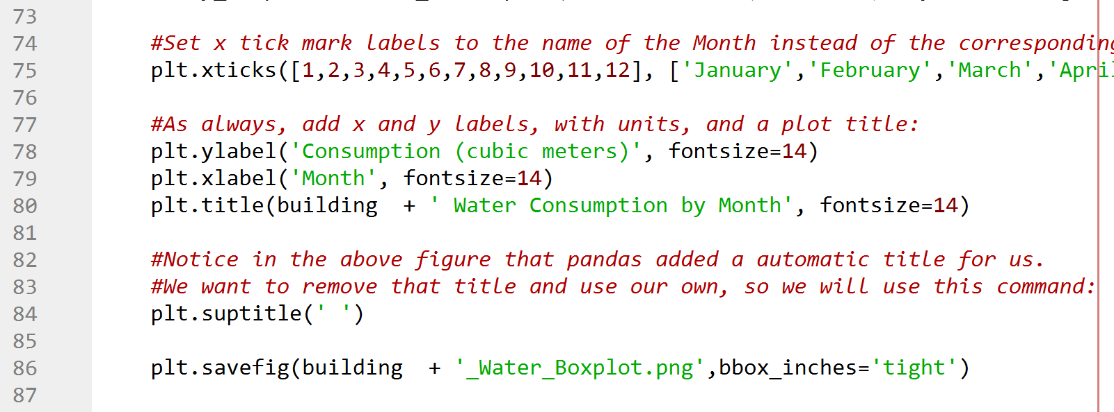
Important Caveats/Things to Remember (2)
Modify name of saved file/output based on each input file name
Otherwise, all saved figures will have the same file name and overwrite each other. You would be left with just 1 figure at the end
Building is a variable which changes based on the file being imported. Contains a 3-letter string of which building is being analyzed.
The + symbol here concatenates the two strings together

Slide 15
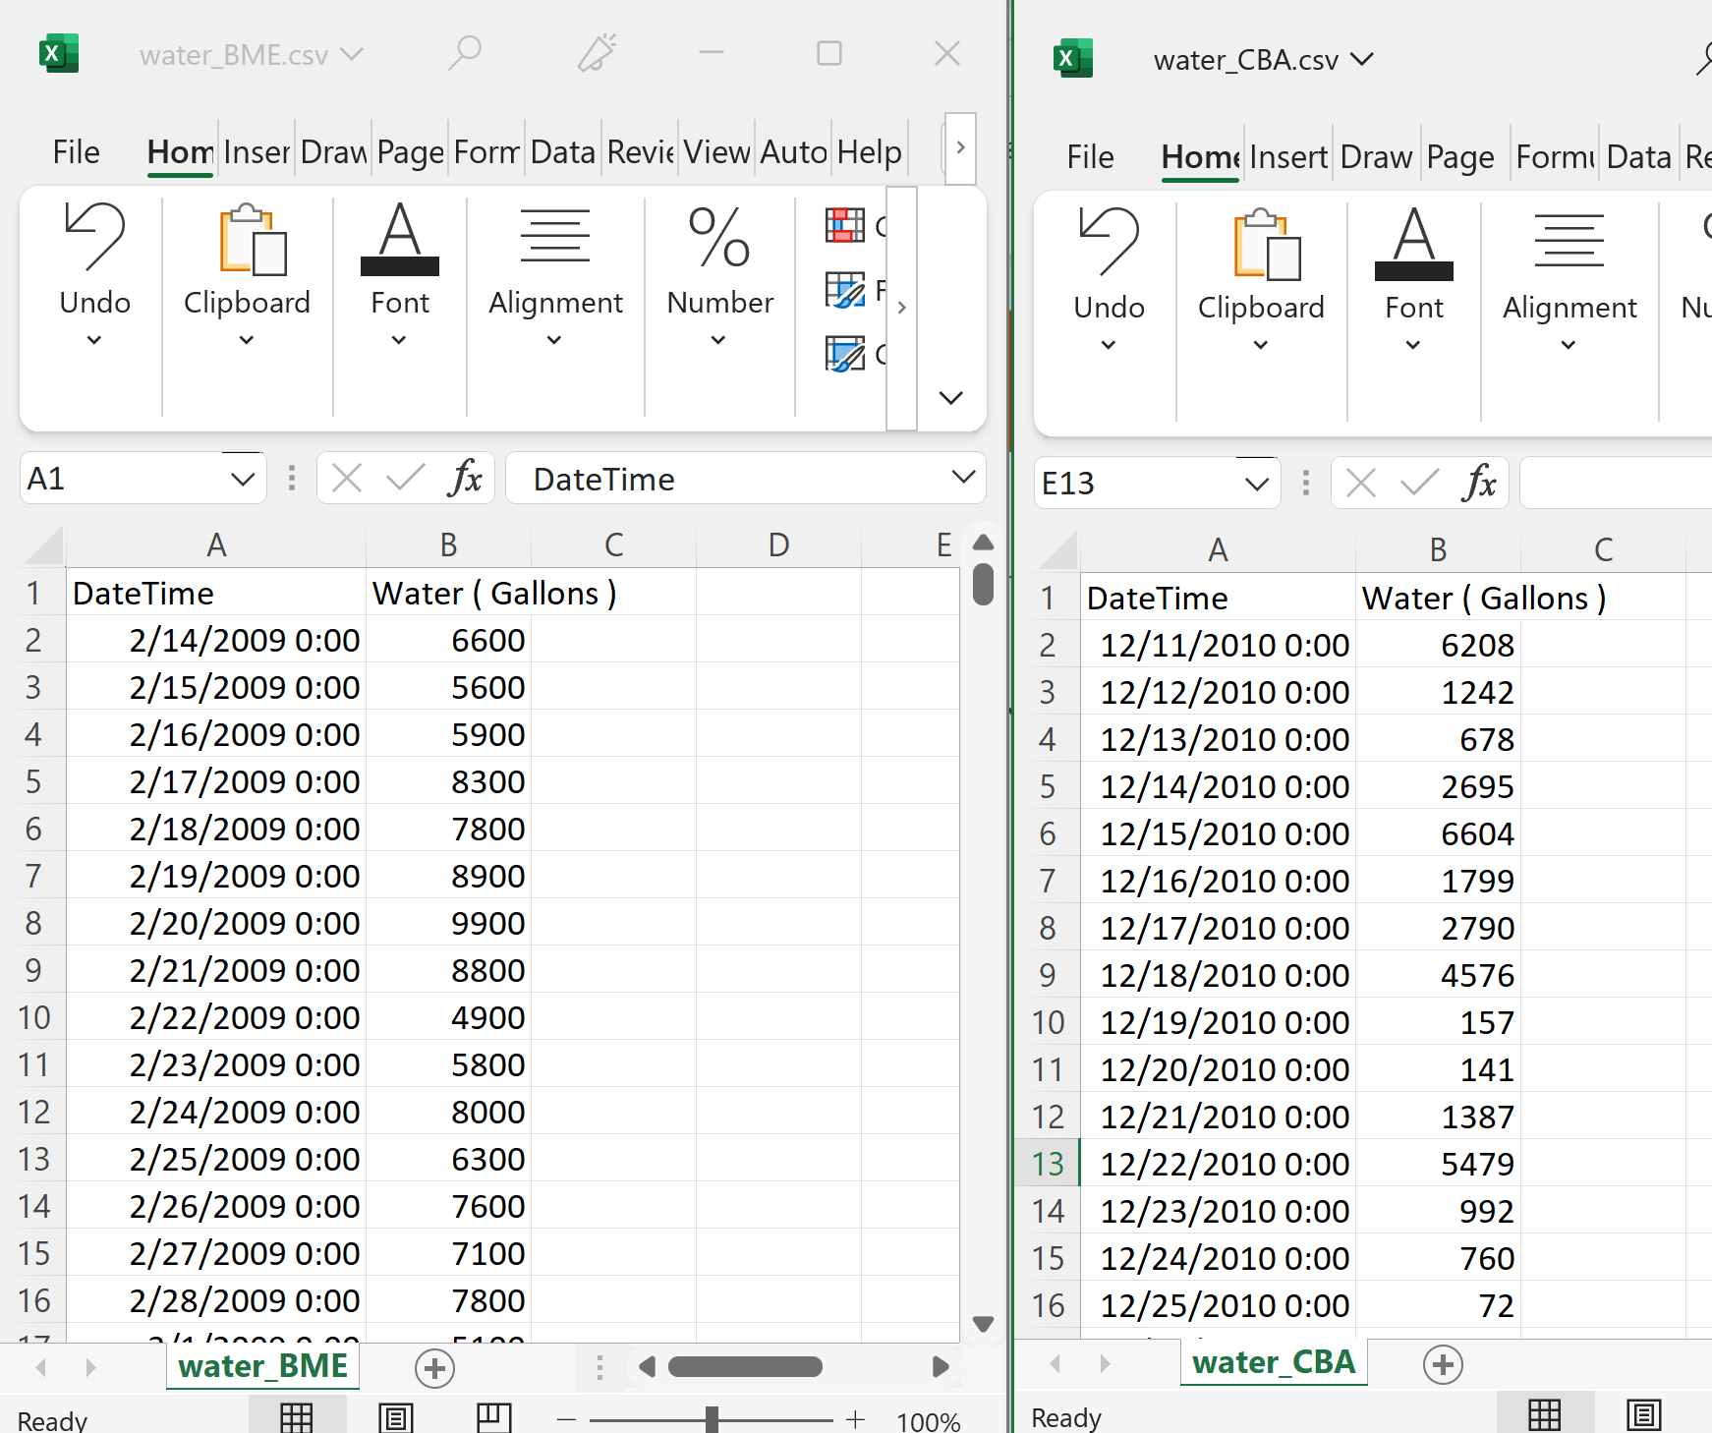
Important Caveats/Things to Remember (3)
Each csv file needs to be formatted the same way with the same type of information in each column
In this example, each of the column headings are the same, and each column has the same type of data (first is datetime, second is a number)

Slide 16
Summary
A useful technique to analyze multiple datasets at once
Could be very useful in a future work scenario

Slide 17
Thanks for a great semester!

