Slide 1
Python Template
Hello John

Slide 2
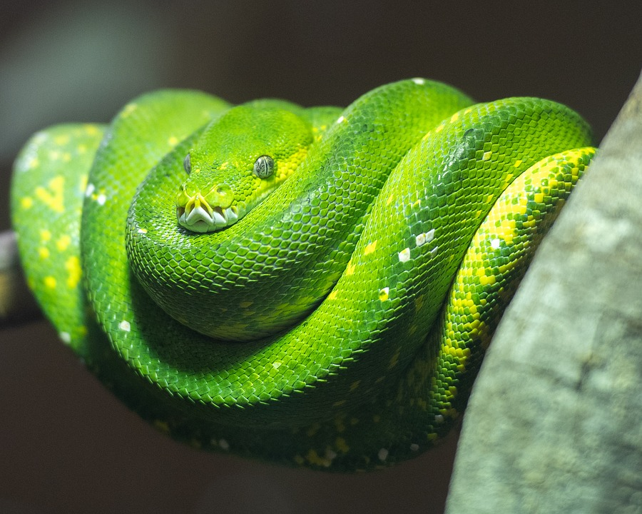
How many snake? 3 snakes

Slide 3
Method
step 1: analysis
step 1: design
step 1: production
step 1: {{ step[3].name }}

Slide 4
Table
Name | Size
Leptotyphlops carlae | 10
Reticulated Pythons | 9000

Slide 5
Table: My filling table
Title | Descriptions
Hello | World
Python | Programming
Data | Science
Machine | Learning
Artificial | Intelligence

