Slide 1
Python Template
Hello John

Slide 2
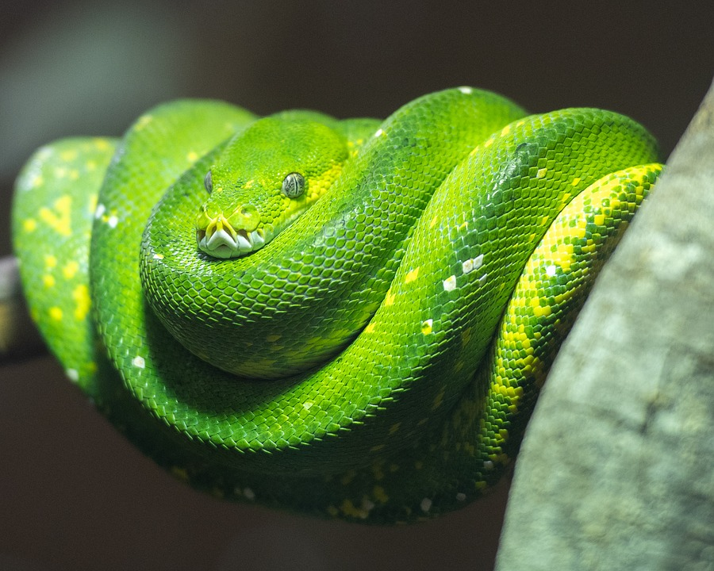
How many snake? 3 snakes

Slide 3
Method
step 1: analysis
step 1: design
step 1: production
step 1: {{ step[3].name }}

Slide 4
Table
Name | Size
Leptotyphlops carlae | 10
Reticulated Pythons | 9000

