Slide 1
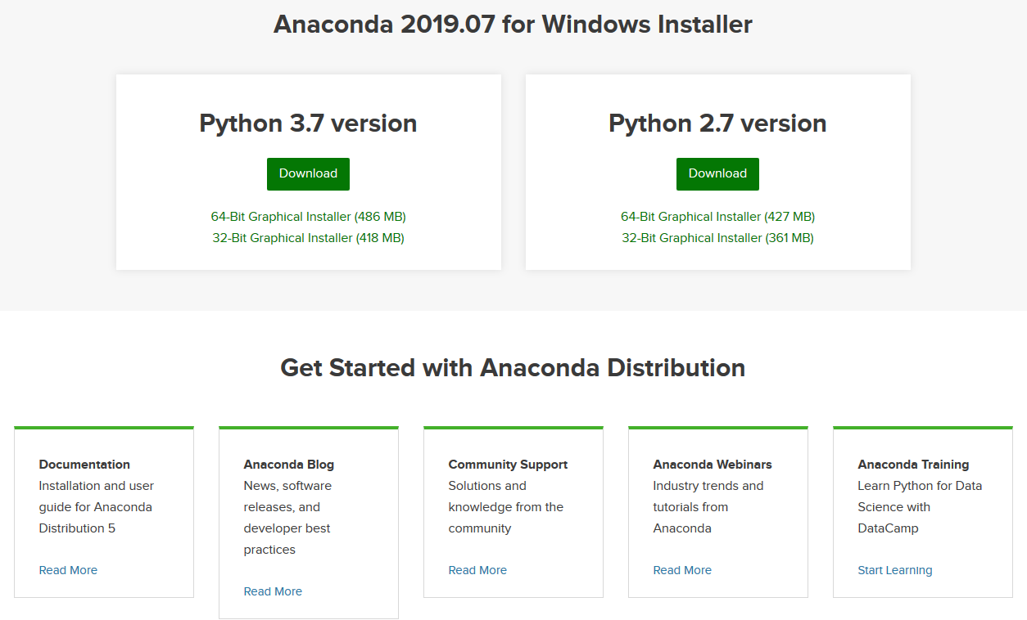
Getting started with MicroPython on the ESP8266
Download and Install Anaconda
https://www.anaconda.com/distribution/

Slide 2
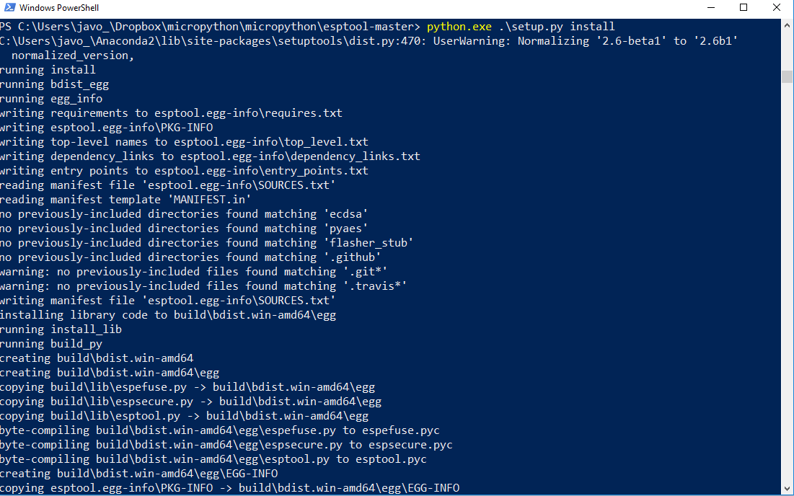
Getting started with MicroPython on the ESP8266
Clone or download esptool and unzip it (follow README.md instructions)
https://github.com/espressif/esptool
Open a console and go to the unziped folder then type
python.exe .\setup.py install

Slide 3
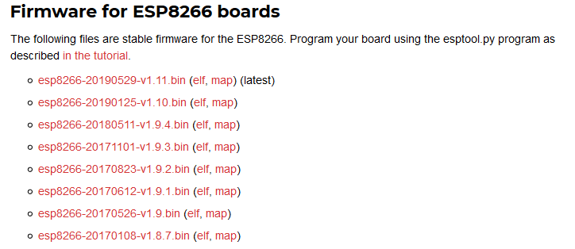
Getting started with MicroPython on the ESP8266
Download the binary for ESP8266
https://micropython.org/download/#esp8266

Slide 4
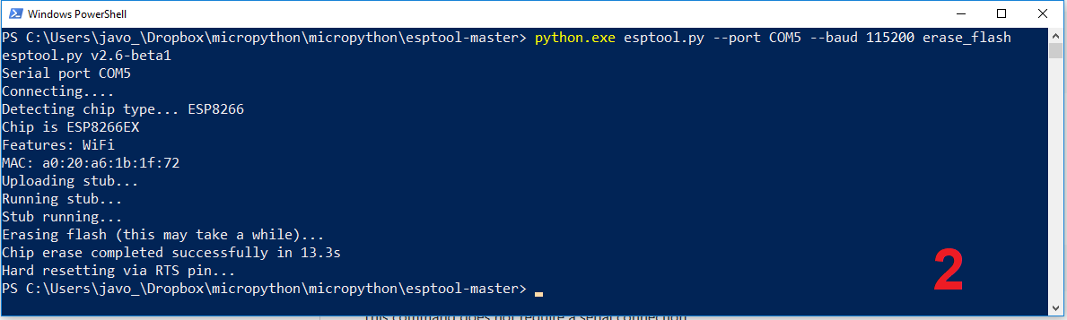
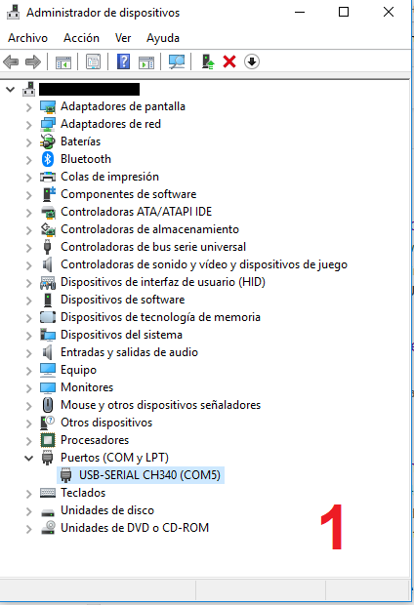
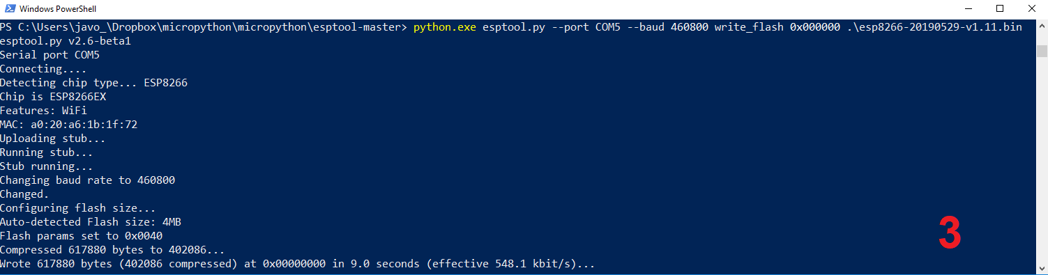
Getting started with MicroPython on the ESP8266
Plug your board ESP8266
Install firmware into device

Slide 5
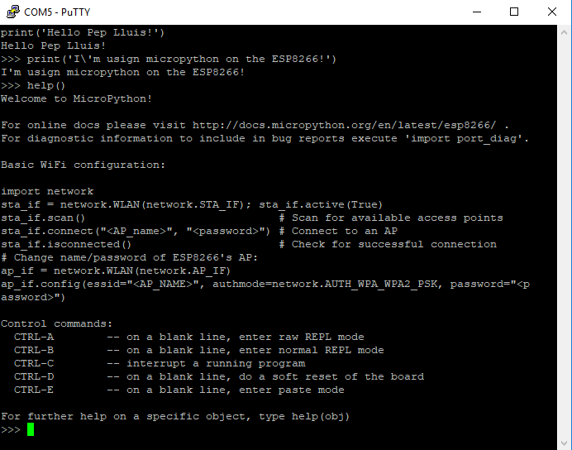
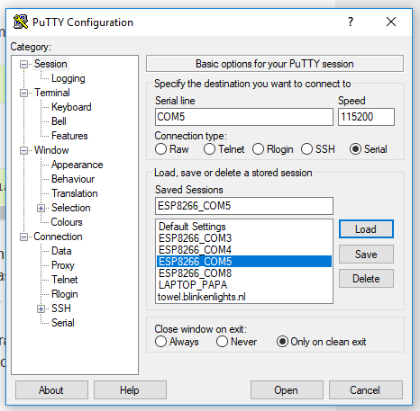
Getting started with MicroPython on the ESP8266
Download and install PuTTY
https://ww.chiark.greenend.org.uk/~sgtatham/putty/latest.html

Slide 6
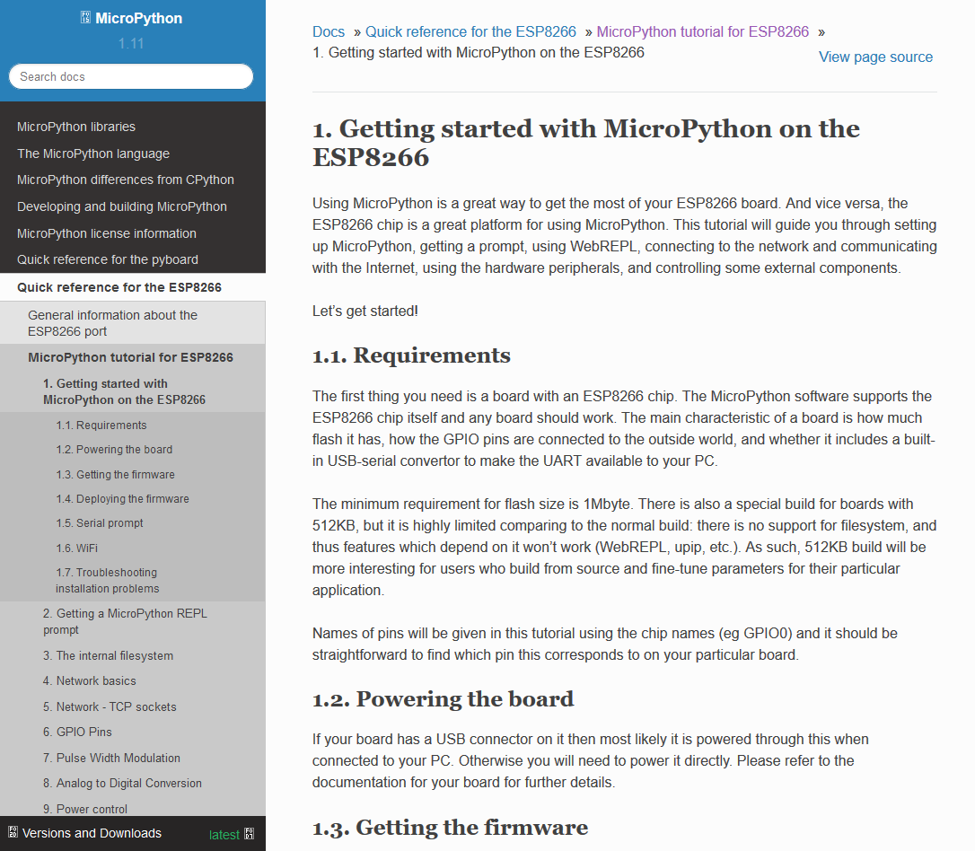
Getting started with MicroPython on the ESP8266
For linux users follow the next instructions
https://docs.micropython.org/en/latest/esp8266/tutorial/intro.html#deploying-the-firmware
Requires elevated privileges:
sudo putty

Slide 7
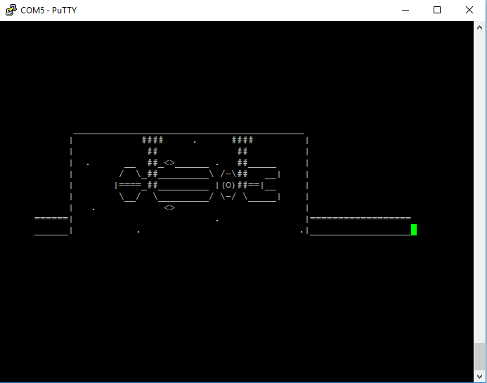
Getting started with MicroPython on the ESP8266
An example with micropython
import socket, network
machine.freq(160000000) # Set cpu working frequency
sta_if = network.WLAN(network.STA_IF)
sta_if.active(True)
for i in sta_if.scan(): # Scan for available access points
print(i)
sta_if.connect("WIFI", "PASSWORD") # Connect to an AP
if sta_if.isconnected(): # Check for successful connection
sta_if.ifconfig()
addr_info = socket.getaddrinfo("towel.blinkenlights.nl", 23)
addr = addr_info[0][-1]
s = socket.socket()
s.connect(addr)
while True:
data = s.recv(500)
print(str(data, 'utf8'), end='')
else:
print('not connected to network!')

Slide 8
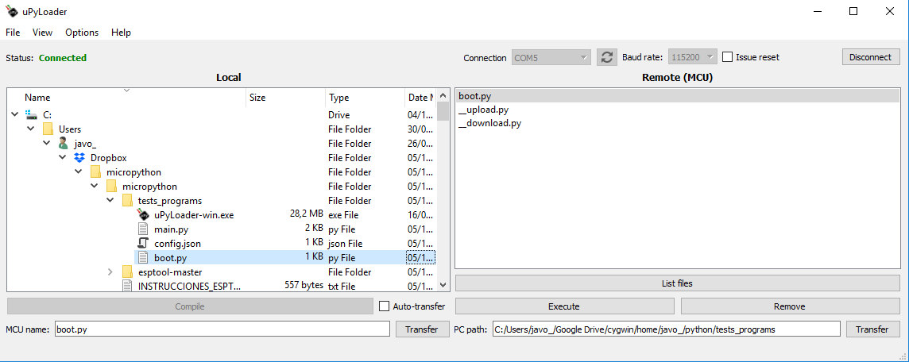
Getting started with MicroPython on the ESP8266
Transferring program files from PC into the ESP8266
https://github.com/BetaRavener/uPyLoader/

