Slide 1
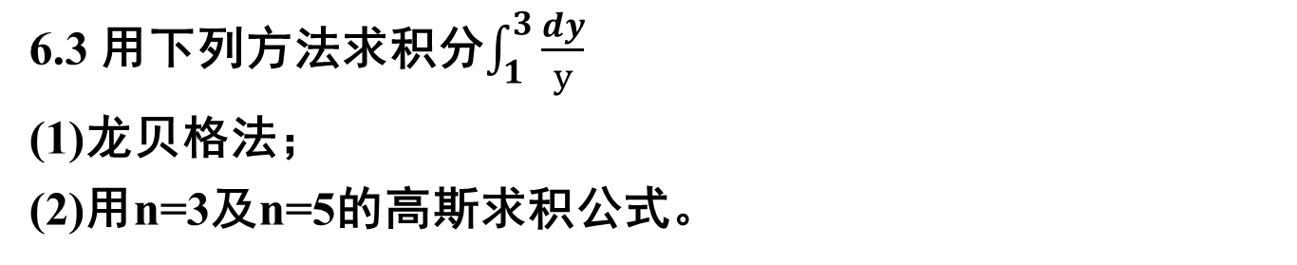
习题六
解：(1) f(x) = 1/x x∈[1,3]
T₁ = f(1) + f(3) = 1.33333
T₂ = 0.5*T₁ + 1*f(2) = 1.16667
S₁ = (4*T₂ - T₁)/3 = 1.11112
T₄ =0.5*T₂ + 0.5*( f(1.5) + f(2.5) ) = 1.11668
S₂ = (4*T₄ – T₂)/3 = 1.10001
C₁ = (16*S₂ – S₁)/15 = 1.09927
T₈ = 0.5*T₄ + 0.25*(f(1.25) + f(1.75) + f(2.25) + f(4.75))=1.10322
S₄ = (4*T₈ –T₄)/3 = 1.09873

Slide 2
习题六
C2 = (16*S4 – S2)/15 = 1.09864
R1 = (64*C2 – C1)/63 = 1.09863
T16 = 0.5*T8 + 0.125*(f(1.125) + f(1.375) + f(1.625) + f(1.875)
+ f(2.125) + f(2.375) + f(2.625) + f(2.875)) = 1.09977
S8 = (4*T16 – T8)/3 = 1.09862
C4 = (16*S8 – S4)/15 = 1.09861
R2 = (64*C4 – C2)/63 = 1.09861
因此可取 I = 1.09861

Slide 3
习题六
(2) 当n = 3 时 使用公式xi = 0.5*(a + b) + 0.5*(b - a)*ti
x1 = 2 + t1 = 1.2254 f(x1) = 0.81606
x2 = 2 + t2 = 2 f(x2) = 0.5
x3 = 2 + t3 = 2.7746 f(x3) = 0.36041
综上，I ≈ 1.09805
当 n = 5 时
x1 = 2 + t1 = 1.09382 f(x1) = 0.91423
x2 = 2 + t2 = 1.46153 f(x2) = 0.68421
x3 = 2 + t3 = 2 f(x3) = 0.5
x4 = 2 + t4 = 2.53847 f(x4) = 0.39394
x5 = 2 + t5 = 2.90618 f(x5) = 0.34409
综上，I ≈ 1.09862

Slide 4

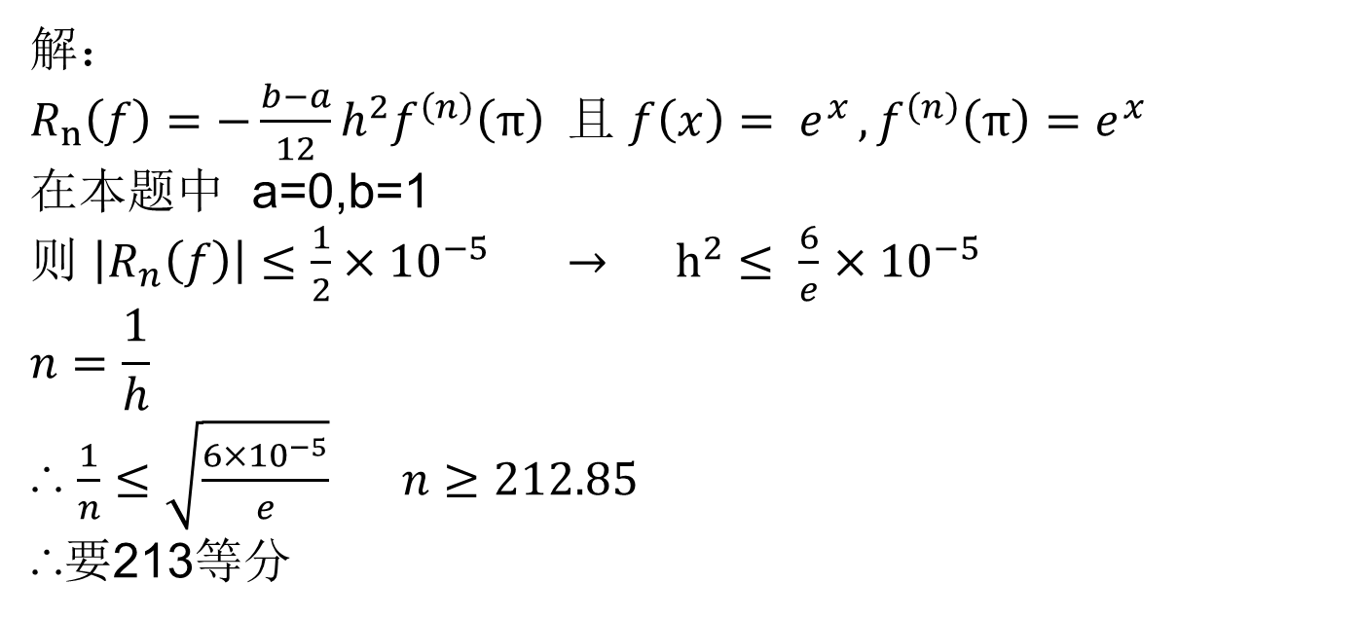
习题六
解：
$R_{n}\left(f\right)=−\frac{b−a}{12}h^{2}f^{\left(n\right)}\left(π\right) 且$ $f\left(x\right)= e^{x }, f^{\left(n\right)}\left(π\right)=e^{x }$
在本题中 a=0,b=1
则 $\left|R_{n}\left(f\right)\right|≤\frac{1}{2}×{10}^{−5} → h^{2}≤ \frac{6}{e}$ $×{10}^{−5}$
$$n=\frac{1}{h}$$
∴ $\frac{1}{n}≤\sqrt{\frac{6×{10}^{−5}}{e}} n≥212.85$
∴要213等分

Slide 5

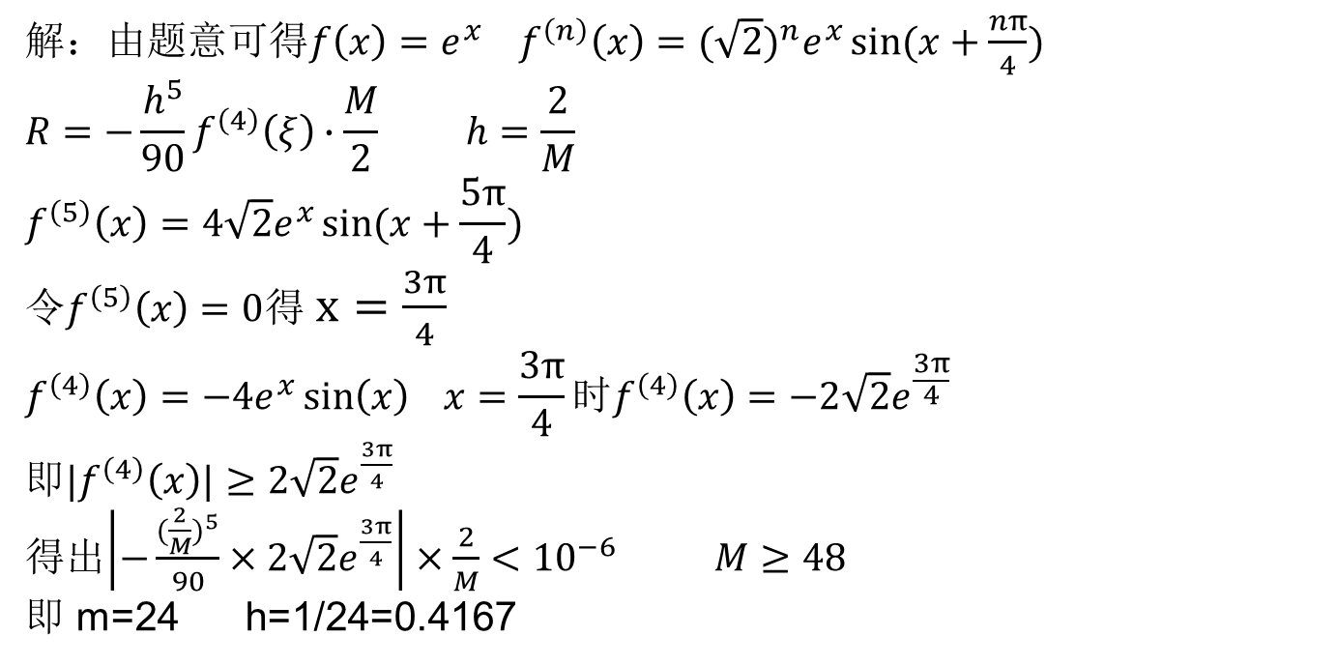
习题六
解：由题意可得$f\left(x\right)=e^{x} f^{\left(n\right)}\left(x\right)={(\sqrt{2})}^{n}e^{x}\sin{(x+\frac{nπ}{4})}$
$$R=−\frac{h^{5}}{90}f^{\left(4\right)}\left(ξ\right)∙\frac{M}{2} h=\frac{2}{M}$$
$$f^{\left(5\right)}\left(x\right)=4\sqrt{2}e^{x}\sin{(x+\frac{5π}{4})}$$
令$f^{\left(5\right)}\left(x\right)=0$得 $x=\frac{3π}{4}$
$$f^{\left(4\right)}\left(x\right)=−4e^{x}\sin\left(x\right) x=\frac{3π}{4}时f^{\left(4\right)}\left(x\right)=−2\sqrt{2}e^{\frac{3π}{4}}$$
即${|f}^{\left(4\right)}\left(x\right)|≥2\sqrt{2}e^{\frac{3π}{4}}$
得出$\left|−\frac{({\frac{2}{M})}^{5}}{90}×2\sqrt{2}e^{\frac{3π}{4}}\right|×\frac{2}{M}<{10}^{−6} M≥48$
即 m=24 h=1/24=0.4167

