Slide 1
Secode: A Security Testing Framework for AI-Generated Code
报告人 陈鹤影 周昶 洪毓谦

Slide 2
一句话总结
In addressing the issue of quality testing for large-model-generated code, we propose the Secode framework based on reverse code generation, and conduct empirical testing specifically targeting the Solidity language.
Notes:
首先我想用一句话来总结我们的工作:
用中文来说就是 针对大模型生成代码质量测试问题，我们提出了基于代码反向生成的Secode框架，并针对Solidity语言进行了实证测试。
在这句话里我们可以发现三个关键信息

Slide 3
议程
研究背景
研究现状
Secode框架
实证测试
数据和分析

Slide 4
研究背景

Slide 5
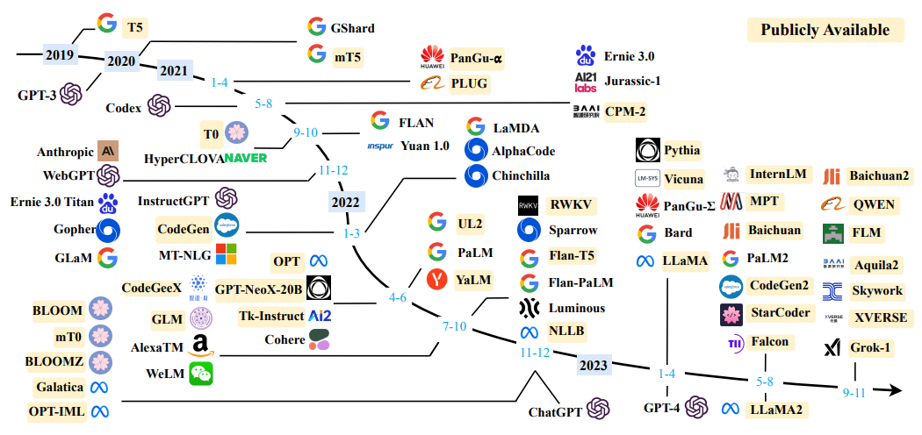
大语言模型
Typically, Large Language Model (LLM) refers to a Transformer language model that contains billions or more of parameters, which are trained on a large amount of textual data.
LLM exhibits some surprising emergent abilities. These abilities are crucial for language models to perform in complex tasks, making artificial intelligence algorithms unprecedentedly powerful and effective.

Slide 6
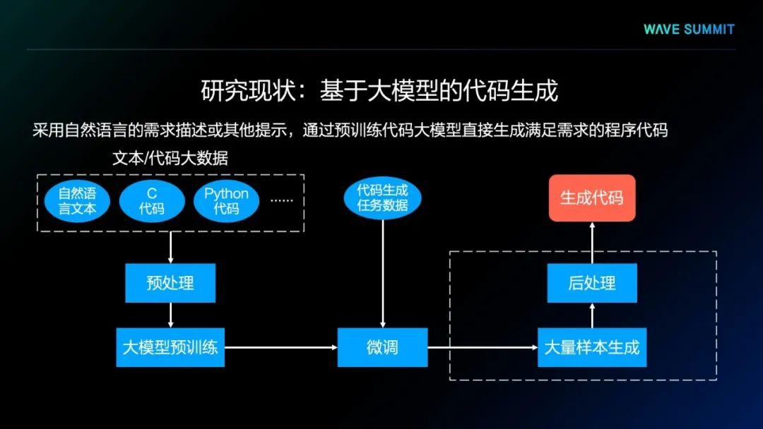
代码生成
The basic idea of this method is to pretrain natural program code to obtain a large language model that can understand the code. Based on such a language model, natural language requirement descriptions or other prompts can be used to directly generate program code that meets the requirements through pretrained code models.

Slide 7
研究现状

Slide 8
Secode框架

Slide 9
Secode框架
Secode is designed to facilitate a precise evaluation of a certain language through the analysis of a substantial amount of generated code. The Secode framework encompasses three dimensions: correctness evaluation, security assessment, and efficiency evaluation.
Secode
Correctness evaluation
Security evaluation
Efficiency evaluation

Slide 10
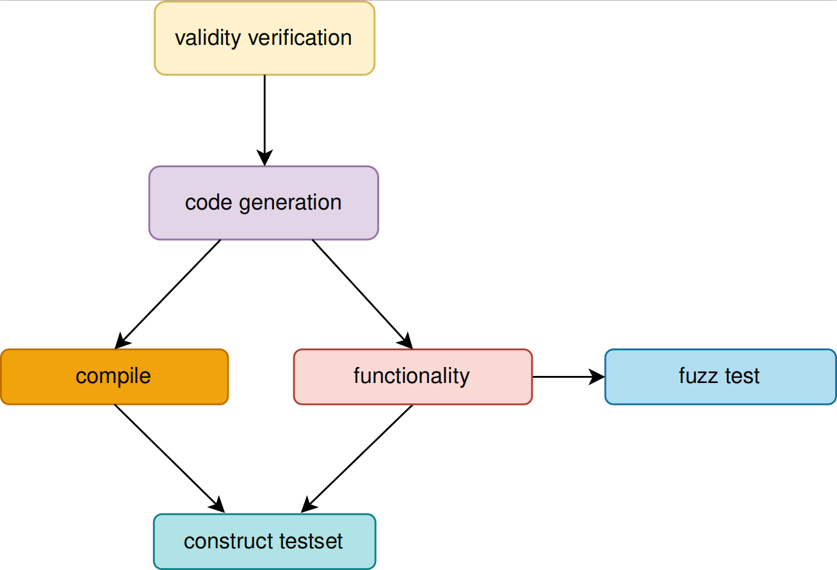
Secode框架
Correctness evaluation in the context of large model_x0002_generated code comprises two integral components: com_x0002_pilation testing and functional testing. Compilation testing ensures the generated code can be successfully executed, while functional testing verifies if the code operates or interacts as intended by the user.

Slide 11
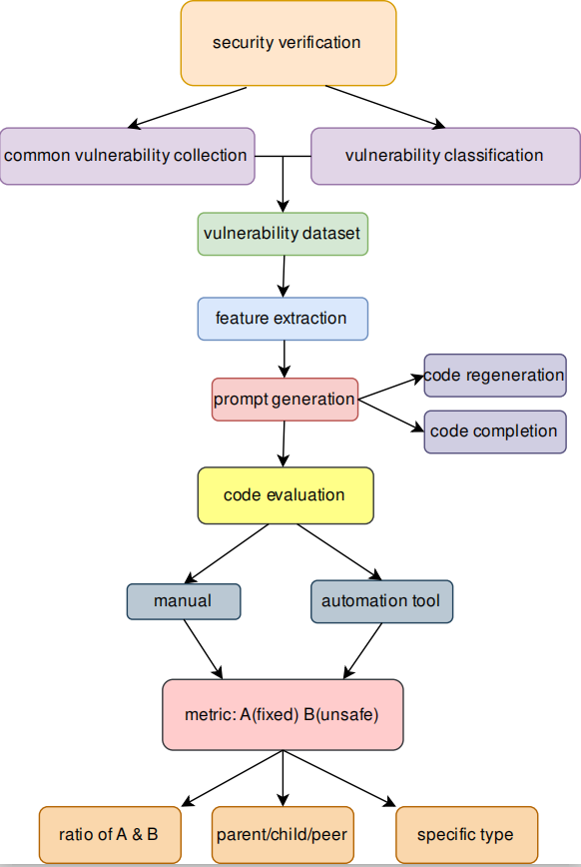

Secode框架
Secode leverages vulnerability datasets of specific programming languages as inputs to reverse-generate code with original functionality using large models. The detection of vulnerability repair rates serves as an evaluation metric for the generative ca_x0002_pacity of large models in the targeted programming language.
The Security Assessment phase consists of four key steps: constructing the vulnerability dataset, extracting vulnerability features, reverse code generation, and code evaluation.

Slide 12
实证测试

Slide 13

实证测试
Research subject: ChatGPT3.5
Research language: C and Solidity
In our research, we choose Solidity as the testing language, which is motivated by the flourishing momentum of blockchain development and the widespread application of large model code generation in contract writing. Solidity’s selection is also guided by its robust community and ecosystem, offering abundant tools and documentation support. This choice streamlines the quality assessment process within the Solidity framework.

Slide 14
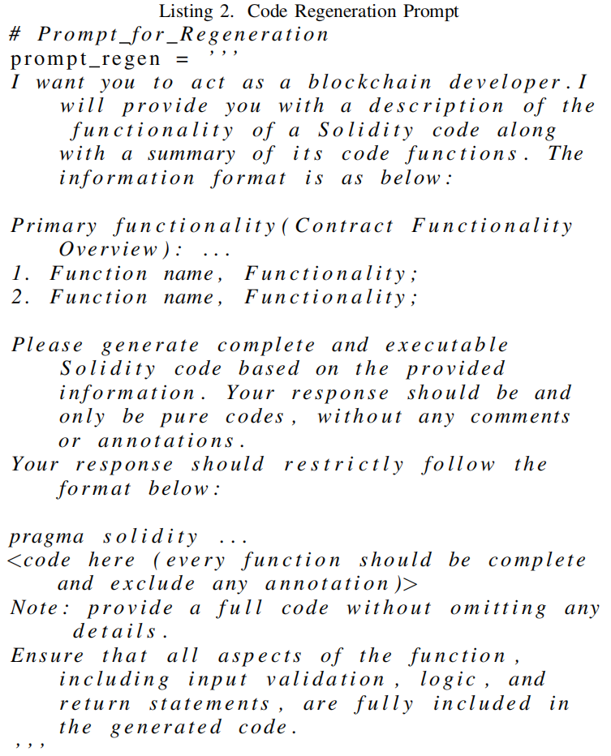
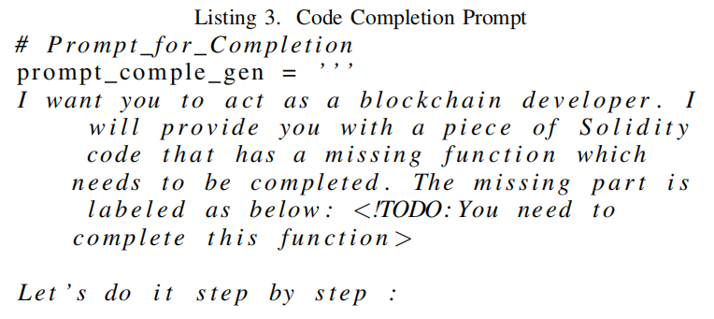
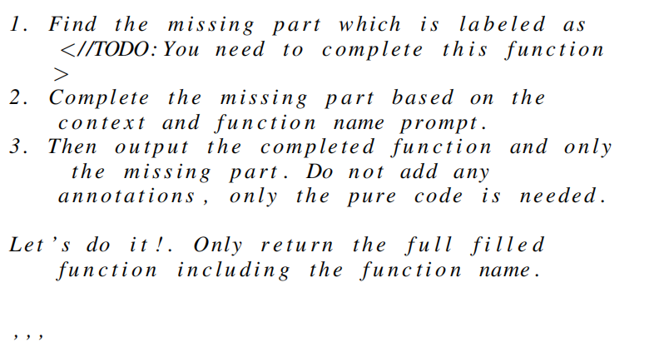
实证测试: Solidity
Building upon the Confuzz dataset, we curated a novel dataset comprising 771 instances of common Solidity vulnerabilities. The vulnerabilities were categorized into 10 distinct classes and meticulously labeled.
Code regeneration and code completion.

Slide 15
数据分析

Slide 16
数据分析
It is known that ChatGPT gave usable code in about 83% of the scenarios, safe code in about 40% of the scenarios, and safe code without vulnerabilities in about 48% of the scenarios with correct code. We analyze that ChatGPT does a excellent job of giving logically correct code suggestions that will pass
compilation, but it is not satisfactory in terms of mainstream language code security.
For the solidity language, the overall performance of Chat_x0002_GPT is not that good. The code suggestions given by it are vulnerable in about 60% of the cases. We find that ChatGPT's performance in the face of complex code environments(e.g. real-world code projects) is still quite flawed overall

Slide 17
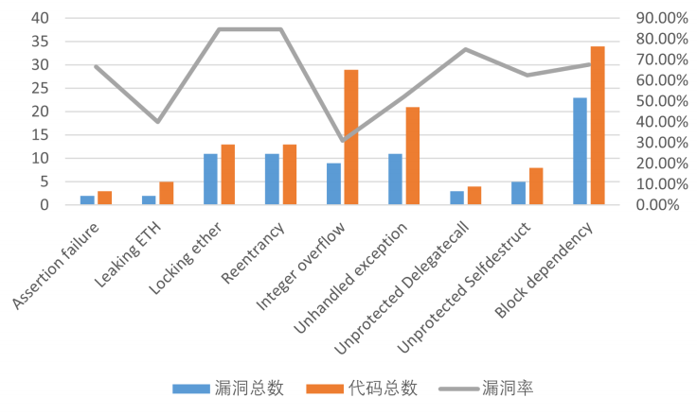
数据分析
In Solidity Scenario One, we use an approach that gives prompts for ChatGPT to generate the corresponding code.
The detection results show that the code suggestion given by ChatGPT-3.5 replicated the original vulnerability in about 25% of the cases and fixed the original vulnerability in up to 75%, which indicates its good ability to fix known vulnerabilities.

Slide 18
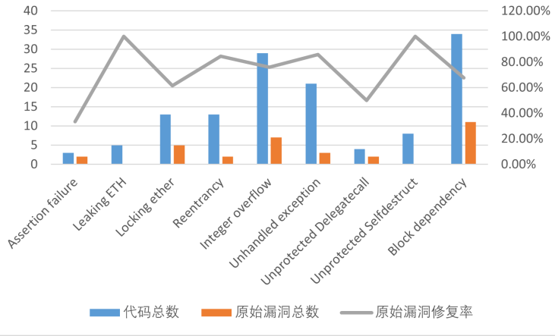
数据分析
Meanwhile, we find that the code suggestions given by ChatGPT vary greatly for different vulnerability scenarios, with a fix rate of more than 50% for the vast majority of given vulnerabilities, and even 100% for the Unprotected Selfde_x0002_struct vulnerability. But for the Assertion failure vulnerability, the rate decreased to about 33%. It does a good job of fixing the code for a given vulnerability and also shows a preference for fixing different vulnerabilities.

Slide 19
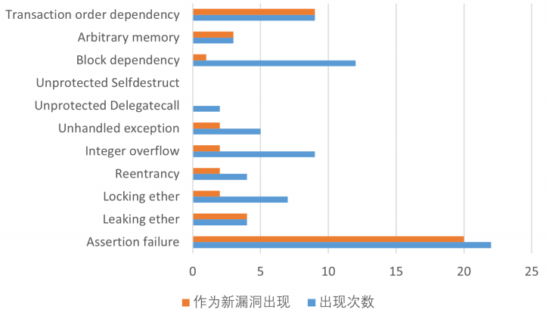
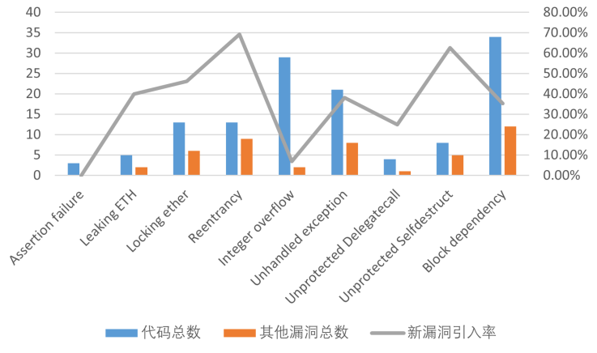
数据分析
ChatGPT's code suggestions also show extreme differentiation in terms of examining the introduction of new vulnerabilities during the fixing process; some vulnerabilities are never introduced as new vulnerabilities, such as the Unprotected Delegatecall vulnerability and the Unprotected Selfdestruct vulnerability, some vulnerabilities are introduced as new vulnerabilities in almost any program, such as the Assertionfailure vulnerability.

Slide 20
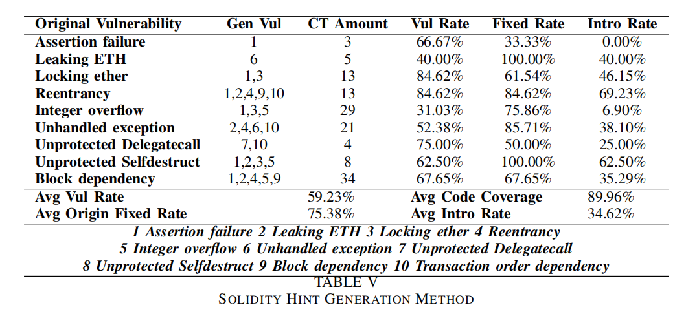
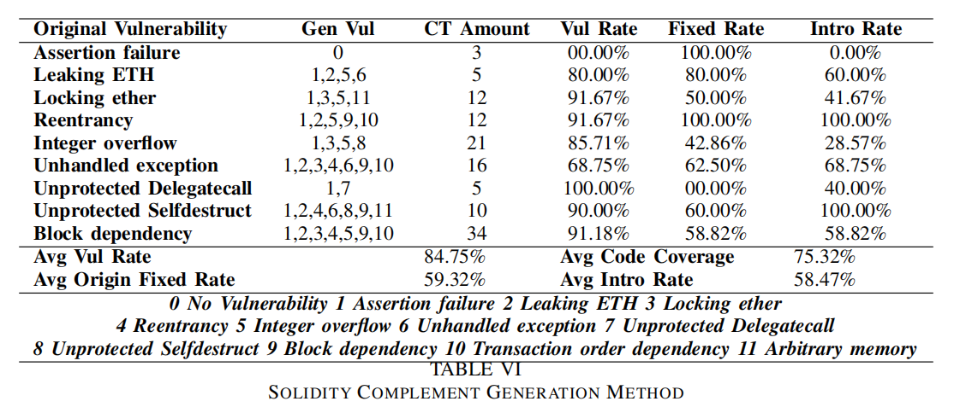
数据分析
In Solidity Scenario Two, the approach we used was to give partial contexts for ChatGPT to patch the code. It turns out that there is a more significant difference compared to the first set of data, where the average vulnerability rate rises to about 85%, while the average original vulnerability fixing rate drops to about 60%, and at the same time unrelated new vulnerabilities are introduced in about 60% of the cases. The insecurity of the same dataset rises almost significantly in this application scenario, and we hypothesize that this usage scenario is not a good one for ChatGPT-3.5, since its generated code is somewhat influenced by the original test code given.

Slide 21
总结推断
We conclude that the first scenario, i.e., giving only the prompt about requirements, is a better representation of the security of the code suggestions given by LLM, which can somewhat shield the generated code from the influence of the original vulnerability data. However, the second scenario also has practical applications in reality, for which the safety of LLM_x0002_given code should be carefully evaluated, and a better way to use it is to use it only in the first scenario.
We then came to some conclusions that ChatGPT can do a better job in code security when only code requirements are given rather than a specific code context. ChatGPT performs well in handling the fixing of known vulnerabilities, although it shows a preference for different vulnerabilities, and it is able to handle the given vulnerability in most of the cases. However, its ability to fix vulnerabilities in real-life complex environments deserves to be questioned and further evaluated, as there is a not-so-small chance that it will introduce one or several unrelated new vulnerabilities while fixing the original vulnerability, which may be caused by its lack of a holistic view of a code project.

Slide 22
感谢观看
创寰宇学府 育天下英才
报告人 姓名

